Slide 1

Non-Dimensionalization of GDEs for Convection Systems
P M V Subbarao
Professor & Head
Mechanical Engineering Department
Wilhelm Nusselt View of “Das Grundgesetz des W¨arme¨uberganges” ….

Slide 2

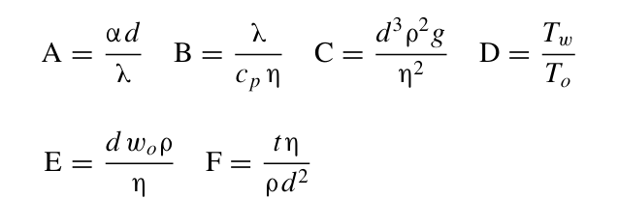

Modern Way of Similitude
The central ideal of Nusselt is the development of dimensional analysis for these four cases of conductive heat transfer.
Buckingham and Lord Rayleigh worked on that same idea at the same time based on their dimensional analysis on a given set of variables chosen from experience.
Nusselt created an open minded method of using the partial differential equations of fluid flow and heat transfer to derive the set of dimensionless numbers.
Nusselt simply denoted by the capital letters A, B, C, D, E, F, the same symbols were used in his final equation:
$$⟹\text{A}\text{= }Φ \text{(}\text{B}\text{, }\text{C}\text{, }\text{D}\text{, }\text{E}\text{, }\text{F}\text{)}$$

Slide 3
Types of Similarity
Geometric (ratio of length scales the same)
Kinematic (velocity structures are the same)
Dynamic (force ratio is the same)
Transport (Diffusivity ratio is the same)
The best situation is: Get all dimensionless variables the same between model and prototype. Then all similarities are preserved…..
Sometimes hard to achieve it all…
Are we missing any and ignoring the true natural characteristic of the convection?

Slide 4
Establishment of Flow in a Convection System
Externally facilitated.
Is it only the cause?
In a gravitational field, there is a net force that pushes a light fluid placed in a heavier fluid upwards.
This force is called the buoyancy force.
May be comparable or only one responsible for the flow in many engineering and natural convection system.
Important to consider the additional forces/variables responsible for the flow.

Slide 5
The Nusselt's Way
Nusselt used to derive his set of dimensionless numbers from the partial differential equations of
fluid flow (now known as the Navier–Stokes equations) and of
heat conduction in solids and fluids (now known as the Fourier equation).
Nusselt viewed Fourier’s feel as convection is nothing but conduction in moving media.

Slide 6
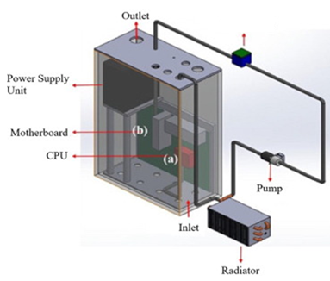
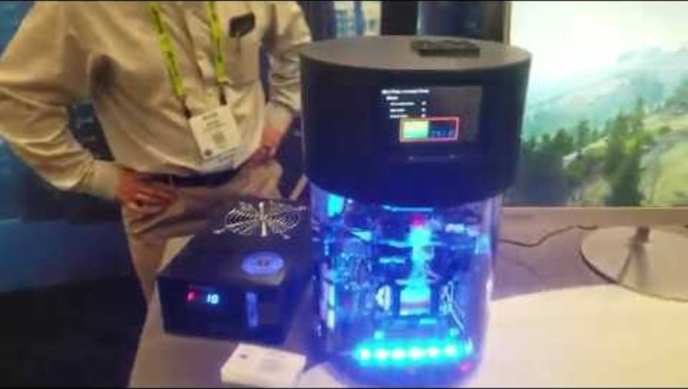
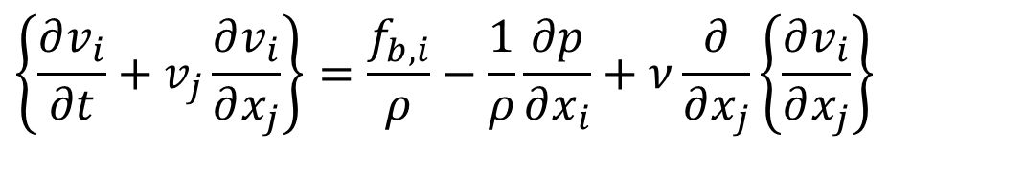
Engineering of Mathematics
Consider the Navier-Stokes equations with reference density in their dimensional form:
$$∇•\vec{v}=0$$
$$\left\{\frac{∂v_{i}}{∂t}+v_{j}\frac{∂v_{i}}{∂x_{j}}\right\}=\frac{f_{b,i}}{ρ}−\frac{1}{ρ}\frac{∂p}{∂x_{i}}+ν\frac{∂}{∂x_{j}}\left\{\frac{∂v_{i}}{∂x_{j}}\right\}$$
Consider highest expected velocity of cooling fluid as U.
Most important dimension of subsystem as L.
These parameters are defined by Reynolds as velocity and length scales.
In the case of flow through a pipe, L might be a pipe diameter (D) and U the flow speed at the pipe inlet.

Slide 7
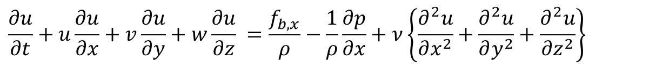
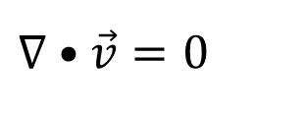
Honor of Osborne Reynolds by Nusselt
Consider the Navier-Stokes equations with constant reference density in their dimensional form:
$$∇•\vec{v}=0$$
X-momentum equation:
$$\frac{∂u}{∂t}+u\frac{∂u}{∂x}+v\frac{∂u}{∂y}+w\frac{∂u}{∂z} =\frac{f_{b,x}}{ρ}−\frac{1}{ρ}\frac{∂p}{∂x}+ν\left\{\frac{∂^{2}u}{∂x^{2}}+\frac{∂^{2}u}{∂y^{2}}+\frac{∂^{2}u}{∂z^{2}}\right\}$$
Define dimensionless variables as:
Substitute dimensional variable in terms of dimensionless variables:
$$u^{∗}=\frac{u}{U}$$
$$x^{∗}=\frac{x}{L}$$
$${u=Uu}^{∗}$$
$$x=Lx^{∗}$$
$$y=Ly^{∗}$$
$${v=Uv}^{∗}$$
$$v^{∗}=\frac{v}{U}$$
$$y^{∗}=\frac{y}{L}$$
$$t^{∗}=t\frac{U}{L}$$
$$z=Lz^{∗}$$
$${w=Uw}^{∗}$$
$$t=t^{∗}\frac{L}{U}$$
$$w^{∗}=\frac{w}{U}$$
$$z^{∗}=\frac{z}{L}$$
$$p^{∗}=\frac{p}{ρU^{2}}$$
$$p=ρU^{2}p^{∗}$$

Slide 8

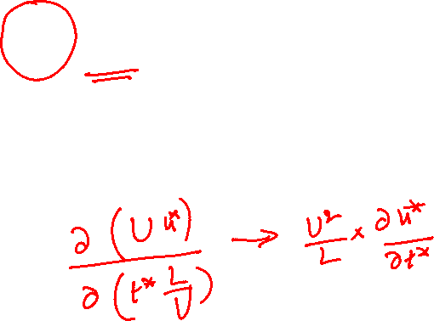

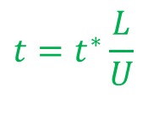
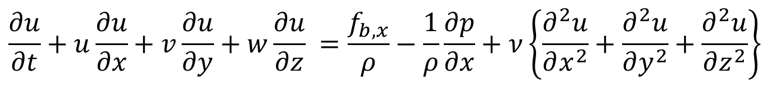
Non-dimensionalization of NS Equation
Consider x-momentum equation for an incompressible flow:
$$\frac{∂u}{∂t}+u\frac{∂u}{∂x}+v\frac{∂u}{∂y}+w\frac{∂u}{∂z} =\frac{f_{b,x}}{ρ}−\frac{1}{ρ}\frac{∂p}{∂x}+ν\left\{\frac{∂^{2}u}{∂x^{2}}+\frac{∂^{2}u}{∂y^{2}}+\frac{∂^{2}u}{∂z^{2}}\right\}$$
Substitute dimensional variable in terms of dimensionless variables:
$$t=t^{∗}\frac{L}{U}$$
$${u=Uu}^{∗}$$
$$x=Lx^{∗}$$

Slide 9
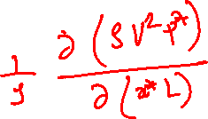
Non-dimensionalization of NS Equation
Consider x-momentum equation for an incompressible flow:
$$\frac{∂u}{∂t}+u\frac{∂u}{∂x}+v\frac{∂u}{∂y}+w\frac{∂u}{∂z} =\frac{f_{b,x}}{ρ}−\frac{1}{ρ}\frac{∂p}{∂x}+ν\left\{\frac{∂^{2}u}{∂x^{2}}+\frac{∂^{2}u}{∂y^{2}}+\frac{∂^{2}u}{∂z^{2}}\right\}$$
Substitute dimensional variable in terms of dimensionless variables:
$$p=ρU^{2}p^{∗}$$

Slide 10
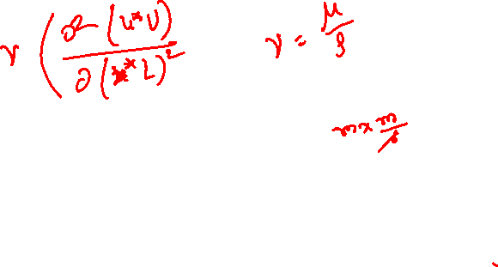
Non-dimensionalization of NS Equation
Consider x-momentum equation for an incompressible flow:
$$\frac{∂u}{∂t}+u\frac{∂u}{∂x}+v\frac{∂u}{∂y}+w\frac{∂u}{∂z} =\frac{f_{b,x}}{ρ}−\frac{1}{ρ}\frac{∂p}{∂x}+ν\left\{\frac{∂^{2}u}{∂x^{2}}+\frac{∂^{2}u}{∂y^{2}}+\frac{∂^{2}u}{∂z^{2}}\right\}$$
Substitute dimensional variable in terms of dimensionless variables:

Slide 11
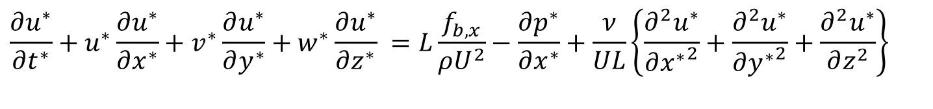
Non-dimensional form of NS Equation
Non-dimensional x-momentum equation for an incompressible flow:
$$\frac{∂u^{∗}}{∂t^{∗}}+u^{∗}\frac{∂u^{∗}}{∂x^{∗}}+v^{∗}\frac{∂u^{∗}}{∂y^{∗}}+w^{∗}\frac{∂u^{∗}}{∂z^{∗}} =L\frac{f_{b,x}}{ρU^{2}}−\frac{∂p^{∗}}{∂x^{∗}}+\frac{ν}{UL}\left\{\frac{∂^{2}u^{∗}}{∂{x^{∗}}^{2}}+\frac{∂^{2}u^{∗}}{∂{y^{∗}}^{2}}+\frac{∂^{2}u^{∗}}{∂z^{2}}\right\}$$
Stokes identified this dimensionless number was referred to as parameter R.
1908: German physicist Arnold Sommerfeld introduced the term "Reynolds number" at the 4th International Congress of Mathematicians in Rome.
The Reynolds Number
$$Re=\frac{UL}{ν}$$
$$Re=\frac{ρUL}{μ}×\frac{A/t}{A/t}=\frac{Inertial Force }{Viscous Force }$$
$$\frac{∂u^{∗}}{∂t^{∗}}+u^{∗}\frac{∂u^{∗}}{∂x^{∗}}+v^{∗}\frac{∂u^{∗}}{∂y^{∗}}+w^{∗}\frac{∂u^{∗}}{∂z^{∗}} = −\frac{∂p^{∗}}{∂x^{∗}}+\frac{1}{Re}\left\{\frac{∂^{2}u^{∗}}{∂{x^{∗}}^{2}}+\frac{∂^{2}u^{∗}}{∂{y^{∗}}^{2}}+\frac{∂^{2}u^{∗}}{∂z^{2}}\right\}$$

Slide 12
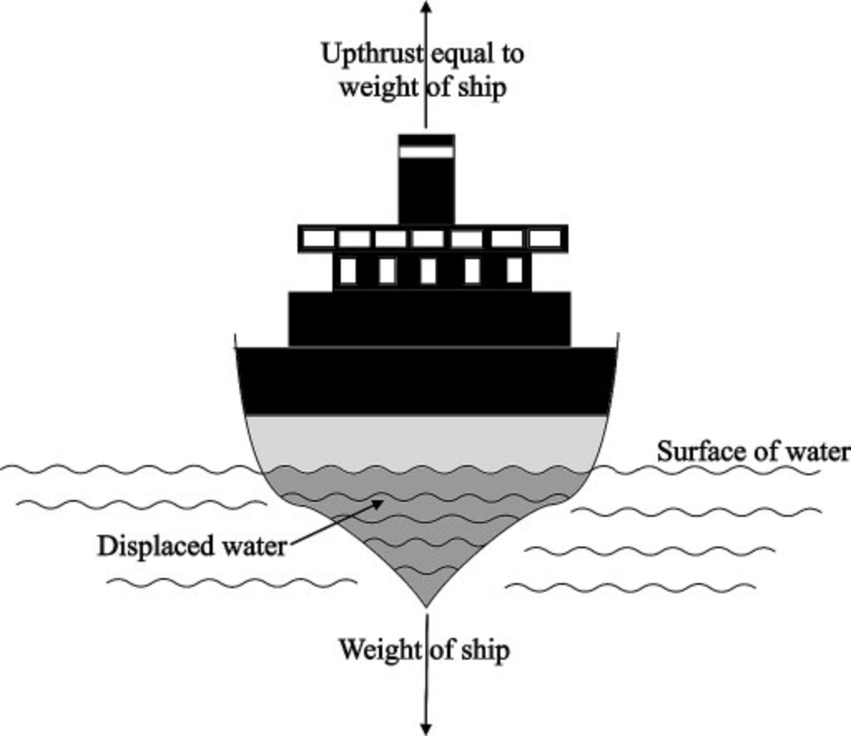

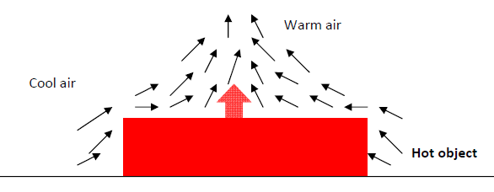
Body force as A Buoyancy force
Archimedes’ principle ∼250BC : The net force is proportional to the difference in the densities of the fluid and the body.
$$F_{body−Arch}=\left(ρ_{boat}−ρ_{fluid}\right)gV_{immersed}$$
19th Century….

Slide 13
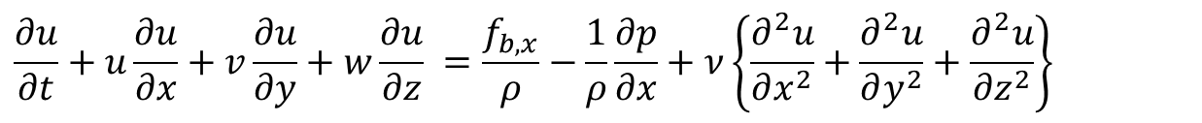

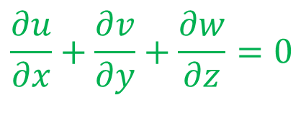
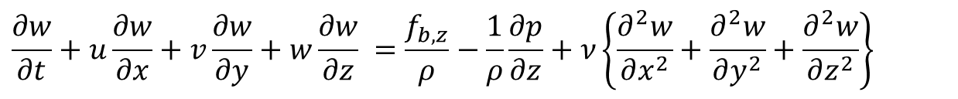
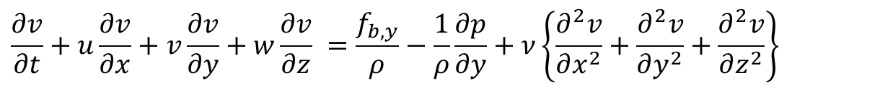
Conservation Laws for Incompressible Convection Systems using perfect gas
Continuity Equation in Cartesian coordinates is:
$$\frac{∂u}{∂x}+\frac{∂v}{∂y}+\frac{∂w}{∂z}=0$$
X-momentum Equation for an incompressible flow is
$$\frac{∂u}{∂t}+u\frac{∂u}{∂x}+v\frac{∂u}{∂y}+w\frac{∂u}{∂z} =\frac{f_{b,x}}{ρ}−\frac{1}{ρ}\frac{∂p}{∂x}+ν\left\{\frac{∂^{2}u}{∂x^{2}}+\frac{∂^{2}u}{∂y^{2}}+\frac{∂^{2}u}{∂z^{2}}\right\}$$
Y-momentum Equation for an incompressible flow is
$$\frac{∂v}{∂t}+u\frac{∂v}{∂x}+v\frac{∂v}{∂y}+w\frac{∂v}{∂z} =\frac{f_{b,y}}{ρ}−\frac{1}{ρ}\frac{∂p}{∂y}+ν\left\{\frac{∂^{2}v}{∂x^{2}}+\frac{∂^{2}v}{∂y^{2}}+\frac{∂^{2}v}{∂z^{2}}\right\}$$
Z-momentum Equation for an incompressible flow is
$$\frac{∂w}{∂t}+u\frac{∂w}{∂x}+v\frac{∂w}{∂y}+w\frac{∂w}{∂z} =\frac{f_{b,z}}{ρ}−\frac{1}{ρ}\frac{∂p}{∂z}+ν\left\{\frac{∂^{2}w}{∂x^{2}}+\frac{∂^{2}w}{∂y^{2}}+\frac{∂^{2}w}{∂z^{2}}\right\}$$
The Energy conservation Equation
$$\frac{{ρc}_{p}DT}{Dt}=\frac{Dp}{Dt}+k\left\{\frac{∂^{2}T}{∂x^{2}}+\frac{∂^{2}T}{∂y^{2}}+\frac{∂^{2}T}{∂z^{2}}\right\}+Φ$$

Slide 14
Body Forces in A General Convection
A general convection may be considered as Mixed convection flow or combined forced and free convection flow.
Mixed Convection Flows arise in many transport processes in engineering devices and in nature.
The name most synonymous with modelling of body force due to natural convection is Joseph Valentin Boussinesq.
In 1897 Boussinesq proposed the striking simplification of the body force due to natural convection.
The Boussinesq model neglects density differences except in the gravity term of the momentum equation.
Almost fifty years after the development of the Navier—Stokes (NS) equations governing fluid motion, Boussinesq established his famous approximation for body forces due to NC.

Slide 15
Body Forces in A General Convection
In 1879, Anton Oberbeck had earlier applied the same concept in his description of heat conduction in liquids accounting for currents driven by thermal gradients.
The model for body force due to NC is now commonly referred to as the Oberbeck—Boussinesq (OB) approximation in recognition of their respective contributions.

Slide 16
The OB scheme
The OB approximation can be formulated as an asymptotic theory based on five physical assumptions:
1. The fluid density depends only on the local temperature or, equivalently, pressure changes yield negligible density changes;
2. The local difference between the temperature,𝑇, and its reference constant value,𝑇₀, is very small;
3. The acceleration experienced by the fluid elements in the flow domain is very small;
4. The viscous stress is very small;
5. The local difference between the pressure gradient and the hydro-static pressure gradient is very small.

Slide 17
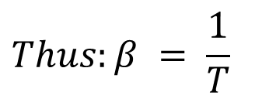
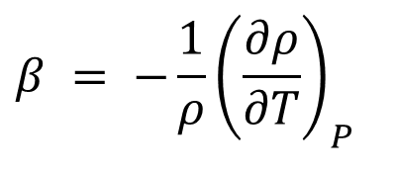
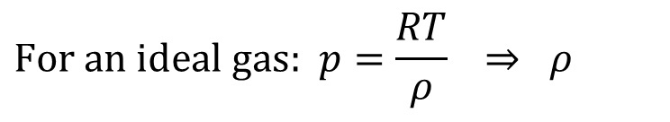

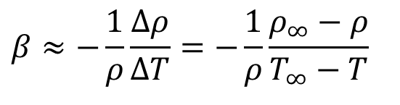
Thermodynamics of Buoyancy Force
Define β, the volumetric thermal expansion coefficient.
$$β = −\frac{1}{ρ}{\left(\frac{∂ρ}{∂T}\right)}_{P}$$
$$\text{For} \text{an} \text{ideal} \text{gas}\text{: }p=\frac{RT}{ρ} ⇒ ρ$$
$$Thus:β = \frac{1}{T}$$
Not valid for liquids and non-ideal gases
$$β≈−\frac{1}{ρ}\frac{Δρ}{ΔT}=−\frac{1}{ρ}\frac{ρ_{∞}−ρ}{T_{∞}−T}$$
Valid for any general fluid
$$ρ_{∞}−ρ≈ρβ(T−T_{∞})$$
Density gradient is due to the temperature gradient
${\vec{f}}_{b}=f_{b,x}\hat{i}$+ $f_{b,x}\hat{j}$+ $f_{b,z}\hat{k}=0 \hat{i}\text{+ }0 \hat{j}\text{+ }\left\{ρ_{0}gβ\left(T−T_{0}\right)\right\}\hat{k}$

Slide 18
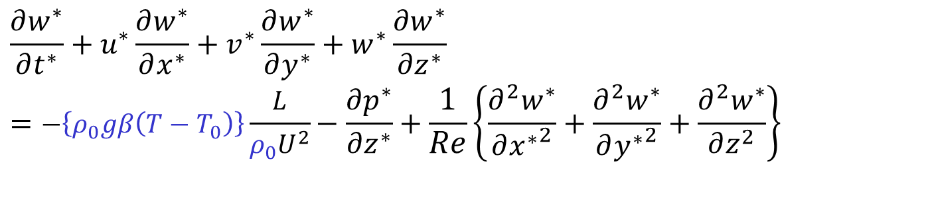
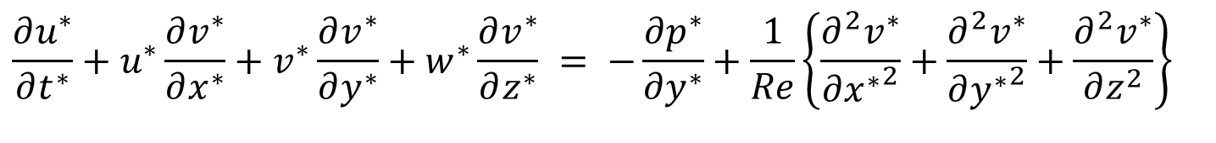
Non-dimensional form of NS Equation
Non-dimensional x-momentum equation for an incompressible flow:
$$\frac{∂u^{∗}}{∂t^{∗}}+u^{∗}\frac{∂u^{∗}}{∂x^{∗}}+v^{∗}\frac{∂u^{∗}}{∂y^{∗}}+w^{∗}\frac{∂u^{∗}}{∂z^{∗}} = −\frac{∂p^{∗}}{∂x^{∗}}+\frac{1}{Re}\left\{\frac{∂^{2}u^{∗}}{∂{x^{∗}}^{2}}+\frac{∂^{2}u^{∗}}{∂{y^{∗}}^{2}}+\frac{∂^{2}u^{∗}}{∂z^{2}}\right\}$$
Non-dimensional y-momentum equation for an incompressible flow:
$$\frac{∂u^{∗}}{∂t^{∗}}+u^{∗}\frac{∂v^{∗}}{∂x^{∗}}+v^{∗}\frac{∂v^{∗}}{∂y^{∗}}+w^{∗}\frac{∂v^{∗}}{∂z^{∗}} = −\frac{∂p^{∗}}{∂y^{∗}}+\frac{1}{Re}\left\{\frac{∂^{2}v^{∗}}{∂{x^{∗}}^{2}}+\frac{∂^{2}v^{∗}}{∂{y^{∗}}^{2}}+\frac{∂^{2}v^{∗}}{∂z^{2}}\right\}$$
Non-dimensional z-momentum equation for an incompressible flow:
$$\frac{∂w^{∗}}{∂t^{∗}}+u^{∗}\frac{∂w^{∗}}{∂x^{∗}}+v^{∗}\frac{∂w^{∗}}{∂y^{∗}}+w^{∗}\frac{∂w^{∗}}{∂z^{∗}}=−\left\{ρ_{0}gβ\left(T−T_{0}\right)\right\}\frac{L}{ρ_{0}U^{2}}−\frac{∂p^{∗}}{∂z^{∗}}+\frac{1}{Re}\left\{\frac{∂^{2}w^{∗}}{∂{x^{∗}}^{2}}+\frac{∂^{2}w^{∗}}{∂{y^{∗}}^{2}}+\frac{∂^{2}w^{∗}}{∂z^{2}}\right\}$$

Slide 19
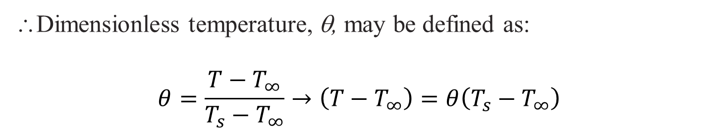



Non-dimensional form of NS Equation for Convection System
Non-dimensional z-momentum equation for an incompressible flow:
$$\frac{∂w^{∗}}{∂t^{∗}}+u^{∗}\frac{∂w^{∗}}{∂x^{∗}}+v^{∗}\frac{∂w^{∗}}{∂y^{∗}}+w^{∗}\frac{∂w^{∗}}{∂z^{∗}}=−\left\{ρ_{0}gβ\left(T−T_{0}\right)\right\}\frac{L}{ρ_{0}U^{2}}−\frac{∂p^{∗}}{∂z^{∗}}+\frac{1}{Re}\left\{\frac{∂^{2}w^{∗}}{∂{x^{∗}}^{2}}+\frac{∂^{2}w^{∗}}{∂{y^{∗}}^{2}}+\frac{∂^{2}w^{∗}}{∂z^{2}}\right\}$$
Maximum possible temperature difference in any convection system is
$${{∆T}_{max}=T}_{s}−T_{∞}$$
∴Dimensionless temperature, θ, may be defined as:
$$θ=\frac{T−T_{∞}}{T_{s}−T_{∞}}→\left(T−T_{∞}\right)=θ\left(T_{s}−T_{∞}\right)$$
$$\frac{\left\{ρ_{0}gβ\left(T_{s}−T_{∞}\right) \right\}L}{ρ_{0}U^{2}}θ$$

Slide 20
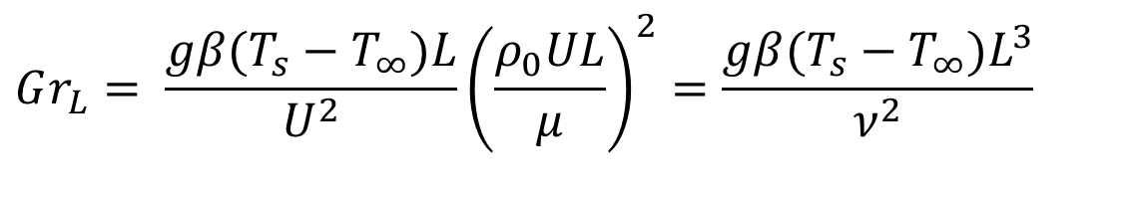
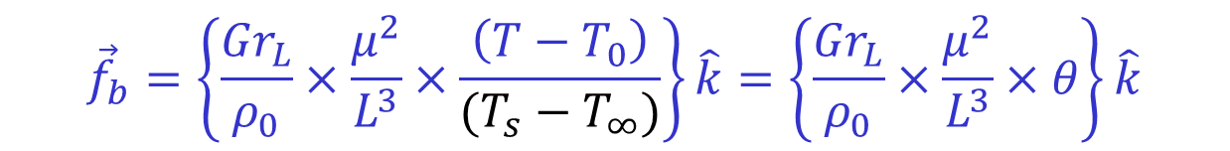
Dimensionless Similarity Parameter
Define new dimensionless parameter,
$$Gr_{L}= \frac{gβ(T_{s}−T_{∞})L}{U^{2}}{\left(\frac{ρ_{0}UL}{μ}\right)}^{2}=\frac{gβ(T_{s}−T_{∞})L^{3}}{ν^{2}}$$
The Grashof number (Gr_{L}) is named after Franz Grashof, a German engineer and professor of machine science.
Grashof made significant contributions to understanding free convection.
However, the Grashof number was named after him after his death in 1893.
${\vec{f}}_{b}=f_{b,x}\hat{i}$+ $f_{b,x}\hat{j}$+ $f_{b,z}\hat{k}=0 \hat{i}\text{+ }0 \hat{j}\text{+ }\left\{ρ_{0}gβ\left(T−T_{0}\right)\right\}\hat{k}$
$${\vec{f}}_{b}=\left\{\frac{{Gr}_{L}}{ρ_{0}}×\frac{μ^{2}}{L^{3}}×\frac{\left(T−T_{0}\right)}{(T_{s}−T_{∞})}\right\}\hat{k}=\left\{\frac{{Gr}_{L}}{ρ_{0}}×\frac{μ^{2}}{L^{3}}×θ\right\}\hat{k}$$

Slide 21
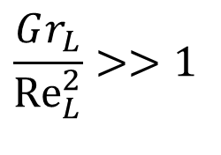
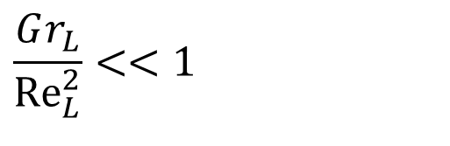
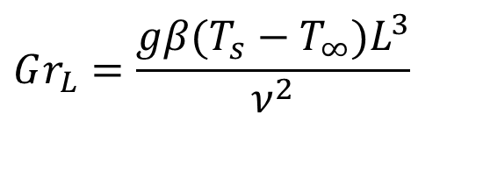
Dimensionless Similarity Parameter
$$Gr_{L}=\frac{gβ(T_{s}−T_{∞})L^{3}}{ν^{2}}$$
Grashof number in natural convection is analogous to the Reynolds number in forced convection.
Grashof number indicates the ratio of the buoyancy force to the viscous force.
Higher Gr number means increased natural convection flow
$$\frac{Gr_{L}}{{Re}_{L}^{2}}<<1$$
Forced Convection
$$\frac{Gr_{L}}{{Re}_{L}^{2}}>>1$$
Natural Convection

Slide 22

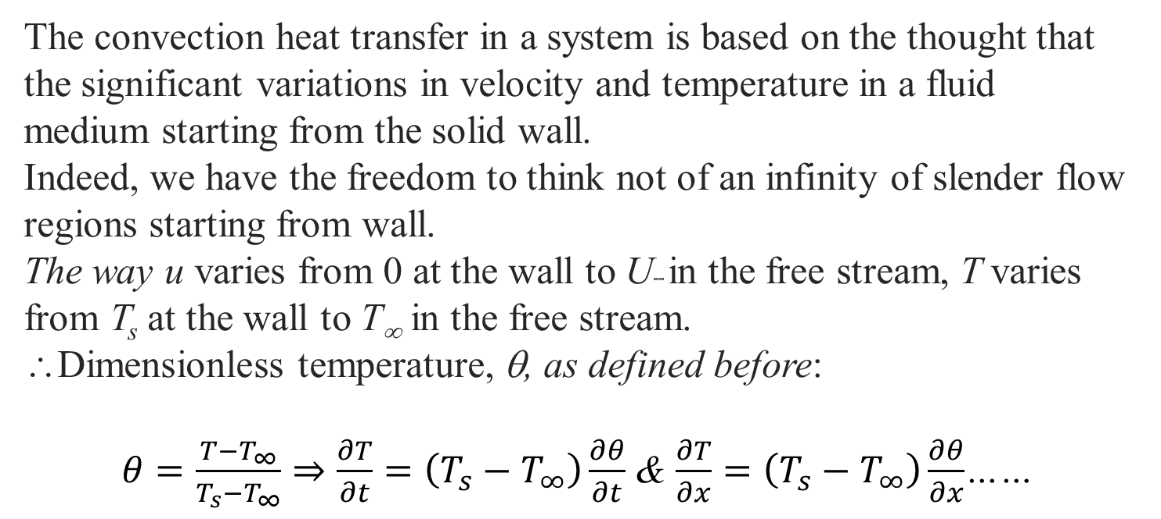
Non-dimensional form of Energy Equation
The Energy conservation Equation for an incompressible flow
$$\frac{{ρc}_{p}DT}{Dt}=\frac{Dp}{Dt}+k\left\{\frac{∂^{2}T}{∂x^{2}}+\frac{∂^{2}T}{∂y^{2}}+\frac{∂^{2}T}{∂z^{2}}\right\}+Φ$$
The convection heat transfer in a system is based on the thought that the significant variations in velocity and temperature in a fluid medium starting from the solid wall.
Indeed, we have the freedom to think not of an infinity of slender flow regions starting from wall.
The way u varies from 0 at the wall to U∞ in the free stream, T varies from T_{s} at the wall to T∞ in the free stream.
∴Dimensionless temperature, θ, as defined before:
$θ=\frac{T−T_{∞}}{T_{s}−T_{∞}}⇒\frac{∂T}{∂t}=\left(T_{s}−T_{∞}\right)\frac{∂θ}{∂t}$ & $\frac{∂T}{∂x}=\left(T_{s}−T_{∞}\right)\frac{∂θ}{∂x}$……

Slide 23
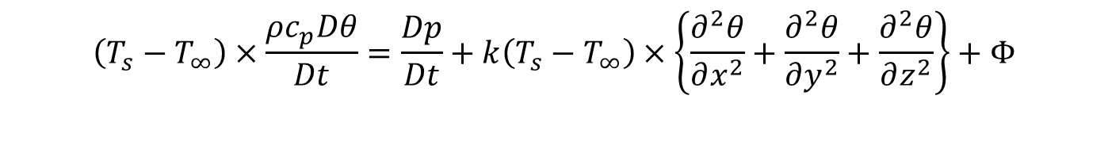
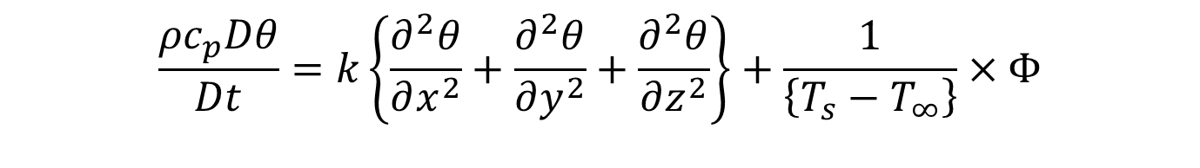
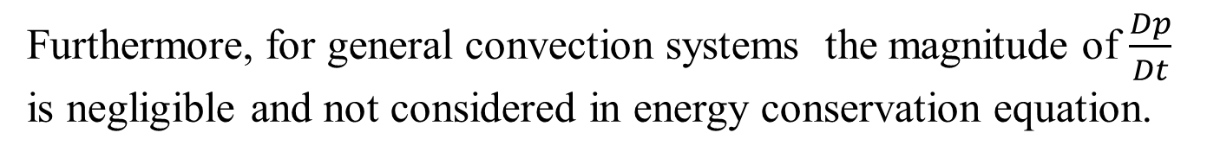
Non-dimensional form of Energy Equation
The Energy conservation Equation for an incompressible flow in terms of non-dimensional temperature.
$$\left(T_{s}−T_{∞}\right)×\frac{ρc_{p}Dθ}{Dt}=\frac{Dp}{Dt}+k\left(T_{s}−T_{∞}\right)×\left\{\frac{∂^{2}θ}{∂x^{2}}+\frac{∂^{2}θ}{∂y^{2}}+\frac{∂^{2}θ}{∂z^{2}}\right\}+Φ$$
Furthermore, for general convection systems the magnitude of $\frac{Dp}{Dt}$ is negligible and not considered in energy conservation equation.
$$\frac{{ρc}_{p}Dθ}{Dt}=k\left\{\frac{∂^{2}θ}{∂x^{2}}+\frac{∂^{2}θ}{∂y^{2}}+\frac{∂^{2}θ}{∂z^{2}}\right\}+\frac{1}{\left\{T_{s}−T_{∞}\right\}}×Φ$$

Slide 24
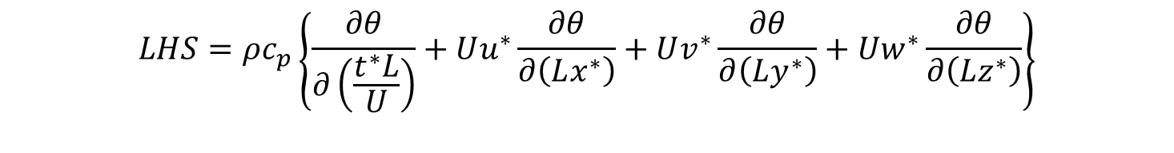

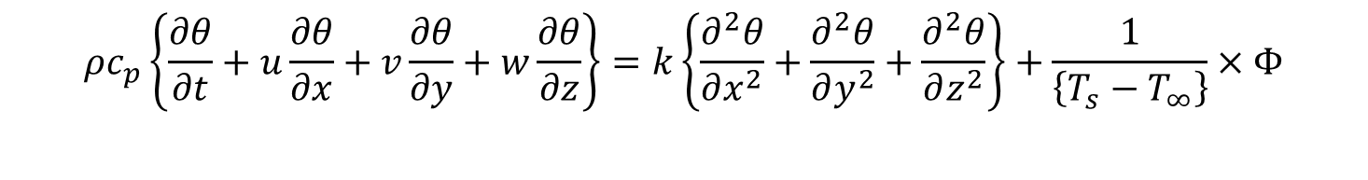
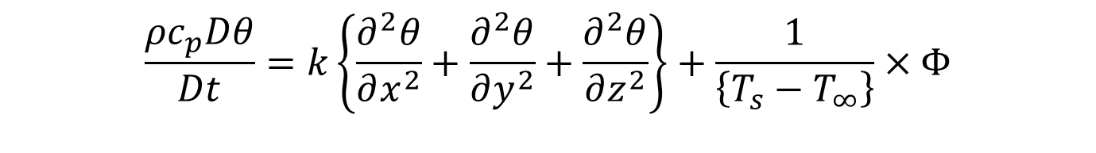
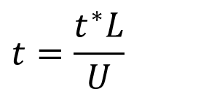


Non-dimensional form of Energy Equation
$$\frac{{ρc}_{p}Dθ}{Dt}=k\left\{\frac{∂^{2}θ}{∂x^{2}}+\frac{∂^{2}θ}{∂y^{2}}+\frac{∂^{2}θ}{∂z^{2}}\right\}+\frac{1}{\left\{T_{s}−T_{∞}\right\}}×Φ$$
$${ρc}_{p}\left\{\frac{∂θ}{∂t}+u\frac{∂θ}{∂x}+v\frac{∂θ}{∂y}+w\frac{∂θ}{∂z}\right\}=k\left\{\frac{∂^{2}θ}{∂x^{2}}+\frac{∂^{2}θ}{∂y^{2}}+\frac{∂^{2}θ}{∂z^{2}}\right\}+\frac{1}{\left\{T_{s}−T_{∞}\right\}}×Φ$$
$$t=\frac{t^{∗}L}{U}$$
$$\vec{v}=U{\vec{v}}^{∗}$$
$$\vec{x}=L{\vec{x}}^{∗}$$
$${LHS=ρc}_{p}\left\{\frac{∂θ}{∂\left(\frac{t^{∗}L}{U}\right)}+Uu^{∗}\frac{∂θ}{∂\left(Lx^{∗}\right)}+Uv^{∗}\frac{∂θ}{∂\left(Ly^{∗}\right)}+Uw^{∗}\frac{∂θ}{∂\left(Lz^{∗}\right)}\right\}$$
$$LHS=\frac{ρUc_{p}}{L}\left\{\frac{∂θ}{∂t^{∗}}+u^{∗}\frac{∂θ}{∂x^{∗}}+v^{∗}\frac{∂θ}{∂y^{∗}}+w^{∗}\frac{∂θ}{∂z^{∗}}\right\}$$

Slide 25
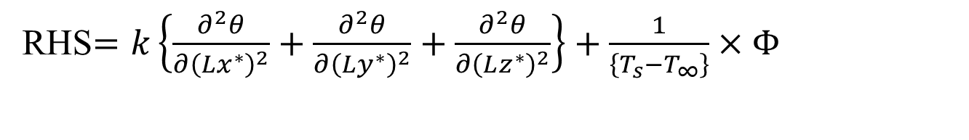
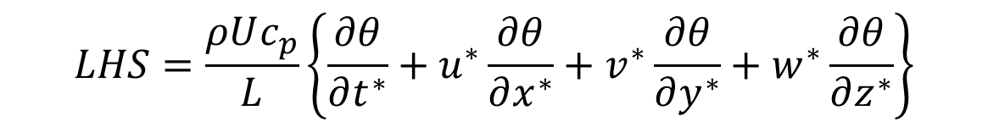
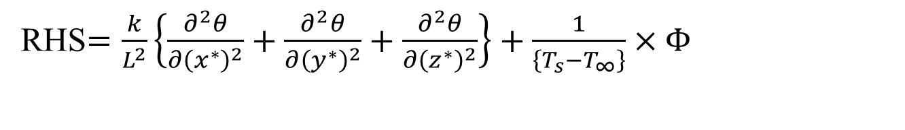
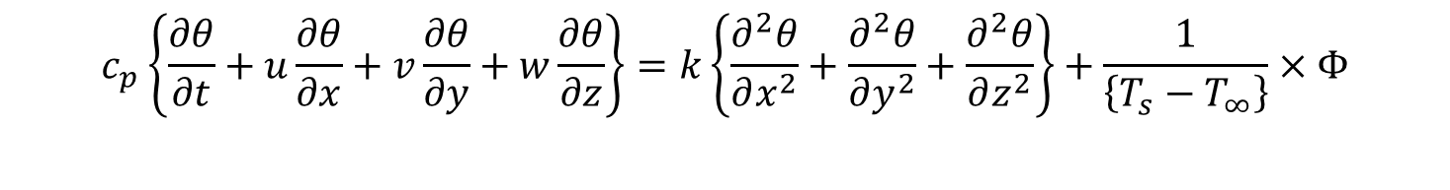
Non-dimensional form of Energy Equation
$$c_{p}\left\{\frac{∂θ}{∂t}+u\frac{∂θ}{∂x}+v\frac{∂θ}{∂y}+w\frac{∂θ}{∂z}\right\}=k\left\{\frac{∂^{2}θ}{∂x^{2}}+\frac{∂^{2}θ}{∂y^{2}}+\frac{∂^{2}θ}{∂z^{2}}\right\}+\frac{1}{\left\{T_{s}−T_{∞}\right\}}×Φ$$
RHS$=k\left\{\frac{∂^{2}θ}{∂{\left(Lx^{∗}\right)}^{2}}+\frac{∂^{2}θ}{∂{\left(Ly^{∗}\right)}^{2}}+\frac{∂^{2}θ}{∂{\left(Lz^{∗}\right)}^{2}}\right\}+\frac{1}{\left\{T_{s}−T_{∞}\right\}}×Φ$
RHS$=\frac{k}{L^{2}}\left\{\frac{∂^{2}θ}{∂{\left(x^{∗}\right)}^{2}}+\frac{∂^{2}θ}{∂{\left(y^{∗}\right)}^{2}}+\frac{∂^{2}θ}{∂{\left(z^{∗}\right)}^{2}}\right\}+\frac{1}{\left\{T_{s}−T_{∞}\right\}}×Φ$
$$LHS=\frac{ρUc_{p}}{L}\left\{\frac{∂θ}{∂t^{∗}}+u^{∗}\frac{∂θ}{∂x^{∗}}+v^{∗}\frac{∂θ}{∂y^{∗}}+w^{∗}\frac{∂θ}{∂z^{∗}}\right\}$$
$$\frac{ρUc_{p}}{L}\left\{\frac{∂θ}{∂t^{∗}}+u^{∗}\frac{∂θ}{∂x^{∗}}+v^{∗}\frac{∂θ}{∂y^{∗}}+w^{∗}\frac{∂θ}{∂z^{∗}}\right\}=\frac{k}{L^{2}}\left\{\frac{∂^{2}θ}{∂{\left(x^{∗}\right)}^{2}}+\frac{∂^{2}θ}{∂{\left(y^{∗}\right)}^{2}}+\frac{∂^{2}θ}{∂{\left(z^{∗}\right)}^{2}}\right\}+\frac{Φ}{\left\{T_{s}−T_{∞}\right\}}$$

Slide 26
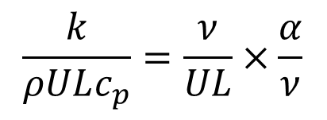
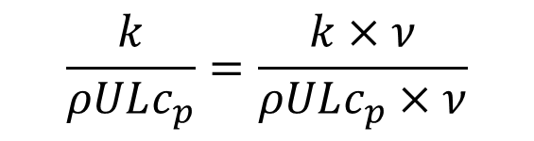
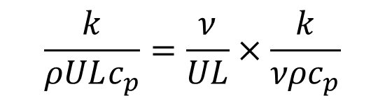
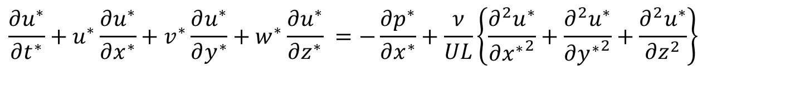
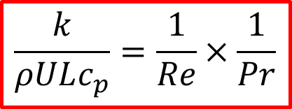
Non-dimensional form of Energy Equation
$$\frac{ρUc_{p}}{L}\left\{\frac{∂θ}{∂t^{∗}}+u^{∗}\frac{∂θ}{∂x^{∗}}+v^{∗}\frac{∂θ}{∂y^{∗}}+w^{∗}\frac{∂θ}{∂z^{∗}}\right\}=\frac{k}{L^{2}}\left\{\frac{∂^{2}θ}{∂{\left(x^{∗}\right)}^{2}}+\frac{∂^{2}θ}{∂{\left(y^{∗}\right)}^{2}}+\frac{∂^{2}θ}{∂{\left(z^{∗}\right)}^{2}}\right\}+\frac{Φ}{\left\{T_{s}−T_{∞}\right\}}$$
$$\left\{\frac{∂θ}{∂t^{∗}}+u^{∗}\frac{∂θ}{∂x^{∗}}+v^{∗}\frac{∂θ}{∂y^{∗}}+w^{∗}\frac{∂θ}{∂z^{∗}}\right\}=\frac{k}{ρULc_{p}}\left\{\frac{∂^{2}θ}{∂{\left(x^{∗}\right)}^{2}}+\frac{∂^{2}θ}{∂{\left(y^{∗}\right)}^{2}}+\frac{∂^{2}θ}{∂{\left(z^{∗}\right)}^{2}}\right\}+\frac{LΦ}{ρUc_{p}\left\{T_{s}−T_{∞}\right\}}$$
$$\frac{∂u^{∗}}{∂t^{∗}}+u^{∗}\frac{∂u^{∗}}{∂x^{∗}}+v^{∗}\frac{∂u^{∗}}{∂y^{∗}}+w^{∗}\frac{∂u^{∗}}{∂z^{∗}} =−\frac{∂p^{∗}}{∂x^{∗}}+\frac{ν}{UL}\left\{\frac{∂^{2}u^{∗}}{∂{x^{∗}}^{2}}+\frac{∂^{2}u^{∗}}{∂{y^{∗}}^{2}}+\frac{∂^{2}u^{∗}}{∂z^{2}}\right\}$$
$$\frac{k}{ρULc_{p}}=\frac{k×ν}{ρULc_{p}×ν}$$
$$\frac{k}{ρULc_{p}}=\frac{ν}{UL}×\frac{k}{{νρc}_{p}}$$
$$\frac{k}{ρULc_{p}}=\frac{ν}{UL}×\frac{α}{ν}$$
$$\frac{k}{ρULc_{p}}=\frac{1}{Re}×\frac{1}{Pr}$$

Slide 27
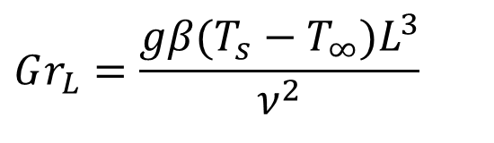

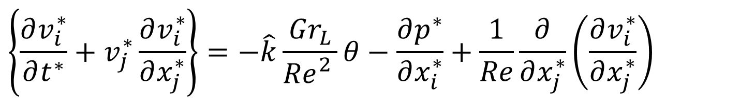
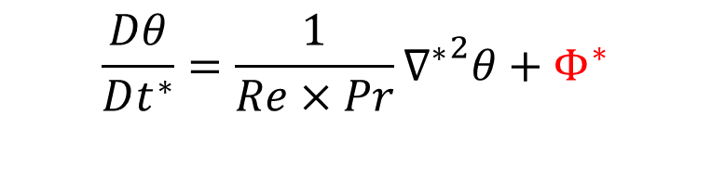
Non-dimensional form of Energy Equation
$$\frac{ρUc_{p}}{L}\left\{\frac{∂θ}{∂t^{∗}}+u^{∗}\frac{∂θ}{∂x^{∗}}+v^{∗}\frac{∂θ}{∂y^{∗}}+w^{∗}\frac{∂θ}{∂z^{∗}}\right\}=\frac{k}{L^{2}}\left\{\frac{∂^{2}θ}{∂{\left(x^{∗}\right)}^{2}}+\frac{∂^{2}θ}{∂{\left(y^{∗}\right)}^{2}}+\frac{∂^{2}θ}{∂{\left(z^{∗}\right)}^{2}}\right\}+\frac{ΦL}{ρUc_{p}\left\{T_{s}−T_{∞}\right\}}$$
$$\frac{Dθ}{Dt^{∗}}=\frac{1}{Re×Pr}{∇^{∗}}^{2}θ+{ Φ}^{∗}$$
$$\left\{\frac{∂v_{i}^{∗}}{∂t^{∗}}+v_{j}^{∗}\frac{∂v_{i}^{∗}}{∂x_{j}^{∗}}\right\}=−\hat{k}\frac{{Gr}_{L}}{{Re}_{}^{2}}θ−\frac{∂p^{∗}}{∂x_{i}^{∗}}+\frac{1}{Re}\frac{∂}{∂x_{j}^{∗}}\left(\frac{∂v_{i}^{∗}}{∂x_{j}^{∗}}\right)$$
$$Gr_{L}=\frac{gβ(T_{s}−T_{∞})L^{3}}{ν^{2}}$$
$$\frac{∂v_{j}^{∗}}{∂x_{j}^{∗}}=0$$

Slide 28


Estimation of Heat Transfer Coefficient
Nusselt cut the Gordian knot in his 1915 paper "The Fundamental Law of Heat Transfer”
$$h=−\frac{k_{fluid}{\left.\left\{\frac{∂T}{∂y}\right\}\right|}_{wall}}{\left\{T_{wall}−T_{∞}\right\}}$$
$${\left.\frac{∂θ}{∂y^{∗}}\right|}_{y^{∗}=0}=\frac{hL}{k_{fluid}}$$
Estimation of heat transfer coefficient is basically computation of temperature profile in equilibrium fluid layer.
Provoked a general analytical, experimental and computational study to understand how the equilibrium layer is developed.
The global geometry of the solid wall and flow conditions will decide the structure of stagnant layer.
Basic Geometry : Internal Flow or External Flow.

Slide 29

Analytics of Open System Processes
Fluid Mechanics
Heat Transfer
1687: Newton’s Law of Viscosity.
1755: Euler Equations.
$\frac{∂\left(ρ\vec{v}\right)}{∂t}+∇.\left(ρ\vec{v}\vec{v}\right)={\vec{f}}_{body}−∇p$
$∇^{2}ψ=0$
1845: N-S Equations.
1903: Development of Flying Machines
1701 Newton’s law of cooling.
1822: Fourier’s Conduction Equation.
1915: Nusselt cut the Gordian knot: Analytical Convection Heat Transfer.
1940: Turbo-machines for Flying Machines

Slide 30

Academic Convection Heat Transfer Problems

