Slide 1



Thermal Energy Balance Equation for Convection Heat Transfer
P M V Subbarao
Professor & Head
Mechanical Engineering Department
Temperature Field is the Cornerstone of Heat Transfer…
Methods to Obtaing Temperature Field …

Slide 2


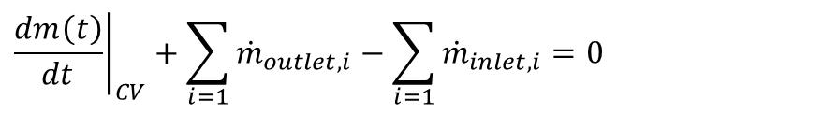
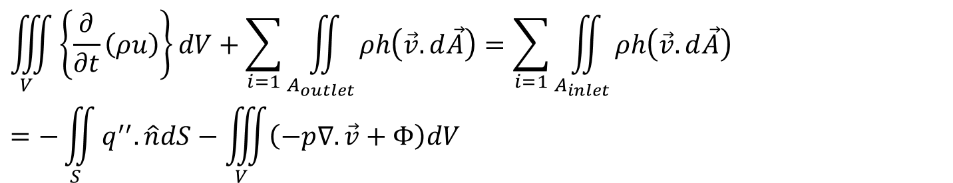
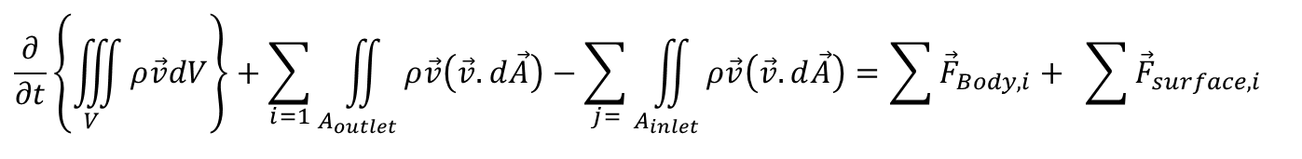
RTT for Integral Convection System
A Practical Convection Systems with multiple inlets and outlets.
Conservation of mass:
$${\left.\frac{dm\left(t\right)}{dt}\right|}_{CV}+\sum_{i=1}{{\dot{m}}_{outlet,i}}−\sum_{i=1}{{\dot{m}}_{inlet,i}}=0$$
Conservation of momentum:
$$\frac{∂}{∂t}\left\{\iiint_{V}{ρ\vec{v}dV}\right\}+\sum_{i=1}{\iint_{A_{outlet}}{ρ\vec{v}\left(\vec{v}.d\vec{A}\right)}}−\sum_{j=}{\iint_{A_{inlet}}{ρ\vec{v}\left(\vec{v}.d\vec{A}\right)=\sum{{\vec{F}}_{Body,i}}+ \sum{{\vec{F}}_{surface,i}} }}$$
Conservation of Thermal Energy:
$$\iiint_{V}{\left\{\frac{∂}{∂t}\left(ρu\right)\right\}dV}+\sum_{i=1}{\iint_{A_{outlet}}{ρh\left(\vec{v}.d\vec{A}\right)}}=\sum_{i=1}{\iint_{A_{inlet}}{ρh\left(\vec{v}.d\vec{A}\right)}}=−\iint_{S}{q^{′′}.\hat{n}dS}−\iiint_{V}{\left(−p∇.\vec{v}+Φ\right)dV}$$

Slide 3
An Integral Analysis for Deeper Study of A Convection Heat Transfer System is necessary but not sufficient!!!

Slide 4
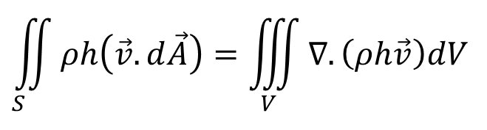
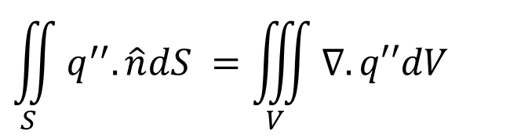
Thermal Energy of A Convection System
The rate of Equation of first law of thermodynamics for a CV
$$\iiint_{V}{\left\{\frac{∂}{∂t}\left(ρu\right)\right\}dV}+\iint_{S_{}}{ρh\left(\vec{v}.d\vec{A}\right)}=−\iint_{S}{q^{′′}.\hat{n}dS}−\iiint_{V}{\left(−p∇.\vec{v}+Φ\right)dV}$$
Using Gauss Divergence Theorem:
$$\iint_{S}{q^{′′}.\hat{n}dS} =\iiint_{V}{∇.q′′dV}$$
$$\iint_{S_{}}{ρh\left(\vec{v}.d\vec{A}\right)}=\iiint_{V}{∇. \left(ρh\vec{v}\right)dV}$$
$$\iiint_{V}{\left\{\frac{∂}{∂t}\left(ρu\right)\right\}dV}+\iiint_{V}{∇. \left(ρh\vec{v}\right)dV}=−\iiint_{V}{∇.q^{′′}dV}−\iiint_{V}{\left(−p∇.\vec{v}+Φ\right)dV}$$

Slide 5
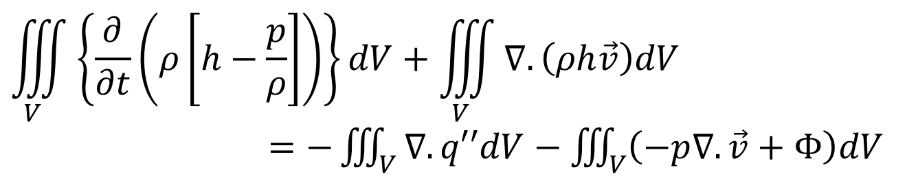
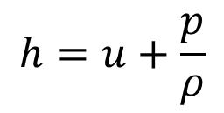
Thermal Energy of A Differential Convection Element
The rate of Equation of first law of thermodynamics for a CV
$$\iiint_{V}{\left\{\frac{∂}{∂t}\left(ρu\right)\right\}dV}+\iiint_{V}{∇.q′′dV}=−\iiint_{V}{∇. \left(ρh\vec{v}\right)dV}−\iiint_{V}{\left(−p∇.\vec{v}+Φ\right)dV}$$
$$h=u+\frac{p}{ρ}$$
$$\iiint_{V}{\left\{\frac{∂}{∂t}\left(ρ\left[h−\frac{p}{ρ}\right]\right)\right\}dV}+\iiint_{V}{∇. \left(ρh\vec{v}\right)dV}$$
$=−\iiint_{V}{∇.q′′dV}−\iiint_{V}{\left(−p∇.\vec{v}+Φ\right)dV}$

Slide 6
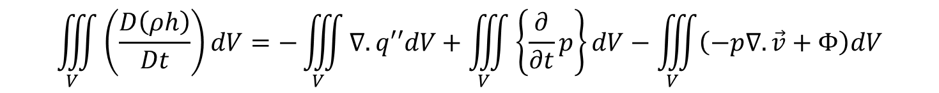
Thermal Energy of A Differential Convection Element
The rate of Equation of first law of thermodynamics for a CV
$$\iiint_{V}{\left\{\frac{∂}{∂t}\left(ρ\left[h−\frac{p}{ρ}\right]\right)\right\}dV}+\iiint_{V}{∇. \left(ρh\vec{v}\right)dV} =−\iiint_{V}{∇.q′′dV}−\iiint_{V}{\left(−p∇.\vec{v}+Φ\right)dV}$$
$\iiint_{V}{\left\{\frac{∂}{∂t}\left(ρ\left[h−\frac{p}{ρ}\right]\right)\right\}dV}=\iiint_{V}{\left\{\frac{∂}{∂t}\left(ρh\right)\right\}dV}$- $\iiint_{V}{\left\{\frac{∂}{∂t}p\right\}dV}$
$$\iiint_{V}{\left\{\frac{∂}{∂t}\left(ρh\right)\right\}dV}\text{−} \iiint_{V}{\left\{\frac{∂}{∂t}p\right\}dV}+\iiint_{V}{∇. \left(ρh\vec{v}\right)dV}=−\iiint_{V}{∇.q′′dV}−\iiint_{V}{\left(−p∇.\vec{v}+Φ\right)dV}$$
$$\iiint_{V}{\left\{\frac{∂}{∂t}\left(ρh\right)\right\}dV}+\iiint_{V}{∇. \left(ρh\vec{v}\right)dV}=−\iiint_{V}{∇.q′′dV}+\iiint_{V}{\left\{\frac{∂}{∂t}p\right\}dV}−\iiint_{V}{\left(−p∇.\vec{v}+Φ\right)dV}$$
$$\iiint_{V}{\left(\frac{D\left(ρh\right)}{Dt}\right)dV}=−\iiint_{V}{∇.q′′dV}+\iiint_{V}{\left\{\frac{∂}{∂t}p\right\}dV}−\iiint_{V}{\left(−p∇.\vec{v}+Φ\right)dV}$$

Slide 7
Thermal Energy of A Differential Convection Element
The rate of Equation of first law of thermodynamics for a CV
$$\iiint_{V}{\left(\frac{D\left\{ρh\right\}}{Dt}\right)dV}=−\iiint_{V}{∇.q′′dV}+\iiint_{V}{\left\{\frac{∂}{∂t}p\right\}dV}−\iiint_{V}{\left(−p∇.\vec{v}+Φ\right)dV}$$
$$\iiint_{V}{\left(\frac{D\left\{ρh\right\}}{Dt}\right)dV}=−\iiint_{V}{∇.q′′dV}+\iiint_{V}{\left\{\frac{∂}{∂t}p\right\}dV}+\iiint_{V}{\left(p∇.\vec{v}\right)dV−\iiint_{V}{ΦdV}}$$
$$\iiint_{V}{\left(\frac{D\left\{ρh\right\}}{Dt}\right)dV}=−\iiint_{V}{∇.q′′dV}+\iiint_{V}{\left(\frac{Dp}{Dt}\right)dV}−\iiint_{V}{ΦdV}$$

Slide 8
Thermal Energy of A Differential Convection Element
The rate of Equation of first law of thermodynamics for a CV
$$\iiint_{V}{\left(\frac{D\left\{ρh\right\}}{Dt}\right)dV}=\iiint_{V}{\left(\frac{Dp}{Dt}−∇.q^{′′}−Φ\right)dV}$$
LHS of the integral equals to RHS of integral for any size and shape of material volume.
Implies that the integrands must also be equal.
$$\left(\frac{D\left\{ρh\right\}}{Dt}\right)=\frac{Dp}{Dt}−∇.q^{′′}−Φ$$
Fourier’s Constitutive Equation for the Heat Flux
$$q′′=−\vec{\vec{k}}•∇T$$

Slide 9
Thermal Energy of A Differential Convection Element
The Equation for an infinitesimal convection element
$$\frac{Dh}{Dt}=\frac{Dp}{Dt}−∇.\left\{−\vec{\vec{k}}•∇T\right\} +Φ$$
For general fluids, k is a scalar.
$$\frac{Dh}{Dt}=\frac{Dp}{Dt}+∇.\left\{k•∇T\right\} +Φ$$
For a perfect gas (Ideal gas with constant properties):
$$\frac{{ρc}_{p}DT}{Dt}=\frac{Dp}{Dt}+k∇^{2}T +Φ$$
What if the fluid is a Real Gas???

Slide 10
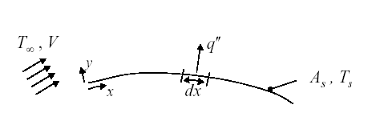
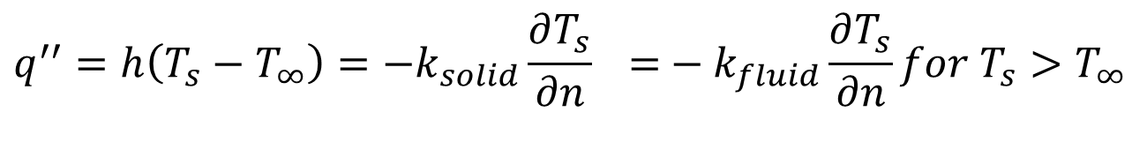
Local Convection Heat Transfer
Consider convection heat transfer as a fluid passes over a surface of arbitrary shape:
Apply Fourier’s version of Newton’s law cooling to a local differential element with length dx.
$$q^{′′}=h\left(T_{s}−T_{∞}\right)=−k_{solid}\frac{∂T_{s}}{∂n} \text{=}−k_{fluid}\frac{∂T_{s}}{∂n}for T_{s}>T_{∞}$$
At the surface/wall, $T_{fluid}=T_{solid}:Thermal Equilibrium$
h is defined as Local Convection Heat Transfer Coefficient, W/m²K

Slide 11
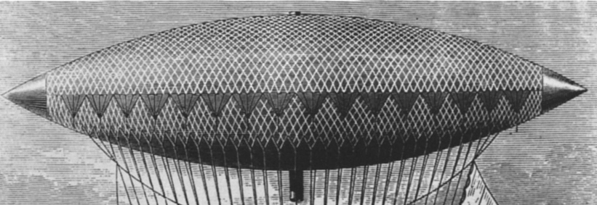
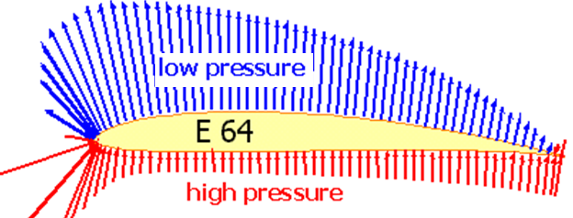
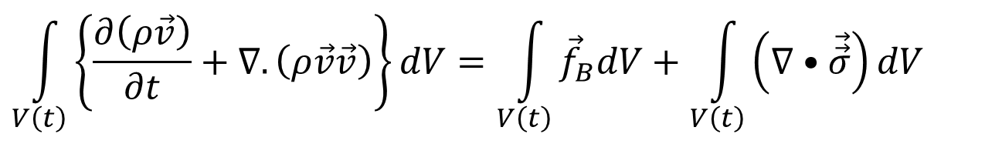
Body Force Vs Surface Forces
$$\int_{V\left(t\right)}{\left\{\frac{∂\left(ρ\vec{v}\right)}{∂t}+∇.\left(ρ\vec{v}\vec{v}\right)\right\}dV}=\int_{V\left(t\right)}{{\vec{f}}_{B}dV}+\int_{V\left(t\right)}{\left(∇•\vec{\vec{σ}}\right)dV}$$
Airship using Body Force
Flyer using Surface Force
The Second term on the right-hand side of above equation represents the resultant surface force acting on the control volume.
As discussed before, force is an extensive quantity and hence surface force must also be proportional to extent of the surface of A control volume.

Slide 12
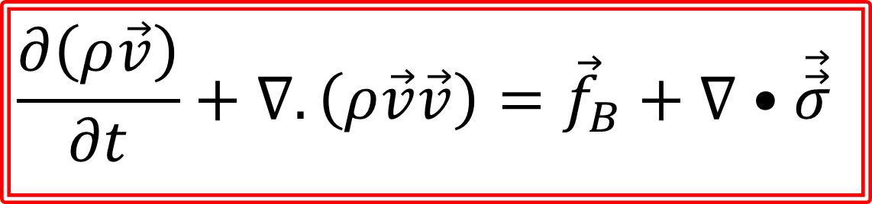
Differential Form of Momentum Conservation Equations for Fluid Flows
$$\int_{V\left(t\right)}{\left\{\frac{∂\left(ρ\vec{v}\right)}{∂t}+∇.\left(ρ\vec{v}\vec{v}\right)\right\}dV}=\int_{V\left(t\right)}{{\vec{f}}_{B}dV}+\int_{V\left(t\right)}{\left(∇•\vec{\vec{σ}}\right)dV}$$
Localization of RTT for Momentum Conservation:
$$\frac{∂\left(ρ\vec{v}\right)}{∂t}+∇.\left(ρ\vec{v}\vec{v}\right)={\vec{f}}_{B}+∇•\vec{\vec{σ}}$$

Slide 13
Lubricity (Slipperiness) of Fluids
In 1687, Newton paid attention to fluid flow and proposed following hypothesis in latin:
In 1729, Andrew Motte translated this hypothesis as:
The resistance arising from the want of lubricity (lack of slipperiness) in the parts of a fluid, is, other things being equal, proportional to velocity with which parts of the fluid separated from one another.

Slide 14
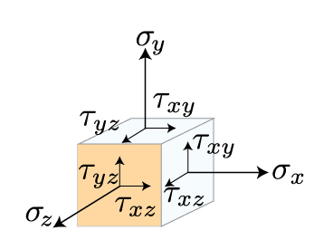
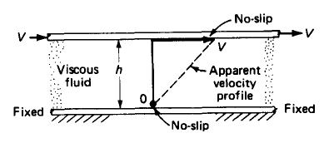
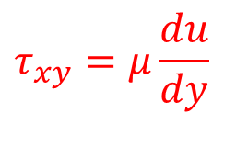
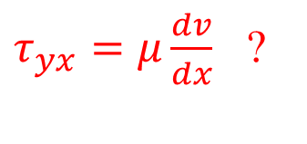
Fluid Mechanics as An Engineering Science
The knowledge of fluid flow cannot be called a discipline of engineering science until Isaac Newton published his famous work Philosophia Naturalis Principia Mathematica in 1687.
Newton stated in his principia that, for straight, parallel and uniform flow, the shear stress , between layers is proportional to the velocity gradient in the direction perpendicular to the layers.
$$τ_{xy}=μ\frac{du}{dy}$$
$τ_{yx}=μ\frac{dv}{dx}$ ?
Mathematicians treated Newton’s Law of viscosity was the most Frugal solution to highly complex truth.

Slide 15







Intellectual Description of An Unknown (Giant)
Each new discoverer either ignored or denigrated his predecessors’ contribution.
Each had his own way to justify their Model.
Each judged differently the kind of motion and the nature of the system to which it is applicable.

Slide 16
The First Five Renaissances of A Model for Frictional Flow Systems
Mathematicians recommenced the analysis of Frictional flows as very complex, and almost made sure that the solutions are unpredictable.
The early life of this equation was as fleeting as the foam on a wave crest.
Navier developed first model in1822 and this was not influential.
Models were rediscovered or re-derived at least four times,
Cauchy in 1823,
Poisson in 1829,
Saint-Venant in 1837
Stokes in 1845.

Slide 17
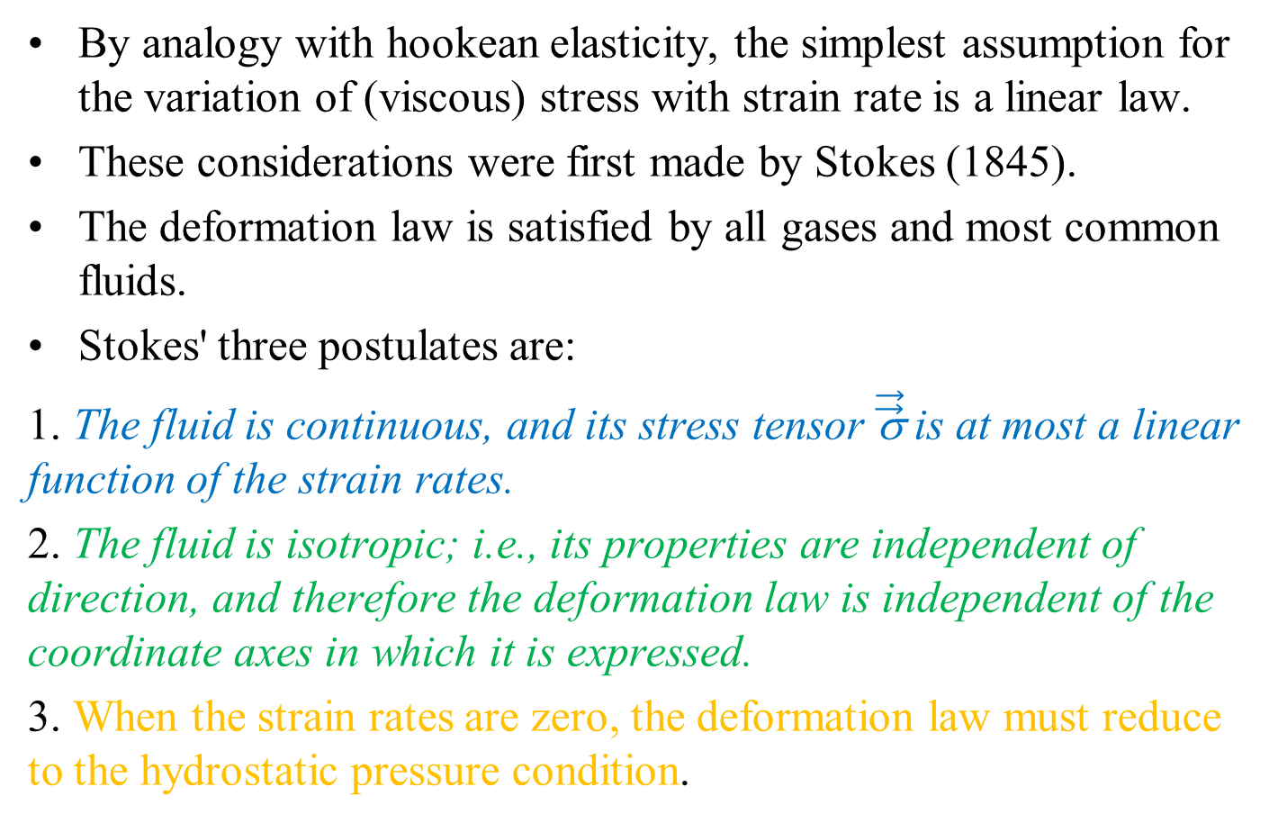
Deformation Postulates for a Newtonian Fluid Flow: By Stokes
By analogy with hookean elasticity, the simplest assumption for the variation of (viscous) stress with strain rate is a linear law.
These considerations were first made by Stokes (1845).
The deformation law is satisfied by all gases and most common fluids.
Stokes' three postulates are:
1. The fluid is continuous, and its stress tensor $\vec{\vec{\text{σ}}}$ is at most a linear function of the strain rates.
2. The fluid is isotropic; i.e., its properties are independent of direction, and therefore the deformation law is independent of the coordinate axes in which it is expressed.
3. When the strain rates are zero, the deformation law must reduce to the hydrostatic pressure condition.

Slide 18
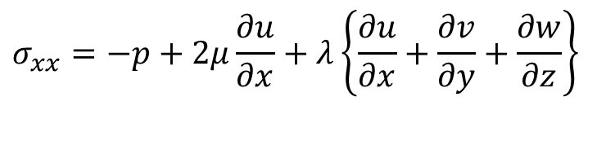

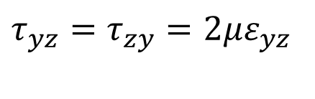
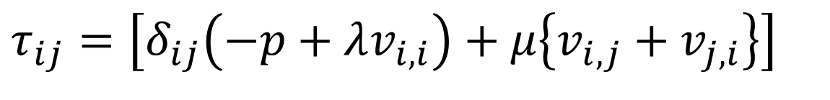

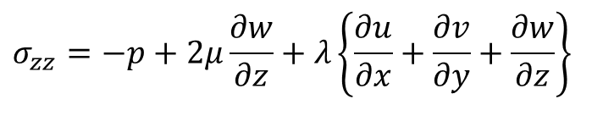
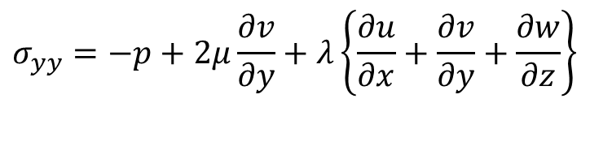
Stress Tensor in Einstein Notation
Consider indices namely, i and j.
Both i and j can take values x, y ,z ….
$$σ_{xx}=−p+2μ\frac{∂u}{∂x}+λ\left\{\frac{∂u}{∂x}+\frac{∂v}{∂y}+\frac{∂w}{∂z}\right\}$$
$$τ_{xy}=τ_{yx}=2με_{xy}$$
$$σ_{yy}=−p+2μ\frac{∂v}{∂y}+λ\left\{\frac{∂u}{∂x}+\frac{∂v}{∂y}+\frac{∂w}{∂z}\right\}$$
$$τ_{yz}=τ_{zy}=2με_{yz}$$
$$σ_{zz}=−p+2μ\frac{∂w}{∂z}+λ\left\{\frac{∂u}{∂x}+\frac{∂v}{∂y}+\frac{∂w}{∂z}\right\}$$
$$τ_{zx}=τ_{xz}=2με_{zx}$$
$$τ_{ij}=\left[δ_{ij}\left(−p+λv_{i,i}\right)+μ\left\{v_{i,j}+v_{j,i}\right\}\right]$$

Slide 19
Incompressible Flows
X-momentum Equation for an incompressible flow is
$$ρ\left\{\frac{∂u}{∂t}+u\frac{∂u}{∂x}+v\frac{∂u}{∂y}+w\frac{∂u}{∂z}\right\}=$$
$$ρg_{x}−\frac{∂p}{∂x}+\frac{∂}{∂x}\left(2μ\frac{∂u}{∂x}\right)+\frac{∂}{∂y}\left\{μ\left(\frac{∂u}{∂y}+\frac{∂v}{∂x}\right)\right\}+\frac{∂}{∂z}\left\{μ\left(\frac{∂w}{∂x}+\frac{∂u}{∂z}\right)\right\}$$
$$ρ\left\{\frac{∂u}{∂t}+u\frac{∂u}{∂x}+v\frac{∂u}{∂y}+w\frac{∂u}{∂z}\right\}=$$
$$ρg_{x}−\frac{∂p}{∂x}+2μ\frac{∂^{2}u}{∂x^{2}}+μ\frac{∂^{2}u}{∂y^{2}}+μ\frac{∂^{2}v}{∂y∂x}+μ\frac{∂^{2}w}{∂z∂x}+μ\frac{∂^{2}u}{∂z^{2}}$$
$$ρ\left\{\frac{∂u}{∂t}+u\frac{∂u}{∂x}+v\frac{∂u}{∂y}+w\frac{∂u}{∂z}\right\}=$$
$$ρg_{x}−\frac{∂p}{∂x}+2μ\frac{∂^{2}u}{∂x^{2}}+μ\frac{∂^{2}u}{∂y^{2}}+μ\frac{∂^{2}u}{∂z^{2}}+μ\frac{∂}{∂x}\left(\frac{∂v}{∂y}+\frac{∂w}{∂z}\right)$$

Slide 20
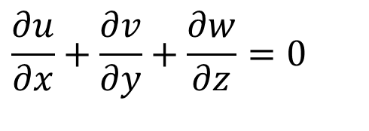
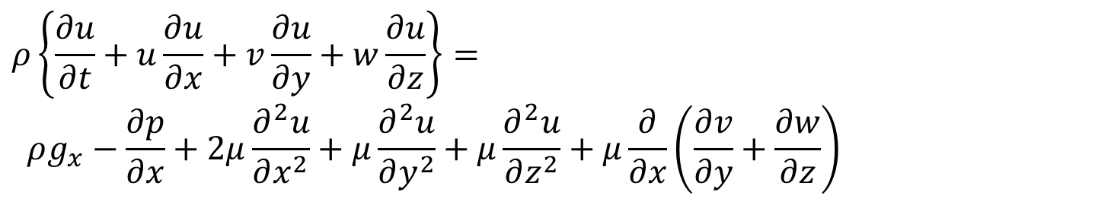
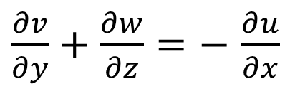
Incompressible Flows
$$ρ\left\{\frac{∂u}{∂t}+u\frac{∂u}{∂x}+v\frac{∂u}{∂y}+w\frac{∂u}{∂z}\right\}=$$
$$ρg_{x}−\frac{∂p}{∂x}+2μ\frac{∂^{2}u}{∂x^{2}}+μ\frac{∂^{2}u}{∂y^{2}}+μ\frac{∂^{2}u}{∂z^{2}}+μ\frac{∂}{∂x}\left(\frac{∂v}{∂y}+\frac{∂w}{∂z}\right)$$
The continuity equation for unsteady incompressible flow is:
$$\frac{∂u}{∂x}+\frac{∂v}{∂y}+\frac{∂w}{∂z}=0$$
$\frac{∂v}{∂y}+\frac{∂w}{∂z}=−$ $\frac{∂u}{∂x}$
$$ρ\left\{\frac{∂u}{∂t}+u\frac{∂u}{∂x}+v\frac{∂u}{∂y}+w\frac{∂u}{∂z}\right\}= ρg_{x}−\frac{∂p}{∂x}+μ\left\{\frac{∂^{2}u}{∂x^{2}}+\frac{∂^{2}u}{∂y^{2}}+\frac{∂^{2}u}{∂z^{2}}\right\}$$

Slide 21
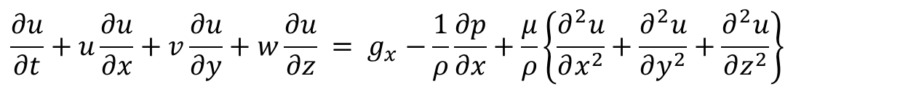
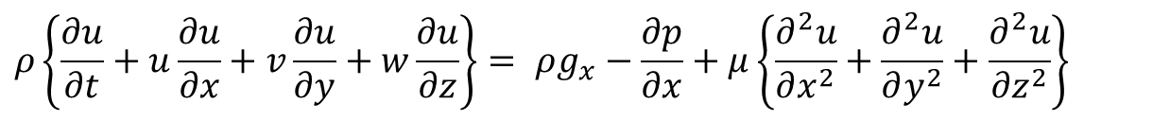
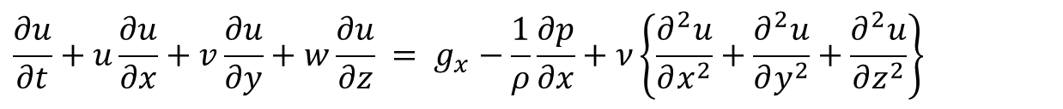
N-S Equations for Incompressible Flows
$$ρ\left\{\frac{∂u}{∂t}+u\frac{∂u}{∂x}+v\frac{∂u}{∂y}+w\frac{∂u}{∂z}\right\}= ρg_{x}−\frac{∂p}{∂x}+μ\left\{\frac{∂^{2}u}{∂x^{2}}+\frac{∂^{2}u}{∂y^{2}}+\frac{∂^{2}u}{∂z^{2}}\right\}$$
$$\frac{∂u}{∂t}+u\frac{∂u}{∂x}+v\frac{∂u}{∂y}+w\frac{∂u}{∂z} = g_{x}−\frac{1}{ρ}\frac{∂p}{∂x}+\frac{μ}{ρ}\left\{\frac{∂^{2}u}{∂x^{2}}+\frac{∂^{2}u}{∂y^{2}}+\frac{∂^{2}u}{∂z^{2}}\right\}$$
X-momentum Equation for an incompressible flow is
$$\frac{∂u}{∂t}+u\frac{∂u}{∂x}+v\frac{∂u}{∂y}+w\frac{∂u}{∂z} = g_{x}−\frac{1}{ρ}\frac{∂p}{∂x}+ν\left\{\frac{∂^{2}u}{∂x^{2}}+\frac{∂^{2}u}{∂y^{2}}+\frac{∂^{2}u}{∂z^{2}}\right\}$$

Slide 22
N-S Equations for Incompressible Flows
Conservation of Mass:
$$∇•\vec{v}=0$$
X-momentum Equation:
$$\frac{∂u}{∂t}+u\frac{∂u}{∂x}+v\frac{∂u}{∂y}+w\frac{∂u}{∂z} = g_{x}−\frac{1}{ρ}\frac{∂p}{∂x}+ν\left\{\frac{∂^{2}u}{∂x^{2}}+\frac{∂^{2}u}{∂y^{2}}+\frac{∂^{2}u}{∂z^{2}}\right\}$$
Y-momentum Equation:
$$\frac{∂v}{∂t}+u\frac{∂v}{∂x}+v\frac{∂v}{∂y}+w\frac{∂v}{∂z} = g_{y}−\frac{1}{ρ}\frac{∂p}{∂y}+ν\left\{\frac{∂^{2}v}{∂x^{2}}+\frac{∂^{2}v}{∂y^{2}}+\frac{∂^{2}v}{∂z^{2}}\right\}$$
Z-momentum Equation:
$$\frac{∂w}{∂t}+u\frac{∂w}{∂x}+v\frac{∂w}{∂y}+w\frac{∂w}{∂z} = g_{z}−\frac{1}{ρ}\frac{∂p}{∂z}+ν\left\{\frac{∂^{2}w}{∂x^{2}}+\frac{∂^{2}w}{∂y^{2}}+\frac{∂^{2}w}{∂z^{2}}\right\}$$

Slide 23
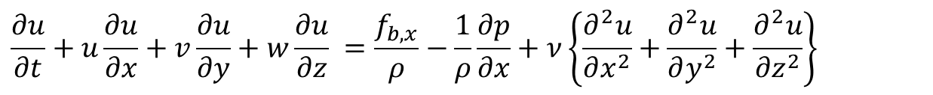

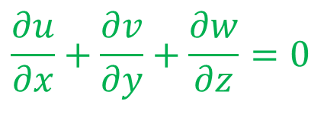
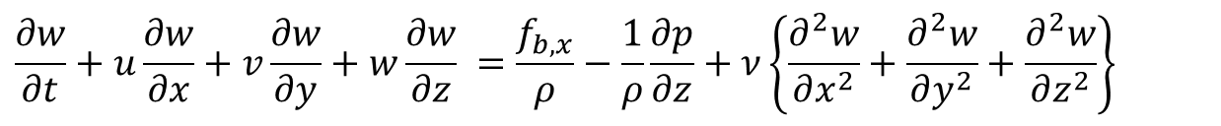
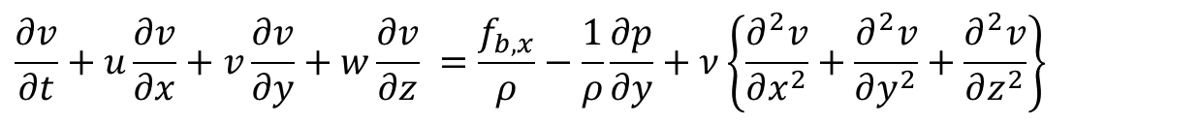
Conservation Laws for Incompressible General Convection Systems using perfect gas & Liquids
Continuity Equation in Cartesian coordinates is:
$$\frac{∂u}{∂x}+\frac{∂v}{∂y}+\frac{∂w}{∂z}=0$$
X-momentum Equation for an incompressible flow is
$$\frac{∂u}{∂t}+u\frac{∂u}{∂x}+v\frac{∂u}{∂y}+w\frac{∂u}{∂z} =\frac{f_{b,x}}{ρ}−\frac{1}{ρ}\frac{∂p}{∂x}+ν\left\{\frac{∂^{2}u}{∂x^{2}}+\frac{∂^{2}u}{∂y^{2}}+\frac{∂^{2}u}{∂z^{2}}\right\}$$
Y-momentum Equation for an incompressible flow is
$$\frac{∂v}{∂t}+u\frac{∂v}{∂x}+v\frac{∂v}{∂y}+w\frac{∂v}{∂z} =\frac{f_{b,x}}{ρ}−\frac{1}{ρ}\frac{∂p}{∂y}+ν\left\{\frac{∂^{2}v}{∂x^{2}}+\frac{∂^{2}v}{∂y^{2}}+\frac{∂^{2}v}{∂z^{2}}\right\}$$
Z-momentum Equation for an incompressible flow is
$$\frac{∂w}{∂t}+u\frac{∂w}{∂x}+v\frac{∂w}{∂y}+w\frac{∂w}{∂z} =\frac{f_{b,x}}{ρ}−\frac{1}{ρ}\frac{∂p}{∂z}+ν\left\{\frac{∂^{2}w}{∂x^{2}}+\frac{∂^{2}w}{∂y^{2}}+\frac{∂^{2}w}{∂z^{2}}\right\}$$
The Energy conservation Equation
$$\frac{{ρc}_{p}DT}{Dt}=\frac{Dp}{Dt}+k\left\{\frac{∂^{2}T}{∂x^{2}}+\frac{∂^{2}T}{∂y^{2}}+\frac{∂^{2}T}{∂z^{2}}\right\}+Φ$$

Slide 24
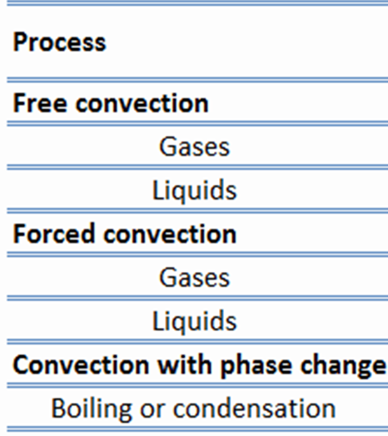
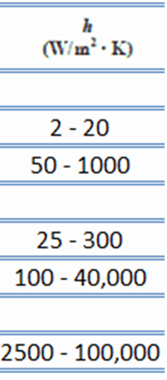
Broad Classification of Convection Systems

Slide 25
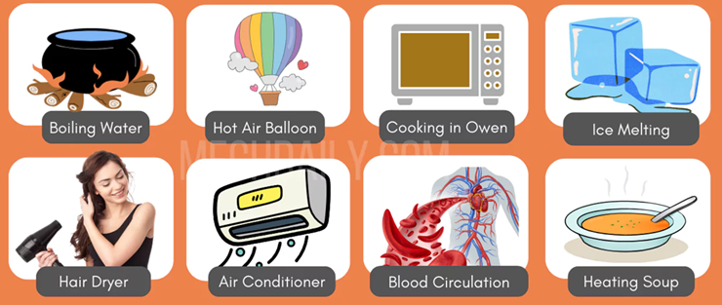
Real-Life Convection Systems

Slide 26
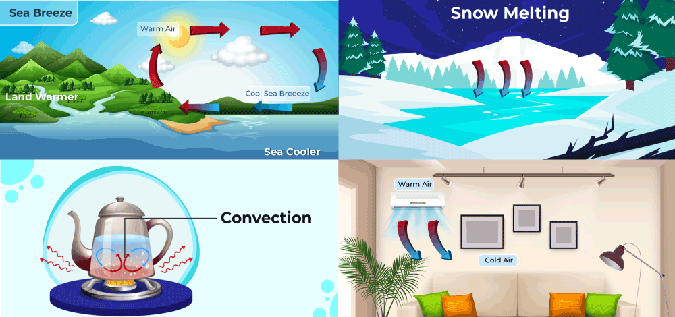
Size Variation of Convection Systems

Slide 27
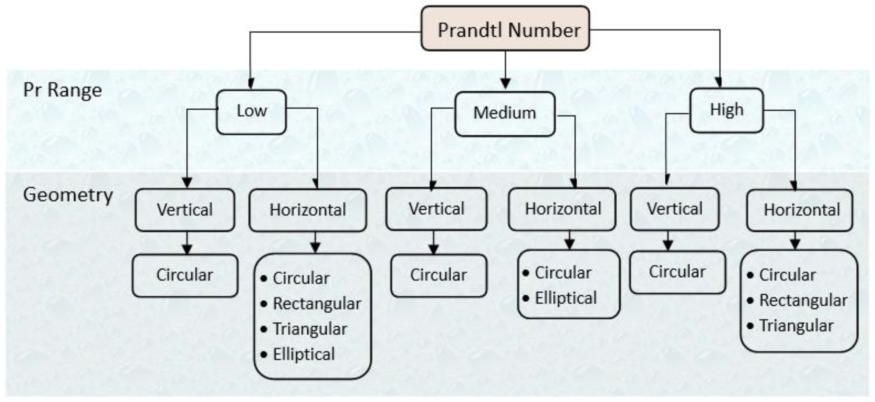
More Reasons to Classify Convection Systems
Non-circular
Non-circular
Non-circular

Slide 28
Buckingham Π Theorem &
Non-Dimensionalization of GDEs for Convection Systems
P M V Subbarao
Professor & Head
Mechanical Engineering Department
Guess & Create Major Similarity Variables Present in Convection System ….

Slide 29
Conservation Laws for Incompressible Convection Systems using perfect gas
Continuity Equation in Cartesian coordinates is:
$$\frac{∂u}{∂x}+\frac{∂v}{∂y}+\frac{∂w}{∂z}=0$$
X-momentum Equation for an incompressible flow is
$$\frac{∂u}{∂t}+u\frac{∂u}{∂x}+v\frac{∂u}{∂y}+w\frac{∂u}{∂z} = g_{x}−\frac{1}{ρ}\frac{∂p}{∂x}+ν\left\{\frac{∂^{2}u}{∂x^{2}}+\frac{∂^{2}u}{∂y^{2}}+\frac{∂^{2}u}{∂z^{2}}\right\}$$
Y-momentum Equation for an incompressible flow is
$$\frac{∂v}{∂t}+u\frac{∂v}{∂x}+v\frac{∂v}{∂y}+w\frac{∂v}{∂z} = g_{y}−\frac{1}{ρ}\frac{∂p}{∂y}+ν\left\{\frac{∂^{2}v}{∂x^{2}}+\frac{∂^{2}v}{∂y^{2}}+\frac{∂^{2}v}{∂z^{2}}\right\}$$
Z-momentum Equation for an incompressible flow is
$$\frac{∂w}{∂t}+u\frac{∂w}{∂x}+v\frac{∂w}{∂y}+w\frac{∂w}{∂z} = g_{z}−\frac{1}{ρ}\frac{∂p}{∂z}+ν\left\{\frac{∂^{2}w}{∂x^{2}}+\frac{∂^{2}w}{∂y^{2}}+\frac{∂^{2}w}{∂z^{2}}\right\}$$
The Energy conservation Equation
$$\frac{{ρc}_{p}DT}{Dt}=\frac{Dp}{Dt}+k\left\{\frac{∂^{2}T}{∂x^{2}}+\frac{∂^{2}T}{∂y^{2}}+\frac{∂^{2}T}{∂z^{2}}\right\}+Φ$$

Slide 30
Method of Developing Similitude Model
Most important step:
Assumes you know something about problem!
Required understanding of variables that govern problem and physical laws that apply.
What is the minimum knowledge required for convection?
Fluid motion generated by any means can help convection heat transfer!
How many ways are you aware of?

Slide 31
Determination of Pi terms
List all (n) variables that are involved in the problem.
Typically have geometry effects (pipe radius, length),
Fluid properties (density and viscosity),
External effects (gravity and pressure).
Variables in the list should be independent; no point in having pipe radius and area.
Decompose variables in terms of the basic dimensions.
Express each on in terms of primary dimensions (MLTθ)
Determine required number of Pi terms (each independent) – i.e. n-p

Slide 32
Method of Repeating Variables
Select p number of repeating variables (equal to number of dimensions).
All the reference dimensions must be included in list of repeating variables.
Each repeating variable must dimensionally be independent from the others.
It is not possible to form a dimensionless number from the repeating variables.
Form each pi terms by multiplying one of the non-repeating variables by the product of repeating variables
Repeat last step for all non-repeating variables
Check that all resulting Pi terms are dimensionless
Express in final form

Slide 33
Important Considerations
The second important step in an analysis is the listing of the relevant variables.
The rest is purely mechanical.
Some questions to consider is, How accurate is the desired answer?
Best to value simplicity ahead of precision.
Variable aspects are geometry Just lengths and angle (angles are
dimensionless).
Geometry invariably plays a role.

Slide 34
Important Considerations
Material properties: These would include density, viscosity, heat capacity.
These are parameters that relate external effects and their responses.
External effects: Anything that effects a change in the flow system, forces, pressures, gravity, velocities.
The categories are not rigid, it is a classification to help identify important quantities.
Note, if a variable is constant, it still needs to be included if it has any impact.
It is the dimensions that are important, not the specific values and whether they are constant.

Slide 35
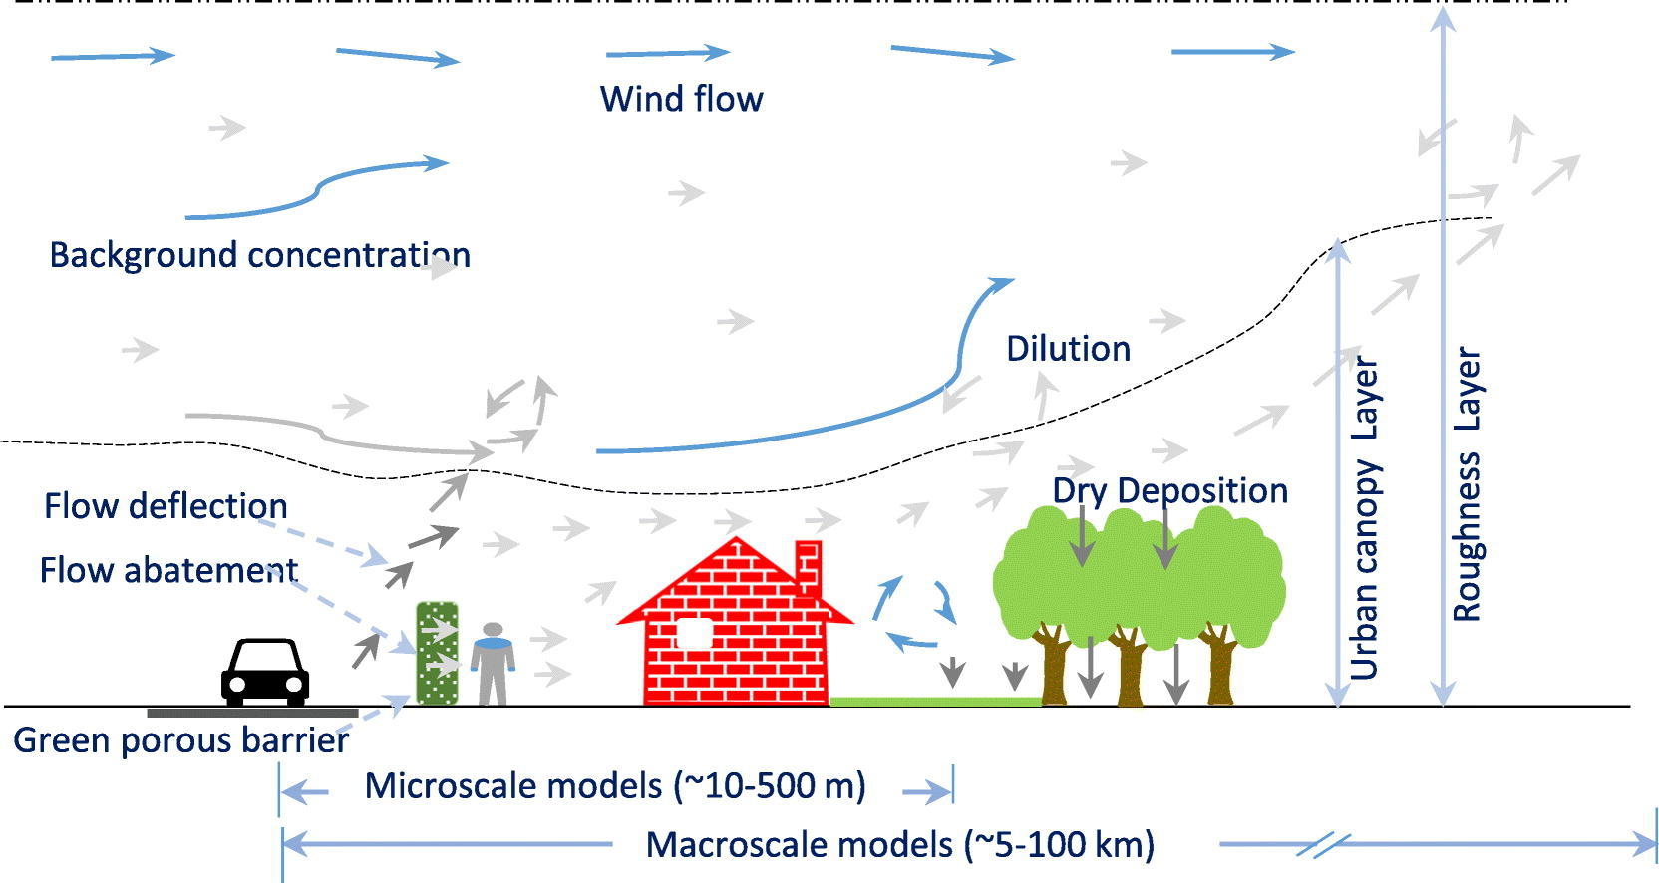
Models for Atmospheric Convection

Slide 36
Types of Similarity
Geometric (ratio of length scales the same)
Kinematic (velocity structures are the same)
Dynamic (force ratio is the same)
The best situation is: Get all dimensionless variables (Pi groups) the same between model and prototype. Then all similarities are preserved…..
Sometimes hard to achieve it all…
Are we missing any and ignoring the true natural characteristic of the convection?

Slide 37
Establishment of Flow in a Convection System
Externally facilitated.
Is it only the cause?
In a gravitational field, there is a net force that pushes a light fluid placed in a heavier fluid upwards.
This force is called the buoyancy force.
May be comparable or only one responsible for the flow in many engineering and natural convection system.
Important to consider the additional force/variables responsible for this force.

Slide 38
Honor of Osborne Reynolds
Consider the Navier-Stokes equations with constant density it their dimensional form:
$$∇•\vec{v}=0$$
$$\left\{\frac{∂v_{i}}{∂t}+v_{j}\frac{∂v_{i}}{∂x_{j}}\right\}=g_{i}−\frac{1}{ρ}\frac{∂p}{∂x_{i}}+ν\frac{∂}{∂x_{j}}\left\{\frac{∂v_{i}}{∂x_{j}}\right\}$$
Define dimensionless variables as:
$${\vec{v}}^{∗}=\frac{\vec{v}}{U}$$
$${\vec{x}}^{∗}=\frac{\vec{x}}{L}$$
$$p^{∗}=\frac{p}{ρU^{2}}$$
$$t^{∗}=t\frac{U}{L}$$
Here U, L are assumed to be a velocity and length characteristic of the problem being studied.
In the case of flow past a body, L might be a body diameter and U the flow speed at infinity.

Slide 39
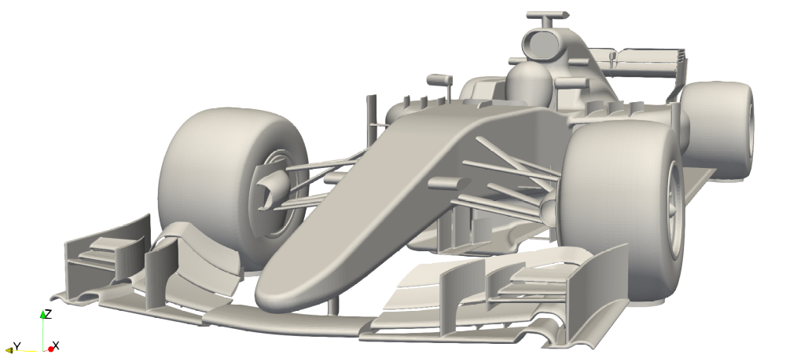
Honor of Osborne Reynolds : Engineering of Mathematics
Consider the Navier-Stokes equations with constant density it their dimensional form:
$$∇•\vec{v}=0$$
$$\frac{∂u}{∂t}+u\frac{∂u}{∂x}+v\frac{∂u}{∂y}+w\frac{∂u}{∂z} = g_{x}−\frac{1}{ρ}\frac{∂p}{∂x}+ν\left\{\frac{∂^{2}u}{∂x^{2}}+\frac{∂^{2}u}{∂y^{2}}+\frac{∂^{2}u}{∂z^{2}}\right\}$$
Consider highest expected velocity of a formula car as U.
Most important dimension of formula car as L.
These parameters are defined by Reynolds as velocity and length scales.
In the case of flow through a pipe, L might be a pipe diameter (D) and U the flow speed at the pipe inlet.

Slide 40
Honor of Osborne Reynolds : Engineering of Mathematics
Consider the Navier-Stokes equations with constant density it their dimensional form:
$$∇•\vec{v}=0$$
$$\frac{∂u}{∂t}+u\frac{∂u}{∂x}+v\frac{∂u}{∂y}+w\frac{∂u}{∂z} = g_{x}−\frac{1}{ρ}\frac{∂p}{∂x}+ν\left\{\frac{∂^{2}u}{∂x^{2}}+\frac{∂^{2}u}{∂y^{2}}+\frac{∂^{2}u}{∂z^{2}}\right\}$$
Define dimensionless variables as:
Substitute dimensional variable in terms of dimensionless variables:
$$u^{∗}=\frac{u}{U}$$
$$x^{∗}=\frac{x}{L}$$
$${u=Uu}^{∗}$$
$$x=Lx^{∗}$$
$$y=Ly^{∗}$$
$${v=Uv}^{∗}$$
$$v^{∗}=\frac{v}{U}$$
$$y^{∗}=\frac{y}{L}$$
$$t^{∗}=t\frac{U}{L}$$
$$z=Lz^{∗}$$
$${w=Uw}^{∗}$$
$$t=t^{∗}\frac{L}{U}$$
$$w^{∗}=\frac{w}{U}$$
$$z^{∗}=\frac{z}{L}$$
$$p^{∗}=\frac{p}{ρU^{2}}$$
$$p=ρU^{2}p^{∗}$$

Slide 41
Non-dimensionalization of NS Equation
Consider x-momentum equation for an incompressible flow:
$$\frac{∂u}{∂t}+u\frac{∂u}{∂x}+v\frac{∂u}{∂y}+w\frac{∂u}{∂z} = g_{x}−\frac{1}{ρ}\frac{∂p}{∂x}+ν\left\{\frac{∂^{2}u}{∂x^{2}}+\frac{∂^{2}u}{∂y^{2}}+\frac{∂^{2}u}{∂z^{2}}\right\}$$
Substitute dimensional variable in terms of dimensionless variables:

Slide 42
Non-dimensionalization of NS Equation
Consider x-momentum equation for an incompressible flow:
$$\frac{∂u}{∂t}+u\frac{∂u}{∂x}+v\frac{∂u}{∂y}+w\frac{∂u}{∂z} = g_{x}−\frac{1}{ρ}\frac{∂p}{∂x}+ν\left\{\frac{∂^{2}u}{∂x^{2}}+\frac{∂^{2}u}{∂y^{2}}+\frac{∂^{2}u}{∂z^{2}}\right\}$$
Substitute dimensional variable in terms of dimensionless variables:
$$p=ρU^{2}p^{∗}$$

Slide 43
Non-dimensionalization of NS Equation
Consider x-momentum equation for an incompressible flow:
$$\frac{∂u}{∂t}+u\frac{∂u}{∂x}+v\frac{∂u}{∂y}+w\frac{∂u}{∂z} = g_{x}−\frac{1}{ρ}\frac{∂p}{∂x}+ν\left\{\frac{∂^{2}u}{∂x^{2}}+\frac{∂^{2}u}{∂y^{2}}+\frac{∂^{2}u}{∂z^{2}}\right\}$$
Substitute dimensional variable in terms of dimensionless variables:

Slide 44
Non-dimensional form of NS Equation
Non-dimensional x-momentum equation for an incompressible flow:
$$\frac{∂u^{∗}}{∂t^{∗}}+u^{∗}\frac{∂u^{∗}}{∂x^{∗}}+v^{∗}\frac{∂u^{∗}}{∂y^{∗}}+w^{∗}\frac{∂u^{∗}}{∂z^{∗}} = −\frac{∂p^{∗}}{∂x^{∗}}+\frac{ν}{UL}\left\{\frac{∂^{2}u^{∗}}{∂{x^{∗}}^{2}}+\frac{∂^{2}u^{∗}}{∂{y^{∗}}^{2}}+\frac{∂^{2}u^{∗}}{∂z^{2}}\right\}$$
Stokes identified this dimensionless number was referred to as parameter R.
1908: German physicist Arnold Sommerfeld introduced the term "Reynolds number" at the 4th International Congress of Mathematicians in Rome.
The Reynolds Number
$$Re=\frac{UL}{ν}$$
$$Re=\frac{ρUL}{μ}×\frac{A/t}{A/t}=\frac{Inertial Force }{Viscous Force }$$
$$\frac{∂u^{∗}}{∂t^{∗}}+u^{∗}\frac{∂u^{∗}}{∂x^{∗}}+v^{∗}\frac{∂u^{∗}}{∂y^{∗}}+w^{∗}\frac{∂u^{∗}}{∂z^{∗}} = −\frac{∂p^{∗}}{∂x^{∗}}+\frac{1}{Re}\left\{\frac{∂^{2}u^{∗}}{∂{x^{∗}}^{2}}+\frac{∂^{2}u^{∗}}{∂{y^{∗}}^{2}}+\frac{∂^{2}u^{∗}}{∂z^{2}}\right\}$$

Slide 45
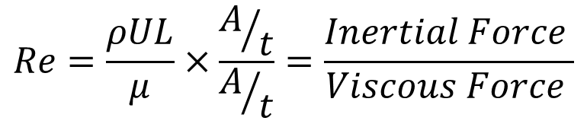
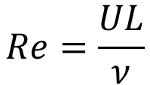
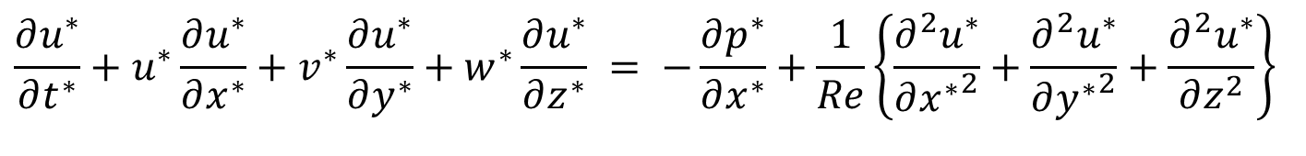
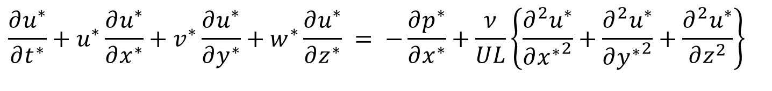
Non-dimensional form of NS Equation
Non-dimensional x-momentum equation for an incompressible flow:
$$\frac{∂u^{∗}}{∂t^{∗}}+u^{∗}\frac{∂u^{∗}}{∂x^{∗}}+v^{∗}\frac{∂u^{∗}}{∂y^{∗}}+w^{∗}\frac{∂u^{∗}}{∂z^{∗}} = −\frac{∂p^{∗}}{∂x^{∗}}+\frac{ν}{UL}\left\{\frac{∂^{2}u^{∗}}{∂{x^{∗}}^{2}}+\frac{∂^{2}u^{∗}}{∂{y^{∗}}^{2}}+\frac{∂^{2}u^{∗}}{∂z^{2}}\right\}$$
At the 4th International Congress of Mathematicians in Rome, Arnold Sommerfeld introduces a dimensionless number that he calls the Reynolds number, in tribute to Osborne Reynolds (1908).
The Reynolds number, which appeared in what’s now known as the Orr– Sommerfeld equation, is among the most famous of all dimensionless numbers.
The Reynolds Number
$$Re=\frac{ρUL}{μ}×\frac{A/t}{A/t}=\frac{Inertial Force }{Viscous Force }$$
$$Re=\frac{UL}{ν}$$
$$\frac{∂u^{∗}}{∂t^{∗}}+u^{∗}\frac{∂u^{∗}}{∂x^{∗}}+v^{∗}\frac{∂u^{∗}}{∂y^{∗}}+w^{∗}\frac{∂u^{∗}}{∂z^{∗}} = −\frac{∂p^{∗}}{∂x^{∗}}+\frac{1}{Re}\left\{\frac{∂^{2}u^{∗}}{∂{x^{∗}}^{2}}+\frac{∂^{2}u^{∗}}{∂{y^{∗}}^{2}}+\frac{∂^{2}u^{∗}}{∂z^{2}}\right\}$$

Slide 46
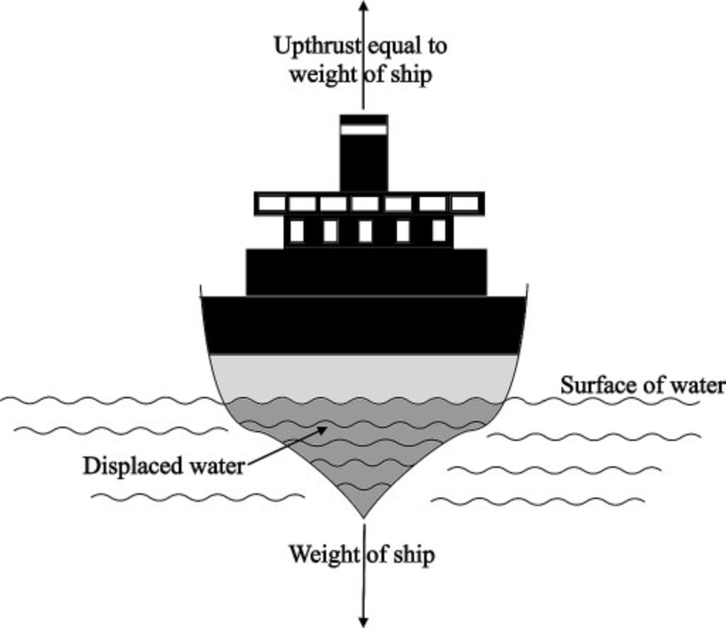

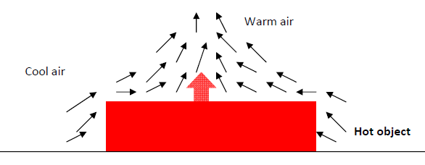
Body force as A Buoyancy force
Archimedes’ principle ∼250BC : The net force is proportional to the difference in the densities of the fluid and the body.
$$F_{body−Arch}=\left(ρ_{boat}−ρ_{fluid}\right)gV_{immersed}$$
19th Century….

Slide 47
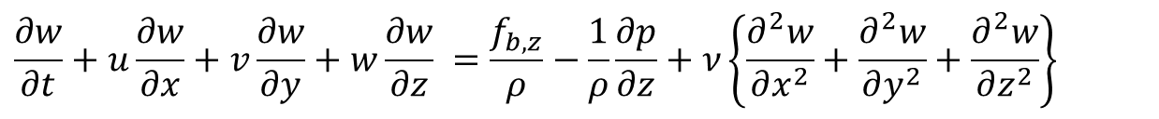
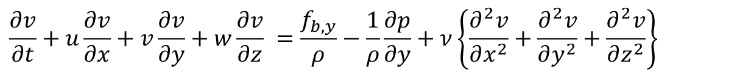
Conservation Laws for Incompressible Convection Systems using perfect gas
Continuity Equation in Cartesian coordinates is:
$$\frac{∂u}{∂x}+\frac{∂v}{∂y}+\frac{∂w}{∂z}=0$$
X-momentum Equation for an incompressible flow is
$$\frac{∂u}{∂t}+u\frac{∂u}{∂x}+v\frac{∂u}{∂y}+w\frac{∂u}{∂z} =\frac{f_{b,x}}{ρ}−\frac{1}{ρ}\frac{∂p}{∂x}+ν\left\{\frac{∂^{2}u}{∂x^{2}}+\frac{∂^{2}u}{∂y^{2}}+\frac{∂^{2}u}{∂z^{2}}\right\}$$
Y-momentum Equation for an incompressible flow is
$$\frac{∂v}{∂t}+u\frac{∂v}{∂x}+v\frac{∂v}{∂y}+w\frac{∂v}{∂z} =\frac{f_{b,y}}{ρ}−\frac{1}{ρ}\frac{∂p}{∂y}+ν\left\{\frac{∂^{2}v}{∂x^{2}}+\frac{∂^{2}v}{∂y^{2}}+\frac{∂^{2}v}{∂z^{2}}\right\}$$
Z-momentum Equation for an incompressible flow is
$$\frac{∂w}{∂t}+u\frac{∂w}{∂x}+v\frac{∂w}{∂y}+w\frac{∂w}{∂z} =\frac{f_{b,z}}{ρ}−\frac{1}{ρ}\frac{∂p}{∂z}+ν\left\{\frac{∂^{2}w}{∂x^{2}}+\frac{∂^{2}w}{∂y^{2}}+\frac{∂^{2}w}{∂z^{2}}\right\}$$
The Energy conservation Equation
$$\frac{{ρc}_{p}DT}{Dt}=\frac{Dp}{Dt}+k\left\{\frac{∂^{2}T}{∂x^{2}}+\frac{∂^{2}T}{∂y^{2}}+\frac{∂^{2}T}{∂z^{2}}\right\}+Φ$$

Slide 48
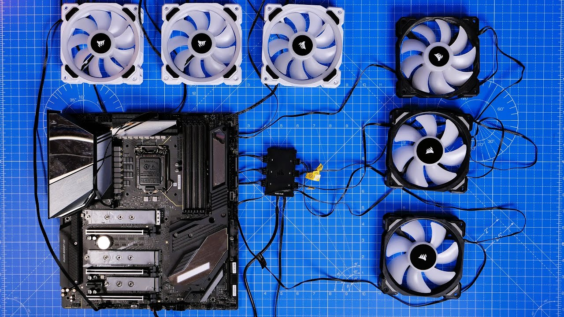
Body Forces in A General Convection
A general convection may be considered as Mixed convection flow or combined forced and free convection flow.
Mixed Convection Flows arise in many transport processes in engineering devices and in nature.
The name most synonymous with modelling of body force due to natural convection is Joseph Valentin Boussinesq.
In 1897 Boussinesq proposed the striking simplification of the body force due to natural convection.
The Boussinesq model neglects density differences except in the gravity term of the momentum equation.
Almost fifty years after the development of the Navier—Stokes (NS) equations governing fluid motion, Boussinesq established his famous approximation for body forces due to NC.

Slide 49
Body Forces in A General Convection
In 1879, Anton Oberbeck had earlier applied the same concept in his description of heat conduction in liquids accounting for currents driven by thermal gradients.
The model for body force due to NC is now commonly referred to as the Oberbeck—Boussinesq (OB) approximation in recognition of their respective contributions.
The OB approximation is established based on the following assumptions:

Slide 50
The OB scheme
The OB approximation can be formulated as an asymptotic theory based on five physical assumptions:
1. The fluid density depends only on the local temperature or, equivalently, pressure changes yield negligible density changes;
2. The local difference between the temperature,𝑇, and its reference constant value,𝑇₀, is very small;
3. The acceleration experienced by the fluid elements in the flow domain is very small;
4. The viscous stress is very small;
5. The local difference between the pressure gradient and the hydro-static pressure gradient is very small.

Slide 51





Thermodynamics of Buoyancy Force
Define β, the volumetric thermal expansion coefficient.
$$β = −\frac{1}{ρ}{\left(\frac{∂ρ}{∂T}\right)}_{P}$$
$$\text{For} \text{an} \text{ideal} \text{gas}\text{: }p=\frac{RT}{ρ} ⇒ ρ$$
$$Thus:β = \frac{1}{T}$$
Not valid for liquids and non-ideal gases
$$β≈−\frac{1}{ρ}\frac{Δρ}{ΔT}=−\frac{1}{ρ}\frac{ρ_{∞}−ρ}{T_{∞}−T}$$
Valid for any general fluid
$$ρ_{∞}−ρ≈ρβ(T−T_{∞})$$
Density gradient is due to the temperature gradient
${\vec{f}}_{b}=f_{b,x}\hat{i}$+ $f_{b,x}\hat{j}$+ $f_{b,z}\hat{k}=0 \hat{i}\text{+ }0 \hat{j}\text{+ }\left\{ρ_{0}gβ\left(T−T_{0}\right)\right\}\hat{k}$

Slide 52


Non-dimensional form of NS Equation
Non-dimensional x-momentum equation for an incompressible flow:
$$\frac{∂u^{∗}}{∂t^{∗}}+u^{∗}\frac{∂u^{∗}}{∂x^{∗}}+v^{∗}\frac{∂u^{∗}}{∂y^{∗}}+w^{∗}\frac{∂u^{∗}}{∂z^{∗}} = −\frac{∂p^{∗}}{∂x^{∗}}+\frac{1}{Re}\left\{\frac{∂^{2}u^{∗}}{∂{x^{∗}}^{2}}+\frac{∂^{2}u^{∗}}{∂{y^{∗}}^{2}}+\frac{∂^{2}u^{∗}}{∂z^{2}}\right\}$$
Non-dimensional y-momentum equation for an incompressible flow:
$$\frac{∂u^{∗}}{∂t^{∗}}+u^{∗}\frac{∂v^{∗}}{∂x^{∗}}+v^{∗}\frac{∂v^{∗}}{∂y^{∗}}+w^{∗}\frac{∂v^{∗}}{∂z^{∗}} = −\frac{∂p^{∗}}{∂y^{∗}}+\frac{1}{Re}\left\{\frac{∂^{2}v^{∗}}{∂{x^{∗}}^{2}}+\frac{∂^{2}v^{∗}}{∂{y^{∗}}^{2}}+\frac{∂^{2}v^{∗}}{∂z^{2}}\right\}$$
Non-dimensional z-momentum equation for an incompressible flow:
$$\frac{∂w^{∗}}{∂t^{∗}}+u^{∗}\frac{∂w^{∗}}{∂x^{∗}}+v^{∗}\frac{∂w^{∗}}{∂y^{∗}}+w^{∗}\frac{∂w^{∗}}{∂z^{∗}}=−\left\{ρ_{0}gβ\left(T−T_{0}\right)\right\}\frac{L}{ρ_{0}U^{2}}−\frac{∂p^{∗}}{∂z^{∗}}+\frac{1}{Re}\left\{\frac{∂^{2}w^{∗}}{∂{x^{∗}}^{2}}+\frac{∂^{2}w^{∗}}{∂{y^{∗}}^{2}}+\frac{∂^{2}w^{∗}}{∂z^{2}}\right\}$$

Slide 53




Non-dimensional form of NS Equation for Convection System
Non-dimensional z-momentum equation for an incompressible flow:
$$\frac{∂w^{∗}}{∂t^{∗}}+u^{∗}\frac{∂w^{∗}}{∂x^{∗}}+v^{∗}\frac{∂w^{∗}}{∂y^{∗}}+w^{∗}\frac{∂w^{∗}}{∂z^{∗}}=−\left\{ρ_{0}gβ\left(T−T_{0}\right)\right\}\frac{L}{ρ_{0}U^{2}}−\frac{∂p^{∗}}{∂z^{∗}}+\frac{1}{Re}\left\{\frac{∂^{2}w^{∗}}{∂{x^{∗}}^{2}}+\frac{∂^{2}w^{∗}}{∂{y^{∗}}^{2}}+\frac{∂^{2}w^{∗}}{∂z^{2}}\right\}$$
Maximum possible temperature difference in any convection system is
$${{∆T}_{max}=T}_{s}−T_{∞}$$
∴Dimensionless temperature, θ, may be defined as:
$$θ=\frac{T−T_{∞}}{T_{s}−T_{∞}}→\left(T−T_{∞}\right)=θ\left(T_{s}−T_{∞}\right)$$
$$\frac{\left\{ρ_{0}gβ\left(T_{s}−T_{∞}\right) \right\}L}{ρ_{0}U^{2}}θ$$

Slide 54

Dimensionless Similarity Parameter
Define new dimensionless parameter,
$$Gr_{L}= \frac{gβ(T_{s}−T_{∞})L}{U^{2}}{\left(\frac{ρ_{0}UL}{μ}\right)}^{2}=\frac{gβ(T_{s}−T_{∞})L^{3}}{ν^{2}}$$
The Grashof number (Gr_{L}) is named after Franz Grashof, a German engineer and professor of machine science.
Grashof made significant contributions to understanding free convection.
However, the Grashof number was named after him after his death in 1893.

Slide 55



Dimensionless Similarity Parameter
$$Gr_{L}=\frac{gβ(T_{s}−T_{∞})L^{3}}{ν^{2}}$$
Grashof number in natural convection is analogous to the Reynolds number in forced convection.
Grashof number indicates the ratio of the buoyancy force to the viscous force.
Higher Gr number means increased natural convection flow
$$\frac{Gr_{L}}{{Re}_{L}^{2}}<<1$$
Forced Convection
$$\frac{Gr_{L}}{{Re}_{L}^{2}}>>1$$
Natural Convection

Slide 56


Non-dimensional form of Energy Equation
The Energy conservation Equation for an incompressible flow
$$\frac{{ρc}_{p}DT}{Dt}=\frac{Dp}{Dt}+k\left\{\frac{∂^{2}T}{∂x^{2}}+\frac{∂^{2}T}{∂y^{2}}+\frac{∂^{2}T}{∂z^{2}}\right\}+Φ$$
The convection heat transfer in a system is based on the thought that the significant variations in velocity and temperature in a fluid medium starting from the solid wall.
Indeed, we have the freedom to think not of an infinity of slender flow regions starting from wall.
The way u varies from 0 at the wall to U∞ in the free stream, T varies from T_{s} at the wall to T∞ in the free stream.
∴Dimensionless temperature, θ, as defined before:
$θ=\frac{T−T_{∞}}{T_{s}−T_{∞}}⇒\frac{∂T}{∂t}=\left(T_{s}−T_{∞}\right)\frac{∂θ}{∂t}$ & $\frac{∂T}{∂x}=\left(T_{s}−T_{∞}\right)\frac{∂θ}{∂x}$……

Slide 57



Non-dimensional form of Energy Equation
The Energy conservation Equation for an incompressible flow in terms of non-dimensional temperature.
$$\left(T_{s}−T_{∞}\right)×\frac{ρc_{p}Dθ}{Dt}=\frac{Dp}{Dt}+k\left(T_{s}−T_{∞}\right)×\left\{\frac{∂^{2}θ}{∂x^{2}}+\frac{∂^{2}θ}{∂y^{2}}+\frac{∂^{2}θ}{∂z^{2}}\right\}+Φ$$
Furthermore, for general convection systems the magnitude of $\frac{Dp}{Dt}$ is negligible and not considered in energy conservation equation.
$$\frac{{ρc}_{p}Dθ}{Dt}=k\left\{\frac{∂^{2}θ}{∂x^{2}}+\frac{∂^{2}θ}{∂y^{2}}+\frac{∂^{2}θ}{∂z^{2}}\right\}+\frac{1}{\left\{T_{s}−T_{∞}\right\}}×Φ$$

Slide 58







Non-dimensional form of Energy Equation
$$\frac{{ρc}_{p}Dθ}{Dt}=k\left\{\frac{∂^{2}θ}{∂x^{2}}+\frac{∂^{2}θ}{∂y^{2}}+\frac{∂^{2}θ}{∂z^{2}}\right\}+\frac{1}{\left\{T_{s}−T_{∞}\right\}}×Φ$$
$${ρc}_{p}\left\{\frac{∂θ}{∂t}+u\frac{∂θ}{∂x}+v\frac{∂θ}{∂y}+w\frac{∂θ}{∂z}\right\}=k\left\{\frac{∂^{2}θ}{∂x^{2}}+\frac{∂^{2}θ}{∂y^{2}}+\frac{∂^{2}θ}{∂z^{2}}\right\}+\frac{1}{\left\{T_{s}−T_{∞}\right\}}×Φ$$
$$t=\frac{t^{∗}L}{U}$$
$$\vec{v}=U{\vec{v}}^{∗}$$
$$\vec{x}=L{\vec{x}}^{∗}$$
$${LHS=ρc}_{p}\left\{\frac{∂θ}{∂\left(\frac{t^{∗}L}{U}\right)}+Uu^{∗}\frac{∂θ}{∂\left(Lx^{∗}\right)}+Uv^{∗}\frac{∂θ}{∂\left(Ly^{∗}\right)}+Uw^{∗}\frac{∂θ}{∂\left(Lz^{∗}\right)}\right\}$$
$$LHS=\frac{ρUc_{p}}{L}\left\{\frac{∂θ}{∂t^{∗}}+u^{∗}\frac{∂θ}{∂x^{∗}}+v^{∗}\frac{∂θ}{∂y^{∗}}+w^{∗}\frac{∂θ}{∂z^{∗}}\right\}$$

Slide 59




Non-dimensional form of Energy Equation
$$c_{p}\left\{\frac{∂θ}{∂t}+u\frac{∂θ}{∂x}+v\frac{∂θ}{∂y}+w\frac{∂θ}{∂z}\right\}=k\left\{\frac{∂^{2}θ}{∂x^{2}}+\frac{∂^{2}θ}{∂y^{2}}+\frac{∂^{2}θ}{∂z^{2}}\right\}+\frac{1}{\left\{T_{s}−T_{∞}\right\}}×Φ$$
RHS$=k\left\{\frac{∂^{2}θ}{∂{\left(Lx^{∗}\right)}^{2}}+\frac{∂^{2}θ}{∂{\left(Ly^{∗}\right)}^{2}}+\frac{∂^{2}θ}{∂{\left(Lz^{∗}\right)}^{2}}\right\}+\frac{1}{\left\{T_{s}−T_{∞}\right\}}×Φ$
RHS$=\frac{k}{L^{2}}\left\{\frac{∂^{2}θ}{∂{\left(x^{∗}\right)}^{2}}+\frac{∂^{2}θ}{∂{\left(y^{∗}\right)}^{2}}+\frac{∂^{2}θ}{∂{\left(z^{∗}\right)}^{2}}\right\}+\frac{1}{\left\{T_{s}−T_{∞}\right\}}×Φ$
$$LHS=\frac{ρUc_{p}}{L}\left\{\frac{∂θ}{∂t^{∗}}+u^{∗}\frac{∂θ}{∂x^{∗}}+v^{∗}\frac{∂θ}{∂y^{∗}}+w^{∗}\frac{∂θ}{∂z^{∗}}\right\}$$
$$\frac{ρUc_{p}}{L}\left\{\frac{∂θ}{∂t^{∗}}+u^{∗}\frac{∂θ}{∂x^{∗}}+v^{∗}\frac{∂θ}{∂y^{∗}}+w^{∗}\frac{∂θ}{∂z^{∗}}\right\}=\frac{k}{L^{2}}\left\{\frac{∂^{2}θ}{∂{\left(x^{∗}\right)}^{2}}+\frac{∂^{2}θ}{∂{\left(y^{∗}\right)}^{2}}+\frac{∂^{2}θ}{∂{\left(z^{∗}\right)}^{2}}\right\}+\frac{Φ}{\left\{T_{s}−T_{∞}\right\}}$$

Slide 60





Non-dimensional form of Energy Equation
$$\frac{ρUc_{p}}{L}\left\{\frac{∂θ}{∂t^{∗}}+u^{∗}\frac{∂θ}{∂x^{∗}}+v^{∗}\frac{∂θ}{∂y^{∗}}+w^{∗}\frac{∂θ}{∂z^{∗}}\right\}=\frac{k}{L^{2}}\left\{\frac{∂^{2}θ}{∂{\left(x^{∗}\right)}^{2}}+\frac{∂^{2}θ}{∂{\left(y^{∗}\right)}^{2}}+\frac{∂^{2}θ}{∂{\left(z^{∗}\right)}^{2}}\right\}+\frac{Φ}{\left\{T_{s}−T_{∞}\right\}}$$
$$\left\{\frac{∂θ}{∂t^{∗}}+u^{∗}\frac{∂θ}{∂x^{∗}}+v^{∗}\frac{∂θ}{∂y^{∗}}+w^{∗}\frac{∂θ}{∂z^{∗}}\right\}=\frac{k}{ρULc_{p}}\left\{\frac{∂^{2}θ}{∂{\left(x^{∗}\right)}^{2}}+\frac{∂^{2}θ}{∂{\left(y^{∗}\right)}^{2}}+\frac{∂^{2}θ}{∂{\left(z^{∗}\right)}^{2}}\right\}+\frac{LΦ}{Uc_{p}\left\{T_{s}−T_{∞}\right\}}$$
$$\frac{U^{2}}{L}\left\{\frac{∂v_{i}^{∗}}{∂t^{∗}}+v_{j}^{∗}\frac{∂v_{i}^{∗}}{∂{x^{∗}}_{j}}\right\}=g_{i}−\frac{∂p^{∗}}{∂{x^{∗}}_{i}}+\frac{νU}{L^{2}}\frac{∂}{∂x_{j}^{∗}}\left(\frac{∂v_{i}^{∗}}{∂x_{j}^{∗}}\right)$$
$$\frac{k}{ρULc_{p}}=\frac{k×ν}{ρULc_{p}×ν}$$
$$\frac{k}{ρULc_{p}}=\frac{ν}{UL}×\frac{k}{{νρc}_{p}}$$
$$\frac{k}{ρULc_{p}}=\frac{ν}{UL}×\frac{α}{ν}$$
$$\frac{k}{ρULc_{p}}=\frac{1}{Re}×\frac{1}{Pr}$$

Slide 61



Non-dimensional form of Energy Equation
$$\frac{ρUc_{p}}{L}\left\{\frac{∂θ}{∂t^{∗}}+u^{∗}\frac{∂θ}{∂x^{∗}}+v^{∗}\frac{∂θ}{∂y^{∗}}+w^{∗}\frac{∂θ}{∂z^{∗}}\right\}=\frac{k}{L^{2}}\left\{\frac{∂^{2}θ}{∂{\left(x^{∗}\right)}^{2}}+\frac{∂^{2}θ}{∂{\left(y^{∗}\right)}^{2}}+\frac{∂^{2}θ}{∂{\left(z^{∗}\right)}^{2}}\right\}+\frac{Φ}{\left\{T_{s}−T_{∞}\right\}}$$
$$\frac{Dθ}{Dt^{∗}}=\frac{1}{Re×Pr}{∇^{∗}}^{2}θ+Ec×Pr{× Φ}^{∗}$$
$$\left\{\frac{∂v_{i}^{∗}}{∂t^{∗}}+v_{j}^{∗}\frac{∂v_{i}^{∗}}{∂x_{j}^{∗}}\right\}=−\hat{k}\frac{\left\{ρ_{0}gβ\left(T_{s}−T_{∞}\right) \right\}L}{ρ_{0}U^{2}}θ−\frac{∂p^{∗}}{∂x_{i}^{∗}}+\frac{1}{Re}\frac{∂}{∂x_{j}^{∗}}\left(\frac{∂v_{i}^{∗}}{∂x_{j}^{∗}}\right)$$
$$\frac{∂v_{j}^{∗}}{∂x_{j}^{∗}}=0$$

Slide 62
Analytical Convective Heat Transfer
Ernst Kraft Wilhelm Nußelt (Nusselt) is the first contributor to analytical convection heat transfer.
For a century Fourier’s work was only analytical work available in heat transfer.
In 1915 Nusselt cut the Gordian knot.
In a single stroke, Nusselt used Dimensional Analysis to prove that there exist a functional form essential for all analytical/experimental works in convection heat transfer.

Slide 63



Analysis of Heat Transfer in Equilibrium Layer
At Thermodynamic equilibrium
$$T_{fluid,wall}=T_{wall}$$
At the wall for fluid layer :
$$−k_{fluid}A\left\{\frac{∂T}{∂y}\right\}=hA\left\{T_{fluid,wall}−T_{∞}\right\}$$
$$h=−\frac{k_{fluid}{\left.\left\{\frac{∂T}{∂y}\right\}\right|}_{wall−layer}}{\left\{T_{wall}−T_{∞}\right\}}$$

Slide 64

Estimation of Heat Transfer Coefficient
$$h=−\frac{k_{fluid}{\left.\left\{\frac{∂T}{∂y}\right\}\right|}_{wall}}{\left\{T_{wall}−T_{∞}\right\}}$$
Estimation of heat transfer coefficient is basically computation of temperature profile in equilibrium fluid layer.
Provoked a general theoretical and experimental study to understand how the equilibrium layer is developed.
The global geometry of the solid wall and flow conditions will decide the structure of stagnant layer.
Basic Geometry : Internal Flow or External Flow.

Slide 65





In search of A Dimensionless Parameter for Convection
$$q^{′′}=h\left(T_{s}−T_{∞}\right)=−k{\left.\frac{∂T}{∂y}\right|}_{y=0}$$
$${\left.\frac{∂T}{∂y}\right|}_{y=0}=\left(\frac{\text{Temperature} \text{scale}}{\text{Length} \text{scale}}\right){\left.\frac{∂θ}{∂y^{∗}}\right|}_{y^{∗}=0}$$
$$h\left(T_{s}−T_{∞}\right)=−k_{fluid}{\left.\left(\frac{T_{∞}−T_{s}}{L}\right)\frac{∂θ}{∂y^{∗}}\right|}_{y^{∗}=0}$$
$${\left.\frac{∂θ}{∂y^{∗}}\right|}_{y^{∗}=0}=\frac{hL}{k_{fluid}}$$
$$=f\left(x^{∗},{Re}_{L}{,}\frac{dp^{∗}}{dx^{∗}},Pr\right)$$

Slide 66


In search of A Dimensionless Parameter for Convection
This dimensionless temperature gradient at the wall is named as
Nusselt Number:
$$Nu=\frac{hL}{k_{fluid}}=\frac{\frac{L}{k_{fluid}}}{\frac{1}{h}}=\frac{\text{Conduction} \text{resistance}}{\text{Convection} \text{resistance}}$$
$$Nu={\left.\frac{∂θ}{∂y^{∗}}\right|}_{y^{∗}=0}=\frac{hL}{k_{fluid}}=f\left(x^{∗},{Re}_{L}{,}\frac{dp^{∗}}{dx^{∗}},Pr\right)$$
Local Nusselt Number

Slide 67

Analytics of Open System Processes
Fluid Mechanics
Heat Transfer
1687: Newton’s Law of Viscosity.
1755: Euler Equations.
$\frac{∂\left(ρ\vec{v}\right)}{∂t}+∇.\left(ρ\vec{v}\vec{v}\right)={\vec{f}}_{body}−∇p$
$∇^{2}ψ=0$
1845: N-S Equations.
1903: Development of Flying Machines
1701 Newton’s law of cooling.
1822: Fourier’s Conduction Equation.
1915: Nusselt cut the Gordian knot: Analytical Convection Heat Transfer.
1940: Turbo-machines for Flying Machines

