Slide 1



Reynolds Transport Theorem for Analysis of Convection Heat Transfer
P M V Subbarao
Professor & Head
Mechanical Engineering Department
Inflow precedes Outflow….
By an infinitesimal time delay …

Slide 2

J. L. M. Poiseuille
Jean Léonard Marie Poiseuille.
A French Physicist & Physiologist
Poiseuille possess extraordinary sense of experimental precision.
He carried out his doctoral research on, ”The force of the aortic heart” in 1828.
Poiseuille invented the U-tube mercury manometer (called the hemodynamometer) and used it to measure pressures in the arteries of horses and dogs.
To this day blood pressures are reported in mm Hg due to Poiseuille's invention.
n 1838, he experimentally derived, and in 1840 and 1846 formulated and published, Poiseuille's law.

Slide 3

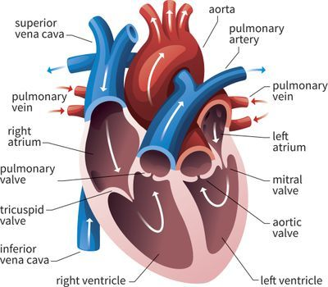
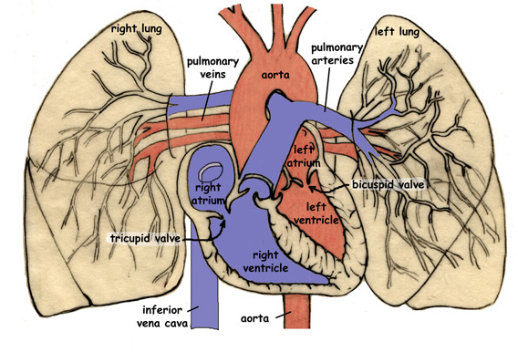
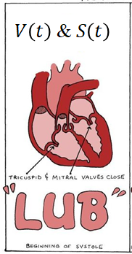
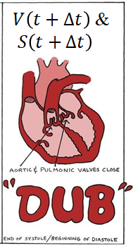
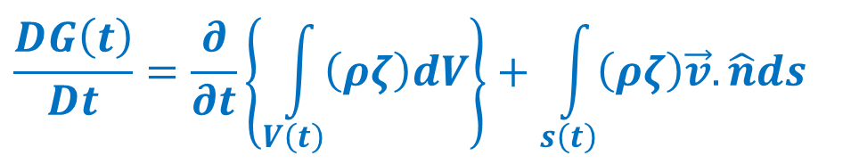
Biologically Inspired Reynolds Control Volume
~1903
$$\frac{DG\left(t\right)}{Dt}=\frac{∂}{∂t}\left\{\int_{V\left(t\right)}{\left(ρζ\right)dV}\right\}+\int_{s\left(t\right)}{\left(ρζ\right)\vec{v}.\hat{n}ds}$$

Slide 4
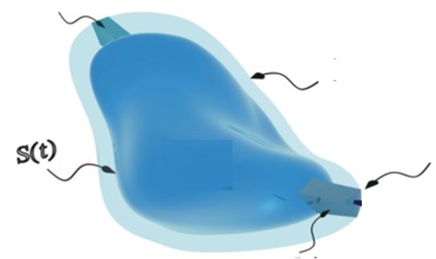
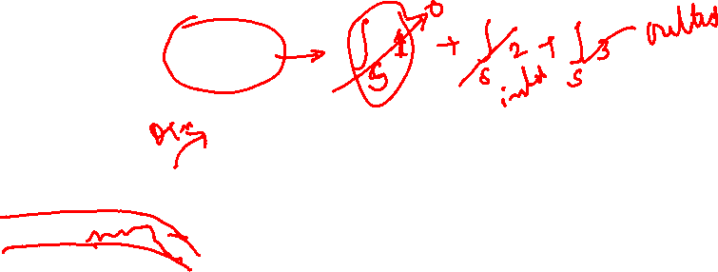
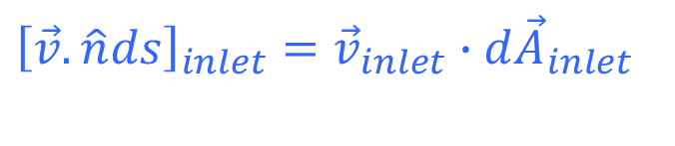
Vectorial Recognition of Inflow & Outflow
$$\frac{DG\left(t\right)}{Dt}=\frac{∂}{∂t}\left\{\int_{V\left(t\right)}{\left(ρζ\right)dV}\right\}+\int_{s\left(t\right)}{\left(ρζ\right)\vec{v}.\hat{n}ds}$$
$${\left[\vec{v}.\hat{n}ds\right]}_{inlet}={\vec{v}}_{inlet}∙{d\vec{A}}_{inlet}$$
$${\vec{A}}_{inlet}$$
$${\vec{v}}_{inlet}$$
Inflow
$$S\left(t+∆t\right)$$
outflow
$${\vec{v}}_{outlet}$$
$${\vec{A}}_{outlet}$$
$${\left[\vec{v}.\hat{n}ds\right]}_{outlet}={\vec{v}}_{outlet}∙{d\vec{A}}_{outlet}$$

Slide 5

Vectorial Recognition of Inflow & Outflow
$$\frac{DG\left(t\right)}{Dt}=\frac{∂}{∂t}\left\{\int_{V\left(t\right)}{\left(ρζ\right)dV}\right\}+\int_{s\left(t\right)}{\left(ρζ\right)\vec{v}.\hat{n}ds}$$
$${\left[\vec{v}.\hat{n}ds\right]}_{inlet}={\left[vnormal×dS\right]}_{inlet}$$
$${\vec{A}}_{inlet}$$
$${\vec{v}}_{inlet}$$
Inflow
$$S\left(t+∆t\right)$$
outflow
$${\vec{v}}_{outlet}$$
$${\vec{A}}_{outlet}$$
$${\left[\vec{v}.\hat{n}ds\right]}_{inlet}={\left[vnormal×dS\right]}_{outlet}$$

Slide 6
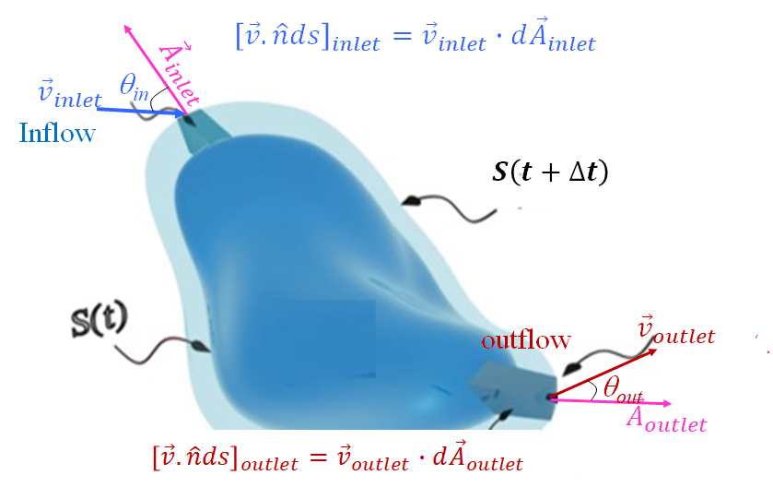
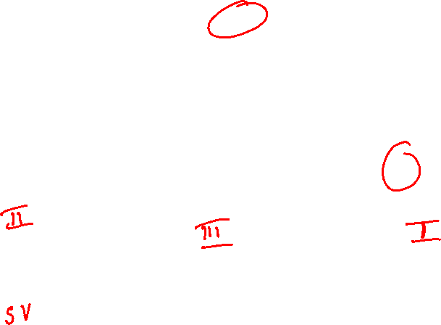
Vectorial Recognition of Inflow & Outflow in Engineering Fluid Mechanics
$$\frac{DG\left(t\right)}{Dt}=\frac{∂}{∂t}\left\{\int_{V\left(t\right)}{\left(ρζ\right)dV}\right\}+\int_{s\left(t\right)}{\left(ρζ\right)\vec{v}.\hat{n}ds}$$
$$\frac{DG\left(t\right)}{Dt}=\frac{∂}{∂t}\left\{\int_{V\left(t\right)}{\left(ρζ\right)dV}\right\}+\int_{s\left(t\right)−outlet}{\left(ρζ\right)\vec{v}.\hat{n}ds}−\int_{s\left(t\right)−inlet}{\left(ρζ\right)\vec{v}.\hat{n}ds}$$

Slide 7
Engineering Version of RTT
Real Engineering systems may have multiple inlets and outlets.
$$\frac{DG\left(t\right)}{Dt}=\frac{∂}{∂t}\left\{\int_{V\left(t\right)}{\left(ρζ\right)dV}\right\}+\sum_{i=1}^{n}{\int_{s_{outlet,i}\left(t\right)}{\left(ρζ\right)\left|\vec{v}.\hat{n}\right|ds}}−\sum_{j=1}^{k}{\int_{s_{inlet,j}\left(t\right)}{\left(ρζ\right)\left|\vec{v}.\hat{n}\right|ds}}$$
$$\frac{DG\left(t\right)}{Dt}=\frac{∂}{∂t}\left\{\iiint_{V}{\left(ρζ\right)dV}\right\}+\sum_{i=1}^{n}{\iint_{A_{outlet}}{ρζ\left(\vec{v}.d\vec{A}\right)}}−\sum_{j=1}^{k}{\iint_{A_{inlet}}{ρζ\left(\vec{v}.d\vec{A}\right)}}$$
$${\left.\frac{dG\left(t\right)}{dt}\right|}_{CM}={\left.\frac{dG\left(t\right)}{dt}\right|}_{CV}+\sum_{i=1}{{\dot{G}}_{outlet,i}}−\sum_{i=1}{{\dot{G}}_{inlet,i}}$$

Slide 8
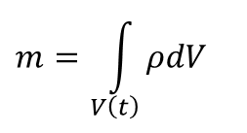
Conservation of Mass
The conservation law of mass requires that the mass contained in a control mass, must be constant:
Mass contained inside the boundary of a Control volume (Region II)
$$m=\int_{V\left(t\right)}{ρdV}$$
How to get this value during any engineering action by a CV?
What is the value of ζ to get “conservation of Mass”??

Slide 9
RTT for Conservation of Mass
$${\left.\frac{dG\left(t\right)}{dt}\right|}_{CM}=\frac{∂}{∂t}\left\{\iiint_{V}{\left(ρζ\right)dV}\right\}+\sum_{i=1}^{n}{\iint_{A_{exit}}{ρζ\left(\vec{v}.d\vec{A}\right)}}−\sum_{j=1}^{m}{\iint_{A_{inlet}}{ρζ\left(\vec{v}.d\vec{A}\right)}}$$
Consider a flow field with field variable value ζ=1 and substitute the same in above equation.
$${\left.\frac{dm\left(t\right)}{dt}\right|}_{CM}=\frac{∂}{∂t}\left\{\iiint_{V}{ρdV}\right\}+\sum_{i=1}{\iint_{A_{exit}}{ρ\left(\vec{v}.d\vec{A}\right)}}−\sum_{j=}{\iint_{A_{inlet}}{ρ\left(\vec{v}.d\vec{A}\right)}}$$
$${\left.\frac{dm\left(t\right)}{dt}\right|}_{CM}={\left.\frac{dm\left(t\right)}{dt}\right|}_{CV}+\sum_{i=1, 2…}{{\dot{m}}_{outlet,i}}−\sum_{i=1,2…}{{\dot{m}}_{inlet,i}}=0$$

Slide 10

RTT for Conservation of Momentum
$${\left.\frac{dG\left(t\right)}{dt}\right|}_{CM}=\frac{∂}{∂t}\left\{\iiint_{V}{\left(ρζ\right)dV}\right\}+\sum_{i=1}^{n}{\iint_{A_{exit}}{ρζ\left(\vec{v}.d\vec{A}\right)}}−\sum_{j=1}^{m}{\iint_{A_{inlet}}{ρζ\left(\vec{v}.d\vec{A}\right)}}$$
Consider a flow field with field variable value ζ=$\vec{v}$ and substitute the same in above equation.
$${\left.\frac{d\left(m\vec{v}\right)}{dt}\right|}_{CM}=\frac{∂}{∂t}\left\{\iiint_{V}{ρ\vec{v}dV}\right\}+\sum_{i=1}{\iint_{A_{exit}}{ρ\vec{v}\left(\vec{v}.d\vec{A}\right)}}−\sum_{j=}{\iint_{A_{inlet}}{ρ\vec{v}\left(\vec{v}.d\vec{A}\right)}}$$
$$\frac{∂}{∂t}\left\{\iiint_{V}{ρ\vec{v}dV}\right\}+\sum_{i=1}{\iint_{A_{exit}}{ρ\vec{v}\left(\vec{v}.d\vec{A}\right)}}−\sum_{j=}{\iint_{A_{inlet}}{ρ\vec{v}\left(\vec{v}.d\vec{A}\right)=\sum{{\vec{F}}_{Body,i}}+ \sum{{\vec{F}}_{surface,i}} }}$$

Slide 11
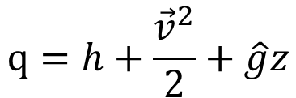
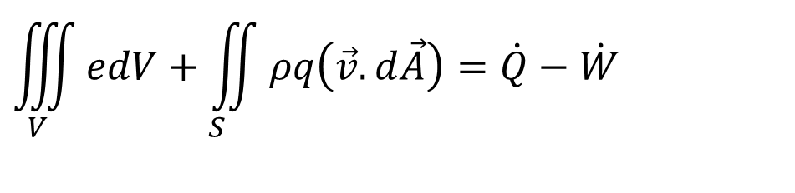
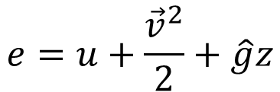
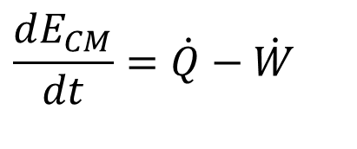
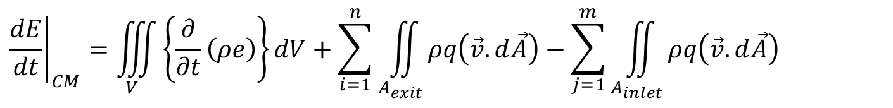
RTT of First Law for A Control Volume
$${\left.\frac{dG\left(t\right)}{dt}\right|}_{CM}=\left\{\iiint_{V}{\left\{\frac{∂}{∂t}\left(ρζ\right)\right\}dV}\right\}+\sum_{i=1}^{n}{\iint_{A_{exit}}{ρζ\left(\vec{v}.d\vec{A}\right)}}−\sum_{j=1}^{m}{\iint_{A_{inlet}}{ρζ\left(\vec{v}.d\vec{A}\right)}}$$
Consider a flow field with field variable value ζ= e AND q and substitute the same in above equation.
$${\left.\frac{dE}{dt}\right|}_{CM}=\iiint_{V}{\left\{\frac{∂}{∂t}\left(ρe\right)\right\}dV}+\sum_{i=1}^{n}{\iint_{A_{exit}}{ρq\left(\vec{v}.d\vec{A}\right)}}−\sum_{j=1}^{m}{\iint_{A_{inlet}}{ρq\left(\vec{v}.d\vec{A}\right)}}$$
$$e=u+\frac{{\vec{v}}^{2}}{2}+\hat{g}z$$
$$q=h+\frac{{\vec{v}}^{2}}{2}+\hat{g}z$$
Valid for Region II only
Valid for Regions I & III only
First law of thermodynamics for CM:
$$\frac{dE_{CM}}{dt}=\dot{Q}−\dot{W}$$
$$\iiint_{V}{edV}+\iint_{S_{}}{ρq\left(\vec{v}.d\vec{A}\right)}=\dot{Q}−\dot{W}$$

Slide 12
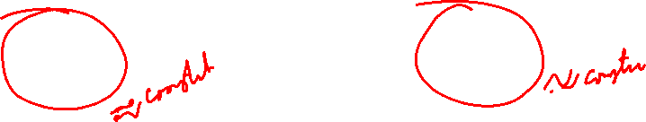
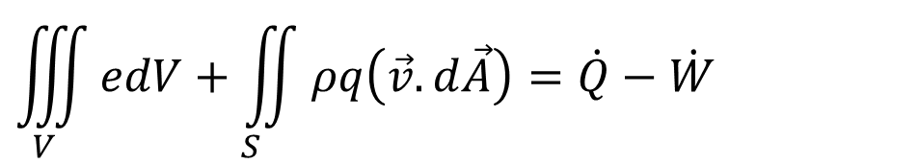
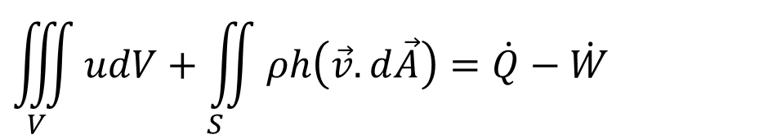
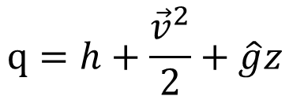
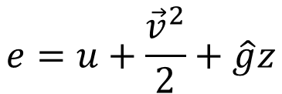
RTT of First Law for A Convection Heat Transfer System
$$\iiint_{V}{edV}+\iint_{S_{}}{ρq\left(\vec{v}.d\vec{A}\right)}=\dot{Q}−\dot{W}$$
$$e=u+\frac{{\vec{v}}^{2}}{2}+\hat{g}z$$
$$q=h+\frac{{\vec{v}}^{2}}{2}+\hat{g}z$$
A General Convection Heat Transfer deals with change internal energy or enthalpy of working fluid only…..
$$\iiint_{V}{udV}+\iint_{S_{}}{ρh\left(\vec{v}.d\vec{A}\right)}=\dot{Q}−\dot{W}$$

Slide 13
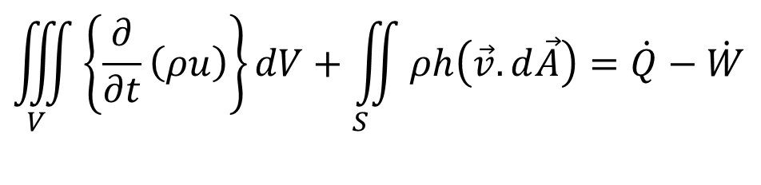
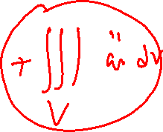
Total Thermal Energy of A Convection System : Rate of Heat Transfer
The rate of Equation of first law of thermodynamics for a CV
$$\iiint_{V}{\left\{\frac{∂}{∂t}\left(ρu\right)\right\}dV}+\iint_{S_{}}{ρh\left(\vec{v}.d\vec{A}\right)}=\dot{Q}−\dot{W}$$
The role of heat transfer is primarily due to mechanical equilibrium and very important and defined by Fourier in his conduction equation in 1822.
Newton’s law of cooling an outcome of Fourier’s conduction.
$$\dot{Q}=−\iint_{S}{q′′.\hat{n}dS}$$

Slide 14
Thermal Energy of A Convection System : Rate of Work Transfer
The rate of Equation of first law of thermodynamics for a CV
$$\iiint_{V}{\left\{\frac{∂}{∂t}\left(ρu\right)\right\}dV}+\iint_{S_{}}{ρh\left(\vec{v}.d\vec{A}\right)}=\dot{Q}−\dot{W}$$
The work transfer is carried out by forces generated due to surface forces.
The work transfer due to parallel surface forces is defined as dissipation rate of the work transfer.
Work done per unit volume of fluid is defined as:
$\left(\vec{\vec{σ}}:\vec{\vec{ε}}\right)=σ_{xx}ε_{xx}$+ $σ_{yy}ε_{yy}$+ $σ_{zz}ε_{zz}$+ $σ_{xy}ε_{xy}+σ_{yz}ε_{yz}+σ_{zx}ε_{zx}$

Slide 15
Final Form of Energy Equation of Convection Heat Transfer
The rate of Equation of first law of thermodynamics for a CV
$$\iiint_{V}{\left\{\frac{∂}{∂t}\left(ρu\right)\right\}dV}+\iint_{S_{}}{ρh\left(\vec{v}.d\vec{A}\right)}=\dot{Q}−\dot{W}$$
$$\iiint_{V}{\left\{\frac{∂}{∂t}\left(ρu\right)\right\}dV}−\iint_{S_{}}{ρh\left(\vec{v}.d\vec{A}\right)}=−\iint_{S}{q′′.\hat{n}dS}−\iiint_{V}{\left(\vec{\vec{σ}}:\vec{\vec{\dot{ε}}}\right)dV}$$
$$\iiint_{V}{\left\{\frac{∂}{∂t}\left(ρu\right)\right\}dV}−\iint_{S_{}}{ρh\left(\vec{v}.d\vec{A}\right)}=−\iint_{S}{q^{′′}.\hat{n}dS}−\iiint_{V}{\left(−p∇.\vec{v}+Φ\right)dV}$$
Φ is called as viscous dissipation function

Slide 16
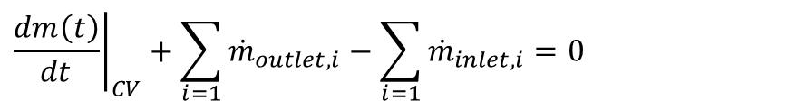
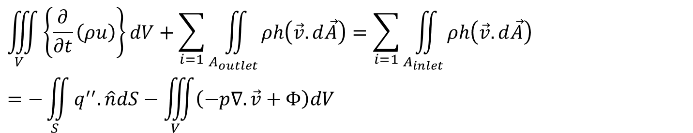
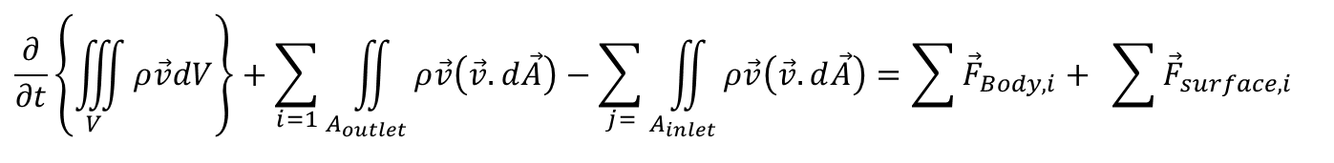
RTT for Integral Convection System
A Practical Convection Systems with multiple inlets and outlets.
Conservation of mass:
$${\left.\frac{dm\left(t\right)}{dt}\right|}_{CV}+\sum_{i=1}{{\dot{m}}_{outlet,i}}−\sum_{i=1}{{\dot{m}}_{inlet,i}}=0$$
Conservation of momentum:
$$\frac{∂}{∂t}\left\{\iiint_{V}{ρ\vec{v}dV}\right\}+\sum_{i=1}{\iint_{A_{outlet}}{ρ\vec{v}\left(\vec{v}.d\vec{A}\right)}}−\sum_{j=}{\iint_{A_{inlet}}{ρ\vec{v}\left(\vec{v}.d\vec{A}\right)=\sum{{\vec{F}}_{Body,i}}+ \sum{{\vec{F}}_{surface,i}} }}$$
Conservation of Thermal Energy:
$$\iiint_{V}{\left\{\frac{∂}{∂t}\left(ρu\right)\right\}dV}+\sum_{i=1}{\iint_{A_{outlet}}{ρh\left(\vec{v}.d\vec{A}\right)}}=\sum_{i=1}{\iint_{A_{inlet}}{ρh\left(\vec{v}.d\vec{A}\right)}}=−\iint_{S}{q^{′′}.\hat{n}dS}−\iiint_{V}{\left(−p∇.\vec{v}+Φ\right)dV}$$

Slide 17
An Integral Analysis for Deeper Study of A Convection Heat Transfer System is necessary but not sufficient!!!

Slide 18
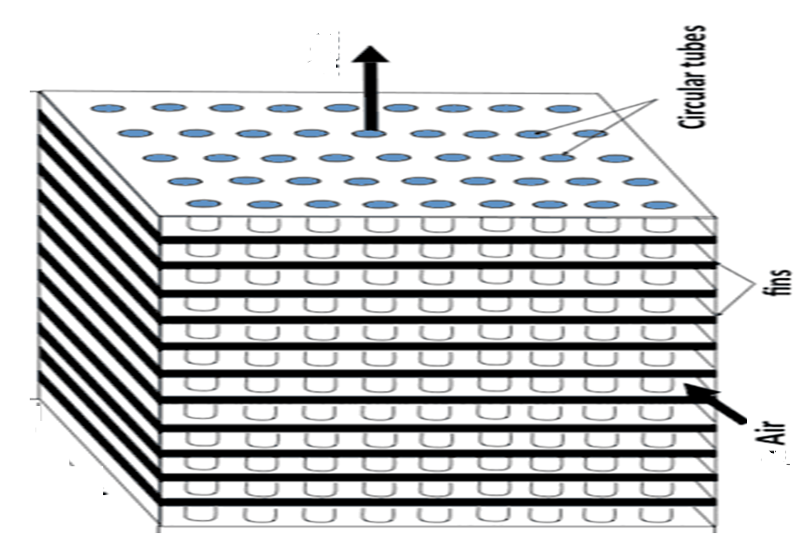
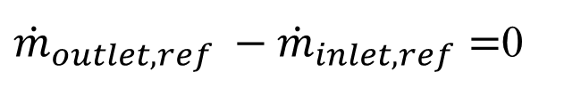
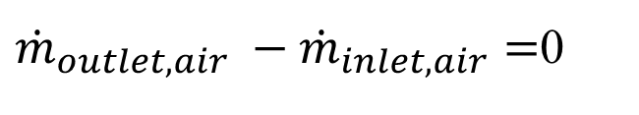
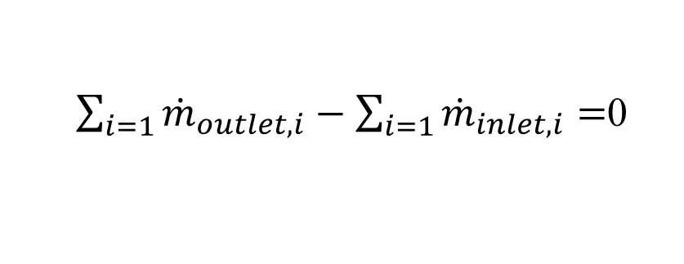
Integral Control Volume analysis: Case Study
Performance analysis of fin and tube Heat Exchanger:
Refrigerant
At steady state:
$\sum_{i=1}{{\dot{m}}_{outlet,i}}−\sum_{i=1}{{\dot{m}}_{inlet,i}}=$0
${\dot{m}}_{outlet,air} −{\dot{m}}_{inlet,air}=$0
${\dot{m}}_{outlet,ref} −{\dot{m}}_{inlet,ref}=$0

Slide 19
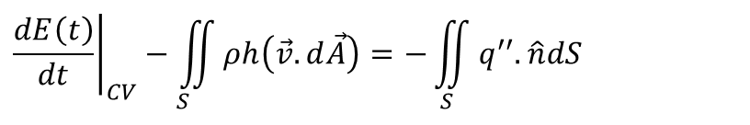
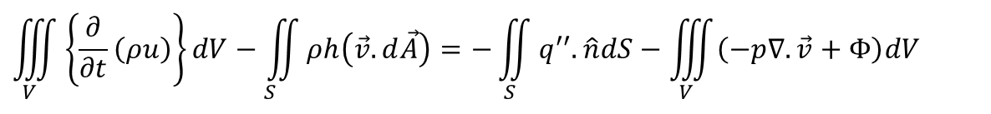
Integral Control Volume analysis: Case Study
Refrigerant
$$\iiint_{V}{\left\{\frac{∂}{∂t}\left(ρu\right)\right\}dV}−\iint_{S_{}}{ρh\left(\vec{v}.d\vec{A}\right)}=−\iint_{S}{q^{′′}.\hat{n}dS}−\iiint_{V}{\left(−p∇.\vec{v}+Φ\right)dV}$$
Work transfer is negligible in a Heat Exchanger for an Incompressible Convection System:
$${\left.\frac{dE\left(t\right)}{dt}\right|}_{CV}−\iint_{S_{}}{ρh\left(\vec{v}.d\vec{A}\right)}=−\iint_{S}{q^{′′}.\hat{n}dS}$$

Slide 20
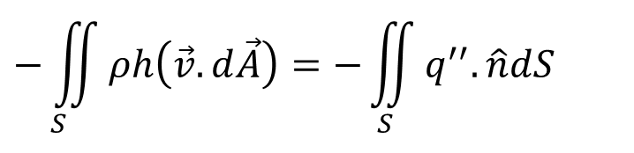
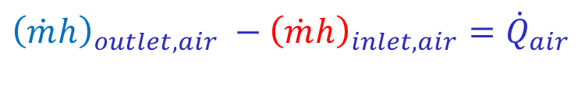
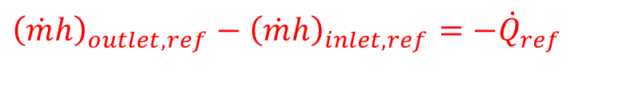
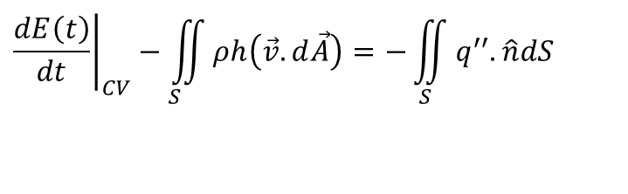
Integral Control Volume analysis: Case Study
$${\left.\frac{dE\left(t\right)}{dt}\right|}_{CV}−\iint_{S_{}}{ρh\left(\vec{v}.d\vec{A}\right)}=−\iint_{S}{q^{′′}.\hat{n}dS}$$
For Steady State Steady Flow
$$−\iint_{S_{}}{ρh\left(\vec{v}.d\vec{A}\right)}=−\iint_{S}{q^{′′}.\hat{n}dS}$$
Fin and tube heat exchanger as a condenser:
Refrigerant
Refrigerant is a hot fluid:
$${\left(\dot{m}h\right)}_{outlet,ref}−{\left(\dot{m}h\right)}_{inlet,ref}={−\dot{Q}}_{ref}$$
Air is a cold fluid:
$${\left(\dot{m}h\right)}_{outlet,air} −{\left(\dot{m}h\right)}_{inlet,air}={\dot{Q}}_{air}$$

Slide 21
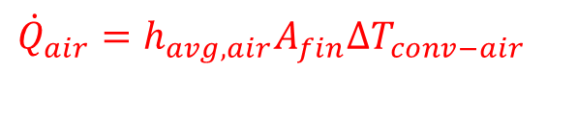
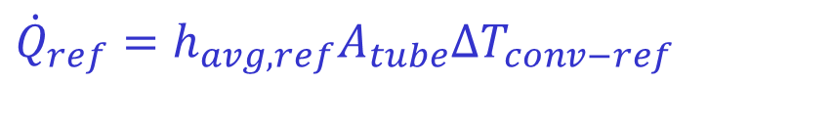
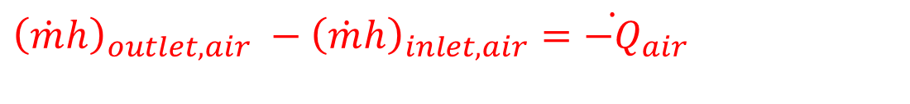
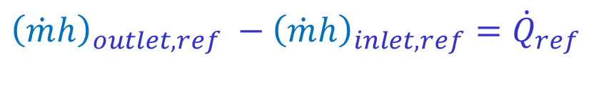
Integral Control Volume analysis: Case Study
Refrigerant
Fin and tube heat exchanger as an Evaporator:
Refrigerant is a cold fluid:
$${\left(\dot{m}h\right)}_{outlet,ref} −{\left(\dot{m}h\right)}_{inlet,ref}={\dot{Q}}_{ref}$$
$${\dot{Q}}_{ref}=h_{avg,ref}A_{tube}∆T_{conv−ref}$$
Air is a hot fluid:
$${\left(\dot{m}h\right)}_{outlet,air} −{\left(\dot{m}h\right)}_{inlet,air}={\dot{−Q}}_{air}$$
$${\dot{Q}}_{air}=h_{avg,air}A_{fin}∆T_{conv−air}$$

Slide 22
Need for Localization of RTT: Case Study
Refrigerant
How effectively aluminum fins are used in a Fin and tube Heat Exchanger???

Slide 23
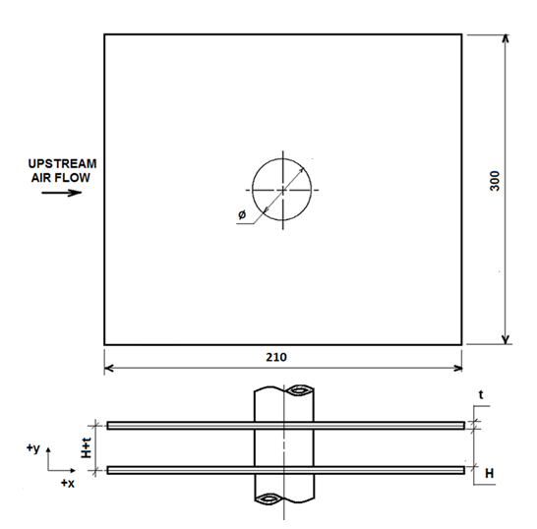
Need for Localization of RTT: Case Study
Refrigerant

Slide 24
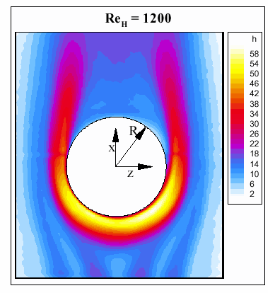
Variation of Heat Transfer Coefficient on fin w/o Winglets
3
4
2
1

Slide 25
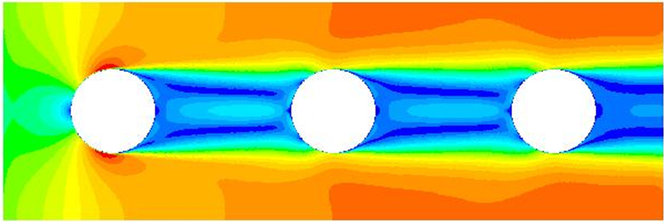
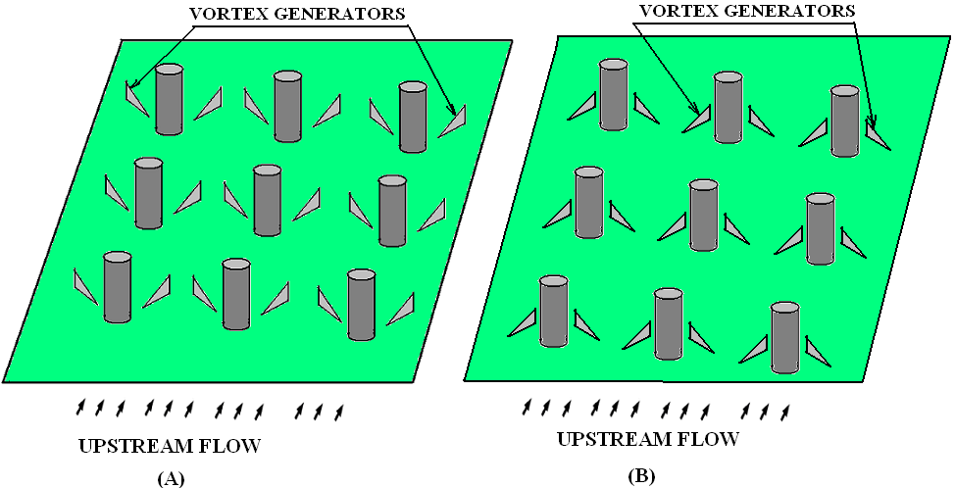
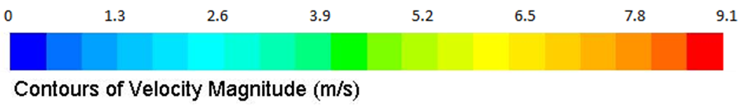
Reasons behind Ineffective Utilization of Fin Surface

Slide 26
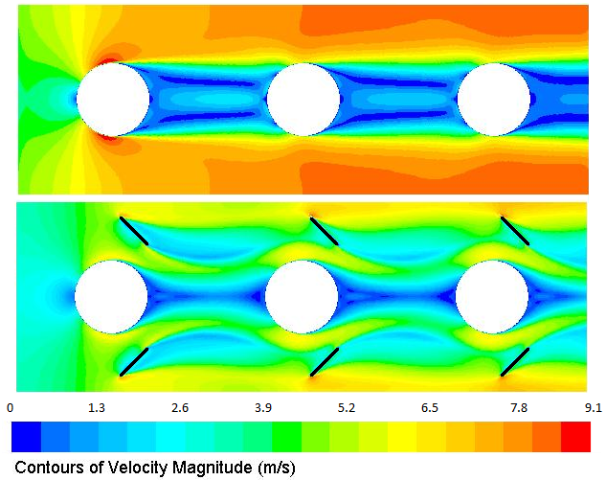
Ingestion of More Air into Wake

Slide 27
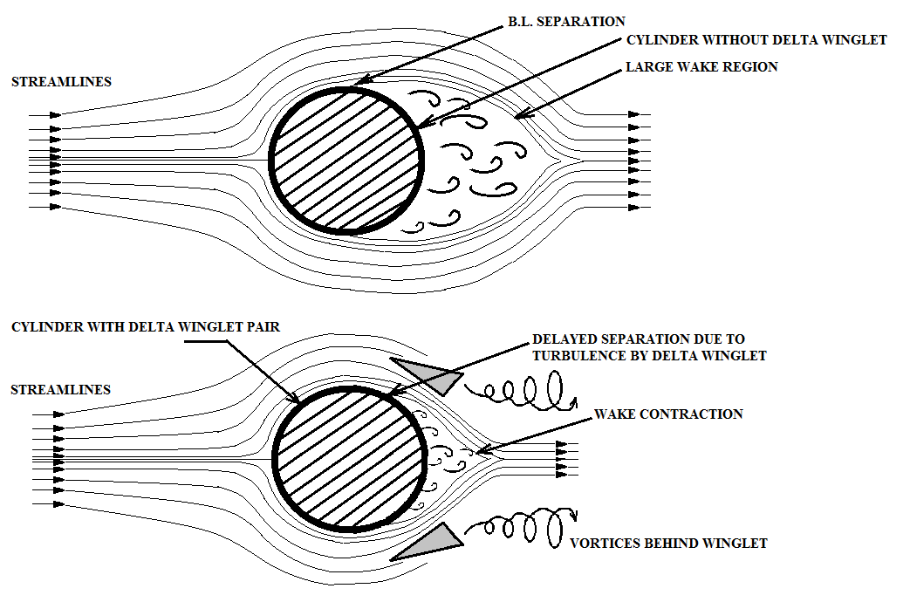

Need for Localization of Conservation Laws

Slide 28
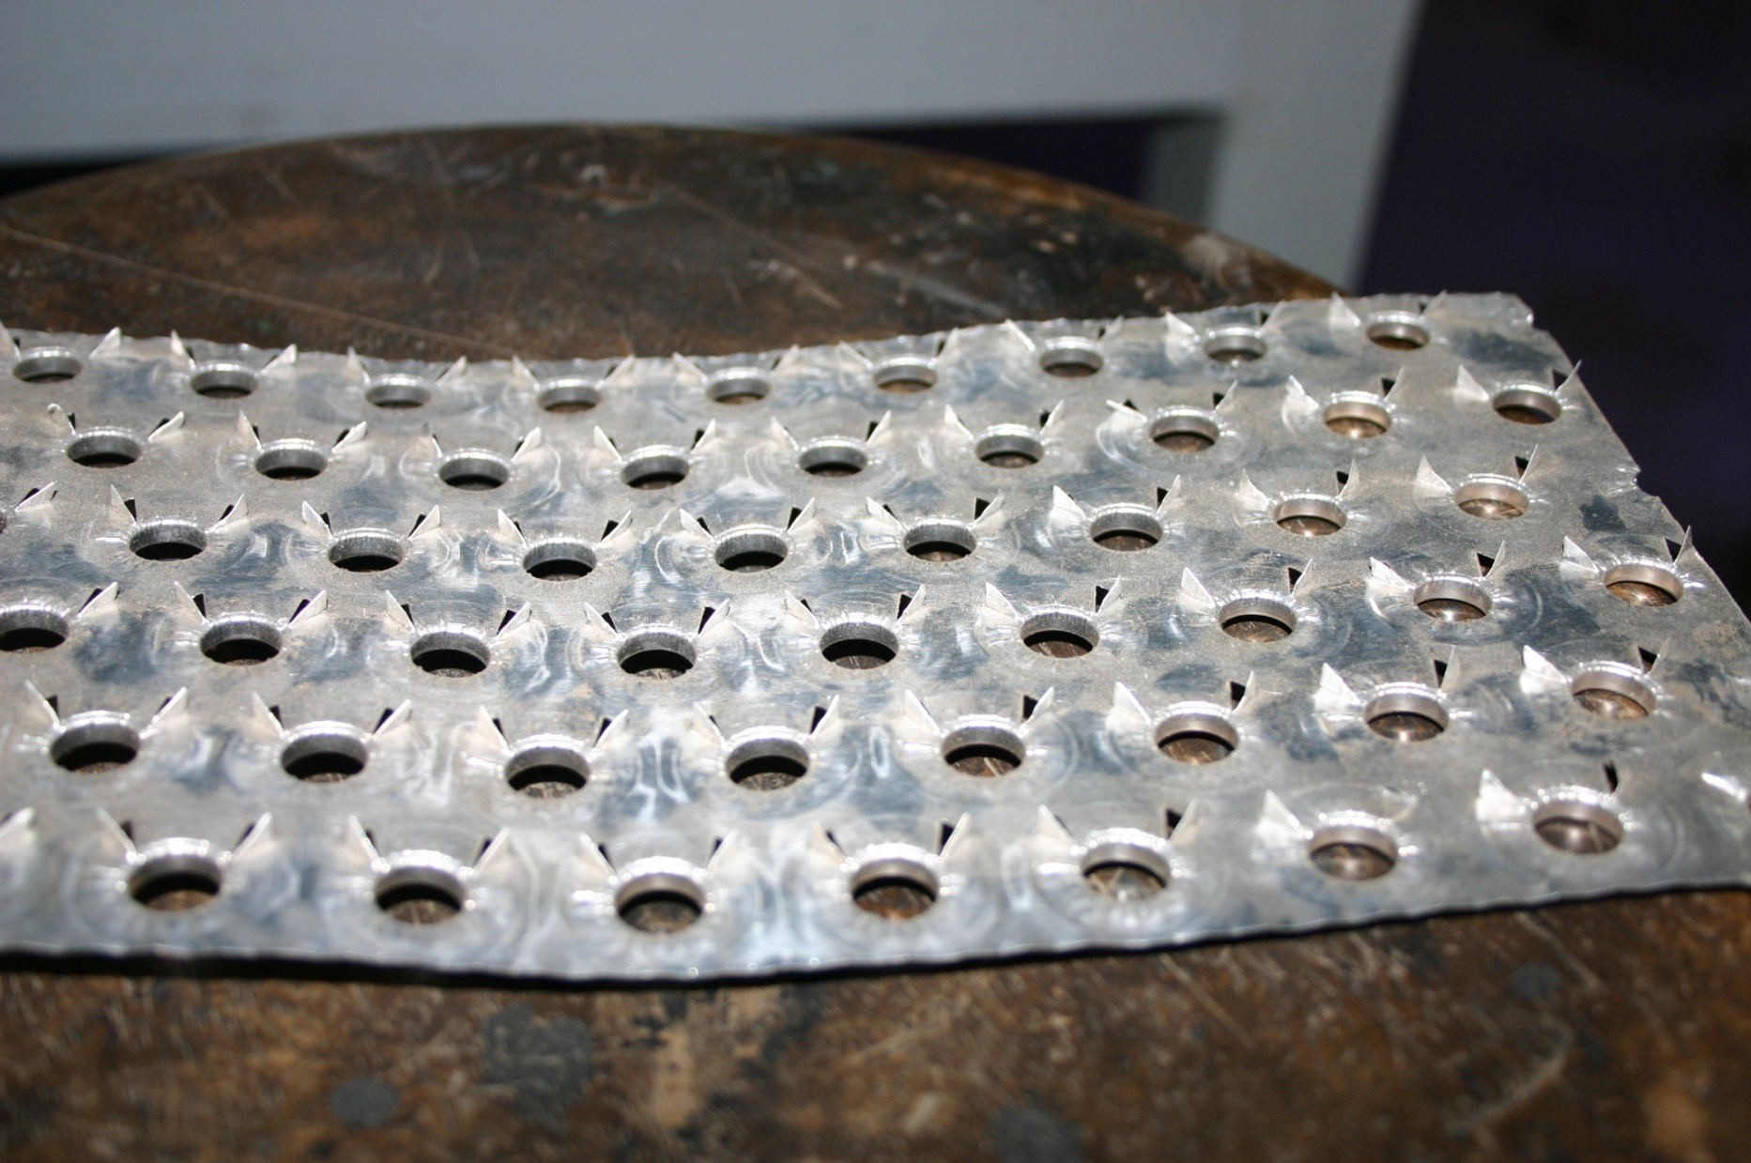
Fins with Winglets

Slide 29
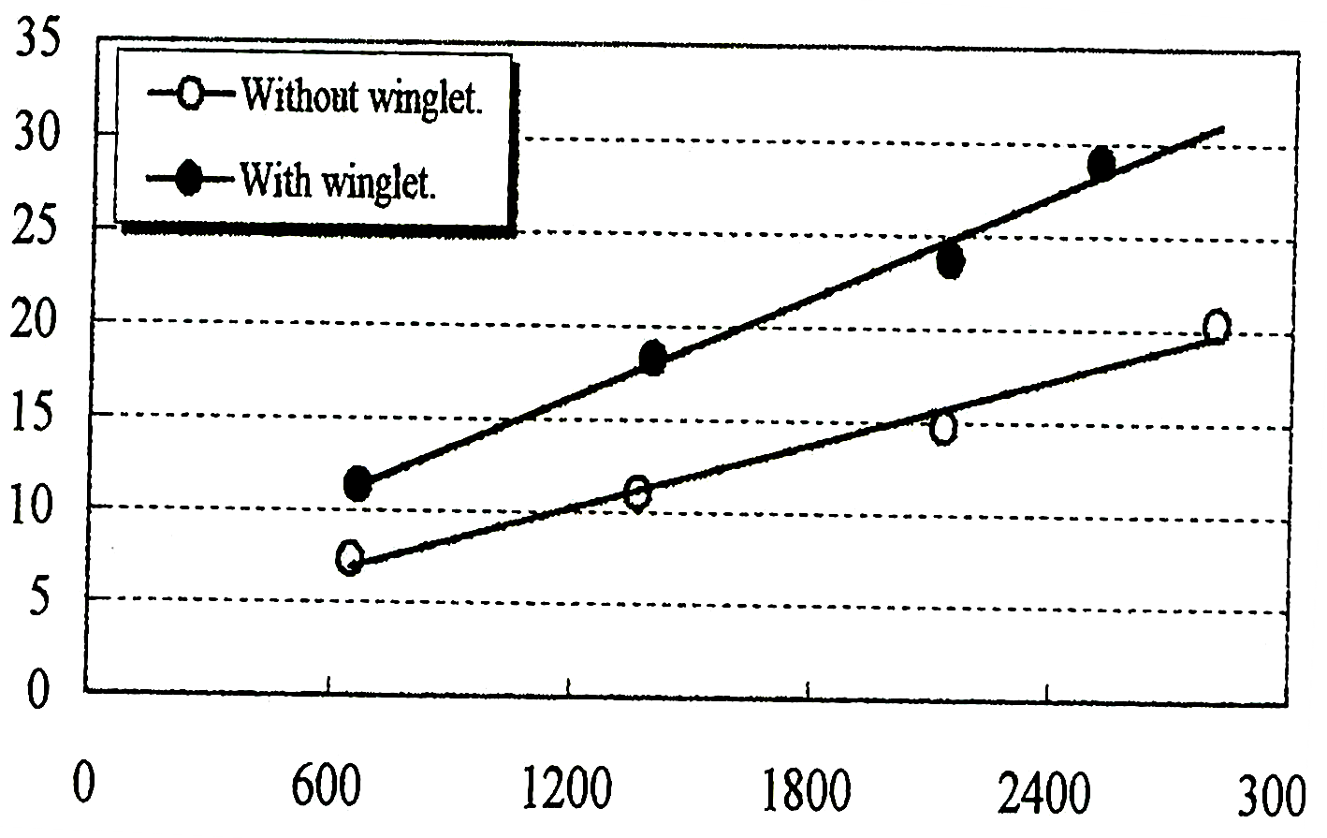
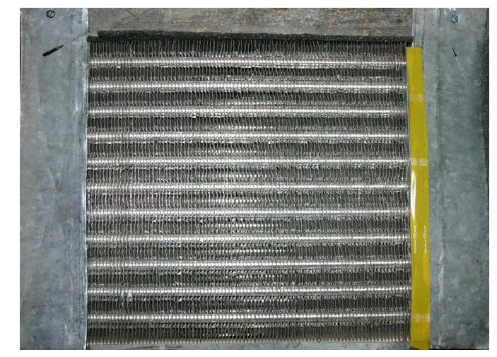

Performance of Integral Control Volume

Slide 30

Optimal Size and Location of Winglets
Development of Sustainable Convection HT Systems need Localization of RTT.

Slide 31




Conservation of Mass for an Infinitesimal Local CV in A Fluid Flow
Recall RTT with all terms as volume integrals:
$$\frac{DG\left(t\right)}{Dt}=\int_{V\left(t\right)}{\left\{\frac{∂g\left(\vec{x},t\right)}{∂t}+∇.\left\{g\left(\vec{x},t\right)\vec{v}\right\}\right\}dV}$$
$$G=\int_{CV}{ζdm}=\int_{CV}{ρζdV}$$
Redefine
$$\frac{DG\left(t\right)}{Dt}=\int_{V\left(t\right)}{\left\{\frac{∂\left(ρζ\right)}{∂t}+∇.\left\{ρζ\vec{v}\right\}\right\}dV}$$
Consider ζ = 1, the conservation of mass for a CV is obtained as:
$$\frac{DG\left(t\right)}{Dt}=\int_{V\left(t\right)}{\left\{\frac{∂ρ}{∂t}+∇.\left\{ρ\vec{v}\right\}\right\}dV}$$

Slide 32
Continuity Equation for Fluid flows
RTT with all terms as volume integrals:
$$\int_{V\left(t\right)}{\left\{\frac{∂ρ}{∂t}+∇.\left\{ρ\vec{v}\right\}\right\}dV}=0$$
This integral is zero for any size and shape of material volume.
Implies that the integrands in the brackets as a total must vanish identically.
This is known as continuity equation and for a general unsteady flow it is written as:
$$\frac{∂ρ}{∂t}+∇.\left(ρ\vec{v}\right)=0$$

Slide 33
Continuity Equation in Cartesian System
$$\frac{∂ρ}{∂t}+∇.\left(ρ\vec{v}\right)=0$$
This Equation is a coordinate invariant equation.
Its index notation in the Cartesian coordinate system given is:
$$\frac{∂ρ}{∂t}+\frac{∂\left(ρu\right)}{∂x}+\frac{∂\left(ρv\right)}{∂y}+\frac{∂\left(ρw\right)}{∂z}=0$$

Slide 34

Continuity Equation in Cylindrical Polar Coordinates
Many flows which involve rotation or radial motion are best described in Cylindrical Polar Coordinates.
In this system coordinates for a point P are r, θ and z.
The velocity components in these directions respectively are v_{r} ,v_{θ} and v_{z}.
Transformation between the Cartesian and the polar systems is provided by the relations,
$$r=\sqrt{x^{2}+y^{2}}$$
$$θ=\tan^{−1}\left(\frac{y}{x}\right)$$

Slide 35
Continuity Equation in Cylindrical Polar Coordinates
The gradient operator is given by,
$$∇=\hat{r}\frac{∂}{∂r}+\frac{1}{r}\hat{θ}\frac{∂}{∂θ}+\hat{z}\frac{∂}{∂z}$$
Therefore, the conservation of mass equation becomes,
$$\frac{∂ρ}{∂t}+\frac{1}{r}\frac{∂\left(rρv_{r}\right)}{∂r}+\frac{1}{r}\frac{∂\left(ρv_{θ}\right)}{∂θ}+\frac{∂\left(ρv_{z}\right)}{∂z}=0$$

Slide 36

Continuity Equation in Spherical Polar Coordinates
Spherical polar coordinates are a system of curvilinear coordinates that are natural for describing atmospheric flows.
Define θ to be the azimuthal angle in the x-y -plane from the x-axis with 0 ≤ θ < 2π .
φ to be the zenith angle and colatitude, with 0 ≤ φ < π
r to be distance (radius) from a point to the origin.
The spherical coordinates (r,θ,φ) are related to the Cartesian coordinates (x,y,z) by
$$r=\sqrt{x^{2}+y^{2}+z^{2}}$$
$$θ=\tan^{−1}\left(\frac{y}{x}\right)$$
$$φ=\cos^{−1}\left(\frac{z}{r}\right)$$

Slide 37
Transformation Function for CCS to SCS
$$x=r\cos{θ}\sin{φ} \\ y=r\sin{θ}\sin{φ} \\ z=\cos{φ}$$
The gradient is
$$∇=\hat{r}\frac{∂}{∂r}+\frac{1}{r\sin{φ}}\hat{θ}\frac{∂}{∂θ}+\frac{1}{r}\hat{φ}\frac{∂}{∂φ}$$
Therefore, conservation of mass equation becomes,
$$\frac{∂ρ}{∂t}+\frac{1}{r^{2}}\frac{∂\left(ρr^{2}v_{r}\right)}{∂r}+\frac{1}{r\sin{θ}}\frac{∂\left(ρv_{θ}\sin{θ}\right)}{∂θ}+\frac{1}{r\sin{θ}}\frac{∂\left(ρv_{φ}\right)}{∂φ}=0$$

Slide 38
Continuity Equation for Convection Systems
Continuity Equation in coordinate invariant form is:
$$\frac{∂ρ}{∂t}+∇.\left(ρ\vec{v}\right)=0$$
In the Cartesian coordinate system, the continuity equation given as:
$$\frac{∂ρ}{∂t}+\frac{∂\left(ρu\right)}{∂x}+\frac{∂\left(ρv\right)}{∂y}+\frac{∂\left(ρw\right)}{∂z}=0$$
In the Cylindrical polar coordinate system, the continuity equation given as:
$$\frac{∂ρ}{∂t}+\frac{1}{r}\frac{∂\left(rρv_{r}\right)}{∂r}+\frac{1}{r}\frac{∂\left(ρv_{θ}\right)}{∂θ}+\frac{∂\left(ρv_{z}\right)}{∂z}=0$$
In the spherical polar coordinate system, the continuity equation given as:
$$\frac{∂ρ}{∂t}+\frac{1}{r^{2}}\frac{∂\left(ρr^{2}v_{r}\right)}{∂r}+\frac{1}{r\sin{θ}}\frac{∂\left(ρv_{θ}\sin{θ}\right)}{∂θ}+\frac{1}{r\sin{θ}}\frac{∂\left(ρv_{φ}\right)}{∂φ}=0$$

Slide 39


Thermal Energy of A Convection System
The rate of Equation of first law of thermodynamics for a CV
$$\iiint_{V}{\left\{\frac{∂}{∂t}\left(ρu\right)\right\}dV}+\iint_{S_{}}{ρh\left(\vec{v}.d\vec{A}\right)}=−\iint_{S}{q^{′′}.\hat{n}dS}−\iiint_{V}{\left(−p∇.\vec{v}+Φ\right)dV}$$
Using Gauss Divergence Theorem:
$$\iint_{S}{q^{′′}.\hat{n}dS} =\iiint_{V}{∇.q′′dV}$$
$$\iint_{S_{}}{ρh\left(\vec{v}.d\vec{A}\right)}=\iiint_{V}{∇. \left(ρh\vec{v}\right)dV}$$
$$\iiint_{V}{\left\{\frac{∂}{∂t}\left(ρu\right)\right\}dV}+\iiint_{V}{∇. \left(ρh\vec{v}\right)dV}=−\iiint_{V}{∇.q^{′′}dV}−\iiint_{V}{\left(−p∇.\vec{v}+Φ\right)dV}$$

