Slide 1

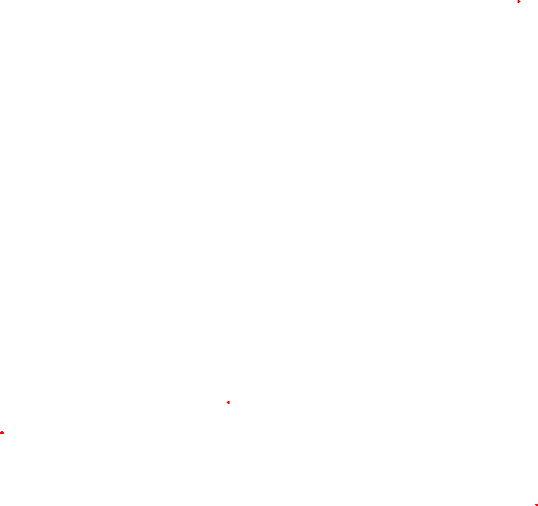

Governing Equations for Convection Heat Transfer
P M V Subbarao
Professor & Head
Mechanical Engineering Department
Physics is experience, arranged in economical order.
— Prof. Ernst Mach
Generalized Mathematical Models to predict Temperature Field…

Slide 2

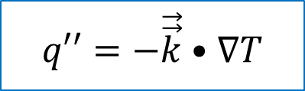
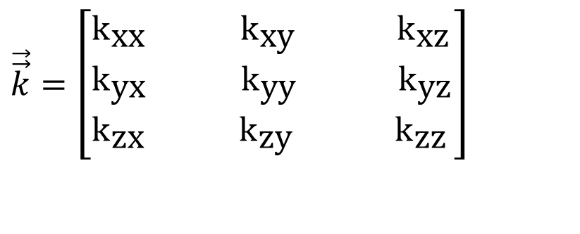
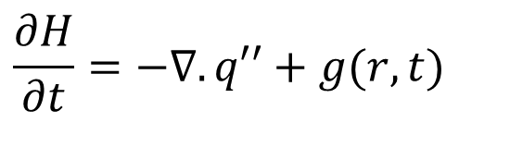
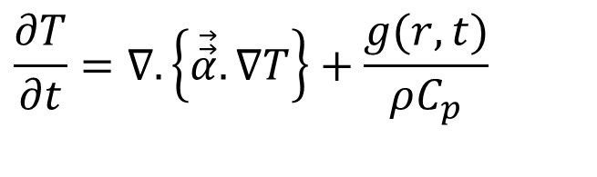
Fourier’s Constitutive Equation for the Heat Flux: 1802
$$\frac{∂H}{∂t}=−∇.q′′+g(r,t)$$
$$q′′=−\vec{\vec{k}}•∇T$$
$$\vec{\vec{k}}=\left[\begin{aligned}&k_{\text{xx}} {\text{k}}_{\text{xy}} {\text{k}}_{\text{xz}} \\ &k_{\text{yx}} {\text{k}}_{\text{yy}} {\text{k}}_{\text{yz}} \\ &k_{\text{zx}} {\text{k}}_{\text{zy}} {\text{k}}_{\text{zz}}\end{aligned}\right]$$
The Fourier Conduction Equation:
$$\frac{∂T}{∂t}=∇.\left\{\vec{\vec{α}}.∇T\right\}+\frac{g(r,t)}{ρC_{p}}$$

Slide 3
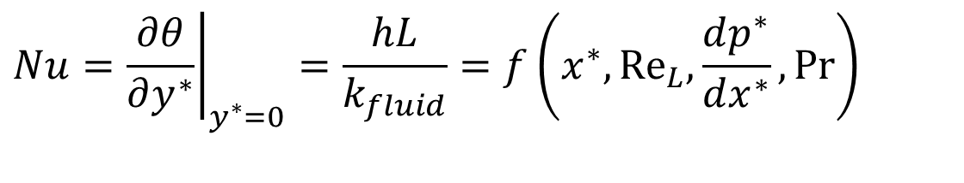
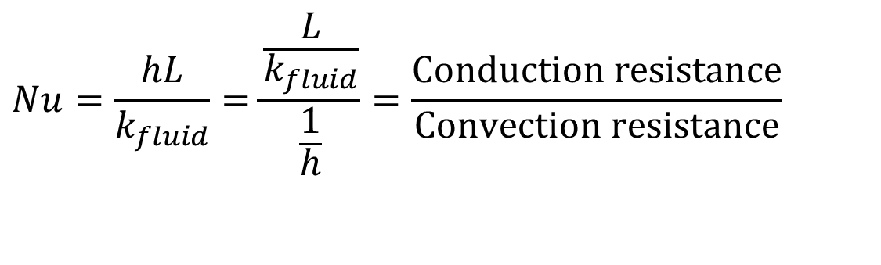
Nusselt's Clue to handle Convective Heat Transfer System
This dimensionless temperature gradient at the wall is named as
Nusselt Number:
$$Nu=\frac{hL}{k_{fluid}}=\frac{\frac{L}{k_{fluid}}}{\frac{1}{h}}=\frac{\text{Conduction} \text{resistance}}{\text{Convection} \text{resistance}}$$
$$Nu={\left.\frac{∂θ}{∂y^{∗}}\right|}_{y^{∗}=0}=\frac{hL}{k_{fluid}}=f\left(x^{∗},{Re}_{L}{,}\frac{dp^{∗}}{dx^{∗}},Pr\right)$$
Local Nusselt Number

Slide 4
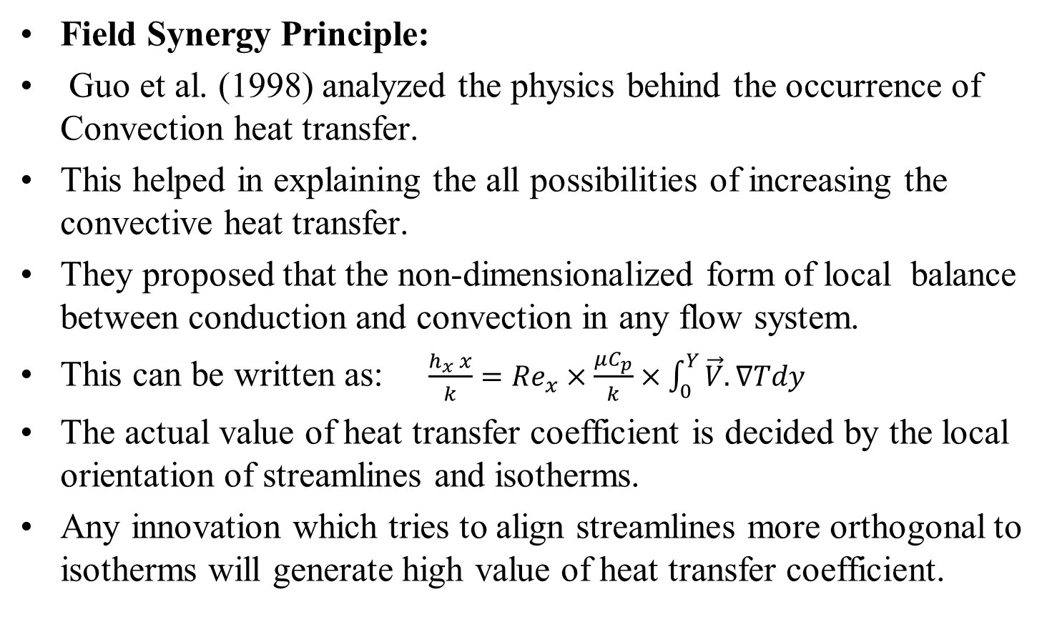
Order of Merit of A
Convective Heat Transfer in a System
Field Synergy Principle:
Guo et al. (1998) analyzed the physics behind the occurrence of Convection heat transfer.
This helped in explaining the all possibilities of increasing the convective heat transfer.
They proposed that the non-dimensionalized form of local balance between conduction and convection in any flow system.
This can be written as: $\frac{h_{x} x}{k}={Re}_{x}×\frac{μC_{p}}{k}×\int_{0}^{Y}{\vec{V}.∇Tdy}$
The actual value of heat transfer coefficient is decided by the local orientation of streamlines and isotherms.
Any innovation which tries to align streamlines more orthogonal to isotherms will generate high value of heat transfer coefficient.

Slide 5
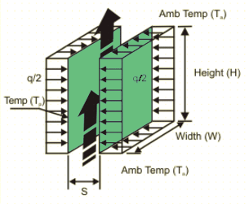
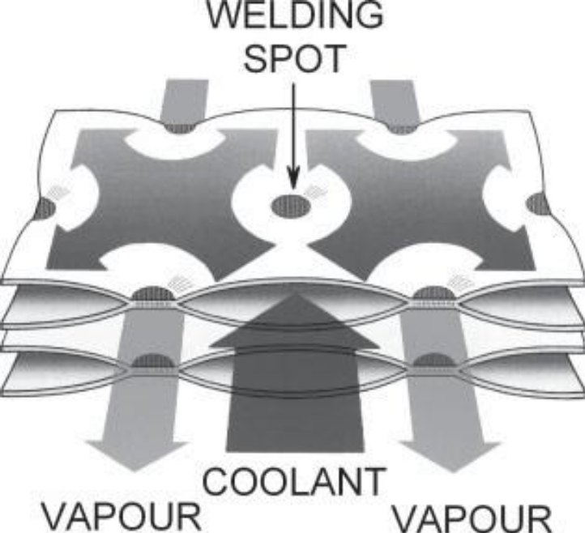
Impact of Flow Channel Geometry on Convection Heat Transfer
$$\frac{h_{x}X}{k}={Re}_{x}×\frac{μC_{p}}{k}×\int_{0}^{Y}{\vec{V}.∇Tdy}$$

Slide 6
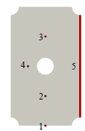
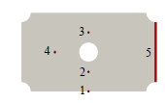
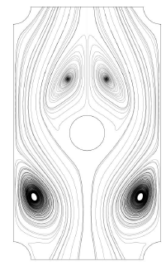
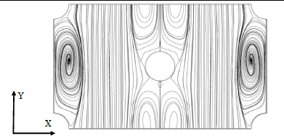
Transverse vs Longitudinal Flow thru Pillows
$$\frac{h_{x}X}{k}={Re}_{x}×\frac{μC_{p}}{k}×\int_{0}^{Y}{\vec{V}.∇Tdy}$$

Slide 7
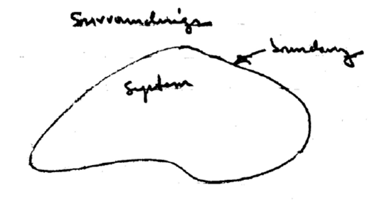
Rate Equations for Laws of Nature for A Thermodynamic Control Mass
Control Mass
$$\frac{dm_{CM}}{dt}=0$$
Conservation of Mass :
$$\frac{d\left(m_{CM}{\vec{V}}_{CM}\right)}{dt}=\sum{{\vec{F}}_{i}}$$
Conservation of Momentum :
$$\frac{dE_{CM}}{dt}=\dot{Q}−\dot{W}$$
First law of thermodynamics :

Slide 8
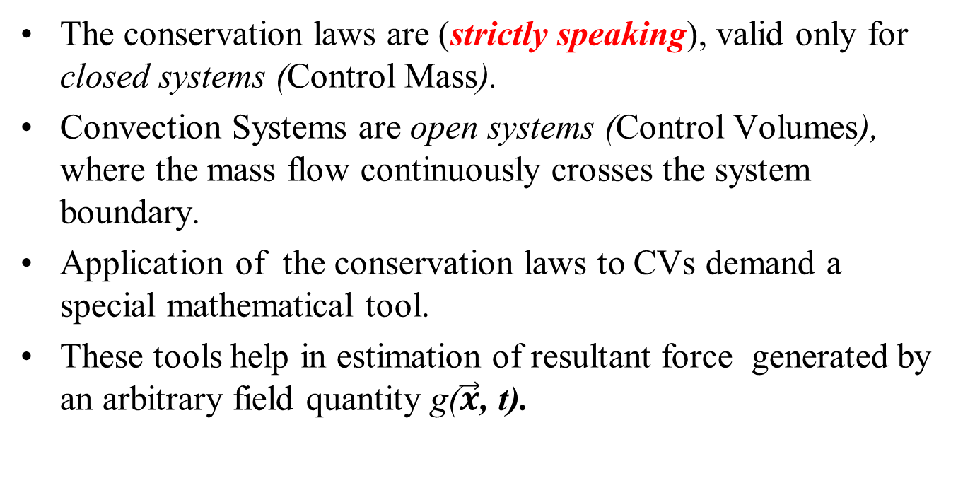
Tools for Comprehensive Description
The conservation laws are (strictly speaking), valid only for closed systems (Control Mass).
Convection Systems are open systems (Control Volumes), where the mass flow continuously crosses the system boundary.
Application of the conservation laws to CVs demand a special mathematical tool.
These tools help in estimation of resultant force generated by an arbitrary field quantity g($\vec{x}$, t).

Slide 9
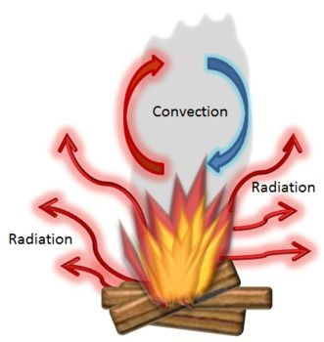
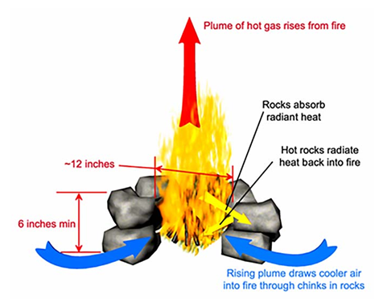

Camp Fire As A Control Volume

Slide 10
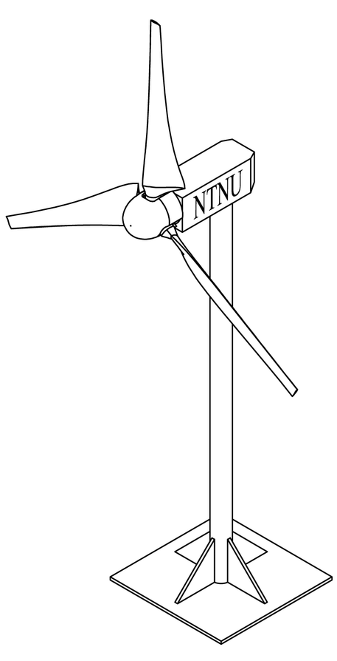
Wind Turbine As A Control Volume

Slide 11
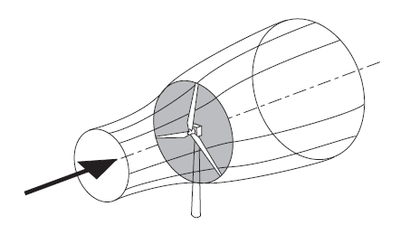
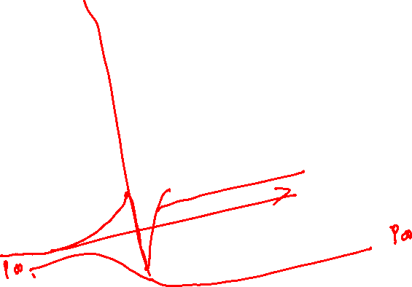
Wind Systems Interacting with A Wind Turbine

Slide 12
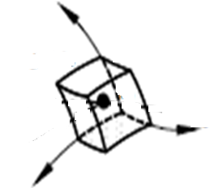
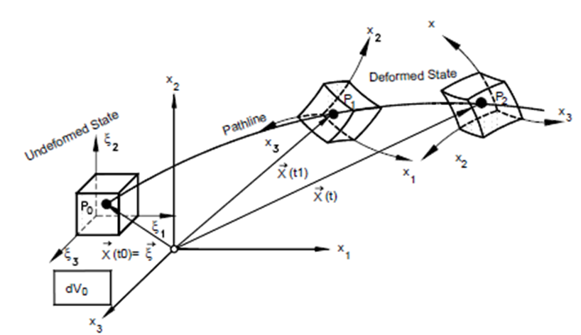
Energetics of A Fluid Parcel across An
Open System
z
Cold undeformed State
Warm deformed State
x
y

Slide 13
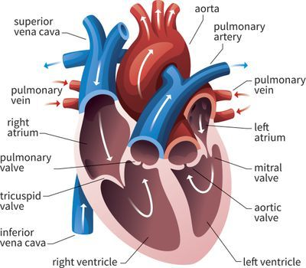
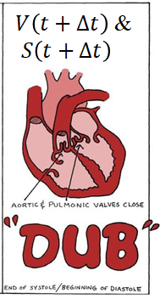
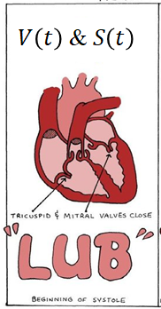
Reynolds Control Volume

Slide 14
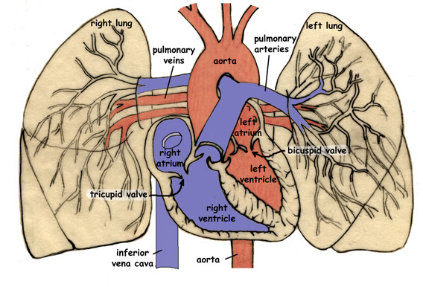
Biologically Inspired Reynolds Control Volume

Slide 15
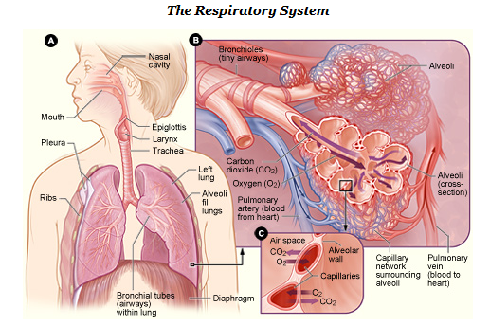
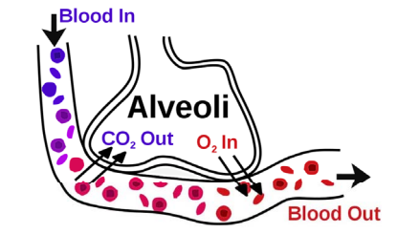
Reynolds Control Volume for Convective Mass Transfer System

Slide 16
Reynolds Description of a Flow System
Every fluid system must be treated as “The control mass.”
Consider a simple Fluid System that occupies region I and region II) at time t₀.
II
I
At time t₀
Fluid particles of region – I are trying to enter Region – II (Control Volume) at time t₀.

Slide 17
Reynolds Thinking about a Flow System
At time t₀
III
II
Why and How?????
At time t₀+δt
I
II
The same fluid system transforms to regions (II+III) after a time δt.
Fluid particles of region-I fully entered CV (Region-II) in a time δt.
Few other fluid particles which were belonging to CV at t₀ are trying exit CV and occupy III at time t₀ + δt.

Slide 18
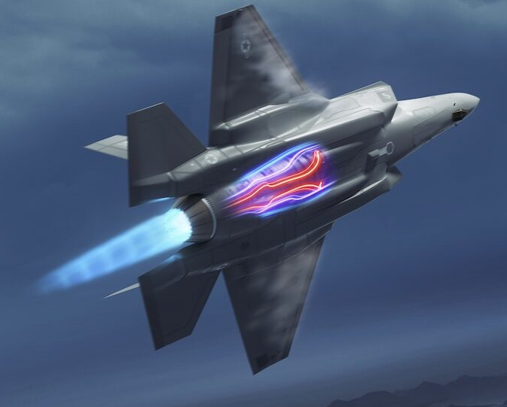
Reynolds Description of A Control Volume
At time t₀
At time t₀+δt

Slide 19
Reynolds Descriptions of a Convection System
III
I has entered and III has left CV at time t₀+δt
II
I is trying to enter CV at time t₀
II
At time t₀+δt
$${\vec{V}}_{CV}$$
I
The control volume may move as time passes.
At time t₀

Slide 20
Actions on Fluid Parcel across A Flow System
z
Cold undeformed State
Warm deformed State
x
y

Slide 21
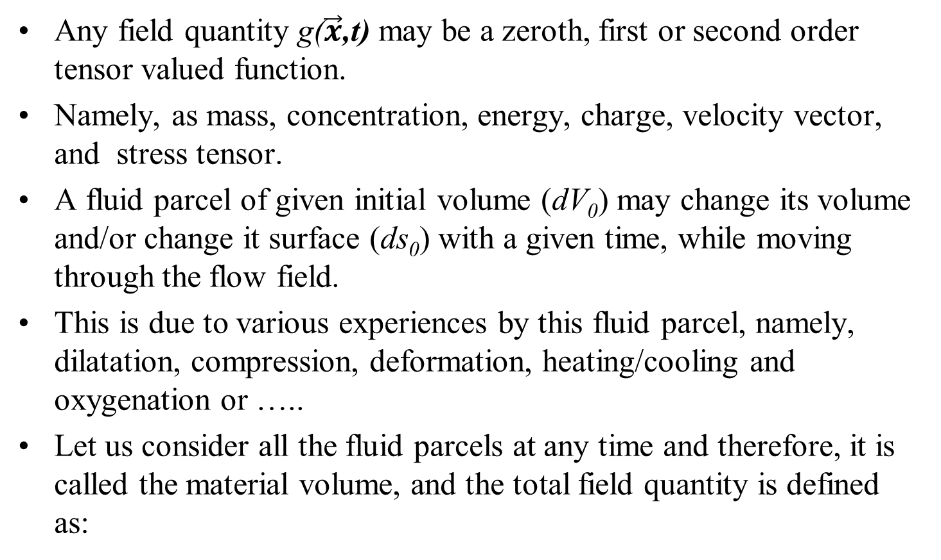
The Field Variable
Any field quantity g($\vec{x}$,t) may be a zeroth, first or second order tensor valued function.
Namely, as mass, concentration, energy, charge, velocity vector, and stress tensor.
A fluid parcel of given initial volume (dV₀) may change its volume and/or change it surface (ds₀) with a given time, while moving through the flow field.
This is due to various experiences by this fluid parcel, namely, dilatation, compression, deformation, heating/cooling and oxygenation or …..
Let us consider all the fluid parcels at any time and therefore, it is called the material volume, and the total field quantity is defined as:
$$G\left(t\right)=\int_{V\left(t\right)}{g\left(\vec{x},t\right)dV}$$

Slide 22
Change in Field quantity of A Convection System
The total value of a field quantity for a CV.
volume integral of the quantity g($\vec{x}$,t):
$$G\left(t\right)=\int_{V\left(t\right)}{g\left(\vec{x},t\right)dV}$$
This is a function of time only.
The integration must be carried out over the varying volume V(t).
The material change of the quantity G(t) is expressed as:
$$\frac{DG\left(t\right)}{Dt}=\frac{D}{Dt}\int_{V\left(t\right)}{g\left(\vec{x},t\right)dV}$$
Since the shape of the volume V(t) changes with time, the differentiation and integration cannot be interchanged.

Slide 23
Need for A Generalized Leibniz Integral Rule
Osborne Reynolds (1842–1912), developed a three-dimensional generalization of the Leibniz integral rule.
It is used to recast time derivatives of integrated quantities and is useful in formulating the basic conservation equations for control volumes.
This is known as Reynolds Transport Theorem.
$$\frac{DG\left(t\right)}{Dt}=\frac{D}{Dt}\int_{V\left(t\right)}{g\left(\vec{x},t\right)dV}$$
$$≅\frac{D}{Dt}\int_{V_{0}}{g\left(\vec{x},t\right)JdV_{0}}$$

Slide 24
Energetics of a differential volume at different instants of time

Slide 25




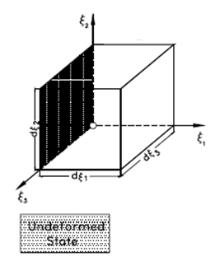
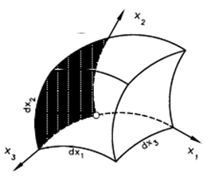


The Fundamental Reynolds Analogy (Algorithm)
$$dV\left(t\right)=J\left(\vec{x},t\right)×dV_{o}$$
Reynolds analogy permits the transformation of the time dependent volume V(t) into the fixed volume V₀ at time t = 0 by using the Jacobian transformation function:
$$J=\left|\begin{aligned}&\frac{∂x_{1}}{∂ξ_{1}} \frac{∂x_{2}}{∂ξ_{1}} \frac{∂x_{3}}{∂ξ_{1}} \\ &\frac{∂x_{1}}{∂ξ_{2}} \frac{∂x_{2}}{∂ξ_{2}} \frac{∂x_{3}}{∂ξ_{2}} \\ &\frac{∂x_{1}}{∂ξ_{3}} \frac{∂x_{2}}{∂ξ_{3}} \frac{∂x_{3}}{∂ξ_{3}}\end{aligned}\right|$$

Slide 26
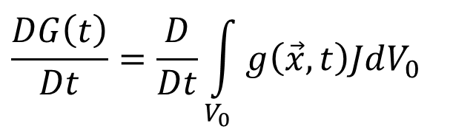
Change in Field quantity of A Convection System
$$\frac{DG\left(t\right)}{Dt}=\frac{D}{Dt}\int_{V_{0}}{g\left(\vec{x},t\right)JdV_{0}}$$
$$\frac{DG\left(t\right)}{Dt}=\frac{D}{Dt}\int_{V\left(t\right)}{g\left(\vec{x},t\right)dV}$$
With this operation it is possible to interchange the sequence of differentiation and integration:
$$\frac{DG\left(t\right)}{Dt}=\int_{V_{0}}{\frac{D\left[g\left(\vec{x},t\right)J\right]}{Dt}dV_{0}}$$
The chain differentiation of the expression within the parenthesis results in
$$\frac{DG\left(t\right)}{Dt}=\int_{V_{0}}{\left\{J\frac{Dg\left(\vec{x},t\right)}{Dt}+g\left(\vec{x},t\right)\frac{DJ}{Dt}\right\}dV_{0}}$$

Slide 27
Material Derivative of Jacobian Function
Every volume element dV follows the motion from x=f(ξ, t) to x=f(ξ, t+dt) and changes its shape and size.
As a result, the Jacobian transformation function undergoes a time change.
This change is the material derivative of J:
$$\frac{DJ}{Dt}=\left(∇.\vec{v}\right)J$$

Slide 28
Transformation Function for CM to CV
$$\frac{DG\left(t\right)}{Dt}=\int_{V_{0}}{\left\{J\frac{Dg\left(\vec{x},t\right)}{Dt}+g\left(\vec{x},t\right)\frac{DJ}{Dt}\right\}dV_{0}}$$
Introducing the material derivative of the Jacobian function and simplifying based on derivatives of transformation functions
$$\frac{DG\left(t\right)}{Dt}=\int_{V_{0}}{\left\{\frac{Dg\left(\vec{x},t\right)}{Dt}+g\left(\vec{x},t\right)∇.\vec{v}\right\}JdV_{0}}$$
$$\frac{DG\left(t\right)}{Dt}=\int_{V_{0}}{\left\{\frac{∂g\left(\vec{x},t\right)}{∂t}+\vec{v}.∇g\left(\vec{x},t\right)+g\left(\vec{x},t\right)∇.\vec{v}\right\}JdV_{0}}$$
The chain rule applied to the second and third term yields:
$$\frac{DG\left(t\right)}{Dt}=\int_{V_{0}}{\left\{\frac{∂g\left(\vec{x},t\right)}{∂t}+∇.\left\{g\left(\vec{x},t\right)\vec{v}\right\}\right\}JdV_{0}}$$

Slide 29
Transformation Function for CM to CV
$$\frac{DG\left(t\right)}{Dt}=\int_{V_{0}}{\left\{\frac{∂g\left(\vec{x},t\right)}{∂t}+∇.\left\{g\left(\vec{x},t\right)\vec{v}\right\}\right\}JdV_{0}}$$
$$\frac{DG\left(t\right)}{Dt}=\int_{V_{0}}{\left\{\frac{∂g\left(\vec{x},t\right)}{∂t}\right\}JdV_{0}}+\int_{V_{0}}{∇.\left\{g\left(\vec{x},t\right)\vec{v}\right\}J}dV_{0}$$
$$\frac{DG\left(t\right)}{Dt}=\frac{∂}{∂t}\left\{\int_{V_{0}}{g\left(\vec{x},t\right)JdV_{0}}\right\}+\int_{V_{0}}{∇.\left\{g\left(\vec{x},t\right)\vec{v}\right\}J}dV_{0}$$
The Reynolds transformation permits the back transformation of the fixed volume integral into the time dependent volume integral.
$$\frac{DG\left(t\right)}{Dt}=\frac{∂}{∂t}\left\{\int_{V\left(t\right)}{g\left(\vec{x},t\right)dV}\right\}+\int_{V\left(t\right)}{∇.\left\{g\left(\vec{x},t\right)\vec{v}\right\}}dV$$

Slide 30
Result of Reynolds Transformation
$$\frac{DG\left(t\right)}{Dt}=\frac{∂}{∂t}\left\{\int_{V\left(t\right)}{g\left(\vec{x},t\right)dV}\right\}+\int_{V\left(t\right)}{∇.\left\{g\left(\vec{x},t\right)\vec{v}\right\}}dV$$
The second volume integral in above equation can be converted into a surface integral by applying the Gauss' divergence theorem:
$$\frac{DG\left(t\right)}{Dt}=\frac{∂}{∂t}\left\{\int_{V\left(t\right)}{g\left(\vec{x},t\right)dV}\right\}+\int_{s\left(t\right)}{g\left(\vec{x},t\right)\vec{v}.\hat{n}ds}$$

Slide 31
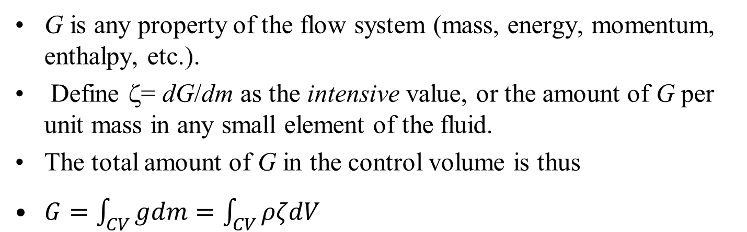
Engineering Mathematics of Reynolds Transport Theorem
$$\frac{DG\left(t\right)}{Dt}=\frac{∂}{∂t}\left\{\int_{V\left(t\right)}{g\left(\vec{x},t\right)dV}\right\}+\int_{s\left(t\right)}{g\left(\vec{x},t\right)\vec{v}.\hat{n}ds}$$
G is any property of the flow system (mass, energy, momentum, enthalpy, etc.).
Define ζ= dG/dm as the intensive value, or the amount of G per unit mass in any small element of the fluid.
The total amount of G in the control volume is thus
$G=\int_{CV}{gdm}=\int_{CV}{ρζdV}$
$$\frac{DG\left(t\right)}{Dt}=\frac{∂}{∂t}\left\{\int_{V\left(t\right)}{\left(ρζ\right)dV}\right\}+\int_{s\left(t\right)}{\left(ρζ\right)\vec{v}.\hat{n}ds}$$

Slide 32
Engineering Use of Reynolds Transformation
$$\frac{DG\left(t\right)}{Dt}=\frac{∂}{∂t}\left\{\int_{V\left(t\right)}{\left(ρζ\right)dV}\right\}+\int_{s\left(t\right)}{\left(ρζ\right)\vec{v}.\hat{n}ds}$$
This Equation is valid for any system boundary with time the dependent volume V(t) and surface s(t) at any time.
Also valid at the time t = t₀ , where the volume V = V_{C} and the surface s = s_{C}.
V_{C} and s_{C} are named as control volume and control surface.
These control surfaces can be inlets or outlets.

Slide 33
Application of RTT to A Natural CV
$$\frac{DG\left(t\right)}{Dt}=\frac{∂}{∂t}\left\{\int_{V\left(t\right)}{\left(ρζ\right)dV}\right\}+\int_{s\left(t\right)}{\left(ρζ\right)\vec{v}.\hat{n}ds}$$
$$\frac{DF\left(t\right)}{Dt}=\int_{V\left(t\right)}{\frac{∂f\left(\vec{x},t\right)}{∂t}dV}+\sum_{i=1}^{n}{\int_{s_{exit,i}\left(t\right)}{f\left(\vec{x},t\right)\left|\vec{v}.\hat{n}\right|ds}}−\sum_{j=1}^{m}{\int_{s_{inlet,j}\left(t\right)}{f\left(\vec{x},t\right)\left|\vec{v}.\hat{n}\right|ds}}$$

Slide 34
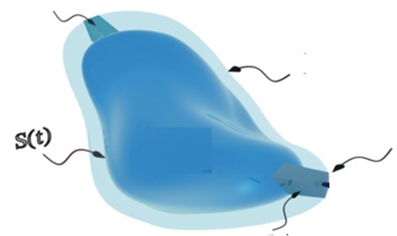
Engineering Use of Reynolds Transformation
$$\frac{DG\left(t\right)}{Dt}=\frac{∂}{∂t}\left\{\int_{V\left(t\right)}{\left(ρζ\right)dV}\right\}+\int_{s\left(t\right)}{\left(ρζ\right)\vec{v}.\hat{n}ds}$$
Inflow
$$S\left(t+∆t\right)$$
outflow

Slide 35
Vectorial Recognition of Inflow & Outflow
$$\frac{DG\left(t\right)}{Dt}=\frac{∂}{∂t}\left\{\int_{V\left(t\right)}{\left(ρζ\right)dV}\right\}+\int_{s\left(t\right)}{\left(ρζ\right)\vec{v}.\hat{n}ds}$$
$${\left[\vec{v}.\hat{n}ds\right]}_{inlet}={\vec{v}}_{inlet}∙{d\vec{A}}_{inlet}$$
$${\vec{A}}_{inlet}$$
$${\vec{v}}_{inlet}$$
Inflow
$$S\left(t+∆t\right)$$
outflow
$${\vec{v}}_{outlet}$$
$${\vec{A}}_{outlet}$$
$${\left[\vec{v}.\hat{n}ds\right]}_{outlet}={\vec{v}}_{outlet}∙{d\vec{A}}_{outlet}$$

