Slide 1


Flow Condensation Heat Transfer
P M V Subbarao
Professor
Mechanical Engineering Department
I I T Delhi
Nusselt’s Popular Contribution to Convection Heat Transfer …

Slide 2

Basics of Flow Condensation
Forced flow internal condensation is a recurrent process in machines working with thermodynamic cycles such as Rankine and refrigeration vapor cycles, closed-loop thermosyphons, and heat pipes.
The condensers employed in these applications are usually the largest component of the systems, presenting a direct impact on the cost and performance of these machines.
Their primary size is determined by the global heat transfer coefficient, which strongly depends on the forced flow internal condensation heat transfer coefficient (HTC).
Therefore, improvements on internal flow condensation HTC have a critical impact on the size and effectivity of a condenser.

Slide 3
Basics of Flow Condensation
Flow condensation is a two-phase heat transfer mechanism where vapor, flowing within a channel, transitions into a liquid phase upon contact with a colder surface.
It is widely used in high-efficiency thermal management systems, such as air conditioning, refrigeration, and electronics cooling, to remove heat.
The heat is removed by flow of vapor past a cold surface (mostly the tube wall).
The condensed liquid then flows off the surface under the influence of gravity, collects, and flows out of the CV.
In some cases, vapor flow rates may be high enough to sweep the liquid off the tubes.
This is called vapor shear and is a concern when liquid is condensing inside a tube.

Slide 4
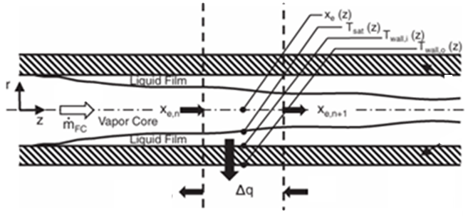
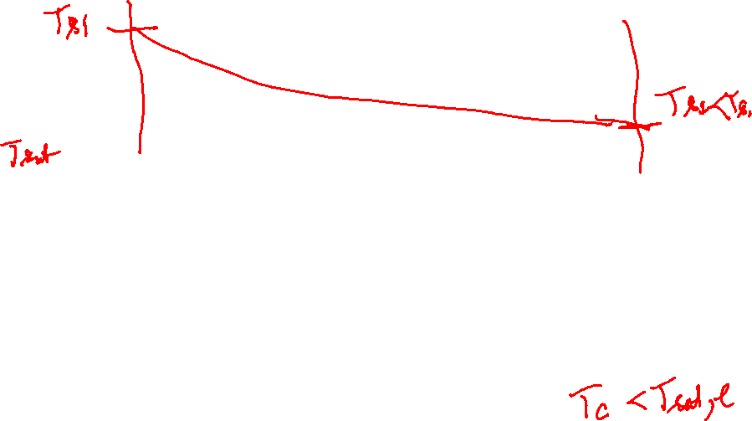
Key features of Flow Condensation System
Saturated Vapor
Liquid Coolant

Slide 5
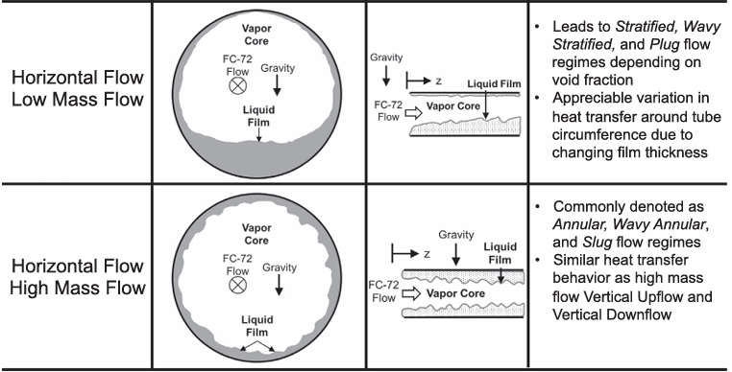
Key features of condensate liquid film distribution

Slide 6
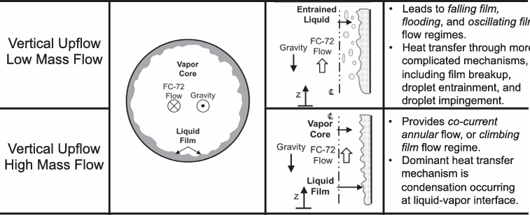
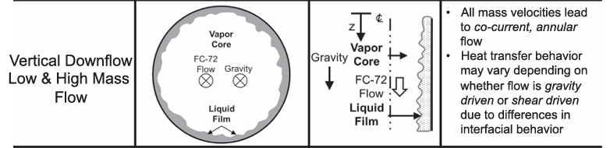
Key features of condensate liquid film distribution

Slide 7
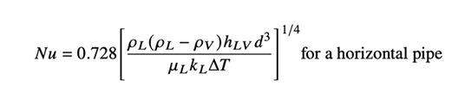

Key features of condensate liquid film distribution
The hydrodynamic group in the law was expressed in an unconventional manner.
This reflects the underlying dominant role of the vapour velocity.
The vapour velocity was commonly acknowledged as the governing parameter controlling the heat transfer process.

Slide 8
Salient Features of Condensation
Under similar conditions, horizontal tubes tend to have larger condensing heat transfer coefficients than vertical tubes.
Vertical tubes are preferred when substantial subcooling of the condensate is required.
In calculations, it is common to assume the vapor-liquid interface is at thermodynamic equilibrium at the vapor temperature.
Liquid adjacent to the cold surface is assumed to be at the surface temperature.
It is also common to treat condensers as constant pressure systems, since the total friction losses through an exchanger are usually small.

Slide 9
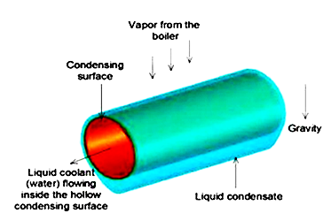
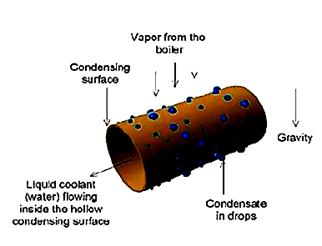
Condensation Mechanisms
There are two main mechanisms of condensation:
Film Condensation
Dropwise Condensation
Vapor
Vapor

Slide 10
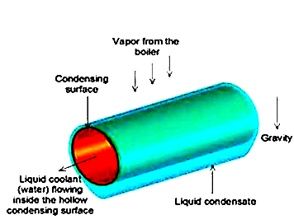
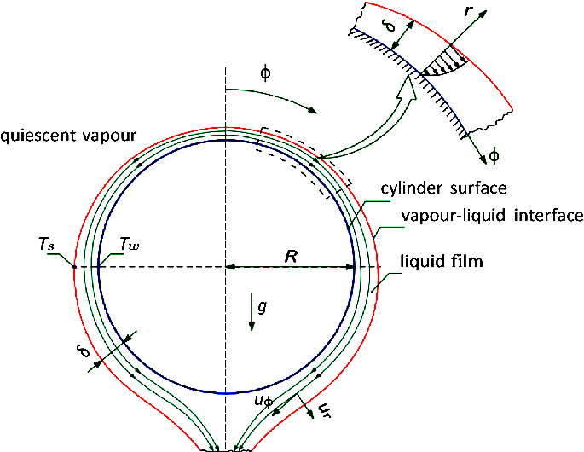
Film Condensation
Film Condensation:
  The condensate "wets" the surface, a film forms as the drops coalesce.
  The condensate forms a continuous layer that flows over the tube (gravity flow) in film type condensation.
  The primary heat transfer resistance is in the film.
Vapor

Slide 11
Dropwise Condensation
Dropwise Condensation:
  The condensate does not wet the surface, drops form at nucleation sites (pits, dust, etc.) and remain separated until carried away by gravity or vapor flow.
  Drops coalesce prior to falling off the tube.
Vapor

Slide 12
Onset of Condensation
In both film and drop-wise condensation mechanism, nucleation is typically the rate limiting step, rather than heat transfer.
Most industrial applications are based on film mechanisms, since it is tricky and expensive to build non-wetting surfaces.
After condensation, the liquid flows down the tube surface under the influence of gravity (unless vapor rates are high enough to produce vapor shear).
The flow may be laminar or turbulent, depending on the fluid, rate of condensation, tube size, etc.
The film tends to thicken as it flows to the bottom of the tube, and the weight of the fluid may cause ripples to form.
These will cause deviations from pure laminar flow.

Slide 13
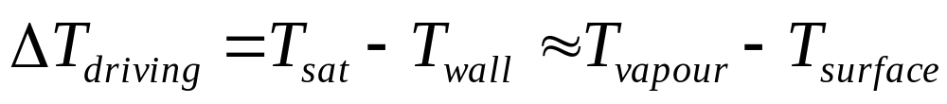
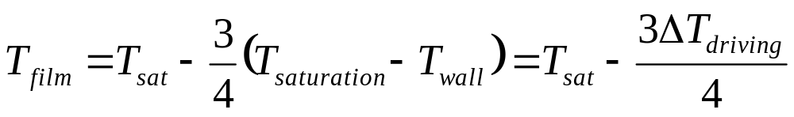
Conditions Required for Condensation
The driving force for condensation is the temperature difference between the cold wall surface and the bulk temperature of the saturated vapor
The viscosity and most other properties used in the condensing correlations are to be evaluated at the film temperature, a weighted mean of the cold surface (wall) temperature and the (hot) vapor saturation temperature

Slide 14
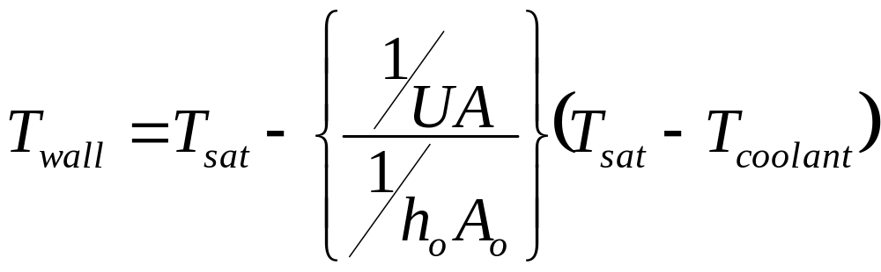
Computation of Wall Temperatures
It is often necessary to calculate the wall temperature by an iterative approach.
The summarized procedure is:
Assume a film temperature, T_{f}
Evaluate the fluid properties (viscosity, density, etc.) at this temperature
Use the properties to calculate a condensing heat transfer coefficient.
Calculate the wall temperature. The relationship will typically be something like

Slide 15
Computation of Wall Temperatures
5. Use the wall temperature to calculate a film temperature
Compare the calculated film temperature to that from the initial step.
If not equal, reevaluate the properties and repeat.

Slide 16
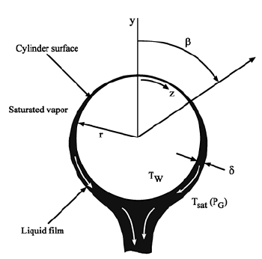
The Laminar film Condensation on a Single Horizontal Tube
The problem of condensation was first attempted by Nusselt.
This method is called as Nusselt integral approach to laminar film condensation.
Condensation on the outside of horizontal tube bundles is often used for shell-and-tube heat exchanger applications and the first step is the analysis of a single tube.
The flow is nearly always laminar on a single tube because of the short cooling length around the perimeter.

Slide 17
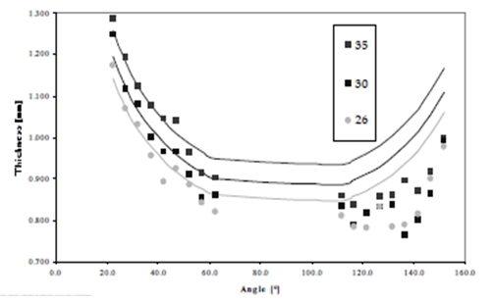

Distribution of Film Thickness
$$∆T_{driving}$$

Slide 18
Condensate Loading on A Tube
The condensate loading on a tube is the mass flow of condensate per unit length that must be traversed by the draining fluid.
The length dimension is perpendicular to the direction the condensate flows;
the perimeter for vertical tubes,
the length for horizontal tubes.

Slide 19
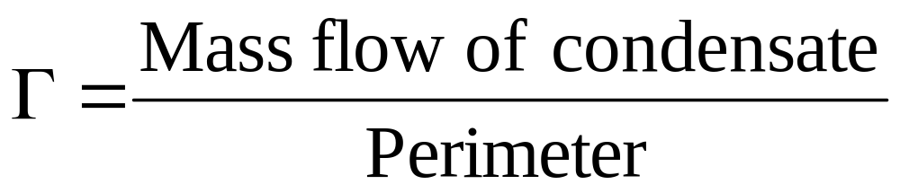
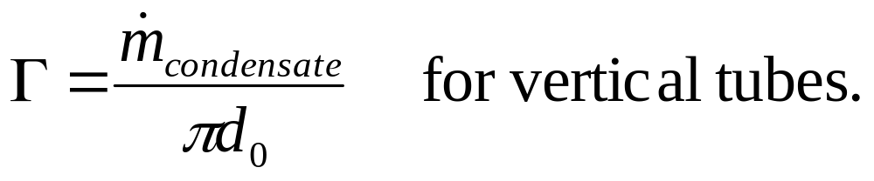
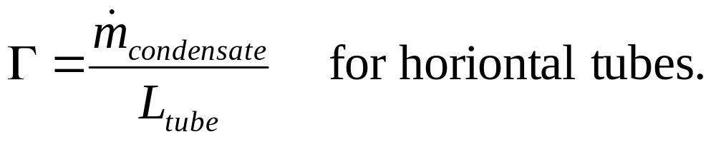
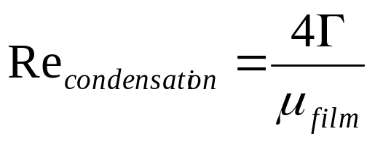
Condensate Loading
General values of condensate loading for horizontal tubes:
0.01 to 0.1 kg/m.s
This can be used to calculate a Reynolds number

Slide 20
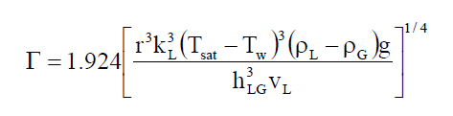

Rate of Condensation

Slide 21
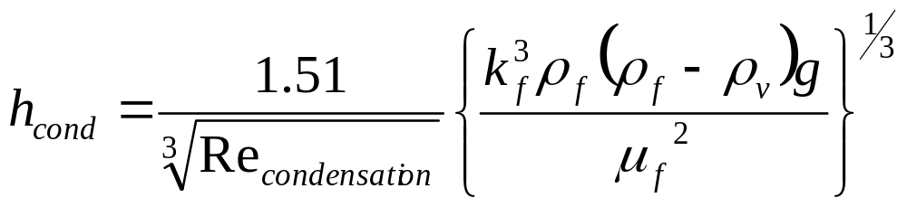
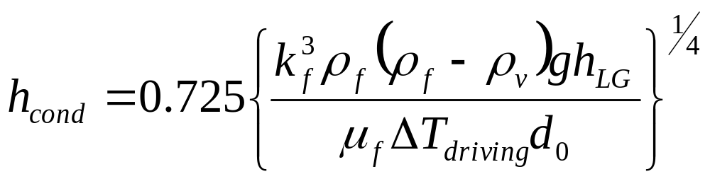
Laminar Flow Outside Horizontal Tubes
When vapor condenses on the surface of horizontal tubes, the flow is almost always laminar.
The flow path is too short for turbulence to develop. Again, there are two forms of the same relationship:
The constant in the second form varies from 0.725 to 0.729.
The rippling condition (add 20%) is suggested for condensate Reynolds Numbers greater than 40.

Slide 22
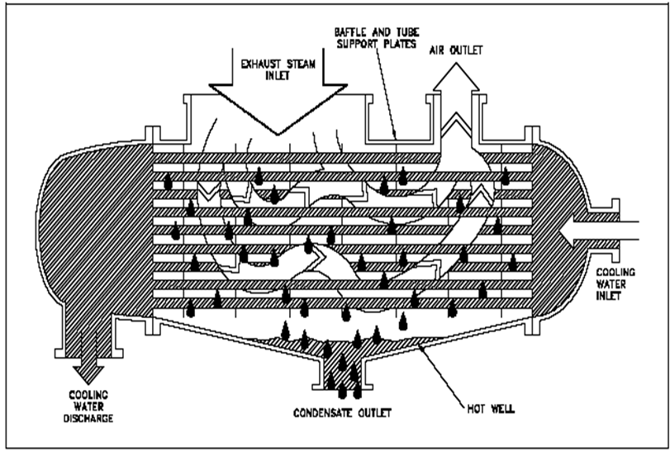
Popular Industrial Condensers

Slide 23
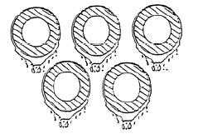
Condensation on Horizontal Tube Bundles
Condensation on tube bundles raises several important considerations:
In what manner does the condensate flow from one tube to the next?
Is subcooling of the film important?
Is the influence of vapor shear significant and, if so, how can this be accounted for?
At which point does the film go through the transition from laminar to turbulent flow?
Laminar films are formed on tubes in the first row,

Slide 24
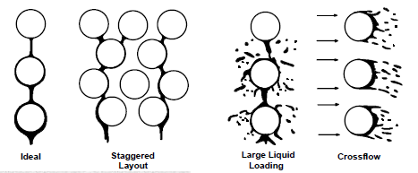
Structure of Condensate during Condensation on Tube Bundle

Slide 25
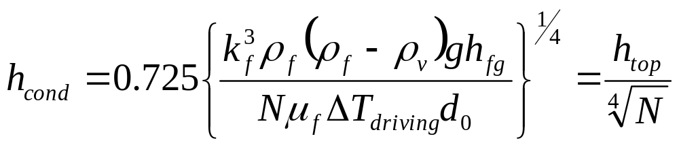
Correction for Structural Variation in Condensation on Tube Bundle
Condenser tubes are typically arranged in banks, so that the condensate which falls off one tube will typically fall onto a tube below.
The bottom tubes in a stack thus have thicker liquid films and consequently poorer heat transfer.
The correlation is adjusted by a factor for the number of tubes, becoming for the N^{th} tube in the stack

Slide 26
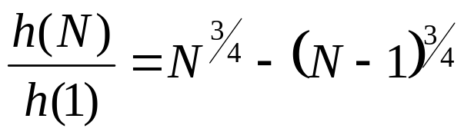
The heat transfer coefficient on the N^{th} tube row
The heat transfer coefficient on the N^{th} tube row in the bundle h(N) is
Kern (1958) concluded from his practice experience in designing condensers that the Nusselt tube row expression was too conservative and that this resulted in condensers that were consistently over-surfaced.
To improve his thermal designs, he replaced the exponent of (-1/4) in the Nusselt expression with a value of (-1/6).

Slide 27
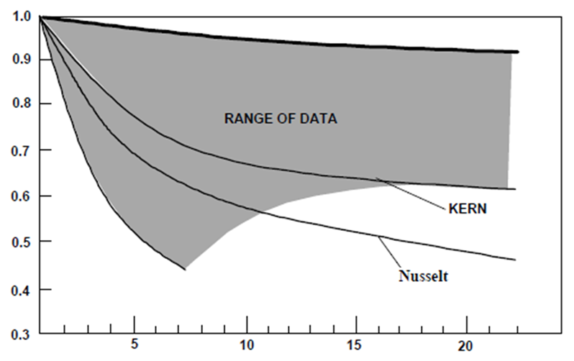
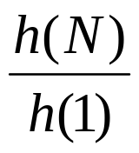
Condensation on Horizontal Bundles: Prediction of Heat Transfer Coefficient in Nth Tube Row
N

Slide 28
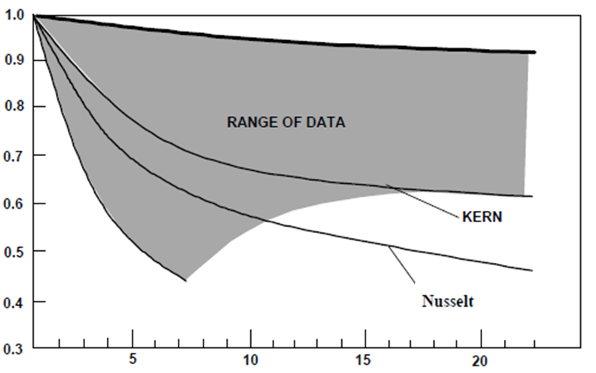
Condensation on Horizontal Bundles: Prediction of Heat Transfer Coefficient in Nth Tube Row
N

Slide 29
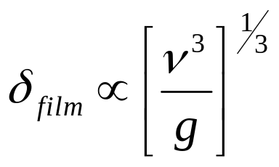
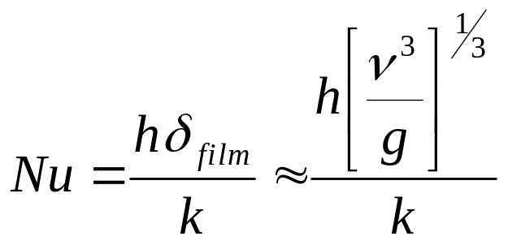
The true characteristic Dimension
The film thickness is the true characteristic dimension:
Nusselt Number,

Slide 30
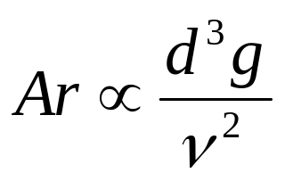
Ripples & Waves
Experimental results showed a positive difference when compared to Nusselt theory.
This positive difference was attributed to interfacial instability and occurrence of ripples in film.
The ripples enhances the surface area and lowers the film thickness.
The effect of ripples are accounted in the Nusselt number through a new number called Archimedes number.
Archimedes Number,

Slide 31



Final Correlations for Condensation Heat Transfer
For the Sheet Mode
For the Jet Mode
For the Drop Mode

Slide 32
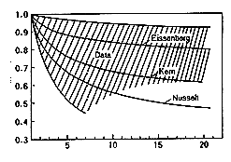
Condensation on Horizontal Bundles: Prediction of Heat Transfer Coefficient in Nth Tube Row
N

Slide 33
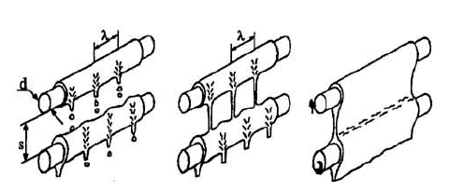
Modes of Condensation on Tube Bundle
The droplet mode
The jet mode
The sheet mode

Slide 34
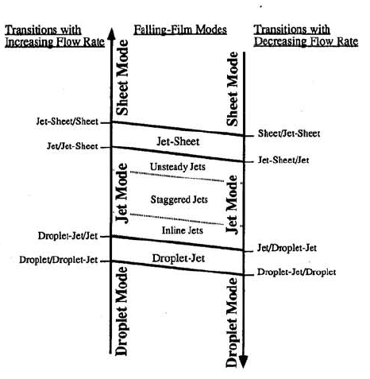
Flow Rate Vs Mode of Falling Film

Slide 35
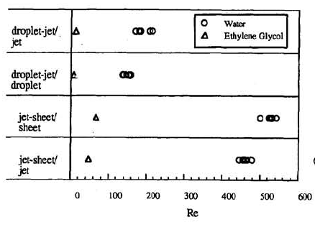
Identification of flow Regimes

Slide 36
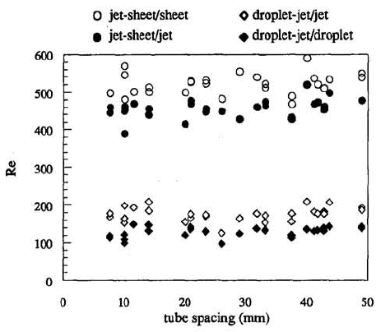
Identification of flow Regimes

Slide 37

Condensation on Horizontal Tube Bundles : Flow Map
Hu and Jacobi (1996) proposed flow mode transition equations with Re_{Γ} versus Ga+ (film Reynolds number vs the Galileo number)
Following principal flow modes were defined : sheet flow, column flow and droplet flow.
The mixed mode transition zones of column-sheet and droplet-column were also considered as regimes, bringing the total to five.

Slide 38
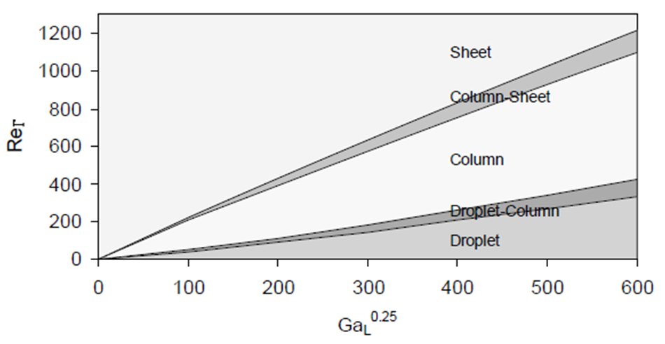
Flow Transition Map

Slide 39
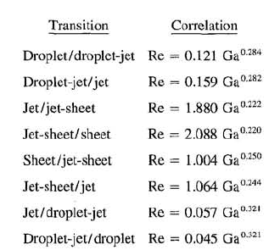
Identification Condensation Mode
https://www.thermopedia.com/content/1210/

Slide 40
Onset of Turbulence & Turbulent Film Condensation
The transition film Reynolds number for the tube bundle is adapted from a vertical plate turbulent transition criterion of 1600 (but also values of 1200, 1800 and 2000 have been proposed).
Thus, the film will become turbulent on the tube bundle at Re_{Γ} equal to 1600 and thus when Re_{Γ} > 1600 the following expression should be used.

Slide 41

Condensation on Horizontal Tube Bundles : Turbulent Flow
Turbulent flow of the condensate film may be reached in a condenser, which significantly increases heat transfer.
Comparatively little has been published on turbulent film condensation on tube bundles compared to the information available for laminar films.
Butterworth (1983) recommends adapting the Labuntsov expression for turbulent film condensation on a horizontal tubes for predicting local turbulent film condensation on the N^{th} tube row in horizontal tube bundles
h

