Slide 1
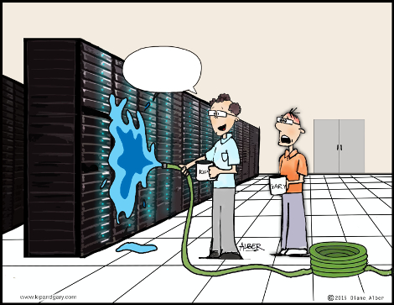

Two Phase Convection Heat Transfer &
Cooling Systems for High Speed Electronic Devices
P M V Subbarao
Professor
Mechanical Engineering Department
I I T Delhi
Unleashing Maximum Heat Transfer for Next-Gen Digital Industry….…..

Slide 2

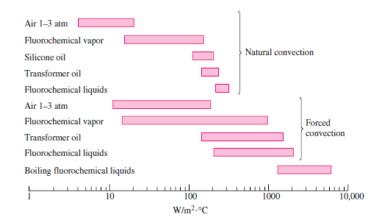
Dielectric Fluids & Typical heat transfer coefficients
Convection Systems for Future

Slide 3
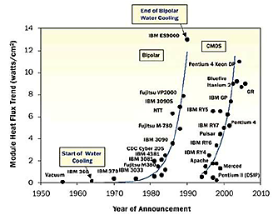
Heat Flux Generated by High End Computing Processors

Slide 4

Heat Flux Generated by High End Computing Processors
Training algorithms for artificially intelligent applications requires large amounts of processing powers.
Dense GPU processors are deployed for this applications.
A large number of high powered GPU produce high heat.
Two phase cooling is most cost efficient and eco-friendly cooling solution.

Slide 5
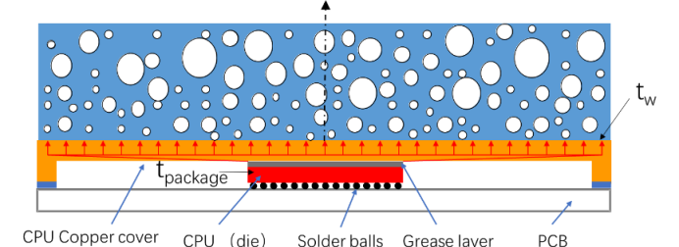
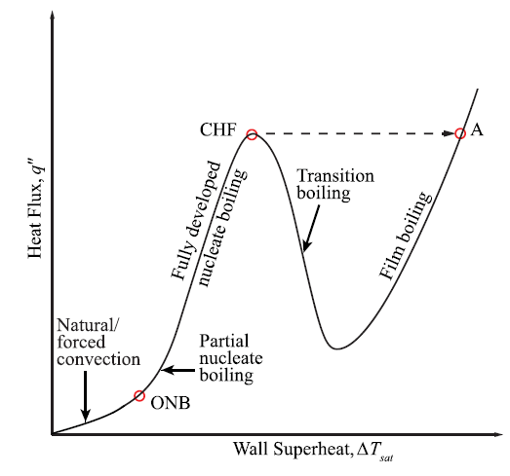
Direct Cooling by Boiling Process : A Self Regulated Cooling Mechanism

Slide 6
Direct Cooling by Boiling Process : A Self Regulated Cooling Mechanism
Boiling processes can be divided into;
  Pool boiling
  External flow boiling
  Hybrid configurations with their combinations
The Pool Boiling (PB) is the simplest scheme among the above-mentioned boiling configurations.
PB has significant benefit of so-called passive cooling without requiring pumping power or moving parts in the system.

Slide 7

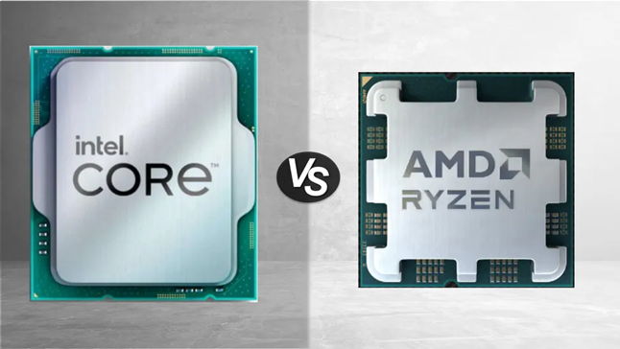
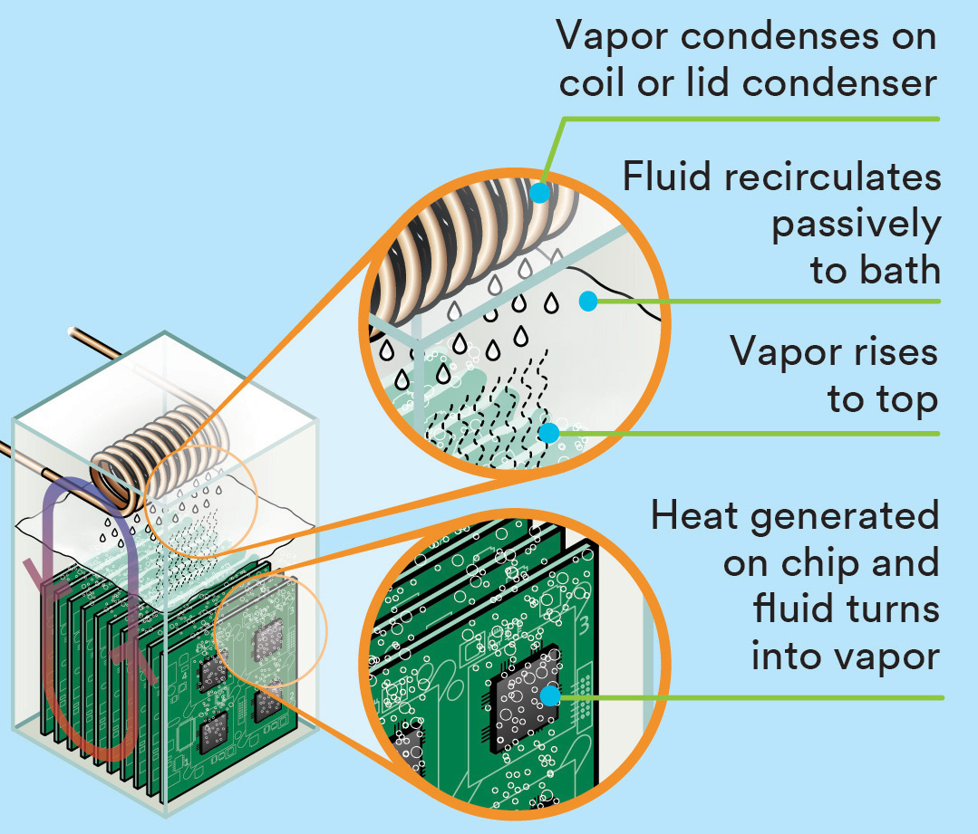
Two-phase Immersion Cooling Cycle of Gigabyte Servers

Slide 8
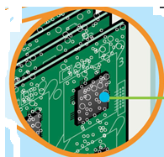
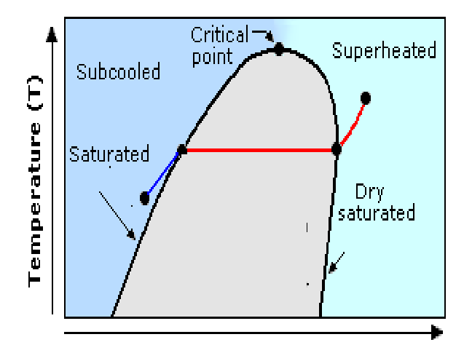


Case Temperature vs Coolant Pressure
Select fluid at a given pressure in a tank
Liquid
Liquid
Liquid
SaturaredLiquid + Vapour
vapour
Single phase cooling conditions:
Coolant can take a heat of mcΔT.
Ex: 1gm of water with 10 °C raise in temperature can carry a heat of 42J.
Internal Energy, kJ

Slide 9

Case Temperature vs Coolant Pressure
Liquid
Liquid
Liquid
SaturaredLiquid + Vapour
vapour
Two phase cooling may be possible.
Coolant can take a heat of mu_{fg}.
Ex: 1gm of water becoming steam can carry a heat of ∼ 2500J.
Boiling coolant can develop compact and efficient cooling systems.
Internal Energy, kJ

Slide 10


Basic Definitions for Boiling Heat Transfer Process
Liquid
Liquid
Liquid
SaturaredLiquid + Vapour
vapour
Initial studies showed that heat flux (q”) plays an important role along wall superheat in boiling process.
Internal Energy, kJ

Slide 11
Boiling Curve &Modes of Boiling

Slide 12
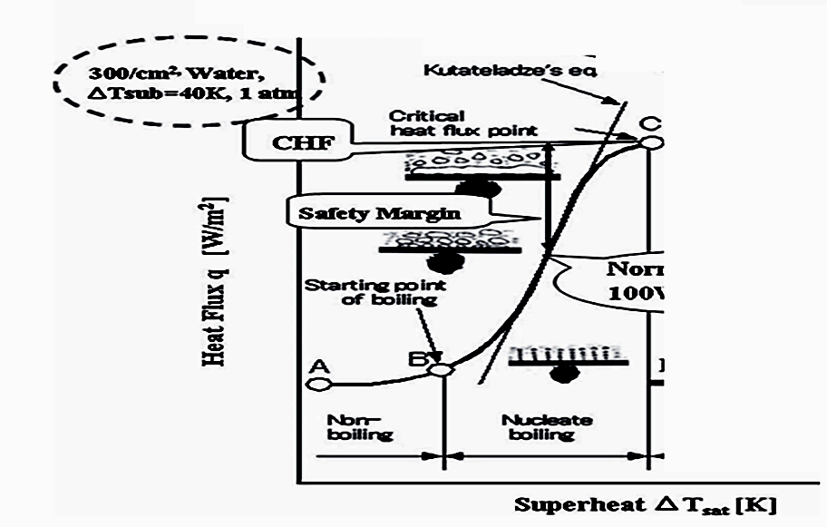
Two Phase Cooling Below Critical Heat Flux

Slide 13
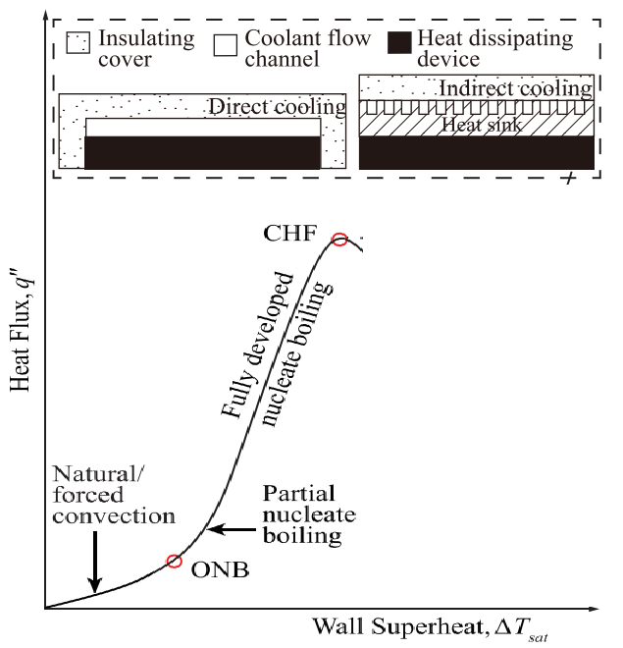

Heat Sinks to Maintain Safe Margin
$$Safe Margin$$

Slide 14
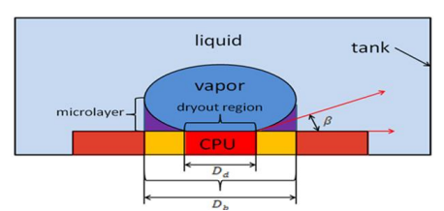
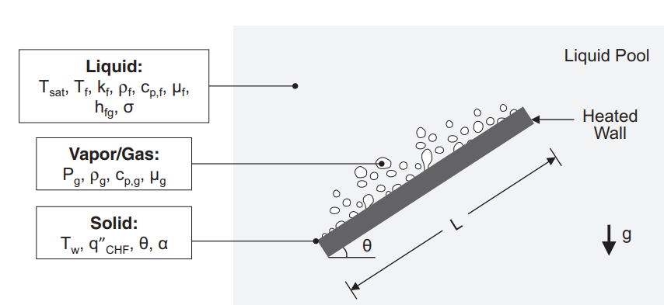
Nucleate Pool Boiling: Bubble Dynamics

Slide 15
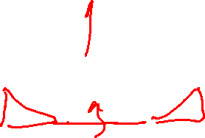

Bubble growth on CPU Direct-Cooling
The process of liquid nucleate boiling includes three basic heat transfer episodes:

Slide 16
Episode 1: Immediately after Departure of Bubble
The departure of bubble from the CPU wall leads to occurrence of the unsteady heat transfer process between the liquid and the heating surface (CPU wall).
The lower temperature liquid enters the heating surface and the nearby space is occupied by the original bubble.
This new liquid will be in direct contact with the heating surface for a period of time.
∴ A heat flux q”_{re} is required for reconstruction of the thermal boundary layer just after the bubble breaks away.
The duration of occurrence of this heat flux is named as the waiting time before the bubble starts to grow.

Slide 17
Episode 2
This episode starts with initiation of bubble growth.
A thin layer of liquid at the bottom of the bubble absorbs heat from the heating surface and vaporizes when the bubble grows.
The evaporation heat flux q”_{me} is provided to the growth of the vapor bubble through heat conduction of the liquid microlayer.
The growth time from the beginning of the bubble growth to when it leaves will have evaporation heat flux.

Slide 18
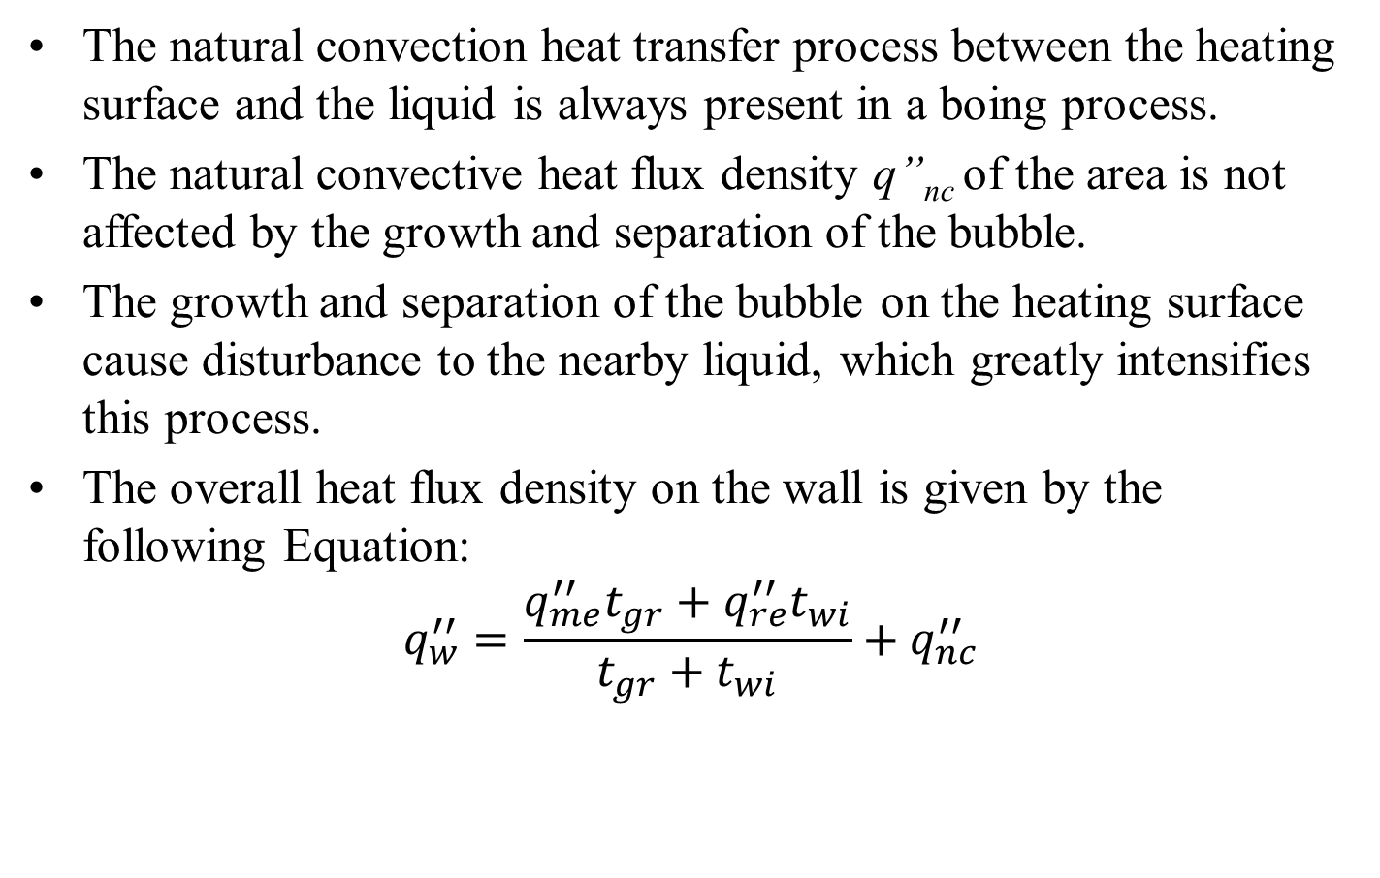
Episode 3
The natural convection heat transfer process between the heating surface and the liquid is always present in a boing process.
The natural convective heat flux density q”_{nc} of the area is not affected by the growth and separation of the bubble.
The growth and separation of the bubble on the heating surface cause disturbance to the nearby liquid, which greatly intensifies this process.
The overall heat flux density on the wall is given by the following Equation:
$$q_{w}^{′′}=\frac{q_{me}^{′′}t_{gr}+q_{re}^{′′}t_{wi}}{t_{gr}+t_{wi}}+q_{nc}^{′′}$$

Slide 19
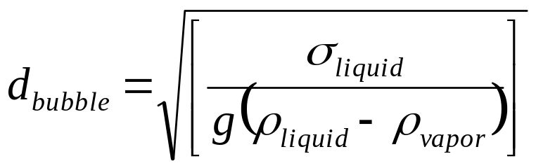
Nucleate Pool Boiling: Bubble Diameter
The average diameter of bubble departing from hot surface of a processor is:

Slide 20
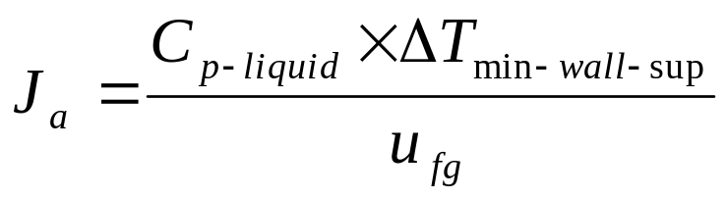
Nucleate Pool Boiling: Minimum Wall Superheat
The minimum degree of superheat required to nucleate pool boiling depends on a non-dimensional number known as Jacob Number

Slide 21
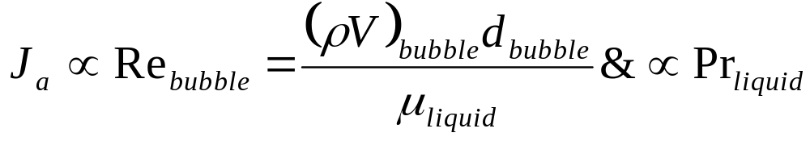
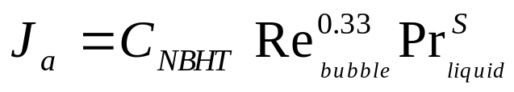
Models for Nucleate Pool Boiling
Jacob Number is function of Reynolds and Prandtl numbers
The value of s varies in the range 1 – 1.7.
C_{NBHT} is to be determined for every case.

Slide 22
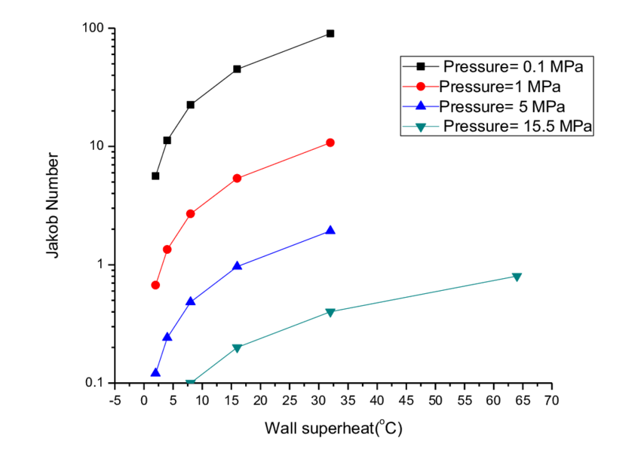
Nucleate Pool Boiling: Minimum Wall Superheat

Slide 23
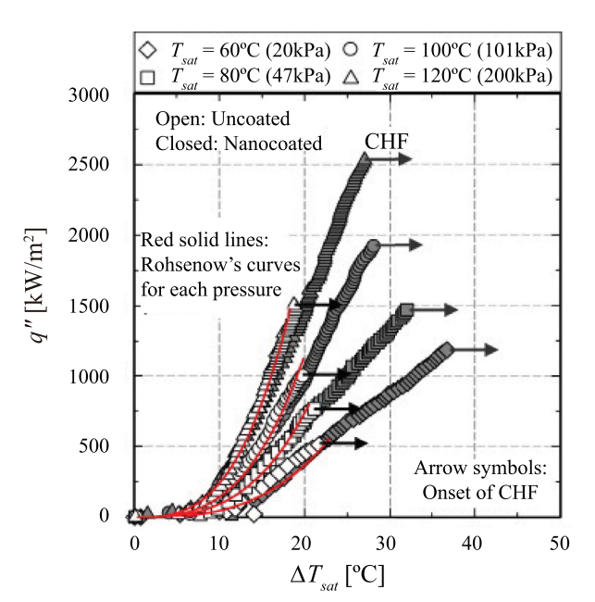

Nucleate Pool Boiling : Selection of Pressure

Slide 24
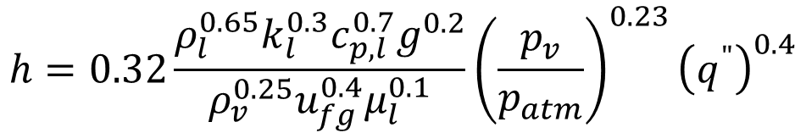
Correlations for Heat Transfer Coefficient
Considering its complexity, there is no widely accepted analytical equation for boiling heat transfer at present.
In order to meet the needs of engineering, many researchers use a large number of experimental data to obtain many boiling heat transfer equations.
Three boiling heat transfer equations have been considered as more useful here:
Shiraishi Correlation
$$h=0.32\frac{ρ_{l}^{0.65}k_{l}^{0.3}c_{p,l}^{0.7}g^{0.2}}{ρ_{v}^{0.25}u_{fg}^{0.4}μ_{l}^{0.1}}{\left(\frac{p_{v}}{p_{atm}}\right)}^{0.23}{\left(q^{"}\right)}^{0.4}$$

Slide 25
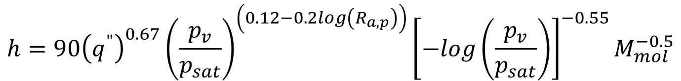
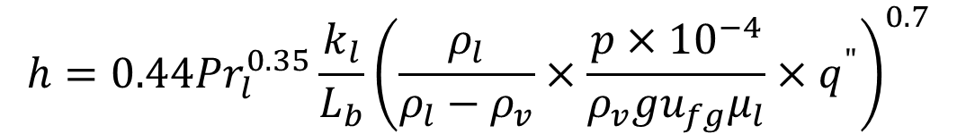
Correlations for Heat Transfer Coefficient
Cooper Correlation
$$h=90{\left(q^{"}\right)}^{0.67}{\left(\frac{p_{v}}{p_{sat}}\right)}^{\left(0.12−0.2log\left(R_{a,p}\right)\right)}{\left[−log\left(\frac{p_{v}}{p_{sat}}\right)\right]}^{−0.55}M_{mol}^{−0.5}$$
Kutateladze Correlation
$$h=0.44{Pr}_{l}^{0.35}\frac{k_{l}}{L_{b}}{\left(\frac{ρ_{l}}{ρ_{l}−ρ_{v}}×\frac{p×{10}^{−4}}{ρ_{v}gu_{fg}μ_{l}}×q^{"}\right)}^{0.7}$$

Slide 26
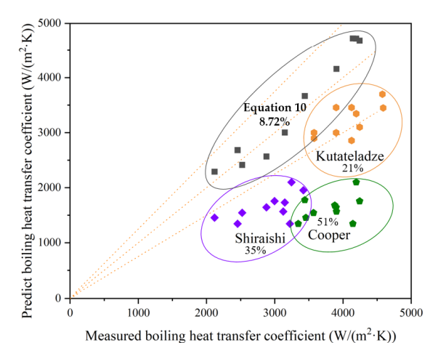
Predicted & Measured Heat Transfer Coefficient

Slide 27
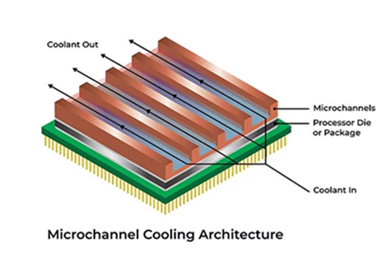
Microchannel Lid Cold Plate（MLCP）
MLCP is a key technology for high-power chip cooling.
It integrates the traditional chip lid and liquid cold plate into a single component.
Facilitates the coolant to flow directly over the chip through micro-scale channels (30–150 microns).

Slide 28
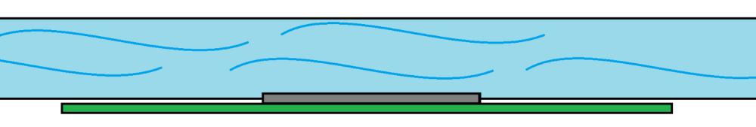
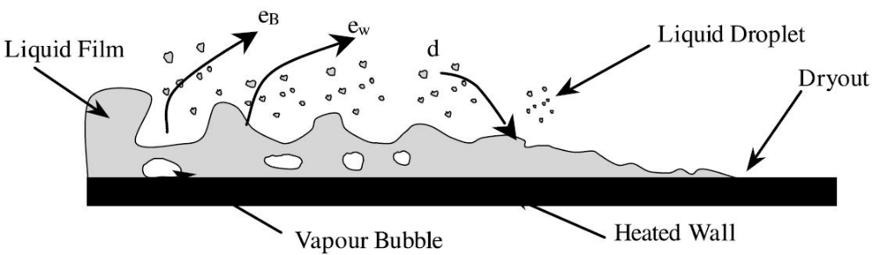
Flow Boiling Process
Flow boiling occurs when all the phases are in bulk flow together in a channel.
The flow boiling is characterized by the forced convective flow over a surface induced by the external force, e.g. a pump.

Slide 29
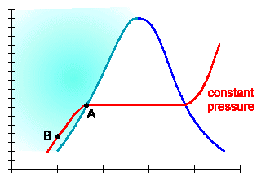
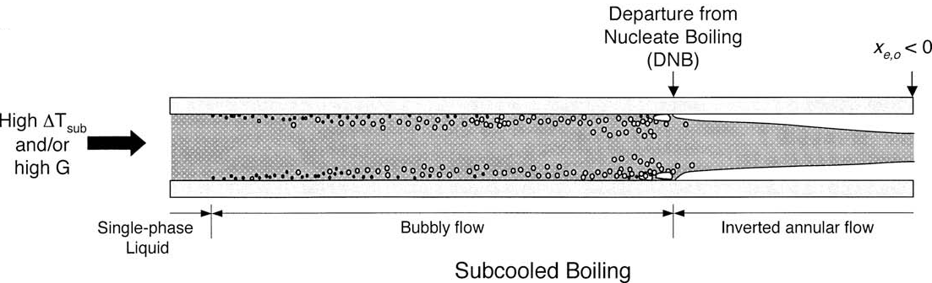
CHF mechanisms for flow boiling in uniformly heated channel: Subcooled Liquid
T, °C
Specific Enhalpy, h (kJ/kg)

Slide 30
Micro-Channel versus Macro-Channel Flow Boiling
Pipe diameters of 100–600 μm is classified as micro-channels.
Distinguishing between macro- and micro-channel flows cannot be based on channel size alone.
A channel may behave as a micro-channel for certain fluids and operating conditions and as a macro-channel for others.
For two-phase flow, this boundary is closely related to the ratio of bubble size to channel diameter,
The larger the ratio, the more likely that the flow will behave as a micro-channel flow.
This ratio is known as Confinement number.

Slide 31
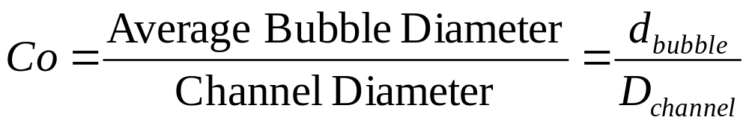
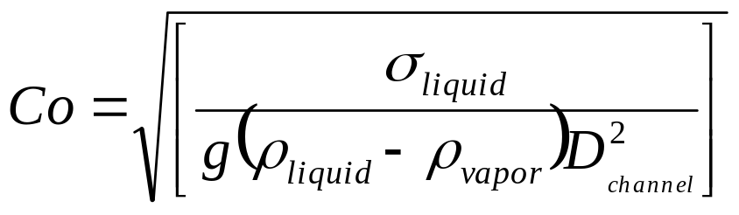
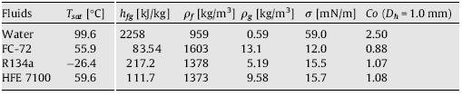
Micro-Channel Flow Boiling : Confinement Number
Confinement number, Co

Slide 32
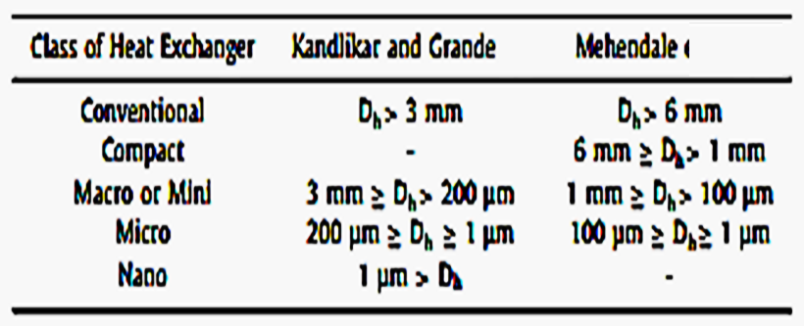
Classification of heat exchanger for different hydraulic diameters

Slide 33
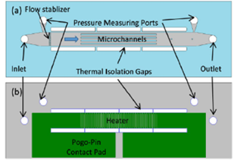
The microchannel Flow Boiling Device
Microchannel test section assembly contains a copper housing with inlet and outlet plenum, test chip and pressure transducers and thermocouples at inlet and outlet of the test chip..

Slide 34
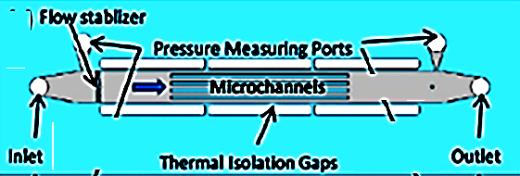
The microchannel Flow Boiling Device
Microchannel test chip:
Five parallel straight microchannels.
Each channel dimension is width, w: 220 μm × height, H: 250 μm × length, L: 10 mm. described in our previous study27.

Slide 35
The microchannel Flow Boiling Device
The microchannel test chip is made from a silicon wafer bonded to a Pyrex wafer by a standard microfabrication process.

Slide 36
The microchannel Flow Boiling Device
A resistor, which serves as both a micro heater to generate heat flux and a thermistor to measure the wall temperature, is deposited onto the back side of the silicon chip.

Slide 37
The microchannel Flow Boiling Device
The heating area (length, L: 10 mm × width, W: 2 mm) is identical to the total base area of microchannel arrays.

Slide 38
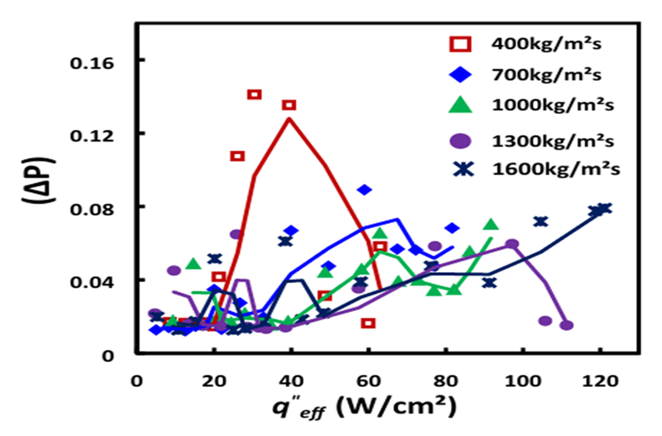
Fluid Dynamics of Flow Boiling

Slide 39
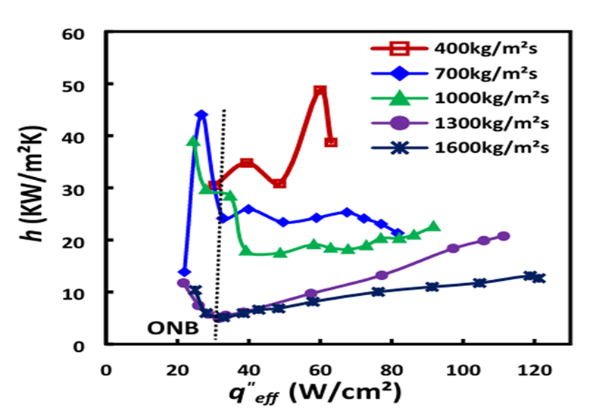
Convection Heat Transfer in Flow Boiling

Slide 40
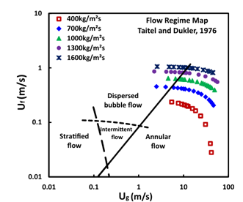
Ullmann–Brauner Flow Regime Map

Slide 41
Flow Pattern Transition in A microchannel Flow Boiling Device
To understand the flow pattern transition and flow regime development in flow boiling microchannels.
A series of high-speed visualization studies were employed from the top of microchannels.
Dielectric fluid HFE-7100 was adopted as the coolant.
Frame rate ranges between 4000 and 70,000 fps.
Mass flux, 400 kg/m²s and heat flux, 30 W/cm².
First Step is to witness the flow Regimes.

Slide 42
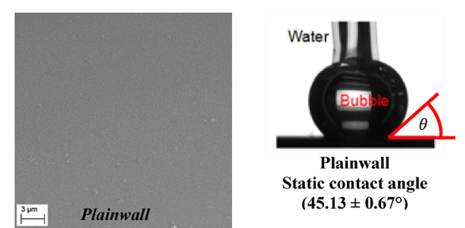
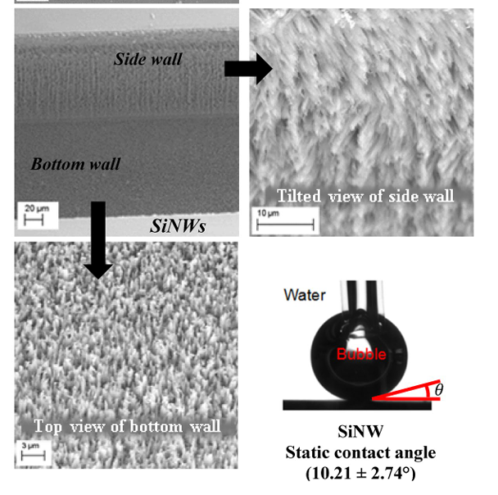
Flow Pattern Transition in A microchannel Flow Boiling Device

Slide 43
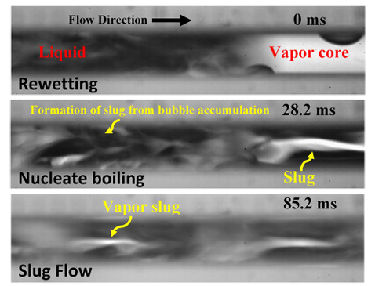
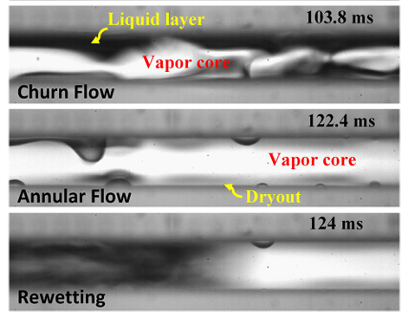
Flow Pattern Transition in A microchannel Flow Boiling Device
Mass flux, 400 kg/m²s
Heat f lux, 30 W/cm²

Slide 44
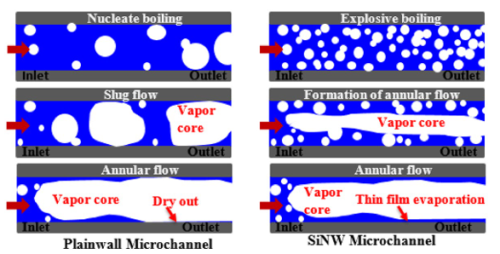
Flow Pattern Transition in A microchannel Flow Boiling Device

Slide 45
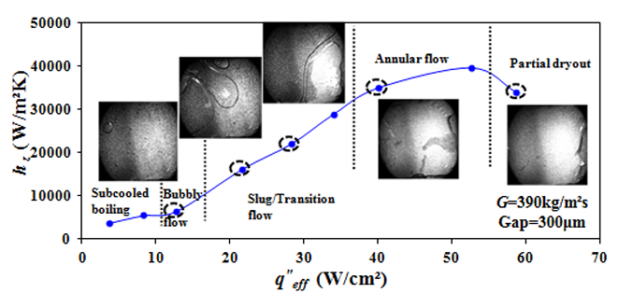
Flow Boiling Maps

Slide 46
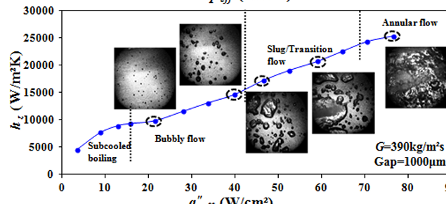
Flow Boiling Maps

Slide 47
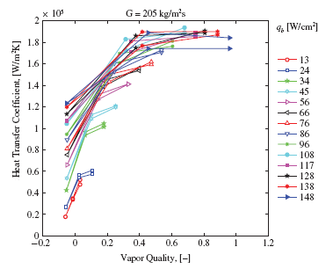
Heat transfer coefficient Vs local vapor quality

Slide 48
Micro-Channel Flow Boiling :Bond Number
Bond number is defined as the ratio of buoyancy force to surface tension force
B$o=\left[\frac{{g\left(ρ_{liquid}−ρ_{vapor}\right)D_{channel}^{2} }_{}}{σ}\right]$
Reynolds number, Re
Re$=\frac{\frac{\dot{m}}{A}{ × D}_{channel}}{μ_{liquid}}$

Slide 49
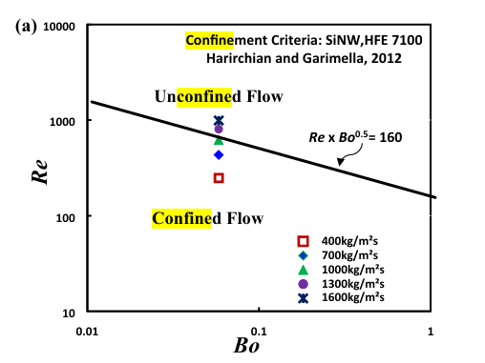
Vapor confinement criteria

Slide 50
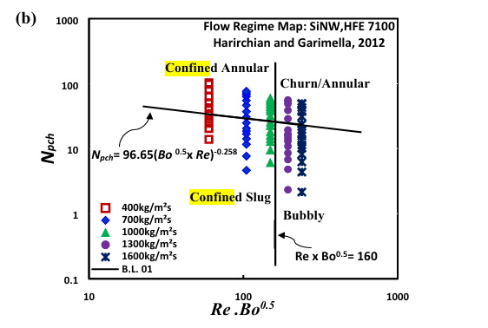
Regime of Vapor confinement

Slide 51
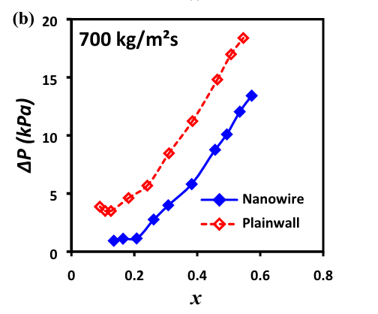
Stable Flow Boiling of Confined Flow

Slide 52

Stable Nature of Confined Flow

Slide 53

Classification of heat exchanger for different hydraulic diameters

Slide 54

Correlation for CHF
CHF correlations are based on either inlet (upstream) channel conditions or outlet (local) conditions.
Pressure, mass velocity and diameter appear in both types of correlations.
However, the effect of inlet quality in inlet conditions correlations is expressed in terms of inlet enthalpy (or inlet subcooling or quality).
These correlations also account for quality variations along the channel through their dependence on channel length

Slide 55


Slide 56

Surface Roughness for Enhanced Heat Transfer
G = 85kg/m², Dryness Fraction, x_{exit} = 0.3

Slide 57

Surface Roughness for Enhanced Heat Transfer
G = 85kg/m², Dryness Fraction, x_{exit} = 0.5

Slide 58

Surface Roughness for Enhanced Heat Transfer
G = 85kg/m², Dryness Fraction, x_{exit} = 0.8

Slide 59

Surface Wettability for Enhanced Heat Transfer

