Slide 1

Flow Boiling Heat Transfer
P M V Subbarao
Professor
Mechanical Engineering Department
I I T Delhi
Means to Generate Bountiful State of A Fluid…

Slide 2

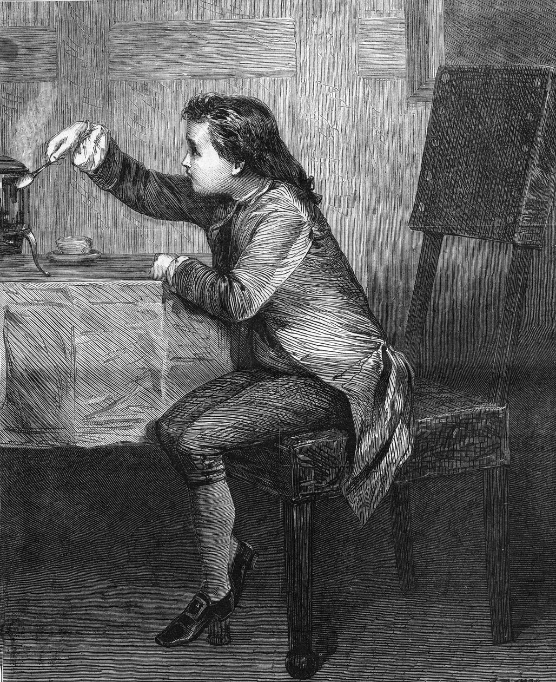
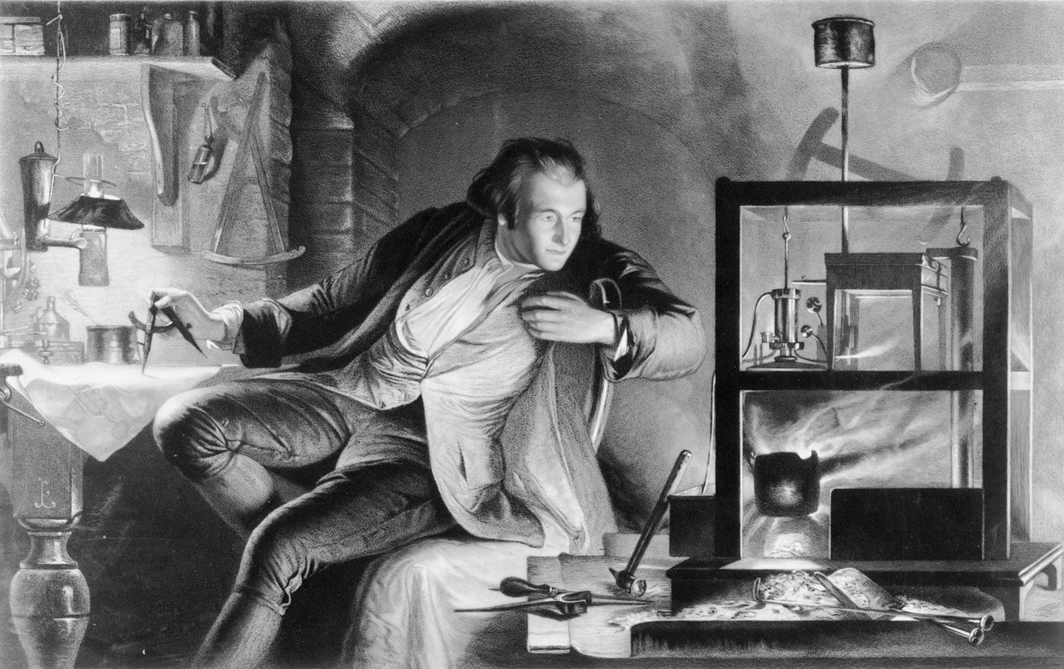
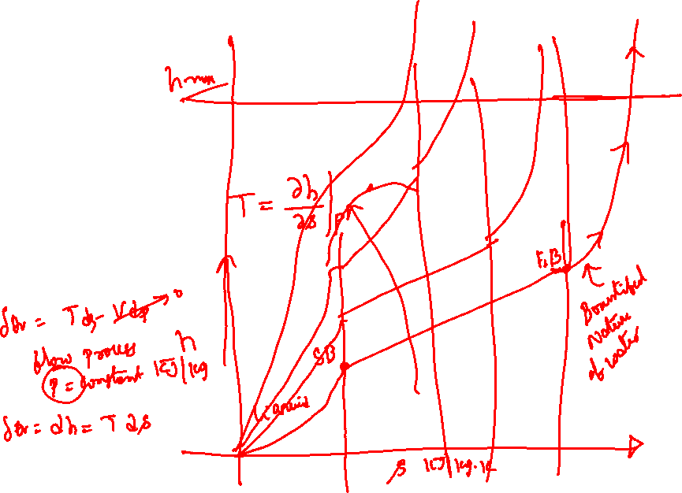
Bountifulness By the Curious James Watt

Slide 3
The Theory of Producing Steam
Water boils and evaporates at 100°C under atmospheric pressure.
By higher pressure, water evaporates at higher temperature - e.g. a pressure of 10 bar equals an evaporation temperature of 184°C.
During the evaporation process, pressure and temperature are constant, and a substantial amount of thermal energy is used for bringing the water from liquid to vapour phase.
When all the water is evaporated, the steam is called dry saturated.
In this condition the steam contains a large amount of latent heat.
Further heating of dry saturated steam will lead to increase in temperature of the steam.
Superheated steam.

Slide 4
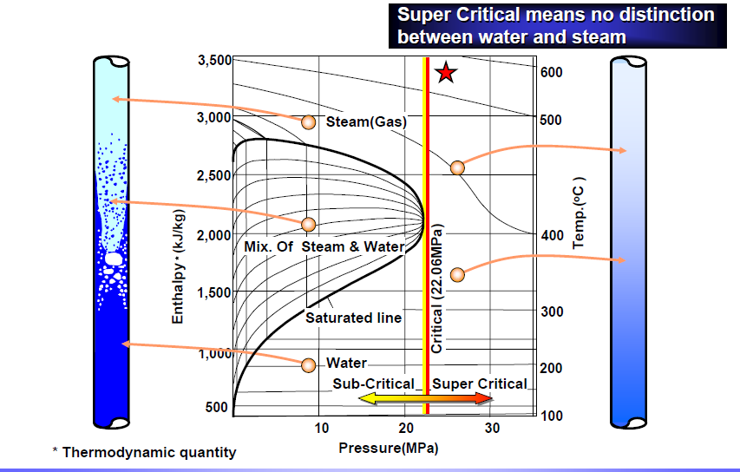
Religious to Secular Attitude of Water

Slide 5
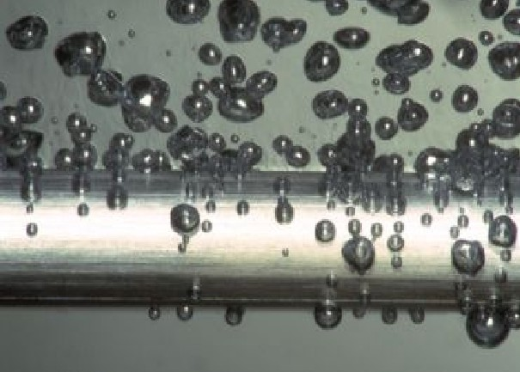
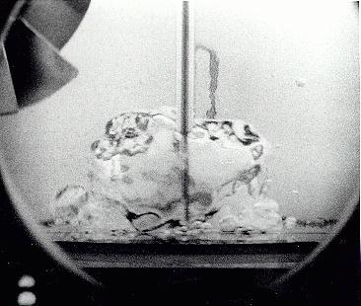
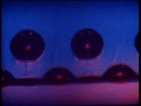
Science of Boiling: Microscopic classification
Nucleate Boiling
Bulk Boiling
Film Boiling

Slide 6
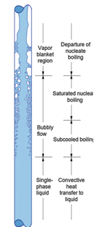
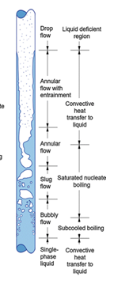
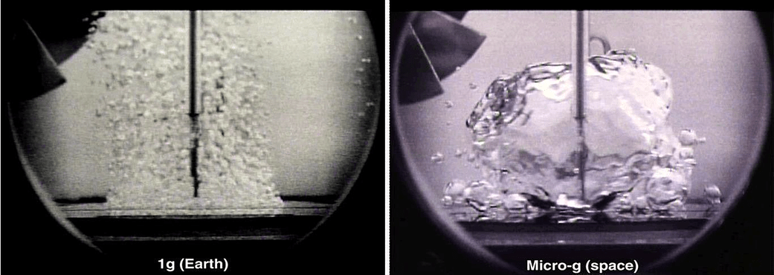
Boiling Technology: Macroscopic Classification
Macroscopic Classification based on Boiling Technology:
Pool Boiling
Flow Boiling:

Slide 7
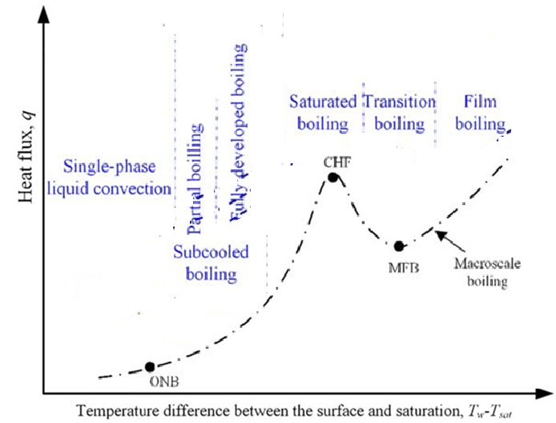
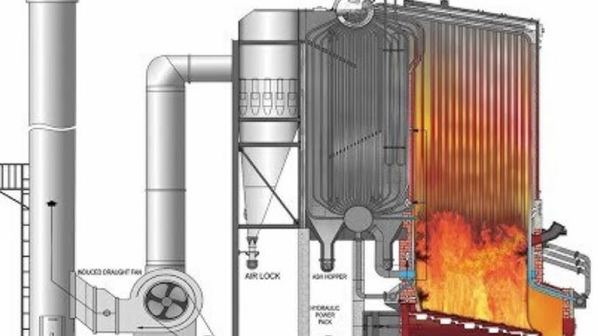
Flow Boiling Curve for Water

Slide 8
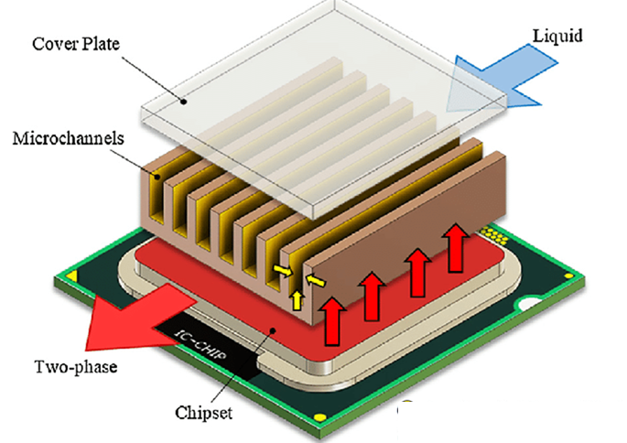
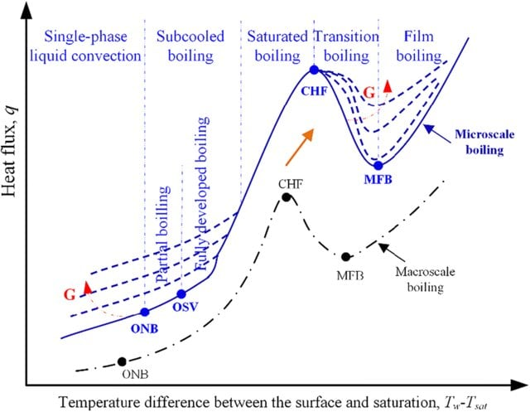
Boiling Curve for Water

Slide 9

Industrial Flow Boiling Practices
Steam
Circulating Flow
Wet Steam
Complete or Once-through Generation
Steam
Heat Input
Water
Heat Input
Water
Water

Slide 10
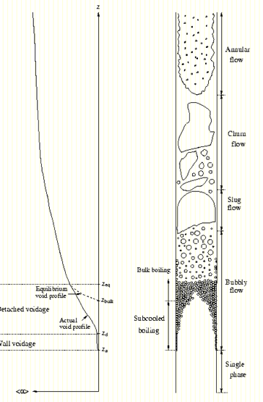
Description of Flow Boiling
Flow boiling occurs when all the phases are in bulk flow together in a channel; e.g., vapor and liquid flow in a pipe.
Void fraction and Pressure drop are two important parameters governing the performance of a real flow boiling.

Slide 11
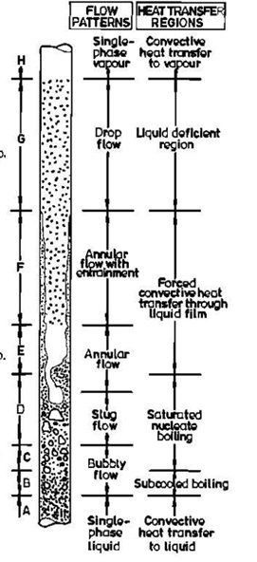

Subcritical Once Through Flow Boiling : Uniform Heat Flux
Fluid Temperature
x=1
Tube Wall
Temperature
x=0

Slide 12
Flow of steam-water mixture
Relatively cold water enters at the bottom of the riser tubes.
The temperature of the water is slightly below the saturation temperature : Sub-cooled liquid.
The lower most section is called as economizer.
This portion of the furnace will receive enough heat to evaporate the water in the immediate neighborhood of the wall.
The bubbles condense owing to the sub-cooled water around it.
This process is known as sub-cooled boiling.
There is no steam generation in this process.
As the water is heated close to its saturation temperature the steam bubbles will not collapse and move up through the water as bubbles.
This is called nucleate boiling.
The heat transfer coefficient is very high.
This bubbly type of flow continues till the steam fraction in the mixture is low.

Slide 13
Subcooled Boiling
The onset of nucleate boiling indicates the location where the vapor can first exist in a stable state on the heater surface without condensing or vapor collapse.
As more energy is input into the liquid (i.e., downstream axially) these vapor bubbles can grow and eventually detach from the heater surface and enter the liquid.
Onset of nucleate boiling occurs at an axial location before the bulk liquid is saturated.
The point where the vapor bubbles could detach from the heater surface would also occur at an axial location before the bulk liquid is saturated.
This axial length over which boiling occurs when the bulk liquid is subcooled is called the "subcooled boiling" length.
This region may be large or small in actual size depending on the fluid properties, mass flow rate, pressures and heat flux.

Slide 14
Zone of Subcooled Boiling
It is a region of inherent nonequilibrium where the flowing mass quality and vapor void fraction are non-zero.
Positive even though the thermodynamic equilibrium quality and volume fraction would be zero;
since the bulk temperature is below saturation.

Slide 15
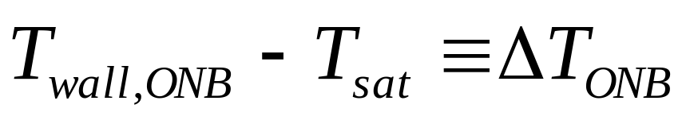
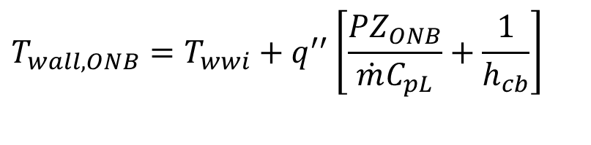
The Onset of Nucleate Boiling
If the wall temperature rises sufficiently above the local saturation temperature pre-existing vapor in wall sites can nucleate and grow.
This temperature, T_{wall,ONB}, marks the onset of nucleate boiling for this flow boiling situation.
From the standpoint of an energy balance this occurs at a particular axial location along the tube length, Z_{ONB}.
For a uniform flux condition,
$$T_{wall,ONB}=T_{wwi}+q^{′′}\left[\frac{PZ_{ONB}}{\dot{m}C_{pL}}+\frac{1}{h_{cb}}\right]$$
We can arrange this energy balance to emphasize the necessary superheat above saturation for the onset of nucleate boiling

Slide 16
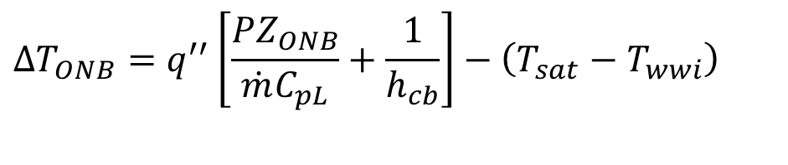
The Onset of Nucleate Boiling
$$ΔT_{ONB}=q^{′′}\left[\frac{PZ_{ONB}}{\dot{m}C_{pL}}+\frac{1}{h_{cb}}\right]−\left(T_{sat}−T_{wwi}\right)$$
Now that we have a relation between ΔT_{ONB} and Z_{ONB} we must provide a stability model for the onset of nucleate boiling.
one can formulate a model based on the metastable condition of nascent vapor nuclei ready to grow into the world.
There are a number of correlation models for this stability line of ΔT_{ONB}.

Slide 17
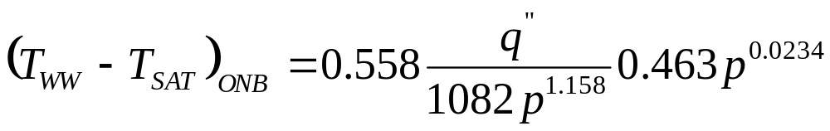
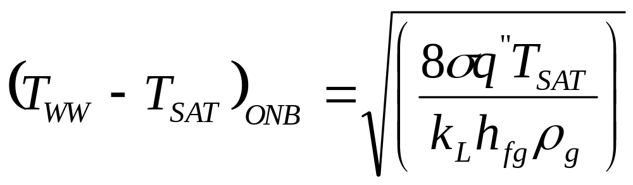
The Onset of Nucleate Boiling
Bergles and Rohsenow (1964) obtained an equation for the wall superheat required for the onset of subcooled boiling.
Their equation is valid for water only, given by
Basic Energy and Force Balance analysis gives:

Slide 18
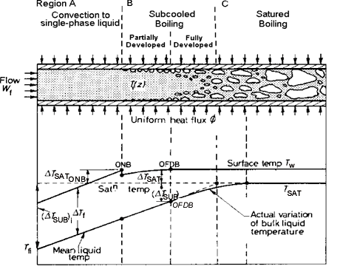
What next ?

Slide 19



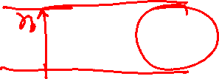
Departure of Vapor Bubble
The next objective is to determine the amount of superheat necessary to allow vapor bubble departure and then the axial location where this would occur.
A force balance to estimate the degree of superheat necessary for bubble departure.
In this conceptual model the bubble radius r_{B}, is assumed to be proportional to the distance to the tip of the vapor bubble,Y_{B} , away from the heated wall.
One can then calculate this distance

Slide 20
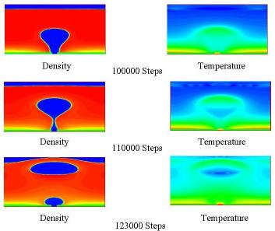
Sequence of Event Leading to Departure

Slide 21
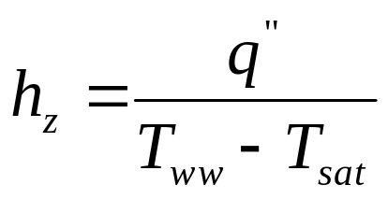
Two-Phase Flow Boiling Heat Transfer Coefficient
The local two-phase flow boiling heat transfer coefficient for evaporation inside a tube, h_{z}, is defined as:
where q” corresponds to the local heat flux from the tube wall into the fluid,
T_{sat} is the local saturation temperature at the local saturation pressure p_{sat}
T_{ww} is the local wall temperature at the axial position along the evaporator tube, assumed to be uniform around the perimeter of the tube.

Slide 22
Models for Heat Transfer Coefficient
Flow boiling models normally consider two heat transfer mechanisms to be important.
Nucleate boiling heat transfer ( h_{nb} )
The bubbles formed inside a tube may slide along the heated surface due to the axial bulk flow, and hence the microlayer evaporation process underneath the growing bubbles may also be affected.
Convective boiling heat transfer ( h_{cb} )
Convective boiling refers to the convective process between the heated wall and the liquid-phase.

Slide 23
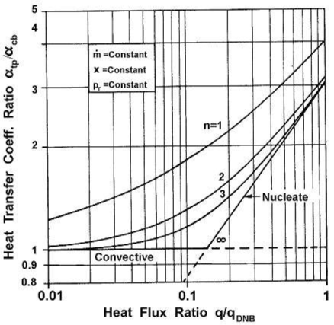
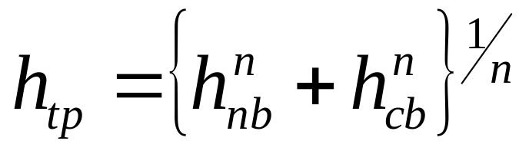
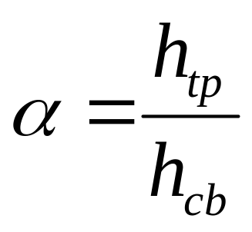
Superposition of Two Mechanisms
Power law format, typical of superposition of two thermal mechanisms upon one another:
n=1
Nucleate Boiling
n=2
n=∞
n=3
Liquid Convection

Slide 24
Correlations for Two-phase Nucleate Flow Boiling
Chen Correlation
Shah Correlation
Gungor-Winterton Correlations
Steiner-Taborek Asymptotic Model

Slide 25
Chen Correlation
Chen (1963, 1966) proposed the first flow boiling correlation for evaporation in vertical tubes to attain widespread use.
The local two-phase flow boiling coefficient h_{tp} is to be the weighted sum of the nucleate boiling contribution h_{nb} and the convective contribution h_{cb}
The temperature gradient in the liquid near the tube wall is steeper under forced convection conditions, relative to that in nucleate pool boiling.
The convection partially suppresses the nucleation of boiling sites and hence reduced the contribution of nucleate boiling.
On the other hand, the vapor formed by the evaporation process increased the liquid velocity and hence the convective heat transfer contribution tends to be increased relative to that of single-phase flow of the liquid.

Slide 26
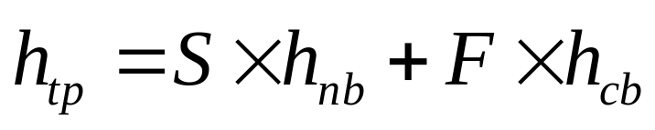
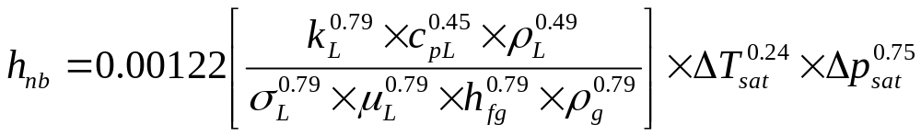
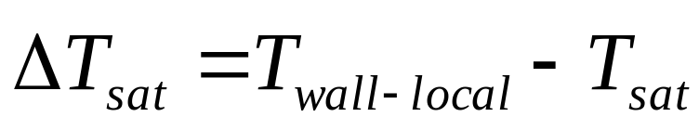
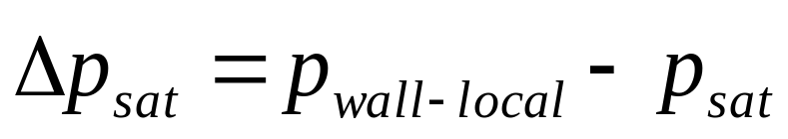
Chen Correlation
Formulation of an expression to account for these two effects:
where the nucleate pool boiling correlation of Forster and Zuber is used to calculate the nucleate boiling heat transfer coefficient, FZ ;
the nucleate boiling suppression factor acting on h_{nb} is S;
Forster-Zuber correlation gives the nucleate pool boiling coefficient as:

Slide 27
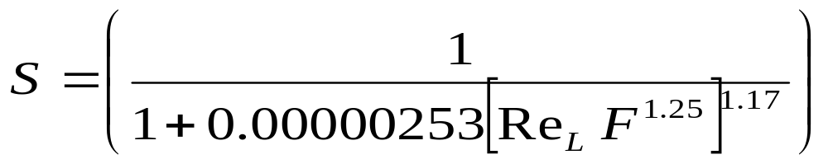
Chen Correlation
The Chen boiling suppression factor S is

Slide 28
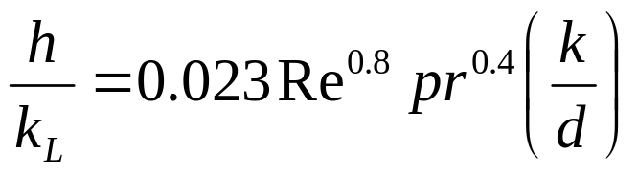
Chen Correlation
Formulation of an expression to account for these two effects:
the turbulent flow correlation of Dittus-Boelter (1930) for tubular flows is used to calculate the liquid-phase convective heat transfer coefficient,
L ; and the increase in the liquid-phase convection due to the two-phase flow is given by his two-phase multiplier F. The
The liquid-phase convective heat transfer coefficient h_{L} is given by the Dittus-Boelter (1930) correlation for the fraction of liquid flowing alone in a tube of internal diameter d_{i} , i.e. using a mass velocity of liquid, as:

Slide 29
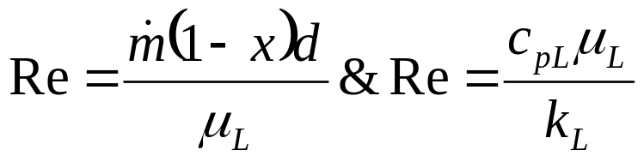
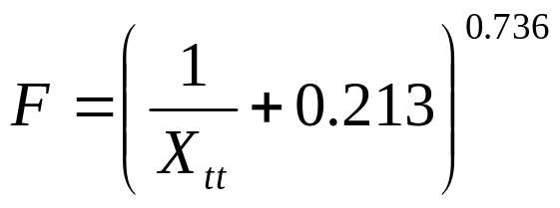
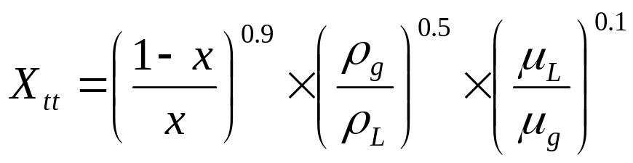
Chen Correlation
Dittus-Boelter correlation:
The two-phase multiplier F of Chen is:
where the Martinelli parameter X _{tt} is used for the two-phase effect on convection.
where X_{tt} is defined as:
Note: however, that when X_{tt} > 10, F is set equal to 1.0.

Slide 30
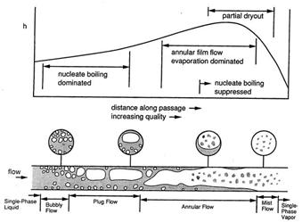
Chen Correlation

Slide 31
Steiner-Taborek Asymptotic Model
Natural limitations to flow boiling coefficients.
Steiner and Taborek (1992) stated that the following limits should apply to evaporation in vertical tubes:
For heat fluxes below the threshold for the onset of nucleate boiling (q′′ < q′ ′_{ONB} ), only the convective contribution should be counted and not the nucleate boiling contribution.
For very large heat fluxes, the nucleate boiling contribution should dominate.
When x = 0, h_{sp} should be equal to the single-phase liquid convective heat transfer coefficient when q’’ <q’’_{ONB}
h_{tp} should correspond to that plus h_{nb} when q’’ > q’’_{ONB} .
When x = 1.0, h_{tp} should equal the vapor-phase convective coefficient h_{Gt}.

Slide 32
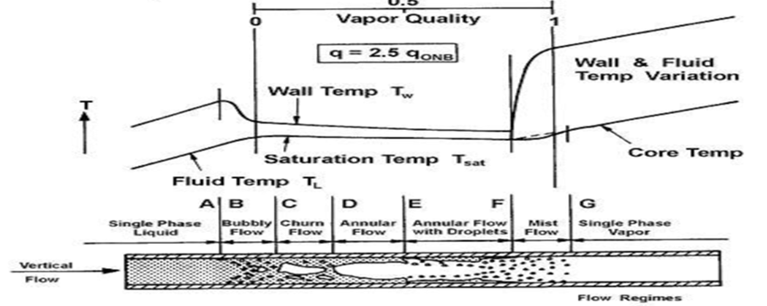
Boiling process in vertical tube according to Steiner-Taborek

Slide 33
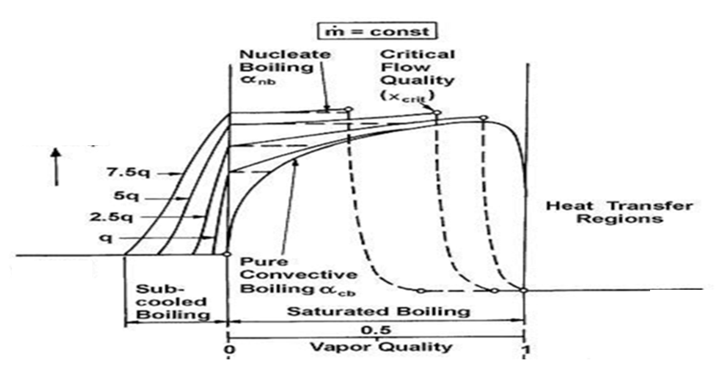




Boiling process in vertical tube according to Steiner-Taborek
$$\log_{10}{h_{tp}}$$
$$q_{NOB}^{′′}$$
$$h_{L}\left(T_{sat}\right)$$
$$h_{G}\left(T_{sat}\right)$$

Slide 34
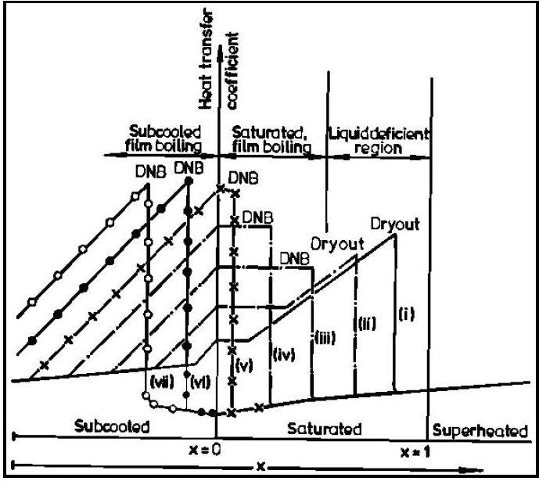

Boiling Map

Slide 35
Departure from Nucleate Boiling and Critical Heat Flux
In practice, if the heat flux is increased, the transition from nucleate boiling to film boiling occurs suddenly, and the temperature difference increases rapidly.
The point of transition from nucleate boiling to film boiling is called the point of departure from nucleate boiling, commonly written as DNB.
The heat flux associated with DNB is commonly called the critical heat flux (CHF).
CHF is an important parameter.

Slide 36
Departure from Nucleate Boiling and Critical Heat Flux
An increase in heat flux beyond the critical heat flux leads to the occurrence of Departure from Nucleate Boiling.
The temperature difference required for heat transfer from the tube surface to boiling fluid increases greatly.
The temperature increase causes the TUBE to exceed its design limits, a failure will occur.
The amount of heat transfer by convection can only be determined after the local heat transfer coefficient is determined.
Such determination must be based on available experimental data.
Experimental data is to be correlated by dimensional analysis.
An equation for the HTC curve is drawn using the correlation.

