Slide 1

Correlations for Turbulent Forced Convection in Ducts
P M V Subbarao
Professor
Mechanical Engineering Department
I I T Delhi
An Efficient & Controlled Method of Heat Transfer…..

Slide 2

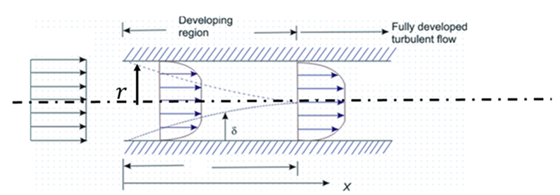
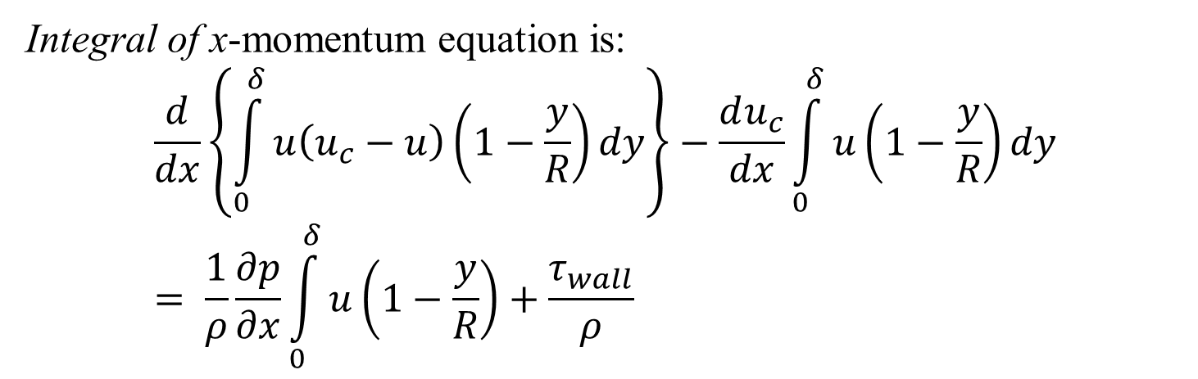


Developing Turbulent Velocity Profile in A Circular Duct
Idealized analysis is possible with simplifying assumptions.
U
$$uc\left(x\right)$$
$$u\left(x,y\right)$$
Integral of x-momentum equation is:
$$\frac{d}{dx}\left\{\int_{0}^{δ}{u\left(u_{c}−u\right)}\left(1−\frac{y}{R}\right)dy\right\}−\frac{du_{c}}{dx}\int_{0}^{δ}{u}\left(1−\frac{y}{R}\right)dy= \frac{1}{ρ}\frac{∂p}{∂x}\int_{0}^{δ}{u}\left(1−\frac{y}{R}\right)+\frac{τ_{wall}}{ρ}$$

Slide 3
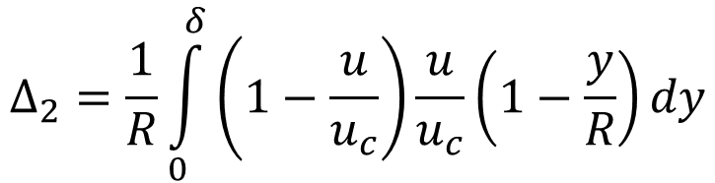
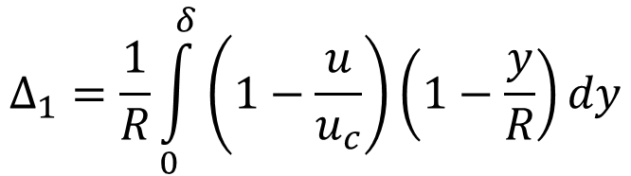
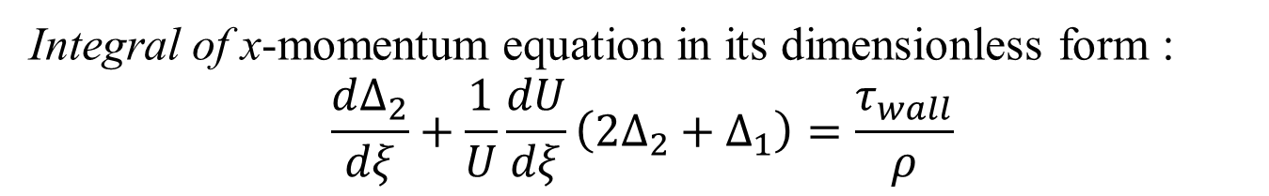
Developing Turbulent Velocity Profile in A Circular Duct
Idealized analysis is possible with simplifying assumptions.
U
$$uc\left(x\right)$$
$$u\left(x,y\right)$$
Integral of x-momentum equation in its dimensionless form :
$$\frac{d∆_{2}}{dξ}+\frac{1}{U}\frac{dU}{dξ}\left(2Δ_{2}+Δ_{1}\right)=\frac{τ_{wall}}{ρ}$$
$$Δ_{1}=\frac{1}{R}\int_{0}^{δ}{\left(1−\frac{u}{u_{c}}\right)}\left(1−\frac{y}{R}\right)dy$$
$$Δ_{2}=\frac{1}{R}\int_{0}^{δ}{\left(1−\frac{u}{u_{c}}\right)\frac{u}{u_{c}}}\left(1−\frac{y}{R}\right)dy$$

Slide 4
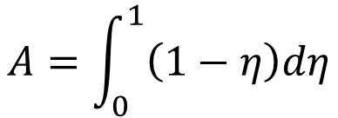
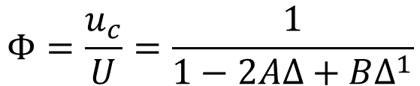
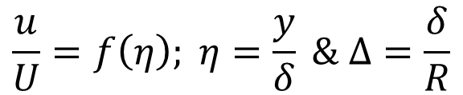
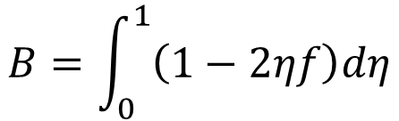
Developing Turbulent Velocity Profile in A Circular Duct
Idealized analysis is possible with simplifying assumptions.
$$uc\left(x\right)$$
$$u\left(x,y\right)$$
Select a suitable function for velocity profile in boundary layer as:
$$\frac{u}{U}=f\left(η\right); η=\frac{y}{δ} \& Δ=\frac{δ}{R}$$
$$A=\int_{0}^{1}{\left(1−η\right)dη}$$
from continuity condition, we obtain
$$Φ=\frac{u_{c}}{U}=\frac{1}{1−2AΔ+BΔ^{1}}$$
$$B=\int_{0}^{1}{\left(1−2ηf\right)dη}$$

Slide 5
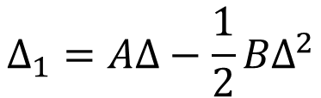
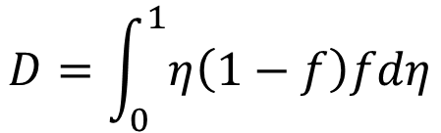
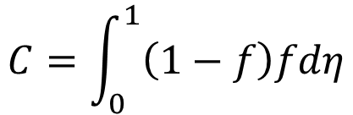
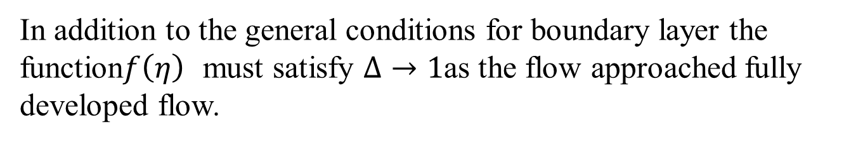

Developing Turbulent Velocity Profile in A Circular Duct
Idealized analysis is possible with simplifying assumptions.
U
$$uc\left(x\right)$$
$$u\left(x,y\right)$$
$$C=\int_{0}^{1}{\left(1−f\right)fdη}$$
$$Δ_{1}=AΔ−\frac{1}{2}{BΔ}^{2}$$
$$D=\int_{0}^{1}{η\left(1−f\right)fdη}$$
$$Δ_{2}=CΔ−DΔ^{2}$$
In addition to the general conditions for boundary layer the function$f\left(η\right)$ must satisfy $Δ→1$as the flow approached fully developed flow.

Slide 6
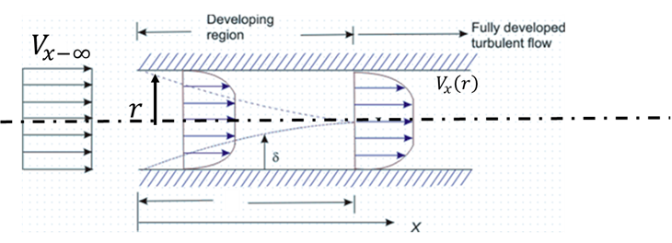
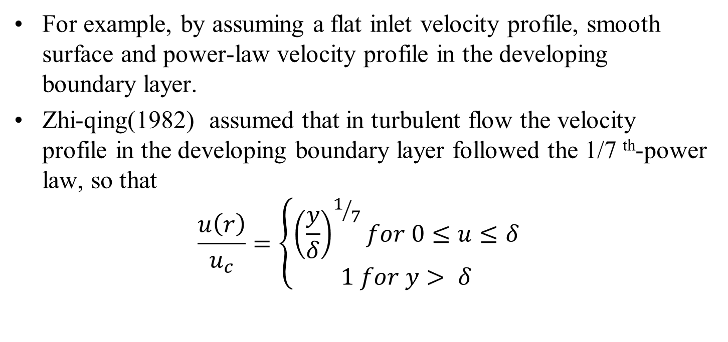
Developing Turbulent Velocity Profile in A Circular Duct
For example, by assuming a flat inlet velocity profile, smooth surface and power-law velocity profile in the developing boundary layer.
Zhi-qing(1982) assumed that in turbulent flow the velocity profile in the developing boundary layer followed the 1/7 ^{th}-power law, so that
$$\frac{u\left(r\right)}{u_{c}}=\left\{\begin{matrix}{\left(\frac{y}{δ}\right)}^{1/7}for 0≤u≤δ \\ 1 for y> δ\end{matrix} \right.$$

Slide 7
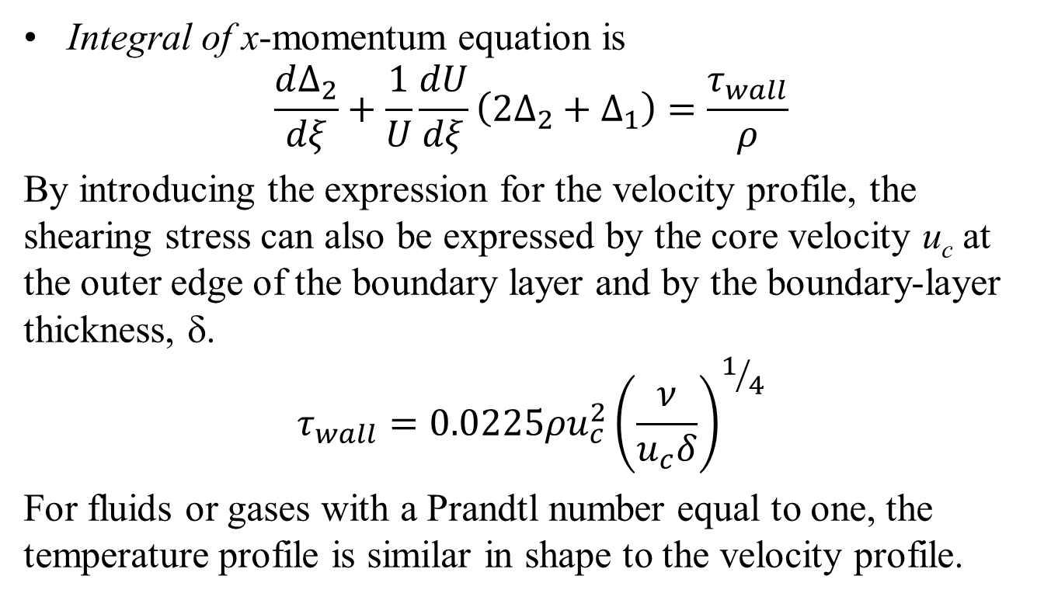
Developing Turbulent Velocity Profile in A Circular Duct : Integral Method
Integral of x-momentum equation is
$$\frac{d∆_{2}}{dξ}+\frac{1}{U}\frac{dU}{dξ}\left(2Δ_{2}+Δ_{1}\right)=\frac{τ_{wall}}{ρ}$$
By introducing the expression for the velocity profile, the shearing stress can also be expressed by the core velocity u_{c} at the outer edge of the boundary layer and by the boundary-layer thickness, δ.
$$τ_{wall}=0.0225ρu_{c}^{2}{\left(\frac{ν}{u_{c}δ}\right)}^{1/4}$$
For fluids or gases with a Prandtl number equal to one, the temperature profile is similar in shape to the velocity profile.

Slide 8
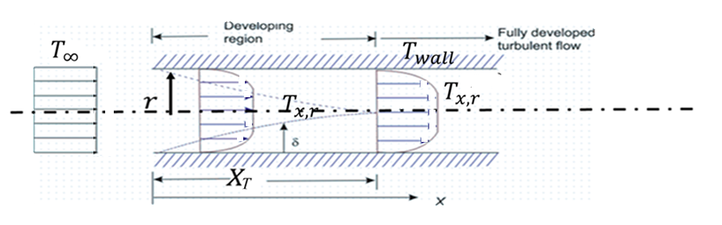
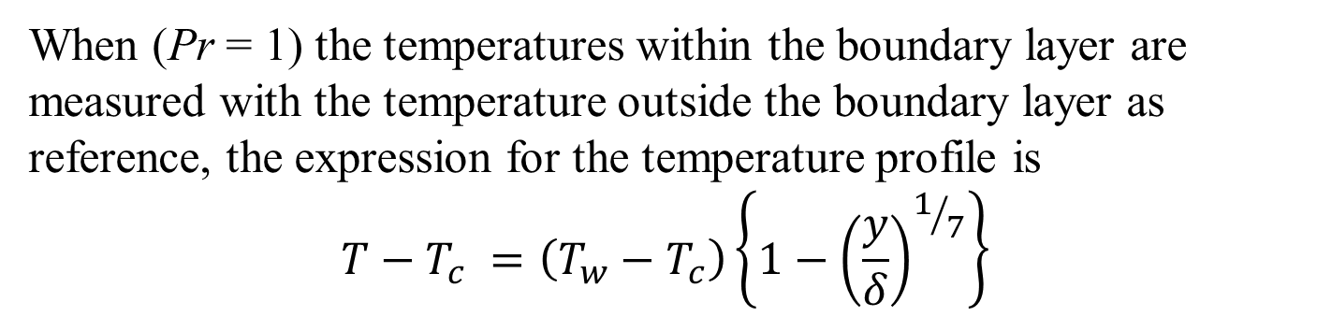
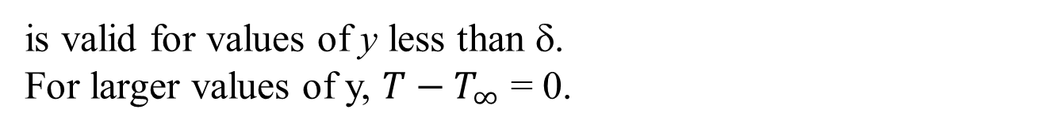
Developing Turbulent Velocity Profile in A Circular Duct : Integral Method
When (Pr = 1) the temperatures within the boundary layer are measured with the temperature outside the boundary layer as reference, the expression for the temperature profile is
$$T−T_{c} =\left(T_{w}−T_{c}\right)\left\{1−{\left(\frac{y}{δ}\right)}^{1/7}\right\}$$
is valid for values of y less than δ.
For larger values of y, $T−T_{∞}$ = 0.

Slide 9
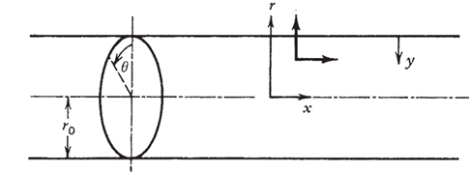
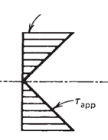
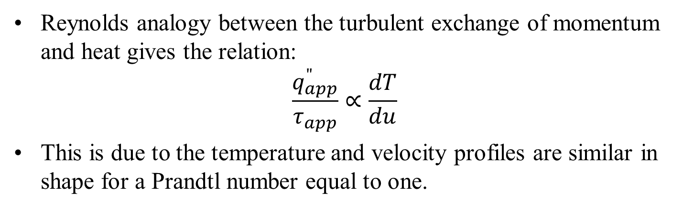





Developing Turbulent Velocity Profile in A Circular Duct : Integral Method
$$τ_{wall}$$
$$q_{wall}^{′′}$$
$$V_{r}$$
$$V_{x}$$
$$q_{app}^{′′}$$
Reynolds analogy between the turbulent exchange of momentum and heat gives the relation:
$$\frac{q_{app}^{"}}{τ_{app}}∝\frac{dT}{du}$$
This is due to the temperature and velocity profiles are similar in shape for a Prandtl number equal to one.

Slide 10

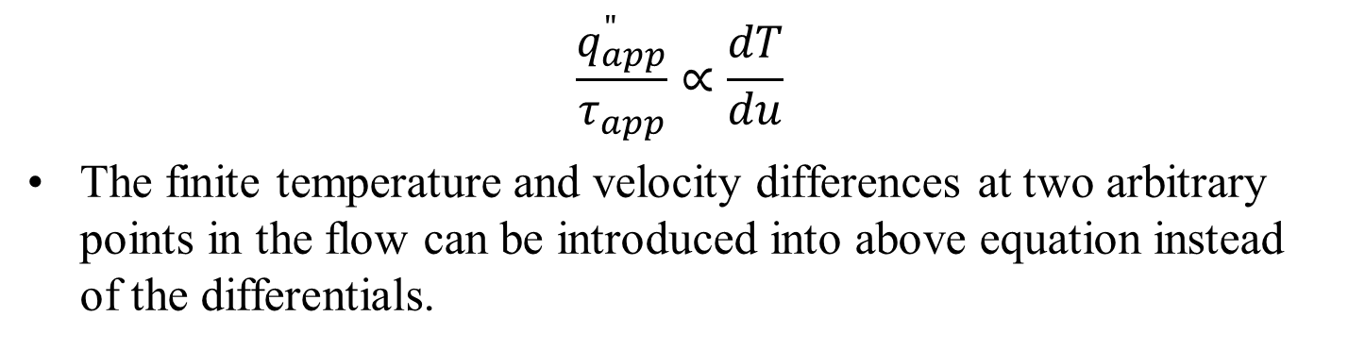
Developing Turbulent Velocity Profile in A Circular Duct : Integral Method
$$\frac{q_{app}^{"}}{τ_{app}}∝\frac{dT}{du}$$
The finite temperature and velocity differences at two arbitrary points in the flow can be introduced into above equation instead of the differentials.
$$\frac{q_{w}^{"}}{τ_{w}}∝\frac{T_{w}−T_{c}}{u_{c}}$$

Slide 11
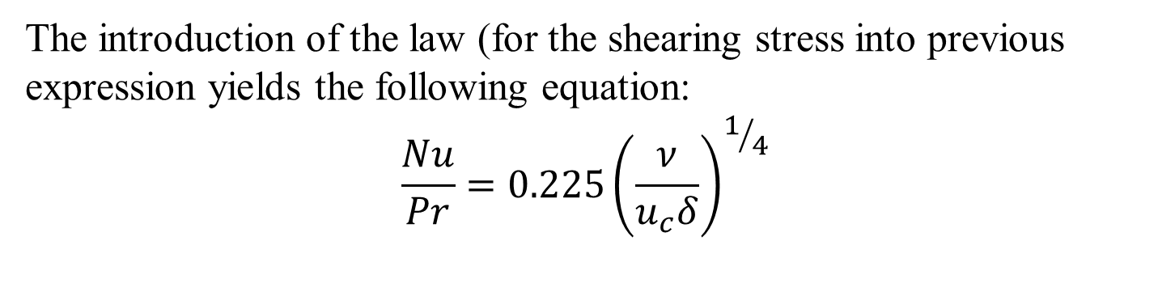
Developing Turbulent Velocity Profile in A Circular Duct : Integral Method
The introduction of the law (for the shearing stress into previous expression yields the following equation:
$$\frac{Nu}{Pr}=0.225{\left(\frac{ν}{u_{c}δ}\right)}^{1/4}$$

Slide 12
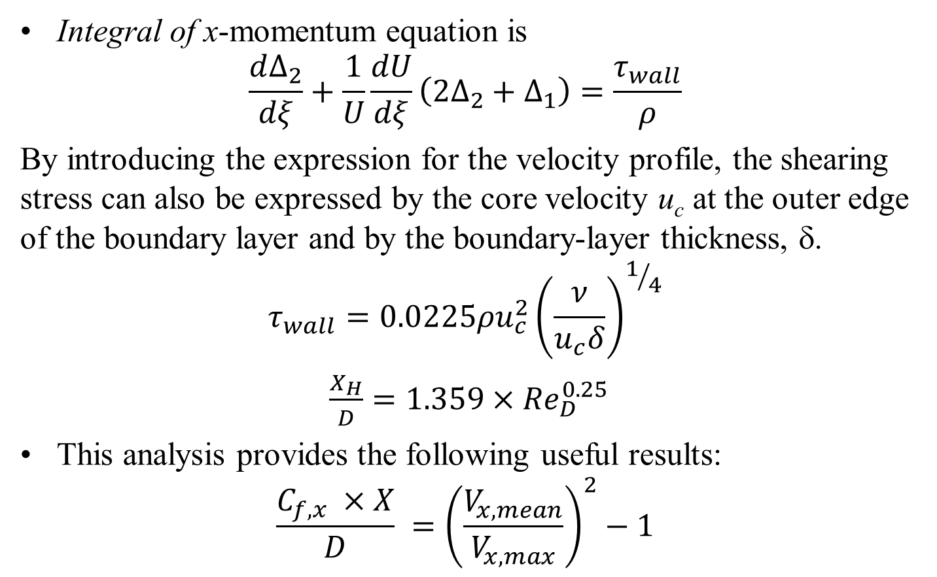
Developing Turbulent Velocity Profile in A Circular Duct : Integral Method
Integral of x-momentum equation is
$$\frac{d∆_{2}}{dξ}+\frac{1}{U}\frac{dU}{dξ}\left(2Δ_{2}+Δ_{1}\right)=\frac{τ_{wall}}{ρ}$$
By introducing the expression for the velocity profile, the shearing stress can also be expressed by the core velocity u_{c} at the outer edge of the boundary layer and by the boundary-layer thickness, δ.
$$τ_{wall}=0.0225ρu_{c}^{2}{\left(\frac{ν}{u_{c}δ}\right)}^{1/4}$$
$\frac{X_{H}}{D}=1.359×{Re}_{D}^{0.25}$
This analysis provides the following useful results:
$$\frac{C_{f,x} ×X}{D} ={\left(\frac{V_{x,mean}}{V_{x,max}}\right)}^{2}−1$$

Slide 13

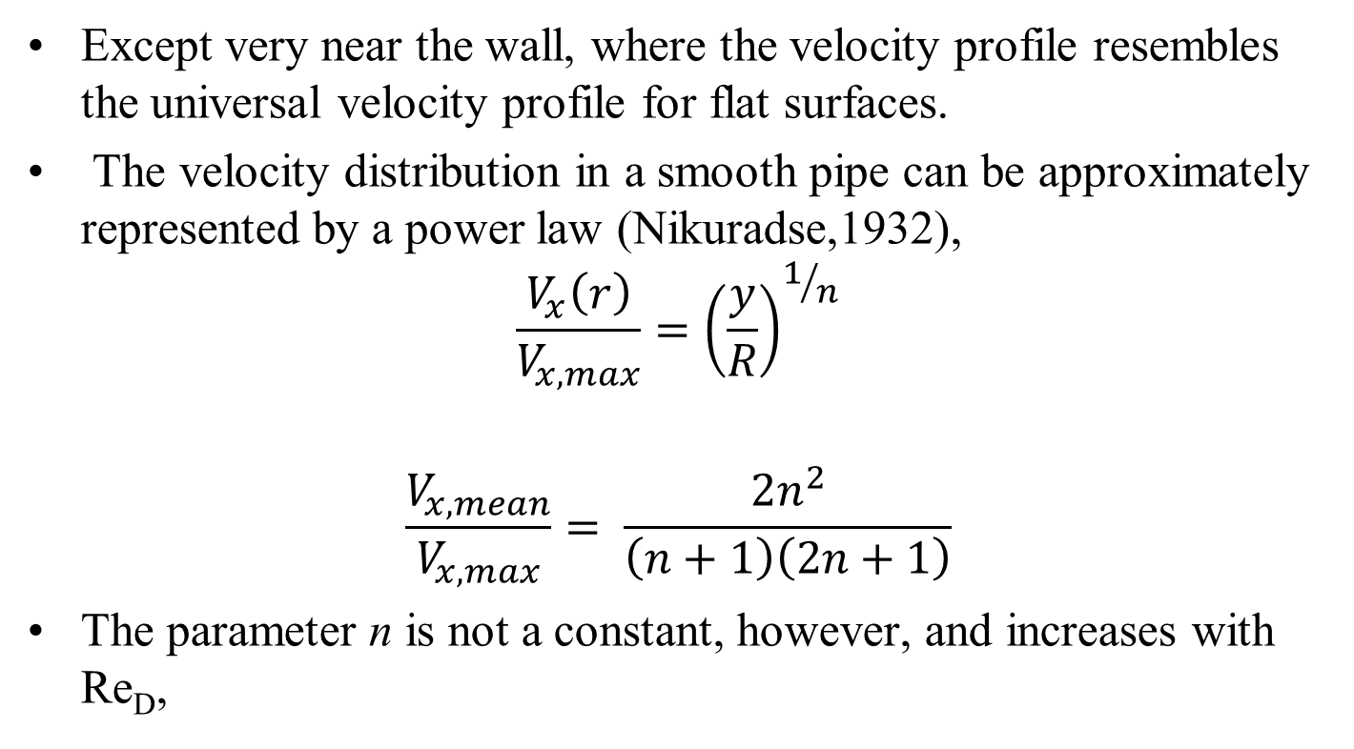
Fully Developed Turbulent Velocity Profile in A Duct : Analogous to Turbulent FPBL
Except very near the wall, where the velocity profile resembles the universal velocity profile for flat surfaces.
The velocity distribution in a smooth pipe can be approximately represented by a power law (Nikuradse,1932),
$$\frac{V_{x}\left(r\right)}{V_{x,max}}={\left(\frac{y}{R}\right)}^{1/n}$$
$$\frac{V_{x,mean}}{V_{x,max}}= \frac{2n^{2}}{\left(n+1\right)\left(2n+1\right)}$$
The parameter n is not a constant, however, and increases with Re_{D},

Slide 14
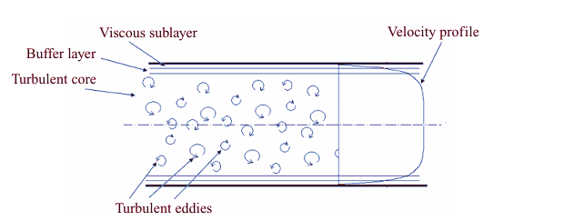
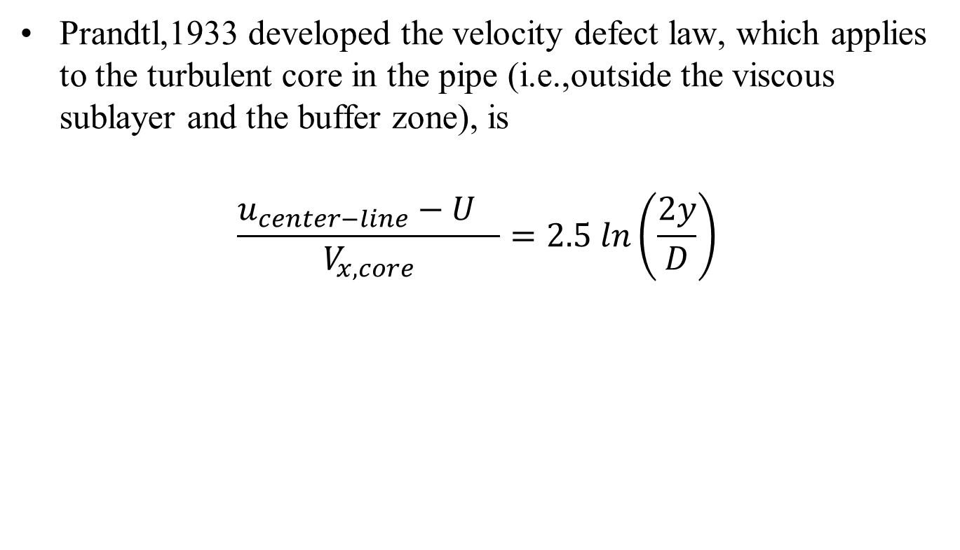
Fully Developed Turbulent Velocity Profile in A Duct
Prandtl,1933 developed the velocity defect law, which applies to the turbulent core in the pipe (i.e.,outside the viscous sublayer and the buffer zone), is
$$\frac{{u_{center−line}−U}_{}}{V_{x,core}}=2.5 ln\left(\frac{2y}{D}\right)$$

Slide 15
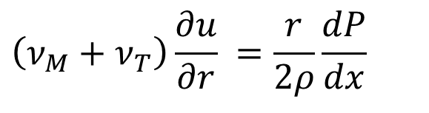
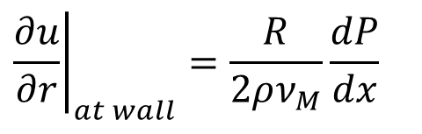
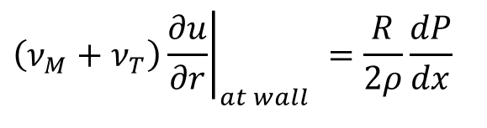
Near Wall Velocity Profile
$$\left(ν_{M}+ν_{T}\right)\frac{∂u}{∂r} =\frac{r}{2ρ}\frac{dP}{dx}$$
Above integral at the wall (r=R) is
$$\left(ν_{M}+ν_{T}\right){\left.\frac{∂u}{∂r}\right|}_{at wall} =\frac{R}{2ρ}\frac{dP}{dx}$$
Turbulent boundary layer analysis proved that ν_{T} << ν_{M} at wall.
$${\left.\frac{∂u}{∂r}\right|}_{at wall}=\frac{R}{2ρν_{M}}\frac{dP}{dx}$$
The mixing length analysis that produced the law of the wall for boundary layer flow could be applied here as well, with the understanding that it breaks down near the pipe centerline.

Slide 16
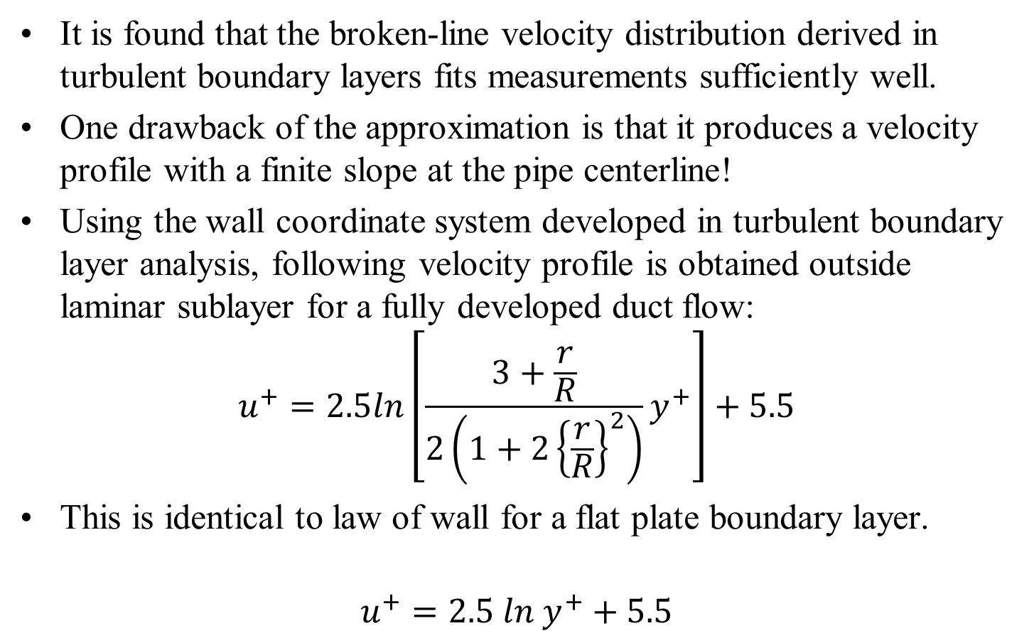
Fully Developed Turbulent Velocity Profile in A Duct: Near Wall Profile
It is found that the broken-line velocity distribution derived in turbulent boundary layers fits measurements sufficiently well.
One drawback of the approximation is that it produces a velocity profile with a finite slope at the pipe centerline!
Using the wall coordinate system developed in turbulent boundary layer analysis, following velocity profile is obtained outside laminar sublayer for a fully developed duct flow:
$$u^{+}=2.5ln\left[\frac{3+\frac{r}{R}}{2\left(1+2{\left\{\frac{r}{R}\right\}}^{2}\right)}y^{+}\right]+5.5$$
This is identical to law of wall for a flat plate boundary layer.
$$u^{+}=2.5 ln{ y}^{+}+5.5$$

Slide 17
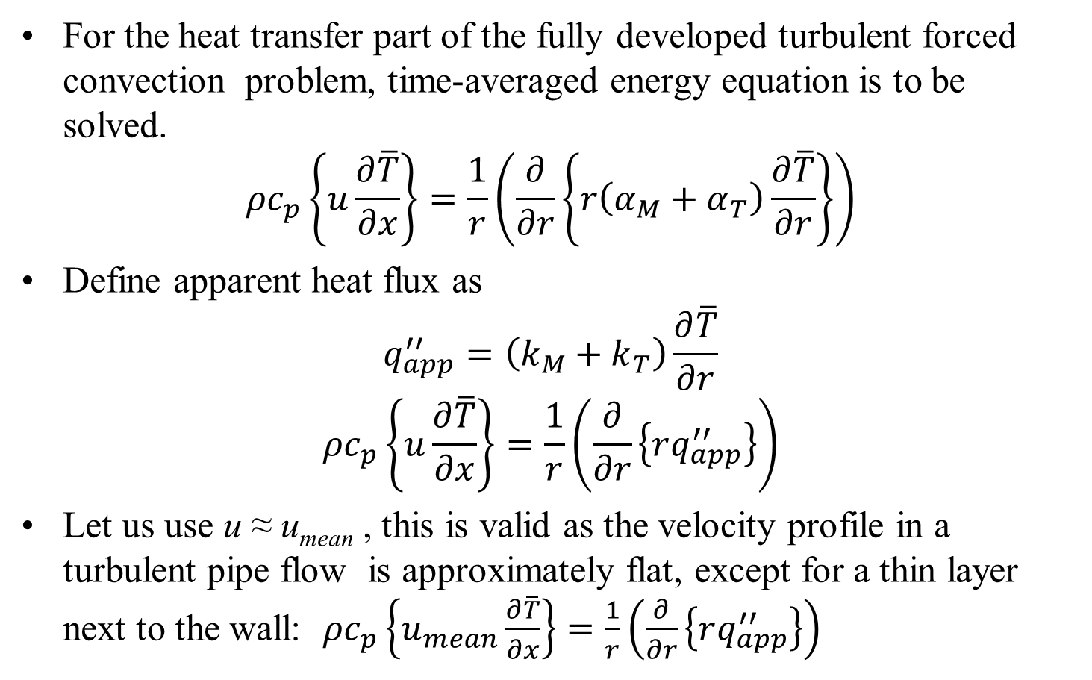
HEAT TRANSFER IN Fully Developed Turbulent Forced Convection in a Duct
For the heat transfer part of the fully developed turbulent forced convection problem, time-averaged energy equation is to be solved.
$${ρc}_{p}\left\{u\frac{∂\overline{T}}{∂x}\right\}=\frac{1}{r}\left(\frac{∂}{∂r}\left\{r\left(α_{M}+α_{T}\right)\frac{∂\overline{T}}{∂r}\right\}\right)$$
Define apparent heat flux as
$$q_{app}^{′′}=\left(k_{M}+k_{T}\right)\frac{∂\overline{T}}{∂r}$$
$${ρc}_{p}\left\{u\frac{∂\overline{T}}{∂x}\right\}=\frac{1}{r}\left(\frac{∂}{∂r}\left\{rq_{app}^{′′}\right\}\right)$$
Let us use u ≈ u_{mean} , this is valid as the velocity profile in a turbulent pipe flow is approximately flat, except for a thin layer next to the wall: ${ρc}_{p}\left\{u_{mean}\frac{∂\overline{T}}{∂x}\right\}=\frac{1}{r}\left(\frac{∂}{∂r}\left\{rq_{app}^{′′}\right\}\right)$

Slide 18
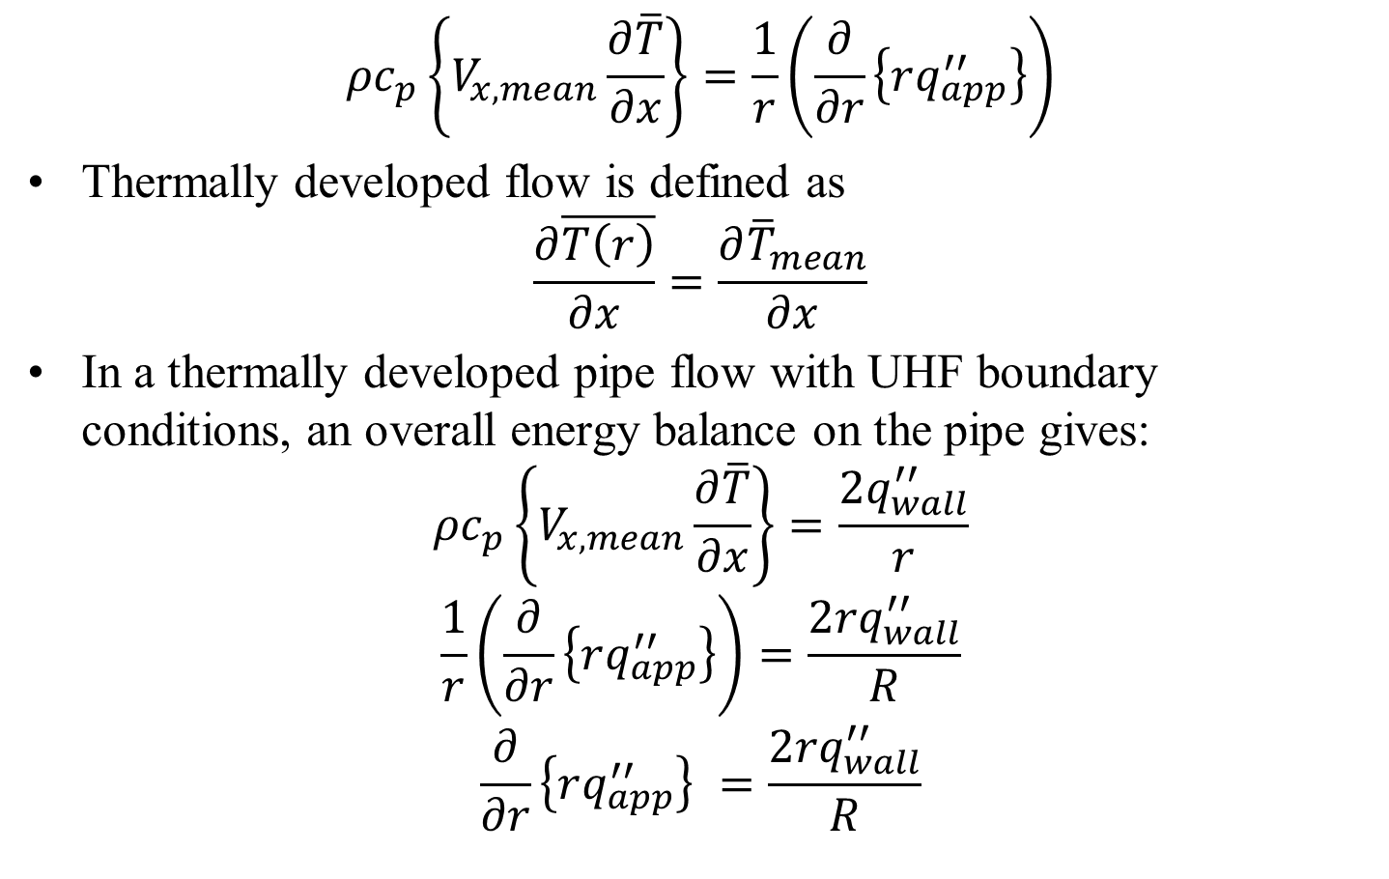
HEAT TRANSFER IN Fully Developed Turbulent Forced Convection in a Duct
$${ρc}_{p}\left\{V_{x,mean}\frac{∂\overline{T}}{∂x}\right\}=\frac{1}{r}\left(\frac{∂}{∂r}\left\{rq_{app}^{′′}\right\}\right)$$
Thermally developed flow is defined as
$$\frac{∂\overline{T\left(r\right)}}{∂x}=\frac{∂{\overline{T}}_{mean}}{∂x}$$
In a thermally developed pipe flow with UHF boundary conditions, an overall energy balance on the pipe gives:
$${ρc}_{p}\left\{V_{x,mean}\frac{∂\overline{T}}{∂x}\right\}=\frac{{2q}_{wall}^{′′}}{r}$$
$$\frac{1}{r}\left(\frac{∂}{∂r}\left\{rq_{app}^{′′}\right\}\right)=\frac{{2rq}_{wall}^{′′}}{R}$$
$$\frac{∂}{∂r}\left\{rq_{app}^{′′}\right\} =\frac{{2rq}_{wall}^{′′}}{R}$$

Slide 19

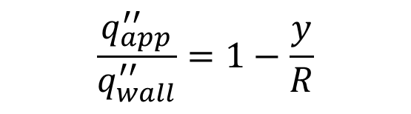


HEAT TRANSFER IN Fully Developed Turbulent Forced Convection in a Duct
$$q_{wall}^{′′}$$
$$V_{r}$$
$$q_{wall}^{′′}$$
$$V_{x}$$
$$q_{app}^{′′}$$
An acceptable approximation for the distribution of apparent heat flux over the pipe cross section is
$$\frac{q_{app}^{′′}}{q_{wall}^{′′}}=1−\frac{y}{R}$$
In conclusion, the apparent heat flux follows a distribution that is practically the same as the one followed by the apparent shear stress.

Slide 20
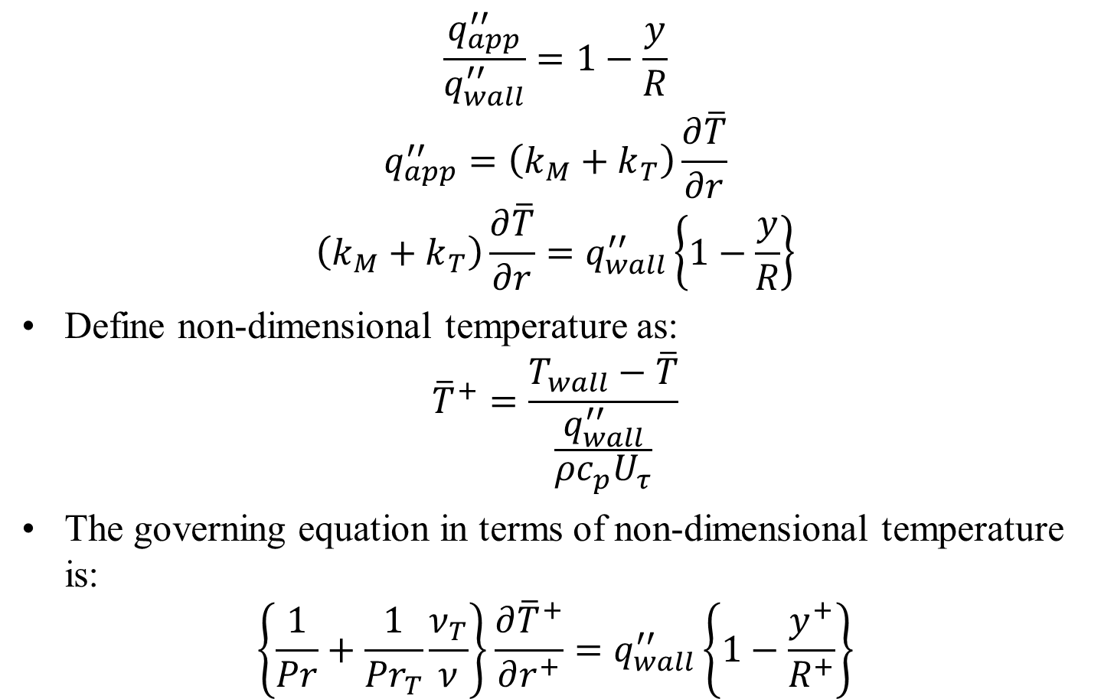
HEAT TRANSFER IN Fully Developed Turbulent Forced Convection in a Duct
$$\frac{q_{app}^{′′}}{q_{wall}^{′′}}=1−\frac{y}{R}$$
$$q_{app}^{′′}=\left(k_{M}+k_{T}\right)\frac{∂\overline{T}}{∂r}$$
$$\left(k_{M}+k_{T}\right)\frac{∂\overline{T}}{∂r}=q_{wall}^{′′}\left\{1−\frac{y}{R}\right\}$$
Define non-dimensional temperature as:
$${\overline{T}}^{+}=\frac{T_{wall}−\overline{T}}{\frac{q_{wall}^{′′}}{{ρc}_{p}U_{τ}}}$$
The governing equation in terms of non-dimensional temperature is:
$$\left\{\frac{1}{Pr}+\frac{1}{{Pr}_{T}}\frac{ν_{T}}{ν}\right\}\frac{∂{\overline{T}}^{+}}{∂r^{+}}=q_{wall}^{′′}\left\{1−\frac{y^{+}}{R^{+}}\right\}$$

Slide 21
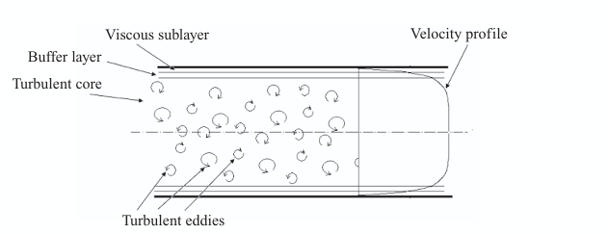
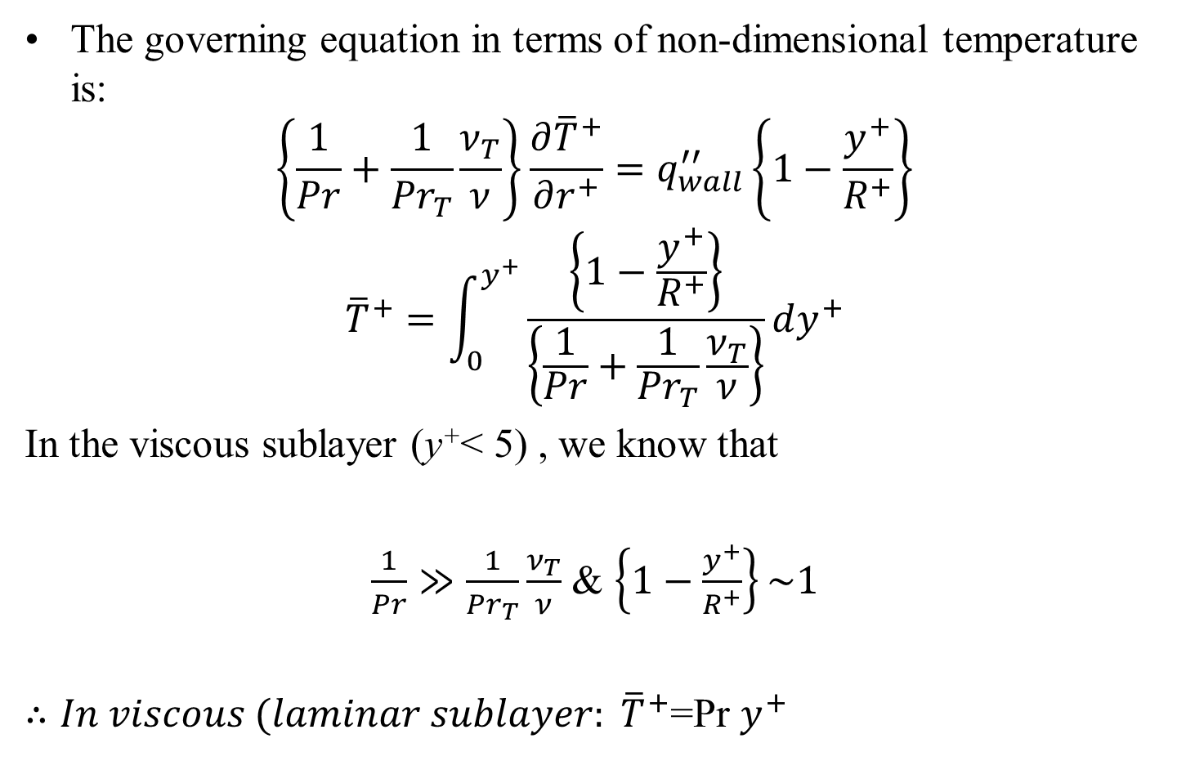
HEAT TRANSFER IN Fully Developed TFC in a Duct: Viscous Sublayer
The governing equation in terms of non-dimensional temperature is:
$$\left\{\frac{1}{Pr}+\frac{1}{{Pr}_{T}}\frac{ν_{T}}{ν}\right\}\frac{∂{\overline{T}}^{+}}{∂r^{+}}=q_{wall}^{′′}\left\{1−\frac{y^{+}}{R^{+}}\right\}$$
$${\overline{T}}^{+}=\int_{0}^{y^{+}}{\frac{\left\{1−\frac{y^{+}}{R^{+}}\right\}}{\left\{\frac{1}{Pr}+\frac{1}{{Pr}_{T}}\frac{ν_{T}}{ν}\right\}}dy^{+}}$$
In the viscous sublayer (y⁺< 5) , we know that
$\frac{1}{Pr}≫\frac{1}{{Pr}_{T}}\frac{ν_{T}}{ν}$ & $\left\{1−\frac{y^{+}}{R^{+}}\right\}\sim 1$
${∴In viscous (laminar sublayer: \overline{T}}^{+}$=Pr $y^{+}$

Slide 22
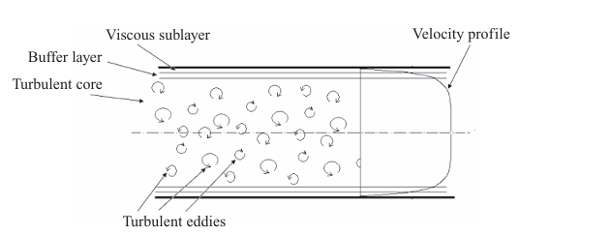
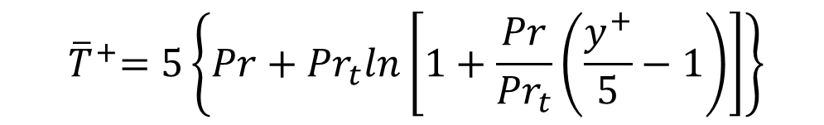
HEAT TRANSFER IN Fully Developed TFC in a Duct: Buffer layer
In the buffer layer (5 < y⁺ < 30) both molecular and turbulent diffusivities are important.
The non-dimensional temperature profile in buffer layer is:
$${ \overline{T}}^{+}=5\left\{Pr+{Pr}_{t}ln\left[1+\frac{Pr}{{Pr}_{t}}\left(\frac{y^{+}}{5}−1\right)\right]\right\}$$

Slide 23
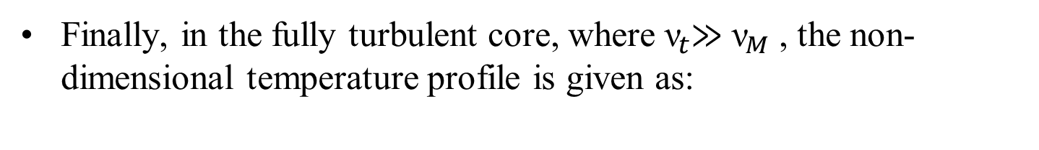
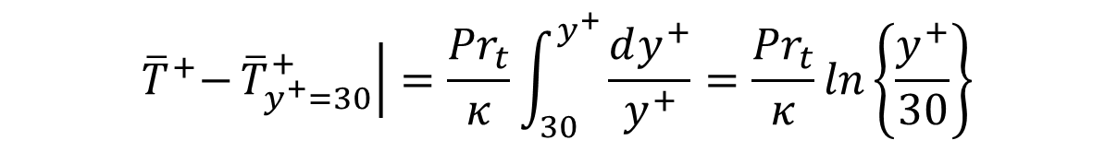

HEAT TRANSFER IN Fully Developed TFC in a Duct : Turbulent Core
Finally, in the fully turbulent core, where ${\text{ν}}_{t}$≫ ${\text{ν}}_{M}$ , the non-dimensional temperature profile is given as:
$${ \overline{T}}^{+}−\left.{\overline{T}}_{y^{+}=30}^{+}\right|=\int_{30}^{y^{+}}{\frac{{Pr}_{t}dy^{+}}{κy^{+}}}$$
$${ \overline{T}}^{+}−\left.{\overline{T}}_{y^{+}=30}^{+}\right|=\frac{{Pr}_{t}}{κ}\int_{30}^{y^{+}}{\frac{dy^{+}}{y^{+}}=\frac{{Pr}_{t}}{κ}ln\left\{\frac{y^{+}}{30}\right\}}$$

Slide 24
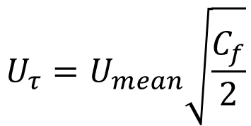

HEAT TRANSFER IN Fully Developed TFC in a Duct : Turbulent Core
Using Stanton’s Analogy:
$$U_{τ}=U_{mean}\sqrt{\frac{C_{f}}{2}}$$
$${ \overline{T}}^{+}−\left.{\overline{T}}_{y^{+}=30}^{+}\right|=\frac{{Pr}_{t}}{κ}ln\left[\frac{y}{30D}\sqrt{\frac{C_{f}}{2}}{Re}_{D}\right]$$

Slide 25
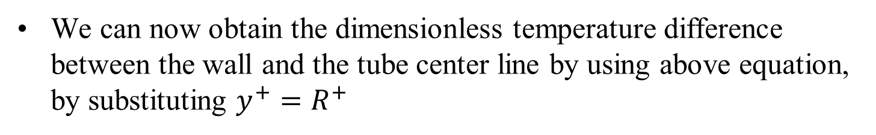

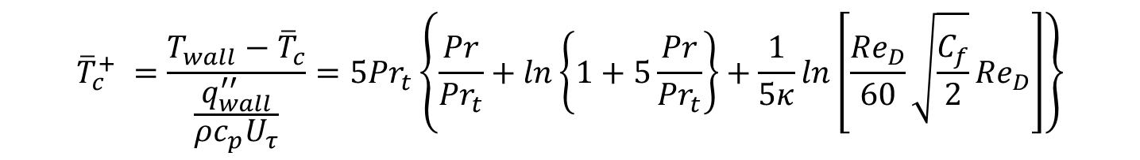
HEAT TRANSFER IN Fully Developed TFC in a Duct : Turbulent Core
$${ \overline{T}}^{+}−\left.{\overline{T}}_{y^{+}=30}^{+}\right|=\frac{{Pr}_{t}}{κ}ln\left[\frac{y}{30D}\sqrt{\frac{C_{f}}{2}}{Re}_{D}\right]$$
We can now obtain the dimensionless temperature difference between the wall and the tube center line by using above equation, by substituting $y^{+}=R^{+}$
$${\overline{T}}_{c}^{+} =\frac{T_{wall}−{\overline{T}}_{c}}{\frac{q_{wall}^{′′}}{ρc_{p}U_{τ}}}={5Pr}_{t}\left\{\frac{Pr}{{Pr}_{t}}+ln\left\{1+5\frac{Pr}{{Pr}_{t}}\right\}+\frac{1}{5κ}ln\left[\frac{{Re}_{D}}{60}\sqrt{\frac{C_{f}}{2}}{Re}_{D}\right]\right\}$$

Slide 26
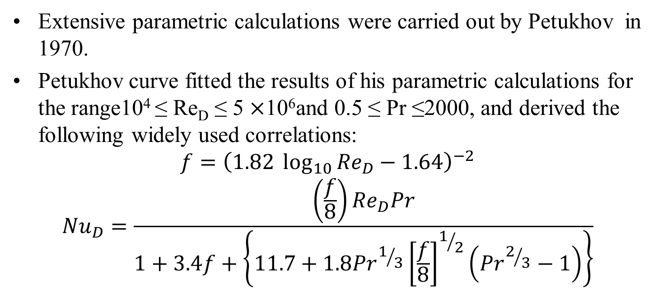
HEAT TRANSFER IN Fully Developed TFC in a Duct
Extensive parametric calculations were carried out by Petukhov in 1970.
Petukhov curve fitted the results of his parametric calculations for the range10⁴ ≤ Re_{D} ≤ 5 $×$10⁶and 0.5 ≤ Pr ≤2000, and derived the following widely used correlations:
$$f={\left(1.82 \log_{10}{{Re}_{D}}−1.64\right)}^{−2}$$
$${Nu}_{D}=\frac{\left(\frac{f}{8}\right){Re}_{D}Pr}{1+3.4f+\left\{11.7+1.8{Pr}^{1/3}{\left[\frac{f}{8}\right]}^{1/2}\left({Pr}^{2/3}−1\right)\right\}}$$

Slide 27
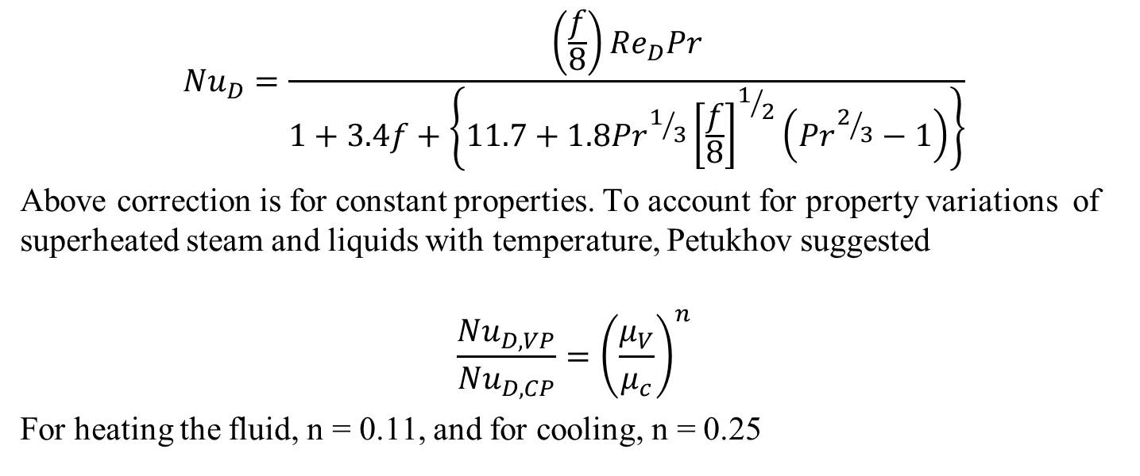
HEAT TRANSFER IN Fully Developed TFC in a Duct
$${Nu}_{D}=\frac{\left(\frac{f}{8}\right){Re}_{D}Pr}{1+3.4f+\left\{11.7+1.8{Pr}^{1/3}{\left[\frac{f}{8}\right]}^{1/2}\left({Pr}^{2/3}−1\right)\right\}}$$
Above correction is for constant properties. To account for property variations of superheated steam and liquids with temperature, Petukhov suggested
$$\frac{{Nu}_{D,VP}}{{Nu}_{D,CP}}={\left(\frac{μ_{V}}{μ_{c}}\right)}^{n}$$
For heating the fluid, n = 0.11, and for cooling, n = 0.25

Slide 28
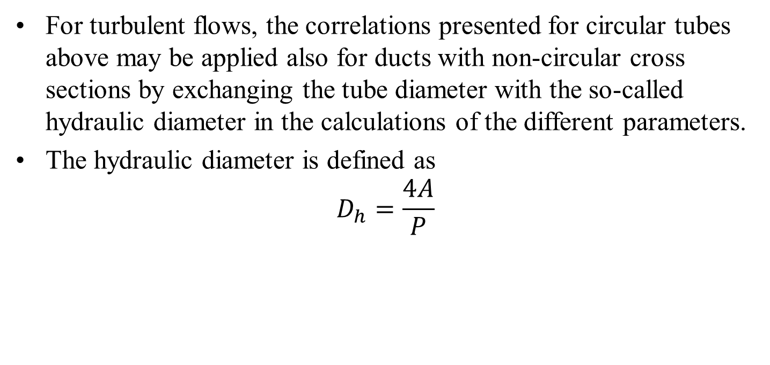
Forced convection in a non-circular duct
For turbulent flows, the correlations presented for circular tubes above may be applied also for ducts with non-circular cross sections by exchanging the tube diameter with the so-called hydraulic diameter in the calculations of the different parameters.
The hydraulic diameter is defined as
$$D_{h}=\frac{4A}{P}$$

Slide 29
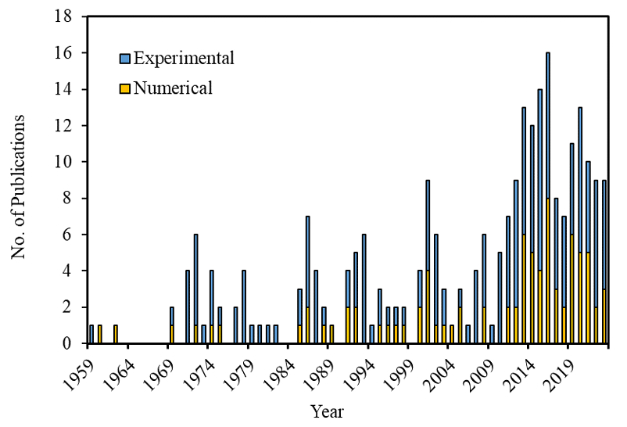
70 Years of Research in Forced convection in Tubes

Slide 30
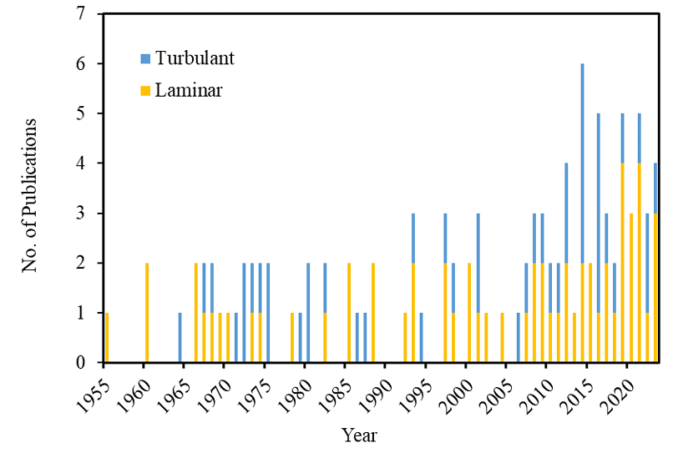
Forced convection in tubes

Slide 31
Forced convection for Sustainable Development
Helical tubes are often used in industrial applications due to benefits like accommodating thermal expansion, a compact design, and improved heat transfer performance.
Fluid flow within helical tubes is more complicated than in straight tubes.
This is because secondary flows are generated in the cross-section due to the coiling, as studies have shown.
The maximum velocity shifts towards the outer wall farthest from the helical axis, resulting in asymmetric velocity and temperature profiles across the section.
Shear stress and heat transfer coefficients around the tube's circumferential wall become uneven.

Slide 32
Forced convection in Helical Tubes
The flow field itself is stabilized by centrifugal forces, which causes the transition from laminar to turbulent flow to be delayed compared to straight tubes.
These factors associated with the curved, rotating geometries of helical tubes complicate the internal fluid dynamics versus simple straight pipes.
While centrifugal forces still influence turbulent flow in helical tubes, their dominance decreases compared to laminar flow.

Slide 33


Secondary Flow in Helical Coils
The form of the secondary flow would depend on the ratio of the tube diameters and other factors.
A representative secondary flow pattern is shown below:
Thirdly, this configuration should lead to a more standard approach for characterizing the heat transfer in the exchanger.
The ratio of the two tube diameters may be one of the ways to characterize the heat transfer.

Slide 34


Heat Transfer in Helical Tubes
Acharya et al. (1992, 2001) developed the following two correlations of the Nusselt number, for Prandtl numbers less than and greater than one, respectively.

Slide 35




Heat Transfer in Helical Annulus
Nusselt numbers for the annulus have been calculated and correlated to a modified Dean number.
The modified dean number for the annulus is calculated as it would be for a normal Dean number, except that the curvature ratio used is based on the ratio of the radius of the outer tube to the radius of curvature of the outer tube, and the Reynolds number based on the hydraulic radius of the annulus.
Thus the modified Dean number is:

Slide 36


Heat Transfer in Helical Annulus

Slide 37


Heat Transfer in Helical Annulus

Slide 38

Heat Transfer in Helical Coil

Slide 39



Helical coils: turbulent flow

Slide 40


Slide 41


Innovations to Save Material

Slide 42

Innovations to Save Material

Slide 43

Innovations to Save Material

Slide 44

Forced convection with Least Material
Double Pipe Heat Exchangers with turbulent Forced Convection

Slide 45






n^{th} order Longitudinal Fins
Δx
thickness
x
$$A(x)=δL{\left\{\frac{x}{b}\right\}}^{n}$$
L
x
q_{b}
b
x=b
x=a=0

Slide 46

Research at IIT Dlehi: CFD Analysis
Making 24 different geometry and number of mesh volume approximate 22 lakh grids
Shape | Rectangular | Triangular | Concave
No of fins | 10, 20 | 10,20 | 10 , 20
width(mm) | 0.5, 1, 1.5, 2 | 0.5,1.1.5,2 | 0.5, 1, 1.5, 2
Notes:
Making 16 different geometry

Slide 47

CFD Analysis
Making 24 different geometry and number of mesh volume approximate 22 lakh
Notes:
Making 16 different geometry

Slide 48
Geometry dimensions
Length of pipe (mm) | 1000
Height of fin (mm) | 11.1
inner diameter of pipe (mm) | 25.4
Outer diameter of fin (mm) | 30.94
Annulus diameter (mm) | 60.3
Intel temperature of hot fluid (air) | 421k
Intel temperature of cold fluid (water) | 300k
Mass flow rate of hot fluid(kg/m^3) | 0.0214
Mass flow rate of cold fluid(kg/m^3) | 0.129
Reynolds number in inner pipe | 23140

Slide 49

CFD Analysis of Test Rig

Slide 50


heat loss per unit weight vs width of fin
Notes:
3. Comparison of Overall heat transfer coefficient

Slide 51


Experimental Study

