Slide 1

Turbulent Forced Convection in Ducts
P M V Subbarao
Professor
Mechanical Engineering Department
I I T Delhi
A Multi-level Analogical Approach to Design an Essential Convection System for Human Development…..

Slide 2

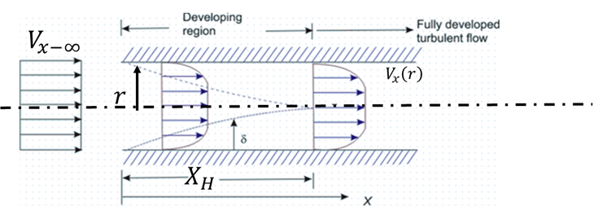
Development of Turbulent Velocity Profile in a Pipe/ Duct
The development of velocity and temperature boundary layers in turbulent duct flow is qualitatively similar to that of laminar flow.
The hydrodynamic entrance length in turbulent flow is shorter than laminar flow.
Strongly depends on the entrance conditions, the intensity of disturbances, and surface roughness.

Slide 3
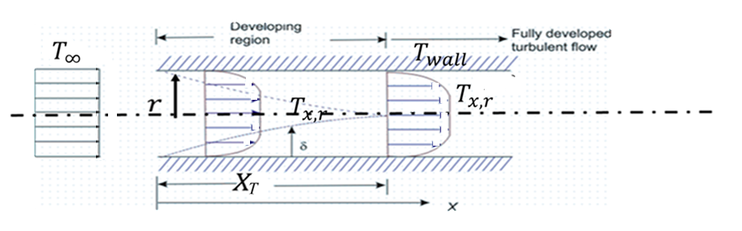
Development of Turbulent Temperature Profile in a Pipe/ Duct
In internal turbulent forced convection, the thermal entrance region is where the temperature profile evolves from its initial state at the inlet (typically uniform) toward a persistent shape known as the thermally fully developed profile.
Profile Evolution in the Entry Region
As fluid enters a heated or cooled pipe, a thermal boundary layer begins to grow from the walls toward the center line.

Slide 4
Development of Turbulent Temperature Profile in a Pipe/ Duct
Near the Inlet (x~0): The temperature profile is nearly flat (plug-like) because the wall's thermal influence is confined to a very thin layer.
Heat transfer is at its maximum here due to the steep temperature gradient at the wall.

Slide 5
Development of Turbulent Temperature Profile in a Pipe/ Duct
Boundary Layer Growth: As the fluid moves downstream, the thermal boundary layer thickens until it meets the layer from the opposite wall.
This merging signifies that the entire fluid mass is now thermally influenced by the wall.

Slide 6
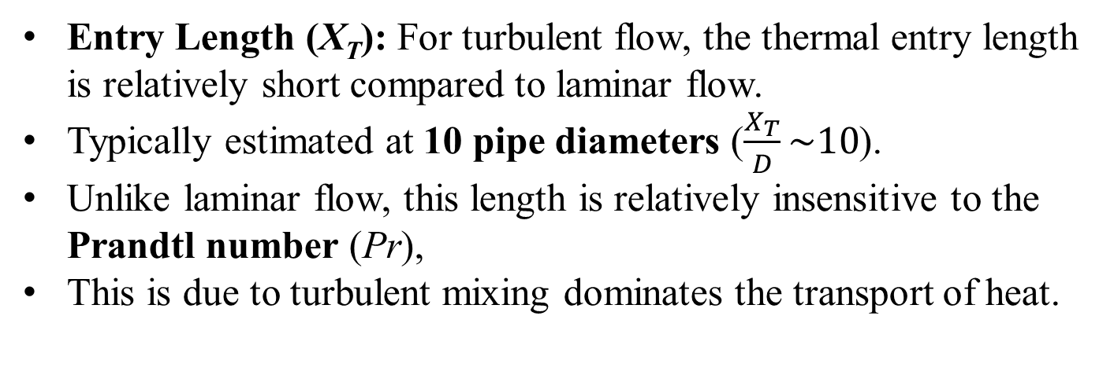
Development of Turbulent Temperature Profile in a Pipe/ Duct
Entry Length (X_{T}): For turbulent flow, the thermal entry length is relatively short compared to laminar flow.
Typically estimated at 10 pipe diameters ($\frac{X_{T}}{D}\sim 10$).
Unlike laminar flow, this length is relatively insensitive to the Prandtl number (Pr),
This is due to turbulent mixing dominates the transport of heat.

Slide 7
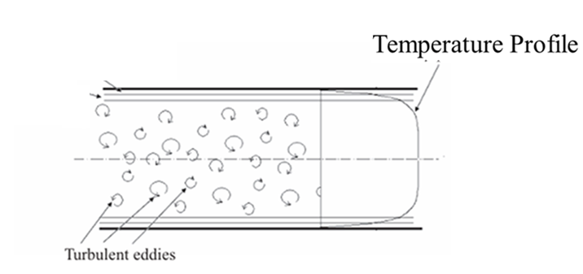
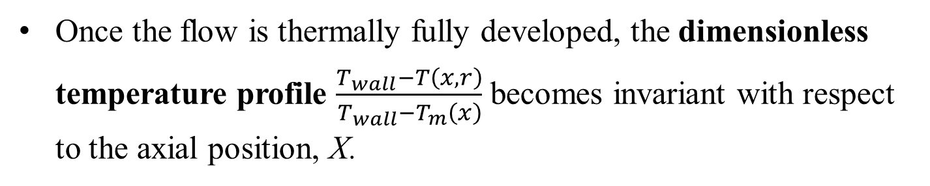
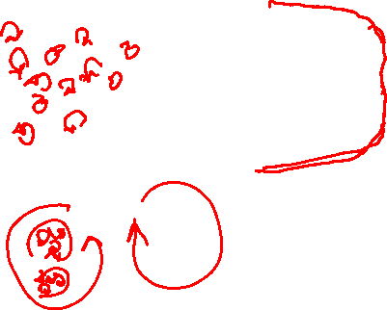
Fully Developed Profile Characteristics
Reynolds Averaged
Once the flow is thermally fully developed, the dimensionless temperature profile $\frac{T_{wall}−T\left(x,r\right)}{T_{wall}−T_{m}\left(x\right)}$ becomes invariant with respect to the axial position, X.

Slide 8
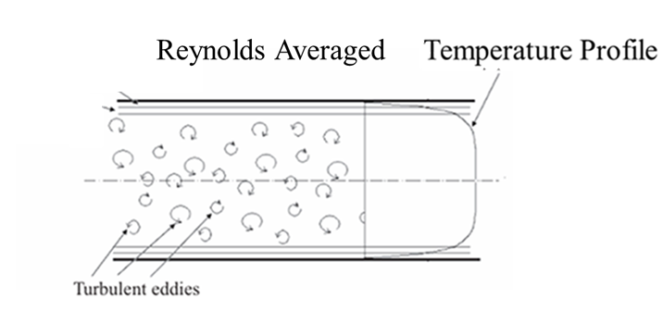
Fully Developed Profile Characteristics
Shape: The profile is significantly "flatter" than the parabolic profiles seen in laminar flow due to intense turbulent mixing in the core.

Slide 9
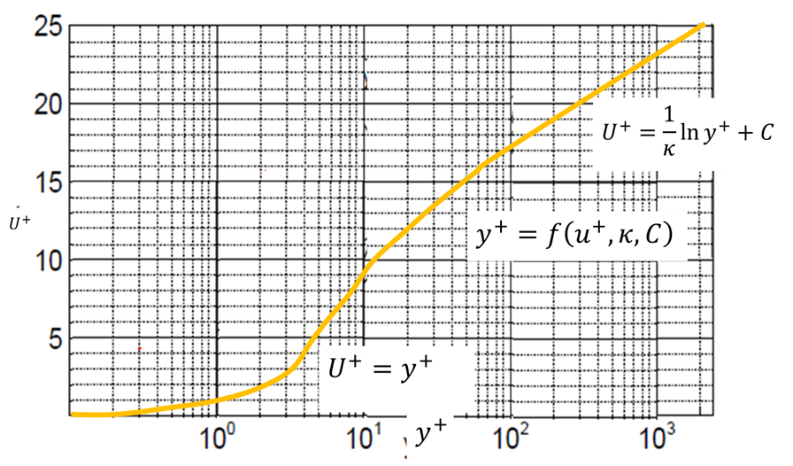
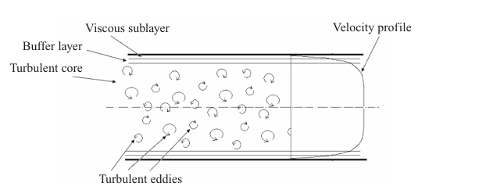
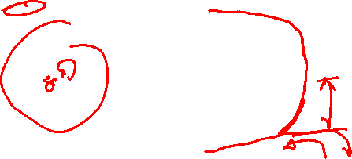
Prandtl’s Analogy between FPBL & Full Developed Turbulent Flow through A Duct
Fully Developed Profile Characteristics
Structure: It is generally divided into three layers:

Slide 10
Prandtl’s Analogy between FPBL & Full Developed Turbulent Flow through A Duct
  Viscous/Laminar Sublayer: A very thin region near the wall where conduction is the primary heat transfer mode.
  Buffer Layer: A transition zone where both conduction and turbulent eddies contribute.
  Turbulent Core: The central region where large-scale eddies cause rapid mixing, maintaining a nearly uniform temperature.

Slide 11
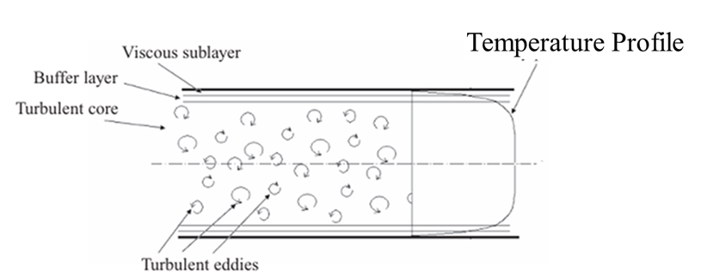
Fully Developed Profile Characteristics
Thermal Sublayer
Prandtl Number Effect: While the development length is stable, the profile's shape near the wall is sensitive to Pr.
High Pr fluids (like oils) have very thin thermal sublayers,
Low Pr fluids (like liquid metals) have thermal effects that extend deep into the flow.

Slide 12
Fully Developed Profile Characteristics: Mathematical Models
Thermal Sublayer
Assignment 2: Explore how these profiles change under specific boundary conditions, such as constant wall heat flux versus constant wall temperature!
Modern research often uses a compound profile approach to describe these distributions:
Inner Layer: Follows a "law-of-the-wall" for temperature, typically a logarithmic function in the region just outside the sublayer.
Core (Wake) Layer: Approximated by a quadratic distribution (defect form) that accounts for the peak temperature at the centerline.

Slide 13
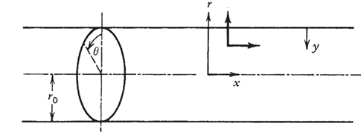
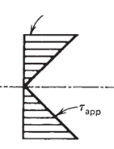





Stanton’s Analogy between Apparent Shear Stress & Heat Flux Profiles
For a Turbulent Forced Convection in a Circular Duct:
$$τ_{wall}$$
$$q_{wall}^{′′}$$
$$V_{r}$$
$$V_{x}$$
$$q_{app}^{′′}$$

Slide 14

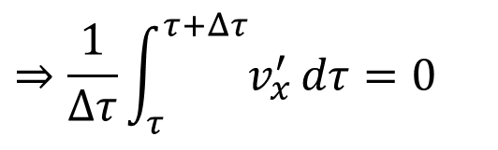
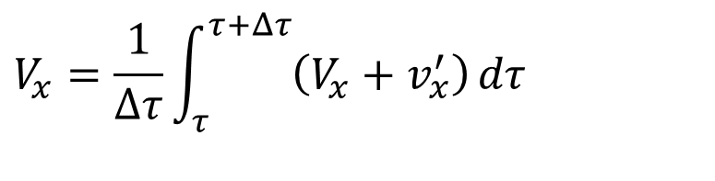
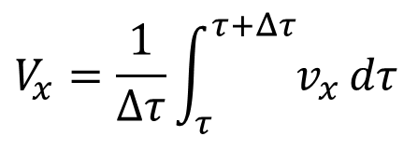


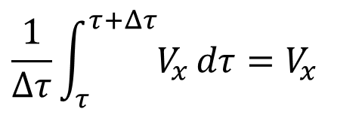
Turbulent Developing Mean Flow in A Circular Duct
For an axi-symmetric developing turbulent flow:
$$v_{x}=V_{x}+v_{x}^{′}$$
$$v_{r}=V_{r}+v_{r}^{′}$$
$$p=P=p′$$
$$V_{x}=\frac{1}{Δτ}\int_{τ}^{τ+Δτ}{v_{x}}dτ$$
$$⇒\frac{1}{Δτ}\int_{τ}^{τ+Δτ}{v_{x}^{′}}dτ=0$$
$$V_{x}=\frac{1}{Δτ}\int_{τ}^{τ+Δτ}{\left(V_{x}+v_{x}^{′}\right)}dτ$$
$$\frac{1}{Δτ}\int_{τ}^{τ+Δτ}{V_{x}}dτ=V_{x}$$

Slide 15
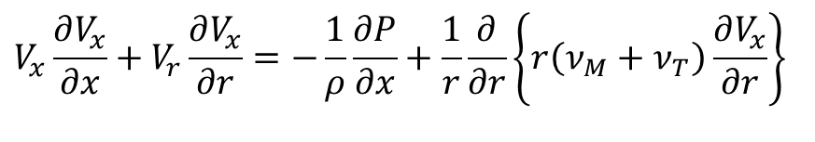
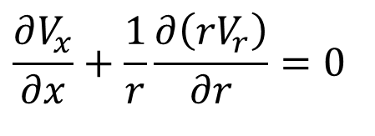
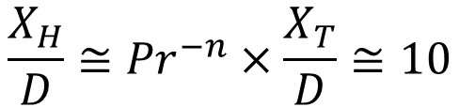
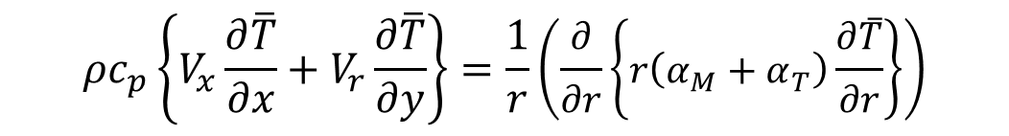
Reynolds Averaged Equations for Developing Turbulent Forced Convection in A Pipe
$$\frac{∂V_{x}}{∂x}+\frac{1}{r}\frac{∂\left(rV_{r}\right)}{∂r}=0$$
$$V_{x}\frac{∂V_{x}}{∂x}+V_{r}\frac{∂V_{x}}{∂r}=−\frac{1}{ρ}\frac{∂P}{∂x}+\frac{1}{r}\frac{∂}{∂r}\left\{r\left(ν_{M}+ν_{T}\right)\frac{∂V_{x}}{∂r}\right\}$$
$${ρc}_{p}\left\{V_{x}\frac{∂\overline{T}}{∂x}+V_{r}\frac{∂\overline{T}}{∂y}\right\}=\frac{1}{r}\left(\frac{∂}{∂r}\left\{r\left(α_{M}+α_{T}\right)\frac{∂\overline{T}}{∂r}\right\}\right)$$
It is observed that the turbulent convection flow becomes hydrodynamically and thermally fully developed after a relatively short distance from the entrance to the tube,
$$\frac{X_{H}}{D}≅{Pr}^{−n}×\frac{X_{T}}{D}≅10$$

Slide 16

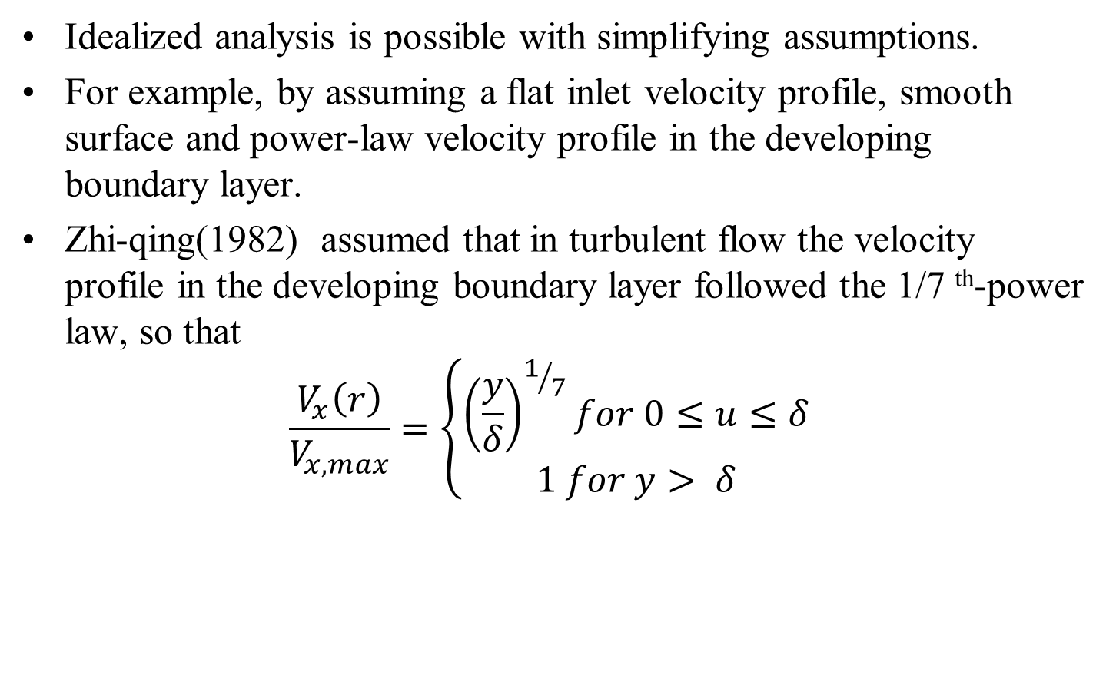
Developing Turbulent Velocity Profile in A Circular Duct
Idealized analysis is possible with simplifying assumptions.
For example, by assuming a flat inlet velocity profile, smooth surface and power-law velocity profile in the developing boundary layer.
Zhi-qing(1982) assumed that in turbulent flow the velocity profile in the developing boundary layer followed the 1/7 ^{th}-power law, so that
$$\frac{V_{x}\left(r\right)}{V_{x,max}}=\left\{\begin{matrix}{\left(\frac{y}{δ}\right)}^{1/7}for 0≤u≤δ \\ 1 for y> δ\end{matrix} \right.$$

Slide 17
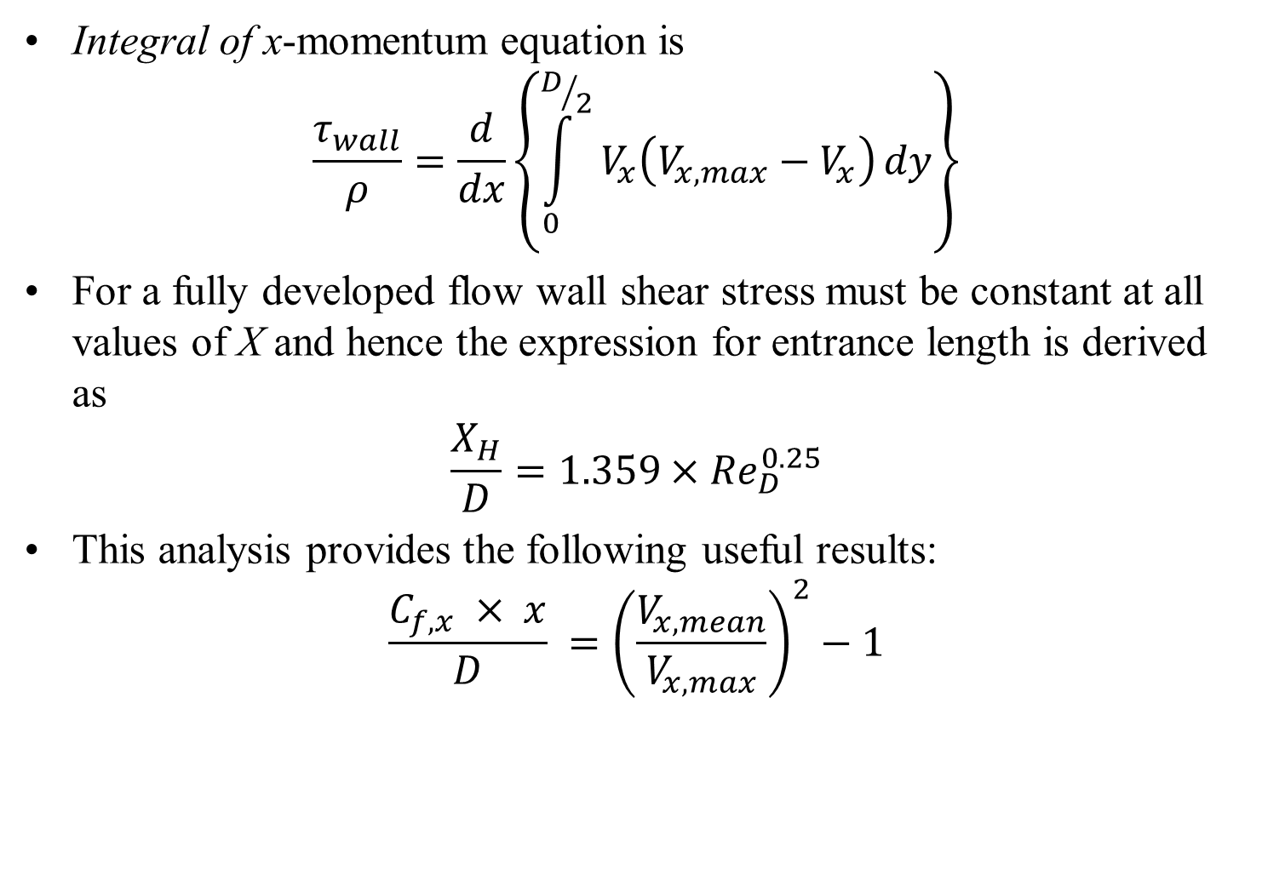
Developing Turbulent Velocity Profile in A Circular Duct : Integral Method
Integral of x-momentum equation is
$$\frac{τ_{wall}}{ρ}=\frac{d}{dx}\left\{\int_{0}^{D/2}{V_{x}\left(V_{x,max}−V_{x}\right)}dy\right\}$$
For a fully developed flow wall shear stress must be constant at all values of X and hence the expression for entrance length is derived as
$$\frac{X_{H}}{D}=1.359×{Re}_{D}^{0.25}$$
This analysis provides the following useful results:
$$\frac{C_{f,x} × x}{D} ={\left(\frac{V_{x,mean}}{V_{x,max}}\right)}^{2}−1$$

Slide 18
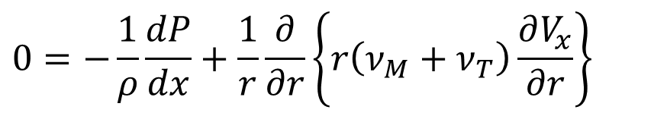
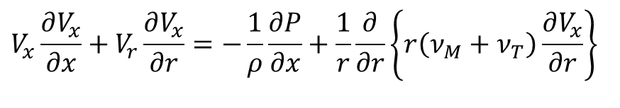
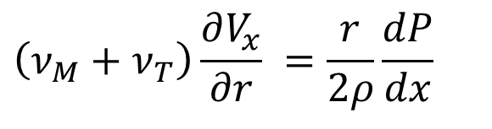
Reynolds Averaged Equations for Fully Developed Turbulent Convection in A Pipe
$$V_{x}\frac{∂V_{x}}{∂x}+V_{r}\frac{∂V_{x}}{∂r}=−\frac{1}{ρ}\frac{∂P}{∂x}+\frac{1}{r}\frac{∂}{∂r}\left\{r\left(ν_{M}+ν_{T}\right)\frac{∂V_{x}}{∂r}\right\}$$
The first feature that distinguishes the pipe flow from the boundary layer flow is that if the pipe flow is fully developed, the inertia terms vanish from the X-momentum equation
$$0=−\frac{1}{ρ}\frac{dP}{dx}+\frac{1}{r}\frac{∂}{∂r}\left\{r\left(ν_{M}+ν_{T}\right)\frac{∂V_{x}}{∂r}\right\}$$
Where dP/dx is a function of x only.
$$\left(ν_{M}+ν_{T}\right)\frac{∂V_{x}}{∂r} =\frac{r}{2ρ}\frac{dP}{dx}$$

Slide 19

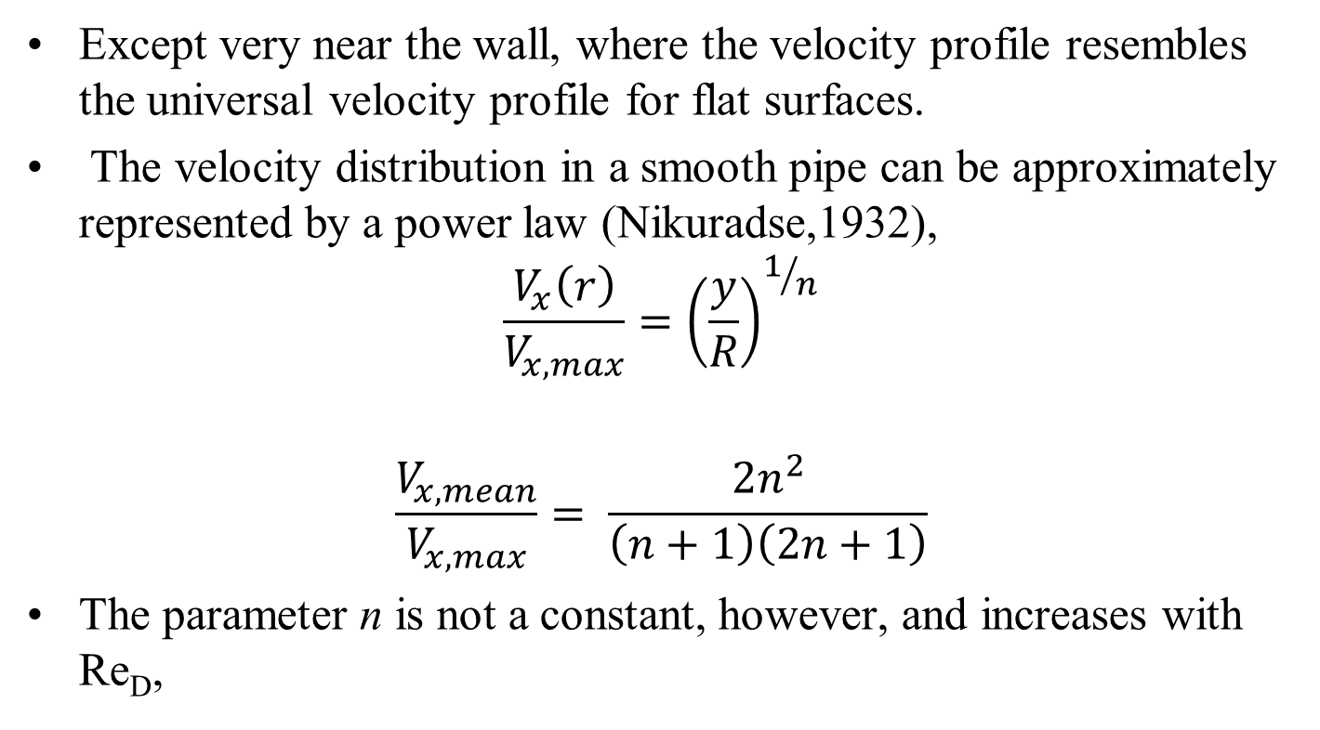
Fully Developed Turbulent Velocity Profile in A Duct : Analogous to Turbulent FPBL
Except very near the wall, where the velocity profile resembles the universal velocity profile for flat surfaces.
The velocity distribution in a smooth pipe can be approximately represented by a power law (Nikuradse,1932),
$$\frac{V_{x}\left(r\right)}{V_{x,max}}={\left(\frac{y}{R}\right)}^{1/n}$$
$$\frac{V_{x,mean}}{V_{x,max}}= \frac{2n^{2}}{\left(n+1\right)\left(2n+1\right)}$$
The parameter n is not a constant, however, and increases with Re_{D},

Slide 20
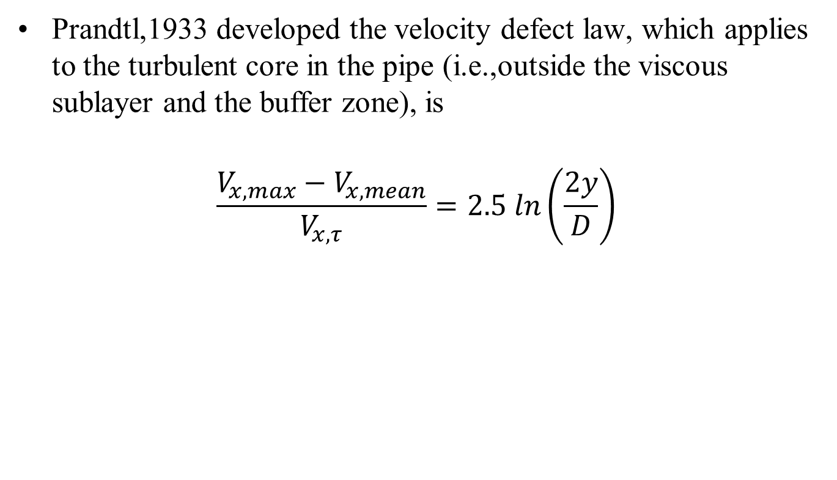
Fully Developed Turbulent Velocity Profile in A Duct
Prandtl,1933 developed the velocity defect law, which applies to the turbulent core in the pipe (i.e.,outside the viscous sublayer and the buffer zone), is
$$\frac{{V_{x,max}−V}_{x,mean}}{V_{x,τ}}=2.5 ln\left(\frac{2y}{D}\right)$$

