Slide 1
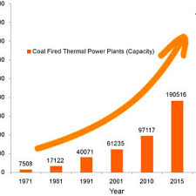

Steady Forced Convection Heat Transfer from A Circular Cylinder
P M V Subbarao
Professor
Mechanical Engineering Department
I I T Delhi
Solutions to most important Geometrical Configuration for Abundant Power generation....

Slide 2


Steady Energy Equation for a Laminar Forced Convection from A Cylinder
$${ρ_{0}c}_{p}\left\{\frac{∂ψ}{∂y}\frac{∂T}{∂x}−\frac{∂ψ}{∂x}\frac{∂T}{∂y}\right\}=k\left\{\frac{∂^{2}T}{∂x^{2}}+\frac{∂^{2}T}{∂y^{2}}\right\}$$
For a circular cylinder with finite radius, it is convenient to use polar coordinate system (r, η).
In order to get a simplified equation in polar coordinate system, replace r with a new coordinates system:
$$ζ=ln\left(\frac{r}{R}\right)$$

Slide 3
Steady Energy Equation for a Convection from A Cylinder
$${ρ_{0}c}_{p}\left\{\frac{∂ψ}{∂η}\frac{∂T}{∂ζ}−\frac{∂ψ}{∂ζ}\frac{∂T}{∂η}\right\}=k\left\{\frac{∂^{2}T}{∂ζ^{2}}+\frac{∂^{2}T}{∂η^{2}}\right\}$$
Define non-dimensional temperature as
$$θ=\frac{T−T_{∞}}{T_{cyl}−T_{∞}}$$
$${ρ_{0}c}_{p}\left\{\frac{∂ψ}{∂η}\frac{∂θ}{∂ζ}−\frac{∂ψ}{∂ζ}\frac{∂θ}{∂η}\right\}=k\left\{\frac{∂^{2}θ}{∂ζ^{2}}+\frac{∂^{2}θ}{∂η^{2}}\right\}$$

Slide 4
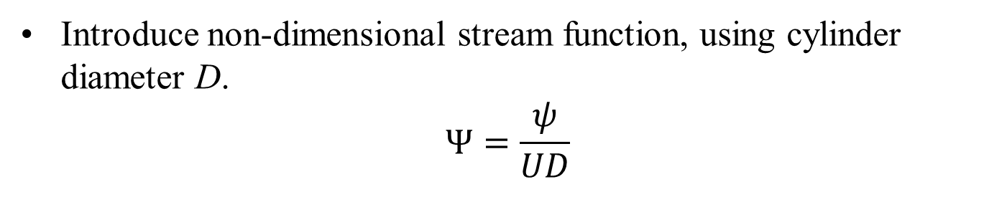
Steady Energy Equation for a Convection from A Cylinder
$${ρ_{0}c}_{p}\left\{\frac{∂ψ}{∂η}\frac{∂θ}{∂ζ}−\frac{∂ψ}{∂ζ}\frac{∂θ}{∂η}\right\}=k\left\{\frac{∂^{2}θ}{∂ζ^{2}}+\frac{∂^{2}θ}{∂η^{2}}\right\}$$
Introduce non-dimensional stream function, using cylinder diameter D.
$$Ψ=\frac{ψ}{UD}$$
$$\left\{\frac{∂Ψ}{∂η}\frac{∂θ}{∂ζ}−\frac{∂Ψ}{∂ζ}\frac{∂θ}{∂η}\right\}=\frac{2}{Re Pr}\left\{\frac{∂^{2}θ}{∂ζ^{2}}+\frac{∂^{2}θ}{∂η^{2}}\right\}$$

Slide 5
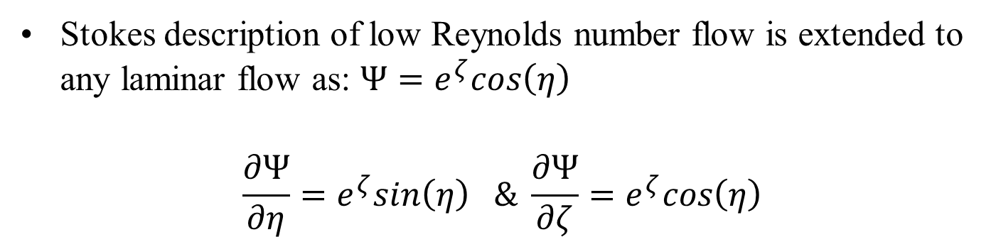
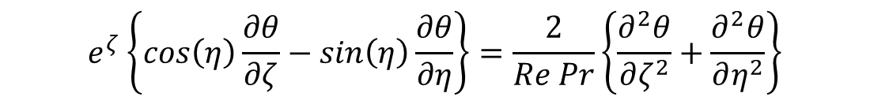

Steady Energy Equation for a Convection from A Cylinder
$$\left\{\frac{∂Ψ}{∂η}\frac{∂θ}{∂ζ}−\frac{∂Ψ}{∂ζ}\frac{∂θ}{∂η}\right\}=\frac{2}{Re Pr}\left\{\frac{∂^{2}θ}{∂ζ^{2}}+\frac{∂^{2}θ}{∂η^{2}}\right\}$$
Stokes description of low Reynolds number flow is extended to any laminar flow as: $Ψ=e^{ζ}cos\left(η\right)$
$$\frac{∂Ψ}{∂η}=e^{ζ}sin\left(η\right) \& \frac{∂Ψ}{∂ζ}=e^{ζ}cos\left(η\right)$$
$$e^{ζ}\left\{cos\left(η\right)\frac{∂θ}{∂ζ}−sin\left(η\right)\frac{∂θ}{∂η}\right\}=\frac{2}{Re Pr}\left\{\frac{∂^{2}θ}{∂ζ^{2}}+\frac{∂^{2}θ}{∂η^{2}}\right\}$$

Slide 6
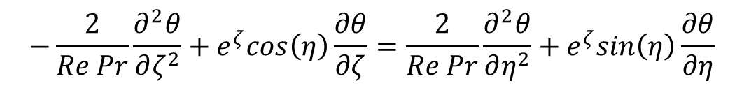
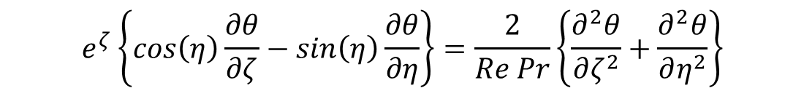
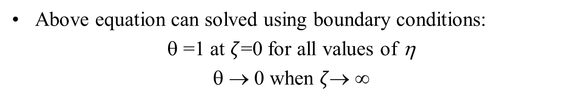
Steady Energy Equation for a Convection from A Cylinder
$$e^{ζ}\left\{cos\left(η\right)\frac{∂θ}{∂ζ}−sin\left(η\right)\frac{∂θ}{∂η}\right\}=\frac{2}{Re Pr}\left\{\frac{∂^{2}θ}{∂ζ^{2}}+\frac{∂^{2}θ}{∂η^{2}}\right\}$$
Above equation can solved using boundary conditions:
θ =1 at $ζ$=0 for all values of η
θ → 0 when $ζ\text{→ }∞$
$${−\frac{2}{Re Pr}\frac{∂^{2}θ}{∂ζ^{2}}+e}^{ζ}cos\left(η\right)\frac{∂θ}{∂ζ}=\frac{2}{Re Pr}\frac{∂^{2}θ}{∂η^{2}}+e^{ζ}sin\left(η\right)\frac{∂θ}{∂η}$$

Slide 7
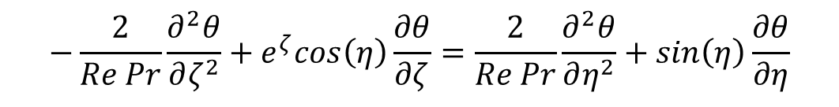
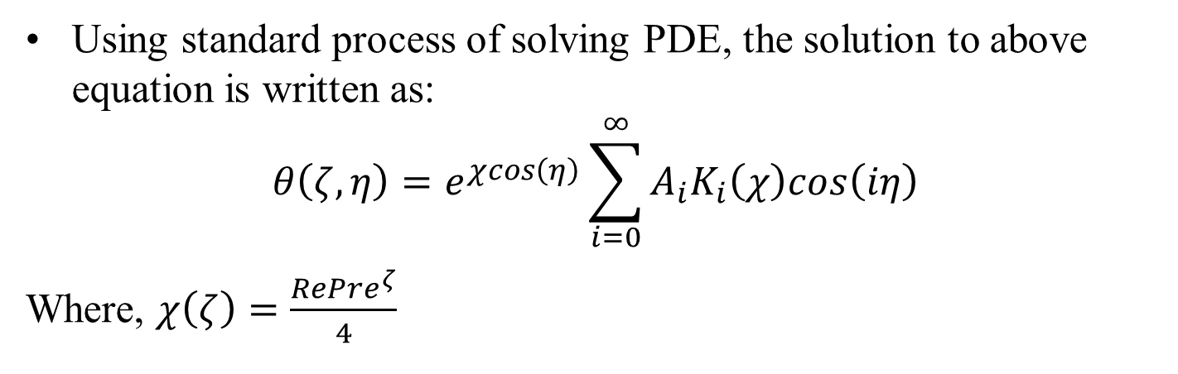
Steady Energy Equation for a Convection from A Cylinder
$${−\frac{2}{Re Pr}\frac{∂^{2}θ}{∂ζ^{2}}+e}^{ζ}cos\left(η\right)\frac{∂θ}{∂ζ}=\frac{2}{Re Pr}\frac{∂^{2}θ}{∂η^{2}}+sin\left(η\right)\frac{∂θ}{∂η}$$
Using standard process of solving PDE, the solution to above equation is written as:
$$θ\left(ζ,η\right)=e^{χcos\left(η\right)}\sum_{i=0}^{∞}{A_{i}K_{i}\left(χ\right)cos\left(iη\right)}$$
Where, $χ\left(ζ\right)=\frac{RePre^{ζ}}{4}$

Slide 8
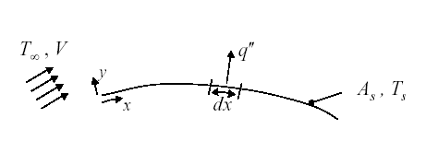
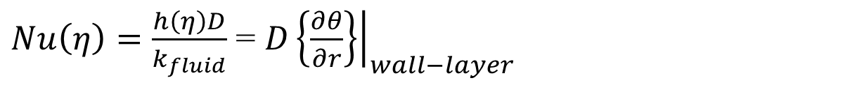
Analysis of Heat Transfer in Equilibrium Layer
At Thermodynamic equilibrium
U
r or ζ
$$T_{fluid,wall}=T_{wall}$$
A_{cyl}, T_{cyl}
η
$$θ=\frac{T−T_{∞}}{T_{cyl}−T_{∞}}$$
At the wall for fluid layer :
$$−k_{fluid}A\left\{\frac{∂T}{∂r}\right\}=hA\left\{T_{fluid,wall}−T_{∞}\right\}$$
$h\left(η\right)=−\frac{k_{fluid}{\left.\left\{\frac{∂T}{∂y}\right\}\right|}_{wall−layer}}{\left\{T_{wall}−T_{∞}\right\}}$ = $k_{fluid}{\left.\left\{\frac{∂θ}{∂r}\right\}\right|}_{wall−layer}$
$Nu\left(η\right)=\frac{h\left(η\right)D}{k_{fluid}}$ = ${D\left.\left\{\frac{∂θ}{∂r}\right\}\right|}_{wall−layer}$

Slide 9

Estimation of Local Nusselt Number
$Nu\left(η\right)=\frac{h\left(η\right)D}{k_{fluid}}$ = ${D\left.\left\{\frac{∂θ}{∂r}\right\}\right|}_{wall−layer}$
Estimation of local Nusselt number is basically computation of non-dimensional temperature profile in equilibrium fluid layer.
Provoked a general theoretical and experimental study to understand how the equilibrium layer is developed.
The global geometry of the solid wall and flow conditions will decide the structure of stagnant layer.
Basic Geometry : External Flow past A cylinder.

Slide 10
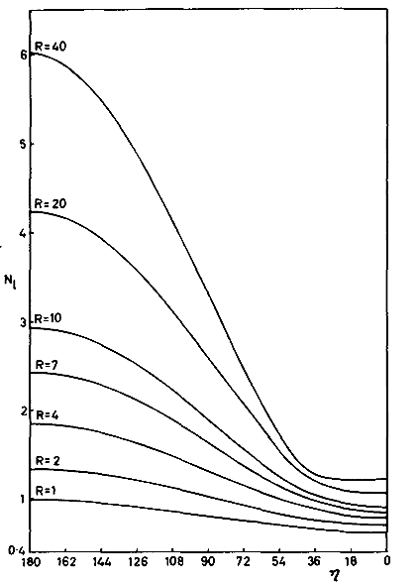
Distribution of Local (Angular) Nusselt Number
Pr = 0.73
Nu_{local}
η

Slide 11
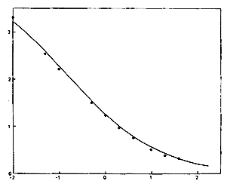
Variation of Average Nusselt Number in Laminar Forced Convection
Pr = 0.73
$$\frac{1}{{Nu}_{avg}}$$
$$\log_{10}{Re}$$

Slide 12
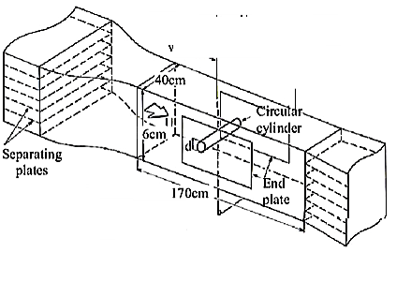
Laminar Forced Convection from A Cylinder in Cross Flow: Wind Tunnel Studies
Pr = 0.73

Slide 13
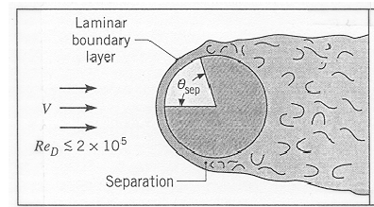
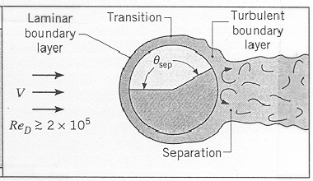
Forced Convection due to Cylinder in Cross Flow

Slide 14

Distribution of Local Nusselt Number on a Cylinder Surface
Nu distributions around a circular cylinder in the Re ranges 4 × 10³ to 5 × 10⁴ for air as working fluid.
Nu is a maximum at η = 0°, where skin-friction is zero!
In this region, the flow is similar to that occurring at the stagnation point for flow normal to a flat-plate.

Slide 15
Distribution of Local Nusselt Number on a Cylinder Surface
Nu distributions around a circular cylinder in the Re ranges 4 × 10³ to 5 × 10⁴ for air as working fluid.
Nu decreases to a minimum near the separation point, at the side of the cylinder, and then increases in the wake.
Most heat transfer occurs through the front half of the cylinder.

Slide 16
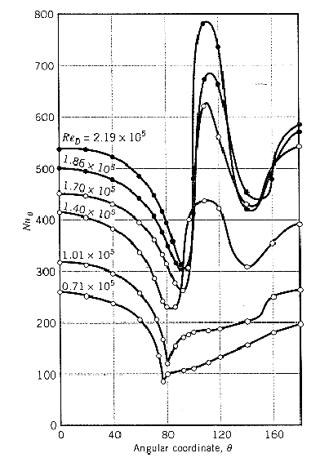
Distribution of Local (Angular) Nusselt Number
Pr = 0.73
η

Slide 17
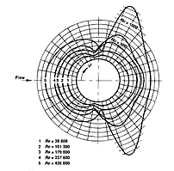
Distribution of Local Nusselt Number on a Cylinder Surface
Nu distributions around a circular cylinder in the Re ranges 3.98 × 10⁴ to 4.26 × 10⁵ for air as working fluid.
As Re increases, heat transfer in the latter half increases due to wake-turbulence.

Slide 18
Distribution of Local Nusselt Number on a Cylinder Surface
Nu distributions around a circular cylinder in the Re ranges 3.98 × 10⁴ to 4.26 × 10⁵ for air as working fluid.
At Re = 2 × 10⁵, a turbulent thermal boundary layer is established, and the Nu distribution is quite complex.
There exist twin minima occurring at around 90° and 140°.
Probably due to laminar-to-turbulent transition in the boundary-layer and boundary-layer separation, respectively.

Slide 19
Distribution of Local Nusselt Number on a Cylinder Surface
Nu distributions around a circular cylinder in the Re ranges 3.98 × 10⁴ to 4.26 × 10⁵ for air as working fluid.
At high Re, there is a large Nu maximum in the turbulent boundary-layer around φ = 110°.
Heat transfer at the rear stagnation-point is by now as much as at the front stagnation point.

Slide 20
Average Nusselt Number
Generally, the overall average Nusselt number for heat transfer with the entire object is important.
As with a flat plate, correlations developed from experimental data to compute Nu as a f(Re^{m},Pr^{n})
Overall Average Nusselt number
$$\overline{Nu_{D}}= \frac{\bar{h}D}{k} = C {Re}_{D}^{m}{ }{Pr}^{1/3}{ }{\left(\frac{Pr}{{Pr}_{s}}\right)}^{1/4} \\ \text{Valid} \text{for}\text{: }\left[\begin{matrix}0.7<\operatorname{Pr}{<}500 \\ 1<{Re}_{D}{<}10^{6}\end{matrix}\right]$$
All properties are evaluated at the freestream temperature, except Pr_{s}
which is evaluated at the surface temperature.

Slide 21
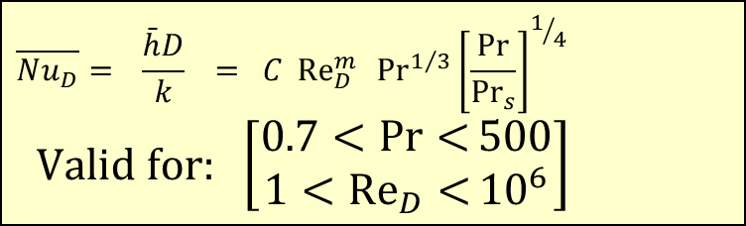
Average Nusselt Number
$$\overline{Nu_{D}}= \frac{\bar{h}D}{k} = C {Re}_{D}^{m}{ }{Pr}^{1/3}{{\left[\frac{Pr}{{Pr}_{s}}\right]}^{1/4} } \\ \text{Valid} \text{for}\text{: }\left[\begin{matrix}0.7<\operatorname{Pr}{<}500 \\ 1<{Re}_{D}{<}10^{6}\end{matrix}\right]$$
Values for C and m
Re_{D} | C | m
1 -40 | 0.75 | 0.4
40 - 1000 | 0.51 | 0.5
1000 – 2X 10⁵ | 0.26 | 0.6
2X 10⁵ - 10⁶ | 0.076 | 0.7
Expect an accuracy within ± 20% with these correlations

Slide 22
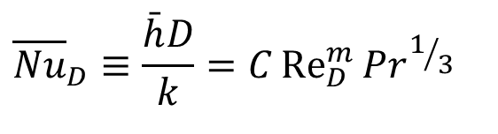
Cylinder in Cross Flow
The empirical correlation due to Hilpert
$${\overline{Nu}}_{D}≡\frac{\bar{h}D}{k}=C{Re}_{D}^{m}{{Pr}^{1/3}}$$
Re_{D} | C | m
0.4 -4 | 0.989 | 0.330
4 - 40 | 0.911 | 0.385
40 -- 4000 | 0.683 | 0.466
4000 -- 40000 | 0.193 | 0.618
40000 -- 400000 | 0.027 | 0.805

Slide 23
Remarks on Convection in Flow Past A Single Tube
A single tube is often inefficient or insufficient for completely cooling hot gas because it provides limited surface area for heat transfer.
This leads to low efficiency, high back-pressure, and the potential for a large temperature difference between the gas and the cooling medium.
To effectively cool hot gas, multiple tubes, larger surface areas, or alternative methods are required

Slide 24
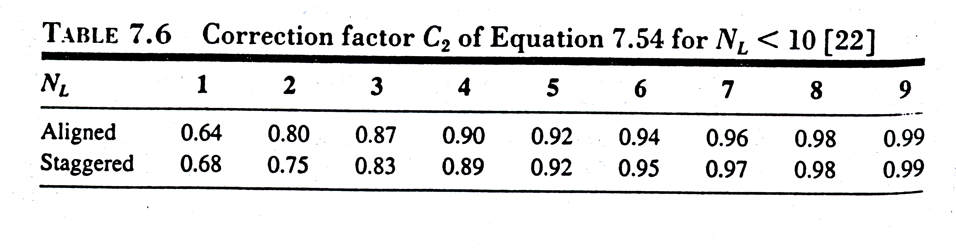
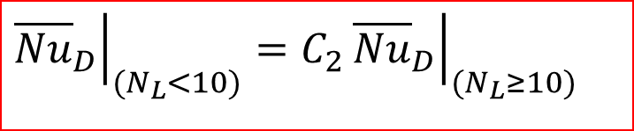
Convection in Flow Past A Tube Row
If number of tubes are less than 10, a correction factor is applied as:
$${\left.{\overline{Nu}}_{D}\right|}_{(N_{L}<10)}=C_{2}{\left.{\overline{Nu}}_{D}\right|}_{(N_{L}≥10)}$$
And values for C₂ are from table

Slide 25
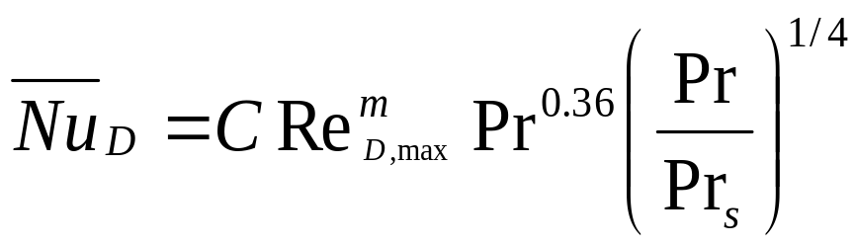
Convection in Flow Past Tube Rows
More recent results have been obtained by Zhukauskas.
$$\text{valid} \text{for}\text{: }\left[\begin{aligned}&1000< \\ {Re}_{6D,max}{0.7<Pr<\text{500}} \\ &N_{L}≥20\end{aligned}\right]$$
All properties except Pr_{s} are evaluated at the arithmetic mean of the fluid inlet and outlet temperatures.
Values for C and m.
$${\left.{\overline{Nu}}_{D}\right|}_{(N_{L}<20)}=C_{2}{\left.{\overline{Nu}}_{D}\right|}_{(N_{L}≥20)}$$

Slide 26
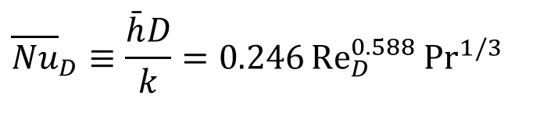
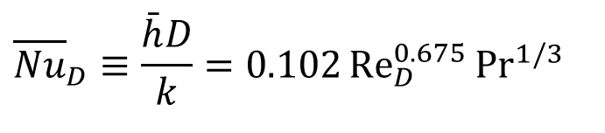
Square Cylinder in Cross Flow
$${\overline{Nu}}_{D}≡\frac{\bar{h}D}{k}=0.246{Re}_{D}^{0.588}{{Pr}^{1/3}}$$
D
Valid for 5 X 10³ < Re_{D} < 10⁵
$${\overline{Nu}}_{D}≡\frac{\bar{h}D}{k}=0.102{Re}_{D}^{0.675}{{Pr}^{1/3}}$$
D
Valid for 5 X 10³ < Re_{D} < 10⁵

Slide 27
Hexagonal Cylinder in Cross Flow
$${\overline{Nu}}_{D}≡\frac{\bar{h}D}{k}=0.160{Re}_{D}^{0.638}{{Pr}^{1/3}{}}$$
Valid for 5 X 10³ < Re_{D} <1.95X10⁴
D
$${\overline{Nu}}_{D}≡\frac{\bar{h}D}{k}=0.0385{Re}_{D}^{0.782}{{Pr}^{1/3}{}}$$
Valid for 1.95X10⁴ < Re_{D} < 10⁵
$${\overline{Nu}}_{D}≡\frac{\bar{h}D}{k}=0.153{Re}_{D}^{0.638}{{Pr}^{1/3}{}}$$
D
Valid for 5 X 10³ < Re_{D} < 10⁵

Slide 28
Vertical Plate in Cross Flow
$${\overline{Nu}}_{D}≡\frac{\bar{h}D}{k}=0.228{Re}_{D}^{0.731}{{Pr}^{1/3}{}}$$
D
Valid for 4 X 10³ < Re_{D} < 1.5 X10⁴

Slide 29
Convection heat transfer with a sphere
External flow and heat transfer relations are similar to those around a cylinder.
Numerous correlations proposed from lab experiments, one being:
$$\overline{Nu_{D}}= \frac{\bar{h}D}{k} =\text{ 2 }+ (\text{0.4 }{Re}_{D}^{1/2}{ }+\text{ 0.06 }{Re}_{D}^{2/3}{)}{Pr}^{0.4}{ }{\left(\frac{μ}{μ_{s}}\right)}^{1/4} \\ \text{Valid} \text{for}\text{: }\left[\begin{matrix}0.71<\operatorname{Pr}{<}380 \\ \begin{aligned}&3.5<{Re}_{D}{<}7.6×10^{4} \\ & 1.0<\left(\frac{μ}{μ_{s}}\right)<3.2\end{aligned}\end{matrix}\right]$$
All properties except μ_{s} are evaluated at T∞.

Slide 30
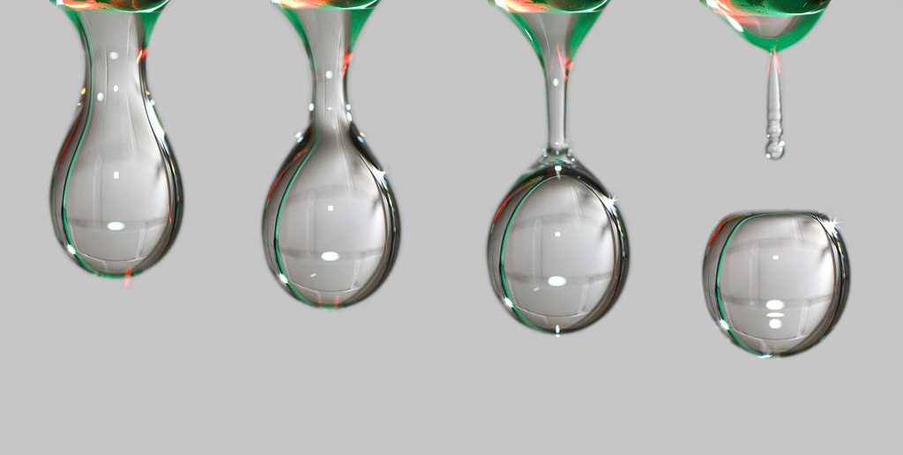
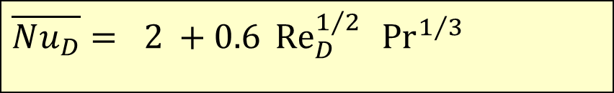
Special case: Free falling liquid drops
$$\overline{Nu_{D}}=\text{ 2 }+\text{0.6 }{Re}_{D}^{1/2}{ }{Pr}^{1/3}{}$$

Slide 31
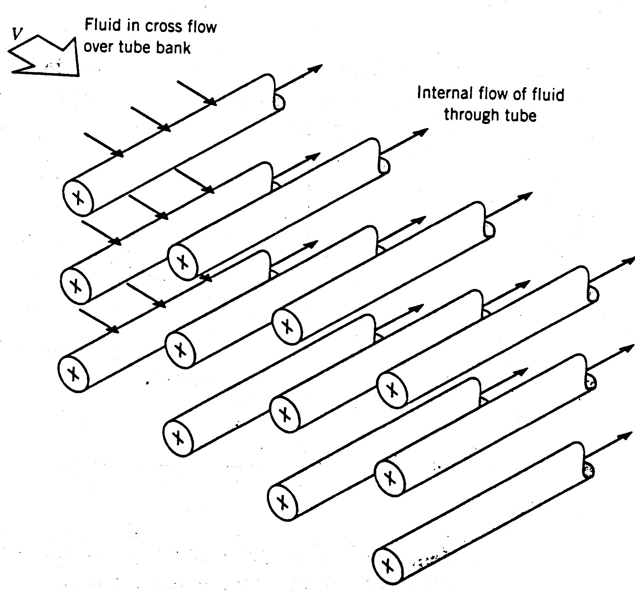
Convection heat transfer with banks of tubes Shell Side
Typically, one fluid moves over the tubes, while a second fluid at a different temperature passes through the tubes. (cross flow)
The tube rows of a bank are staggered or aligned.
The configuration is characterized by the tube diameter D, the transverse pitch S_{T} and longitudinal pitch S_{L}.

Slide 32
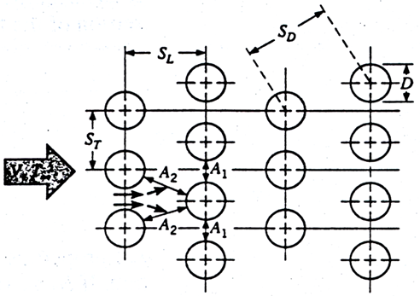
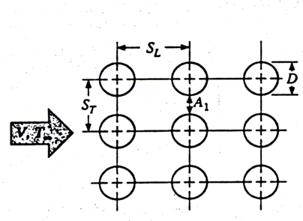
Combined Internal & External Flow
Inline Arrangement
Zig-Zag Arrangement
Square Pitch
Triangular Pitch

Slide 33
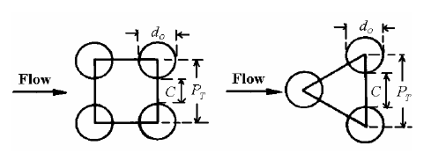
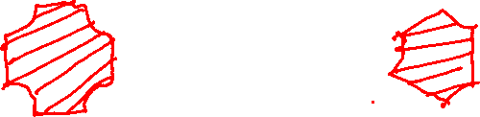
Array of Cylinders in Cross Flow : Hydraulic Diameter
$$D_{h}=\frac{4×\text{Free} \text{Flow} \text{Area}}{\text{Wetted} \text{Perimeter}}$$
The equivalent diameter is calculated as four times the net flow area as layout on the tube bank (for any pitch layout) divided by the wetted perimeter.

Slide 34
Hydraulic Diameter : Square Pitch
d_{o}
P_{T}
P_{T}
$$D_{h}=\frac{4×A_{flow}}{P_{\text{wet}}}=\frac{4\left(P_{T}^{2}−\frac{πd_{o}^{2}}{4}\right)}{πd_{o}}$$

Slide 35
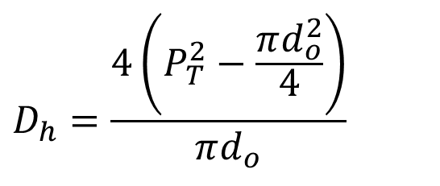
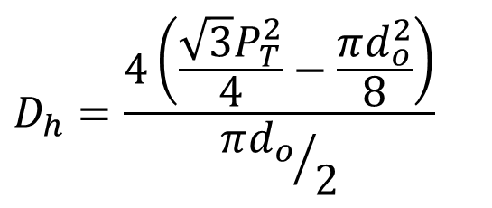
Hydraulic Diameter : Pitch
For square pitch:
$$D_{h}=\frac{4\left(P_{T}^{2}−\frac{πd_{o}^{2}}{4}\right)}{πd_{o}}$$
For triangular pitch:
$$D_{h}=\frac{4\left(\frac{\sqrt{3}P_{T}^{2}}{4}−\frac{πd_{o}^{2}}{8}\right)}{{πd_{o}}/2}$$

Slide 36
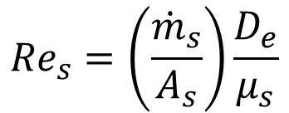

Reynolds Number
The tube clearance C is expressed as:
$$C=P_{T}−d_{O}$$
Then the out-side mass velocity is found with
$$G_{shell}=\frac{{\dot{m}}_{shell}}{A_{s}}$$
Outside Reynolds Number:
$${Re}_{s}=\left(\frac{{\dot{m}}_{s}}{A_{s}}\right)\frac{D_{e}}{μ_{s}}$$

Slide 37
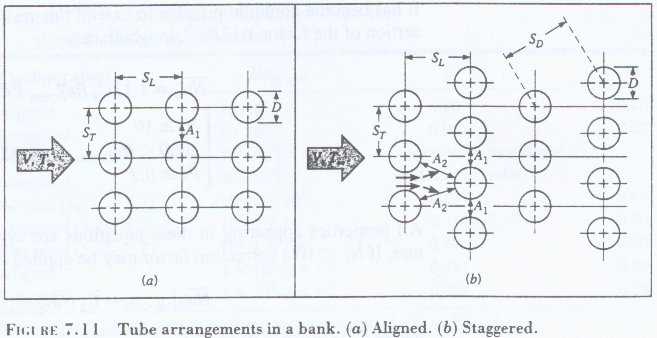
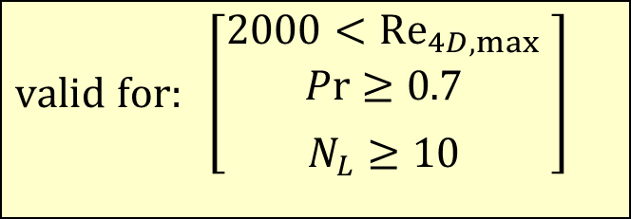
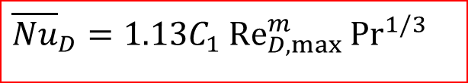
Outside Nusselt Number
For tube bundles composed of 10 or more rows
$$\text{valid} \text{for}\text{: }\left[\begin{aligned}&2000<{Re}_{4D,max} \\ Pr≥\text{0.7} \\ \begin{aligned}& \\ N_{L}≥10\end{aligned}\end{aligned} \right]$$
$${\overline{Nu}}_{D}=1.13C_{1}{Re}_{D,max}^{m}{{Pr}^{1/3}}$$

Slide 38

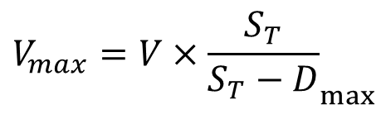

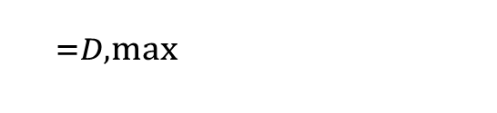
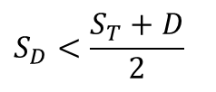
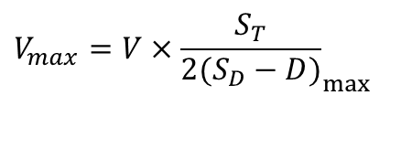
Outside Nusselt Number
$${\overline{Nu}}_{D}=1.13C_{1}{Re}_{D,max}^{m}{{Pr}^{1/3}}$$
$${}_{=D,max}{}$$
For Reynolds number
${Re}_{D,max}=$ $\frac{V_{max}D}{ν}$
$${V_{max}=V×\frac{S_{T}}{S_{T}−D}}_{max}$$
or
$${V_{max}=V×\frac{S_{T}}{2(S_{D}−D)}}_{max}$$
$$S_{D}<\frac{S_{T}+D}{2}$$
If staggered and

Slide 39
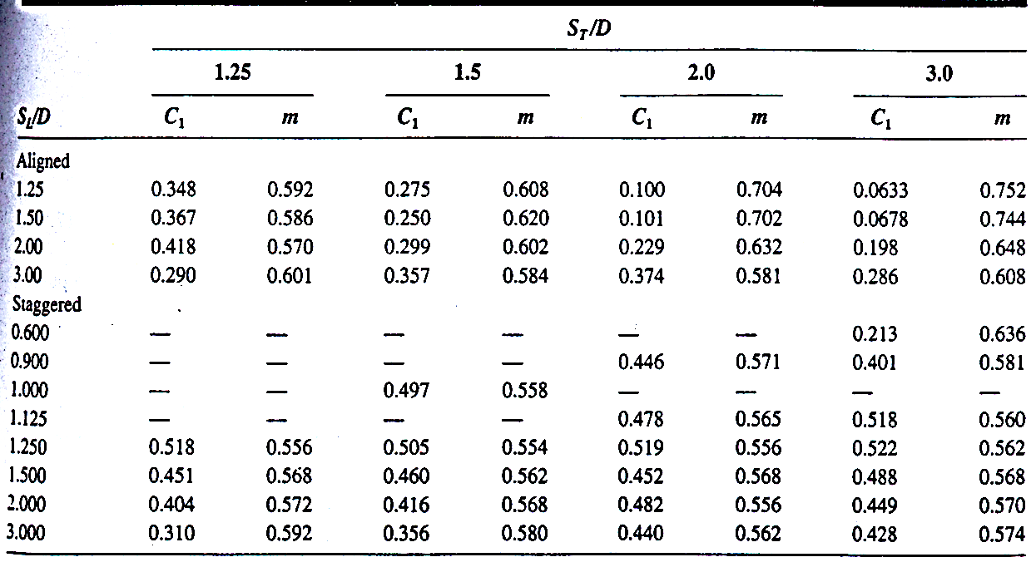

Table of Constants
$${\overline{Nu}}_{D}=1.13C_{1}{Re}_{D,max}^{m}{{Pr}^{1/3}}$$
All properties are evaluated at the film temperature.

