Slide 1

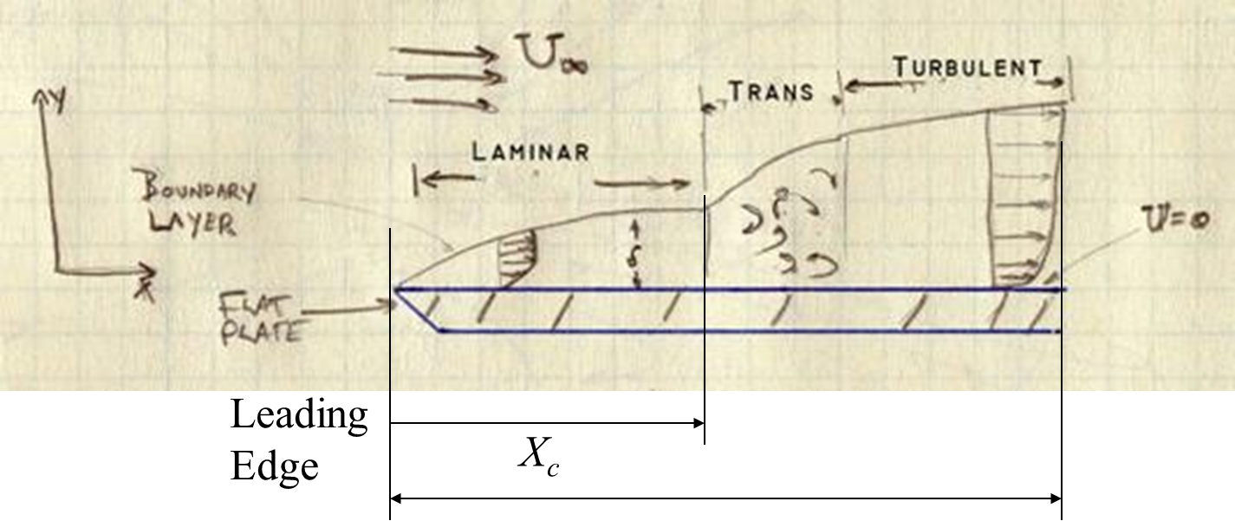
Bluff Body Turbulent Convection Systems
P M V Subbarao
Professor
Mechanical Engineering Department
I I T Delhi
Advanced Wake Engineering for Superior Convection..

Slide 2

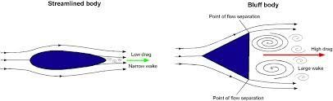
Streamlined Body Vs Bluff Body

Slide 3
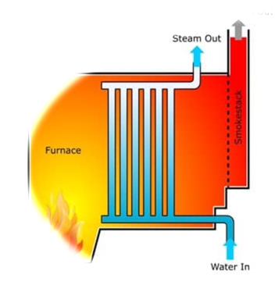
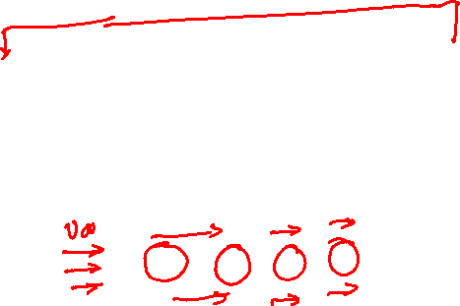
External-Internal Flow Convection Systems
Turbulent Forced Convection from Cylindrical Surfaces
Turbulent Forced Convection in Pipes

Slide 4
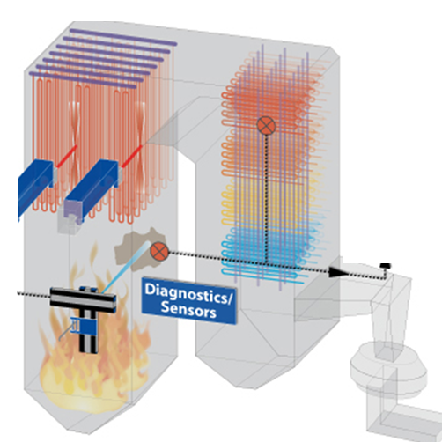
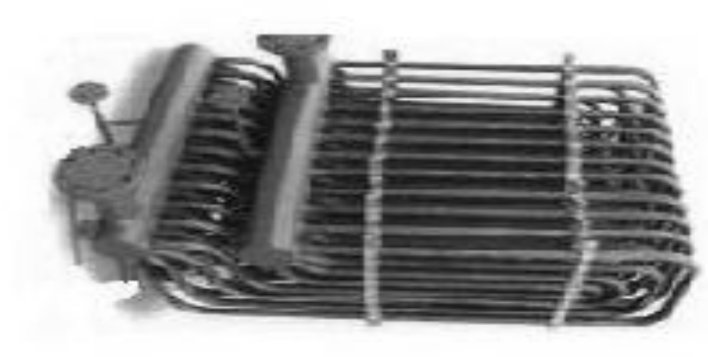
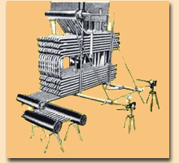
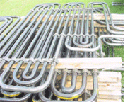
Cross Flow Heat Exchangers in Modern Power Plant Steam Generators

Slide 5
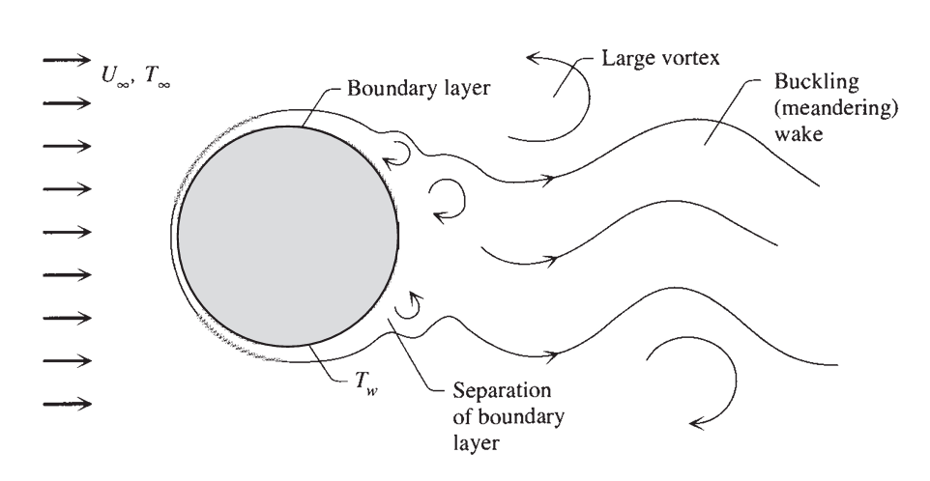
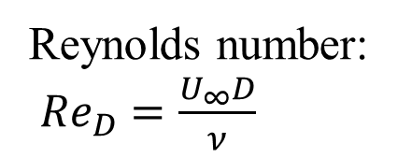
External Flows : Single Cylinder in Cross Flow
Reynolds number:
${Re}_{D}=\frac{U_{∞}D}{ν}$
Consider the heat transfer between a long cylinder oriented across a fluid stream of uniform velocity (U∞) and temperature (T∞).
The temperature of the cylindrical surface is uniform (T_{w}).
There are many heat transfer correlations for this configuration, but generally speaking, they are not in very good agreement with the experimental data.

Slide 6
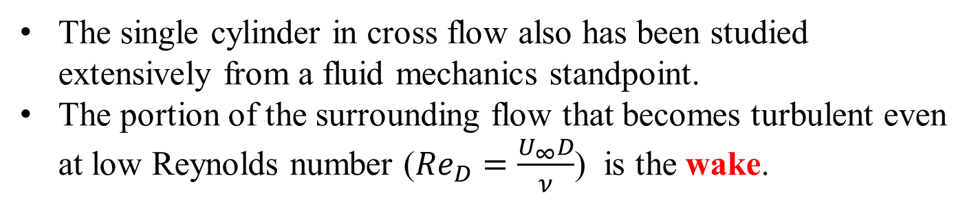
External Flows : Single Cylinder in Cross Flow
The single cylinder in cross flow also has been studied extensively from a fluid mechanics standpoint.
The portion of the surrounding flow that becomes turbulent even at low Reynolds number (${Re}_{D}=\frac{U_{∞}D}{ν}$) is the wake.

Slide 7


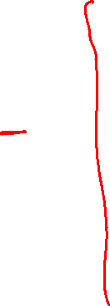
Regimes of Cross Flow Past A Cylinder
When the Reynolds number is of order 5 or smaller, the flow is nearly symmetric about the transversal diameter of the cylinder.

Slide 8


Regimes of Cross Flow Past A Cylinder
The Signature of Viscous forces grow at Re> 5.
The flow configurate will start deviating from Inviscid Flow.
However, symmetry is still maintained.
Boundary layer will separate in the downstream side.

Slide 9
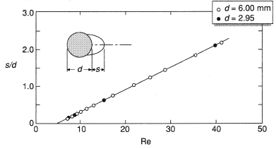
Buckled External Flows : Single Cylinder in Cross Flow
The viscous forces cause the streamlines to move further apart on the downstream side than on the upstream side of the tube.
In the Reynolds number range of 5 ≤ Re_{D} ≤ 45, the flow separates from the rear side of the tube and a symmetric pair of vortices is formed in the near wake.
The streamwise length of the vortices increases linearly with Reynolds number as shown as

Slide 10
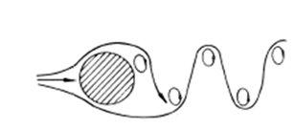

External Flows : Single Cylinder in Cross Flow
Eddies of size comparable with the cylinder itself begin to shed periodically when Re_{D} ∼ 40–70.
This is another manifestation of the local Reynolds number criterion of transition to turbulence.
The wake becomes increasingly turbulent as Re_{D} increases.
However, the shedding of vortices of diameter comparable with D remains a feature of the wake over most of the 10² < Re_{D} < 10⁷ range.

Slide 11
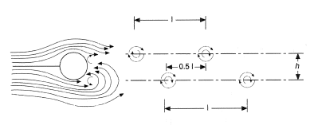
Buckled External Flows : Single Cylinder in Cross Flow
As the Reynolds number is further increased the wake becomes unstable and Vortex Shedding is initiated.
At first, one of the two vortices breaks away and then the second is shed because of the nonsymmetric pressure in the wake.
The intermittently shed vortices form a laminar periodic wake of staggered vortices of opposite sign.

Slide 12
External Flows : Single Cylinder in Cross Flow
The frequency f_{v}[s^{–1}] with which the vortices shed is roughly proportional to the flow velocity:
$$f_{v}\sim 0.21\frac{U_{∞}}{D}$$

Slide 13
Buckled External Flows : Single Cylinder in Cross Flow
This phenomenon is often called the Karman vortex street. von Karman showed analytically and confirmed experimentally that the pattern of vortices in a vortex street follows a mathematical relationship, namely,

Slide 14
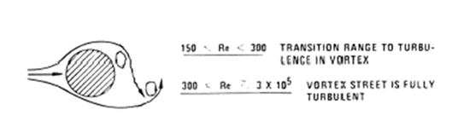
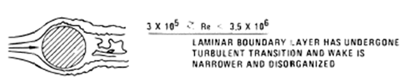
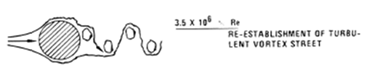
Regimes of Cross Flow Past A Cylinder

Slide 15
External Flows : Single Cylinder in Cross Flow
The wake becomes increasingly turbulent as Re_{D} increases.
However, the shedding of vortices of diameter comparable with D remains a feature of the wake over most of the 10² < Re_{D} < 10⁷ range.

Slide 16
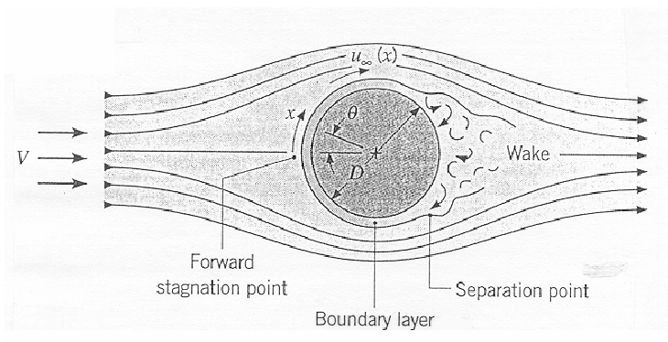
Forced Convection due to Cylinder in Cross Flow

Slide 17
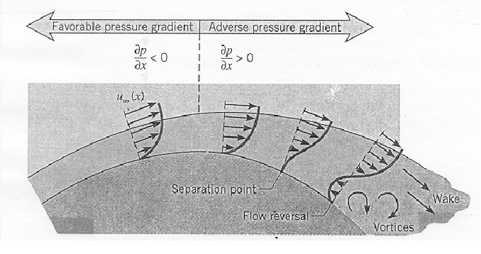
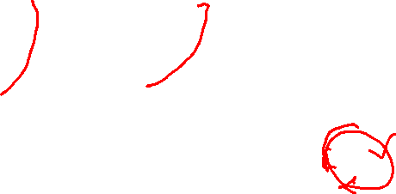
Forced Convection due to Cylinder in Cross Flow

Slide 18
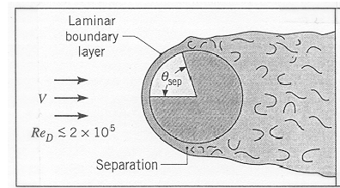
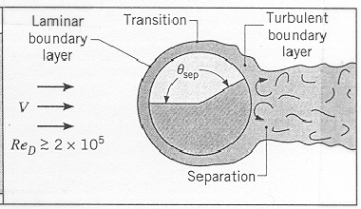
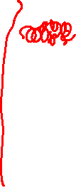
Forced Convection due to Cylinder in Cross Flow

Slide 19
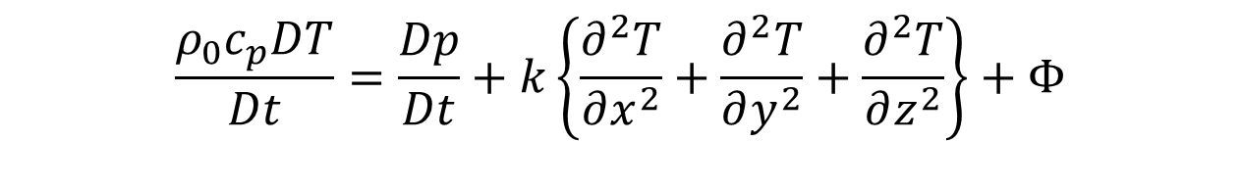
Steady Energy Equation for a Laminar Forced Convection from A Cylinder
$$\frac{{ρ_{0}c}_{p}DT}{Dt}=\frac{Dp}{Dt}+k\left\{\frac{∂^{2}T}{∂x^{2}}+\frac{∂^{2}T}{∂y^{2}}+\frac{∂^{2}T}{∂z^{2}}\right\}+Φ$$
Neglecting frictional heat dissipation for A laminar convection from a Long Cylinder:
$${ρ_{0}c}_{p}\left\{u\frac{∂T}{∂x}+v\frac{∂T}{∂y}\right\}=k\left\{\frac{∂^{2}T}{∂x^{2}}+\frac{∂^{2}T}{∂y^{2}}\right\}$$

Slide 20

Steady Energy Equation for a Laminar Forced Convection from A Cylinder
$${ρ_{0}c}_{p}\left\{+u\frac{∂T}{∂x}+v\frac{∂T}{∂y}\right\}=k\left\{\frac{∂^{2}T}{∂x^{2}}+\frac{∂^{2}T}{∂y^{2}}\right\}$$
Consider an isothermal cylinder with uniform velocity of flow U at r →∞.
The flow is assumed to be incompressible so that a stream function ψ(x,y) exists.

Slide 21

Steady Energy Equation for a Laminar Forced Convection from A Cylinder
$${ρ_{0}c}_{p}\left\{u\frac{∂T}{∂x}+v\frac{∂T}{∂y}\right\}=k\left\{\frac{∂^{2}T}{∂x^{2}}+\frac{∂^{2}T}{∂y^{2}}\right\}$$
$${ρ_{0}c}_{p}\left\{\frac{∂ψ}{∂y}\frac{∂T}{∂x}−\frac{∂ψ}{∂x}\frac{∂T}{∂y}\right\}=k\left\{\frac{∂^{2}T}{∂x^{2}}+\frac{∂^{2}T}{∂y^{2}}\right\}$$
Stokes derived an analytical expression for stream function valid at very low Reynolds numbers.

Slide 22
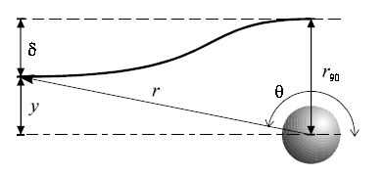
Severe Displacement of Streamlines in Stokes Flow
$$v_{r}=U\cos{θ}\left(1+\frac{a^{3}}{2r^{3}}−\frac{3a}{2r}\right)$$
$$v_{θ}=−U\sin{θ}\left(1−\frac{a^{3}}{4r^{3}}−\frac{3a}{4r}\right)$$
Since velocity disturbances only decay as 1/r , effects of the sphere blockage are felt even at rather large distances from it.

Slide 23
Properties of Stokes Solution
This celebrated solution has several extraordinary properties:
The streamlines and velocities are entirely independent of the fluid viscosity.
This is true of all creeping flows.
The streamlines possess perfect fore-and-aft symmetry.
The local velocity is everywhere retarded from its freestream value.
The effect of the Cylinder extends to enormous distances:
At r = 10a, the velocities are still about 10 percent below their free-stream values.

