Slide 1

Analysis of Turbulent Convection Systems
P M V Subbarao
Professor
Mechanical Engineering Department
I I T Delhi
Thermo-physical Properties of Infected Systems..

Slide 2

Reynolds stresses & Heat Fluxes
Performing the Reynolds Averaging Process, new terms has arisen, namely the Reynolds-stress tensor:
$$τ_{ij,\text{infection}}=τ_{ij−laminar}−ρ\overline{u_{i}′u_{j}′}$$
$$q_{i−infection}^{′′}=q_{i−laminar}^{′′}−ρc_{p}\overline{u_{i}^{′}T^{′}}$$
This brings us at the turbulent closure problem, the fact that we have more unknowns than equations.
  Three velocities + pressure + six Reynolds-stresses+Temperature + three Rynolds heat flux
  Three momentum equations + the continuity equation+the energy equation
To close the problem, we need additional equations to solve infected flow.

Slide 3
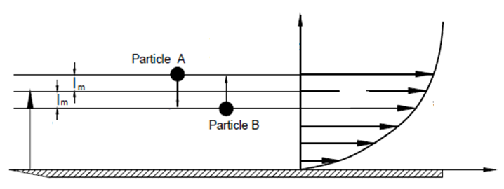
Prandtl Mixing Length Hypothesis
The fluid particle A with the mass dm located at the position , y+l_{m} and has the longitudinal velocity component U+ΔU is fluctuating.
This particle is moving downward with the lateral velocity v′ and the fluctuation momentum dI′_{y}=dm×v′.
It arrives at the layer which has a lower velocity U.
According to the Prandtl hypothesis, this macroscopic momentum exchange most likely gives rise to a positive fluctuation u′ >0.
Y
$$\overline{u^{′}v^{′}}<0$$
$$v^{′}<0 \\ u^{′}>0$$
$$U$$
$$U+ΔU$$
$$U$$
y
$$U−ΔU$$
$$v^{′}>0 \\ u^{′}<0$$
X

Slide 4
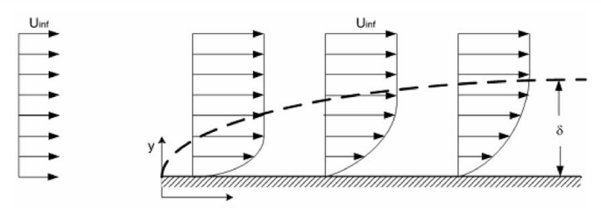
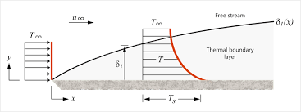
Prandtl Mixing Hypothesis
$$u^{′}<0 \\ T^{′}>0$$
$$u^{′}>0 \\ T^{′}<0$$
δ
L
$$\overline{u^{′}T^{′}}<0$$

Slide 5
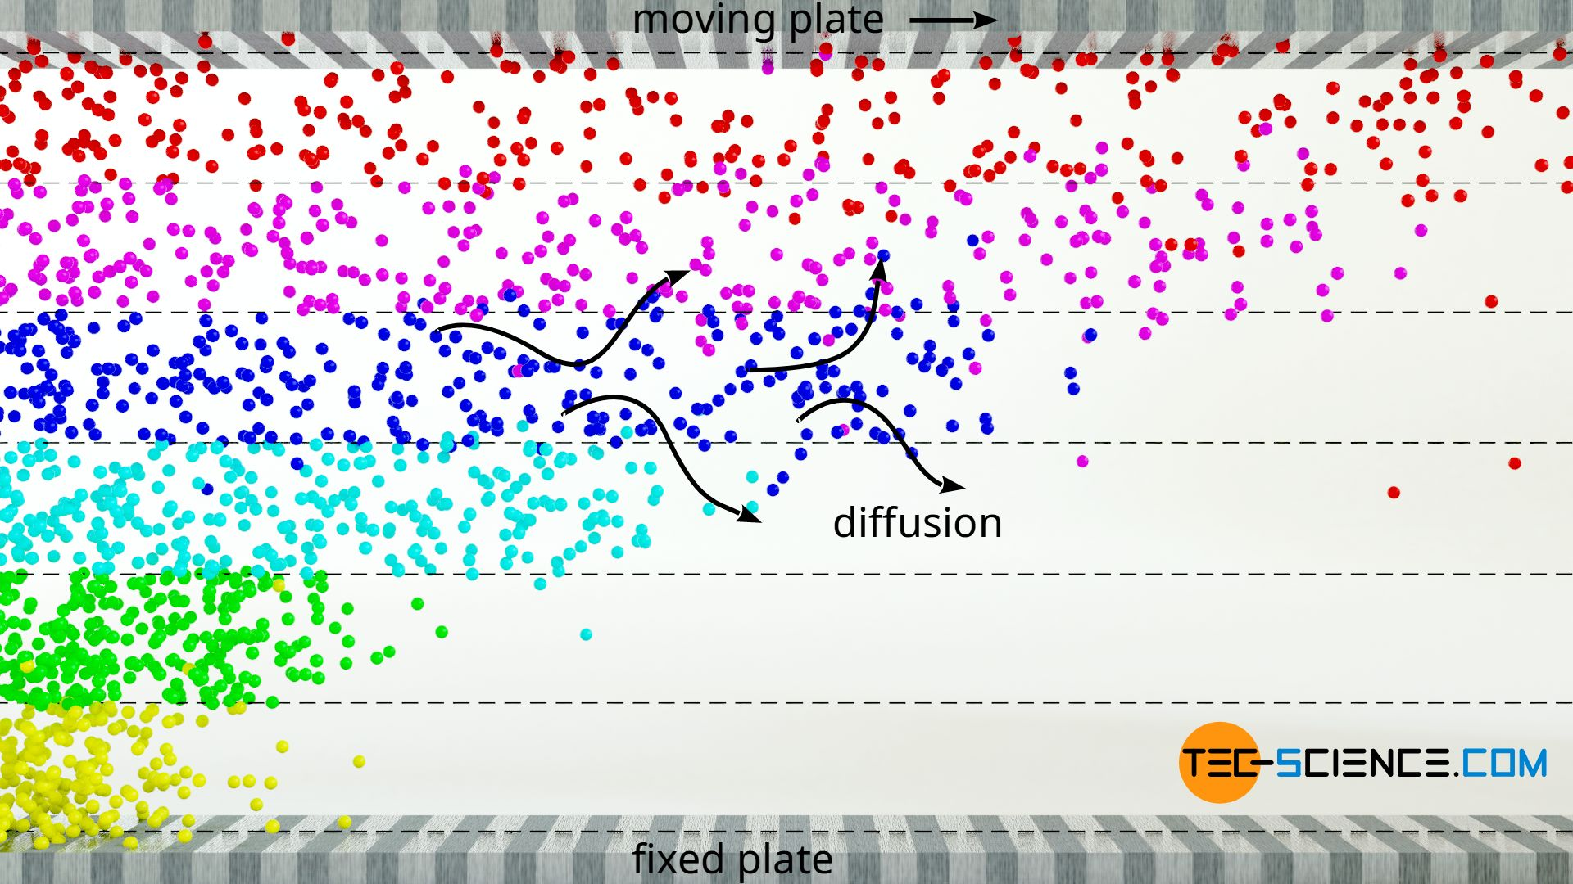
Microscopic View of Viscosity of Gases
The slowing down effect of fluid layers near a wall in gases is mainly due to the momentum transfer of the gas molecules when they diffuse from a slower layer into a faster layer.
F

Slide 6
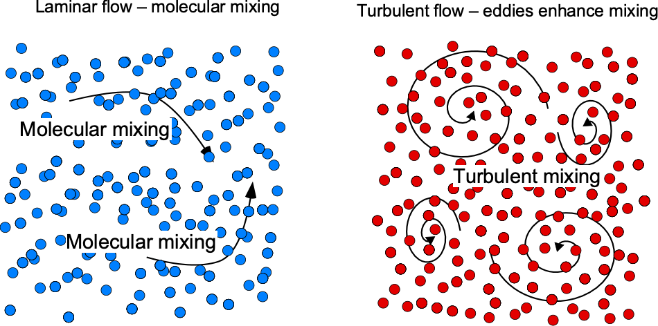
Analogy between Molecular Diffusivity and Eddy Diffusivity

Slide 7
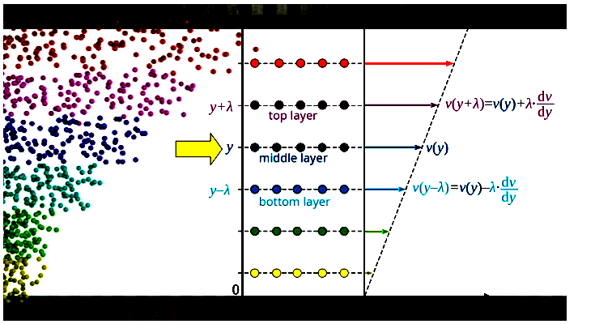
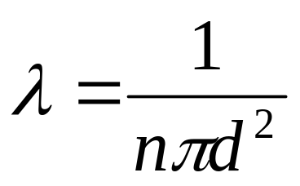
Microscopic View of Viscosity of Gases
F
$$μ=2{\dot{n}}_{A}mλ$$
Viscosity of ideal gases:
https://www.tec-science.com/thermodynamics/kinetic-theory-of-gases/viscosity-of-an-ideal-gas/

Slide 8
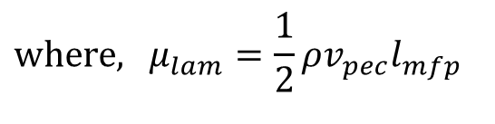
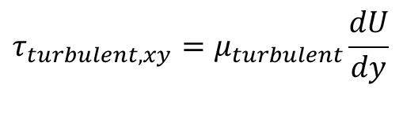
Algebraic Mean Viscosity Model
Prandtl was the first to present a working algebraic turbulence model that is applied to wakes, jets and boundary layer flows.
The model is based on mixing length hypothesis deduced from experiments and is analogous, to some extent, to the mean free path in kinetic gas theory.
Turbulent transport
Molecular transport
$$τ_{lam,xy}=μ_{lam}\frac{du}{dy}$$
$$τ_{turbulent,xy}=μ_{turbulent}\frac{dU}{dy}$$
$$\text{where}\text{, }μ_{lam}=\frac{1}{2}ρv_{pec}l_{mfp}$$

Slide 9
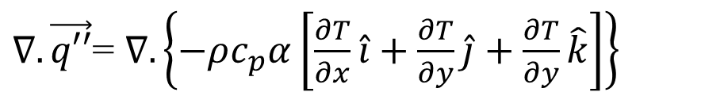
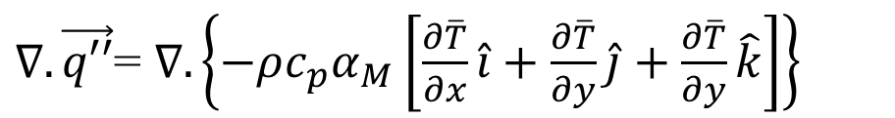
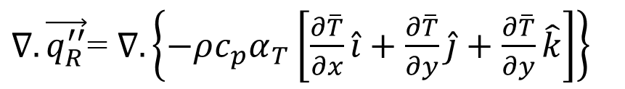
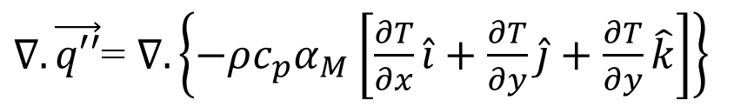
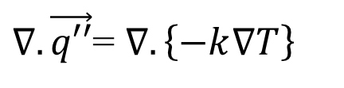
Conduction : Molecular and Turbulent Analogy
$∇.\vec{q′′}$= $∇.\left\{−k∇T\right\}$
$∇.\vec{q′′}$= $∇.\left\{−ρc_{p}α\left[\frac{∂T}{∂x}\hat{i}+\frac{∂T}{∂y}\hat{j}+\frac{∂T}{∂y}\hat{k}\right]\right\}$
This is a molecular level heat conduction process and α is called as molecular diffusivity.
$∇.\vec{q′′}$= $∇.\left\{−ρc_{p}α_{M}\left[\frac{∂T}{∂x}\hat{i}+\frac{∂T}{∂y}\hat{j}+\frac{∂T}{∂y}\hat{k}\right]\right\}$
The molecular conduction heat transfer in a turbulent flow is defined as:
$∇.\vec{q′′}$= $∇.\left\{−ρc_{p}α_{M}\left[\frac{∂\overline{T}}{∂x}\hat{i}+\frac{∂\overline{T}}{∂y}\hat{j}+\frac{∂\overline{T}}{∂y}\hat{k}\right]\right\}$
Consider Reynolds Heat Flux:
$$∇.\vec{q_{R}^{′′}}=ρc_{p}∇.\left\{\overline{\left(u^{′}T′\right)}\hat{i}+\overline{\left(v^{′}T′\right)}\hat{j}+\overline{\left(w^{′}T′\right)} \hat{k}\right\}$$
The turbulent heat conduction process with turbulent/eddy diffusivity α_{T} is defined as:
$∇.\vec{q_{R}^{′′}}$= $∇.\left\{−ρc_{p}α_{T}\left[\frac{∂\overline{T}}{∂x}\hat{i}+\frac{∂\overline{T}}{∂y}\hat{j}+\frac{∂\overline{T}}{∂y}\hat{k}\right]\right\}$

Slide 10
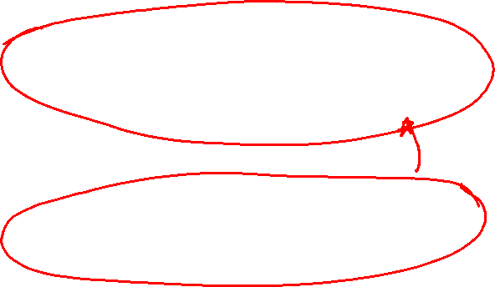
Enhanced Conduction Heat Transfer in Turbulent Convection Systems
The molecular conduction heat transfer in a turbulent flow is:
$∇.\vec{q′′}$= $∇.\left\{−ρc_{p}α_{M}\left[\frac{∂\overline{T}}{∂x}\hat{i}+\frac{∂\overline{T}}{∂y}\hat{j}+\frac{∂\overline{T}}{∂y}\hat{k}\right]\right\}$
The turbulent heat conduction heat transfer in a turbulent flow is:
$∇.\vec{q_{R}^{′′}}$= $∇.\left\{−ρc_{p}α_{T}\left[\frac{∂\overline{T}}{∂x}\hat{i}+\frac{∂\overline{T}}{∂y}\hat{j}+\frac{∂\overline{T}}{∂y}\hat{k}\right]\right\}$
The enhanced heat conduction heat transfer in a turbulent flow is:
$∇.\left\{\vec{q′′}+\vec{q_{R}^{′′}}\right\}$= $∇.\left\{−ρc_{p} \left(α_{M}+α_{T}\right) \left[\frac{∂\overline{T}}{∂x}\hat{i}+\frac{∂\overline{T}}{∂y}\hat{j}+\frac{∂\overline{T}}{∂y}\hat{k}\right]\right\}$

Slide 11
Simplified Reynolds Averaged Navier Stokes equations
$$\frac{∂U}{∂x}+\frac{∂V}{∂y}+\frac{∂W}{∂z}=0$$
$$ρ∇•\left(U\vec{V}\right)=−\frac{∂P}{∂x}+∇•\left(\left(μ+μ_{t}\right)∇U\right)$$
$$ρ∇•\left(V\vec{V}\right)=−\frac{∂P}{∂y}+∇•\left(\left(μ+μ_{t}\right)∇V\right)$$
$$ρ∇•\left(W\vec{V}\right)=−\frac{∂P}{∂z}+∇•\left(\left(μ+μ_{t}\right)∇W\right)$$
$${ρc}_{p}\left\{U\frac{∂\overline{T}}{∂x}+V\frac{∂\overline{T}}{∂y}+W\frac{∂\overline{T}}{∂z}\right\}=∇•\left(\left(k+k_{t}\right)∇\overline{T}\right)$$
5 equations 7 unknowns → We need two more ???

Slide 12
Case Studies to Develop Two Additional Equations

Slide 13
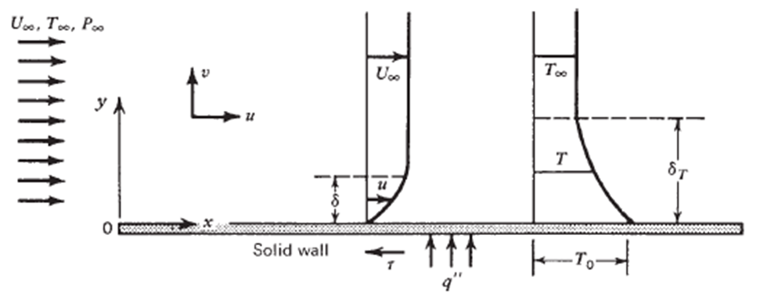
Steady Flat Plate Boundary Layer : Analogy between Laminar & Turbulent Regimes
Reynolds Averaged turbulent boundary layer equations for flat plate:
Prandtl’s laminar boundary layer equations for flat plate:
$$\frac{∂u}{∂x}+\frac{∂v}{∂y}=0$$
$$\frac{∂U}{∂x}+\frac{∂V}{∂y}=0$$
$$ρ\left\{u\frac{∂u}{∂x}+v\frac{∂u}{∂y}\right\}=μ\left(\frac{∂^{2}u}{∂y^{2}}\right)$$
$$ρ \left\{U\frac{∂U}{∂x}+V\frac{∂U}{∂y}\right\}=−\frac{1}{ρ}\frac{d\overline{p}}{dx}+\left(μ_{M}+μ_{T}\right)\left(\frac{∂^{2}U}{∂y^{2}}\right)$$
$${ρc}_{p} \left\{u\frac{∂T}{∂x}+v\frac{∂T}{∂y}\right\}=k\left(\frac{∂^{2}T}{∂y^{2}}\right)$$
$${ρc}_{p}\left\{U\frac{∂\overline{T}}{∂x}+V\frac{∂\overline{T}}{∂y}\right\}=\left(k_{M}+k_{T}\right)\frac{∂^{2}T}{∂y^{2}}$$

Slide 14
Pradntl’s Hypothesis of Turbulent Flows
In a laminar flow the random motion is at the molecular level only.
Macro instruments cannot detect this randomness.
Macro Engineering devices feel it as molecular viscosity.
Turbulent flow is due to random movement of fluid parcels/bundles.
Even Macro instruments detect this randomness.
Macro Engineering devices feel it as enhanced viscosity….!

Slide 15
Prandtl Mixing Length Hypothesis
$$\overline{u^{′}v^{′}}<0$$
Y
$$v^{′}>0 \\ u^{′}<0$$
$$U+ΔU$$
$$U$$
$$U−ΔU$$
$$U$$
y
$$v^{′}<0 \\ u^{′}>0$$
Particles A & B experience a velocity difference which can be approximated as:
$$ΔU=l_{m}\frac{ΔU}{Δy}≈l_{m}\frac{dU}{dy}$$
X

Slide 16
Definition of Mixing Length
$$ΔU=l_{m}\frac{ΔU}{Δy}≈l_{m}\frac{dU}{dy}$$
The distance between the two layers l_{m} is called mixing length.
Since ΔU has the same order of magnitude as u′, Prandtl arrived at
$$\left|u^{′}\right|=l_{m}\left|\frac{dU}{dy}\right|$$
By virtue of the Prandtl hypothesis, the longitudinal fluctuation component u′ was brought about by the impact of the lateral component v′ , it seems reasonable to assume that
$$∴ \left|v^{′}\right|=C_{1}l_{m}\left|\frac{dU}{dy}\right|$$
$$\left|u^{′}\right|∝\left|v^{′}\right|$$

Slide 17
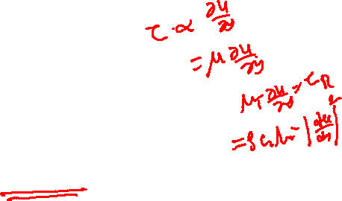
Prandtl Mixing Length Model
Thus, the component of the Reynolds stress tensor becomes
$$\overline{u^{′}v^{′}}=−C_{2}l_{m}^{2}{\left(\frac{dU}{dy}\right)}^{2}$$
The turbulent shear stress component becomes
$$τ_{turbulent,xy}=−ρ\overline{u^{′}v^{′}}=ρC_{2}l_{m}^{2}{\left[\frac{dU}{dy}\right]}^{2}$$
This is the Prandtl mixing length hypothesis.
Prandtl deduced that the eddy viscosity can be expressed as
$$μ_{turbulent}=ρl_{m}^{2}\left|\frac{dU}{dy}\right|$$

Slide 18
Estimation of Mixing Length
To find an algebraic expression for the mixing length l_{m}, several empirical correlations were suggested in literature.
The mixing length l_{m} does not have a universally valid character and changes from case to case.
Therefore, it is not appropriate for three-dimensional flow applications.
However, it is successfully applied to boundary layer flow, fully developed duct flow and particularly to free turbulent flows.
Prandtl and many others started with analysis of the two-dimensional boundary layer infected by disturbance.
For wall flows, the main source of infection is wall.
The wall roughness contains many cavities and troughs, which infect the flow and introduce disturbances.

Slide 19
Quantification of Infection by seeing the Effect
Develop simple experimental test rigs.
Measure wall shear stress.
Define wall friction velocity using the wall shear stress by the relation
$$u_{τ}=\sqrt{\frac{τ_{wall}}{ρ}}$$
Define non-dimensional boundary layer coordinates.
$$y^{+}=\frac{u_{τ}y}{ν}$$
$$U^{+}=\frac{U}{u_{τ}}$$
$$x^{+}=\frac{u_{τ}x}{ν}$$

Slide 20
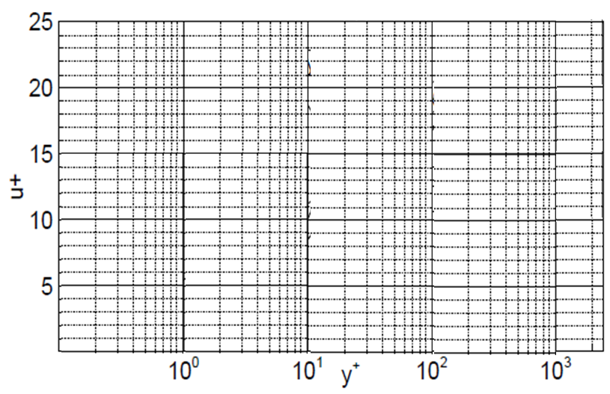
Approximation of velocity distribution for a fully turbulent 2D Boundary Layer
$$U^{+}=y^{+}$$
$$U^{+}=\frac{1}{κ}\ln{y^{+}}+C$$
$$U^{+}$$
$$y^{+}=f\left(u^{+},κ,C\right)$$
$$y^{+}$$

Slide 21
Approximation of velocity distribution for a fully turbulent 2D Boundary Layer
For a fully developed turbulent flow, the constants are experimentally found to be κ=0.41 and C=5.0.
$$U^{+}=\frac{1}{κ}\ln{y^{+}}+C$$
$$U^{+}$$
$$y^{+}=f\left(u^{+},κ,C\right)$$
$$U^{+}=y^{+}$$
$$y^{+}$$

Slide 22
Measures for Mixing Length
Outside the viscous sublayer marked as the logarithmic layer, the mixing length is approximated by a simple linear function.
$$l_{m}=κy$$
Accounting for viscous damping, the mixing length for the viscous sublayer is modeled by introducing a damping function D.
As a result, the mixing length in viscous sublayer:
$$l_{m}=κDy$$
The damping function D proposed by van Driest
$$D=1−\exp^{−\frac{y^{+}}{A^{+}}}{}$$
with the constant A⁺ = 26 for a boundary layer at zero-pressure gradient.

Slide 23
Effect of Mean Pressure Gradient on Mixing Length
Based on experimental evaluation of a large number of velocity profiles, Kays and Moffat developed an empirical correlation for that accounts for different pressure gradients.
$$A^{+}=\frac{26}{abP^{+}+1.0}$$
With
$$\left.for P^{+}<0\right\} _{b=4.25}^{a=9.0}$$
$$\left.for P^{+}>0\right\} _{b=2.29}^{a=9.0}$$
$$P^{+}=\frac{μ\left[{dP}/{dx}\right]}{ρ^{1/2}τ_{w}^{1.5}}$$

Slide 24
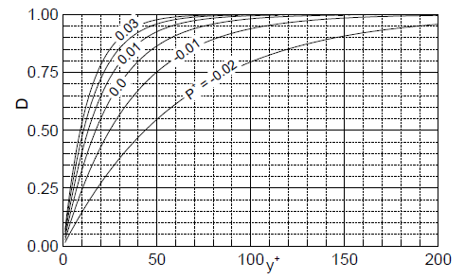
Van Driest damping function

Slide 25
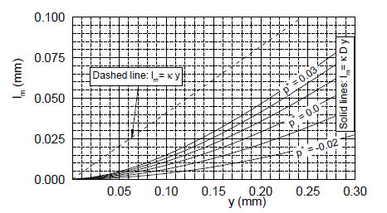
Distribution of Mixing length in near-wall region

Slide 26
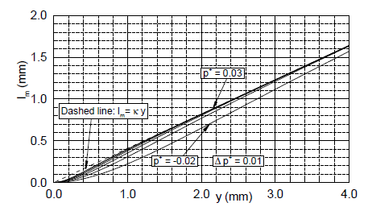
Mixing length in far wall Region

Slide 27
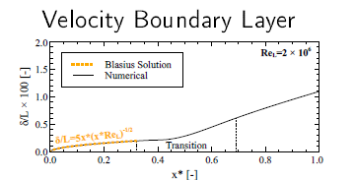
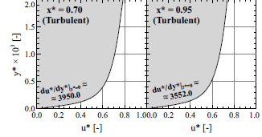
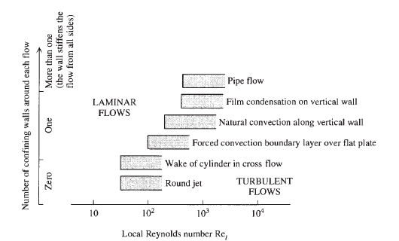
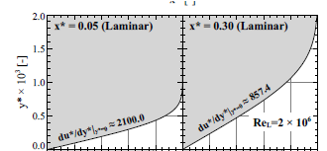
Computational Analysis of Forced Convection on a Flat Plate

Slide 28
HEAT TRANSFER IN BOUNDARY LAYER FLOW
For the heat transfer part of the turbulent boundary layer problem, time-averaged energy equation is to be solved.
Assume that sufficiently close to the solid wall:
The energy equation reduces to the statement that the apparent heat flux $q_{app}^{′′}$does not depend on y.
At the wall $q_{wall−app}^{′′}=\left(k_{M}+k_{T}\right)\frac{∂\overline{T}}{∂y}={\left[\left(k_{M}+k_{T}\right)\frac{∂\overline{T}}{∂y}\right]}_{y=0}$
Define non-dimensional wall coordinates of the flow problem:
$$U^{+}=\frac{U}{u_{τ}}$$
$$V^{+}=\frac{V}{u_{τ}}$$
$$q_{wall−app}^{′′}=\left(k_{M}+k_{T}\right)\frac{∂\overline{T}}{∂y}$$
$$x^{+}=\frac{u_{τ}x}{ν}$$
$$y^{+}=\frac{u_{τ}y}{ν}$$
$$q_{wall−app}^{′′}=\left(k_{M}+k_{T}\right)\frac{u_{τ}}{ν}\frac{∂\overline{T}}{∂y^{+}}$$

Slide 29
HEAT TRANSFER IN BOUNDARY LAYER FLOW
Define non-dimensional wall coordinates of the flow problem:
$$q_{wall−app}^{′′}=\left(k_{M}+k_{T}\right)\frac{u_{τ}}{ν}\frac{∂\overline{T}}{∂y^{+}}$$
This form is the basis for defining the temperature in wall coordinates:
$$T^{+}\left(x^{+},y^{+}\right)=\frac{ρc_{p}u_{τ}}{{ q}_{wall−app}^{′′}}\left(\overline{T}−T_{0}\right)$$
$$\frac{∂T^{+}}{∂y^{+}}=\frac{ρc_{p}u_{τ}}{{ q}_{wall−app}^{′′}}\frac{∂\left(\overline{T}−T_{0}\right)}{∂y^{+}}$$
$$q_{wall−app}^{′′}=\left(k_{M}+k_{T}\right) \frac{{ q}_{wall−app}^{′′}}{ρc_{p}u_{τ}} \frac{u_{τ}}{ν}\frac{∂T^{+}}{∂y^{+}}$$

Slide 30
HEAT TRANSFER IN BOUNDARY LAYER FLOW
$$q_{wall−app}^{′′}=\left(k_{M}+k_{T}\right) \frac{{ q}_{wall−app}^{′′}}{ρc_{p}u_{τ}} \frac{u_{τ}}{ν}\frac{∂T^{+}}{∂y^{+}}$$
$$\frac{1}{ρc_{p}} \frac{\left(k_{M}+k_{T}\right)}{ν}\frac{∂T^{+}}{∂y^{+}}=1$$
$$\frac{\left(\frac{k_{M}}{ρc_{p}}+\frac{k_{T}}{ρc_{p}}\right)}{ν}\frac{∂T^{+}}{∂y^{+}}=1$$
$$\frac{\left(α_{M}+α_{T}\right)}{ν}\frac{∂T^{+}}{∂y^{+}}=1$$
$$\left\{\frac{α_{M}}{ν}+\frac{α_{T}}{ν}\right\}\frac{∂T^{+}}{∂y^{+}}=1$$
$$\left\{\frac{1}{Pr}+\frac{α_{T}}{ν}\frac{ν_{T}}{ν_{T}}\right\}\frac{∂T^{+}}{∂y^{+}}=1$$

Slide 31
Temperature profile in turbulent boundary layer flow in wall coordinates
Energy equation for turbulent boundary layer with forced convection:
$${ρc}_{p}\left\{U\frac{∂\overline{T}}{∂x}+V\frac{∂\overline{T}}{∂y}\right\}=\left(k_{M}+k_{T}\right)\frac{∂^{2}T}{∂y^{2}}$$
Energy equation near wall in wall coordinates:
$$\left\{\frac{1}{Pr}+\frac{α_{T}}{ν_{T}}\frac{ν_{T}}{ν}\right\}\frac{∂T^{+}}{∂y^{+}}=1$$
$$\frac{∂T^{+}}{∂y^{+}}=\frac{1}{\left\{\frac{1}{Pr}+\frac{1}{{Pr}_{T}}\frac{ν_{T}}{ν}\right\}}$$
$$T^{+}=\int_{0}^{y^{+}}{\frac{dy^{+}}{\left\{\frac{1}{Pr}+\frac{1}{{Pr}_{T}}\frac{ν_{T}}{ν}\right\}}}$$
The temperature profile in the $q_{wall−app}^{′′}=constant$ region is governed by the (Molecular) Prandtl number, the Turbulent Prandtl number and the velocity distribution in the same region.

Slide 32
Temperature profile in turbulent boundary layer flow in wall coordinates
Temperature profile in near Wall region of a turbulent boundary layer:
$$T^{+}=\int_{0}^{y^{+}}{\frac{dy^{+}}{\left\{\frac{1}{Pr}+\frac{1}{{Pr}_{T}}\frac{ν_{T}}{ν}\right\}}}$$
The integral appearing on the right-hand side of above equation can be evaluated in closed form based on further assumptions regarding Pr, Pr_{T} and $\frac{ν_{T}}{ν}$.
In the fully turbulent region of the constant τ_{app} layer:
$$\frac{ν_{T}}{ν}=\frac{dy^{+}}{du^{+}}=κy^{+}$$

Slide 33

Extension of Prandtl's Mixing Length
$$T^{+}=\int_{0}^{y^{+}}{\frac{dy^{+}}{\left\{\frac{1}{Pr}+\frac{1}{{Pr}_{T}}κy^{+}\right\}}}$$
According to the mixing length model, the second term in the denominator of the integrand given above increases steadily as y⁺ increases.
Both Pr and PrT do not depart too drastically from O(1).
Chances are good that in the integrand of above equation, the second term will outweigh the first term if y⁺ sufficiently large and vice versa.

Slide 34
Two Layer Model for Temperature Profile in Turbulent Boundary Layer
$$T^{+}=\int_{0}^{y^{+}}{\frac{dy^{+}}{\left\{\frac{1}{Pr}+\frac{1}{{Pr}_{T}}κy^{+}\right\}}}$$
Near the wall due to no-slop condition, molecular conduction is dominant.
This layer is called Conduction Sub Layer (CSL).
The thickness of CSL is denoted by $y_{CSL.}^{+}$
Outside CSL, turbulence is significant and turbulent diffusivity is large compared to molecular diffusivity.
The two-layer model is expressed as:
$T^{+}=\int_{0}^{y_{CSL}^{+}}{\frac{dy^{+}}{\left\{\frac{1}{Pr}\right\}}}+$ $\int_{y_{CSL}^{+}}^{y^{+}}{\frac{dy^{+}}{\left\{\frac{κy^{+}}{{Pr}_{T}}\right\}}}$

Slide 35
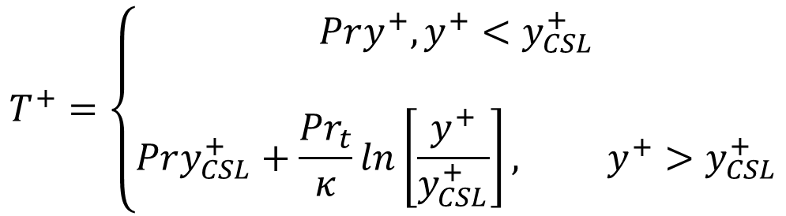
Two Layer Model for Temperature Profile in Turbulent Boundary Layer
$T^{+}=\int_{0}^{y_{CSL}^{+}}{\frac{dy^{+}}{\left\{\frac{1}{Pr}\right\}}}+$ $\int_{y_{CSL}^{+}}^{y^{+}}{\frac{dy^{+}}{\left\{\frac{κy^{+}}{{Pr}_{T}}\right\}}}$
A broken line expression for the temperature profile is obtained as:
$$T^{+}=\left\{\begin{matrix}Pry^{+},y^{+}<y_{CSL}^{+} \\ \\ Pry_{CSL}^{+}+\frac{{Pr}_{t}}{κ}ln\left[\frac{y^{+}}{y_{CSL}^{+}}\right], y^{+}>y_{CSL}^{+}\end{matrix}\right.$$

Slide 36
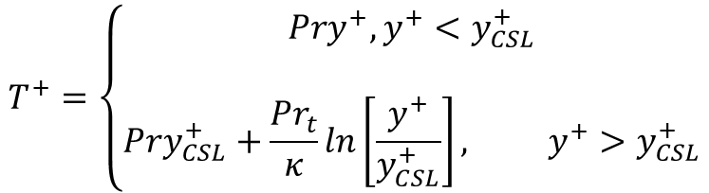
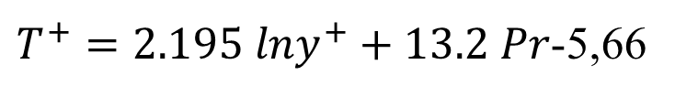
Two Layer Model for Temperature Profile in Turbulent Boundary Layer
$$T^{+}=\left\{\begin{matrix}Pry^{+},y^{+}<y_{CSL}^{+} \\ \\ Pry_{CSL}^{+}+\frac{{Pr}_{t}}{κ}ln\left[\frac{y^{+}}{y_{CSL}^{+}}\right], y^{+}>y_{CSL}^{+}\end{matrix}\right.$$
This result depends on three empirical constants, Pr_{t}, κ, and y⁺_{CSL}.
provided that the Prandtl number of the fluid is in the range 0.5–5.
Substituting these values into the y⁺ > y⁺ _{CSL} portion of the T⁺ profile yields
$T^{+}=2.195 lny^{+}+13.2 Pr$-5,66

Slide 37
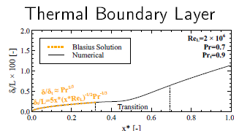
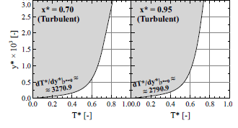
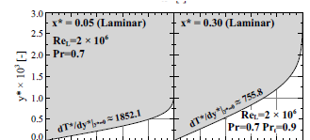
Computational Analysis of Forced Convection BL on A Cold Flat Plate

Slide 38
Computational Analysis of Forced Convection BL on A Cold Flat Plate
Velocity BL
Thermal BL

Slide 39
Turbulent Flow Regime
For a flat place boundary layer becomes turbulent at Re_{x} ~ 5 X 10⁵.
The local friction coefficient is well correlated by an expression of the form
$$C_{f,x}=0.059{Re}_{x}^{{−1}/5}{ \text{R}{\text{e}}_{x}}≤10^{7}$$
$$Nu_{x}=0.029{Re}_{x}^{4/5}{p}r^{1/3}\text{ 0.6}< pr<60$$
Local Nusselt number:

Slide 40
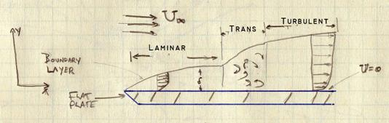
Boundary Layer on A Long Flat Plate
At a certain distance away from the leading edge, the flow begins to swirl, and various layers of flow mix violently with each other.
This violent mixing of the various layers, it signals that the flow is shifting from the smooth laminar flow near the edge to the turbulent flow away from the edge has occurred.
When the boundary layer changes from a laminar flow to a turbulent flow it is referred to as transition.

Slide 41
Mixed Boundary Layer
In a flow past a long flat plate initially, the boundary layer will be laminar and then it will become turbulent.
The distance at which this transitions starts is called critical distance (X_{c}) measured from edge and corresponding Reynolds number is called as Critical Reynolds number.
If the length of the plate (L) is such that 0.95 ≤ X_{c}/L ≤ 1, the entire flow is approximated as laminar.
When the transition occurs sufficiently upstream of the trailing edge, X_{c}/L ≤ 0.95, the surface average coefficients will be influenced by both laminar and turbulent boundary layers.

Slide 42
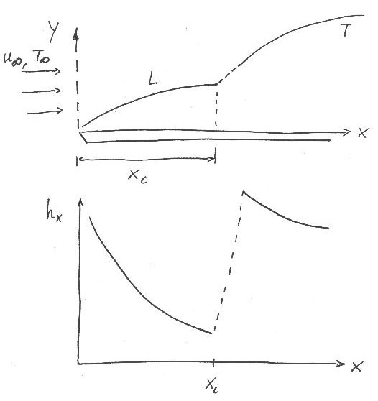
Mixed Flat Plate Boundary Layer
Important point:
  Typically, a turbulent boundary layer is preceded by a laminar boundary layer first upstream
  ∴ need to consider case with mixed boundary layer conditions!
$${\bar{h}}_{x}=\frac{1}{L}\left[\int_{0}^{xc}{h_{lam}dx }+\int_{xc}^{L}{h_{turb}dx }\right]$$

Slide 43
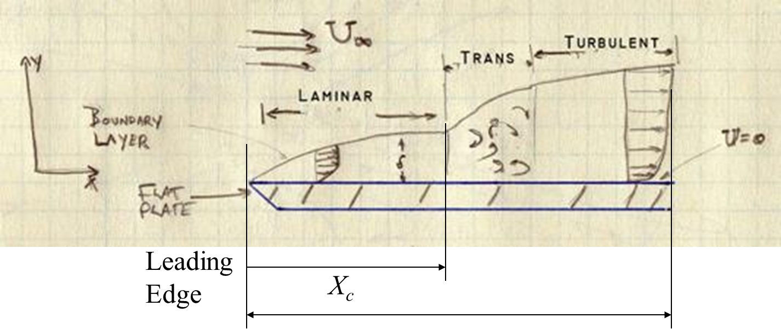
Mixed Boundary Layer
Trailing
Edge
L
$$h_{avg,L}=\frac{1}{L}\left\{\int_{0}^{x_{c}}{h_{lam,x}dx}+\int_{x_{c}}^{L}{h_{turb,x}dx}\right\}$$
$$h_{avg,L}=\frac{k}{L}\left\{0.332{\left(\frac{u_{∞}}{ν}\right)}^{1/2}\int_{0}^{x_{c}}{\frac{dx}{x^{1/2}}}+0.0296{\left(\frac{u_{∞}}{ν}\right)}^{4/5}\int_{x_{c}}^{L}{\frac{dx}{x^{1/5}}dx}\right\}pr^{1/3}$$

Slide 44
Mixed Boundary Layer
On integration:
$$Nu_{avg,L}=\left[0.664{Re}_{x_{c}}^{1/2}{+}0.037\left({Re}_{L}^{4/5}{−}{Re}_{x_{c}}^{4/5}{}\right)\right]pr^{1/3}$$
$$Nu_{avg,L}=\left[0.037{Re}_{L}^{4/5}{−}A\right]pr^{1/3}$$
For a smooth flat plate: Re_{xc} = 5 X 10⁵
$$Nu_{avg,L}=\left[0.037{Re}_{L}^{4/5}{−}871\right]pr^{1/3}$$

