Slide 1



Formulation of Convection Heat Transfer
P M V Subbarao
Professor & Head
Mechanical Engineering Department
Physics is experience, arranged in economical order.
— Prof. Ernst Mach
Formalization (~Over 300 years ) of Newton’s Original Work for Human Development…

Slide 2

Pre Newton Era
The pursuit of the nature of heat ranges from the period of speculation by the early philosophers from 600 B.C. to 1600AD.
The period 1600 to 1800, which represents the dawn of the science of heat.
In the eighteenth century the caloric theory (heat as a substance) dominated.
According to caloric theory, heat is supposed to be an indestructible imaginary fluid called the caloric.
Heat flows from a body at higher temperature to a body at lower temperature.
The caloric can neither be created nor destroyed.
Heating of a body means addition of caloric; a body is cooled by drawing out caloric from a body.

Slide 3
Newton in Deep Contemplation
Newton was both experimentalist and observer. He laid down the mathematical principles through which nature operates.
Substantial parts of both Principia and Opticks are devoted to reporting in detail the results of Newton's own experimental work.
The following experiments on heat by Newton are noted here:
1. Experiments to determine the rate at which very hot bodies cool (Book III, Prop. XLI, pp. 521-522).
2. "A Scale of the Degrees of Heat“ (1701) describes experiments on the melting points of various metals.

Slide 4
Genesis of Newton’s Law of Cooling – Part 1
Statement from his 1701 paper for clarity and convenience.
The First Statement:
For the heat, which the hot iron communicates in a given time, to cold bodies, which are near it, that is, the heat which the iron loses in a given time, is proportional to the whole heat of the iron.
And so, if the times of cooling are taken equal, the heats will be in a geometrical progression and consequently can easily be found with a table of logarithms.
The first part was later known as Newton’s law of cooling.

Slide 5
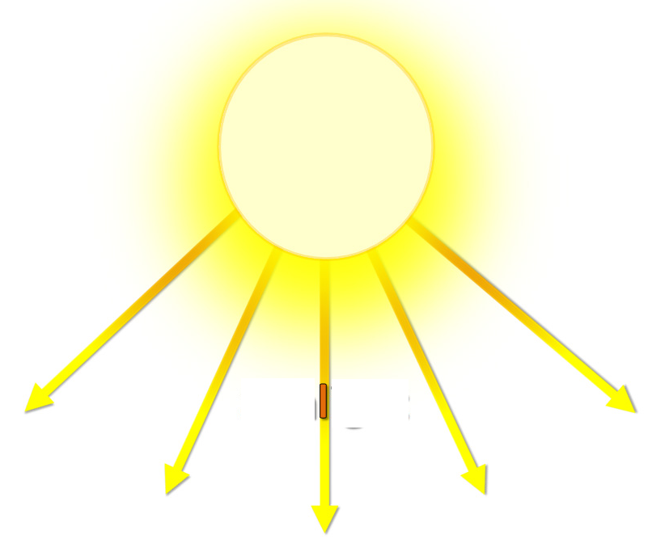

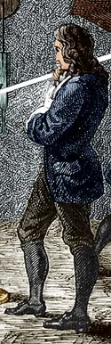
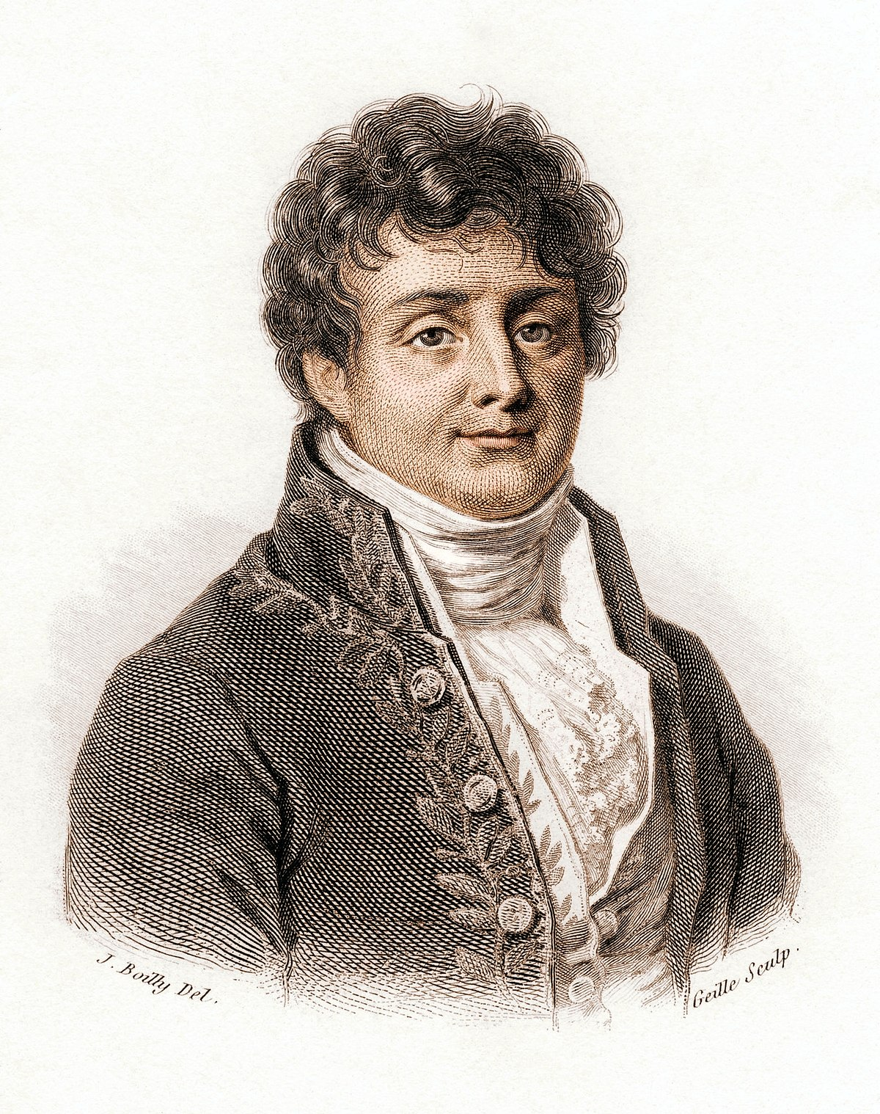

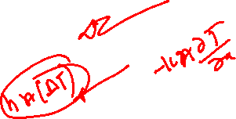
Fourier's Interpretation of Newton’s Experience

Slide 6
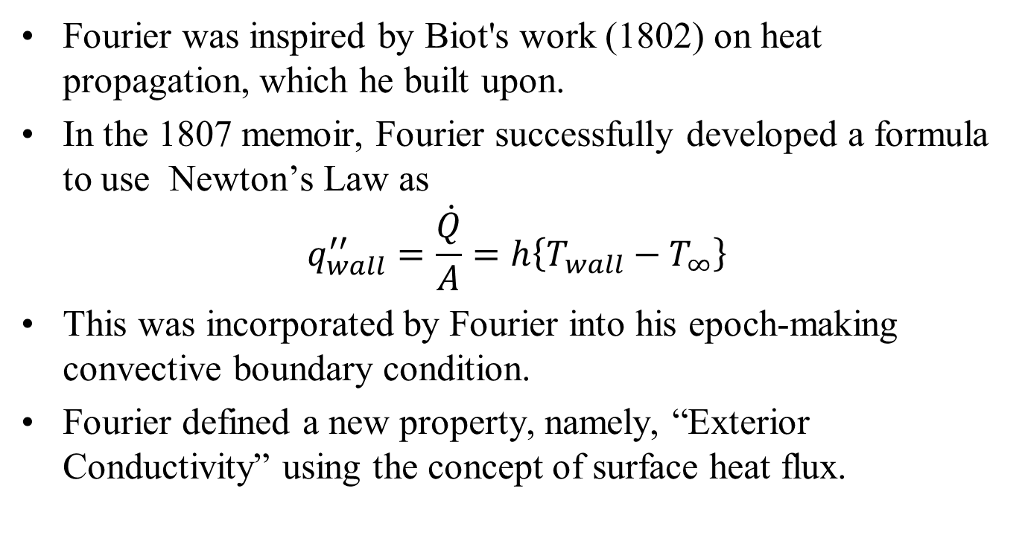
From Newton (1701) to Fourier (1822)
Fourier was inspired by Biot's work (1802) on heat propagation, which he built upon.
In the 1807 memoir, Fourier successfully developed a formula to use Newton’s Law as
$$q_{wall}^{′′}=\frac{\dot{Q}}{A}=h\left\{T_{wall}−T_{∞}\right\}$$
This was incorporated by Fourier into his epoch-making convective boundary condition.
Fourier defined a new property, namely, “Exterior Conductivity” using the concept of surface heat flux.

Slide 7
Newtons Law of Cooling by Fourier
Fourier practically completed the modern heat conduction theory using Newton’s law of cooling.
In Fourier’s heat conduction theory, the unsteady term of his equation and the resulting exponential term involving time in analytical solution represents Newton’s legacy.
In the analytical solution of unsteady heat conduction problem involving a solid sphere, Newton’s cooling problem results when the Biot number is very small.
Therefore, Fourier presented the exact analytical solution of Newton’s cooling problem.

Slide 8
Joseph Fourier: The Physicist
Quoting Herivel’s remark (1975):
“Fourier’s condition was not only amenable to mathematical formulation, but through its mathematical treatment, first by Fourier himself.
Then by his disciples Sturm and Liouville, and after them by an army of other workers.
It opened-up the whole field of eigenvalues and eigenfunctions of such enormous importance for modern applied mathematics and theoretical physics.
The trend and influence continue for convective heat transfer problems in the 20th century and later….

Slide 9
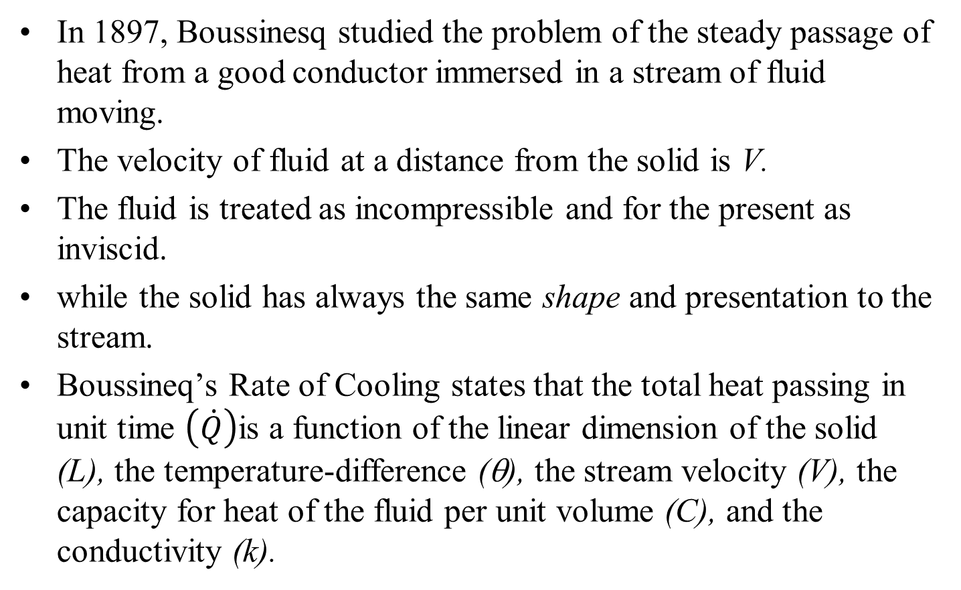
Post Fourier Research on Newton’s Law of Cooling
In 1897, Boussinesq studied the problem of the steady passage of heat from a good conductor immersed in a stream of fluid moving.
The velocity of fluid at a distance from the solid is V.
The fluid is treated as incompressible and for the present as inviscid.
while the solid has always the same shape and presentation to the stream.
Boussineq’s Rate of Cooling states that the total heat passing in unit time $\left(\dot{Q}\right)$is a function of the linear dimension of the solid (L), the temperature-difference (θ), the stream velocity (V), the capacity for heat of the fluid per unit volume (C), and the conductivity (k).

Slide 10
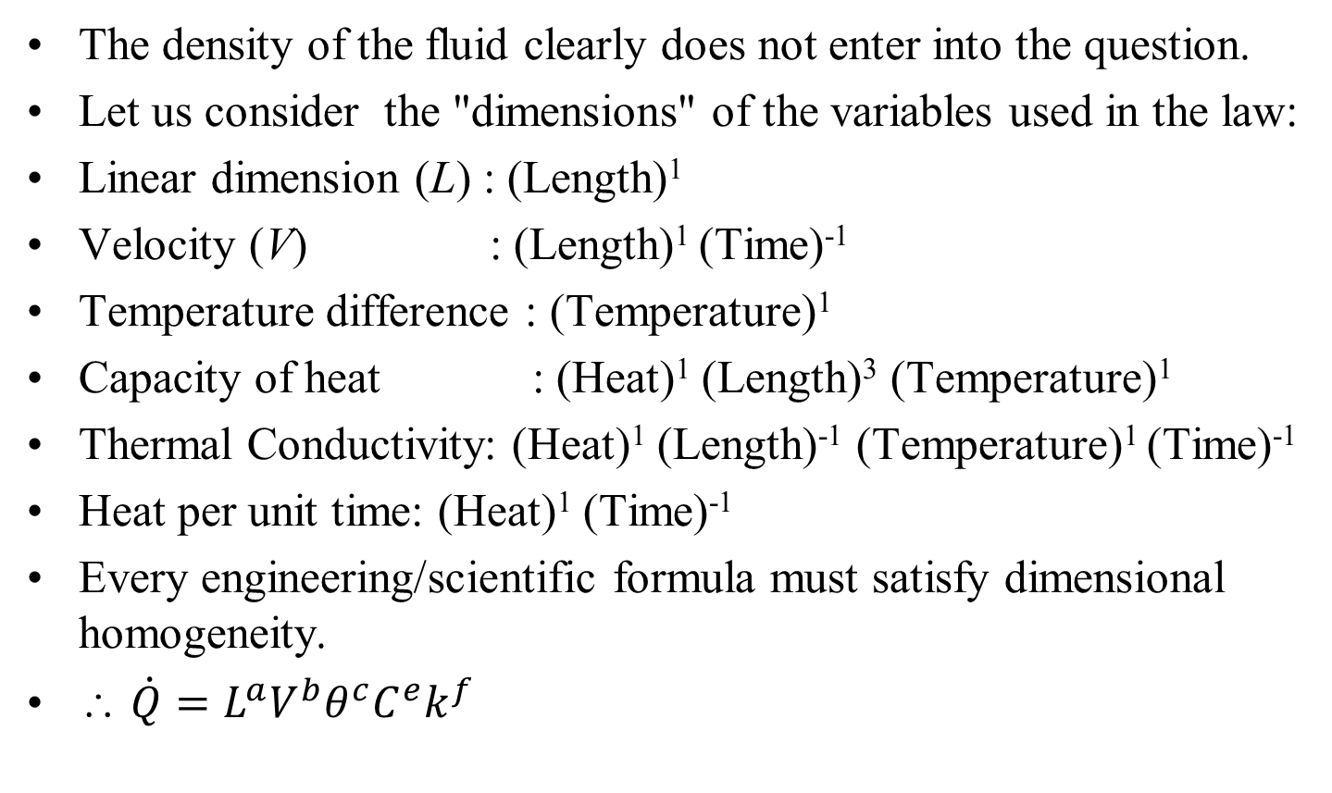
Post Fourier Research on Newton’s Law of Cooling
The density of the fluid clearly does not enter into the question.
Let us consider the "dimensions" of the variables used in the law:
Linear dimension (L) : (Length)¹
Velocity (V) : (Length)¹ (Time)⁻¹
Temperature difference : (Temperature)¹
Capacity of heat : (Heat)¹ (Length)³ (Temperature)¹
Thermal Conductivity: (Heat)¹ (Length)⁻¹ (Temperature)¹ (Time)⁻¹
Heat per unit time: (Heat)¹ (Time)⁻¹
Every engineering/scientific formula must satisfy dimensional homogeneity.
∴ $\dot{Q}=L^{a}V^{b}θ^{c}C^{e}k^{f}$

Slide 11
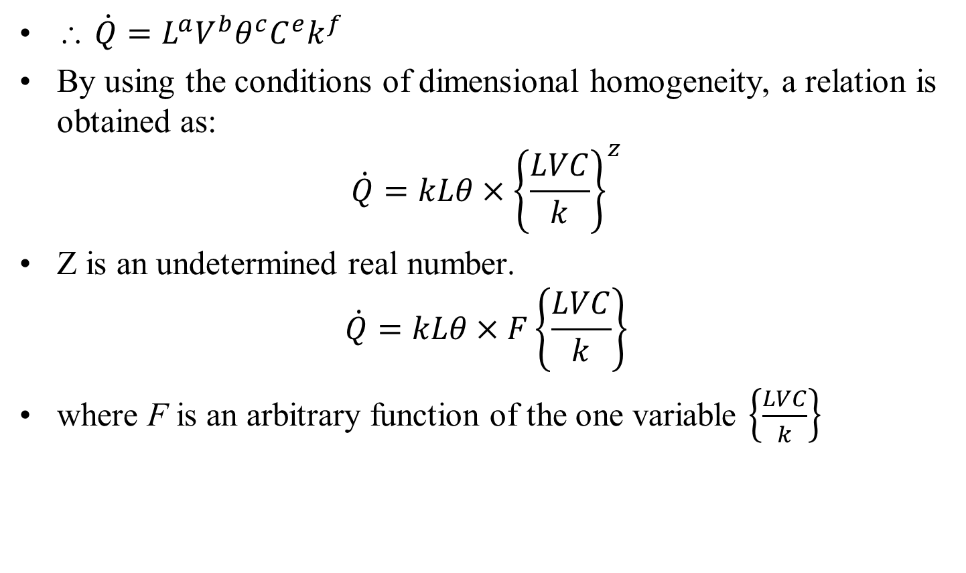
Post Fourier Research on Newton’s Law of Cooling
∴ $\dot{Q}=L^{a}V^{b}θ^{c}C^{e}k^{f}$
By using the conditions of dimensional homogeneity, a relation is obtained as:
$$\dot{Q}=kLθ×{\left\{\frac{LVC}{k}\right\}}^{z}$$
Z is an undetermined real number.
$$\dot{Q}=kLθ×F\left\{\frac{LVC}{k}\right\}$$
where F is an arbitrary function of the one variable $\left\{\frac{LVC}{k}\right\}$

Slide 12
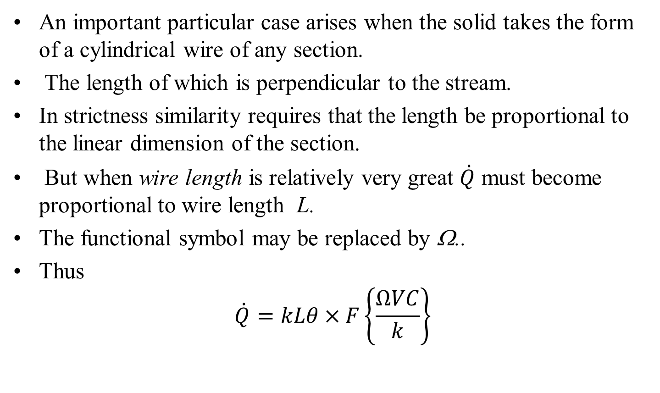
Post Fourier Research on Newton’s Law of Cooling
An important particular case arises when the solid takes the form of a cylindrical wire of any section.
The length of which is perpendicular to the stream.
In strictness similarity requires that the length be proportional to the linear dimension of the section.
But when wire length is relatively very great $\dot{Q}$ must become proportional to wire length L.
The functional symbol may be replaced by Ω..
Thus
$$\dot{Q}=kLθ×F\left\{\frac{ΩVC}{k}\right\}$$

Slide 13
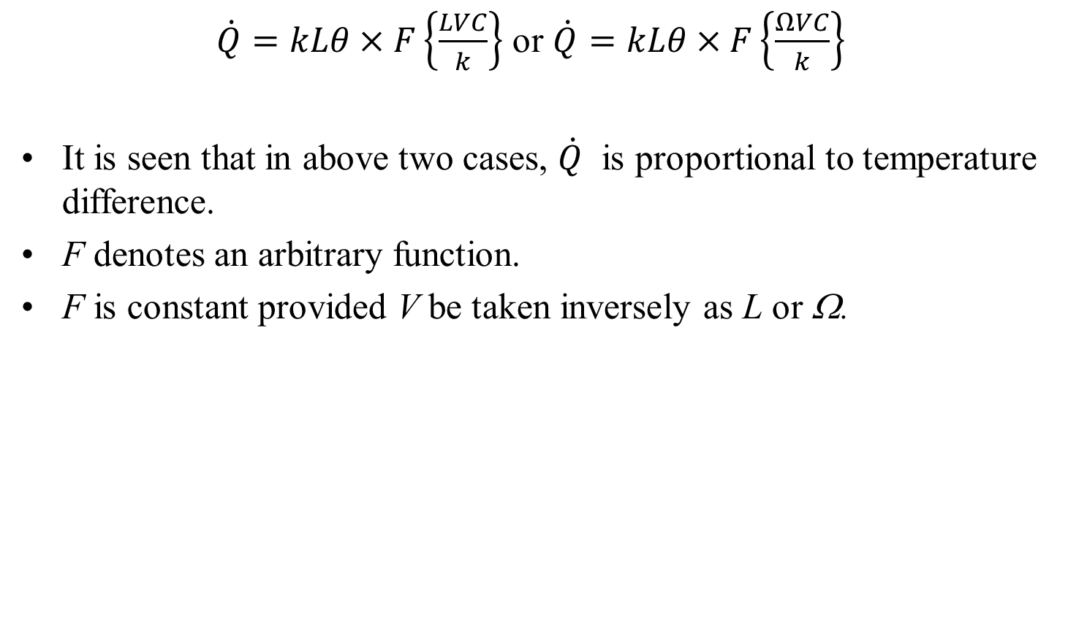
Post Fourier Research on Newton’s Law of Cooling
$\dot{Q}=kLθ×F\left\{\frac{LVC}{k}\right\}$ or $\dot{Q}=kLθ×F\left\{\frac{ΩVC}{k}\right\}$
It is seen that in above two cases, $\dot{Q}$ is proportional to temperature difference.
F denotes an arbitrary function.
F is constant provided V be taken inversely as L or Ω.

Slide 14
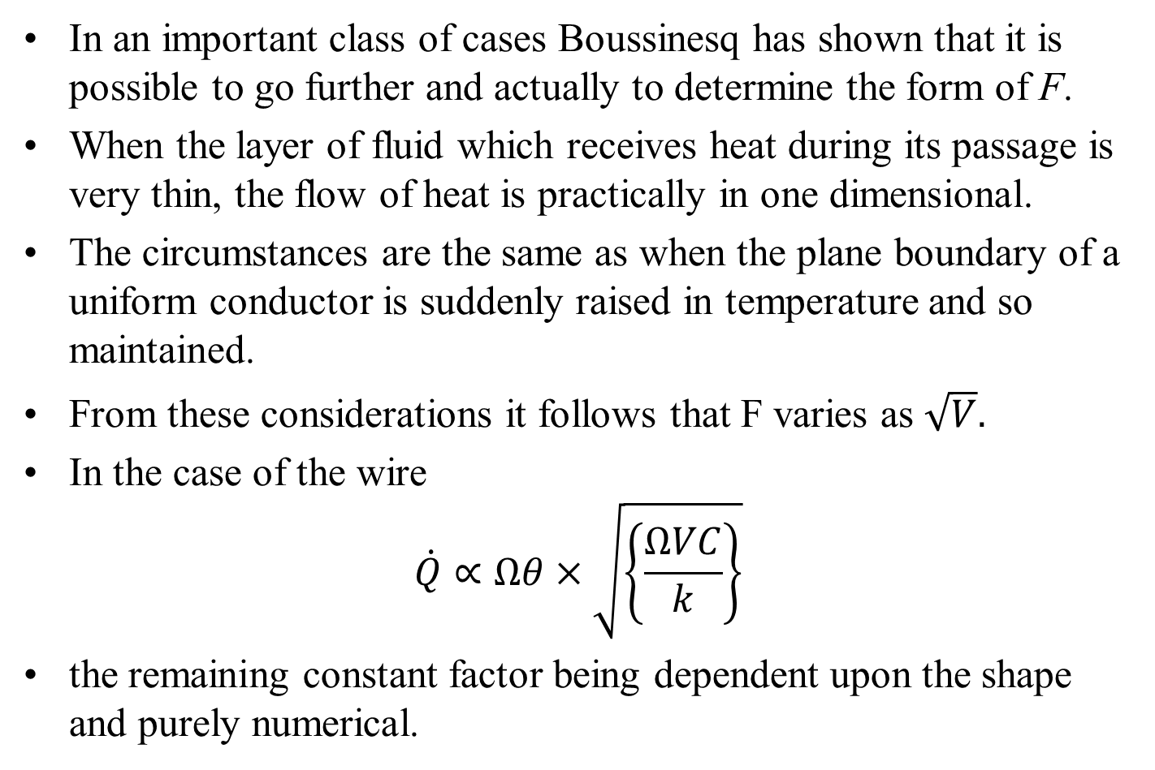
Boussinesq’s Discussion
In an important class of cases Boussinesq has shown that it is possible to go further and actually to determine the form of F.
When the layer of fluid which receives heat during its passage is very thin, the flow of heat is practically in one dimensional.
The circumstances are the same as when the plane boundary of a uniform conductor is suddenly raised in temperature and so maintained.
From these considerations it follows that F varies as $\sqrt{V}.$
In the case of the wire
$$\dot{Q}∝Ωθ×\sqrt{\left\{\frac{ΩVC}{k}\right\}}$$
the remaining constant factor being dependent upon the shape and purely numerical.

Slide 15
Similitude Centric Analytical Convective Heat Transfer
Ernst Kraft Wilhelm Nußelt (Nusselt) is the first contributor to analytical convection heat transfer.
For a century Fourier’s work was only analytical work available in heat transfer.
In 1915 Nusselt cut the Gordian knot.
In a single stroke, Nusselt used Dimensional Analysis to prove that there exist a functional form essential for all analytical/experimental works in convection heat transfer.

Slide 16
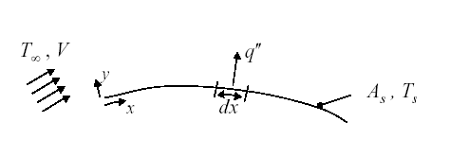
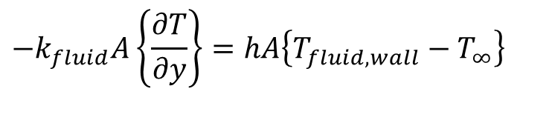

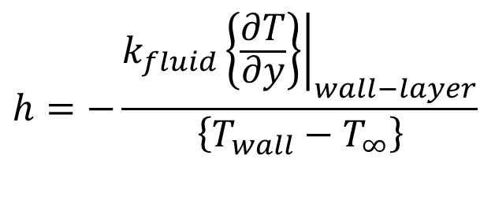
Analysis of Heat Transfer in Equilibrium Layer
The equilibrium is Curious & universal !!!
By James Black (1786)
At Thermodynamic equilibrium
At the wall for fluid layer :
$$T_{fluid,wall}=T_{wall}$$
$$−k_{fluid}A\left\{\frac{∂T}{∂y}\right\}=hA\left\{T_{fluid,wall}−T_{∞}\right\}$$
$$h=−\frac{k_{fluid}{\left.\left\{\frac{∂T}{∂y}\right\}\right|}_{wall−layer}}{\left\{T_{wall}−T_{∞}\right\}}$$

Slide 17
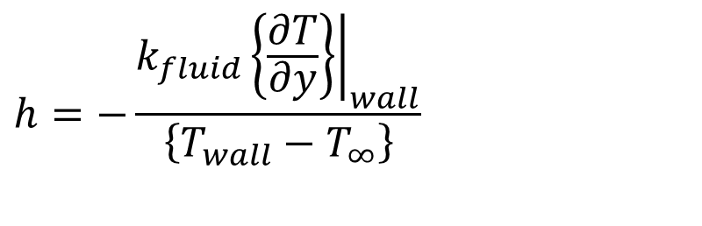
Estimation of Heat Transfer Coefficient
$$h=−\frac{k_{fluid}{\left.\left\{\frac{∂T}{∂y}\right\}\right|}_{wall}}{\left\{T_{wall}−T_{∞}\right\}}$$
Estimation of heat transfer coefficient is basically computation of temperature profile in equilibrium fluid layer.
Provoked a general theoretical and experimental study to understand how the equilibrium layer is developed.
The global geometry of the solid wall and flow conditions will decide the structure of stagnant layer.
Basic Geometry : Internal Flow or External Flow.

Slide 18
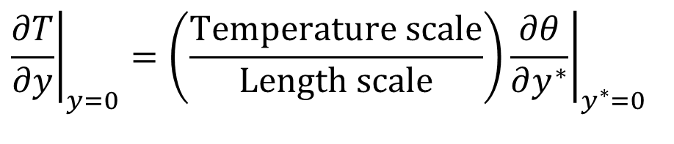
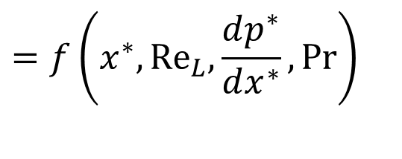
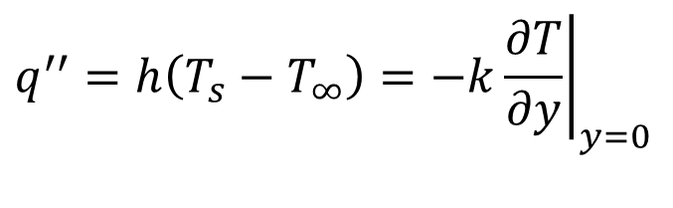
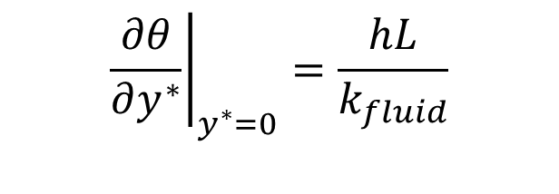
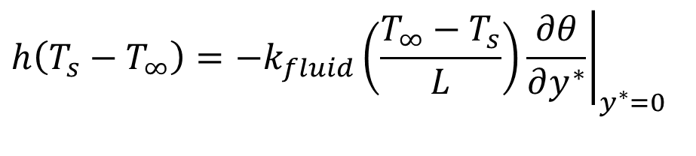
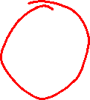
In search of A Dimensionless Parameter for Convection
$$q^{′′}=h\left(T_{s}−T_{∞}\right)=−k{\left.\frac{∂T}{∂y}\right|}_{y=0}$$
$${\left.\frac{∂T}{∂y}\right|}_{y=0}=\left(\frac{\text{Temperature} \text{scale}}{\text{Length} \text{scale}}\right){\left.\frac{∂θ}{∂y^{∗}}\right|}_{y^{∗}=0}$$
$$h\left(T_{s}−T_{∞}\right)=−k_{fluid}{\left.\left(\frac{T_{∞}−T_{s}}{L}\right)\frac{∂θ}{∂y^{∗}}\right|}_{y^{∗}=0}$$
$${\left.\frac{∂θ}{∂y^{∗}}\right|}_{y^{∗}=0}=\frac{hL}{k_{fluid}}$$
$$=f\left(x^{∗},{Re}_{L}{,}\frac{dp^{∗}}{dx^{∗}},Pr\right)$$

Slide 19
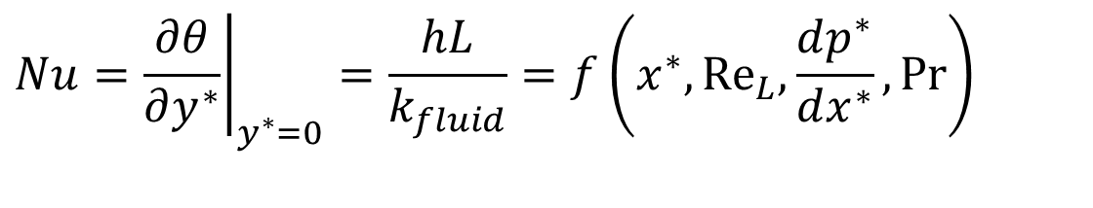
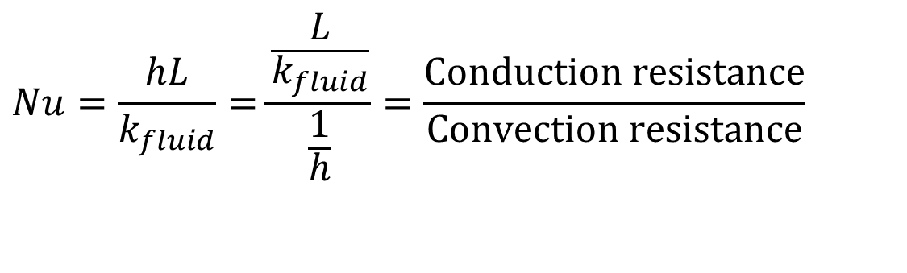
In search of A Dimensionless Parameter for Convection
This dimensionless temperature gradient at the wall is named as
Nusselt Number:
$$Nu=\frac{hL}{k_{fluid}}=\frac{\frac{L}{k_{fluid}}}{\frac{1}{h}}=\frac{\text{Conduction} \text{resistance}}{\text{Convection} \text{resistance}}$$
$$Nu={\left.\frac{∂θ}{∂y^{∗}}\right|}_{y^{∗}=0}=\frac{hL}{k_{fluid}}=f\left(x^{∗},{Re}_{L}{,}\frac{dp^{∗}}{dx^{∗}},Pr\right)$$
Local Nusselt Number

Slide 20
20th Century Convective Heat Transfer
Introduction: Application of convective heat transfer, Foundations of heat transfer
Governing Equations: Derivation of energy equation, Derivation of boundary layer equation, Derivation of boundary layer energy equation.
Convection in Laminar Boundary: Blasius solution: similarity method, Pohlhausen solution: similarity method, Pohlhausen solution: heat transfer parameters, Falkner-Skan equation: Boundary layer flow over a wedge.
Laminar BL flow over flat plate: Uniform surface temperature, Laminar BL flow over flat plate: Uniform surface heat flux, Solution of example problems.

Slide 21
20th Century Convective Heat Transfer
Convection in Internal Flows : Hydrodynamic and thermal regions: Energy balance in channel flow.
Determination of heat transfer coefficient, Velocity profile in fully-developed channel flows, Thermally fully developed laminar slug flow with uniform wall heat flux condition.
Hydrodynamically and thermally fully developed flow with uniform wall heat flux condition, Fully developed flow through parallel plate channel with uniform wall temperature, Fully developed flow through circular pipe with uniform wall temperature.
Thermally developing flow through circular pipe with uniform wall heat flux, Thermally developing flow through circular pipe with uniform wall temperature. Heat transfer in plane Couette flow.

Slide 22
20th Century Convective Heat Transfer
Natural convection over a vertical plate: Similarity solution of energy equation, Integral solution, Natural convection over inclined plate and mixed convection.
Natural convection inside enclosures, Solution of example problems.
Convection in Turbulent Flows: Derivation of Reynolds Averaged Navier-Stokes Equations, External Turbulent Flow, Integral solution for turbulent boundary layer flow over a flat plate.
Convection in turbulent pipe flows.
Pool Boiling and Flow Boiling: Boiling regimes and boiling curve.
Laminar film condensation on a vertical plate, Laminar film condensation on horizontal tubes.

Slide 23
An Analytical Ingestion into Convective Heat Transfer…

Slide 24
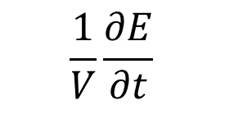
Fourier’s Energy Balance Equation
The energy conservation equation is a differential statement of the thermal energy balance in a body under study.
The thermal energy content E (J) of a material body can change only if energy is removed/added through its bounding surface or energy is generated or absorbed within the body.
Consider a small volume element V inside a material undergoing heat conduction processes.
The rate of change of thermal energy E of a Control Mass with at a point inside the volume, V is
$$\frac{1}{V}\frac{∂E}{∂t}$$

Slide 25
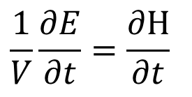
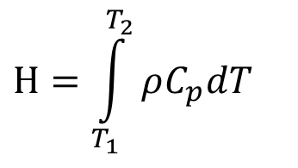
20th Century Thermal Energy Balance Equation for A Control Mass
$$\frac{1}{V}\frac{∂E}{∂t}=\frac{∂Η}{∂t}$$
where enthalpy Η of the material (J/m³) is the amount of thermal energy per unit volume E/V .
From thermodynamics, the following relationship expresses the accumulated enthalpy in a material resulting from increasing its temperature from T₁ to T₂,
$$Η=\int_{T_{1}}^{T_{2}}{ρC_{p}dT}$$
More complex Η - T relationships are also important.

Slide 26
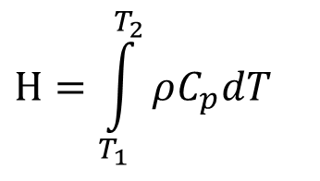
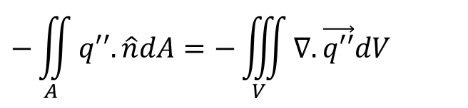
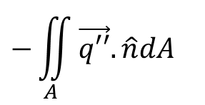
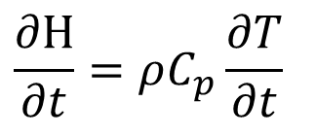
The Rate of Change in Energy of A Control Mass
$$Η=\int_{T_{1}}^{T_{2}}{ρC_{p}dT}$$
Introducing the above Η - T relationship, the rate of change of thermal energy gives:
$$\frac{∂Η}{∂t}=ρC_{p}\frac{∂T}{∂t}$$
Fourier identified that the rate of changed of thermal energy of a control mass is a reaction.
The action is “net outflow of thermal energy” through the bounding surface A of volume V is given by
$$−\iint_{A}{\vec{q′′}.\hat{n}dA}$$
Fourier’s Original Invention is: What causes above action???
$$−\iint_{A}{q′′.\hat{n}dA}=−\iiint_{V}{∇.\vec{q′′}dV}$$
Using divergence theorem :

Slide 27
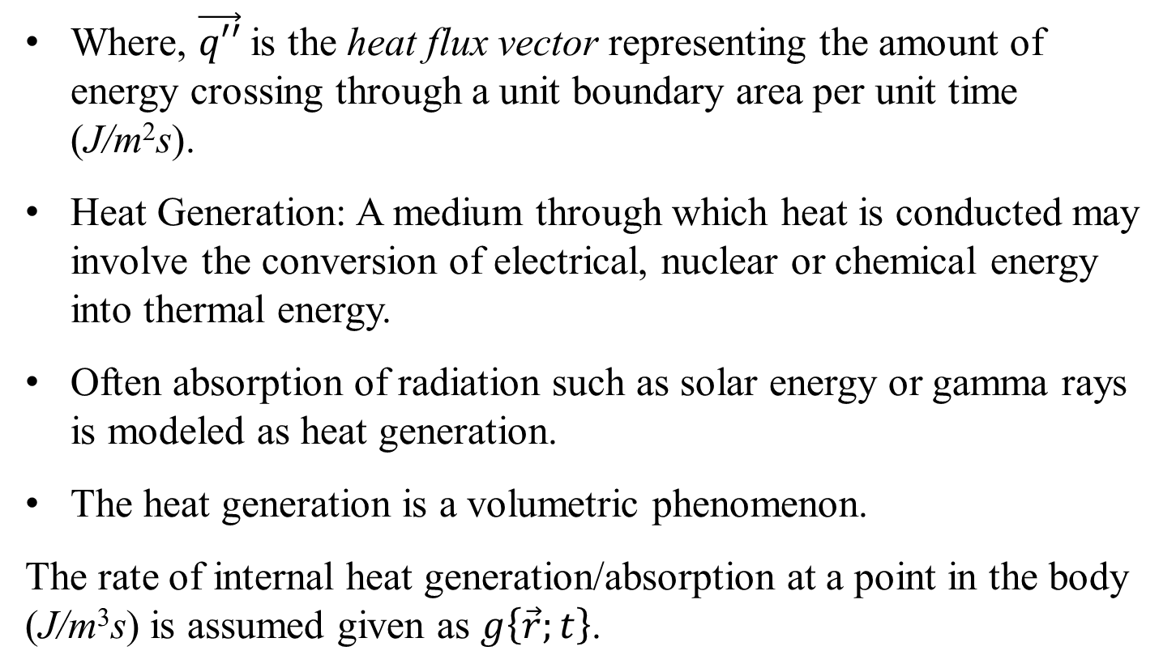

Additional Action (Energy) Term by Fourier
$$−\iiint_{V}{∇.\vec{q′′}dV}$$
Where, $\vec{q′′}$is the heat flux vector representing the amount of energy crossing through a unit boundary area per unit time (J/m²s).
Heat Generation: A medium through which heat is conducted may involve the conversion of electrical, nuclear or chemical energy into thermal energy.
Often absorption of radiation such as solar energy or gamma rays is modeled as heat generation.
The heat generation is a volumetric phenomenon.
The rate of internal heat generation/absorption at a point in the body (J/m³s) is assumed given as $g\left\{\vec{r};t\right\}$.

Slide 28
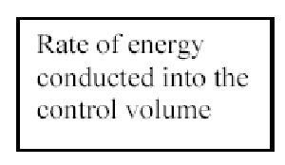
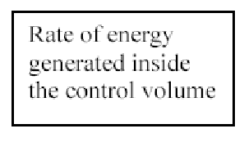


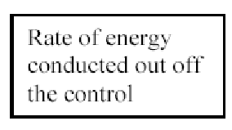
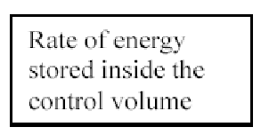
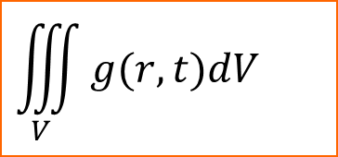
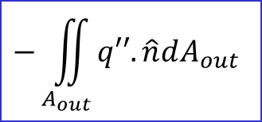
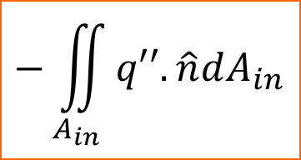
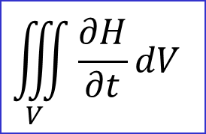
The thermal energy balance equation by Fourier
Apply Conservation of Energy to the system under study:
$$\iiint_{V}{g(r,t)dV}$$
$$−\iint_{A_{in}}{q′′.\hat{n}dA_{in}}$$
$$\iiint_{V}{\frac{∂H}{∂t}dV}$$
$$−\iint_{A_{out}}{q′′.\hat{n}dA_{out}}$$

Slide 29
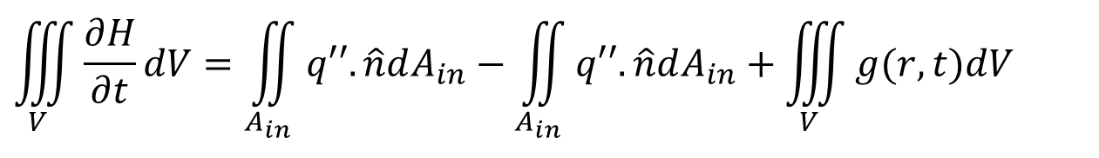
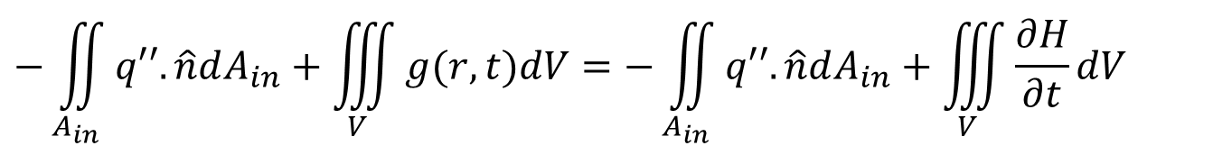
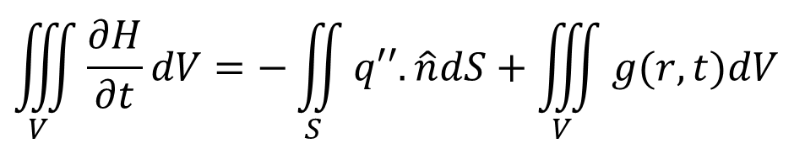
The Thermal Energy Balance Equation
$$−\iint_{A_{in}}{q′′.\hat{n}dA_{in}}+\iiint_{V}{g(r,t)dV}=−\iint_{A_{in}}{q′′.\hat{n}dA_{in}}+\iiint_{V}{\frac{∂H}{∂t}dV}$$
$$\iiint_{V}{\frac{∂H}{∂t}dV}=\iint_{A_{in}}{q′′.\hat{n}dA_{in}}−\iint_{A_{in}}{q′′.\hat{n}dA_{in}}+\iiint_{V}{g(r,t)dV}$$
$$\iiint_{V}{\frac{∂H}{∂t}dV}=−\iint_{S}{q′′.\hat{n}dS}+\iiint_{V}{g(r,t)dV}$$

Slide 30
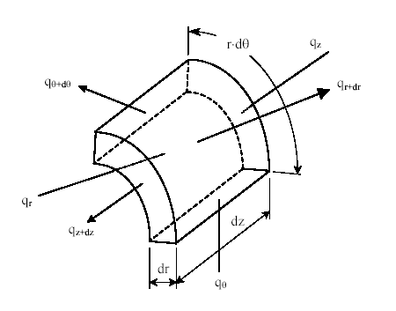
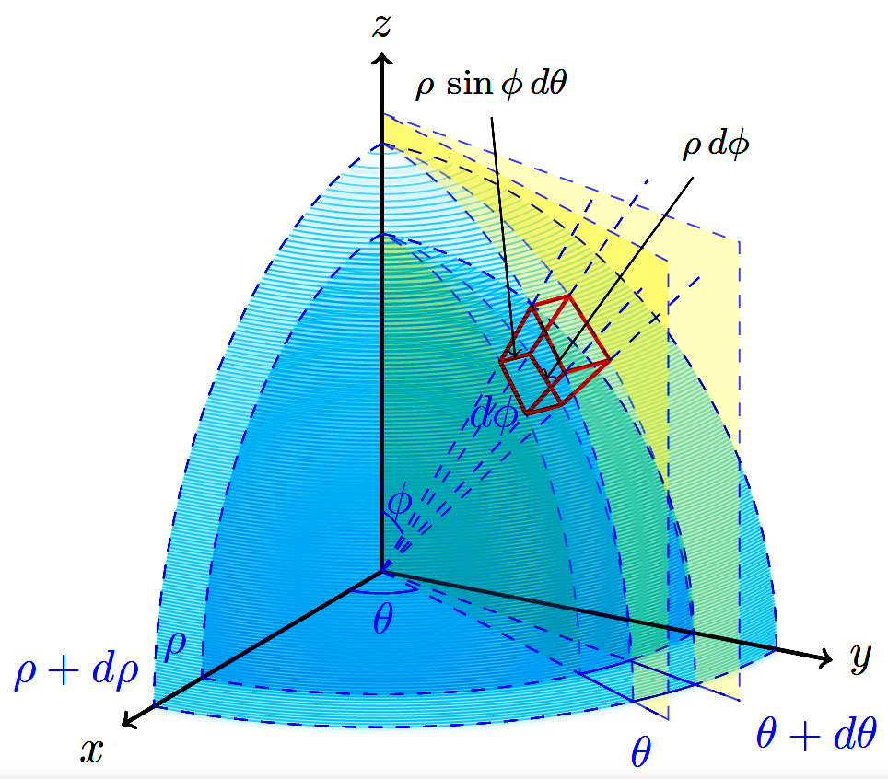
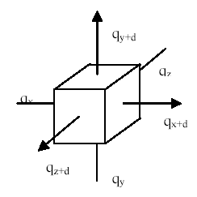
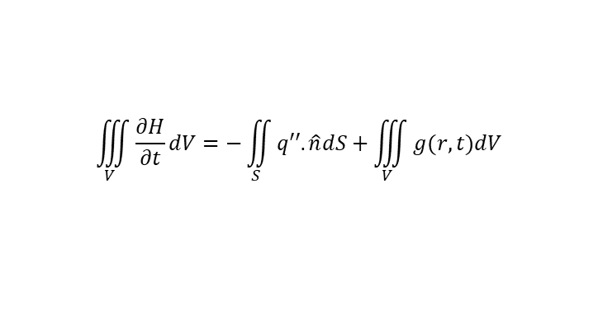
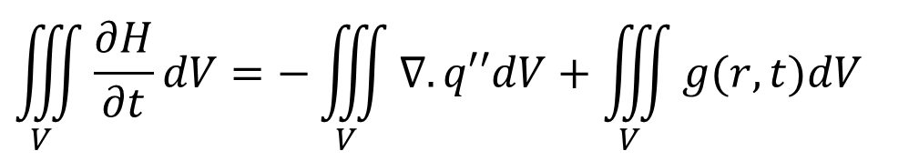

Energy Balance for a Differential Element by Fourier
$$\iiint_{V}{\frac{∂H}{∂t}dV}=−\iint_{S}{q′′.\hat{n}dS}+\iiint_{V}{g(r,t)dV}$$
Apply Conservation of Energy to the differential element.
The thermal energy balance equation for the volume dV is then
Using Gauss Divergence Theorem:
$$\iiint_{V}{\frac{∂H}{∂t}dV}=−\iiint_{V}{∇.q′′dV}+\iiint_{V}{g(r,t)dV}$$

Slide 31
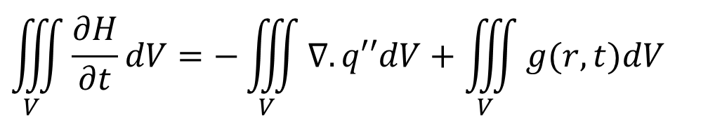
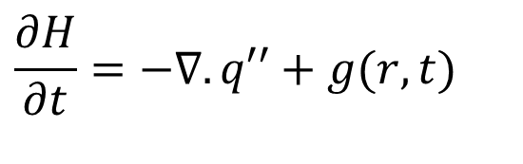
The Fourier Thermal Energy Equation
$$\iiint_{V}{\frac{∂H}{∂t}dV}=−\iiint_{V}{∇.q′′dV}+\iiint_{V}{g(r,t)dV}$$
However, since the integrals are equal the arguments are also equal, and the most general form of the differential thermal energy balance equation is
$$\frac{∂H}{∂t}=−∇.q′′+g(r,t)$$
This is called the differential thermal energy balance equation.
∴ Newton’s law of cooling is a boundary condition of a Control Mass.

Slide 32
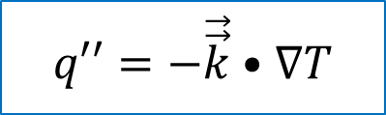



Fourier’s Constitutive Equation for the Heat Flux
$$\frac{∂H}{∂t}=−∇.q′′+g(r,t)$$
$$q′′=−\vec{\vec{k}}•∇T$$
$$\vec{\vec{k}}=\left[\begin{aligned}&k_{\text{xx}} {\text{k}}_{\text{xy}} {\text{k}}_{\text{xz}} \\ &k_{\text{yx}} {\text{k}}_{\text{yy}} {\text{k}}_{\text{yz}} \\ &k_{\text{zx}} {\text{k}}_{\text{zy}} {\text{k}}_{\text{zz}}\end{aligned}\right]$$
The Fourier Conduction Equation
$$\frac{∂T}{∂t}=∇.\left\{\vec{\vec{α}}.∇T\right\}+\frac{g(r,t)}{ρC_{p}}$$

