Slide 1

Analysis of Turbulent (Infected by Disturbance) Flows
P M V Subbarao
Professor
Mechanical Engineering Department
I I T Delhi
Quantification of the Infection & its Effect on Heat Transfer Potential....

Slide 2

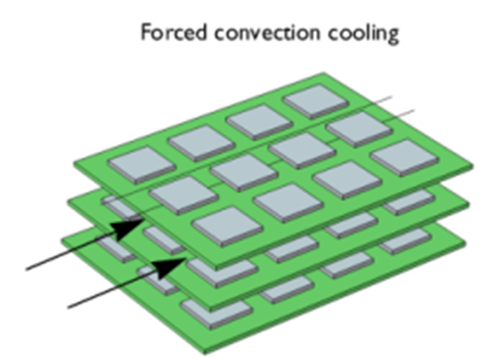

Strategic Realization of Newton’s Cooling of PCBs
$$\dot{m}\& ∆p$$

Slide 3

Initial Remarks
The convection systems studied so far are laminar and, as such, are destined to exist only under special circumstances.
It is common knowledge—a fact reinforced daily by direct observations—that laminar flows can come undone and breakdown to a seemingly more complicated flow called turbulence.
In convective heat transfer research, however, the study of transition is important because the heat transfer potential of a turbulent flow differs vastly from that of its laminar counterpart.
The special circumstances necessary for the transition from analytically predictable laminar flows to analytically unpredictable turbulent f lows

Slide 4
The Overshadowed Ultimate Truth
In an 1854 paper, Hagen noted that the difference between laminar and turbulent flow was clearly visible in the efflux jet.
This jet was either “smooth or fluctuating,” and in glass tubes, where sawdust particles either “moved axially” or, at higher Q, “came into whirling motion.”
Thus Hagen was a true pioneer in fluid mechanics experimentation.
Unfortunately, his achievements were somewhat overshadowed by the more widely publicized 1840 tube-flow studies of J. L. M. Poiseuille, the French physician.

Slide 5
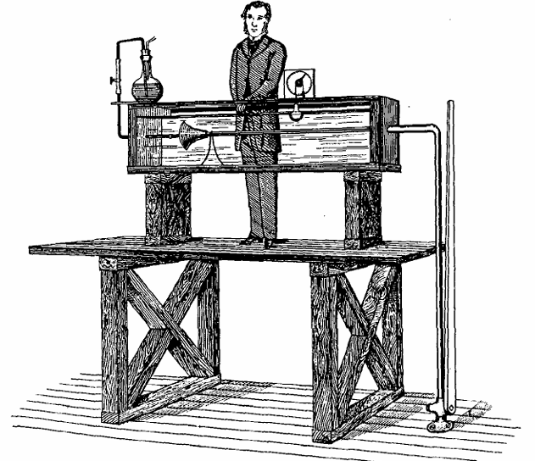
Reynolds Studies on Viscous Flow with very low to High Inertial Force

Slide 6
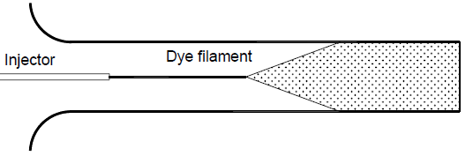
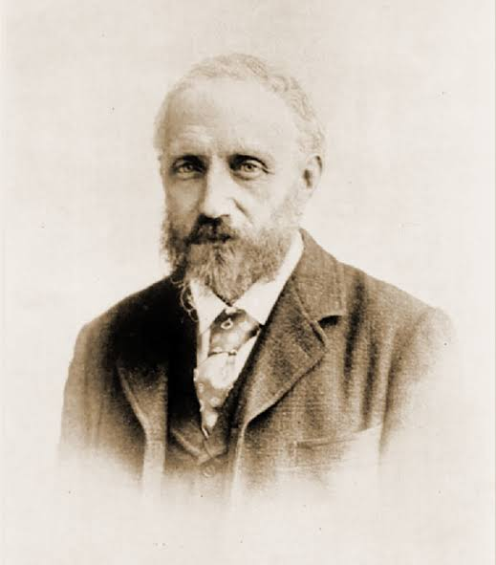
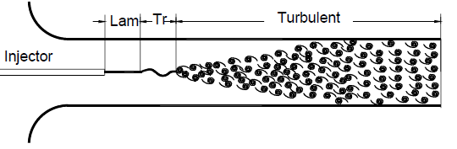
Laminar-Turbulent Transition

Slide 7
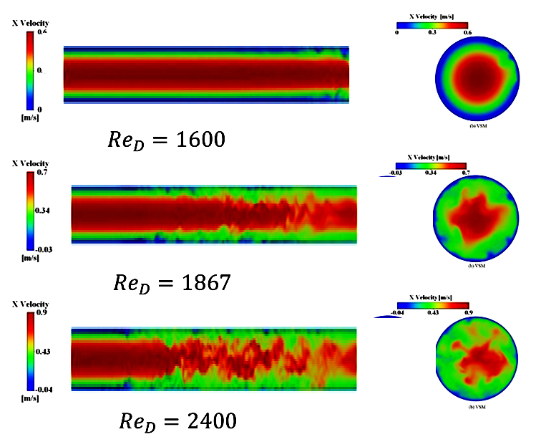
Receptivity of Pipe Flow to Ambient Disturbances

Slide 8
Can a given physical state withstand a disturbance and still return to its original state?

Slide 9
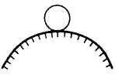
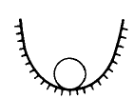


Stability of a Physical State
Stable
Unstable
neutral stability
Stable for small disturbances but unstable for large ones

Slide 10
The Instability of Convection Systems
The equations of Convection Heat Transfer proved that every convection system will have exclusive Velocity and temperature Profiles.
Stability of Convection System ???
If the flow is disturbed, will the disturbance gradually die down, or will the disturbance grow such that the flow departs from its initial profiles and never recovers???

Slide 11
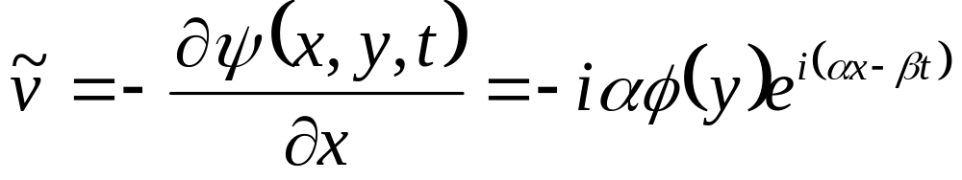
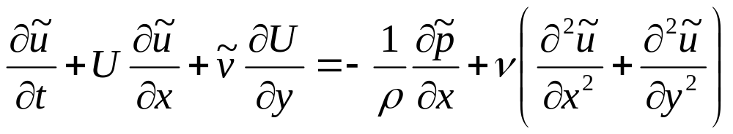
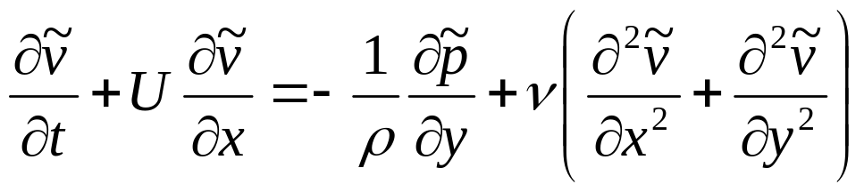
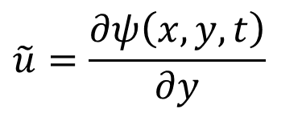
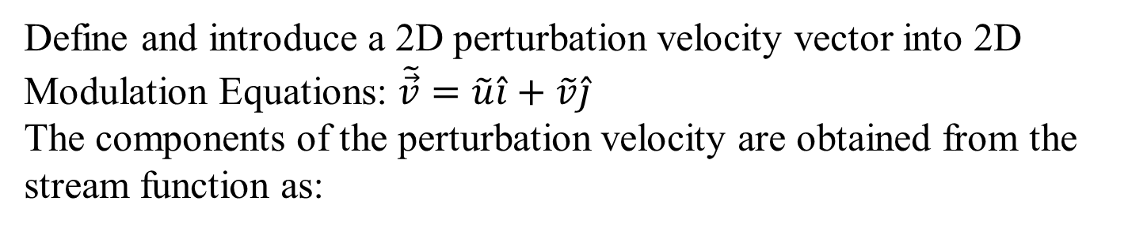
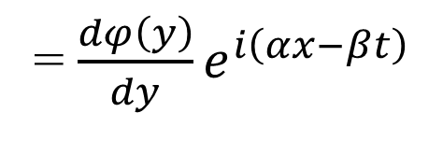
The perturbation of Velocity Field
Define and introduce a 2D perturbation velocity vector into 2D Modulation Equations: $\tilde{\vec{v}}=\tilde{u}\hat{i}+\tilde{v}\hat{j}$
The components of the perturbation velocity are obtained from the stream function as:
$$\tilde{u}=\frac{∂ψ\left(x,y,t\right)}{∂y}$$
= $\frac{dφ\left(y\right)}{dy}e^{i\left(αx−βt\right)}$
Introduce the disturbance velocities into stability equations:

Slide 12
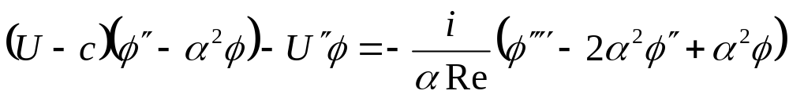
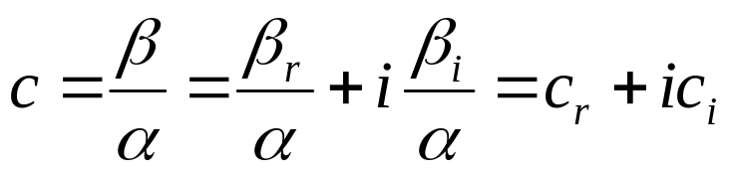
Orr-Sommerfeld -equation
The Orr-Sommerfeld -equation was derived by Orr and independently Sommerfeld .
This equation is obtained by Introducing disturbance velocity functions into modulation equations .
Eliminate the pressure terms by differentiating the first component of the equation with respect to y and the second with respect to x respectively and subtracting the results from each other.
This constitutes the fundamental differential equation for stability of laminar flows in dimensionless form.

Slide 13

Orr-Sommerfeld Eigen value Problem
The Orr-Sommerfeld equation is a fourth order linear homogeneous ordinary differential equation.
With this equation the linear stability problem has been reduced to an eigenvalue problem. :
$$\left(U−c\right)\left(φ^{″}−α^{2}φ\right)−U^{″}φ=−\frac{i}{αRe\left(φ^{{‴^{′2}}^{″2}}()\right)}$$
OSEV Equation contains the main flow velocity distribution U(y) which is specified for the particular flow motion under investigation, the Reynolds number, and the parameters α, c_{r}, and c_{i} .

Slide 14
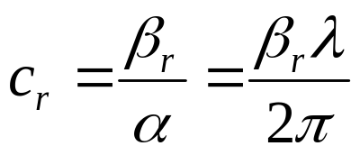
Solution of OS Equations
The Orr-Sommerfeld equation is an eigenvalue problem .
To solve this differential equation, first of all the velocity distribution must be specified.
As an example, the velocity distribution for plane Poisseule flow can be prescribed.
For given Reynolds number and the wavelength, OSE with the boundary conditions provide one eigen function φ(y) and one complex eigen value c=c_{r}+ic_{i} with
as the phase velocity of the prescribed disturbance.

Slide 15
Recognition of Stability of Flow
c=c_{r}+ic_{i}
For a given value of α disturbances are damped if c_{i} <0 and stable laminar flow persists.
c_{i} > 0 indicates a disturbance amplification leading to instability of the laminar flow.
The neutral stability is characterized by c_{i} = 0.
For a prescribed laminar flow with a given U(y) the results of a stability analysis is presented schematically on a Re Vs frequency of disturbance.

Slide 16
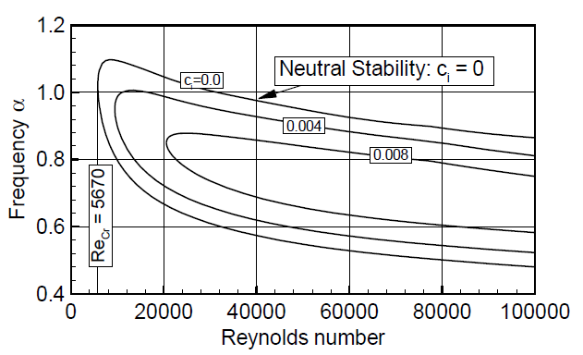
Stability Condition for a plane Poiseuille Flow
Disturbance

Slide 17
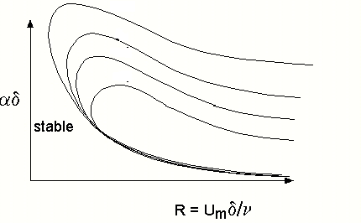
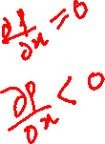
Effect of pressure gradient
Negative values of pressure gradient signify a favourable pressure gradient.
positive values signify an adverse pressure gradient (pressure increasing downstream),

Slide 18
Major Classes of Instability
Wall-bounded Convection Systems:
  Boundary layers, pipe flows, etc.
  Any general convection system non-inflexion point velocity profile.
  viscosity plays a role
  sensitive to the form of the basic flow
Free-shear flows:
  mixing layers, wakes, jets, etc
  less sensitive to the form of the basic flow
  Viscosity is not responsible.

Slide 19
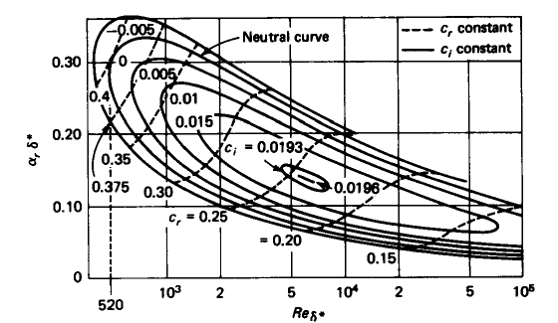
Stability of Blasius BL

Slide 20
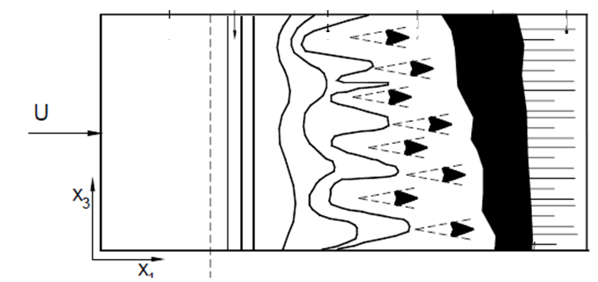
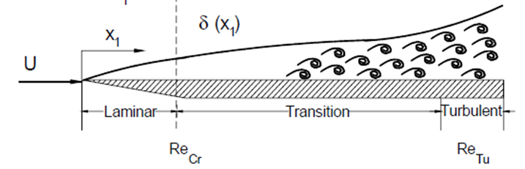
Sketch of transition process in the boundary layer along a flat Plate
A stable laminar flow is established that starts from the leading edge and extends to the point of inception of the unstable two-dimensional Tollmien-Schlichting waves.
Fluid Mechanics for Engineers, A Graduate Textbook, Meinhard T. Schobeiri, 2010.

Slide 21

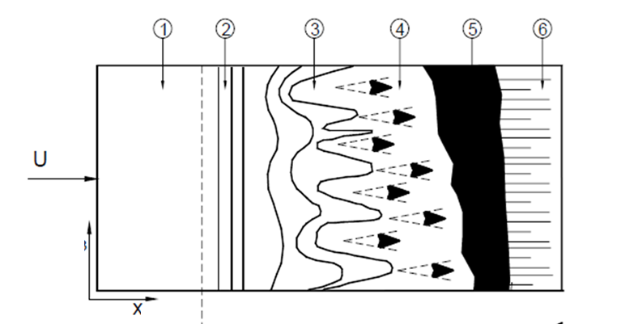
Sketch of transition process in the boundary layer along a flat Plate
Location 1: Stable Laminar Zone
z

Slide 22
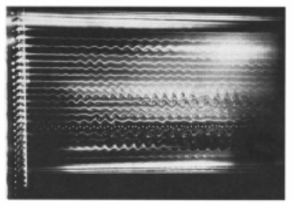
Sketch of transition process in the boundary layer along a flat Plate
Location 2: Onset of the unstable One -dimensional Tollmien-Schlichting waves.
Laminar Flow fighting against the Disturbances
z

Slide 23
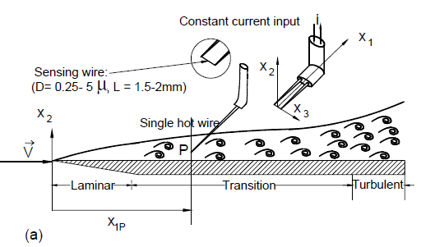
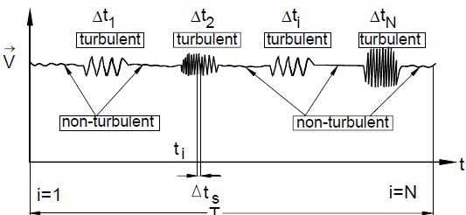
An intermittently laminar-turbulent flow

Slide 24
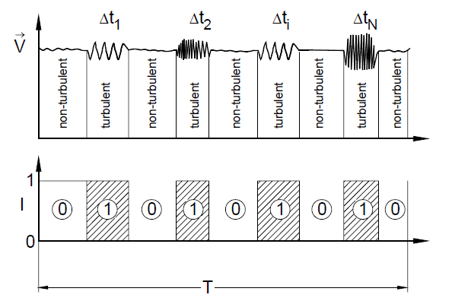
Intermittency Factor

Slide 25
Sketch of transition process in the boundary layer along a flat Plate
Location 3: Onset of the unstable two-dimensional Tollmien-Schlichting waves.
z

Slide 26
Sketch of transition process in the boundary layer along a flat Plate
Location 3⁺: Bursts of turbulence in places with high vorticity
z

Slide 27
Sketch of transition process in the boundary layer along a flat Plate
Location 3⁺⁺Intermittent formation of turbulent spots (Horseshoe) with high vortical core at intense fluctuation.
z

Slide 28
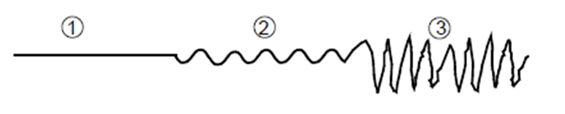
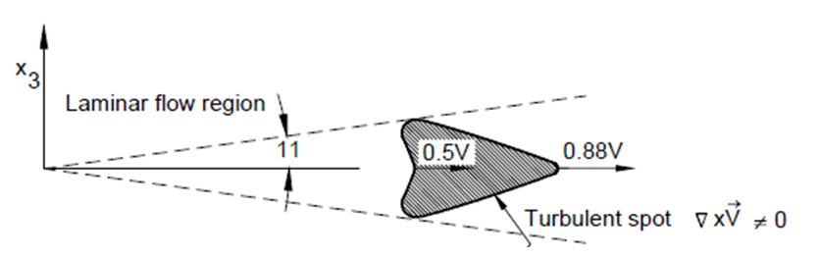
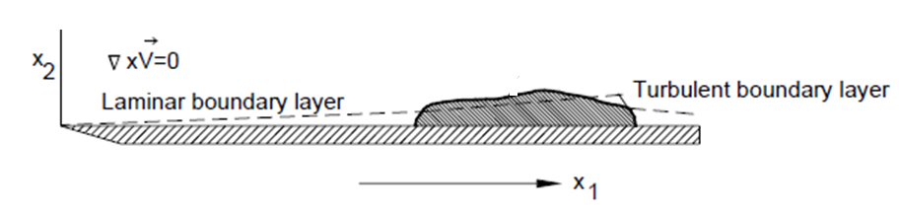
Transition process along Flow Direction on A flat plate

Slide 29

Hans Albert Einstein
(May 14, 1904 – July 26, 1973)
Hans Albert Einstein an avid sailor, frequently taking colleagues and family out for excursions on the San Francisco Bay.
On his many field trips and academic excursions, he took thousands of pictures, many of which he developed himself and presented as slide shows.
In 1988, the American Society of Civil Engineers created the Hans Albert Einstein Award to recognize outstanding achievements in erosion control, sedimentation and/or waterway development.

Slide 30
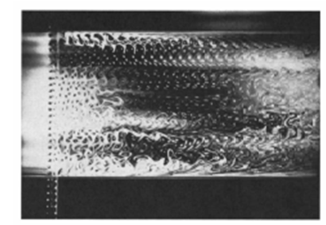
Sketch of transition process in the boundary layer along a flat Plate
Location 4: Development of unstable, three-dimensional waves and the formation of vortex cascades
Laminar Flow Accepting the Disturbances
z

Slide 31
Sketch of transition process in the boundary layer along a flat Plate
Zone 5: Coalescence of turbulent spots into a fully developed turbulent boundary layer.
z

Slide 32
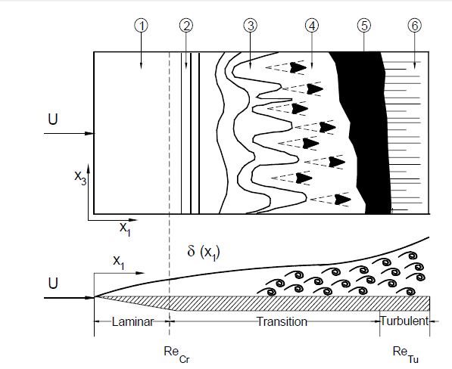
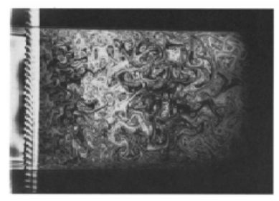
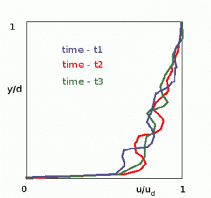
Sketch of transition process in the boundary layer along a flat Plate
Fully Developed Turbulent Zone
z
Fully Developed Turbulent Flow

Slide 33
Definition of A Turbulent Flow
A Fluid motion in which velocity, pressure, and other flow quantities fluctuate irregularly in time and space.
“Turbulent Fluid motion is an irregular condition of flow in which the various quantities show a random variation with time and space coordinates, so that statistically distinct average values can be observed.” - Hinze
“Turbulence is due to the formation of point or line vortice on which some component of the velocity becomes infinite.:” -Jean Leray

Slide 34
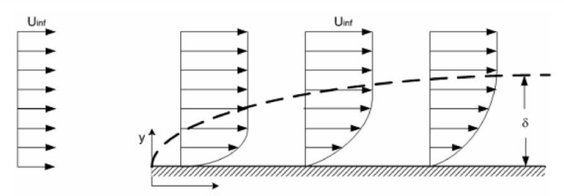
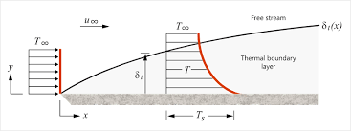
2-D Turbulent Boundary Layer Convection Heat Transfer
δ
L

Slide 35
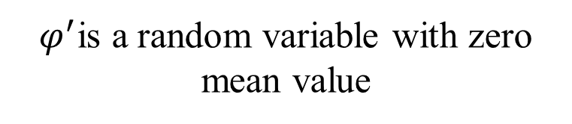


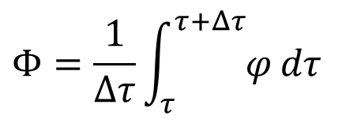
First Method of Analyzing Steady Turbulent Convection System
Reynolds (1895) decomposed the field variable into a time average
variable and a turbulent fluctuation
- Likewise
$$φ= Φ +φ^{′}$$
φ stands for any scalar: u, v, w, T, p, where:
$$Φ=\frac{1}{Δτ}\int_{τ}^{τ+Δτ}{φ}dτ$$
$$Representa as Φ=\overline{φ}=\overline{Φ+φ^{′}}$$
Time averaged Scalar
$φ^{′}$is a random variable with zero mean value

Slide 36





Average and Fluctuating Flow Properties
$$p= P+p^{′}$$
Instantaneous velocity
$$u=U+u^{′}$$
fluctuation
around
average
velocity
$$v=V+v′$$
Average
velocity
$$w=W+w′$$
time
T$=\overline{T}+T′$
Local velocity
fluctuation
around
average
velocity
Average
velocity
x

Slide 37

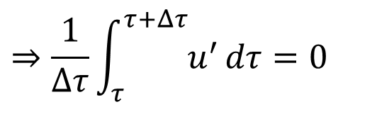

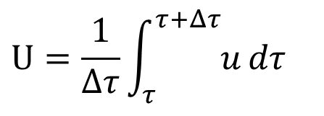
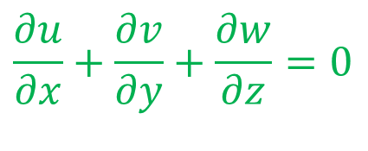
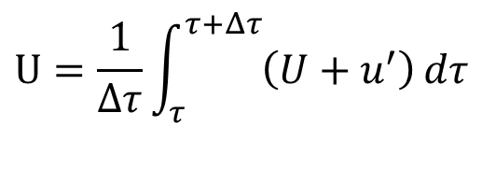
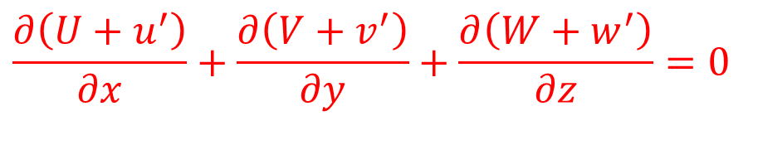
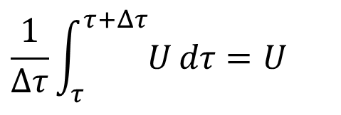

Averaging of Continuity Equations
$$\frac{∂u}{∂x}+\frac{∂v}{∂y}+\frac{∂w}{∂z}=0$$
$$⇒\frac{1}{Δτ}\int_{τ}^{τ+Δτ}{u^{′}}dτ=0$$
$$U=\frac{1}{Δτ}\int_{τ}^{τ+Δτ}{u}dτ$$
$$U=\frac{1}{Δτ}\int_{τ}^{τ+Δτ}{\left(U+u^{′}\right)}dτ$$
$$\frac{1}{Δτ}\int_{τ}^{τ+Δτ}{U}dτ=U$$
$$u=U+u^{′}$$
$$v=V+v^{′}$$
$$w=W+w^{′}$$
Substitute Reynolds Decomposition into continuity equation:
$$\frac{∂\left(U+u^{′}\right)}{∂x}+\frac{∂\left(V+v^{′}\right)}{∂y}+\frac{∂\left(W+w^{′}\right)}{∂z}=0$$

Slide 38
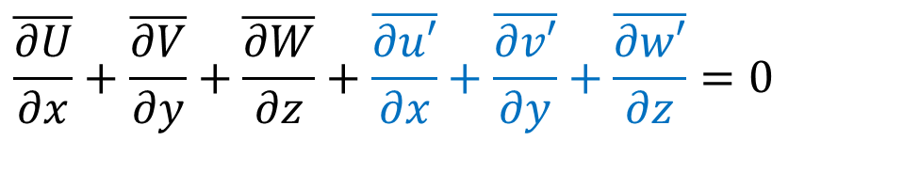
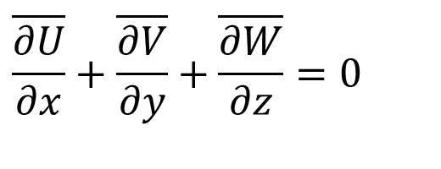
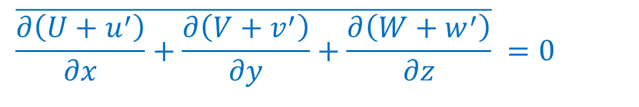
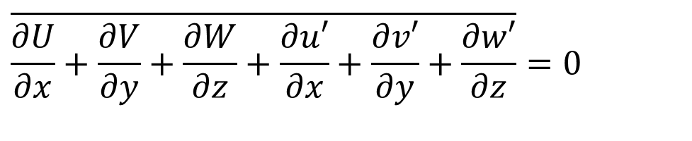
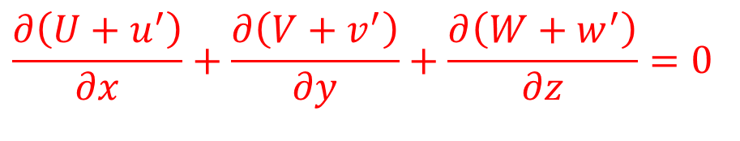

Averaging of Continuity Equations
Continuity equation for an Infected flow:
$$\frac{∂\left(U+u^{′}\right)}{∂x}+\frac{∂\left(V+v^{′}\right)}{∂y}+\frac{∂\left(W+w^{′}\right)}{∂z}=0$$
Consider Reynolds Averaging of An Infected continuity equation:
$$\overline{\frac{∂\left(U+u^{′}\right)}{∂x}+\frac{∂\left(V+v^{′}\right)}{∂y}+\frac{∂\left(W+w^{′}\right)}{∂z}} =0$$
$$\overline{\frac{∂U}{∂x}+\frac{∂V}{∂y}+\frac{∂W}{∂z}+\frac{∂u′}{∂x}+\frac{∂v′}{∂y}+\frac{∂w′}{∂z}}=0$$
$$\overline{\frac{∂U}{∂x}}+\overline{\frac{∂V}{∂y}}+\overline{\frac{∂W}{∂z}}+\overline{\frac{∂u′}{∂x}}+\overline{\frac{∂v′}{∂y}}+\overline{\frac{∂w′}{∂z}}=0$$
$$\overline{\frac{∂U}{∂x}}+\overline{\frac{∂V}{∂y}}+\overline{\frac{∂W}{∂z}}=0$$
$$\frac{∂U}{∂x}+\frac{∂V}{∂y}+\frac{∂W}{∂z}=0$$

Slide 39








Time Averaging Operations
$$\overline{Φ}=Φ$$
$$\overline{φ}′=0$$
$$\overline{Φ+φ′}=Φ$$
$$\overline{Φφ}′=0$$
$$\overline{φ_{1}φ_{2}}=\overline{(Φ_{1}+φ′_{1})(Φ_{2}+φ′_{2})}=Φ_{1}Φ_{2}+\overline{φ′_{1}φ′_{2}}$$
$$\overline{∇•φ}=∇•Φ$$
$$\overline{∇• (φ_{1}φ_{2})}=∇• (Φ_{1}Φ_{2})+ ∇•\overline{ (φ_{1}^{′}φ_{2}^{′})}$$
$$\overline{∇•(∇φ)}=∇• ∇ Φ$$

Slide 40

Reynolds Averaging of Energy Equation
The general Energy conservation Equation of an Infected Convection System: $T\left(\vec{x},t\right) \& \vec{V}\left(\vec{x},t\right)$
$${ρc}_{p}\left\{\frac{∂T}{∂t}+u\frac{∂T}{∂x}+v\frac{∂T}{∂y}++w\frac{∂T}{∂z}\right\}=k\left\{\frac{∂^{2}T}{∂x^{2}}+\frac{∂^{2}T}{∂y^{2}}+\frac{∂^{2}T}{∂z^{2}}\right\}$$
$$\vec{v}=\vec{V}+{\vec{v}}^{′}$$
T$=\overline{T}+T′$
$$\left\{\frac{∂\left(\overline{T}+T′ \right)}{∂t}+\left(U+u^{′}\right)\frac{∂\left(\overline{T}+T′ \right)}{∂x}+\left(V+v′\right)\frac{∂\left(\overline{T}+T′ \right)}{∂y}+\left(W+w′\right)\frac{∂\left(\overline{T}+T′ \right)}{∂z}\right\}$$
$$\left(U+u^{′}\right)\frac{∂\left(\overline{T}+T′ \right)}{∂x}=U\frac{∂\overline{T}}{∂x}+u^{′}\frac{∂\overline{T}}{∂x}+U\frac{∂T′}{∂x}+u^{′}\frac{∂T′}{∂x}$$

Slide 41
Method of Reynolds Averaging
$$\left(U+u^{′}\right)\frac{∂\left(\overline{T}+T′ \right)}{∂x}=U\frac{∂\overline{T}}{∂x}+u^{′}\frac{∂\overline{T}}{∂x}+U\frac{∂T′}{∂x}+u^{′}\frac{∂T′}{∂x}$$
Reynolds Averaging of $u\frac{∂T}{∂x}$
$$\overline{u\frac{∂T}{∂x}}=\overline{U\frac{∂\overline{T}}{∂x}} +\overline{u^{′}\frac{∂\overline{T}}{∂x}}+\overline{U\frac{∂T′}{∂x}}+\overline{u^{′}\frac{∂T′}{∂x}}$$
$$\overline{u\frac{∂T}{∂x}}=\overline{U\frac{∂\overline{T}}{∂x}} +\overline{u^{′}\frac{∂T′}{∂x}}$$
Similarly
$$\overline{v\frac{∂T}{∂y}}=\overline{V\frac{∂\overline{T}}{∂y}} +\overline{v^{′}\frac{∂T′}{∂y}}$$
$$\overline{w\frac{∂T}{∂z}}=\overline{W\frac{∂\overline{T}}{∂z}} +\overline{w^{′}\frac{∂T′}{∂z}}$$

Slide 42


Method of Reynolds Averaging
$$\overline{u\frac{∂T}{∂x}+v\frac{∂T}{∂y}++w\frac{∂T}{∂z}}$$
Reynolds Averaging of
$$\overline{U\frac{∂\overline{T}}{∂x}}+\overline{V\frac{∂\overline{T}}{∂y}}+\overline{W\frac{∂\overline{T}}{∂z}}+\overline{u^{′}\frac{∂T′}{∂x}}+\overline{v^{′}\frac{∂T′}{∂y}}+ +\overline{w^{′}\frac{∂T′}{∂z}}$$
$$\overline{U\frac{∂\overline{T}}{∂x}}+\overline{V\frac{∂\overline{T}}{∂y}}+\overline{W\frac{∂\overline{T}}{∂z}}+\overline{u^{′}\frac{∂T′}{∂x}}+\overline{v^{′}\frac{∂T′}{∂y}}+ \overline{w^{′}\frac{∂T′}{∂z}}$$

Slide 43
Reynolds Averaged Energy Equation for Convection
The general Energy conservation Equation
$${ρc}_{p}\left\{\frac{∂T}{∂t}+u\frac{∂T}{∂x}+v\frac{∂T}{∂y}++w\frac{∂T}{∂z}\right\}=k\left\{\frac{∂^{2}T}{∂x^{2}}+\frac{∂^{2}T}{∂y^{2}}+\frac{∂^{2}T}{∂z^{2}}\right\}$$
Reynolds Averaging gives:
$$\left\{\frac{∂^{2}\overline{T}}{∂x^{2}}+\frac{∂^{2}\overline{T}}{∂y^{2}}+\frac{∂^{2}\overline{T}}{∂z^{2}}\right\}$$
$$U\frac{∂\overline{T}}{∂x} +V\frac{∂\overline{T}}{∂y}+W\frac{∂\overline{T}}{∂z}+\overline{\frac{∂\left(u^{′}T′\right)}{∂x}}+\overline{\frac{∂\left(v^{′}T′\right)}{∂y}}+\overline{\frac{∂\left(w^{′}T′\right)}{∂z}}$$
$${ρc}_{p}\left\{\frac{∂\overline{T}}{∂t}+U\frac{∂\overline{T}}{∂x} +V\frac{∂\overline{T}}{∂y}+W\frac{∂\overline{T}}{∂z}+\overline{\frac{∂\left(u^{′}T′\right)}{∂x}}+\overline{\frac{∂\left(v^{′}T′\right)}{∂y}}+\overline{\frac{∂\left(w^{′}T′\right)}{∂z}} \right\}=k\left\{\frac{∂^{2}\overline{T}}{∂x^{2}}+\frac{∂^{2}\overline{T}}{∂y^{2}}+\frac{∂^{2}\overline{T}}{∂z^{2}}\right\}$$

Slide 44
Reynolds Heat Flux Vector
$$\vec{q_{R}^{′′}}=ρc_{p}\left\{\left(u^{′}T′\right)\hat{i}+\left(v^{′}T′\right)\hat{j}+\left(w^{′}T′\right) \hat{k}\right\}$$
This is usually called the Reynolds/Eddy Heat Flux vector.
Fourier’s Constitutive Equation for the Heat Flux
$$\vec{q′′}=−k∇T$$
$∇.\vec{q′′}$= $∇.\left\{−k∇T\right\}$
$∇.\vec{q′′}$= $∇.\left\{−k\left[\frac{∂T}{∂x}\hat{i}+\frac{∂T}{∂y}\hat{j}+\frac{∂T}{∂y}\hat{k}\right]\right\}$
$$∇.\vec{q_{R}^{′′}}=ρc_{p}∇.\left\{\left(u^{′}T′\right)\hat{i}+\left(v^{′}T′\right)\hat{j}+\left(w^{′}T′\right) \hat{k}\right\}$$

Slide 45
Reynolds Averaged Energy Equation for Turbulent Convection
The general Averaged Energy conservation Equation for turbulent convection
$${ρc}_{p}\left\{\frac{∂\overline{T}}{∂t}+U\frac{∂\overline{T}}{∂x}+V\frac{∂\overline{T}}{∂y}+W\frac{∂\overline{T}}{∂z}\right\}=−∇∙\left\{−k∇T\right\}−{ρc}_{p}\left\{\overline{\frac{∂\left(u^{′}T′\right)}{∂x}}+\overline{\frac{∂\left(v^{′}T′\right)}{∂y}}+\overline{\frac{∂\left(w^{′}T′\right)}{∂z}} \right\}$$
The Big question is :
If the products $\overline{\left(u^{′}T′\right)}$, $\overline{\left(v^{′}T′\right)}$and $\overline{\left(w^{′}T′\right)}$survive the time-averaging
process, that is, if they are nonzero, are they negative or positive?

Slide 46
Averaging of x-momentum Equation
$$ρ\left(\frac{∂u}{∂τ}+u\frac{∂u}{∂x}+v\frac{∂u}{∂y}+w\frac{∂u}{∂z}\right)=−\frac{∂p}{∂x}+μ\left(\frac{∂^{2}u}{∂x^{2}}+\frac{∂^{2}u}{∂y^{2}}+\frac{∂^{2}u}{∂z^{2}}\right)$$
Write x-momentum equations in a short format:
$$ρ\left(\frac{∂u}{∂τ}+∇•\left(u\vec{v}\right)\right)=−\frac{∂p}{∂x}+μ ∇•\left(∇u\right)$$
Reynolds decomposition of turbulent flow variables:
$$p= P+p^{′}$$
$$u=U+u^{′}$$
$$v=V+v′$$
$$w=W+w′$$

Slide 47
Reynolds Averaging of x-momentum Equation
$$\overline{ρ\frac{∂u}{∂τ}}+ρ\overline{∇•\left(u\vec{v}\right)}=−\overline{\frac{∂p}{∂x}}+μ \overline{∇•\left(∇u\right)}$$
$$\overline{∇•\left(u\vec{v}\right)}=\overline{∇•\left(\left\{U+u^{′}\right\}\left\{\vec{V}+\vec{v^{′}}\right\}\right)}$$
$$=∇•\overline{\left(U\vec{V}+U\vec{v^{′}}+u^{′}\vec{V}+u^{′}\vec{v^{′}}\right)}$$
$$∇•\left(U\vec{V}\right)+\frac{∂\overline{\left(u^{′}u^{′}\right)}}{∂x}+\frac{∂\overline{\left(u^{′}v^{′}\right)}}{∂y}+\frac{∂\overline{\left(u^{′}w^{′}\right)}}{∂z}$$
$=∇•\overline{\left(U\vec{V}\right)}+∇•\overline{\left(U\vec{v^{′}}\right)}+∇•\overline{\left(u^{′}\vec{V}\right)}$+ $∇•\overline{\left(u^{′}\vec{v^{′}}\right)}$
$=∇•\overline{\left(U\vec{V}\right)}$+ $∇•\overline{\left(u^{′}\vec{v^{′}}\right)}$

Slide 48
Reynolds Averaging of x-momentum Equation
$$\overline{ρ\frac{∂u}{∂τ}}+ρ\overline{∇•\left(u\vec{v}\right)}=−\overline{\frac{∂p}{∂x}}+μ \overline{∇•\left(∇u\right)}$$
$$\overline{∇•\left(∇u\right)}=∇•\left(∇\overline{\left(U+u^{′}\right)}\right)$$
$$=∇•\left(∇U\right)+∇•\left(∇\overline{u^{′}}\right)$$
$$=∇•\left(∇U\right)$$

Slide 49
Reynolds Averaged Steady Turbulent Momentum Equations
$$\overline{ρ\left(\frac{∂u}{∂τ}+∇•\left(u\vec{v}\right)\right)}=−\overline{\frac{∂p}{∂x}}+μ \overline{∇•\left(∇u\right)}$$
Reynolds averaged x-momentum equation for steady incompressible turbulent flow
$$ρ\left(∇•\left(U\vec{V}\right)+\overline{\frac{∂\left(u^{′}u^{′}\right)}{∂x}}+\overline{\frac{∂\left(u^{′}v^{′}\right)}{∂y}}+\overline{\frac{∂\left(u^{′}w^{′}\right)}{∂z}}\right)=−\frac{∂P}{∂x}+μ∇•\left(∇U\right)$$
$$ρ∇•\left(U\vec{V}\right)=−\frac{∂P}{∂x}+μ∇•\left(∇U\right)−ρ\left(\overline{\frac{∂\left(u^{′}u^{′}\right)}{∂x}}+\overline{\frac{∂\left(u^{′}v^{′}\right)}{∂y}}+\overline{\frac{∂\left(u^{′}w^{′}\right)}{∂z}}\right)$$

Slide 50
Reynolds Averaged Steady Turbulent Momentum Equations
Reynolds averaged y-momentum equation for steady incompressible turbulent flow
$$ρ∇•\left(V\vec{V}\right)=−\frac{∂P}{∂y}+μ∇•\left(∇V\right)−ρ\left(\overline{\frac{∂\left(v^{′}u^{′}\right)}{∂x}}+\overline{\frac{∂\left(v^{′}v^{′}\right)}{∂y}}+\overline{\frac{∂\left(v^{′}w^{′}\right)}{∂z}}\right)$$
Reynolds averaged z-momentum equation for steady incompressible turbulent flow
$$ρ∇•\left(W\vec{V}\right)=−\frac{∂P}{∂z}+μ∇•\left(∇W\right)−ρ\left(\overline{\frac{∂\left(w^{′}u^{′}\right)}{∂x}}+\overline{\frac{∂\left(w^{′}v^{′}\right)}{∂y}}+\overline{\frac{∂\left(w^{′}w^{′}\right)}{∂z}}\right)$$

Slide 51
Reynolds Averaged Equations for Forced Convection
$$\frac{∂U}{∂x}+\frac{∂V}{∂y}+\frac{∂W}{∂z}=0$$
$$ρ∇•\left(U\vec{V}\right)=−\frac{∂P}{∂x}+μ∇•\left(∇U\right)−ρ\left(\overline{\frac{∂\left(u^{′}u^{′}\right)}{∂x}}+\overline{\frac{∂\left(u^{′}v^{′}\right)}{∂y}}+\overline{\frac{∂\left(u^{′}w^{′}\right)}{∂z}}\right)$$
$$ρ∇•\left(V\vec{V}\right)=−\frac{∂P}{∂y}+μ∇•\left(∇V\right)−ρ\left(\overline{\frac{∂\left(v^{′}u^{′}\right)}{∂x}}+\overline{\frac{∂\left(v^{′}v^{′}\right)}{∂y}}+\overline{\frac{∂\left(v^{′}w^{′}\right)}{∂z}}\right)$$
$$ρ∇•\left(W\vec{V}\right)=−\frac{∂P}{∂z}+μ∇•\left(∇W\right)−ρ\left(\overline{\frac{∂\left(w^{′}u^{′}\right)}{∂x}}+\overline{\frac{∂\left(w^{′}v^{′}\right)}{∂y}}+\overline{\frac{∂\left(w^{′}w^{′}\right)}{∂z}}\right)$$
$${ρc}_{p}\left\{\frac{∂\overline{T}}{∂t}+U\frac{∂\overline{T}}{∂x}+V\frac{∂\overline{T}}{∂y}+W\frac{∂\overline{T}}{∂z}\right\}=k\left\{\frac{∂^{2}\overline{T}}{∂x^{2}}+\frac{∂^{2}\overline{T}}{∂y^{2}}+\frac{∂^{2}\overline{T}}{∂z^{2}}\right\}−{ρc}_{p}\left\{\overline{\frac{∂\left(u^{′}T′\right)}{∂x}}+\overline{\frac{∂\left(v^{′}T′\right)}{∂y}}+\overline{\frac{∂\left(w^{′}T′\right)}{∂z}} \right\}$$

Slide 52
Reynolds Stress Tensor
$$\vec{\vec{R}}=\left[\begin{matrix}\overline{u^{′2}} & \overline{u^{′}v^{′}} & \overline{u^{′}w^{′}} \\ \overline{v^{′}u^{′}} & \overline{v^{′2}} & \overline{v^{′}w^{′}} \\ \overline{w^{′}u^{′}} & \overline{w^{′}v^{′}} & \overline{w^{′2}}\end{matrix}\right]$$
This is usually called the Reynolds stress tensor
$$\vec{\vec{R}}=\left[\begin{matrix}\overline{u^{′2}} & \overline{u^{′}v^{′}} & \overline{u^{′}w^{′}} \\ \overline{u^{′}v^{′}} & \overline{v^{′2}} & \overline{v^{′}w^{′}} \\ \overline{u^{′}w^{′}} & \overline{v^{′}w^{′}} & \overline{w^{′2}}\end{matrix}\right]$$
Reynolds stresses : total 9 → 6 are unknown

Slide 53
Time averaged Infected Navier Stokes Equation
$$U\frac{∂U}{∂x}+V\frac{∂U}{∂y}+W\frac{∂U}{∂z}=−\frac{1}{ρ}\frac{dp}{dx}+v\left(\frac{∂^{2}U}{∂x^{2}}+\frac{∂^{2}U}{∂y^{2}}+\frac{∂^{2}U}{∂z^{2}}\right)−\left(\frac{∂\overline{u^{′2}}}{∂x}+\frac{∂\overline{u′v′}}{∂y}+\frac{∂\overline{u′w′}}{∂z}\right)$$
$$U\frac{∂U}{∂x}+V\frac{∂U}{∂y}+W\frac{∂U}{∂z}=−\frac{1}{ρ}\frac{dp}{dx}+\frac{1}{ρ}\left(\frac{∂τ_{xx}}{∂x}+\frac{∂τ_{xy}}{∂y}+\frac{∂τ_{xz}}{∂z}\right)−\left(\frac{∂\overline{u^{′2}}}{∂x}+\frac{∂\overline{u′v′}}{∂y}+\frac{∂\overline{u′w′}}{∂z}\right)$$
For all the Three Momentum Equations, total turbulent stress tensor:
$$τ_{ij,\text{infected}}=\left[\begin{matrix}(τ_{xx}−\overline{u′^{2}}) & (τ_{xy}−\overline{u′v′}) & (τ_{xz}−\overline{u′w′}) \\ (τ_{yx}−\overline{v′u′}) & (τ_{yy}−\overline{v′^{2}}) & (τ_{yz}−\overline{v′w′}) \\ (τ_{zx}−\overline{u′w′}) & (τ_{zy}−\overline{w′v′}) & (τ_{zz}−\overline{w′^{2}})\end{matrix}\right]$$

Slide 54
Reynolds stresses & Heat Fluxes
Performing the Reynolds Averaging Process, new terms has arisen, namely the Reynolds-stress tensor:
$$τ_{ij,\text{infection}}=τ_{ij−laminar}−ρ\overline{u_{i}′u_{j}′}$$
$$q_{i−infection}^{′′}=q_{i−laminar}^{′′}−ρc_{p}\overline{u_{i}^{′}T^{′}}$$
This brings us at the turbulent closure problem, the fact that we have more unknowns than equations.
  Three velocities + pressure + six Reynolds-stresses+Temperature + three Rynolds heat flux
  Three momentum equations + the continuity equation+the energy equation
To close the problem, we need additional equations to solve infected flow.

Slide 55

Prandtl Mixing Length Hypothesis
The fluid particle A with the mass dm located at the position , y+l_{m} and has the longitudinal velocity component U+ΔU is fluctuating.
This particle is moving downward with the lateral velocity v′ and the fluctuation momentum dI′_{y}=dm×v′.
It arrives at the layer which has a lower velocity U.
According to the Prandtl hypothesis, this macroscopic momentum exchange most likely gives rise to a positive fluctuation u′ >0.
Y
$$\overline{u^{′}v^{′}}<0$$
$$v^{′}<0 \\ u^{′}>0$$
$$U$$
$$U+ΔU$$
$$U$$
y
$$U−ΔU$$
$$v^{′}>0 \\ u^{′}<0$$
X

