Slide 1

Fully Developed Forced Convection in Laminar Internal Flows
P M V Subbarao
Professor
Mechanical Engineering Department
Minimum Capacity of A Heat Transfer Systems……..

Slide 2

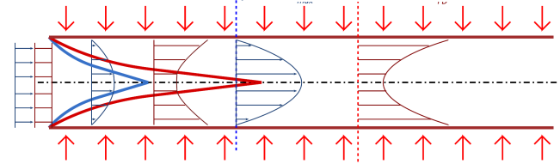
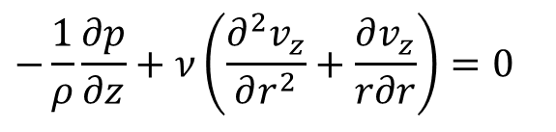
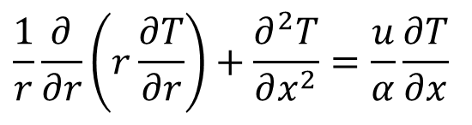
HEAT TRANSFER TO FULLY DEVELOPED DUCT FLOW
For Steady fully Developed flow NS and thermal energy equations are simplified as:
$$−\frac{1}{ρ}\frac{∂p}{∂z}+ν\left(\frac{∂^{2}v_{z}}{∂r^{2}}+\frac{∂v_{z}}{r∂r}\right)=0$$
$$\frac{1}{r}\frac{∂}{∂r}\left(r\frac{∂T}{∂r}\right)+\frac{∂^{2}T}{∂x^{2}}=\frac{u}{α}\frac{∂T}{∂x}$$

Slide 3
HEAT TRANSFER TO FULLY DEVELOPED DUCT FLOW
This section of convection heat transfer was developed in parallel with modern thermodynamics
The key question about the heat transfer to duct flow is the relationship between the wall–stream temperature difference and the wall–stream heat transfer rate.
The wall–stream heat transfer rate is responsible for the longitudinal (Fourier) and streamwise (first law) temperature variation of the stream.

Slide 4
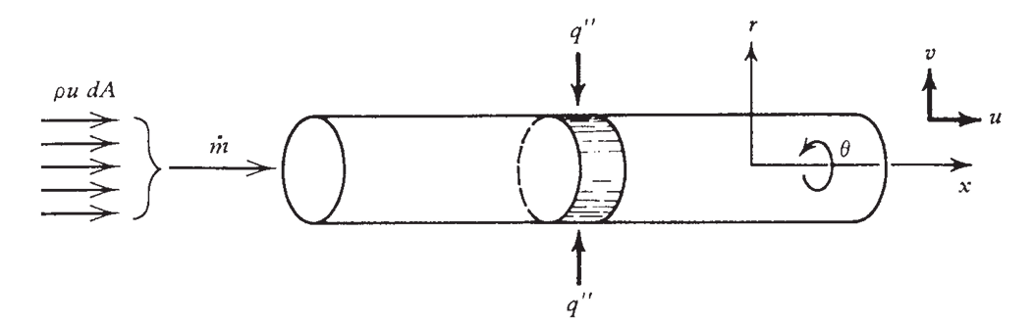
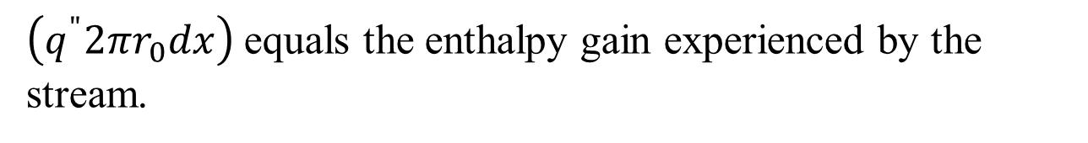
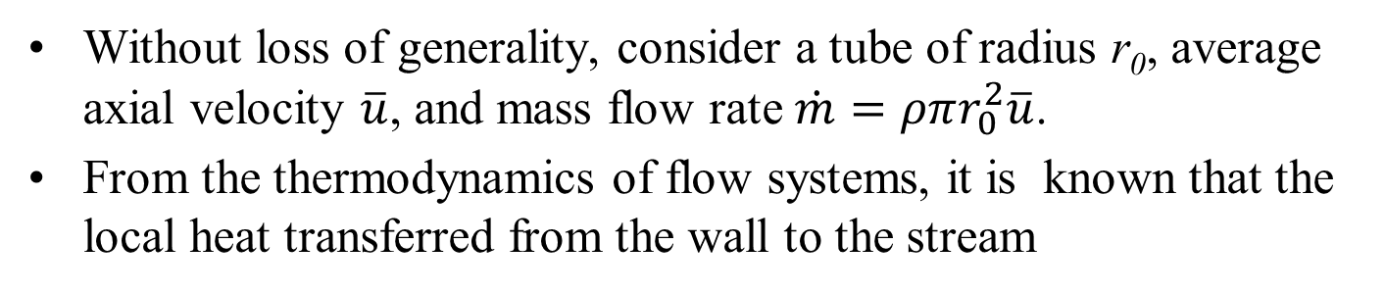
HEAT TRANSFER TO FULLY DEVELOPED DUCT FLOW
Without loss of generality, consider a tube of radius r₀, average axial velocity $\overline{u}$, and mass flow rate $\dot{m}=ρπr_{0}^{2}\overline{u}$.
From the thermodynamics of flow systems, it is known that the local heat transferred from the wall to the stream
$\left(q^{"}2πr_{0}dx\right)$ equals the enthalpy gain experienced by the stream.

Slide 5
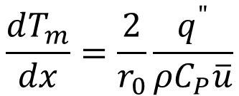

HEAT TRANSFER TO FULLY DEVELOPED DUCT FLOW
for the control volume of length dx shown in Figure, the first law of thermodynamics requires
$$q^{"}2πr_{0}dx=\dot{m}\left(h_{x+dx}−h_{x}\right)$$
Model the fluid as an ideal gas (dh = C_{P} dT_{m})
or an incompressible liquid with negligible pressure changes (dh ≅ C dT_{m}).
$$\frac{dT_{m}}{dx}=\frac{2}{r_{0}}\frac{q^{"}}{ρC_{P}\overline{u}}$$

Slide 6
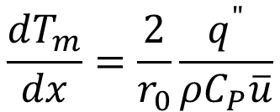
HEAT TRANSFER TO FULLY DEVELOPED DUCT FLOW
$$\frac{dT_{m}}{dx}=\frac{2}{r_{0}}\frac{q^{"}}{ρC_{P}\overline{u}}$$
The temperature T_{m} appearing in the first law analysis of the duct ‘‘control volume’’ is the bulk temperature of the stream.
In heat transfer—an activity that developed in parallel with modern thermodynamics T_{m} is the mean temperature of the stream.
Implicit in this name is the fact that the fluid temperature cannot be uniform over the duct cross section.

Slide 7
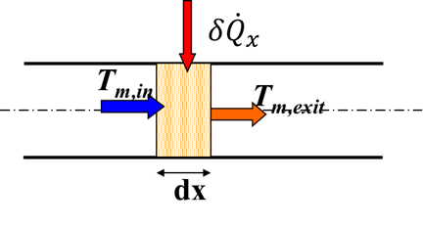
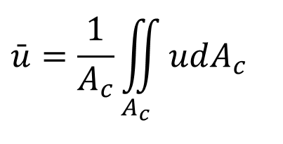

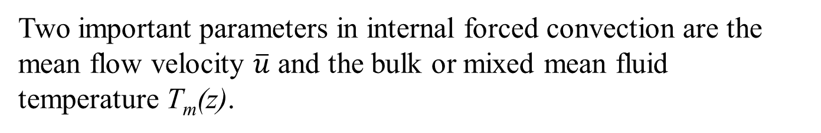
Incompressible Steady System :
Mean Velocity and Bulk Temperature
Two important parameters in internal forced convection are the mean flow velocity $\overline{u}$ and the bulk or mixed mean fluid temperature T_{m}(z).
The mass flow rate is defined as:
$$\bar{u}=\frac{1}{A_{c}}\iint_{A_{c}}{udA_{c}}$$
$$\dot{m}=ρ\bar{u}A_{c}$$
while the bulk or mixed mean temperature is defined as:
$$T_{m}(x)=\frac{\iint_{A_{c}}{ρuC_{p}TdA_{c}}}{\dot{m}C_{p}}$$
For Incompressible Flows:
$$T_{m}(x)=\frac{1}{\bar{u}A_{c}}\iint_{A_{c}}{uTdA_{c}}$$

Slide 8
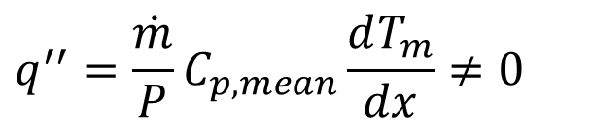

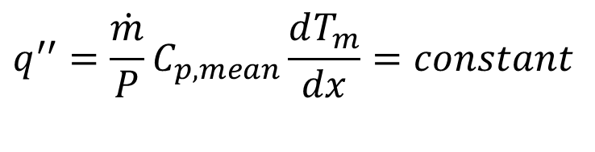
Physics of Convective Heat Transfer
Constant Wall Heat Flux
Condition for occurrence of Convection heat transfer:
$$δ{\dot{Q}}_{x}$$
T_{m,in}
T_{m,exit}
$$q^{′′}=\frac{\dot{m}}{P}C_{p,mean}\frac{dT_{m}}{dx}≠0$$
dx
For Constant Wall Heat Flux:
$$q^{′′}=\frac{\dot{m}}{P}C_{p,mean}\frac{dT_{m}}{dx}=constant$$
$$∴\frac{dT_{m}}{dx}=Constant$$
This condition is true for entire flow region, i.e., both in thermally developing and developed regions!

Slide 9
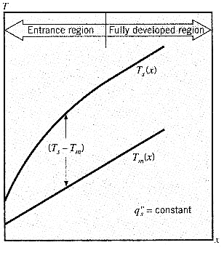
Constant Wall Heat Flux : Newton’s Law of Cooling
$$h_{x} \& \left(T_{s}−T_{m}\left(x\right)\right) are constant$$
$$h_{x} is ↓\& \left(T_{s}−T_{m}\left(x\right)\right)↑$$
$$h_{x}\left(T_{s}−T_{m}\left(x\right)\right)=constant$$
$$\frac{dT_{m}}{dx}=Constant$$

Slide 10

Constant Surface Heat Flux : Heating of Fluid
Energy equation for fully developed flow in a pipe:
$$\frac{1}{r}\frac{∂}{∂r}\left(r\frac{∂T}{∂r}\right)=\frac{2u_{m}}{α}\left\{1−\frac{r^{2}}{r_{o}^{2}}\right\}\frac{dT_{m}}{dx}$$
x=0

Slide 11
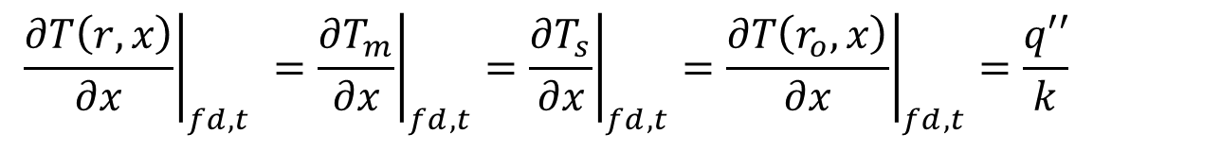

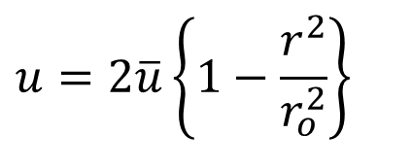
Constant Heat Flux : Fully Developed Pipe Flow
$$\frac{1}{r}\frac{∂}{∂r}\left(r\frac{∂T}{∂r}\right)+\frac{∂^{2}T}{∂x^{2}}=\frac{u}{α}\frac{∂T}{∂x}$$
Boundary conditions:
$$q^{"}=\text{constant} at r=r_{o}$$
$$\frac{∂T}{∂r}=0 \text{at} r=0$$
$$u=2\overline{u}\left\{1−\frac{r^{2}}{r_{o}^{2}}\right\}$$
For hydrodynamically developed flow:
$${\left.\frac{∂T\left(r,x\right)}{∂x}\right|}_{fd,t} ={\left.\frac{∂T_{m}}{∂x}\right|}_{fd,t}={\left.\frac{∂T_{s}}{∂x}\right|}_{fd,t}={\left.\frac{∂T\left(r_{o},x\right)}{∂x}\right|}_{fd,t}=\frac{q′′}{k}$$

Slide 12
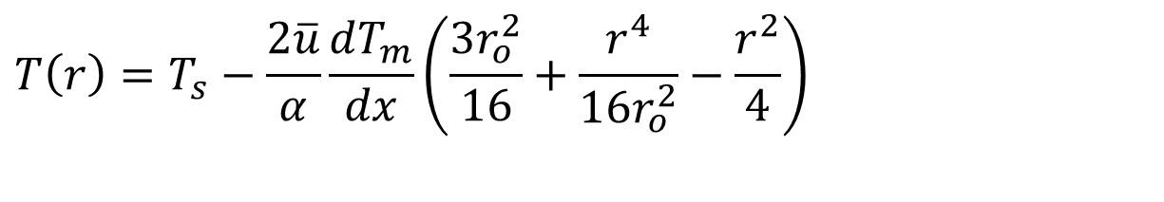
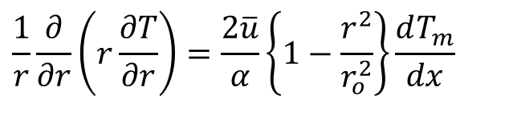
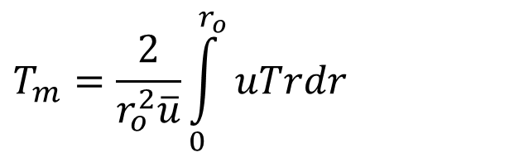
Constant Heat Flux : Fully Developed Pipe Flow
$$\frac{1}{r}\frac{∂}{∂r}\left(r\frac{∂T}{∂r}\right)=\frac{2\overline{u}}{α}\left\{1−\frac{r^{2}}{r_{o}^{2}}\right\}\frac{dT_{m}}{dx}$$
Integration of above equation with substitution of boundary conditions:
$$T\left(r\right)=T_{s}−\frac{2\overline{u}}{α}\frac{dT_{m}}{dx}\left(\frac{3r_{o}^{2}}{16}+\frac{r^{4}}{16r_{o}^{2}}−\frac{r^{2}}{4}\right)$$
$$T_{m}=\frac{2}{r_{o}^{2}\overline{u}}\int_{0}^{r_{o}}{uTrdr}$$
Substitute T(r) & u (r) and integrate to get
$$T_{m}\left(x\right)=T_{s}−\frac{11}{96}\frac{2u_{m}}{α}\frac{dT_{m}}{dx}r_{o}^{2}$$

Slide 13
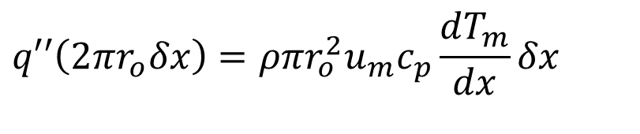
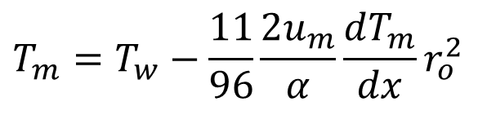
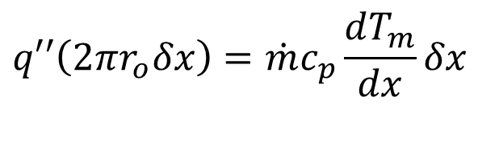
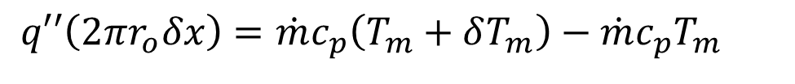
Constant Heat Flux : Infinitesimal Length of A Fully Developed Pipe Flow
$$T_{m}=T_{w}−\frac{11}{96}\frac{2u_{m}}{α}\frac{dT_{m}}{dx}r_{o}^{2}$$
$$q′′=h\left(T_{s}−T_{m}\right)=h\frac{11}{48}\frac{u_{m}}{α}\frac{dT_{m}}{dx}r_{o}^{2}$$
δq
First law for an infinitesimal fluid volume
T_{m}
T_{m} + δT_{m}
δx
$$q′′\left(2πr_{o}δx\right)=\dot{m}c_{p}\left(T_{m}+δT_{m}\right)−\dot{m}c_{p}T_{m}$$
$$q′′\left(2πr_{o}δx\right)=\dot{m}c_{p}\frac{dT_{m}}{dx}δx$$
$$q′′\left(2πr_{o}δx\right)=ρπr_{o}^{2}u_{m}c_{p}\frac{dT_{m}}{dx}δx$$

Slide 14
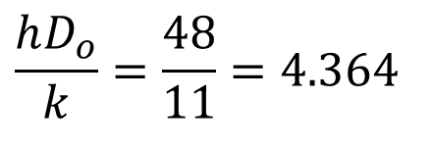
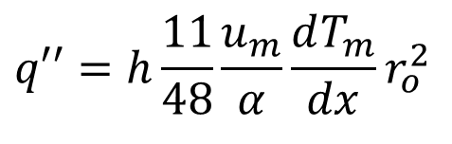
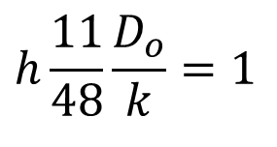
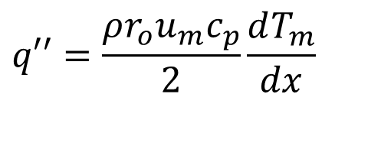
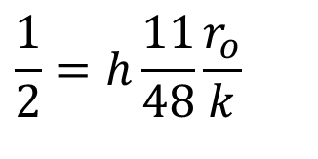
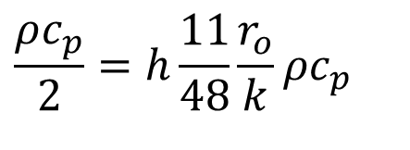
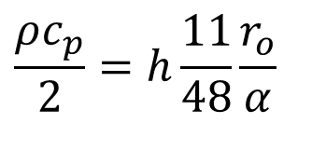
Nusselt’s Confluence of HT into Thermodynamics
$$q′′=\frac{ρr_{o}u_{m}c_{p}}{2}\frac{dT_{m}}{dx}$$
$$q′′=h\frac{11}{48}\frac{u_{m}}{α}\frac{dT_{m}}{dx}r_{o}^{2}$$
$$\frac{ρc_{p}}{2}=h\frac{11}{48}\frac{r_{o}}{α}$$
$$\frac{1}{2}=h\frac{11}{48}\frac{r_{o}}{k}$$
$$\frac{ρc_{p}}{2}=h\frac{11}{48}\frac{r_{o}}{k}ρc_{p}$$
$$h\frac{11}{48}\frac{D_{o}}{k}=1$$
$$\frac{hD_{o}}{k}=\frac{48}{11}=4.364$$

Slide 15
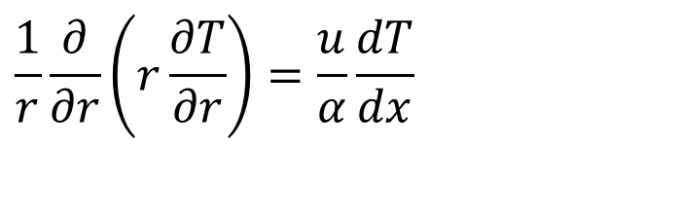
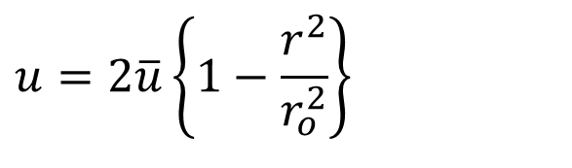
Thermally Developed Pipe Flow: Constant Wall Temperature
$$\frac{1}{r}\frac{∂}{∂r}\left(r\frac{∂T}{∂r}\right)=\frac{u}{α}\frac{dT}{dx}$$
Boundary conditions:
$$T=T_{s} −con\text{stant} at r=r_{o}$$
$$\frac{∂T}{∂r}=0 \text{at} r=0$$
For hydrodynamically developed flow:
$$u=2\overline{u}\left\{1−\frac{r^{2}}{r_{o}^{2}}\right\}$$

Slide 16
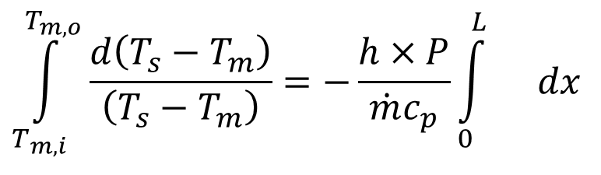
Fully Developed Pipe Flow : Constant Surface Temperature heating or cooling
For a small control volume:
δq
T_{m}
T_{m} + dT_{m}
dx
$$h×P×dx×\left(T_{s}−T_{m}\right)=\dot{m}c_{p}dT_{m}$$
$$\frac{dT_{m}}{\left(T_{s}−T_{m}\right)}=\frac{h×P}{\dot{m}c_{p}}dx$$
$$\frac{d\left(T_{s}−T_{m}\right)}{\left(T_{s}−T_{m}\right)}=−\frac{h×P}{\dot{m}c_{p}}dx$$
Integrating from x=0 (in Developed flow regime) to x = L (T_{m} = T_{m,o}) :
$$\int_{T_{m,i}}^{T_{m,o}}{\frac{d\left(T_{s}−T_{m}\right)}{\left(T_{s}−T_{m}\right)}}=−\frac{h×P}{\dot{m}c_{p}}\int_{0}^{L}{}dx$$

Slide 17
Uniform Hot Wall Temperature
Suppose that the stream bulk temperature is T_{m} at some place x = 0 in the fully developed region.
Given the temperature difference T_{s} − T_{m}, heat will be transferred from the wall to the stream.
The stream temperature will rise monotonically in the direction of flow.
This also means that T_{s}− T_{m} (and q”) will decrease monotonically in the x direction.
This discussion can easily be translated into analysis by combining the first law of thermodynamics with the only other thing we know at this point (T_{s} = constant).
$$q^{′′}=h×\left(T_{s}−T_{m}\left[x\right]\right)$$

Slide 18
Constant Surface Temperature Heating or Cooling
$$\int_{T_{m,i}}^{T_{m,o}}{}\frac{d\left(T_{s}−T_{m}\right)}{\left(T_{s}−T_{m}\right)}=−\frac{h×P}{\dot{m}c_{p}}\int_{0}^{L}{}dx$$
$$\ln\left\{\frac{T_{s}−T_{m,o}}{T_{s}−T_{m,i}}\right\}=−\frac{h×P×L}{\dot{m}c_{p}}$$
$$\ln\left\{\frac{T_{s}−T_{m,o}}{T_{s}−T_{m,i}}\right\}=−\frac{h×A_{surface}}{\dot{m}c_{p}}$$
$$h=−\frac{\dot{m}c_{p}}{A_{surface}}\ln\left\{\frac{T_{s}−T_{m,o}}{T_{s}−T_{m,i}}\right\}$$
h : Convective heat transfer coefficient in fully developed region!

Slide 19
Constant Surface Temperature Heating or Cooling
$$\frac{T_{s}−T_{m,o}}{T_{s}−T_{m,i}}=\exp\left\{−\frac{h_{avg}×A_{surface}}{\dot{m}c_{p}}\right\}$$
The above result illustrates the exponential behavior of the bulk fluid for constant wall temperature.
It may also be written as:
$$\frac{T_{s}−T_{m}\left(x\right)}{T_{s}−T_{m,i}}=\exp\left\{−\frac{h_{avg}×P×x}{\dot{m}c_{p}}\right\}$$
$$\ln\left\{\frac{T_{s}−T_{m}\left(x\right)}{T_{s}−T_{m,i}}\right\}=−\frac{h_{avg}×P×x}{\dot{m}c_{p}}$$

Slide 20
Constant Surface Temperature heating or cooling
The mean temperature difference decreases exponentially in the flow direction and so does the heat flux
T
T
$$\text{I}\text{f} {\text{T}}_{s}>T_{i}$$
$$T_{s}$$
$$\text{I}\text{f} {\text{T}}_{s}<T_{i}$$
$$T_{m}$$
$$T_{m}$$
$$T_{s}$$
x
x

Slide 21
Constant Surface Temperature Heating or Cooling
$$\ln\left\{\frac{T_{s}−T_{m}\left(x\right)}{T_{s}−T_{m,i}}\right\}=−\frac{h_{avg}×P×x}{\dot{m}c_{p}}$$
The heat transfer coefficient appearing in above equation can be calculated by again solving the energy equation.
$$\frac{1}{r}\frac{∂}{∂r}\left(r\frac{∂T}{∂r}\right)=\frac{u}{α}\frac{∂T}{∂x}$$
Define the non-dimensional shape function for fully developed flow as:
$$φ\left(r_{∗}=\frac{r}{r_{o}}\right)=\frac{T_{s}−T\left(r,x\right)}{T_{s}−T_{m}\left\{x\right\}}$$

Slide 22
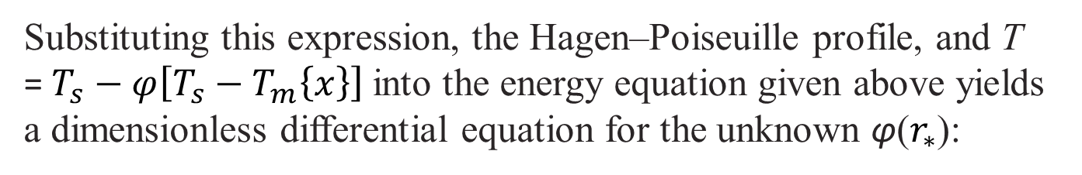
Constant Surface Temperature Heating or Cooling
$$\frac{1}{r}\frac{∂}{∂r}\left(r\frac{∂T}{∂r}\right)=\frac{u}{α}\frac{∂T}{∂x}$$
$$φ\left(r_{∗}\right)=\frac{T_{s}−T\left(r,x\right)}{T_{s}−T_{m}\left\{x\right\}}$$
Now ∂T/∂x is replaced as
$$\frac{∂T}{∂x}=\frac{∂}{∂x}\left(T_{s}−φ\left[T_{s}−T_{m}\left\{x\right\}\right]\right)$$
$$∴\frac{∂T}{∂x}=φ\frac{∂T_{m}}{∂x}$$
$$→ \frac{1}{r}\frac{∂}{∂r}\left(r\frac{∂T}{∂r}\right)=\frac{u}{α}φ\frac{∂T_{m}}{∂x}$$
Substituting this expression, the Hagen–Poiseuille profile, and T = $T_{s}−φ\left[T_{s}−T_{m}\left\{x\right\}\right]$into the energy equation given above yields a dimensionless differential equation for the unknown φ($r_{∗}$):

Slide 23
Mean Fluid Temperature in Fully Developed Pipe Flow : Constant Surface Temperature
$$\frac{d^{2}φ}{dr_{∗}^{2}}+\frac{1}{r_{∗}}\frac{dφ}{dr_{∗}}=−2Nu\left(1−r_{∗}^{2}φ\right)$$
This equation is similar to the ODE obtained for uniform heat flux, except that the unknown φ(r*) is present on the left-hand side.
The two boundary conditions for ϕ are obtained as:
$$\frac{dφ}{dr_{∗}}= =at r_{∗}=0 Radial symmetry$$
$$φ=0 at r_{∗}=1 Isothermal Wall$$
In principle, above equations are sufficient for determining the unknown function φ.

Slide 24
Nusselt Number for Fully Developed Pipe Flow : Constant Surface Temperature
$$\frac{d^{2}φ}{dr_{∗}^{2}}+\frac{1}{r_{∗}}\frac{dφ}{dr_{∗}}=−2Nu\left(1−r_{∗}^{2}φ\right)$$
However, in view of the makeup of above, the
radial profile φ will be a function of both r* and Nu.
Where Nu is the unknown in this problem.
The original definition for Nu can be written as:
$$Nu=−2{\left.\frac{dφ}{dr_{∗}}\right|}_{r_{∗=0}}$$
The problem statement is now complete.
The value of Nu must be such that the φ(r*, Nu) solution of above equations satisfies the Nu definition.

Slide 25
Radial Temperature profile in Fully Developed Pipe Flow : Constant Surface Temperature
$$\frac{d^{2}φ}{dr_{∗}^{2}}+\frac{1}{r_{∗}}\frac{dφ}{dr_{∗}}=−2Nu\left(1−r_{∗}^{2}φ\right)$$
The actual solution may be pursued in a number of ways.
In this digital era, it is more convenient to solve the problem numerically.
The differential equation is first approximated by finite differences and integrated from r* = 1 to r* = 0.
To perform the integration at all, we must first guess the value of Nu, which also gives us a guess for the initial slope of the ensuing φ(r*) curve.
The success of the Nu guess is judged by means of the first of conditions; the refined result is ultimately: Nu=3.66

Slide 26
Nusselt Number for Fully Developed Pipe Flow : Constant Surface Temperature
$$\ln\left\{\frac{T_{s}−T_{m,o}}{T_{s}−T_{m,i}}\right\}=−\frac{h_{avg}×P×L}{\dot{m}c_{p}}$$
to get the local variation in bulk temperature.
For practical use, it important to relate the wall temperature, the inlet and exit temperatures, and the rate of heat transfer one single expression.
To get this we write an energy balance for entire pipe in fully developed region:
$$\dot{Q}=\overset{•}{m}c_{p}\left\{T_{m,o}−T_{m,i}\right\}$$
$$=\overset{•}{m}c_{p}\left\{\left(T_{s}−T_{m,o}\right)−\left(T_{s}−T_{m,i}\right)\right\}=\overset{•}{m}c_{p}\left\{ΔT_{o}−ΔT_{i}\right\}$$
$$\overset{•}{m}c_{p}=\frac{\dot{Q}}{\left\{ΔT_{o}−ΔT_{i}\right\}}$$

Slide 27
Convection correlations: laminar flow in circular tubes
The fully developed region for constant surface heat flux
$$Nu_{D}≡\frac{hD}{k}=4.36$$
$$q_{s}^{″}=C$$
The fully developed region for constant surface temperature
$$Nu_{D}≡\frac{hD}{k}=3.66$$
Note: the thermal conductivity k should be evaluated at average T_{m}

Slide 28
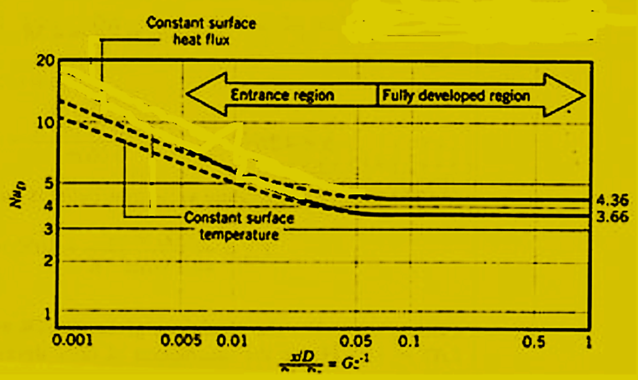
Fully Developed Internal Flows

Slide 29
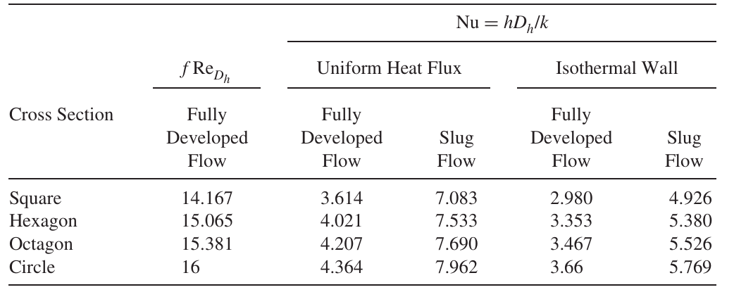

Noncircular Tubes: Correlations
For noncircular cross-sections, define an effective diameter, known as the hydraulic diameter:
Use the correlations for circular cross-sections.

