Slide 1

Laminar Natural Convection on A Vertical Plate : Development of Engineering Relations
P M V Subbarao & Head
Professor
Mechanical Engineering Department
Models for Design of Natural Convection Systems….

Slide 2

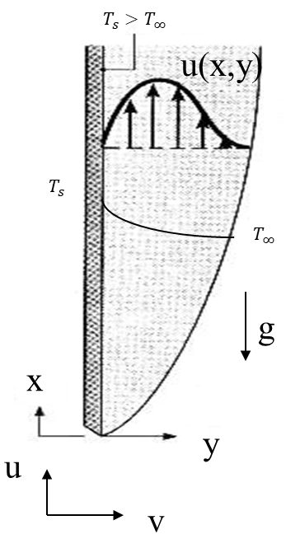
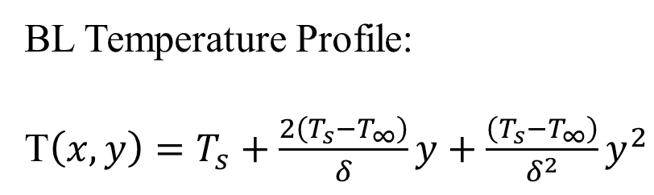
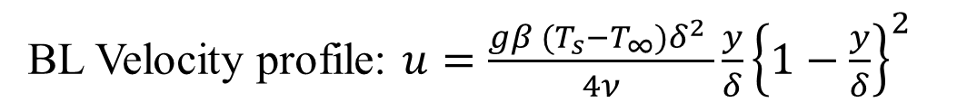
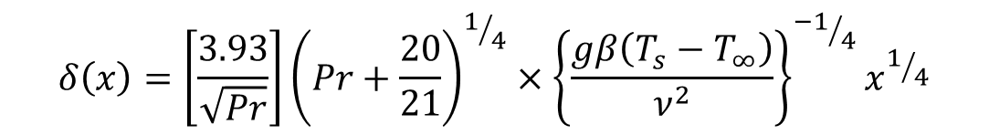
Boundary Layer Variables : Isothermal Wall
BL Velocity profile: $u=\frac{gβ (T_{s}−T_{∞})δ^{2} }{4ν}\frac{y}{δ}{\left\{1−\frac{y}{δ}\right\}}^{2}$
BL Temperature Profile:
T$\left(x,y\right)=T_{s}+\frac{2\left(T_{s}−T_{∞}\right)}{δ}y+\frac{\left(T_{s}−T_{∞}\right)}{δ^{2}}y^{2}$
BL Thickness Function:
Y
$$δ\left(x\right)=\left[\frac{3.93}{\sqrt{Pr}}\right]{\left(Pr+\frac{20}{21}\right)}^{1/4}×{\left\{\frac{gβ\left(T_{s}−T_{∞}\right)}{ν^{2}}\right\}}^{{−1}/4}x^{1/4}$$

Slide 3
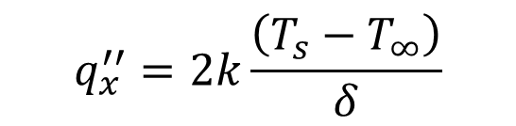
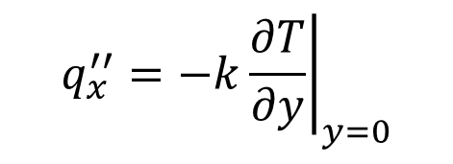
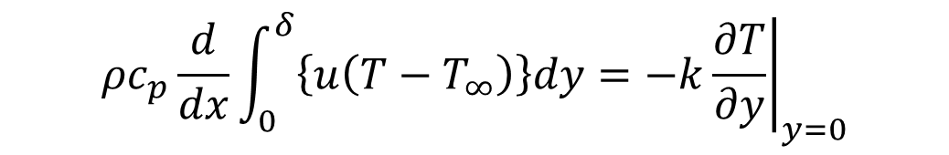
Boundary Layer Variables : Isothermal Wall
Consider Integral Energy Equation:
$$ρc_{p}\frac{d}{dx}\int_{0}^{δ}{\left\{u\left(T−T_{∞}\right)\right\}dy=−k{\left.\frac{∂T}{∂y}\right|}_{y=0}}$$
$$q_{x}^{′′}=−k{\left.\frac{∂T}{∂y}\right|}_{y=0}$$
Substitute the velocity profile and the temperature profile in above equation and integrate to get:
Y
$$q_{x}^{′′}=2k\frac{\left(T_{s}−T_{∞}\right)}{δ}$$

Slide 4
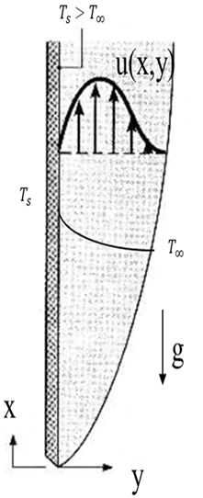

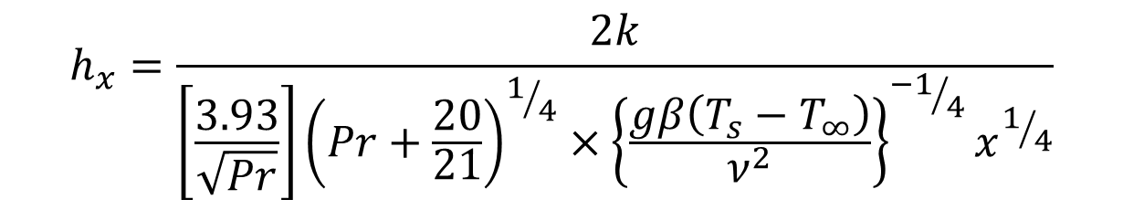
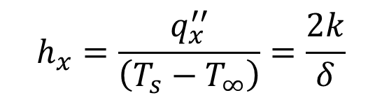
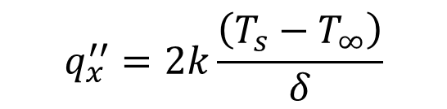
Heat Transfer Coefficient : Isothermal Wall
$$q_{x}^{′′}=2k\frac{\left(T_{s}−T_{∞}\right)}{δ}$$
The local heat transfer coefficient is:
$$h_{x}=\frac{q_{x}^{′′}}{\left(T_{s}−T_{∞}\right)}=\frac{2k}{δ}$$
Substitute the expression for δ:
$$h_{x}=\frac{2k}{\left[\frac{3.93}{\sqrt{Pr}}\right]{\left(Pr+\frac{20}{21}\right)}^{1/4}×{\left\{\frac{gβ\left(T_{s}−T_{∞}\right)}{ν^{2}}\right\}}^{{−1}/4}x^{1/4}}$$

Slide 5
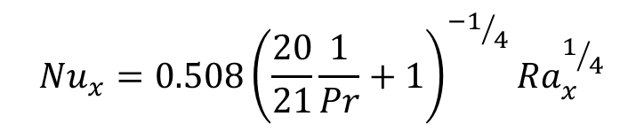

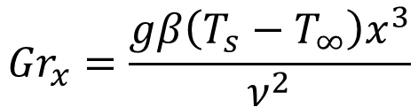

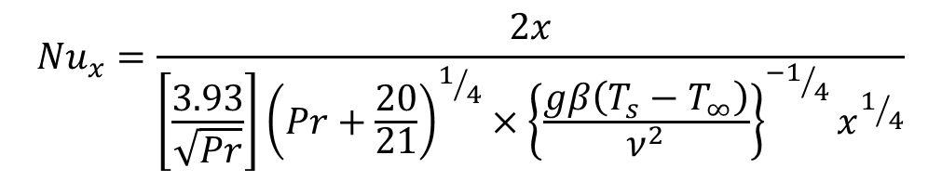

Local Nusselt Number: Isothermal Wall
$${Nu}_{x}=\frac{h_{x}x}{k}$$
The local Nusselt number:
$${Nu}_{x}=\frac{2x}{\left[\frac{3.93}{\sqrt{Pr}}\right]{\left(Pr+\frac{20}{21}\right)}^{1/4}×{\left\{\frac{gβ\left(T_{s}−T_{∞}\right)}{ν^{2}}\right\}}^{{−1}/4}x^{1/4}}$$
L
Grashof number :
$${Gr}_{x}=\frac{gβ\left(T_{s}−T_{∞}\right)x^{3}}{ν^{2}}$$
Rayleigh number:
$${{Ra}_{x}=Gr}_{x}×Pr$$
$${Nu}_{x}=0.508{\left(\frac{20}{21}\frac{1}{Pr}+1\right)}^{{−1}/4}{Ra}_{x}^{1/4}$$
$${Nu}_{avg}=\frac{1}{L}\int_{x=0}^{L}{{Nu}_{x}dx}=\frac{4}{3}{Nu}_{x=L}$$

Slide 6

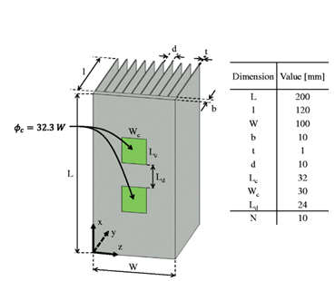
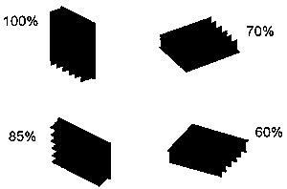

Art of Thermal Management of Electronics

Slide 7
Constant Heat Flux Vertical Wall : Velocity and Length Scales
Scale for master Velocity
$$φ_{0}=F\left(q_{s}^{′′},k,ν,g,β\right)$$
Scale for length
$$δ_{0}=G\left(q_{s}^{′′},k,ν,g,β\right)$$
$$δ_{0}=\frac{1}{\sqrt[4]{\frac{gβq_{s}^{′′}}{kν^{2}}}}$$
$$φ_{0}=\sqrt[4]{\frac{gβq_{s}^{′′}ν^{2}}{k}}$$
Using dimensional analysis:
∴non-dimensional master velocity : $Ω=\frac{φ}{φ_{0}}$
∴non-dimensional Boundary layer thickness : $Δ=\frac{δ}{δ_{0}}$
$$θ=\frac{\left(T−T_{∞}\right)}{\frac{δq_{s}^{′′}}{2k}}$$
Define non-dimensional master temperature :

Slide 8
ODEs for master profiles : Constant Heat Flux Vertical Wall
$$\frac{d}{dx^{∗}}\left(\frac{Ω^{2}Δ}{105}\right)=\frac{Δ^{2}}{6}−\frac{Ω}{Δ}$$
$$\frac{d}{dx}\left(\frac{ΩΔ^{2}}{30}\right)=\frac{2}{Pr}$$
The solution to these Equations is:
$$Ω=\frac{\sqrt[5]{6000×{x^{∗}}^{3}}}{\sqrt[5]{Pr{\left(0.8+Pr\right)}^{2}}}$$
$$∆=\frac{\sqrt[5]{360×x^{∗}}}{\sqrt[5]{{Pr}^{2}\left(0.8+Pr\right)}}$$

Slide 9
Boundary Layer Properties for a Constant Heat Flux Vertical Wall:
$${Gr}_{x}^{∗}=\frac{gβq_{s}^{′′}x^{4}}{kν^{2}}$$
Define modified Grashof Number as
$$\frac{δ}{x}=\sqrt[5]{ \frac{360×\left\{0.8+Pr\right\}}{{Pr}^{2}{Gr}_{x}^{∗}}}$$
Boundary Layer Thickness:
$${Nu}_{x}^{∗}=\frac{q_{s}^{′′}x}{k{\left(T_{s}−T_{∞}\right)}_{x}}$$
Local Nusselt Number:
$${Nu}_{x}^{∗}=0.62{\left(\frac{{Pr}^{2}}{0.8+Pr}\right)}^{1/5}{{Gr}_{x}^{∗}}^{1/5}$$
$$T_{s}−T_{∞}=1.622\frac{q_{s}^{′′}x}{k} ×\sqrt[5]{ \frac{\left\{0.8+Pr\right\}}{{Pr}^{2}{Gr}_{x}^{∗}}}$$

Slide 10
Natural Convection Profiles for a Vertical Wall
Constant Heat Flux VW
Constant Temperature VW
$${Nu}_{x}^{∗}=0.62{\left(\frac{{Pr}^{2}}{0.8+Pr}\right)}^{1/5}{{Gr}_{x}^{∗}}^{1/5}$$
$${Nu}_{x}^{∗}=0.508 \sqrt{\frac{P}{\sqrt{\left(Pr+\frac{20}{21}\right)}}}{ × {Gr}_{x}^{}}^{1/4}$$
Variation of Wall Temperature for CHF :
$$T_{s}−T_{∞}=1.622\frac{q_{s}^{′′}x}{k} ×\sqrt[5]{ \frac{\left\{0.8+Pr\right\}}{{Pr}^{2}{Gr}_{x}^{∗}}}$$
Variation of Wall Heat Flux for CT :
$$q_{s}^{′′}=0.508 \frac{k}{x}\sqrt{\frac{P}{\sqrt{\left(Pr+\frac{20}{21}\right)}}}×{Gr}_{X}^{1/4}×\left(T_{s}−T_{∞}\right)$$

Slide 11
General Empirical Correlations
Typical correlations for average heat transfer coefficient for vertical wall developed from experimental data are expressed as:
$$\overline{Nu_{L}}=\frac{\bar{h}L}{k}=CRa_{L}^{n}$$
$$Ra_{L}=Gr_{L}⋅\operatorname{Pr}{ } = \frac{gβ \left(T_{s}−T_{∞}\right) L^{3}}{να}$$
Where n=1/4.

Slide 12
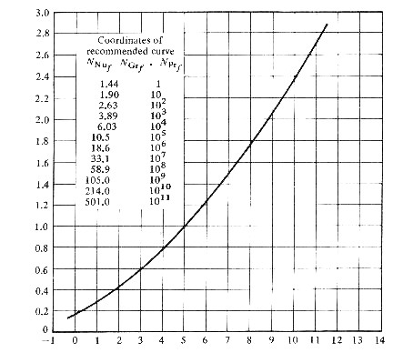
Vertical Plate at constant T_{s}
$$Log_{10}Nu_{L}$$
$$Log_{10}Ra_{L}$$

Slide 13
Alternative Correlation applicable to entire Rayleigh number range (for constant Ts)
$$\overline{Nu_{L}}={\left\{0.825+\frac{0.387 Ra_{L}^{1/6}}{{\left[1+(0.492/\operatorname{Pr}{)^{9/16}}\right]}^{8/27}}\right\}}^{2}$$
Vertical Cylinders
Use same correlations for vertical flat plate if:
$$\frac{D}{L}\tilde{≥} \frac{35}{Gr_{L}^{1/4}}$$

Slide 14
Empirical Correlations : Horizontal Plate
Define the characteristic length, L as
$$L≡\frac{A_{s}}{P}$$
Upper surface of heated plate, or Lower surface of cooled plate :
$$\overline{Nu_{L}} = 0.54 Ra_{L}^{1/4} \left(\text{1}{\text{0}}^{4}≤Ra_{L}≤\text{1}{\text{0}}^{7}\right) \\ \overline{Nu_{L}} = 0.15 Ra_{L}^{1/3} \left(\text{1}{\text{0}}^{7}≤Ra_{L}≤\text{1}{\text{0}}^{\text{11}}\right)$$
Lower surface of heated plate, or Upper surface of cooled plate :
$$\overline{Nu_{L}} = 0.27 Ra_{L}^{1/4} \left(\text{1}{\text{0}}^{5}≤Ra_{L}≤\text{1}{\text{0}}^{\text{10}}\right)$$
$$T_{f}=\frac{T_{s}+T_{∞}}{2}$$
Note: Use fluid properties at the film temperature

Slide 15
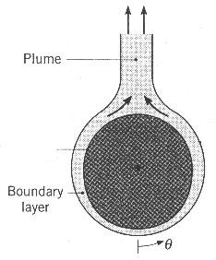
Empirical Correlations : Long Horizontal Cylinder
Very common geometry (pipes, wires)
For isothermal cylinder surface, use general form equation for computing Nusselt #
$$\overline{Nu_{D}}=\frac{\bar{h}D}{k}=CRa_{D}^{n}$$

Slide 16
Constants for general Nusselt number Equation: Horizontal Cylinder
Ra_{D} C n
$$10^{−10}\text{ − }10^{−2}\text{ 0.675 0.058} \\ 10^{−2}\text{ − }10^{+2}\text{ 1.02 0.148} \\ 10^{2}\text{ − }10^{4}\text{ 0.850 0.188} \\ 10^{4}\text{ − }10^{7}\text{ 0.480 0.250} \\ 10^{7}\text{ − }10^{12}\text{ 0.125 0.333}$$

Slide 17
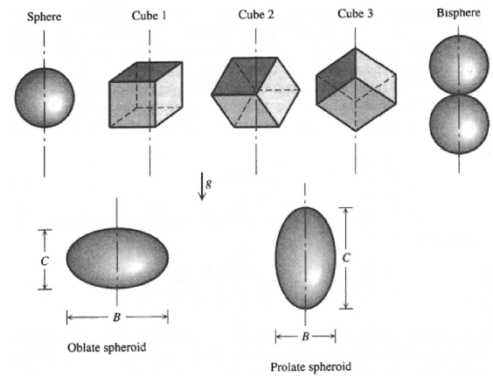
Laminar Natural convection on blunt shapes
In 1987, Yovanovich, studied natural convection heat transfer on Blunt Shapes:

Slide 18
Laminar Natural convection on blunt shapes
In 1987, Yovanovich, proposed a correlation for natural convection heat transfer on Blunt Shapes:
Define a characteristic length for a 3D body as: $D_{c}=\sqrt{A_{surface}}$
$${Nu}_{D_{c}}={\left[{Nu}_{D_{c}}\right]}_{{Ra}_{Dc→0}}+\frac{0.67G_{Dc}{Ra}_{Dc}^{1/4}}{{\left\{1+{\left(\frac{0.492}{Pr}\right)}^{9/{16}}\right\}}^{4/9}}$$
The coefficient G_{Dc} is a geometric parameter, and
Nu_{Dc}→0 represents the average Nusselt number at the limit of Ra_{Dc} → 0, namely, when heat transfer is due to pure conduction.

Slide 19
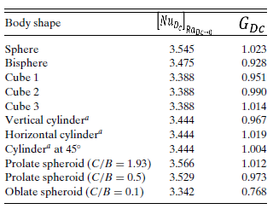
Constants for Yovanovich’s correlation

Slide 20
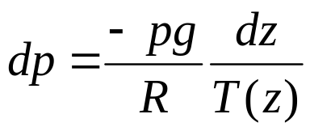
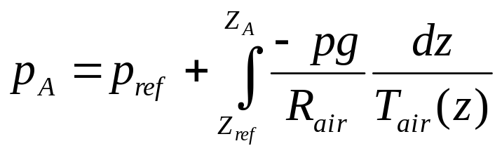
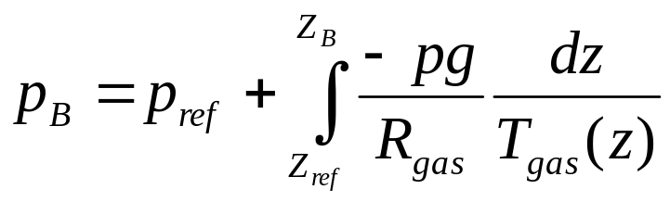
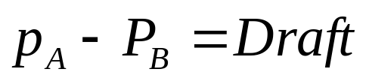



Natural Convection in Vertical Flow Passages
Zref
H_{chimney}
p_{A} = p_{ref} +Δp_{air column}
p_{B} = p_{ref} +Δp_{gas column}
Chimney
T_{atm}
Furnace
T_{gas}
A
B

Slide 21


FORCED CONVECTION IN LAMINAR INTERNAL FLOWS
An Essential System for Human Development thru Exchanging Heat……..
Creation of Energy Mediators …

Slide 22
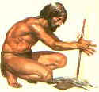
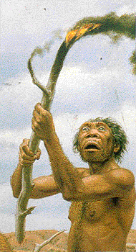
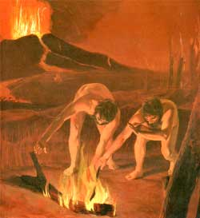
Discovery of FIRE, FLAME and TORCH
Fire is a discovery rather than an invention.
Homo erectus probably discovered fire by accident.
As early as 400,000 BC, fire was kindled in the caves of Peking man.

Slide 23
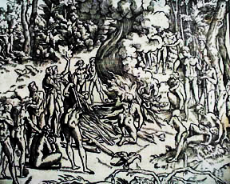
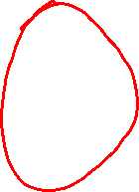
Sharing of Skills

Slide 24
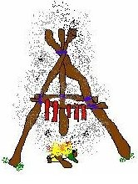
The First Civilized Food Processing !!!!!
Fire Can only Heat Solids !!!!!

Slide 25
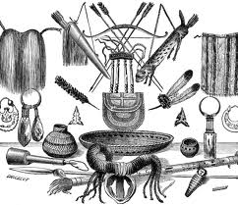
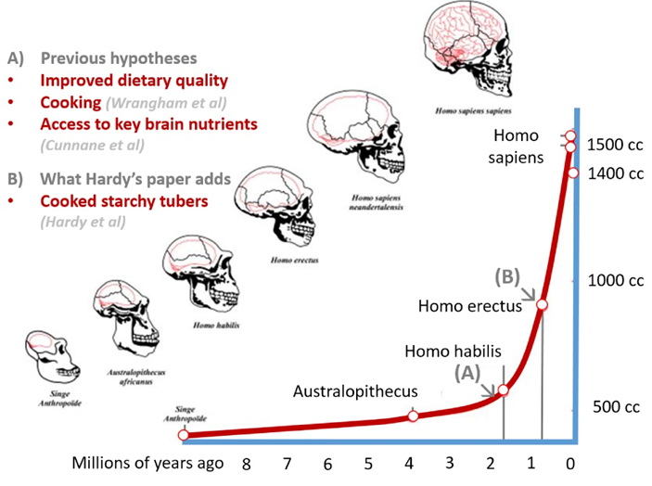
EARLIEST TYPES OF CS : COOKING

Slide 26
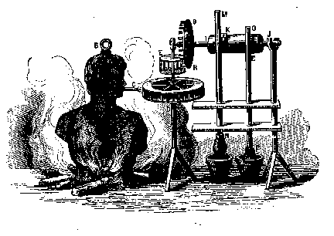
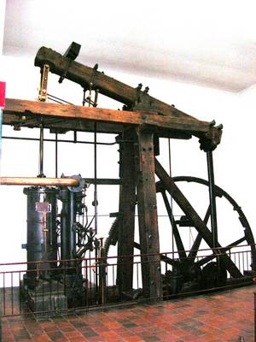
Convection Systems to Enhance the Utility of Fire
Can they do so beyond stomach ????
Branca's Steam Turbine
James Watt’s Engine

Slide 27
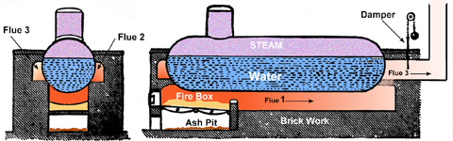
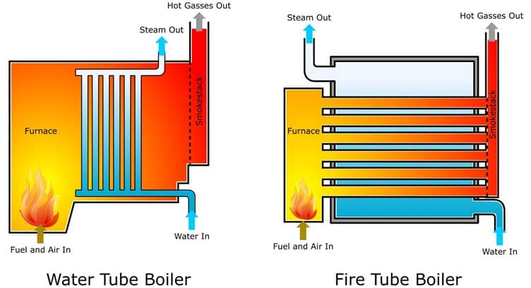
Onset of Internal Flow Convection Systems
The Plain Cylinder Boiler:

Slide 28
Energy Mediators – A first step in Civilization and Development…
How exactly this mediation Occurs???

Slide 29
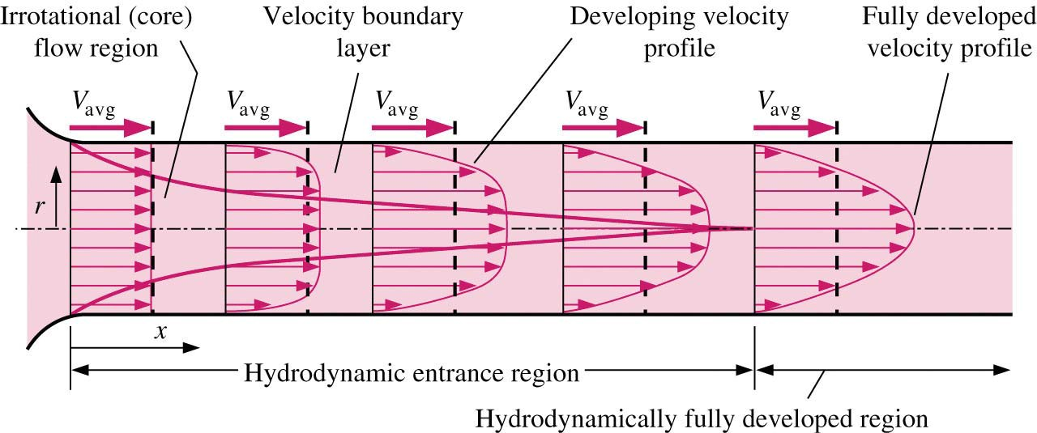
Occurrence of Mechanical Equilibrium in Internal Flows
The entry of flow into a pipe/duct is controlled by the law of occurrence of mechanical equilibrium between fluid and walls of pipe/ducts.
The size of fluid layer under the influence of mechanical equilibrium slowly is increases from entrance to inside….
The region of the flow in which the effects of the viscous shearing forces (Forces leading to Mechanical equilibrium) are felt is called the velocity (Momentum) boundary layer.

Slide 30
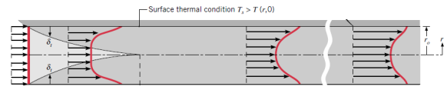
Occurrence of Thermal Equilibrium in Internal Flows
The fluid under mechanical equilibrium is subject to zeroth law of thermodynamics.
Conduction heat transfer is responsible for the onset of thermal equilibrium.
The size of fluid layer under the influence of thermal equilibrium also slowly is increases from entrance to inside….
The region of the flow, which has the dominance of conduction heat transfer is called the temperature (Thermal) boundary layer.

Slide 31
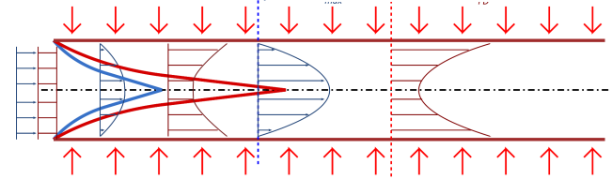
Simultaneous Occurrence of Thermal and Mechanical Equilibrium
The hypothetical boundary surface divides the flow in a pipe into two regions:
1a. The momentum boundary layer region, in which the viscous effects and the velocity changes are significant.
1b. The thermal boundary layer region, in which the conduction heat transfer is significant.

Slide 32
Simultaneous Occurrence of Thermal and Mechanical Equilibrium
2a. The irrotational (core) flow region, in which the frictional effects are negligible, and the velocity remains essentially constant in the radial direction.
2b. The uniform temperature region, in which the convection heat transfer is significant.

Slide 33
Transport Similarity
Estimate Convection thru Learning of Fluid Flow

Slide 34




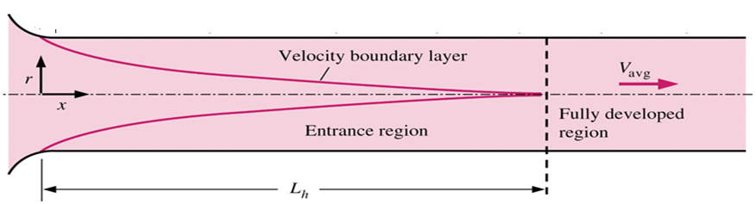
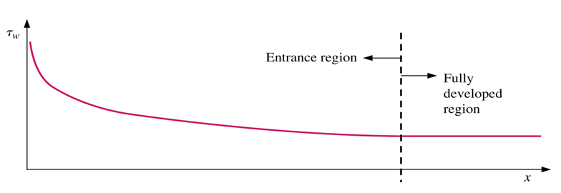
Resistance to flow & Operational Cost of Duct Flow
$$τ_{wall}=μ{\left.\frac{∂V}{∂r}\right|}_{wall}$$
Newton’s Law of Viscosity:
$$d{F_{shear−}}_{wall}=\left\{μ{\left.\frac{∂V}{∂r}\right|}_{wall}\right\}Pdx$$

Slide 35
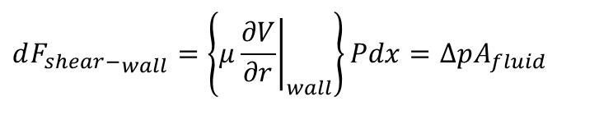

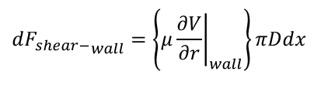
Condition for Steady flow with Wall Resistance
$$d{F_{shear−}}_{wall}=\left\{μ{\left.\frac{∂V}{∂r}\right|}_{wall}\right\}πDdx$$
For Steady flow:
$$d{F_{shear−}}_{wall}=\left\{μ{\left.\frac{∂V}{∂r}\right|}_{wall}\right\}Pdx=ΔpA_{fluid}$$
$$d{F_{shear−}}_{wall}$$

Slide 36
Condition for Steady flow with Wall Resistance
$$d{F_{shear−}}_{wall}=\left\{μ{\left.\frac{∂V}{∂r}\right|}_{wall}\right\}πDdx$$
For Steady flow:
$$d{F_{shear−}}_{wall}=\left\{μ{\left.\frac{∂V}{∂r}\right|}_{wall}\right\}Pdx=ΔpA_{fluid}$$
$$d{F_{shear−}}_{wall}$$

Slide 37
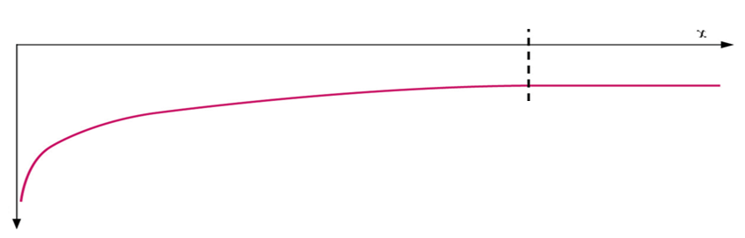
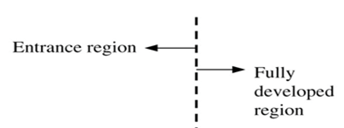
Negative Pressure Gradient for Steady flow
For Steady flow:
$$d{F_{shear−}}_{wall}=\left\{μ{\left.\frac{∂V}{∂r}\right|}_{wall}\right\}Pdx=dpA_{fluid}$$
$$\frac{dp}{dx}$$

Slide 38
Heating of Flow with Cooling of PCB
Thermal Boundary Layer
Plug Fluid
$${δ\dot{Q}}_{cooling}=−\left\{k_{fluid}{\left.\frac{∂T}{∂r}\right|}_{wall}\right\}Pdx={\dot{m}}_{fluid}c_{p}\left[dT_{fluid}\right]$$
$$δ{\dot{Q}}_{c}$$

Slide 39

Condition for Steady flow with Wall Resistance
For Steady flow:
$$\frac{dp}{dx}=\frac{P}{A_{fluid}}\left\{μ{\left.\frac{∂V}{∂r}\right|}_{wall}\right\}→Δp\left(x\right)=\frac{P}{A}\int_{0}^{x}{\left\{μ{\left.\frac{∂V}{∂r}\right|}_{wall}\right\}dx}$$

Slide 40
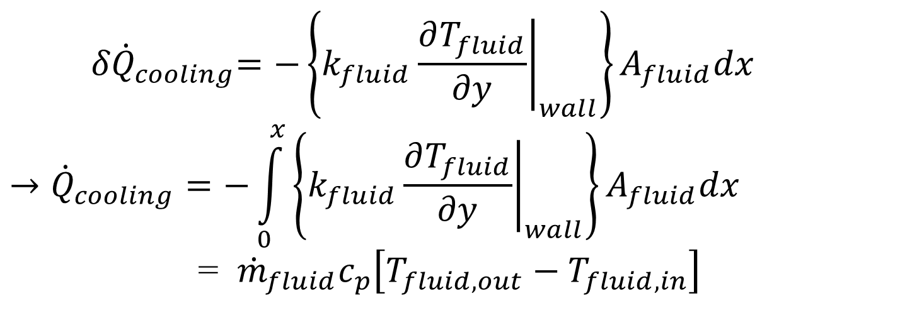
Heating of Fluid due to Cooling of DUCT Walls
Thermal Boundary Layer
Plug Fluid
$${ δ\dot{Q}}_{cooling}=−\left\{k_{fluid}{\left.\frac{∂T_{fluid}}{∂r}\right|}_{wall}\right\}A_{fluid}dx$$
$$→{\dot{Q}}_{cooling}=−\int_{0}^{x}{\left\{k_{fluid}{\left.\frac{∂T_{fluid}}{∂r}\right|}_{wall}\right\}A_{fluid}dx}$$
= ${\dot{m}}_{fluid}c_{p}\left[T_{fluid,out}−T_{fluid,in}\right]$

