Slide 1

Laminar Natural Convection on A Vertical Plate : Integral Solutions
P M V Subbarao & Head
Professor
Mechanical Engineering Department
More Focus on Events at Wall in Natural Convection Processes….

Slide 2

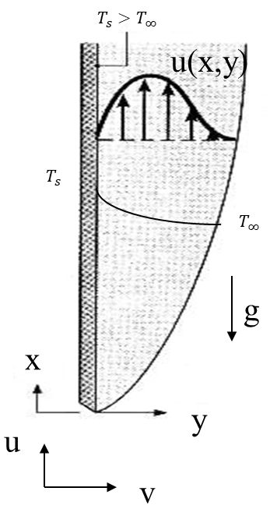
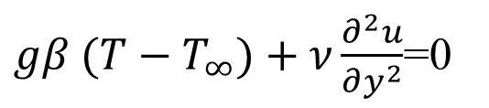
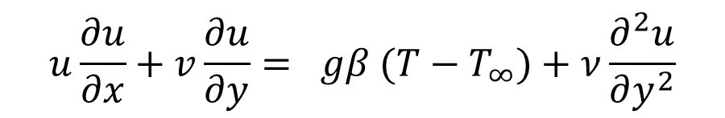
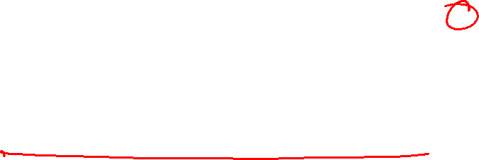

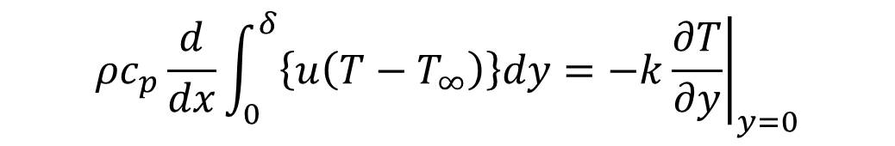
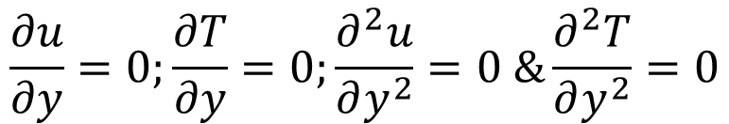

Integrodifferential Equations for Natural Convection : Isothermal Wall
$$\frac{1}{2}\frac{d}{dx}\int_{0}^{Y}{\left(u^{2}\right)dy}−gβ\int_{0}^{Y}{ \left(T−T_{∞}\right)dy}=−\frac{τ_{s}}{ρ}$$
$$ρc_{p}\frac{d}{dx}\int_{0}^{δ}{\left\{u\left(T−T_{∞}\right)\right\}dy=−k{\left.\frac{∂T}{∂y}\right|}_{y=0}}$$
Boundary conditions:
$$At y=0;u=0;v=0 \& T= T_{s}$$
Another Wall BC can be obtained using
x-momentum equation:
$$u\frac{∂u}{∂x}+v\frac{∂u}{∂y}= gβ (T−T_{∞})+ν\frac{∂^{2}u}{∂y^{2}}$$
$gβ (T−T_{∞})+ν\frac{∂^{2}u}{∂y^{2}}$=0
Y
$$At y=δ;u=0 \& T= T_{∞}$$
$$\frac{∂u}{∂y}=0;\frac{∂T}{∂y}=0;\frac{∂^{2}u}{∂y^{2}}=0 \&\frac{∂^{2}T}{∂y^{2}}=0$$

Slide 3
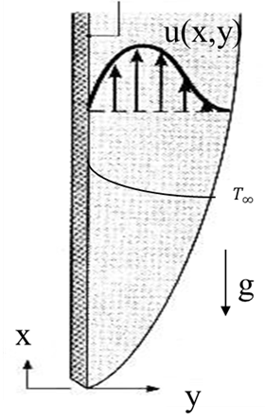
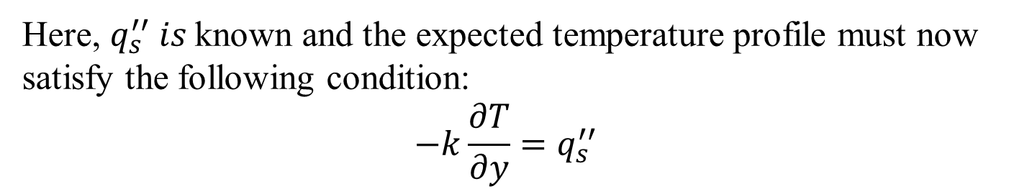
Integral Analysis of Natural Convection from Constant Heat Flux Vertical Flat Plate
Integrated Momentum Equation:
$$\frac{d}{dx}\int_{0}^{Y}{u^{2}dy}−gβ\int_{0}^{Y}{\left(T−T_{∞}\right)dy}=−\frac{τ_{s}}{ρ}$$
$$q_{s}^{′′}$$
Integrated Energy Equation:
$$ρc_{p}\frac{d}{dx}\int_{0}^{Y}{u\left(T−T_{∞}\right)dy}=q_{s}^{′′}$$
Laminar Flow, Uniform Heat flux:
Here, $q_{s}^{′′} is$known and the expected temperature profile must now satisfy the following condition:
$$−k\frac{∂T}{∂y}=q_{s}^{′′}$$

Slide 4
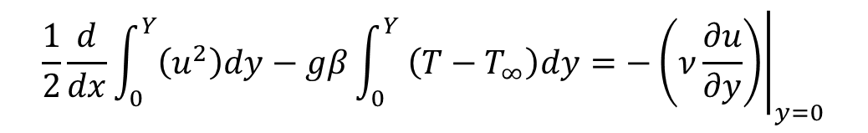
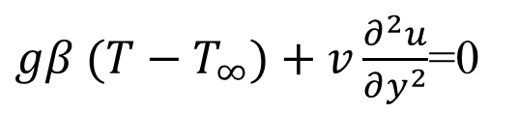
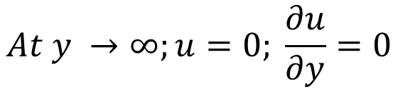

Selection of Valid Velocity Profile: Isothermal Wall
$$\frac{1}{2}\frac{d}{dx}\int_{0}^{Y}{\left(u^{2}\right)dy}−gβ\int_{0}^{Y}{ \left(T−T_{∞}\right)dy}=−{\left.\left(ν\frac{∂u}{∂y}\right)\right|}_{y=0}$$
Consider a fourth-degree polynomial for velocity, u:
$$u\left(x,y\right)= a_{o}\left(x\right)+a_{1}\left(x\right)y+a_{2}\left(x\right)y^{2}+a_{3}\left(x\right)y^{3}$$
There are four unknown coefficients, which are functions of x.
Boundary conditions:
$$At y=0;u=0$$
$gβ (T−T_{∞})+v\frac{∂^{2}u}{∂y^{2}}$=0
Y
$$At y →∞;u=0; \frac{∂u}{∂y}=0$$

Slide 5
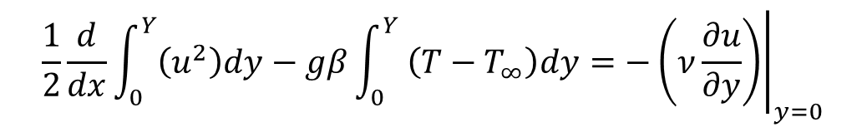
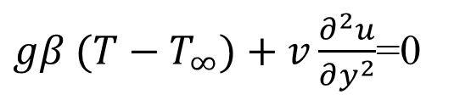
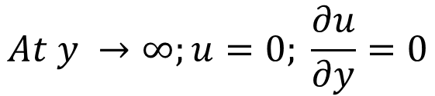
Selection of Valid Velocity Profile: Isothermal Wall
$$\frac{1}{2}\frac{d}{dx}\int_{0}^{Y}{\left(u^{2}\right)dy}−gβ\int_{0}^{Y}{ \left(T−T_{∞}\right)dy}=−{\left.\left(ν\frac{∂u}{∂y}\right)\right|}_{y=0}$$
Consider a fourth-degree polynomial for velocity, u:
$$u\left(x,y\right)= a_{o}\left(x\right)+a_{1}\left(x\right)y+a_{2}\left(x\right)y^{2}+a_{3}\left(x\right)y^{3}$$
There are four unknown coefficients, which are functions of x.
Boundary conditions:
$$At y=0;u=0$$
$gβ (T−T_{∞})+v\frac{∂^{2}u}{∂y^{2}}$=0
Y
$$At y →∞;u=0; \frac{∂u}{∂y}=0$$
Use these boundary condition to get the unknown of coefficients..

Slide 6
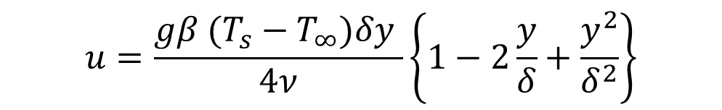
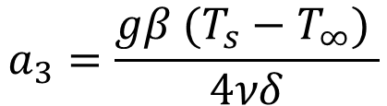
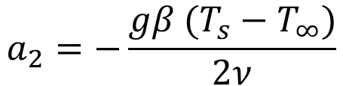
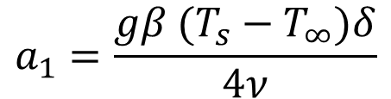
Selection of Valid Velocity Profile: Isothermal Wall
$$u\left(x,y\right)= a_{o}\left(x\right)+a_{1}\left(x\right)y+a_{2}\left(x\right)y^{2}+a_{3}\left(x\right)y^{3}$$
$$a_{2}=−\frac{gβ (T_{s}−T_{∞})}{2ν}$$
$$a_{1}=\frac{gβ (T_{s}−T_{∞})δ}{4ν}$$
$$a_{3}=\frac{gβ (T_{s}−T_{∞}) }{4νδ}$$
Substitute all these coefficients in the assumed velocity profile.
The required velocity profile is:
Y
$$u=\frac{gβ (T_{s}−T_{∞})δy }{4ν}\left\{1−2\frac{y}{δ}+\frac{y^{2}}{δ^{2}}\right\}$$

Slide 7
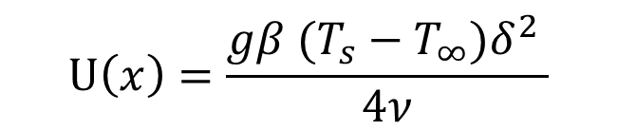
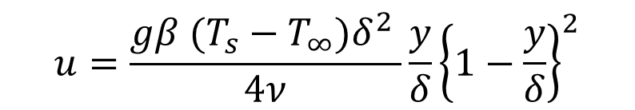
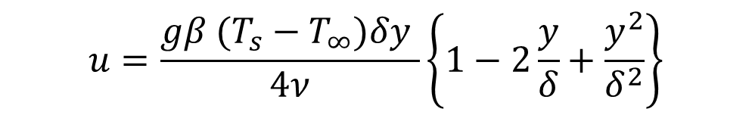
Selection of Valid Velocity Profile: Isothermal Wall
The velocity profile in boundary layer is:
$$u=\frac{gβ (T_{s}−T_{∞})δy }{4ν}\left\{1−2\frac{y}{δ}+\frac{y^{2}}{δ^{2}}\right\}$$
$$u=\frac{gβ (T_{s}−T_{∞})δ^{2} }{4ν}\frac{y}{δ}{\left\{1−\frac{y}{δ}\right\}}^{2}$$
The characteristic velocity is defined as:
Y
$$U\left(x\right)=\frac{gβ (T_{s}−T_{∞})δ^{2} }{4ν}$$

Slide 8
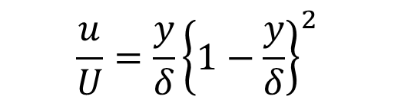
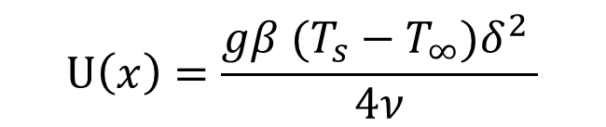
Valid Velocity Profile: Isothermal Wall
The characteristic velocity is defined as:
$$U\left(x\right)=\frac{gβ (T_{s}−T_{∞})δ^{2} }{4ν}$$
The non-dimensional velocity profile is
$$\frac{u}{U}=\frac{y}{δ}{\left\{1−\frac{y}{δ}\right\}}^{2}$$
This known velocity profile can be used to find the maximum velocity and its location.
The location of maximum velocity profile is obtained by taking the derivative of velocity u, then equating it to 0.
Y

Slide 9

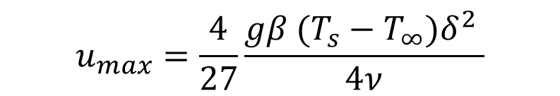
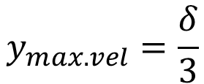
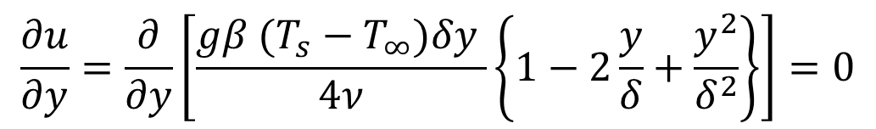
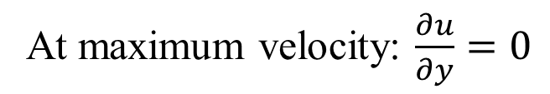
Location of Maximum Velocity : Isothermal Wall
At maximum velocity: $\frac{∂u}{∂y}=0$
$$\frac{∂u}{∂y}=\frac{∂}{∂y}\left[\frac{gβ (T_{s}−T_{∞})δy }{4ν}\left\{1−2\frac{y}{δ}+\frac{y^{2}}{δ^{2}}\right\}\right]=0$$
$$\left(δ−y\right)×\left(δ−3y\right)=0$$
$$y_{max. vel}=\frac{δ}{3}$$
Y
$$u_{max}=\frac{4}{27}\frac{gβ (T_{s}−T_{∞})δ^{2} }{4ν}$$

Slide 10
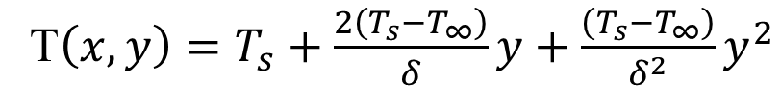
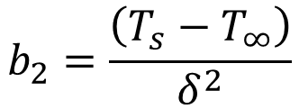
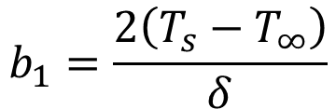

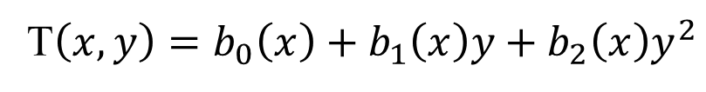
Selection of Suitable Temperature Profile: Isothermal Wall
T$\left(x,y\right)=b_{0}\left(x\right)+b_{1}\left(x\right)y+b_{2}\left(x\right)y^{2}$
$$b_{o}=T_{s}$$
$$b_{1}=\frac{2\left(T_{s}−T_{∞}\right)}{δ}$$
$$b_{2}=\frac{\left(T_{s}−T_{∞}\right)}{δ^{2}}$$
T$\left(x,y\right)=T_{s}+\frac{2\left(T_{s}−T_{∞}\right)}{δ}y+\frac{\left(T_{s}−T_{∞}\right)}{δ^{2}}y^{2}$
Both velocity profile as well as the temperature profile are selected.
Substitute these profiles into the integral equations.
Y

Slide 11
Selection of Suitable Temperature Profile: Isothermal Wall
T$\left(x,y\right)=b_{0}\left(x\right)+b_{1}\left(x\right)y+b_{2}\left(x\right)y^{2}$
$$b_{o}=T_{s}$$
$$b_{1}=\frac{2\left(T_{s}−T_{∞}\right)}{δ}$$
$$b_{2}=\frac{\left(T_{s}−T_{∞}\right)}{δ^{2}}$$
T$\left(x,y\right)=T_{s}+\frac{2\left(T_{s}−T_{∞}\right)}{δ}y+\frac{\left(T_{s}−T_{∞}\right)}{δ^{2}}y^{2}$
Y

Slide 12
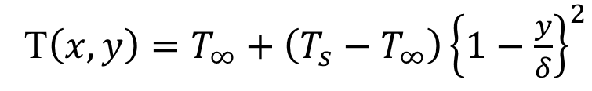
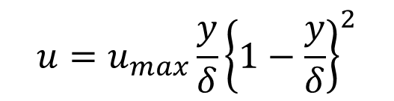
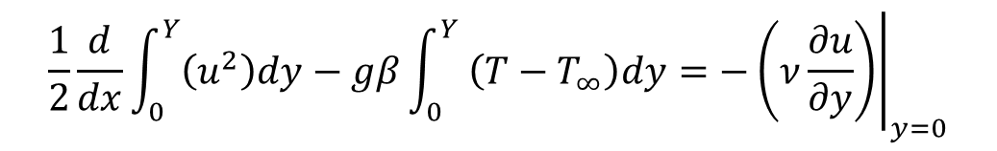
GDE for BL: Isothermal Wall
Both the valid velocity profile as well as the temperature profile are available now.
Substitute this profiles into the integral equations.
The momentum integral equation need the temperature profile as well as the velocity profile.
$$\frac{1}{2}\frac{d}{dx}\int_{0}^{Y}{\left(u^{2}\right)dy}−gβ\int_{0}^{Y}{ \left(T−T_{∞}\right)dy}=−{\left.\left(ν\frac{∂u}{∂y}\right)\right|}_{y=0}$$
$$u=u_{max}\frac{y}{δ}{\left\{1−\frac{y}{δ}\right\}}^{2}$$
Y
T$\left(x,y\right)=T_{∞}+\left(T_{s}−T_{∞}\right){\left\{1−\frac{y}{δ}\right\}}^{2}$

Slide 13
GDE for BL: Isothermal Wall
Both the valid velocity profile as well as the temperature profile are available now.
Substitute this profiles into the integral equations.
The momentum integral equation need the temperature profile as well as the velocity profile.
$$\frac{1}{2}\frac{d}{dx}\int_{0}^{Y}{\left(u^{2}\right)dy}−gβ\int_{0}^{Y}{ \left(T−T_{∞}\right)dy}=−{\left.\left(ν\frac{∂u}{∂y}\right)\right|}_{y=0}$$
$$u=u_{max}\frac{y}{δ}{\left\{1−\frac{y}{δ}\right\}}^{2}$$
Y
T$\left(x,y\right)=T_{∞}+\left(T_{s}−T_{∞}\right){\left\{1−\frac{y}{δ}\right\}}^{2}$

Slide 14

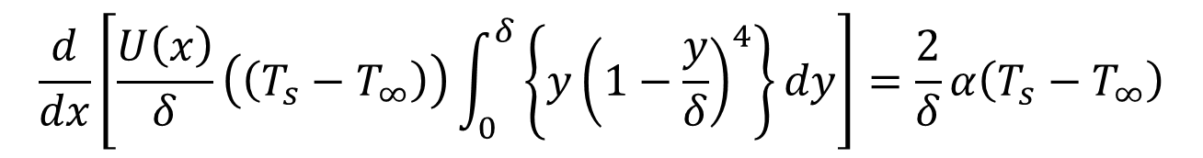
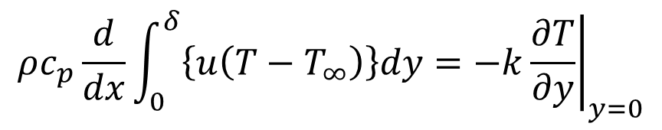
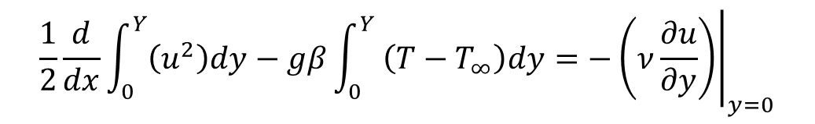
GDE for BL: Isothermal Wall
$$\frac{1}{2}\frac{d}{dx}\int_{0}^{Y}{\left(u^{2}\right)dy}−gβ\int_{0}^{Y}{ \left(T−T_{∞}\right)dy}=−{\left.\left(ν\frac{∂u}{∂y}\right)\right|}_{y=0}$$
$$\frac{1}{105}\frac{d}{dx}\left({U\left(x\right)}^{2}δ\right)=\frac{1}{3}gβ\left(T_{s}−T_{∞}\right)δ−ν\frac{U\left(x\right)}{δ}$$
Similarly, substitute temperature profile and velocity profile in the energy integral equation.
$$ρc_{p}\frac{d}{dx}\int_{0}^{δ}{\left\{u\left(T−T_{∞}\right)\right\}dy=−k{\left.\frac{∂T}{∂y}\right|}_{y=0}}$$
Y
$$\frac{d}{dx}\left[\frac{U\left(x\right)}{δ}\left(\left(T_{s}−T_{∞}\right)\right)\int_{0}^{δ}{\left\{y{\left(1−\frac{y}{δ}\right)}^{4}\right\}dy}\right]=\frac{2}{δ}α\left(T_{s}−T_{∞}\right)$$

Slide 15
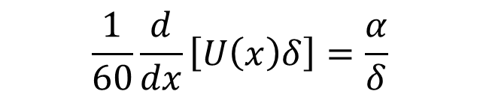
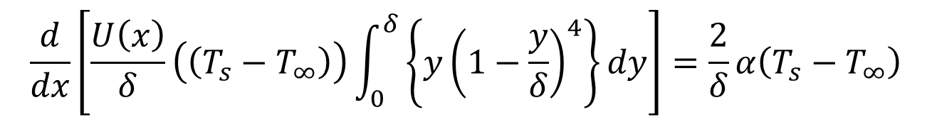
GDE for BL: Isothermal Wall
$$\frac{d}{dx}\left[\frac{U\left(x\right)}{δ}\left(\left(T_{s}−T_{∞}\right)\right)\int_{0}^{δ}{\left\{y{\left(1−\frac{y}{δ}\right)}^{4}\right\}dy}\right]=\frac{2}{δ}α\left(T_{s}−T_{∞}\right)$$
Rearrange the terms to get
$$\frac{1}{60}\frac{d}{dx}\left[U\left(x\right)δ\right]=\frac{α}{δ}$$
Y

Slide 16

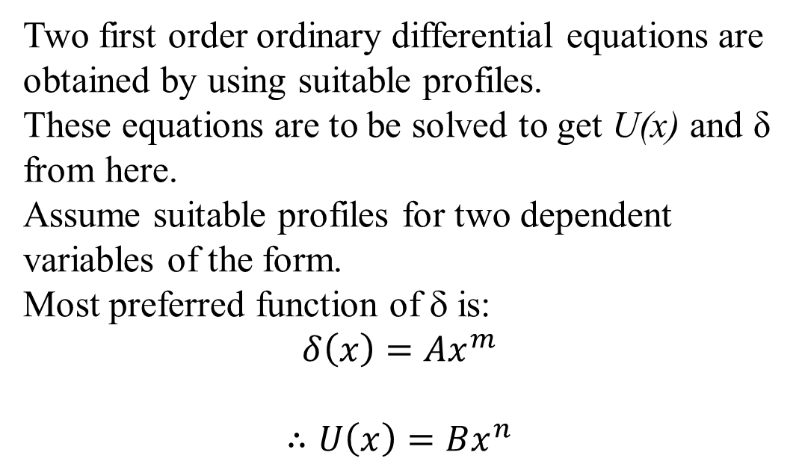
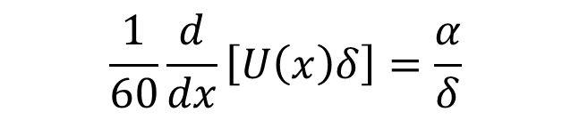
GDE for BL: Isothermal Wall
$$\frac{1}{105}\frac{d}{dx}\left({U\left(x\right)}^{2}δ\right)=\frac{1}{3}gβ\left(T_{s}−T_{∞}\right)δ−ν\frac{U\left(x\right)}{δ}$$
$$\frac{1}{60}\frac{d}{dx}\left[U\left(x\right)δ\right]=\frac{α}{δ}$$
Two first order ordinary differential equations are obtained by using suitable profiles.
These equations are to be solved to get U(x) and δ from here.
Assume suitable profiles for two dependent variables of the form.
Most preferred function of δ is:
$$δ\left(x\right)=Ax^{m}$$
$$∴U\left(x\right)=Bx^{n}$$
Y

Slide 17
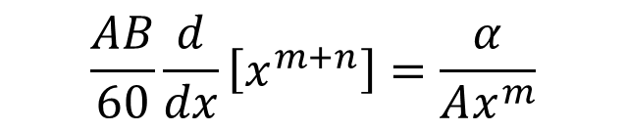
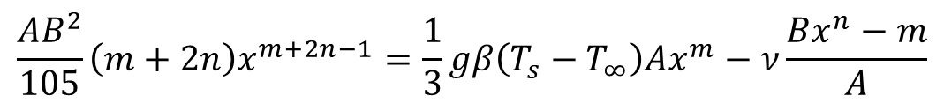
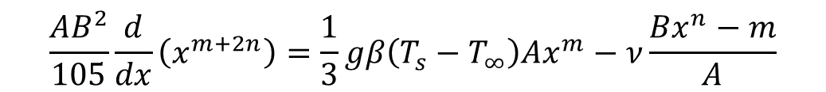
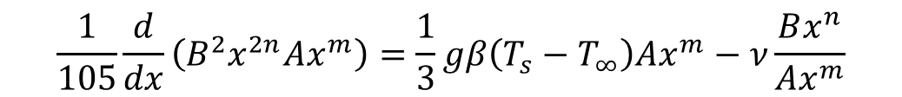
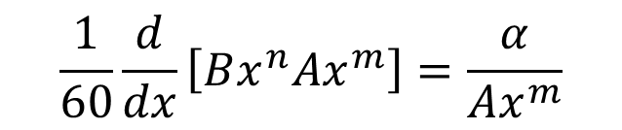
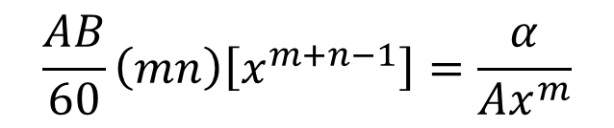
Solution of GDE for BL: Isothermal Wall
$$\frac{1}{105}\frac{d}{dx}\left(B^{2}x^{2n}Ax^{m}\right)=\frac{1}{3}gβ\left(T_{s}−T_{∞}\right)Ax^{m}−ν\frac{Bx^{n}}{Ax^{m}}$$
$$\frac{1}{60}\frac{d}{dx}\left[Bx^{n}Ax^{m}\right]=\frac{α}{Ax^{m}}$$
$$\frac{AB^{2}}{105}\frac{d}{dx}\left(x^{m+2n}\right)=\frac{1}{3}gβ\left(T_{s}−T_{∞}\right)Ax^{m}−ν\frac{Bx^{n}−m}{A}$$
$$\frac{AB}{60}\frac{d}{dx}\left[x^{m+n}\right]=\frac{α}{Ax^{m}}$$
$$\frac{AB^{2}}{105}\left(m+2n\right)x^{m+2n−1}=\frac{1}{3}gβ\left(T_{s}−T_{∞}\right)Ax^{m}−ν\frac{Bx^{n}−m}{A}$$
Y
$$\frac{AB}{60}\left(mn\right)\left[x^{m+n−1}\right]=\frac{α}{Ax^{m}}$$

Slide 18
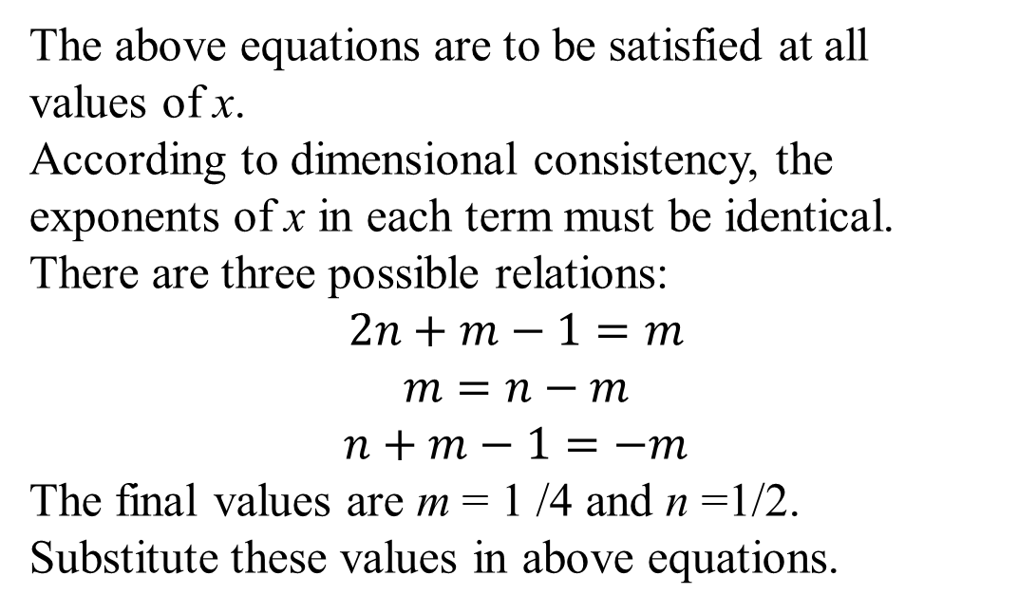
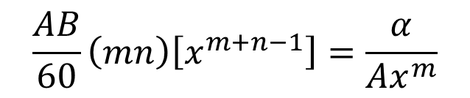
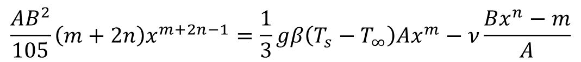
Solution of GDE for BL: Isothermal Wall
$$\frac{AB^{2}}{105}\left(m+2n\right)x^{m+2n−1}=\frac{1}{3}gβ\left(T_{s}−T_{∞}\right)Ax^{m}−ν\frac{Bx^{n}−m}{A}$$
$$\frac{AB}{60}\left(mn\right)\left[x^{m+n−1}\right]=\frac{α}{Ax^{m}}$$
The above equations are to be satisfied at all values of x.
According to dimensional consistency, the exponents of x in each term must be identical.
There are three possible relations:
$$2n+m−1=m$$
$$m=n−m$$
$$n+m−1=−m$$
The final values are m = 1 /4 and n =1/2.
Substitute these values in above equations.
Y

Slide 19





Solution of GDE for BL: Isothermal Wall
$$\frac{AB^{2}}{105}\left(m+2n\right)x^{m+2n−1}=\frac{1}{3}gβ\left(T_{s}−T_{∞}\right)Ax^{m}−ν\frac{Bx^{n}−m}{A}$$
$$\frac{AB}{60}\left(mn\right)\left[x^{m+n−1}\right]=\frac{α}{Ax^{m}}$$
With m = 1 /4 and n =1/2.
$$\frac{AB^{2}}{84}=\frac{1}{3}gβ\left(T_{s}−T_{∞}\right)A−ν\frac{B}{A}$$
$$\frac{AB}{60}=\frac{α}{A}$$
$$\frac{6400}{84}α^{2}=\frac{1}{3}gβ\left(T_{s}−T_{∞}\right)A^{4}−80αν$$
$$A^{4}={80α}^{2}\left(\frac{ν}{α}+\frac{20}{21}\right)\frac{3}{gβ\left(T_{s}−T_{∞}\right)}$$
Y
$$A=\left[\frac{3.93}{\sqrt{Pr}}\right]{\left(Pr+\frac{20}{21}\right)}^{1/4}×{\left\{\frac{gβ\left(T_{s}−T_{∞}\right)}{ν^{2}}\right\}}^{{−1}/4}$$

Slide 20



Solution of GDE for BL: Isothermal Wall
$$A=\left[\frac{3.93}{\sqrt{Pr}}\right]{\left(Pr+\frac{20}{21}\right)}^{1/4}×{\left\{\frac{gβ\left(T_{s}−T_{∞}\right)}{ν^{2}}\right\}}^{{−1}/4}$$
B$=5.17ν{\left(Pr+\frac{20}{21}\right)}^{{−1}/2}×{\left\{\frac{gβ\left(T_{s}−T_{∞}\right)}{ν^{2}}\right\}}^{1/2}$
$$δ\left(x\right)=\left[\frac{3.93}{\sqrt{Pr}}\right]{\left(Pr+\frac{20}{21}\right)}^{1/4}×{\left\{\frac{gβ\left(T_{s}−T_{∞}\right)}{ν^{2}}\right\}}^{{−1}/4}x^{1/4}$$
$$U\left(x\right)=5.17ν{\left(Pr+\frac{20}{21}\right)}^{{−1}/2}×{\left\{\frac{gβ\left(T_{s}−T_{∞}\right)}{ν^{2}}\right\}}^{1/2}x^{1/2}$$
Y

Slide 21
Master Velocity and Temperature Profiles: CHF
Shapes of master velocity and temperature profiles are similar for both CT and CHF Vertical Plates.
$$u=φ\left(η^{3}−2η^{2}+η\right)$$
$$η=\frac{y}{δ}$$
$$∂η=\frac{∂y}{δ}$$
$$θ=φ\left(η^{2}−2η+1\right)$$
$$−k\frac{∂\left(T_{s}−T_{∞}\right)}{∂y}=q_{s}^{′′}$$
$$−k\frac{∂\left(T_{s}−T_{∞}\right)}{∂η}×\frac{1}{δ}=q_{s}^{′′}$$
$$−k\frac{∂\left(T_{s}−T_{∞}\right)}{∂η}×\frac{∂η}{∂y}=q_{s}^{′′}$$
$$\frac{∂\left(T_{s}−T_{∞}\right)}{∂η}=−\frac{δq_{s}^{′′}}{k}$$
Define non-dimensional temperature as:
$$\left(T_{s}−T_{∞}\right) ∝\frac{δq_{s}^{′′}}{k}$$
$$θ=\frac{\left(T−T_{∞}\right)}{\left(T_{s}−T_{∞}\right)} ∝\frac{\left(T−T_{∞}\right)}{\frac{δq_{s}^{′′}}{2k}}$$

Slide 22
Velocity and Length Scales
Scale for master Velocity
$$φ_{0}=F\left(q_{s}^{′′},k,ν,g,β\right)$$
Scale for length
$$δ_{0}=G\left(q_{s}^{′′},k,ν,g,β\right)$$
$$δ_{0}=\frac{1}{\sqrt[4]{\frac{gβq_{s}^{′′}}{kν^{2}}}}$$
$$φ_{0}=\sqrt[4]{\frac{gβq_{s}^{′′}ν^{2}}{k}}$$
Using dimensional analysis:
∴non-dimensional master velocity : $Ω=\frac{φ}{φ_{0}}$
∴non-dimensional Boundary layer thickness : $Δ=\frac{δ}{δ_{0}}$
$$θ=\frac{\left(T−T_{∞}\right)}{\frac{δq_{s}^{′′}}{2k}}$$
Define non-dimensional master temperature :

Slide 23

Integral Analysis of Natural Convection from Vertical Flat Plate with UHF
The dimensionless temperature therefore is defined here as:
$$θ=\frac{T−T_{∞}}{\frac{q_{s}^{′′}δ}{2k}}$$
The dimensionless x- axis defined here as:
$$x^{∗}=x×\sqrt[4]{\frac{gβq_{s}^{′′}}{kν^{2}}}$$

Slide 24
ODEs for master profiles in the case of Constant Heat Flux Vertical Wall
$$\frac{d}{dx^{∗}}\left(\frac{Ω^{2}Δ}{105}\right)=\frac{Δ^{2}}{6}−\frac{Ω}{Δ}$$
$$\frac{d}{dx}\left(\frac{ΩΔ^{2}}{30}\right)=\frac{2}{Pr}$$
The solution to these Equations is:
$$Ω=\frac{\sqrt[5]{6000×{x^{∗}}^{3}}}{\sqrt[5]{Pr{\left(0.8+Pr\right)}^{2}}}$$
$$∆=\frac{\sqrt[5]{360×x^{∗}}}{\sqrt[5]{{Pr}^{2}\left(0.8+Pr\right)}}$$

