Slide 1

Natural Convection on A Vertical Plate with Constant Heat Flux
P M V Subbarao & Head
Professor
Mechanical Engineering Department
Models for Analysis of Factual Natural Convection Processes….

Slide 2

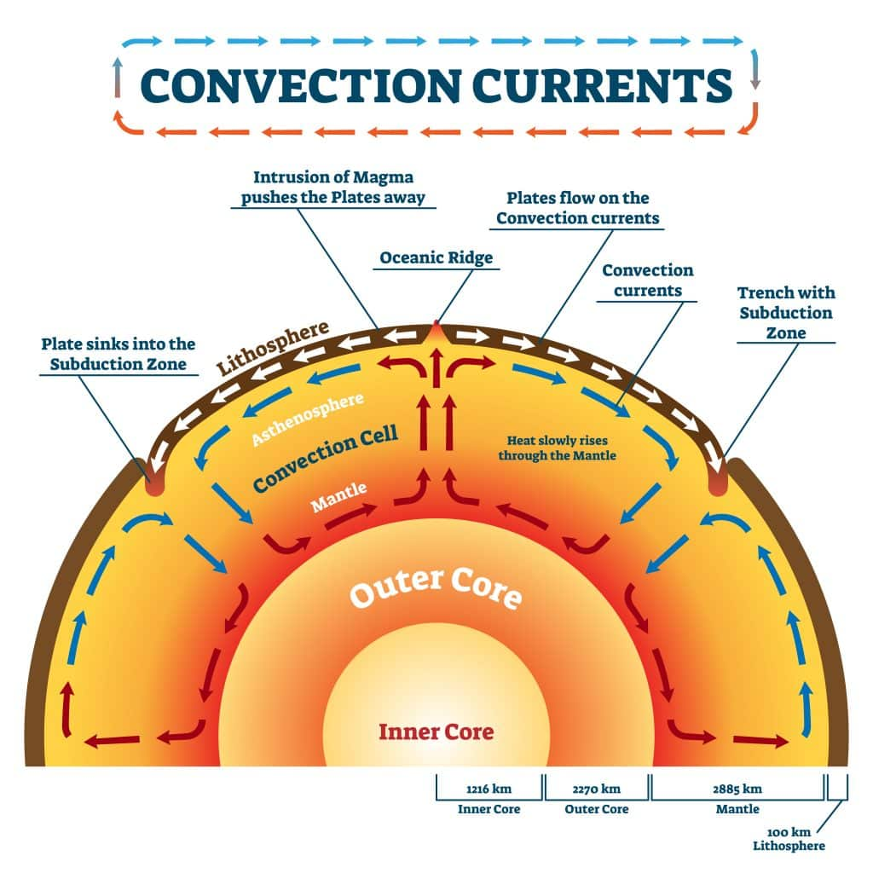
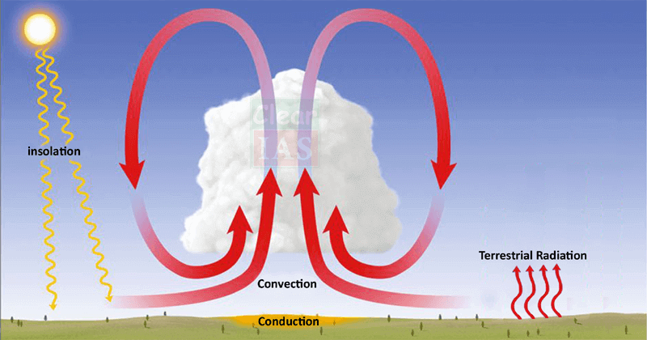
अतर् बहिश्च तत् सर्वम् व्याप्य
प्राकृतिक संवहन

Slide 3
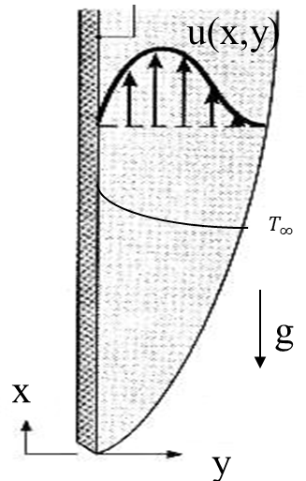
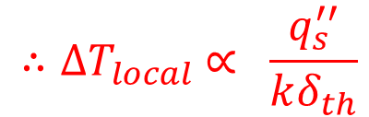
Natural Convection on A VFP : Constant Heat Flux
$$u\frac{∂u}{∂x}+v\frac{∂u}{∂y}= gβ (T−T_{∞})+v\frac{∂^{2}u}{∂y^{2}}$$
$$u\frac{∂T}{∂x}+v\frac{∂T}{∂y} = α\frac{∂^{2}T}{∂y^{2}}$$
The boundary conditions will be
$$q_{s}^{′′}$$
$$u=0 at x=0$$
$$u=0 \& y=0 at y =0$$
$$q_{s}^{′′}=−k{\left.\frac{∂T}{∂y}\right|}_{y=0}=constant$$
$$u=0 \& T=T_{∞} at y →∞$$
$$∴{∆T}_{local} ∝ \frac{q_{s}^{′′}}{kδ_{th}}$$

Slide 4
Natural Convection : Constant Heat Flux
In 1956, Sparrow and Gregg, derived a similarity solution for this system by defining novel similarity variables:
$$η=\sqrt[5]{\frac{gβq_{s}^{′′}}{5kν^{2}x}} ×y$$
$$q_{s}^{′′}$$
$$θ\left(η\right)=\left(T_{∞}−T\right)\sqrt[5]{\frac{gβq_{s}^{′′}}{5kν^{2}}} ×\left[\frac{k}{q_{s}^{′′}\sqrt[5]{x}}\right]$$
$$ψ=\sqrt[5]{\frac{125gβq_{s}^{′′}ν^{3}}{k}} ×x^{4/5}×F\left(η\right)$$

Slide 5
Governing ODEs Natural Convection on Vertical Plate with Constant Heat Flux
$$\frac{d^{3}F}{dη^{3}}+4F\frac{d^{2}F}{dη^{2}}−3{\left(\frac{dF}{dη}\right)}^{2}+θ=0$$
$$\frac{1}{Pr}\frac{d^{2}θ}{dη^{2}}+4\frac{dθ}{dη}F−θ\frac{dF}{dη}=0$$
$$q_{s}^{′′}$$
The modified Grashof number is defined as
$${Gr}_{x}^{∗}=\frac{gβq_{s}^{′′}x^{4}}{kν^{2}}$$

Slide 6
Natural Convection : Constant Heat Flux
The modified Grashof number is defined as
$${Gr}_{x}^{∗}=\frac{gβq_{s}^{′′}x^{4}}{kν^{2}}$$
Constant wall heat flux leads to a wall with (T_{s} − T∞) ∼ x^{1/5} .
Finally, the local Nusselt number is defined as:
$${Nu}_{x}=−\frac{1}{\sqrt[5]{5}}\frac{\sqrt[5]{{Gr}_{x}^{∗}}}{θ′\left(0\right)}$$
$${Nu}_{x}=\frac{2}{\sqrt[5]{360}} \sqrt[5]{\left\{\frac{{Pr}^{2}{×{Gr}_{x}^{∗}}}{\frac{4}{5}+Pr}\right\}}$$
$$q_{s}^{′′}$$

Slide 7
Impact and Extensions
The 1956 solution for uniform surface heat flux served as a foundation for several subsequent advancements in convection and condensation research:
Laminar Film Condensation: Sparrow and Gregg's similarity approach was later used to solve problems of laminar film condensation on vertical surfaces, providing a base for understanding condensation phenomena.
Complex Geometries: Their method was extended to vertical cylinders by adding series expansions for cylindrical effects to the flat plate solution.
Variable Gravity: Later researchers generalized their approach to account for situations where gravity varies along the flow direction due to surface curvature or rotating fields.

Slide 8
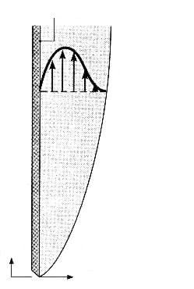
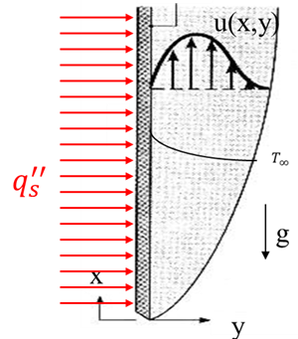
Natural Convection on A Vertical Flat Plate
Isothermal Hot Plate
Constant Heat-flux Hot Plate
$$\frac{d^{3}F}{dη^{3}}+3F\frac{d^{2}F}{dη^{2}}−2{\left(\frac{dF}{dη}\right)}^{2}+θ=0$$
$$\frac{d^{3}F}{dη^{3}}+4F\frac{d^{2}F}{dη^{2}}−3{\left(\frac{dF}{dη}\right)}^{2}+θ=0$$
$$T_{s}>T_{∞}$$
$$\frac{1}{Pr}\frac{d^{2}θ}{dη^{2}}+3F\frac{dθ}{dη}=0$$
u(x,y)
$$\frac{1}{Pr}\frac{d^{2}θ}{dη^{2}}+4\frac{dθ}{dη}F−θ\frac{dF}{dη}=0$$
$$T_{s}$$
$$Gr_{x}= \frac{gβ(T_{s}−T_{∞})x^{3}}{ν^{2}}$$
$$T_{∞}$$
$${Gr}_{x}^{∗}=\frac{gβq_{s}^{′′}x^{4}}{kν^{2}}$$
g
x
u
y
v
$${Nu}_{x}=\frac{0.75 \sqrt{Pr}}{\sqrt[4]{4×\left[0.609+1.221\sqrt{Pr}+1.238Pr\right] }}×{\left(\frac{{Gr}_{x}}{4}\right)}^{1/4}$$
$${Nu}_{x}=\frac{2}{\sqrt[5]{360}} \sqrt[5]{\left\{\frac{{Pr}^{2}{×{Gr}_{x}^{∗}}}{\frac{4}{5}+Pr}\right\}}$$

Slide 9
Similarity Solutions to Natural Convections Systems are Tough!

Slide 10
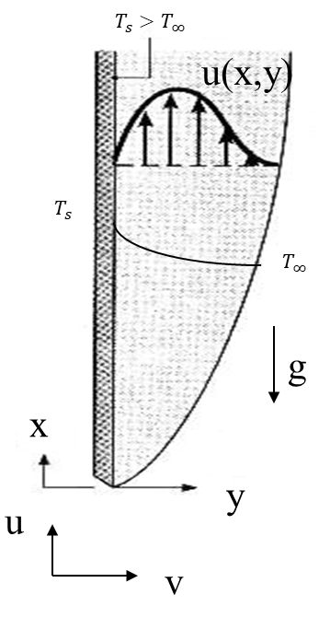
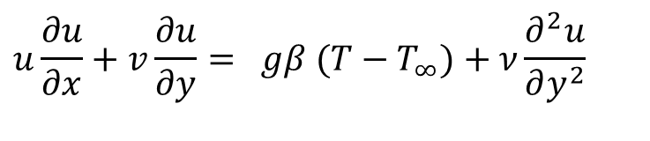
Integral Analysis for Natural Convection
$$u\frac{∂u}{∂x}+v\frac{∂u}{∂y}= gβ (T−T_{∞})+ν\frac{∂^{2}u}{∂y^{2}}$$
$$\frac{∂u}{∂x}+\frac{∂v}{∂y}=0$$
$$u\frac{∂T}{∂x}+v\frac{∂T}{∂y} = α\frac{∂^{2}T}{∂y^{2}}$$
For Integral analysis of Natural Convection on a vertical flat plate, a modified momentum integral equation and energy integral equation are necessary to deal with the buoyancy term in the boundary layer equations.
Also recall that the goal of Integral analysis is to develop ODEs for momentum boundary layer thickness δ and thermal boundary layer thickness δ_{T} .

Slide 11
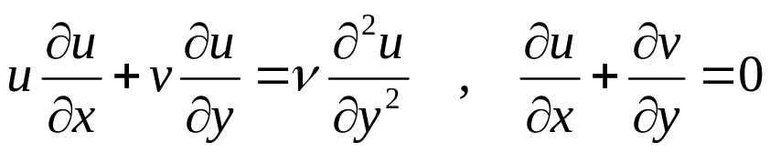
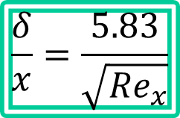
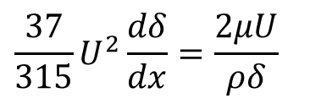
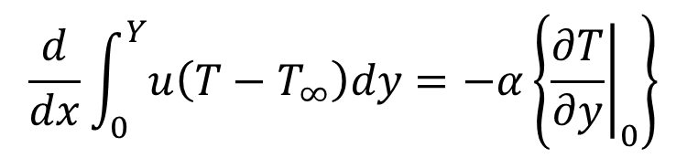
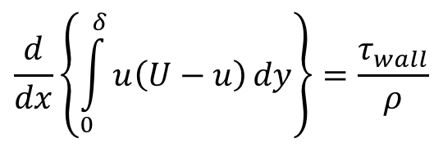
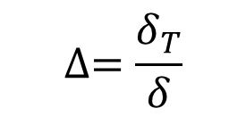
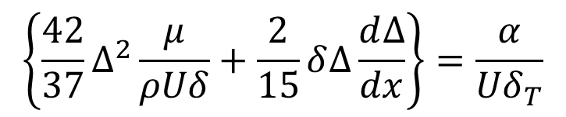
Integral Analysis for Forced Convection
$$\frac{37}{315}U^{2}\frac{dδ}{dx}=\frac{2μU}{ρδ}$$
$$\frac{d}{dx}\left\{\int_{0}^{δ}{u\left(U−u\right)}dy\right\}=\frac{τ_{wall}}{ρ}$$
$$\frac{δ}{x}=\frac{5.83}{\sqrt{{Re}_{x}}}$$
$$\frac{d}{dx}\int_{0}^{Y}{u\left(T−T_{∞}\right)dy}=−α\left\{{\left.\frac{∂T}{∂y}\right|}_{0}\right\}$$
$$∆=\frac{δ_{T}}{δ}$$
$$\left\{\frac{42}{37}∆^{2}\frac{μ}{ρUδ}+\frac{2}{15}δ∆\frac{d∆}{dx}\right\}=\frac{α}{{Uδ}_{T}}$$

Slide 12
Integral Analysis for Natural Convection
$$u\frac{∂u}{∂x}+v\frac{∂u}{∂y}= gβ (T−T_{∞})+ν\frac{∂^{2}u}{∂y^{2}}$$
$$\frac{∂u}{∂x}+\frac{∂v}{∂y}=0$$
$$u\frac{∂T}{∂x}+v\frac{∂T}{∂y} = α\frac{∂^{2}T}{∂y^{2}}$$
The plate is maintained at uniform wall temperature T_{w} and the quiescent medium temperature is T∞ and that is also maintained at constant temperature.
Assumptions: 2-dimensional steady laminar flow with constant properties, neglect the viscous dissipation.

Slide 13
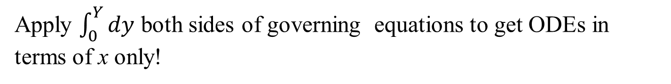
Integral Analysis for Natural Convection
$$u\frac{∂u}{∂x}+v\frac{∂u}{∂y}= gβ (T−T_{∞})+ν\frac{∂^{2}u}{∂y^{2}}$$
$$\frac{∂u}{∂x}+\frac{∂v}{∂y}=0$$
$$u\frac{∂T}{∂x}+v\frac{∂T}{∂y} = α\frac{∂^{2}T}{∂y^{2}}$$
Y
Assume Pr ≈ 1, so that δ = δ_{th}.
Define the control volume shown, where Y = constant,
Y is chosen so that everywhere Y > δ or δ_{th}.
Apply $\int_{0}^{Y}{dy}$ both sides of governing equations to get ODEs in terms of x only!

Slide 14
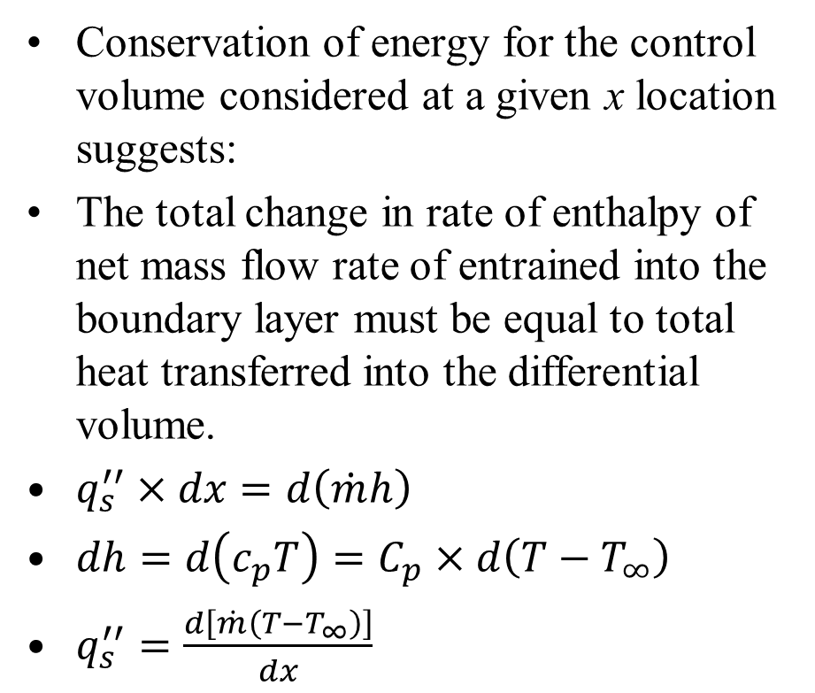
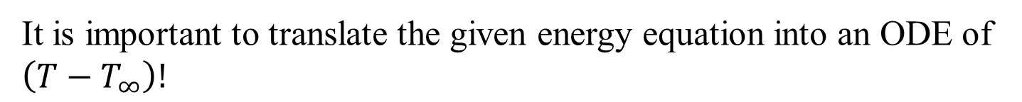
Integral Analysis of Energy Equation
Conservation of energy for the control volume considered at a given x location suggests:
The total change in rate of enthalpy of net mass flow rate of entrained into the boundary layer must be equal to total heat transferred into the differential volume.
$q_{s}^{′′}×dx=d\left(\dot{m}h\right)$
$dh=d\left(c_{p}T\right)=C_{p}×d\left(T−T_{∞}\right)$
$q_{s}^{′′}=\frac{d\left[\dot{m}\left(T−T_{∞}\right)\right]}{dx}$
Y
It is important to translate the given energy equation into an ODE of $\left(T−T_{∞}\right)!$

Slide 15
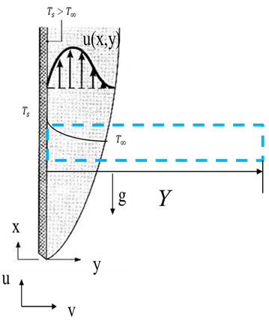
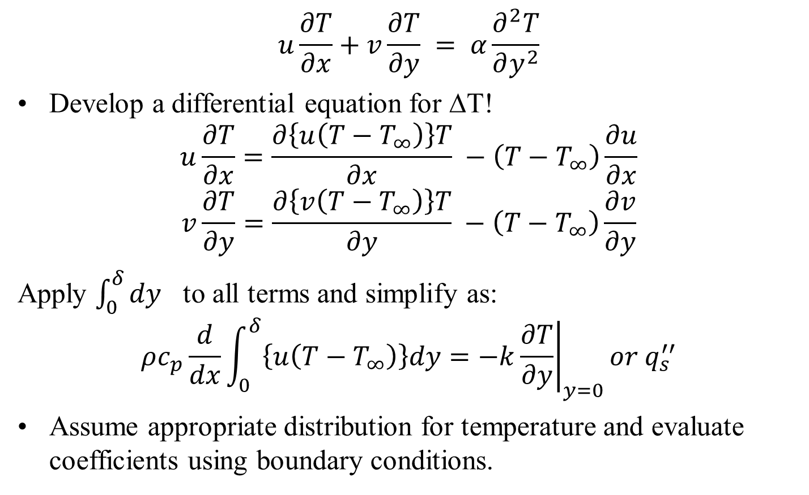
Integral Analysis of Energy Equation
$$u\frac{∂T}{∂x}+v\frac{∂T}{∂y} = α\frac{∂^{2}T}{∂y^{2}}$$
Develop a differential equation for ΔT!
$$u\frac{∂T}{∂x}=\frac{∂\left\{u\left(T−T_{∞}\right)\right\}T}{∂x} −\left(T−T_{∞}\right)\frac{∂u}{∂x}$$
$$v\frac{∂T}{∂y}=\frac{∂\left\{v\left(T−T_{∞}\right)\right\}T}{∂y} −\left(T−T_{∞}\right)\frac{∂v}{∂y}$$
Apply $\int_{0}^{δ}{dy}$ to all terms and simplify as:
$$ρc_{p}\frac{d}{dx}\int_{0}^{δ}{\left\{u\left(T−T_{∞}\right)\right\}dy=−k{\left.\frac{∂T}{∂y}\right|}_{y=0}or q_{s}^{′′}}$$
Assume appropriate distribution for temperature and evaluate coefficients using boundary conditions.

Slide 16
Integral Analysis for Natural Convection
Consider continuity equation and Apply $\int_{0}^{Y}{dy}$ both sides of this equation as.
$$\int_{0}^{Y}{\left(\frac{∂v}{∂y}\right)dy} =−\int_{0}^{Y}{\left(\frac{∂u}{∂x}\right)dy}$$
Y
$${\left.v\right|}_{Y}−v_{s}=−\frac{d}{dx}\left\{\int_{0}^{Y}{udy}\right\}$$
$${\left.v\right|}_{Y}=v_{s}−\frac{d}{dx}\left\{\int_{0}^{Y}{udy}\right\}$$

Slide 17
Integral Analysis for Natural Convection
Consider Momentum equation:
$$u\frac{∂u}{∂x}+v\frac{∂u}{∂y}= gβ (T−T_{∞})+v\frac{∂^{2}u}{∂y^{2}}$$
Modify the second term as
$$v\frac{∂u}{∂y}=\frac{∂\left(uv\right)}{∂y}−u\frac{∂v}{∂y}$$
Y
Modified momentum equation is
$$u\frac{∂u}{∂x}+\frac{∂\left(uv\right)}{∂y}−u\frac{∂v}{∂y}= gβ (T−T_{∞})+v\frac{∂^{2}u}{∂y^{2}}$$

Slide 18
Integral Analysis for Natural Convection
$$u\frac{∂u}{∂x}+\frac{∂\left(uv\right)}{∂y}−u\frac{∂v}{∂y}= gβ (T−T_{∞})+v\frac{∂^{2}u}{∂y^{2}}$$
Applying $\int_{0}^{Y}{dy}$ both sides of above equation.
$$\int_{0}^{Y}{\left(u\frac{∂u}{∂x}\right)dy}+\int_{0}^{Y}{\left(\frac{∂\left(uv\right)}{∂y}\right)dy}−\int_{0}^{Y}{\left(u\frac{∂v}{∂y}\right)dy}=\int_{0}^{Y}{\left(gβ (T−T_{∞})\right)dy}+\int_{0}^{Y}{\left(v\frac{∂^{2}u}{∂y^{2}}\right)dy}$$
Y
$$\frac{1}{2}\frac{d}{dx}\int_{0}^{Y}{\left(u^{2}\right)dy}+{\left.uv\right|}_{0}^{Y}−\int_{0}^{Y}{\left(u\frac{∂v}{∂y}\right)dy}=gβ\int_{0}^{Y}{ \left(T−T_{∞}\right)dy}+{\left.\left(v\frac{∂u}{∂y}\right)\right|}_{0}^{Y}$$

Slide 19
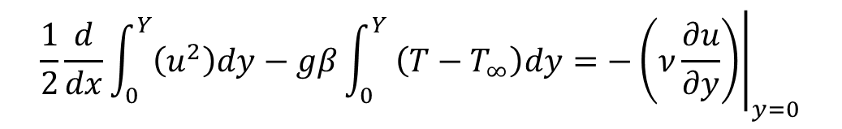
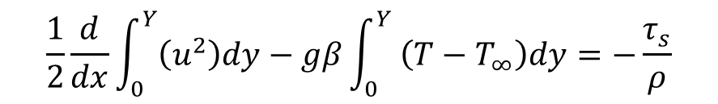
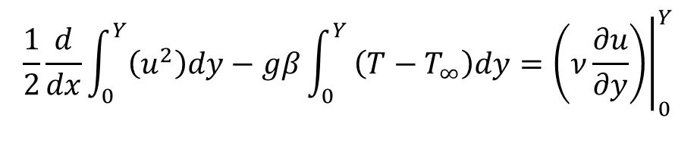
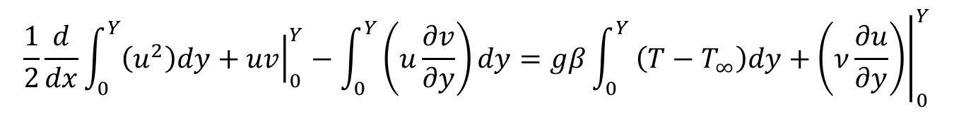
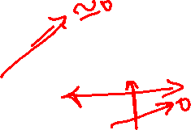
Integral Analysis for Natural Convection
$$\frac{1}{2}\frac{d}{dx}\int_{0}^{Y}{\left(u^{2}\right)dy}+{\left.uv\right|}_{0}^{Y}−\int_{0}^{Y}{\left(u\frac{∂v}{∂y}\right)dy}=gβ\int_{0}^{Y}{ \left(T−T_{∞}\right)dy}+{\left.\left(ν\frac{∂u}{∂y}\right)\right|}_{0}^{Y}$$
$$\frac{1}{2}\frac{d}{dx}\int_{0}^{Y}{\left(u^{2}\right)dy}−gβ\int_{0}^{Y}{ \left(T−T_{∞}\right)dy}={\left.\left(ν\frac{∂u}{∂y}\right)\right|}_{0}^{Y}$$
$$\frac{1}{2}\frac{d}{dx}\int_{0}^{Y}{\left(u^{2}\right)dy}−gβ\int_{0}^{Y}{ \left(T−T_{∞}\right)dy}=−{\left.\left(ν\frac{∂u}{∂y}\right)\right|}_{y=0}$$
Y
$$\frac{1}{2}\frac{d}{dx}\int_{0}^{Y}{\left(u^{2}\right)dy}−gβ\int_{0}^{Y}{ \left(T−T_{∞}\right)dy}=−\frac{τ_{s}}{ρ}$$

Slide 20
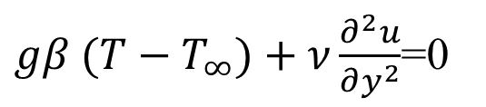
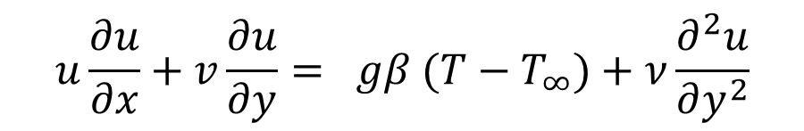

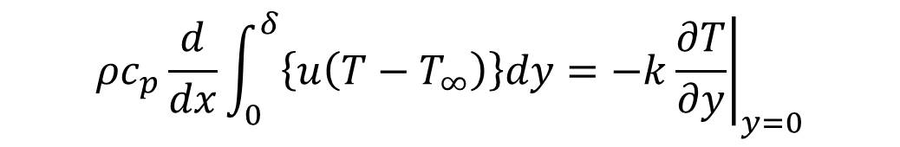
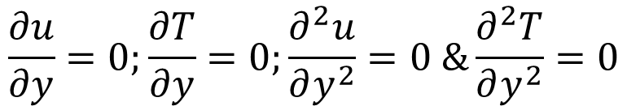

Integrodifferential Equations for Natural Convection : Isothermal Wall
$$\frac{1}{2}\frac{d}{dx}\int_{0}^{Y}{\left(u^{2}\right)dy}−gβ\int_{0}^{Y}{ \left(T−T_{∞}\right)dy}=−\frac{τ_{s}}{ρ}$$
$$ρc_{p}\frac{d}{dx}\int_{0}^{δ}{\left\{u\left(T−T_{∞}\right)\right\}dy=−k{\left.\frac{∂T}{∂y}\right|}_{y=0}}$$
Boundary conditions:
$$At y=0;u=0;v=0 \& T= T_{s}$$
Consider x-momentum equation:
$$u\frac{∂u}{∂x}+v\frac{∂u}{∂y}= gβ (T−T_{∞})+ν\frac{∂^{2}u}{∂y^{2}}$$
$gβ (T−T_{∞})+ν\frac{∂^{2}u}{∂y^{2}}$=0
Y
$$At y=δ;u=0 \& T= T_{∞}$$
$$\frac{∂u}{∂y}=0;\frac{∂T}{∂y}=0;\frac{∂^{2}u}{∂y^{2}}=0 \&\frac{∂^{2}T}{∂y^{2}}=0$$

Slide 21
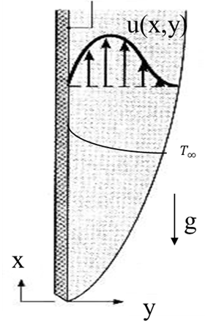
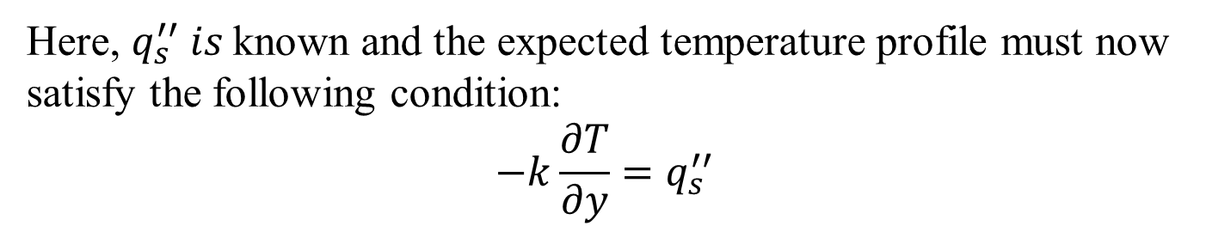
Integral Analysis of Natural Convection from Constant Heat Flux Vertical Flat Plate
Integrated Momentum Equation:
$$\frac{d}{dx}\int_{0}^{Y}{u^{2}dy}−gβ\int_{0}^{Y}{\left(T−T_{∞}\right)dy}=−\frac{τ_{s}}{ρ}$$
$$q_{s}^{′′}$$
Integrated Energy Equation:
$$ρc_{p}\frac{d}{dx}\int_{0}^{Y}{u\left(T−T_{∞}\right)dy}=q_{s}^{′′}$$
Laminar Flow, Uniform Heat flux:
Here, $q_{s}^{′′} is$known and the expected temperature profile must now satisfy the following condition:
$$−k\frac{∂T}{∂y}=q_{s}^{′′}$$

