Slide 1

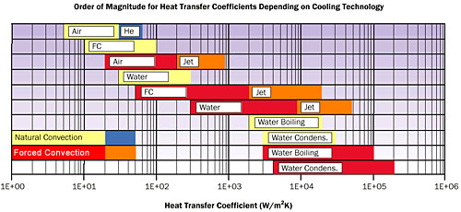

Natural Convection HT on A Flat Plate
P M V Subbarao
Professor & Head
Mechanical Engineering Department
Cooling/Heating with Zero Operating Cost….

Slide 2

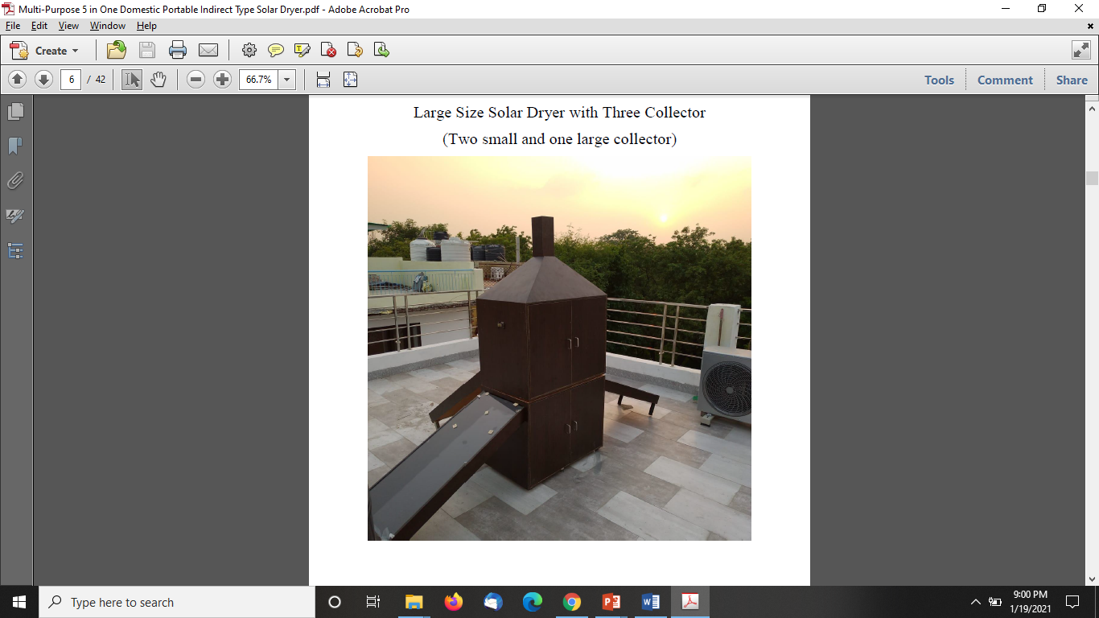
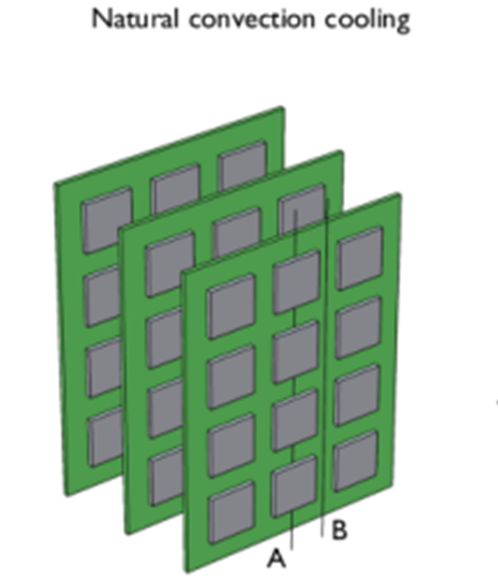
Sustainable Convection Systems
Basic Needs to Exotic Needs.
A Solar Dryer

Slide 3
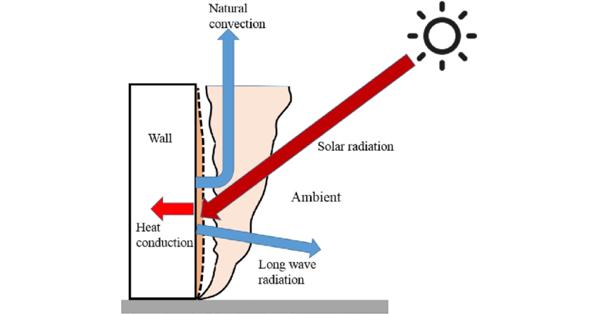
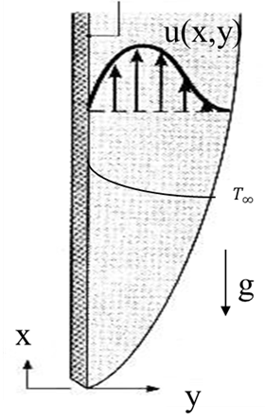
Solar Radiation Drive Natural Convection
$$q_{s}^{′′}$$

Slide 4

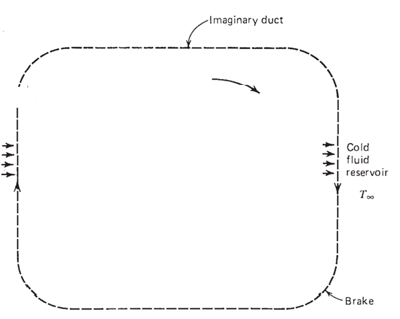
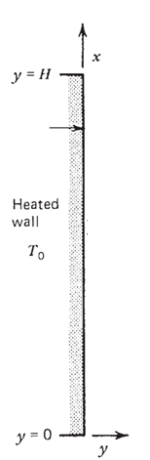
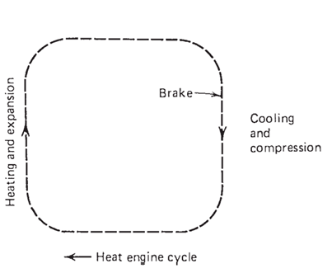

Hot Vertical Plate as A Heat Engine

Slide 5
Natural Convection in Electronic Devices
Natural convection in vertical channels with asymmetric heating of this nature is found in communication equipment.
In such equipment, vertical circuit cards containing heat generating electronic devices are arrayed to form vertical channels and are cooled by free convection.
Natural or free convection occurs due to the change in density of the fluid caused by heating process.
In a gravity field, the fluid, which has a lower density, is lighter and therefore rises, creating a movement in the fluid which is called convection.
This movement permits the fluid to pick up heat and carry it away.
The natural convection is A Sustainable method in electronics cooling.

Slide 6
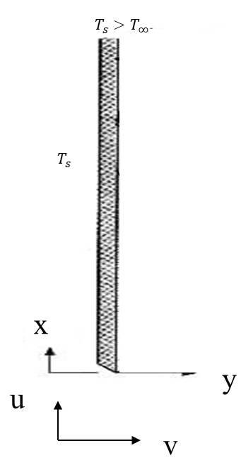

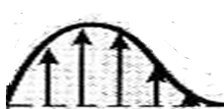
Natural Convection from A Heated Vertical Plate: Creation of Boundary Layers
We focus on free convection flows bounded by a vertical surface.
The classic example is
T(x₄,y)
u(x₅,y)
Quiescent fluid
T(x₃,y)
u(x₄,y)
u(x₃,y)
T(x₂,y)
u(x₂,y)
T(x₁,y)
u(x₁,y)

Slide 7
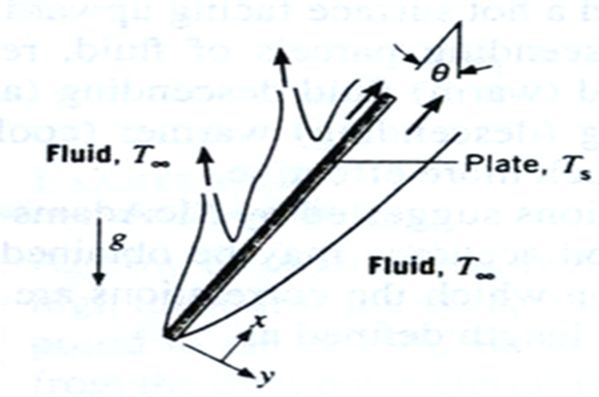
Natural Convection on Inclined Hot Flat Surface

Slide 8
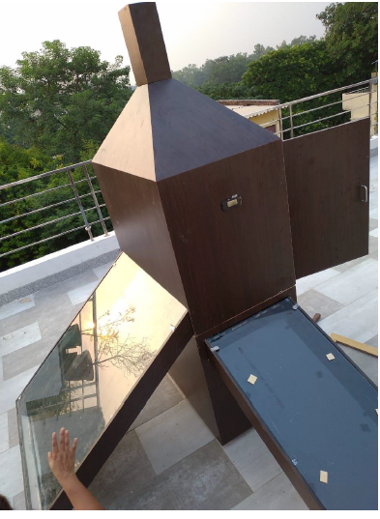
Solar Dryers for Agricultural Products
IIT Delhi Designs
Medium Size Solar Dryer with Two Collector
(One small and one large collector)
Large Size Solar Dryer with Three Collector
(Two small and one large collector)

Slide 9
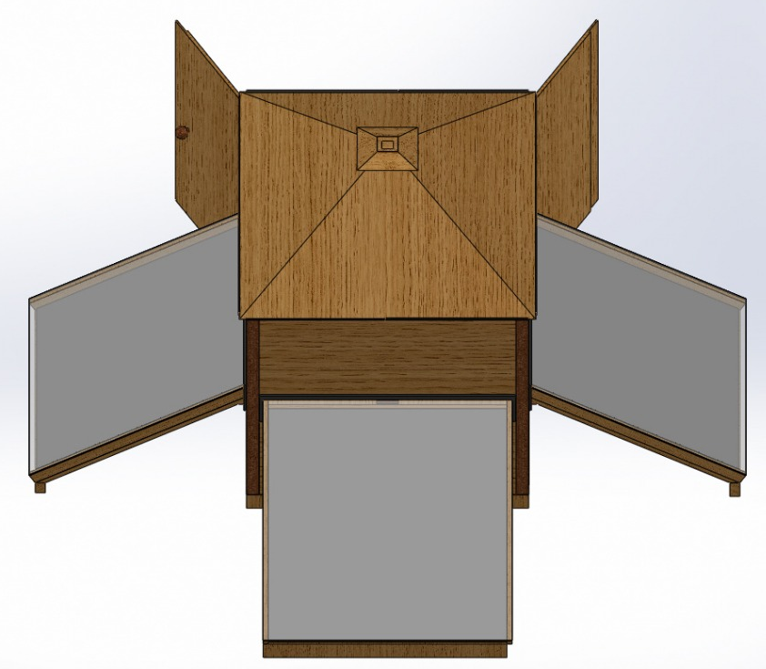
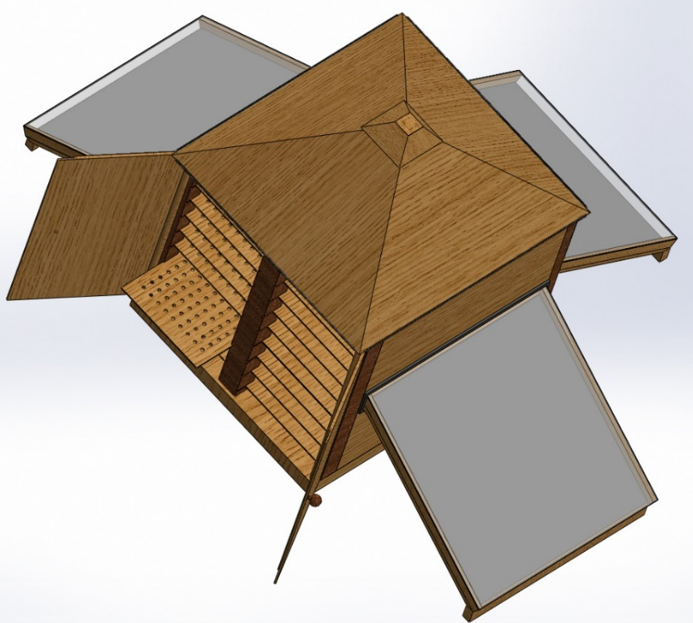
Product Development : 1. Multipurpose 5 in 1 Indirect Type of Solar Dryer

Slide 10
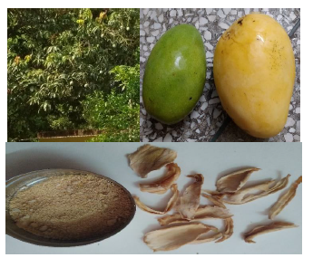
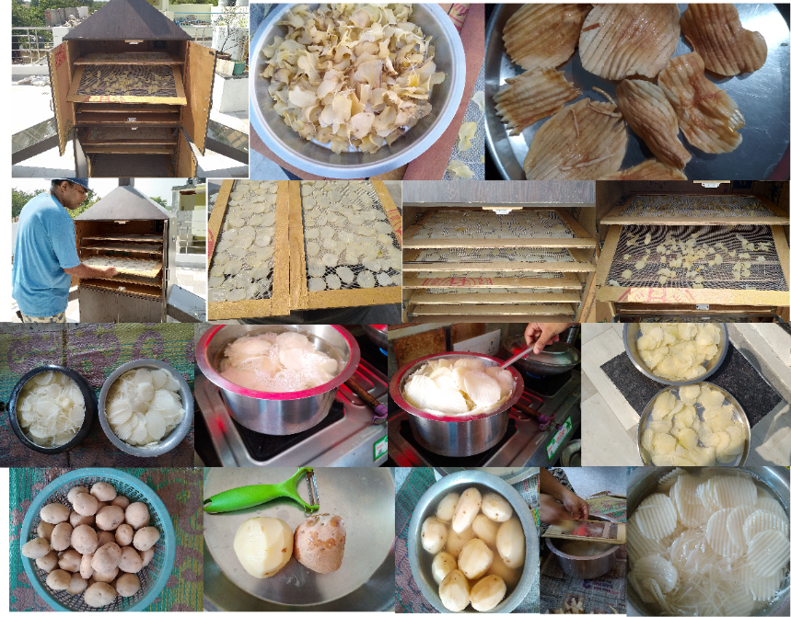
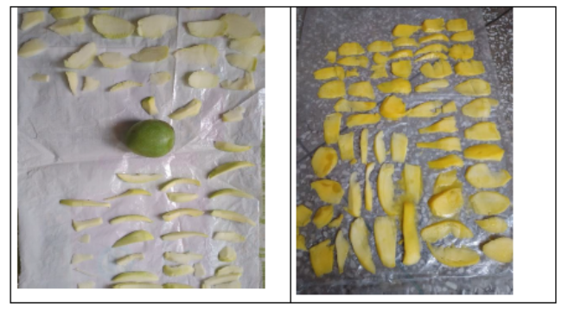
Mango Drying and Potato Drying
5 kg Potato Drying within 24 hours

Slide 11
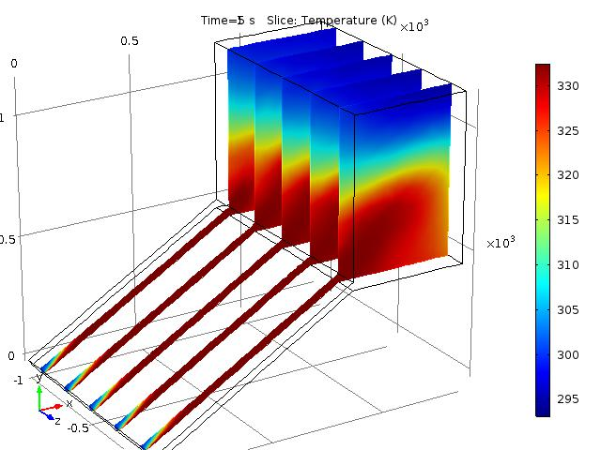
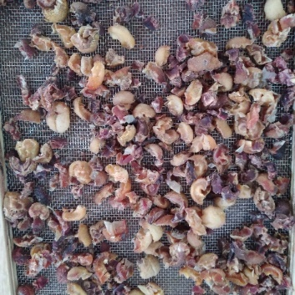
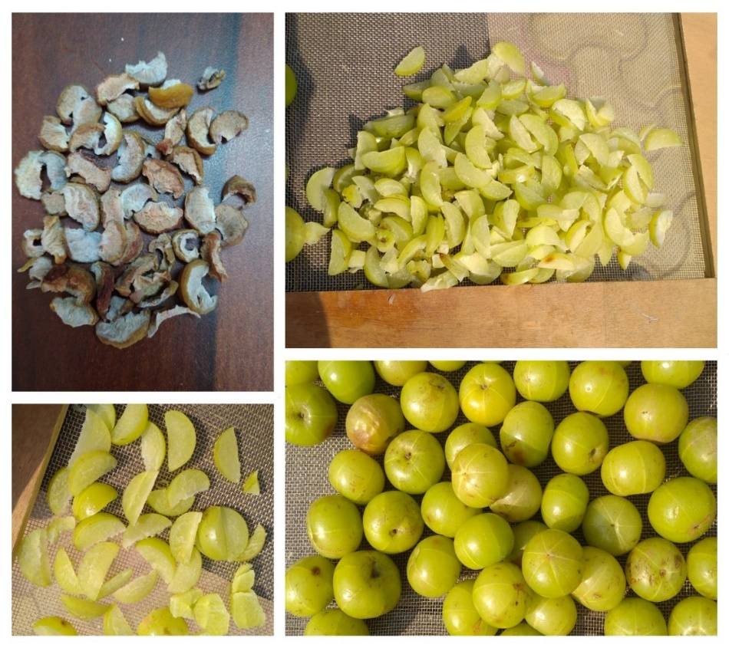
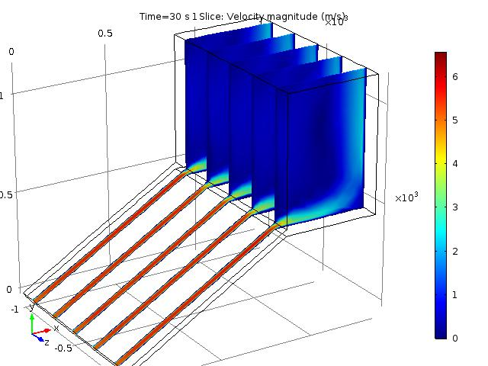
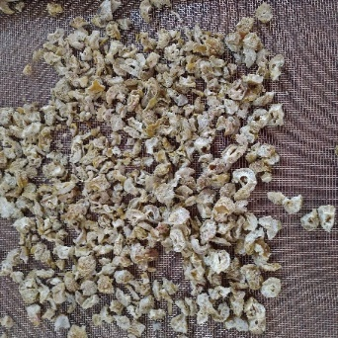
CFD Analysis of Dryers
Open Sun Drying
Solar Drying

Slide 12
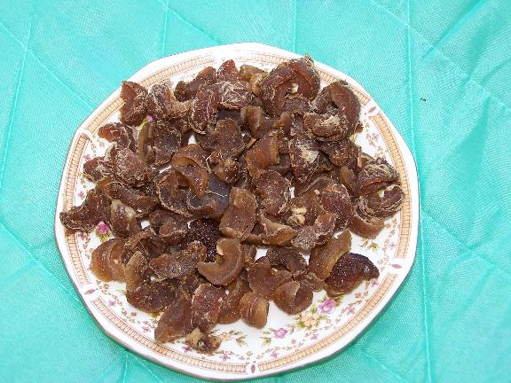
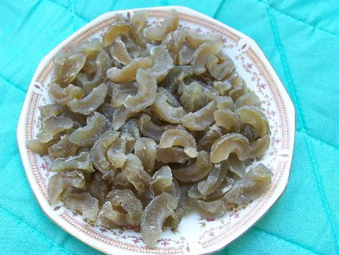
Quality of Solar Air-Dried Products
Open Sun dried
Dried on Solar dryer
Main Product: Amla Candy: Excellent Colour, Aroma and Taste

Slide 13
Natural Convection on Inclined Hot Flat Surface

Slide 14
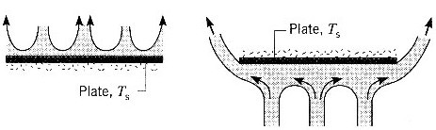
Natural Convection from Horizontal Plate
Hot Plate (Ts > T∞)

Slide 15
Boundary Layer Theory for Natural Convection from A Heated Vertical Plate
We focus on free convection flows bounded by a vertical surface.
The classic example is
T(x₄,y)
u(x₅,y)
Quiescent fluid
T(x₃,y)
u(x₄,y)
u(x₃,y)
T(x₂,y)
u(x₂,y)
T(x₁,y)
u(x₁,y)

Slide 16
The Momentum Equation for Natural Convection
The difference between the two flows (forced flow and free flow) is that, in free convection, a major role is played by buoyancy forces.
$$F_{b}=−ρg$$
Very important
Consider the x-momentum equation.
$$u\frac{∂u}{∂x}+v\frac{∂u}{∂y} = −\frac{1}{ρ}\frac{∂p}{∂x} −g+ ν\frac{∂^{2}u}{∂y^{2}}$$
It is well known that $\frac{∂p}{∂y}=0 for a boundary layer flow.$
Therefore, the x-pressure gradient in the boundary layer must equal that in the quiescent region outside the boundary layer.
Pascal Law :
$$\frac{∂p}{∂x} =−ρ_{∞}g$$

Slide 17
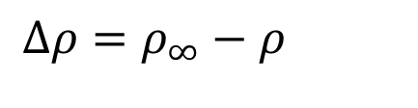
Equations Governing the Natural Convection
x-momentum equation for a Natural Convection boundary layer flow :
$$u\frac{∂u}{∂x}+v\frac{∂u}{∂y} = \frac{1}{ρ}\left(ρ_{∞}g\right) −g+ ν\frac{∂^{2}u}{∂y^{2}}$$
$$u\frac{∂u}{∂x}+v\frac{∂u}{∂y} = \left(\frac{Δρ}{ρ}\right)g+ ν\frac{∂^{2}u}{∂y^{2}}$$
Buoyancy force
$$Δρ=ρ_{∞}−ρ$$

Slide 18
Thermodynamics of Buoyancy Force
Define β, the volumetric thermal expansion coefficient.
$$β = −\frac{1}{ρ}{\left(\frac{∂ρ}{∂T}\right)}_{P}$$
$$\text{For} \text{an} \text{ideal} \text{gas}\text{: }p=\frac{RT}{ρ} ⇒ ρ$$
$$Thus:β = \frac{1}{T}$$
Not valid for liquids and non-ideal gases
$$β≈−\frac{1}{ρ}\frac{Δρ}{ΔT}=−\frac{1}{ρ}\frac{ρ_{∞}−ρ}{T_{∞}−T}$$
Valid for any general fluid
$$ρ_{∞}−ρ≈ρβ(T−T_{∞})$$
Density gradient is due to the temperature gradient

Slide 19
Governing Equations for Natural Convection
x-momentum equation with Buoyancy effects replacing pressure gradient.
$$u\frac{∂u}{∂x}+v\frac{∂u}{∂y}= gβ (T−T_{∞})+v\frac{∂^{2}u}{∂y^{2}}$$
The buoyancy effects are confined to the momentum equation, so the mass and energy equations are the same.
$$\frac{∂u}{∂x}+\frac{∂v}{∂y}=0$$
$$u\frac{∂T}{∂x}+v\frac{∂T}{∂y} = α\frac{∂^{2}T}{∂y^{2}}+\frac{ν}{c_{p}}{\left(\frac{∂u}{∂y}\right)}^{2}$$
Strongly coupled and must be solved simultaneously

Slide 20
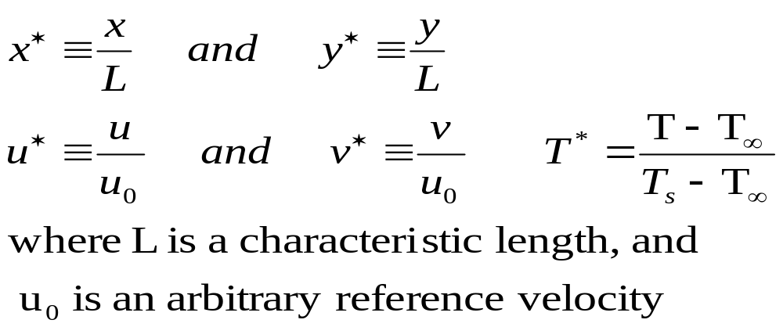
Dimensionless Analysis and Similarity Variables
The x-momentum and energy equations are
$$u^{∗}\frac{∂u^{∗}}{∂x^{∗}}+v^{∗}\frac{∂u^{∗}}{∂y^{∗}} = \frac{gβ(T_{s}−T_{∞})L}{u_{0}^{2}} {\text{T}}^{∗} + \frac{1}{{Re}_{L}{}}\frac{∂^{2}u^{∗}}{∂{y^{∗}}^{2}}$$
$$u^{∗}\frac{∂T^{∗}}{∂x^{∗}}+v^{∗}\frac{∂T^{∗}}{∂y^{∗}} = \frac{1}{{Re}_{L}{Pr} }\frac{∂^{2}T^{∗}}{∂{y^{∗}}^{2}}$$

Slide 21
Dimensionless Similarity Parameter
Define new dimensionless parameter,
$$Gr_{L}= \frac{gβ(T_{s}−T_{∞})L}{u_{0}^{2}}{\left(\frac{u_{0}L}{ν}\right)}^{2}=\frac{gβ(T_{s}−T_{∞})L^{3}}{ν^{2}}$$
Grashof number in natural convection is analogous to the Reynolds number in forced convection.
Grashof number indicates the ratio of the buoyancy force to the viscous force.
Higher Gr number means increased natural convection flow
$$\frac{Gr_{L}}{{Re}_{L}^{2}}<<1$$
$$\frac{Gr_{L}}{{Re}_{L}^{2}}>>1$$
Forced Convection
Natural Convection

Slide 22
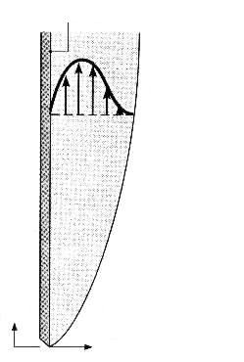
Laminar Free Convection on a Vertical Flat Plate
As y → ∞ : u = 0, T = T∞
At y = 0 : u = 0, T = T_{s}
With little or no external driving flow, Re ≅ 0 and forced convection effects can be safely neglects
$$T_{s}>T_{∞}$$
u(x,y)
$$T_{s}$$
$$T_{∞}$$
g
$$\frac{Gr_{L}}{{Re}_{L}^{2}}>>1$$
x
y
u
v
$$Nu_{L}=f(Gr_{L},\operatorname{Pr}{)}$$

Slide 23
Final Governing Equations for Natural Convection
$$u\frac{∂u}{∂x}+v\frac{∂u}{∂y}= gβ (T−T_{∞})+v\frac{∂^{2}u}{∂y^{2}}$$
$$T_{s}>T_{∞}$$
u(x,y)
$$\frac{∂u}{∂x}+\frac{∂v}{∂y}=0$$
$$T_{s}$$
$$u\frac{∂T}{∂x}+v\frac{∂T}{∂y} = α\frac{∂^{2}T}{∂y^{2}}$$
$$T_{∞}$$
g
x
$$u=0 at x=0$$
y
u
$$u=0, v=0 \& T=T_{s} at y=0$$
v
$$u=0 \& T=T_{∞} as y →∞$$
Local Grashof Number: Measure of local driving force/resistance force ratio
$$Gr_{x}= \frac{gβ(T_{s}−T_{∞})x^{3}}{ν^{2}}$$

Slide 24
Source of Kinetic Energy to Create Velocity Field NC in VFP-BL
By means of the various intuitive and transformations skills acquired thru FPBL theory, it can easily be verified that
$$\frac{u_{O}^{2}}{2}∝β∆Tgx$$
The proportionality variable is a function of y.
As the value of $β∆Tg$ is same for entire plate, there exist a mater profile for velocity as function of a similarity variable η.
The challenge is to find the definitions of η and the mother of velocity field ψ as function of this similarity variable, $F\left(η\right)$.
Using the definition of Grashof number
$$u_{O}=2\sqrt{Gr}×\frac{ν}{x}×\frac{dF}{dη}$$

Slide 25
Creator of Flow Field in Natural Convection
$$Gr_{x}= \frac{gβ(T_{s}−T_{∞})x^{3}}{ν^{2}}$$
u, v and T in x-y plane
→x,η plane
T(x₄,y)
u(x₅,y)
Discovery of η axis
$$η=\frac{y}{x}{\left(\frac{{Gr}_{x}}{4}\right)}^{1/4}$$
T(x₃,y)
u(x₄,y)
u(x₃,y)
T(x₂,y)
u(x₂,y)
T(x₁,y)
u & v are siblings!
u(x₁,y)
$$ψ=4νF\left(η\right){\left(\frac{{Gr}_{x}}{4}\right)}^{1/4}$$

Slide 26
The Stream Function Generated by Buoyancy
The velocity components in the (x, y) coordinate system are defined as
$$u=\frac{∂ψ}{∂y} \& v=−\frac{∂ψ}{∂x}$$
In (x, η) coordinates:
$$u={\left.\frac{∂η}{∂y}\right|}_{x} \frac{∂ψ}{∂η}$$
$$v={\left.\frac{∂ψ}{∂x}\right|}_{η}−{\left.\frac{∂η}{∂x}\right|}_{y} \frac{∂ψ}{∂η}$$
$$T_{s}>T_{∞}$$
u(x,y)
$$T_{s}$$
$$T_{∞}$$
g
x
y
u
v

Slide 27
Development of ODEs as Governing Equations
$$u={\left.\frac{∂η}{∂y}\right|}_{x} \frac{∂ψ}{∂η}$$
$$T_{s}>T_{∞}$$
u(x,y)
$$\frac{∂u}{∂x}+\frac{∂v}{∂y}=0$$
$$T_{s}$$
$$v={\left.\frac{∂ψ}{∂x}\right|}_{η}−{\left.\frac{∂η}{∂x}\right|}_{y} \frac{∂ψ}{∂η}$$
$$T_{∞}$$
g
x
$$ψ=4νF\left(η\right){\left(\frac{{Gr}_{x}}{4}\right)}^{1/4}$$
y
u
v

Slide 28
The ODE for Momentum Equation
$$T_{s}>T_{∞}$$
u(x,y)
$$u\frac{∂u}{∂x}+v\frac{∂u}{∂y}= gβ (T−T_{∞})+v\frac{∂^{2}u}{∂y^{2}}$$
$$T_{s}$$
$$u={\left.\frac{∂η}{∂y}\right|}_{x} \frac{∂ψ}{∂η}$$
$$v={\left.\frac{∂ψ}{∂x}\right|}_{η}−{\left.\frac{∂η}{∂x}\right|}_{y} \frac{∂ψ}{∂η}$$
$$T_{∞}$$
g
x
$$ψ=4νF\left(η\right){\left(\frac{{Gr}_{x}}{4}\right)}^{1/4}$$
y
u
v
$$\frac{d^{3}F}{dη^{3}}+3F\frac{d^{2}F}{dη^{2}}−2{\left(\frac{dF}{dη}\right)}^{2}+\frac{T−T_{∞}}{T_{s}−T_{∞}}=0$$

Slide 29
The ODE for Natural Convection
$$\frac{d^{3}F}{dη^{3}}+3F\frac{d^{2}F}{dη^{2}}−2{\left(\frac{dF}{dη}\right)}^{2}+\frac{T−T_{∞}}{T_{s}−T_{∞}}=0$$
$$T_{s}>T_{∞}$$
u(x,y)
$$θ=\frac{T−T_{∞}}{T_{s}−T_{∞}}$$
$$T_{s}$$
$$T_{∞}$$
$$\frac{d^{3}F}{dη^{3}}+3F\frac{d^{2}F}{dη^{2}}−2{\left(\frac{dF}{dη}\right)}^{2}+θ=0$$
g
x
y
u
$$F=0,\frac{dF}{dη}=0 \& θ=1 at η=0$$
v
$$\frac{dF}{dη}=0 \& θ=0 at η →∞$$

Slide 30
The Energy Equation for Natural Convectio
$$u\frac{∂T}{∂x}+v\frac{∂T}{∂y} = α\frac{∂^{2}T}{∂y^{2}}$$
$$T_{s}>T_{∞}$$
u(x,y)
$$θ=\frac{T−T_{∞}}{T_{s}−T_{∞}}$$
$$T_{s}$$
$$T_{∞}$$
$$\frac{1}{Pr}\frac{d^{2}θ}{dη^{2}}+3F\frac{dθ}{dη}=0$$
g
x
The boundary conditions are
y
u
$$F=0,\frac{dF}{dη}=0 \& θ=1 at η=0$$
v
$$\frac{dF}{dη}=0 \& θ=0 at η →∞$$

Slide 31
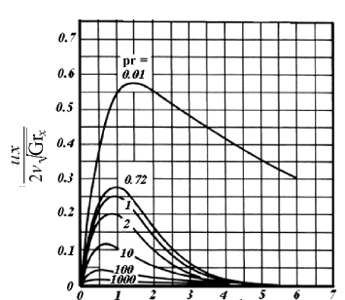
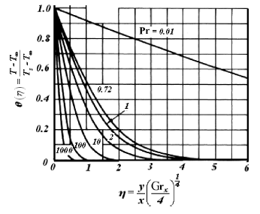
Natural Generation of Temperature & Flow Fields
Ostrach (1953) numerically solved the preceding equations for the 0.01 < Pr < 1000 range.
$$η=\frac{y}{x}{\left(\frac{{Gr}_{x}}{4}\right)}^{1/4}$$

Slide 32
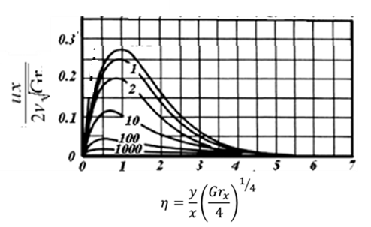
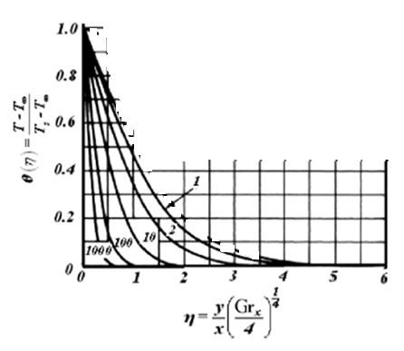
Natural Generation of Temperature & Flow Fields
For Pr ≥1, as noted, δ > δ_{th}.

Slide 33
Natural Generation of Temperature & Flow Fields for
Pr ≥1
The velocity boundary layer is generally thicker than the
thermal boundary layer in such fluids.
the buoyant fluid layer causes macroscopic motion in a thicker fluid layer because of the strong viscosity.

Slide 34
Natural Generation of Temperature & Flow Fields
$$η=\frac{y}{x}{\left(\frac{{Gr}_{x}}{4}\right)}^{1/4}$$
For fluids Pr ≪ 1, however, the relatively low viscosity makes the effect of shear stress unimportant near the outer edge of the thermal boundary layer, and δth ≥ δ becomes possible.

Slide 35
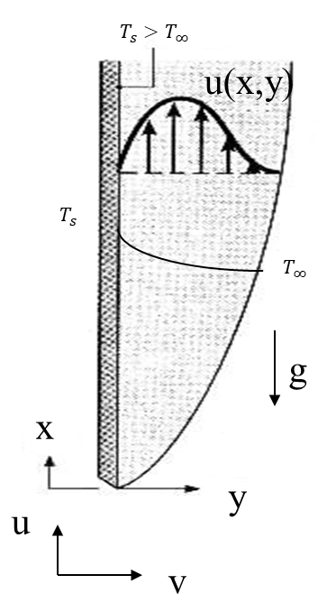
Measure of Convection Heat Trnsfer
Measure of Natural Convection:
$${\left.q^{′′}\right|}_{y=0}=−k{\left\{\frac{∂T}{∂y}\right\}}_{y=0}$$
$${\left.q^{′′}\right|}_{y=0}=−k{\left\{\frac{dθ}{∂η}\right\}}_{η=0}×\frac{\left(T_{s}−T_{∞}\right)}{x}×{\left(\frac{Gr}{4}\right)}^{1/4}$$
$$h_{x}=\frac{{\left.q^{′′}\right|}_{y=0}}{\left(T_{s}−T_{∞}\right)}$$
$${\left.q^{′′}\right|}_{y=0}=h_{x}\left(T_{s}−T_{∞}\right)$$
$${Nu}_{x}=\frac{−k{\left\{\frac{dθ}{∂η}\right\}}_{η=0}}{\sqrt{2}}×{\left(\frac{Gr}{4}\right)}^{1/4}$$
$${Nu}_{x}=\frac{x}{k}\frac{{\left.q^{′′}\right|}_{y=0}}{\left(T_{s}−T_{∞}\right)}$$

Slide 36
Measure of Convection Heat Transfer
$${Nu}_{x}=\frac{−k{\left\{\frac{dθ}{∂η}\right\}}_{η=0}}{\sqrt{2}}×{\left(\frac{Gr}{4}\right)}^{1/4}$$
$$=φ\left(Pr\right)×{\left(\frac{Gr}{4}\right)}^{1/4}$$
The shape of function φ can of course be found by numerically solving the ODEs.
LeFevre (1956) derived the following curve fit to the numerical results:
$$φ\left(Pr\right)=\frac{0.75 \sqrt{Pr}}{\sqrt[4]{4×\left[0.609+1.221\sqrt{Pr}+1.238Pr\right] }}$$

Slide 37
Average Nusselt Number
The average heat transfer coefficient is defined as
$$h_{L}=\frac{1}{L}\int_{0}^{L}{h_{x}dx}$$
The average Nusselt number for a given vertical plate of length L, is related to local Nusselt number at x=L, as
$${Nu}_{L}= {\left.\frac{4}{3}{Nu}_{x}\right|}_{at x=L}$$
This solution was based on the assumption that no blowing or suction took place through the wall and that the wall temperature was constant.
It can be expected that the surface temperature of the plate will vary as a power law function:
$$T_{s}−T_{∞}=Ax^{n}$$

Slide 38
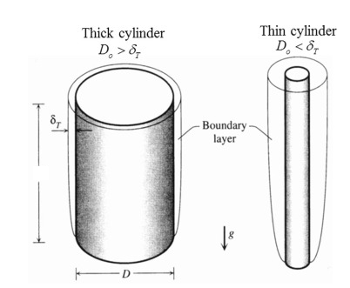
Extension of Vertical Plate Solutions
Thus the preceding solutions can be applied to the outside of a vertical cylinder as long as:
$$\frac{D}{L}>\frac{35}{\sqrt[4]{{Gr}_{L}}}$$
When this criterion is met, for Pr = 0.7 and Pr = 1, the application of flat-surface solutions introduces less than 5% error.
For fluids with Pr >∼ 1 the following criterion can be used
$$\frac{D}{L}>\frac{1}{\sqrt[4]{{Gr}_{L}×Pr}}$$
When the preceding criteria are not met, the integral method is to be applied by taking into account the curvature of the surface.

Slide 39
Natural Convection of Early Civilization to Till date
Drying has been and continues to be a major method of preserving agricultural products.
It is an integral part of agricultural processing and is usually the last step of operation before storage.
Defined as the removal of moisture by heat from a substance which yields a solid product at an acceptable moisture level (AML).
This acceptable limit is the one which prevents deterioration within a certain period of time for marketing, safe storage, processing, or transportation.
Drying consists of;
the process of heat transfer to the product from the heating source,
mass transfer of moisture from the interior of the product to its surface and from this surface to the surrounding air.

