Slide 1


Integral Solutions for Forced Convection HT in
FPBL
P M V Subbarao
Professor & Head
Mechanical Engineering Department
Solutions for 21st Century Use of Boundary Layer Convection….

Slide 2


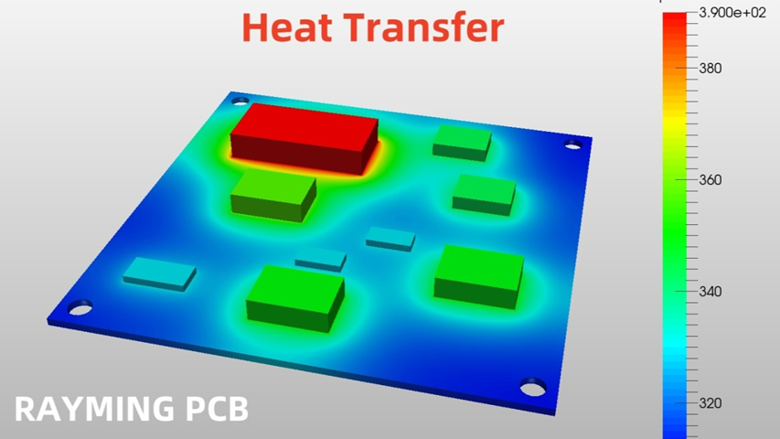

Slide 3
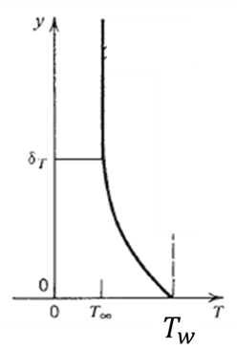
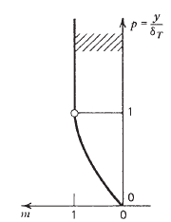
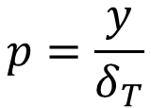

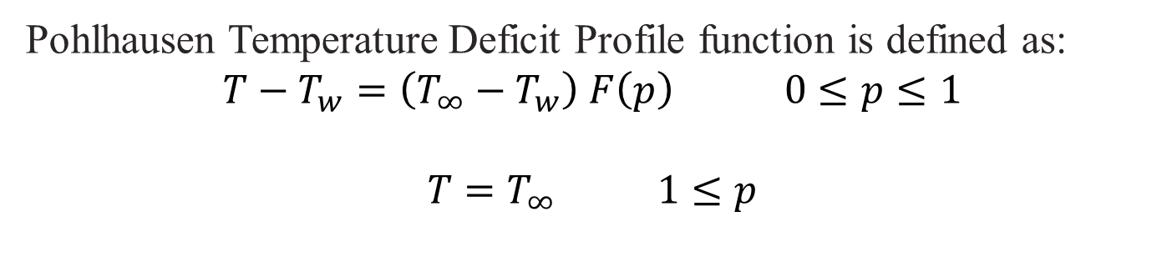

Pohlhausen’s Temperature Deficit Profile
$$p=\frac{y}{δ_{T}}$$
$$F\left(p\right)$$
Pohlhausen Temperature Deficit Profile function is defined as:
$$T−T_{w}=\left(T_{∞}−T_{w}\right) F\left(p\right) 0≤p≤1$$
$$T=T_{∞} 1≤p$$

Slide 4
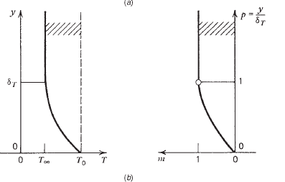

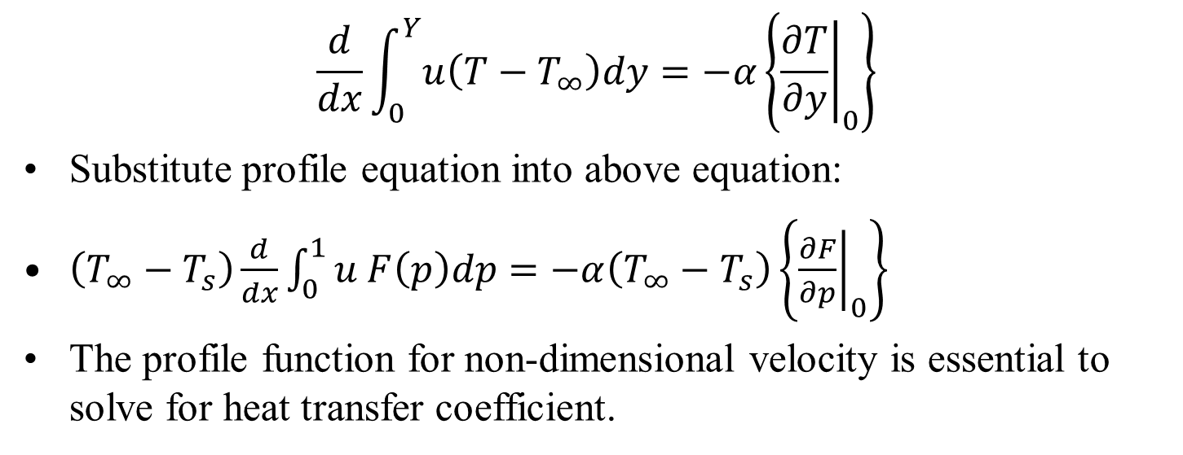
Energy equation Using Pohlhausen’s Temperature Profile
$$\frac{d}{dx}\int_{0}^{Y}{u\left(T−T_{∞}\right)dy}=−α\left\{{\left.\frac{∂T}{∂y}\right|}_{0}\right\}$$
Substitute profile equation into above equation:
$\left(T_{∞}−T_{s}\right)\frac{d}{dx}\int_{0}^{1}{u F\left(p\right)dp}=−α\left(T_{∞}−T_{s}\right)\left\{{\left.\frac{∂F}{∂p}\right|}_{0}\right\}$
The profile function for non-dimensional velocity is essential to solve for heat transfer coefficient.
$$F\left(p\right)$$

Slide 5
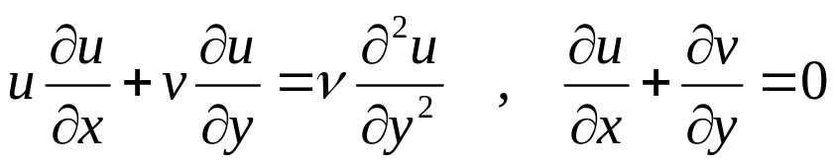
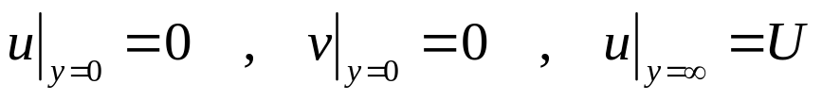
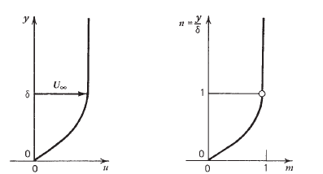
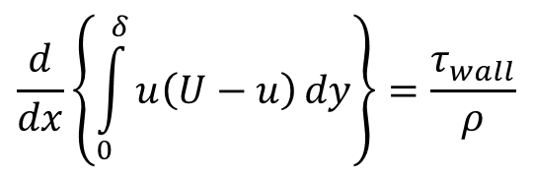
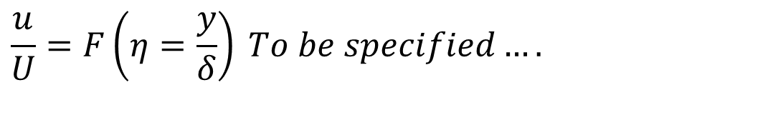
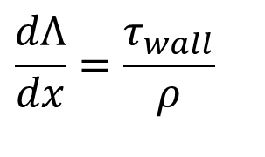
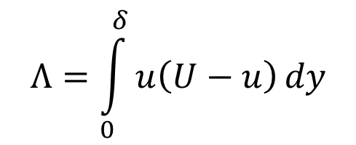

Master Velocity Profile Functions
Define momentum thickness, Λas
$$\frac{d}{dx}\left\{\int_{0}^{δ}{u\left(U−u\right)}dy\right\}=\frac{τ_{wall}}{ρ}$$
$$Λ=\int_{0}^{δ}{u\left(U−u\right)}dy$$
$$\frac{dΛ}{dx}=\frac{τ_{wall}}{ρ}$$
Define a shape function that varies from 0 to1.
$$\frac{u}{U}=F\left(η=\frac{y}{δ}\right) To be specified….$$
$$u=UF\left(η\right) 0≤η≤1$$
u$=U 1≤η$

Slide 6

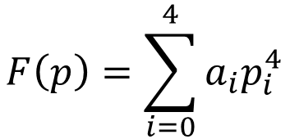
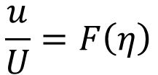
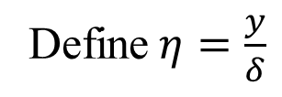
Pohlhausen’s Analogy of Master Velocity & Temperature Profiles
Define$η=\frac{y}{δ}$
$$\frac{u}{U}=F\left(η\right)$$
$F\left(η\right)$ = $\sum_{i=0}^{4}{a_{i}η_{i}^{4}}=a_{0}+a_{1}η+a_{2}η^{2}+a_{3}η^{3}+a_{4}η^{4}$
$$T_{∞}−T=\left(T_{∞}−T_{s}\right)F\left(p\right)$$
$$F\left(p\right)=\sum_{i=0}^{4}{a_{i}p_{i}^{4}}$$

Slide 7
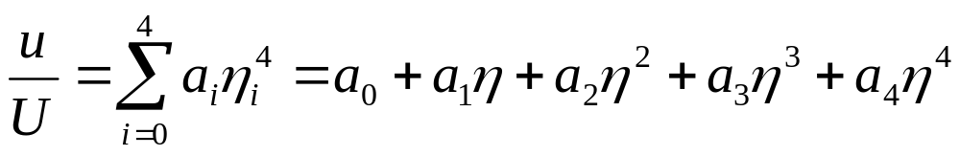

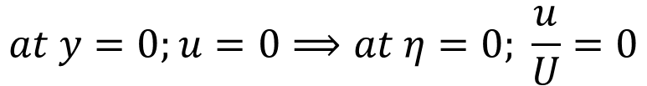

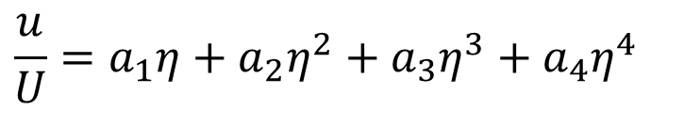
Master Velocity Profile Functions
$$\frac{dΛ}{dx}=\frac{τ_{wall}}{ρ}$$
Polhausen’s Proposition to polynomial to $F\left(η\right)$
$$at y=0;u=0⟹at η=0; \frac{u}{U}=0$$
$$→ a_{0}=0$$
$$\frac{u}{U}=a_{1}η+a_{2}η^{2}+a_{3}η^{3}+a_{4}η^{4}$$

Slide 8
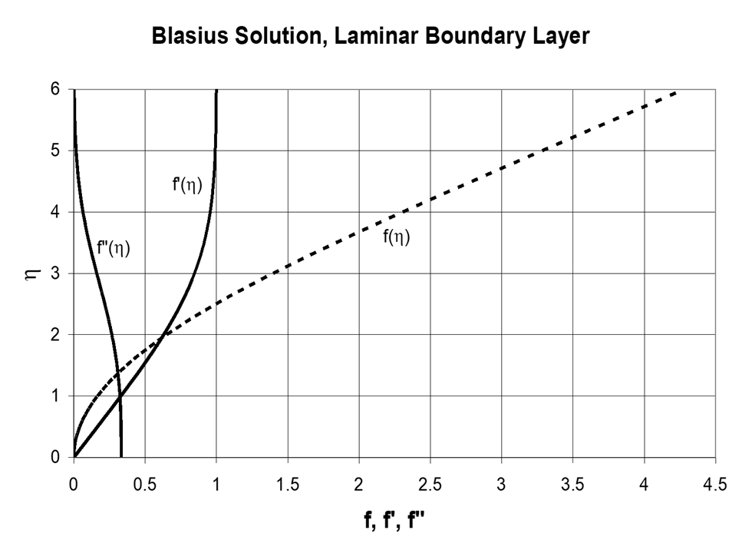
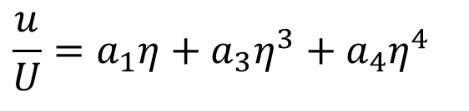
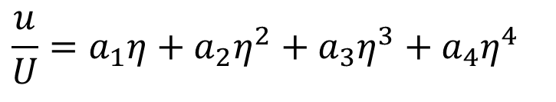

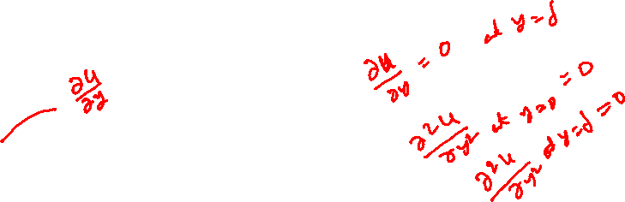
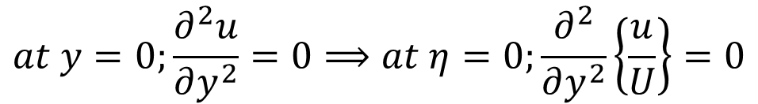

Master Velocity Profile Functions
$$\frac{dθ}{dx}=\frac{τ_{wall}}{ρ}$$
$$\frac{u}{U}=a_{1}η+a_{2}η^{2}+a_{3}η^{3}+a_{4}η^{4}$$
$$at y=0;\frac{∂^{2}u}{∂y^{2}}=0⟹at η=0;\frac{∂^{2}}{∂y^{2}}\left\{\frac{u}{U}\right\}=0$$
$$→ a_{2}=0$$
$$\frac{u}{U}=a_{1}η+a_{3}η^{3}+a_{4}η^{4}$$

Slide 9
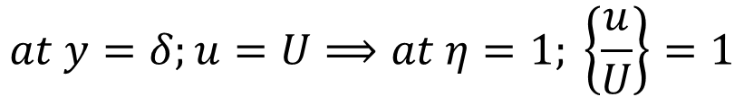
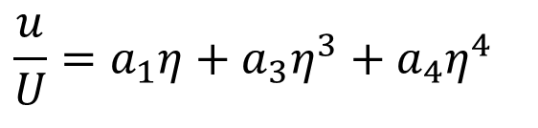


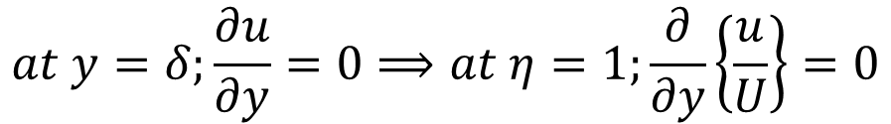
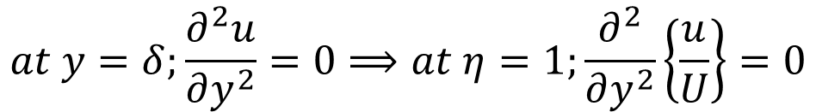

Master Velocity Profile Functions
$$\frac{dθ}{dx}=\frac{τ_{wall}}{ρ}$$
$$\frac{u}{U}=a_{1}η+a_{3}η^{3}+a_{4}η^{4}$$
$$at y=δ;\frac{∂u}{∂y}=0⟹at η=1;\frac{∂}{∂y}\left\{\frac{u}{U}\right\}=0$$
$$→ a_{1}+3a_{3}+4a_{4}=0$$
$$at y=δ;u=U⟹at η=1; \left\{\frac{u}{U}\right\}=1$$
$$→ a_{1}+a_{3}+a_{4}=1$$
$$at y=δ;\frac{∂^{2}u}{∂y^{2}}=0⟹at η=1;\frac{∂^{2}}{∂y^{2}}\left\{\frac{u}{U}\right\}=0$$
$$→ a_{3}+2a_{4}=0$$

Slide 10
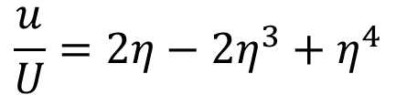

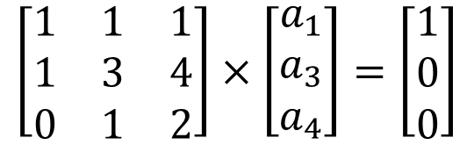

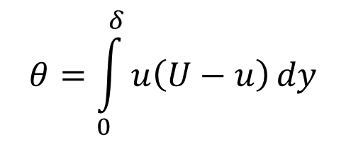

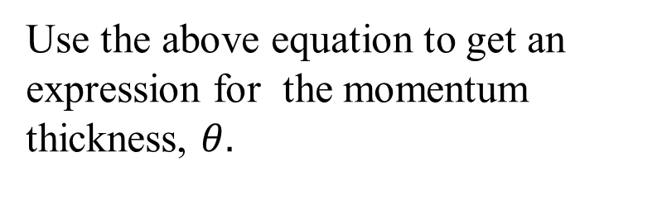
Von Karman-Pohlhausen Method for Flow over a Flat Plate
$$→ a_{1}+a_{3}+a_{4}=1$$
$$→ a_{1}+3a_{3}+4a_{4}=0$$
$$→ a_{3}+2a_{4}=0$$
$$\left[\begin{matrix}1 & 1 & 1 \\ 1 & 3 & 4 \\ 0 & 1 & 2\end{matrix}\right]×\left[\begin{matrix}a_{1} \\ a_{3} \\ a_{4}\end{matrix}\right]=\left[\begin{matrix}1 \\ 0 \\ 0\end{matrix}\right]$$
$$→a_{0}=0,a_{1}=2,a_{2}=0,a_{3}=−2, a_{4}=1$$
$$\frac{u}{U}=2η−2η^{3}+η^{4}$$
$$θ=\int_{0}^{δ}{u\left(U−u\right)}dy$$
Use the above equation to get an expression for the momentum thickness, $θ.$

Slide 11
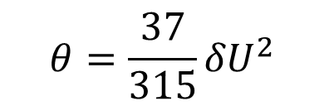
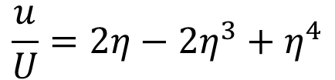
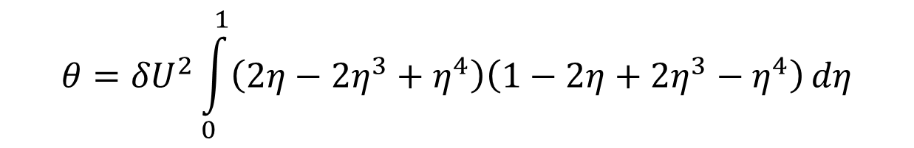
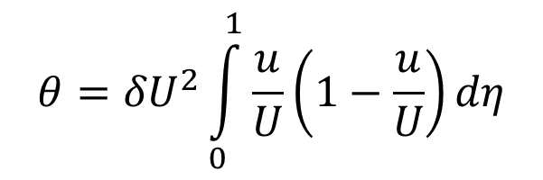
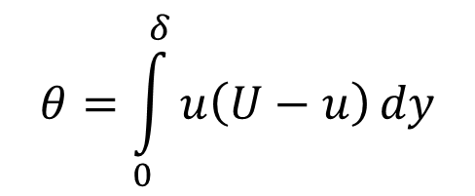

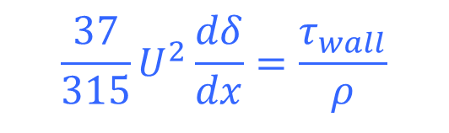
Von Karman-Pohlhausen Method for Flow over a Flat Plate
$$\frac{u}{U}=2η−2η^{3}+η^{4}$$
$$θ=\int_{0}^{δ}{u\left(U−u\right)}dy$$
$$θ={δU}^{2}\int_{0}^{1}{\frac{u}{U}\left(1−\frac{u}{U}\right)}dη$$
$$θ={δU}^{2}\int_{0}^{1}{\left(2η−2η^{3}+η^{4}\right)\left(1−2η+2η^{3}−η^{4}\right)}dη$$
$$θ=\frac{37}{315}{δU}^{2}$$
$$\frac{dθ}{dx}=\frac{τ_{wall}}{ρ}$$
$$\frac{37}{315}U^{2}\frac{dδ}{dx}=\frac{τ_{wall}}{ρ}$$

Slide 12
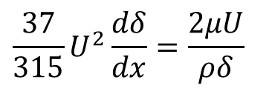

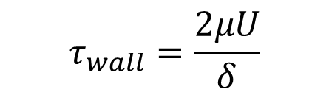
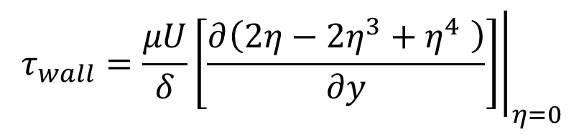
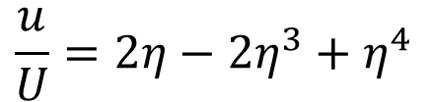
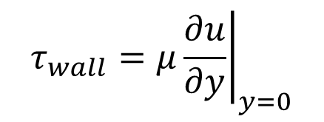
Von Karman-Pohlhausen equation for Wall Shear Stress
$$\frac{37}{315}U^{2}\frac{dδ}{dx}=\frac{τ_{wall}}{ρ}$$
$$τ_{wall}=μ{\left.\frac{∂u}{∂y}\right|}_{y=0}$$
$$\frac{u}{U}=2η−2η^{3}+η^{4}$$
$$τ_{wall}=\frac{μU}{δ}{\left.\left[\frac{∂\left(2η−2η^{3}+η^{4} \right)}{∂y}\right]\right|}_{η=0}$$
$$τ_{wall}=\frac{2μU}{δ}$$
$$\frac{37}{315}U^{2}\frac{dδ}{dx}=\frac{2μU}{ρδ}$$

Slide 13
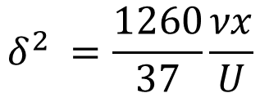

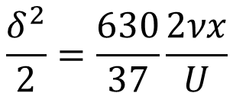
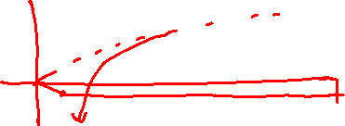

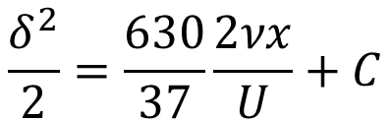
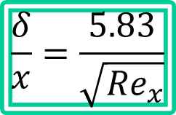
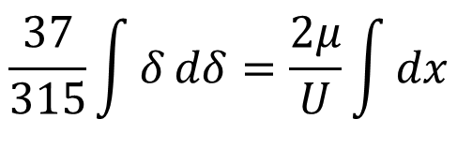

Von Karman-Pohlhausen Equation for a Flat Plate Boundary Layer Thickness
$$\frac{37}{315}U^{2}\frac{dδ}{dx}=\frac{2μU}{ρδ}$$
$$\frac{37}{315}\int{δ}dδ=\frac{2μ}{U}\int{dx}$$
$$\frac{δ^{2}}{2}=\frac{630}{37}\frac{2νx}{U}+C$$
$$at x=0, δ=0→C=0$$
$$\frac{δ^{2}}{2}=\frac{630}{37}\frac{2νx}{U}$$
$$δ^{2} =\frac{1260}{37}\frac{νx}{U}$$
$$δ=5.83\sqrt{\frac{νx}{U}}$$
$$\frac{δ}{x}=\frac{5.83}{\sqrt{{Re}_{x}}}$$

Slide 14

Integral Solutions to Momentum Equation of FPBL
The expressions for local boundary layer thickness and skin friction coefficient are obtained using Integral solution to momentum equation.
$$→\frac{δ}{x}=\frac{5.83}{\sqrt{{Re}_{x}}}$$
$τ_{wall}=\frac{2μU}{\frac{5.83}{\sqrt{{Re}_{x}}}}$ $C_{f,x}=\frac{τ_{w}}{\frac{ρU^{2}}{2}}$
$$C_{f,x}=\frac{0.684}{\sqrt{{Re}_{x}}}$$
The constant 0.684 is only marginally different from 0.664, obtained using the Blasius solution.

Slide 15

Blasius Profile Vs Pohlhausen Profile

Slide 16





Energy equation Using Pohlhausen Temperature Profile
$$\frac{d}{dx}\int_{0}^{Y}{u\left(T−T_{∞}\right)dy}=−α\left\{{\left.\frac{∂T}{∂y}\right|}_{0}\right\}$$
Define $p=\frac{y}{δ_{T}}$
$$∆=\frac{δ_{T}}{δ}$$
$$θ=\frac{T−T_{w}}{T_{∞}−T_{w}}$$
$$at y=0; T=T_{w}→θ=0$$
$$at y=δ_{T};T=T_{∞}→θ=1$$
$$θ=2p−2p^{3}+p^{4}$$

Slide 17






Energy equation Using Pohlhausen Temperature Profile
$$\frac{d}{dx}\int_{0}^{Y}{u\left(T−T_{∞}\right)dy}=−α\left\{{\left.\frac{∂T}{∂y}\right|}_{0}\right\}$$
$$θ=2p−2p^{3}+p^{4}$$
$$T−T_{∞}=\left(T_{∞}−T_{w}\right)\left(θ−1\right)$$
$$\int_{0}^{Y}{u\left(T−T_{∞}\right)dy}=U\left(T_{∞}−T_{w}\right)δ_{T}\int_{0}^{1}{\frac{u}{U}\left(θ−1\right)dp}$$
$$η=\frac{y}{δ}=\frac{y}{δ_{T}}\frac{δ_{T}}{δ}=p∆$$
$$η=2∆p−2∆^{3}p^{3}+∆^{4}p^{4}$$
$$\int_{0}^{Y}{u\left(T−T_{∞}\right)dy}=U\left(T_{∞}−T_{w}\right)δ_{T}\int_{0}^{1}{\frac{u}{U}\left(θ−1\right)dp}$$

Slide 18







Energy equation Using Pohlhausen Temperature Profile
$$\int_{0}^{Y}{u\left(T−T_{∞}\right)dy}=U\left(T_{∞}−T_{w}\right)δ_{T}\int_{0}^{1}{\frac{u}{U}\left(θ−1\right)dp}$$
$$\frac{u}{U}=2p∆−2p^{3}∆^{3}+p^{4}∆^{4}$$
$$θ=2p−2p^{3}+p^{4}$$
$$\int_{0}^{Y}{u\left(T−T_{∞}\right)dy}=U\left(T_{∞}−T_{w}\right)δ_{T}\int_{0}^{1}{\left\{2p∆−2p^{3}∆^{3}+p^{4}∆^{4}\right\}\left(2p−2p^{3}+p^{4}−1\right)dp}$$
$$\int_{0}^{Y}{u\left(T−T_{∞}\right)dy}=−U\left(T_{∞}−T_{w}\right)δ_{T}\left[\frac{2}{15}∆=\frac{3}{140}∆^{3}+\frac{1}{180}∆^{4}\right]$$

Slide 19



Energy equation Using Pohlhausen Temperature Profile
$$\frac{d}{dx}\left\{U\left(T_{∞}−T_{w}\right)δ_{T}\left[\frac{2}{15}∆−\frac{3}{140}∆^{3}+\frac{1}{180}∆^{4}\right]\right\}=α\left\{{\left.\frac{∂T}{∂y}\right|}_{0}\right\}$$
$$α\left\{{\left.\frac{∂T}{∂y}\right|}_{0}\right\}=α\frac{\left(T_{∞}−T_{w}\right)}{δ_{T}}{\left.\frac{∂θ}{∂p}\right|}_{p=0}=2α\frac{\left(T_{∞}−T_{w}\right)}{δ_{T}}$$
$$\frac{d}{dx}\left\{U\left(T_{∞}−T_{w}\right)δ_{T}\left[\frac{2}{15}∆−\frac{3}{140}∆^{3}+\frac{1}{180}∆^{4}\right]\right\}=2α\frac{\left(T_{∞}−T_{w}\right)}{δ_{T}}$$

Slide 20






Pohlhausen ODE for Thermal Boundary Layer Thickness
$$\frac{d}{dx}\left\{U\left(T_{∞}−T_{w}\right)δ_{T}\left[\frac{2}{15}∆−\frac{3}{140}∆^{3}+\frac{1}{180}∆^{4}\right]\right\}=2α\frac{\left(T_{∞}−T_{w}\right)}{δ_{T}}$$
$$for Pr>0.5$$
$$\frac{d}{dx}\left\{U\left(T_{∞}−T_{w}\right)δ_{T}\left[\frac{2}{15}∆\right]\right\}=2α\frac{\left(T_{∞}−T_{w}\right)}{δ_{T}}$$
$$U\left(T_{∞}−T_{w}\right)\frac{2}{15}\frac{d}{dx}\left\{δ_{T}∆\right\}=2α\frac{\left(T_{∞}−T_{w}\right)}{δ_{T}}$$

Slide 21






Pohlhausen ODE for Thermal Boundary Layer Thickness
$$\frac{1}{15}\frac{d}{dx}\left\{δ_{T}∆\right\}=\frac{α}{{Uδ}_{T}}$$
$$\frac{1}{15}\frac{d}{dx}\left\{δ\frac{δ_{T}}{δ}∆\right\}=\frac{1}{15}\frac{d}{dx}\left\{δ∆^{2}\right\}$$
$$\frac{1}{15}\frac{d}{dx}\left\{δ∆^{2}\right\}=\frac{1}{15}\left\{∆^{2}\frac{dδ}{dx}+2δ∆\frac{d∆}{dx}\right\}$$
$$\frac{1}{15}\left\{∆^{2}\frac{dδ}{dx}+2δ∆\frac{d∆}{dx}\right\}=\frac{α}{{Uδ}_{T}}$$
From momentum integral:
$$\frac{37}{315}U^{2}\frac{dδ}{dx}=\frac{2μU}{ρδ}$$
$$\frac{dδ}{dx}=\frac{630}{37}\frac{μ}{ρUδ}$$

Slide 22





Pohlhausen’s ODE for Thermal Boundary Layer Thickness
$$\left\{\frac{42}{37}∆^{2}\frac{μ}{ρUδ}+\frac{2}{15}δ∆\frac{d∆}{dx}\right\}=\frac{α}{{Uδ}_{T}}$$
$$\frac{δ}{x}=\frac{5.83}{\sqrt{{Re}_{x}}}$$
$$∆=\frac{δ_{T}}{δ}$$
$$Δ=\frac{δ_{T}}{δ}\text{=} \text{0.976}×{\left(\frac{ν}{α}\right)}^{{−1}/3}$$
$$Δ=\frac{δ_{T}}{δ}\text{=} \text{0.976}×{\left(Pr\right)}^{{−1}/3}$$

Slide 23

Integral Solution to Isothermal Flat Plate
$$Δ=\frac{δ_{T}}{δ}\text{=} \text{0.976}×{Pr}^{{−1}/3}$$
$$h=−\frac{k_{fluid}{\left.\left\{\frac{∂T}{∂y}\right\}\right|}_{wall}}{\left\{T_{wall}−T_{∞}\right\}}$$
For Isothermal Flat Plate
$$h=0.331\frac{k}{x}{Pr}^{1/3}{Re}_{x}^{1/2}$$
$$Nu=\frac{hx}{k}=0.331{Pr}^{1/3}{Re}_{x}^{1/2}$$

Slide 24


Integral Solution to Isothermal Flat Plate
$$Nu=\frac{hx}{k}=0.331{Pr}^{1/3}{Re}_{x}^{1/2}$$

Slide 25

Uniform Heat Flux
The object of heattransfer analysis is the prediction of the wall temperature variation T_{w}(x).
The design objective is to control this temperature and to keep it under an allowable limit.
$$q^{′′}$$

Slide 26

Flat Plate with Uniform Heat Flux
The heat transfer problem continues to be the calculation of heat transfer coefficient
$$h=\frac{q^{′′}}{T_{w}−T_{∞}}$$
when the heat flux q′′ is known.
$$q^{′′}$$

Slide 27
Integral Solution to Isoheatflux Flat Plate
$Δ=\frac{δ_{T}}{δ}\text{=}\text{ 1.229}\text{6}×{Pr}^{{−1}/3}$
$h=−\frac{k_{fluid}{\left.\left\{\frac{∂T}{∂y}\right\}\right|}_{wall}}{\left\{T_{wall}−T_{∞}\right\}}$
For Iso-heat flux Flat Plate
$h=\frac{q^{′′}}{T_{w}\left(x\right)−T_{∞}}=0.417\frac{k}{x}{Pr}^{1/3}{Re}_{x}^{1/2}$
$T_{w}\left(x\right)−T_{∞}=\frac{q^{′′}x}{0.417k{Pr}^{1/3}{Re}_{x}^{1/2}}$
$Nu=\frac{hx}{k}=0.417{Pr}^{1/3}{Re}_{x}^{1/2}$

Slide 28

Impact of the assumed profile shape on the integral solution

Slide 29

Advanced Applications of FCBL
Forced convection cooling of an electric and electronic circuit boards are the modern application of FCFPBL Theory.
The heating effect in these applications is distributed discretely along the flat plate.
The simplest model is sketched as:

Slide 30
Arbitrary Wall Temperature
$$∆T_{wall}= T_{wall}−T_{∞}=f\left(x\right)$$
The integral solution for heat transfer with an unheated starting length is the building block for the construction of heat transfer solutions for this case.

Slide 31

Simplification of Arbitrary Wall Temperature
$$∆T_{wall,1}$$
$$∆T_{wall,3}$$
$$∆T_{wall,2}$$
$$∆T_{wall}= T_{wall}−T_{∞}=f\left(x\right)$$
$$∆T_{wall,1}$$
$$∆T_{wall,2}$$
$$∆T_{wall,3}$$

Slide 32


Flat Plate Convection with Unheated Starting Length
The simplest model is sketched as:
What is the heat transfer rate from the wall to the fluid stream if the leading segment 0 < x < x₀ is unheated (T = T∞)?
Pohlhausen’s “The Integral Solution Method” is usedful here!

Slide 33

Flat Plate Convection with Unheated Starting Length
The simplest model is sketched as:
Unheated Starting Length:
Assuming the temperature profile shape:
$$F\left(p\right)=\frac{p}{2}×\left(3−p^{2}\right)$$
Similarly, velocity profile shape:
$$F\left(η\right)=\frac{η}{2}×\left(3−η^{2}\right)$$

Slide 34

Energy Equation for Unheated Starting Length
Define $Δ=\frac{δ_{T}}{δ}$
The energy equation in terms of Δ:
$Δ^{3}$+4 $Δ^{2}x\frac{dΔ}{dx}=\frac{0.929}{Pr}$
The general solution of above equation is :
$$Δ^{3}=\frac{0.929}{Pr}+Cx^{{−3}/4}$$
Constant C follows from the condition that heating (that is, a thermal boundary layer,) starts at x = x₀.

Slide 35
Flat Plate Convection with Unheated Starting Length
The simplest model is sketched as:
Due to the effect of the unheated length x0 on the local Nusselt number drops below 20% if x is beyond 3x0 from the leading edge of the flat plate.
$$Δ^{3}=\frac{0.929}{Pr}×{\left\{1−{\left(\frac{x_{0}}{x}\right)}^{3/4}\right\}}^{{−1}/3}$$
The final solution is given as:
The local Nusselt number is
$$Nu=\frac{hx}{k}=0.332{Pr}^{1/3}×\sqrt{{Re}_{x}}{\left\{1−{\left(\frac{x_{0}}{x}\right)}^{3/4}\right\}}^{{−1}/3}$$

Slide 36




Arbitrary Wall Temperature
$$x_{i}$$
$$x_{i+1}$$
0 < x < x_{i+1}, the unheated started length, where q’’= 0 because the wall is in thermal equilibrium with the free stream
0 < x < x_{i}, the unheated started length, where q’’= 0 because the wall is in thermal equilibrium with the free stream
$$x_{i}$$
$$x_{i+1}$$

Slide 37
Arbitrary Wall Temperature
$$\frac{d}{dx}\int_{0}^{Y}{u\left(T−T_{∞}\right)dy−}\frac{dT_{∞}}{dx}\int_{0}^{Y}{udy}=−α\left\{{\left.\frac{∂T}{∂y}\right|}_{0}\right\}$$
0 < x < x_{i}, the unheated started length, where q’’= 0 because the wall is in thermal equilibrium with the free stream
$${Nu}_{i}=\frac{hx}{k}=0.332{Pr}^{1/3}×\sqrt{{Re}_{c}}{\left\{1−{\left(\frac{x_{i}}{x}\right)}^{3/4}\right\}}^{{−1}/3}$$
$$x_{i}$$
$$h_{i}=\frac{k×0.332{Pr}^{1/3}×\sqrt{{Re}_{c}}}{c}{\left\{1−{\left(\frac{x_{i}}{x}\right)}^{3/4}\right\}}^{{−1}/3}$$

Slide 38
Wall Heatflux in FP with Arbitrary Wall Temperature
$$x_{i}$$
$${Nu}_{i}=\frac{hx}{k}=0.332{Pr}^{1/3}×\sqrt{{Re}_{c}}{\left\{1−{\left(\frac{x_{i}}{x}\right)}^{3/4}\right\}}^{{−1}/3}$$
$$q_{i}^{′′}=0.332{Pr}^{1/3}×\sqrt{{Re}_{c}}\frac{∆T_{i} }{{\left\{1−{\left(\frac{x_{i}}{x}\right)}^{3/4}\right\}}^{1/3}}$$
$$q_{i}^{′′}=h×∆T_{i}$$

Slide 39
Arbitrary Wall Temperature
0 < x < x_{i+1}, the unheated started length, where q’’= 0 because the wall is in thermal equilibrium with the free stream
$$x_{i+1}$$
$${Nu}_{i+1}=\frac{hx}{k}=0.332{Pr}^{1/3}×\sqrt{{Re}_{c}}{\left\{1−{\left(\frac{x_{i+1}}{x}\right)}^{{−3}/4}\right\}}^{{−1}/3}$$
$$q_{i+1}^{′′}=h×∆T_{i+1}$$
$$q_{i+1}^{′′}=0.332{Pr}^{1/3}×\sqrt{{Re}_{c}}\frac{∆T_{i+1} }{{\left\{1−{\left(\frac{x_{i+1}}{x}\right)}^{3/4}\right\}}^{1/3}}$$

Slide 40
Arbitrary Wall Temperature
$$x_{i}$$
$$x_{i+1}$$
$$q_{i→i+1}^{′′}=0.332{Pr}^{1/3}×\sqrt{{Re}_{c}}\left[\frac{∆T_{i}}{{\left\{1−{\left(\frac{x_{i}}{x}\right)}^{3/4}\right\}}^{1/3}}−\frac{∆T_{i+1}}{{\left\{1−{\left(\frac{x_{i+1}}{x}\right)}^{3/4}\right\}}^{1/3}}\right]$$

Slide 41
Arbitrary Wall Temperature
$$∆T_{wall}= T_{wall}−T_{∞}=f\left(x\right)$$
$$q_{AWT}^{′′}=0.332{Pr}^{1/3}×\sqrt{{Re}_{c}}\sum_{i=1}^{N}{\left[\frac{∆T_{i}}{{\left\{1−{\left(\frac{x_{i}}{x}\right)}^{3/4}\right\}}^{1/3}}\right]}$$
where x_{i} is the longitudinal position of each temperature step change ΔT_{i}..

Slide 42
Arbitrary Wall Temperature
$$∆T_{wall}= T_{wall}−T_{∞}=f\left(x\right)$$
If the arbitrary wall temperature varies smoothly, T0(x), the summation is replaced by its integral limit (the limit of infinitesimally small steps):
$$q_{AWT}^{′′}=0.332{Pr}^{1/3}×\sqrt{{Re}_{c}}\int_{0}^{x}{\left[\frac{∆T_{i}}{{\left\{1−{\left(\frac{ζ_{i}}{ζ}\right)}^{3/4}\right\}}^{1/3}}\right]dζ}$$

