Slide 1


Laminar Convection Heat Transfer in A Flat Plate Boundary Layer : Post Blasius Research
P M V Subbarao
Professor & Head
Mechanical Engineering Department
Application of More Mathematical Tricks????

Slide 2
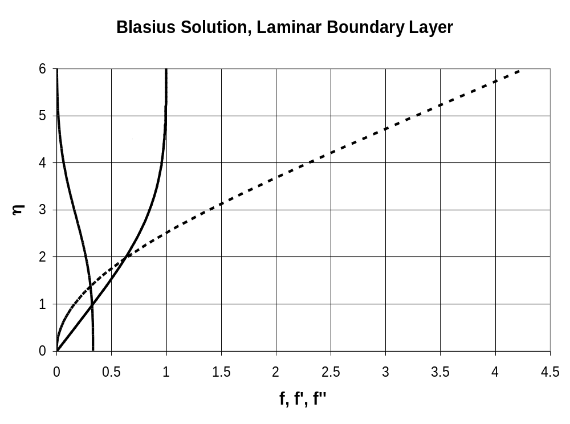

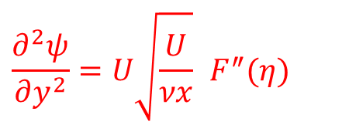
$$F^{′}$$
$$F^{″}$$
$$F$$
$$\frac{∂^{2}ψ}{∂y^{2}}=U\sqrt{\frac{U}{νx}} F^{″}(η)$$
$$F, F^{′}, F^{″}$$

Slide 3
Master Profile of Thermal Boundary Layer
$$θ\left(η\right)=1− \frac{\int_{0}^{η}{\begin{aligned}\begin{aligned} \\ \left\{e^{\left\{−\frac{Pr}{2}\int_{0}^{η}{Fdη}\right\}}\right\}dη\end{aligned} \\ \end{aligned}}}{\int_{0}^{∞}{\begin{aligned}\begin{aligned} \\ \left\{e^{\left\{−\frac{Pr}{2}\int_{0}^{η}{Fdη}\right\}}\right\}dη\end{aligned} \\ \end{aligned}}}$$
The solution is now complete.
Master Temperature profiles for different Prandtl Number can be generated using above equation.

Slide 4
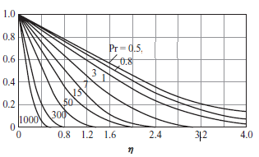
Master Temperature Profile for FP Boundary Layer
$$G\left(η\right)$$

Slide 5
Estimation of Local Heat Transfer Coefficient Using Master Profiles
$$θ\left(η\right)=1− \frac{\int_{0}^{η}{\begin{aligned}\begin{aligned} \\ \left\{e^{\left\{−\frac{Pr}{2}\int_{0}^{η}{Fdη}\right\}}\right\}dη\end{aligned} \\ \end{aligned}}}{\int_{0}^{∞}{\begin{aligned}\begin{aligned} \\ \left\{e^{\left\{−\frac{Pr}{2}\int_{0}^{η}{Fdη}\right\}}\right\}dη\end{aligned} \\ \end{aligned}}}$$
The value of $θ^{′}$(0) is the most important information for calculating convection heat transfer coefficient.
Recall the local application of Newton’s law of wall cooling.
$$q^{′′}=h\left(T_{s}−T_{∞}\right)=−k{\left.\frac{∂T}{∂y}\right|}_{y=0}$$
$$h=\frac{−k}{\left(T_{s}−T_{∞}\right)}{\left.\frac{∂T}{∂y}\right|}_{y=0}$$

Slide 6
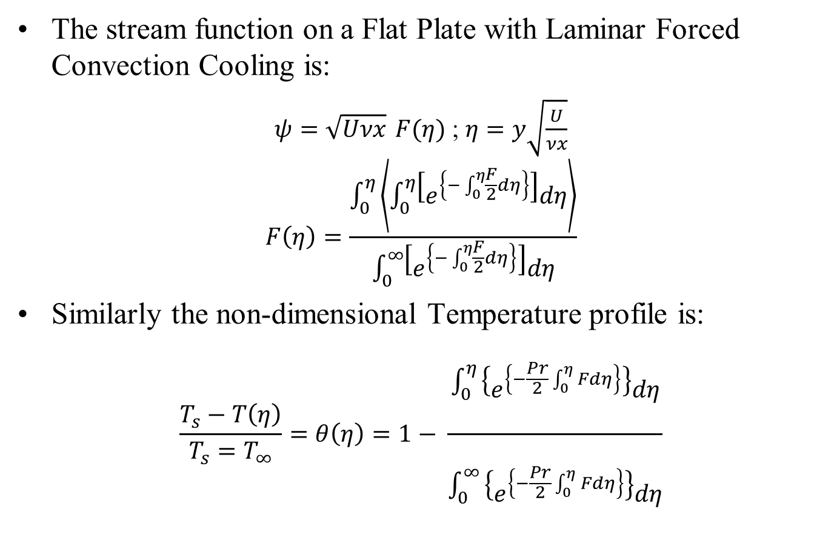
Stream Function and Temperature Profiles
The stream function on a Flat Plate with Laminar Forced Convection Cooling is:
$ψ=\sqrt{Uνx} F(η)$ ; $η=y\sqrt{\frac{U}{νx}}$
$$F\left(η\right)=\frac{\int_{0}^{η}{\left\langle \int_{0}^{η}{\left[e^{\left\{−\int_{0}^{η}{\frac{F}{2}dη}\right\}}\right]dη}\right\rangle }}{\int_{0}^{∞}{\left[e^{\left\{−\int_{0}^{η}{\frac{F}{2}dη}\right\}}\right]dη}}$$
Similarly the non-dimensional Temperature profile is:
$$\frac{T_{s}−T\left(η\right)}{T_{s}=T_{∞}}=θ\left(η\right)=1− \frac{\int_{0}^{η}{\begin{aligned}\begin{aligned} \\ \left\{e^{\left\{−\frac{Pr}{2}\int_{0}^{η}{Fdη}\right\}}\right\}dη\end{aligned} \\ \end{aligned}}}{\int_{0}^{∞}{\begin{aligned}\begin{aligned} \\ \left\{e^{\left\{−\frac{Pr}{2}\int_{0}^{η}{Fdη}\right\}}\right\}dη\end{aligned} \\ \end{aligned}}}$$

Slide 7
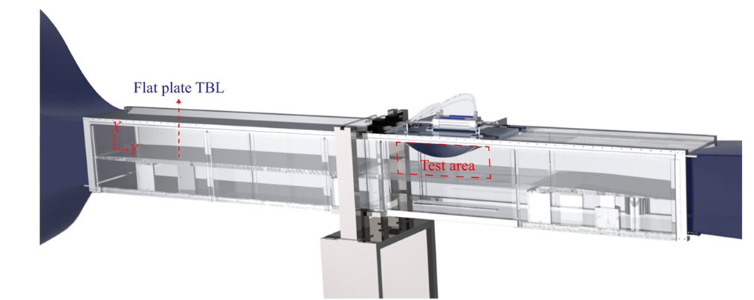
Prandtl’s Wind Tunnel for FPBL

Slide 8


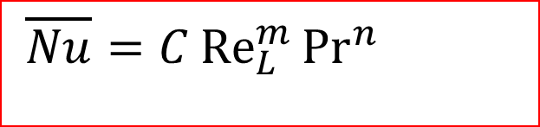
Experimental Validation of Blasius Solution
$$T_{∞}, U_{∞}$$
$$T_{\text{wing} \text{surface}}$$
What are the parameters involved?
  Velocity, –Plate length,
  Prandtl number, –viscosity,
  Nusselt number,
Which of these can we control easily?
Looking for the relation using Principle of Similitude:
$$\overline{Nu}=C{Re}_{L}^{m}{{Pr}^{n}}$$

Slide 9
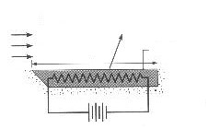

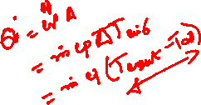
Experimental Studies to Develop Empirical Correlation
$$T_{∞}, U_{∞}$$
L
Insulation
At steady state electrical power input to the heater is equal to rate of total cooling (Convection Heat Transfer) by surrounding fluid.
Measure current (hence heat transfer) with various fluids and test conditions.
Fluid properties are typically evaluated at the mean film temperature

Slide 10
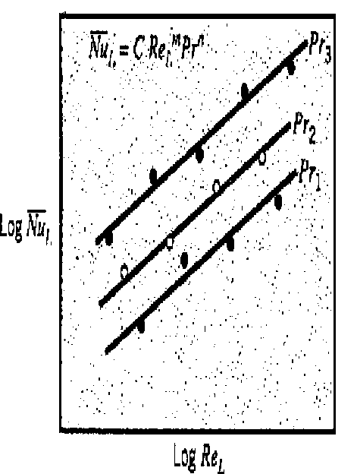
Post Processing of Experimental Observations

Slide 11
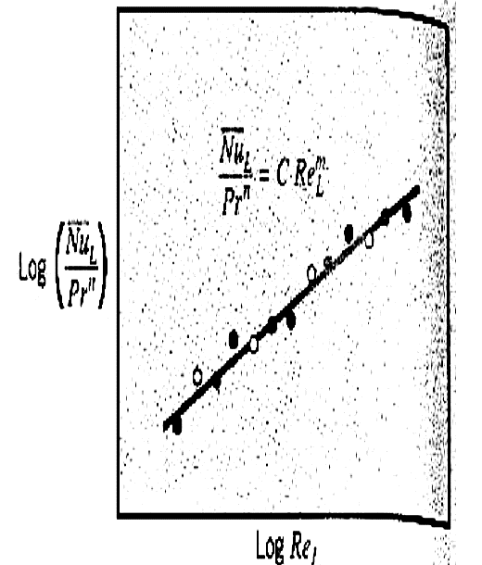
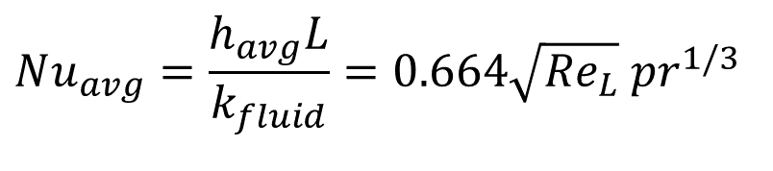
Similarity Variables
$$Nu_{avg}=\frac{h_{avg}L}{k_{fluid}}=0.664\sqrt{{Re}_{L}} pr^{1/3}$$
Found to be very accurate for all fluids with Pr > 0.5.

Slide 12
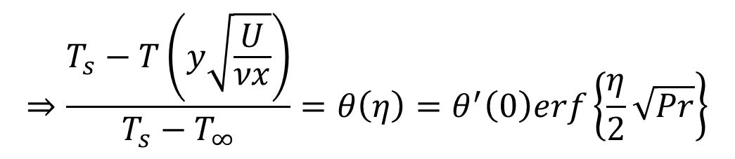
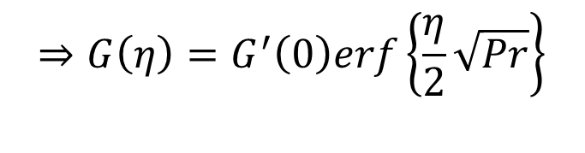
Local Nusselt Number Low Prandtl Number Thermal Boundary Layer
$$⇒G\left(η\right)=G^{′}\left(0\right)erf\left\{\frac{η}{2}\sqrt{Pr}\right\}$$
The similarity solution for the local temperature of the fluid is therefore
$$⇒\frac{T_{s}−T\left(y\sqrt{\frac{U}{νx}}\right)}{T_{s}−T_{∞}}=θ\left(η\right)=θ^{′}\left(0\right)erf\left\{\frac{η}{2}\sqrt{Pr}\right\}$$
$$Nu\left(x\right)=\frac{h\left(x\right)x}{k}=0.564×\sqrt{{Re}_{x}×Pr} for Pr→0.$$
This limiting heat transfer result holds for Pr < 0.5

Slide 13
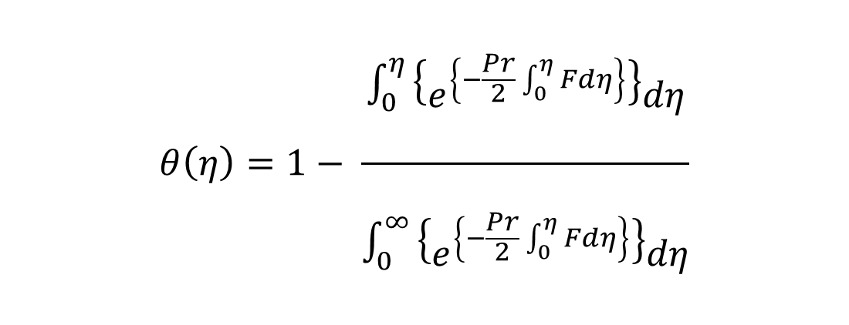
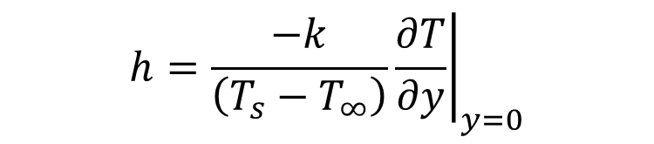
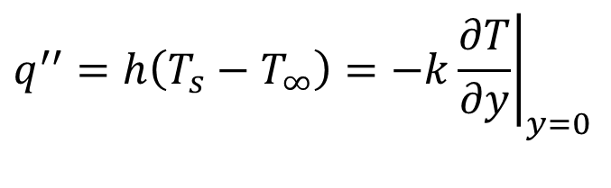
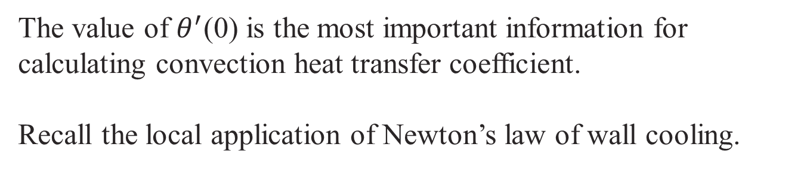
Estimation of Local Heat Transfer Coefficient Using Master Profiles : Pr >0.5
$$θ\left(η\right)=1− \frac{\int_{0}^{η}{\begin{aligned}\begin{aligned} \\ \left\{e^{\left\{−\frac{Pr}{2}\int_{0}^{η}{Fdη}\right\}}\right\}dη\end{aligned} \\ \end{aligned}}}{\int_{0}^{∞}{\begin{aligned}\begin{aligned} \\ \left\{e^{\left\{−\frac{Pr}{2}\int_{0}^{η}{Fdη}\right\}}\right\}dη\end{aligned} \\ \end{aligned}}}$$
The value of $θ^{′}$(0) is the most important information for calculating convection heat transfer coefficient.
Recall the local application of Newton’s law of wall cooling.
$$q^{′′}=h\left(T_{s}−T_{∞}\right)=−k{\left.\frac{∂T}{∂y}\right|}_{y=0}$$
$$h=\frac{−k}{\left(T_{s}−T_{∞}\right)}{\left.\frac{∂T}{∂y}\right|}_{y=0}$$

Slide 14
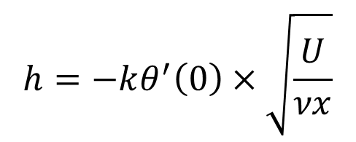
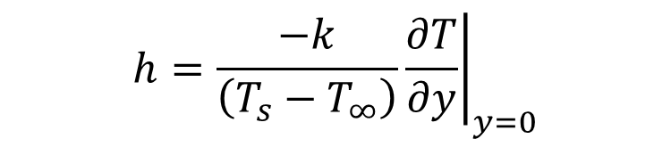

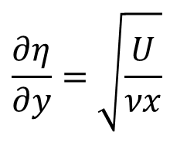
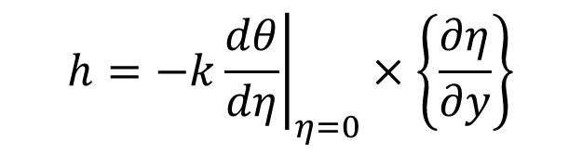
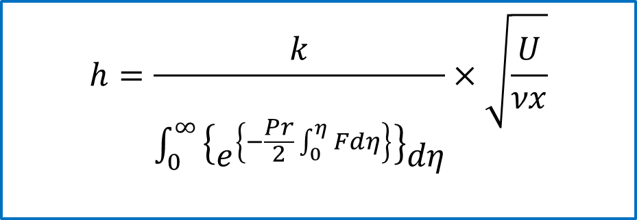

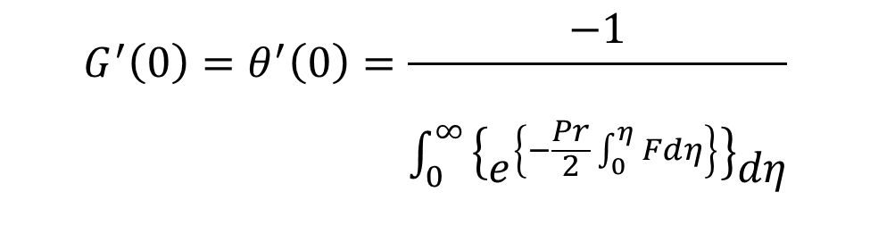
Local Heat Transfer Coefficient
$$h=\frac{−k}{\left(T_{s}−T_{∞}\right)}{\left.\frac{∂T}{∂y}\right|}_{y=0}$$
$$h=−k{\left.\frac{∂θ}{∂y}\right|}_{y=0}$$
$$h=−k{\left.\frac{dθ}{dη}\right|}_{η=0}×\left\{\frac{∂η}{∂y}\right\}$$
$$\frac{∂η}{∂y}=\sqrt{\frac{U}{νx}}$$
$$h=−kθ^{′}\left(0\right)×\left\{\frac{∂η}{∂y}\right\}$$
$$G^{′}\left(0\right)=θ^{′}\left(0\right)=\frac{−1}{\int_{0}^{∞}{\begin{aligned}\begin{aligned} \\ \left\{e^{\left\{−\frac{Pr}{2}\int_{0}^{η}{Fdη}\right\}}\right\}dη\end{aligned} \\ \end{aligned}}}$$
$$h=−kθ^{′}\left(0\right)×\sqrt{\frac{U}{νx}}$$
$$h=\frac{k}{\int_{0}^{∞}{\begin{aligned}\begin{aligned} \\ \left\{e^{\left\{−\frac{Pr}{2}\int_{0}^{η}{Fdη}\right\}}\right\}dη\end{aligned} \\ \end{aligned}}}×\sqrt{\frac{U}{νx}}$$

Slide 15
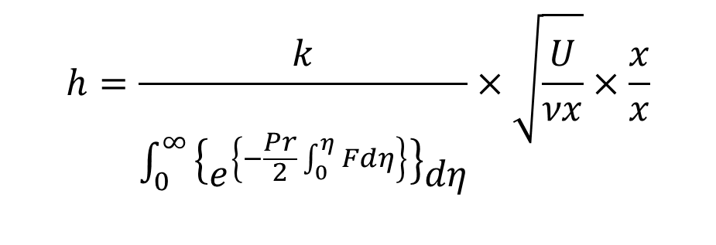
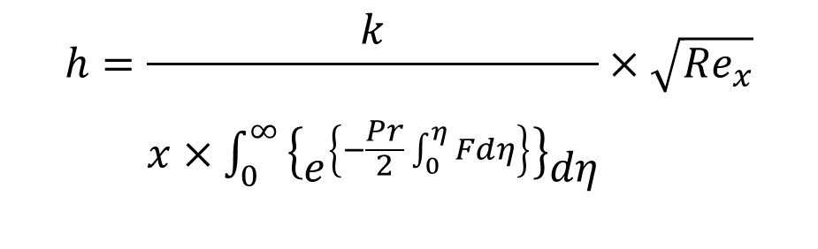
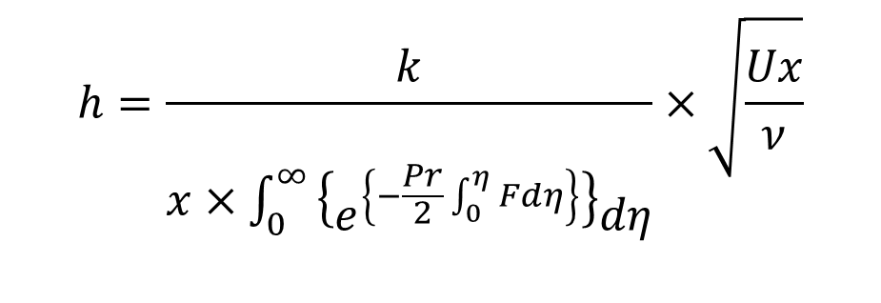
Local Heat Transfer Coefficient
$$h=\frac{k}{\int_{0}^{∞}{\begin{aligned}\begin{aligned} \\ \left\{e^{\left\{−\frac{Pr}{2}\int_{0}^{η}{Fdη}\right\}}\right\}dη\end{aligned} \\ \end{aligned}}}×\sqrt{\frac{U}{νx}}×\frac{x}{x}$$
$$h=\frac{k}{x×\int_{0}^{∞}{\begin{aligned}\begin{aligned} \\ \left\{e^{\left\{−\frac{Pr}{2}\int_{0}^{η}{Fdη}\right\}}\right\}dη\end{aligned} \\ \end{aligned}}}×\sqrt{\frac{Ux}{ν}}$$
$$h=\frac{k}{x×\int_{0}^{∞}{\begin{aligned}\begin{aligned} \\ \left\{e^{\left\{−\frac{Pr}{2}\int_{0}^{η}{Fdη}\right\}}\right\}dη\end{aligned} \\ \end{aligned}}}×\sqrt{{Re}_{x}}$$

Slide 16
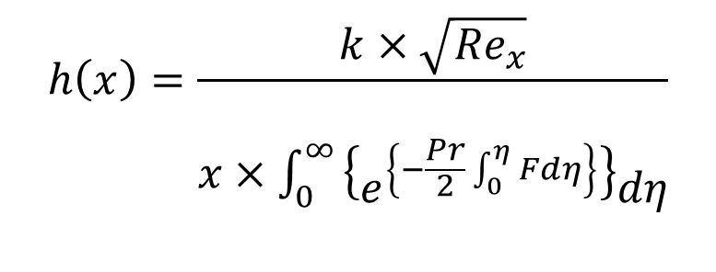
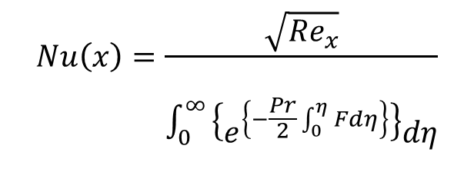
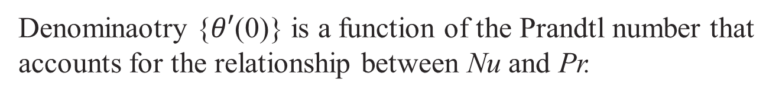
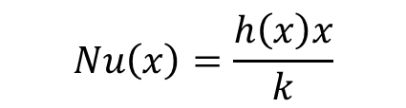
Local Nusselt Number
$$h\left(x\right)=\frac{k×\sqrt{{Re}_{x}}}{x×\int_{0}^{∞}{\begin{aligned}\begin{aligned} \\ \left\{e^{\left\{−\frac{Pr}{2}\int_{0}^{η}{Fdη}\right\}}\right\}dη\end{aligned} \\ \end{aligned}}}$$
$$Nu\left(x\right)=\frac{h\left(x\right)x}{k}$$
$$Nu\left(x\right)=\frac{\sqrt{{Re}_{x}}}{\int_{0}^{∞}{\begin{aligned}\begin{aligned} \\ \left\{e^{\left\{−\frac{Pr}{2}\int_{0}^{η}{Fdη}\right\}}\right\}dη\end{aligned} \\ \end{aligned}}}$$
Denominaotry {$θ′$(0)} is a function of the Prandtl number that accounts for the relationship between Nu and Pr.

Slide 17

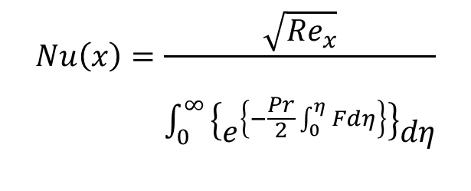
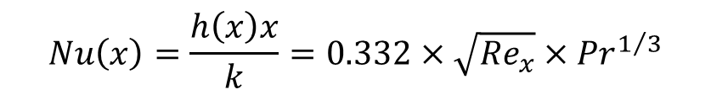
Local Nusselt Number
$$Nu\left(x\right)=\frac{\sqrt{{Re}_{x}}}{\int_{0}^{∞}{\begin{aligned}\begin{aligned} \\ \left\{e^{\left\{−\frac{Pr}{2}\int_{0}^{η}{Fdη}\right\}}\right\}dη\end{aligned} \\ \end{aligned}}}$$
Pohlhausen in 1921 calculated several θ(0) values that for Pr > 0.5 are correlated accurately by
$$θ^{′}\left(0\right)=0.332×{Pr}^{1/3}$$
The similarity solution for the local heat transfer coefficient (local Nusselt number) is therefore
$$Nu\left(x\right)=\frac{h\left(x\right)x}{k}=0.332×\sqrt{{Re}_{x}}×{Pr}^{1/3}$$

Slide 18
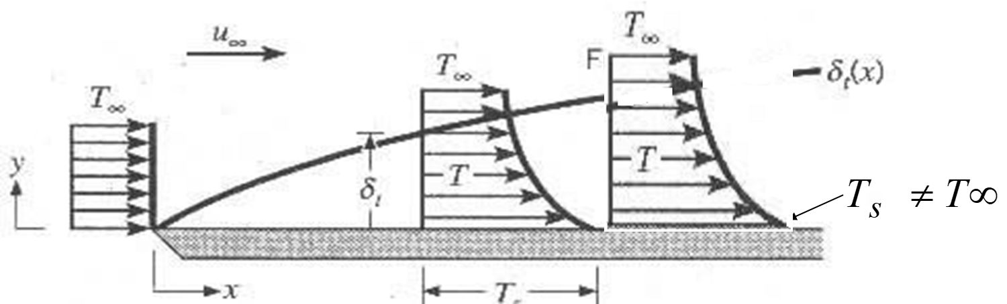
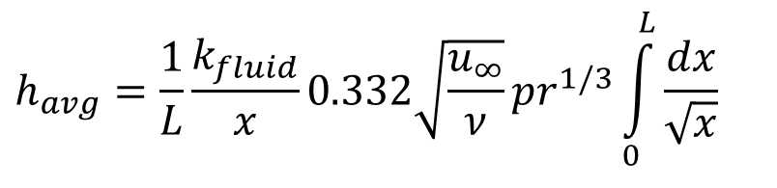
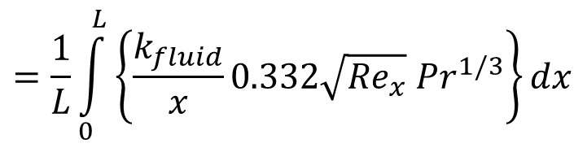
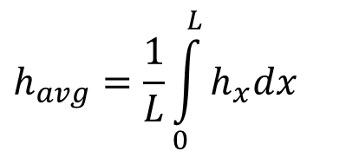
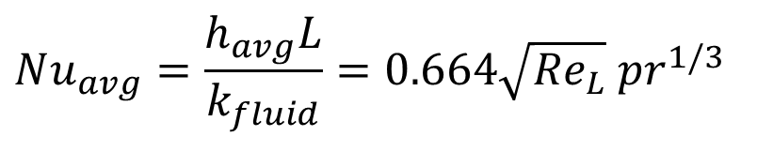
Average Heat Transfer Coefficient for Total Thermal Boundary Layer
Consider a flat plate of unit width and define the average of h as:
$$h_{avg}=\frac{1}{L}\int_{0}^{L}{h_{x}dx}$$
$$=\frac{1}{L}\int_{0}^{L}{\left\{\frac{k_{fluid}}{x}0.332\sqrt{{Re}_{x}} Pr^{1/3}\right\}dx}$$
$$h_{avg}=\frac{1}{L}\frac{k_{fluid}}{x}0.332\sqrt{\frac{u_{∞}}{ν}}pr^{1/3}\int_{0}^{L}{\frac{dx}{\sqrt{x}}}$$
$$Nu_{avg}=\frac{h_{avg}L}{k_{fluid}}=0.664\sqrt{{Re}_{L}} pr^{1/3}$$

Slide 19
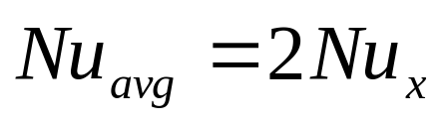
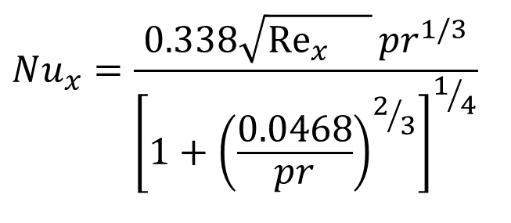
Unified Forced Convection Correlations for All Fluids
A single correlation, which applies for all Prandtl numbers,
Has been developed by Churchill and Ozoe..
$$Nu_{x}=\frac{0.338\sqrt{{Re}_{x}{}}pr^{1/3}}{{\left[1+{\left(\frac{0.0468}{pr}\right)}^{2/3}\right]}^{1/4}}$$

Slide 20
Karl Pohlhausen
Karl Pohlhausen was born on 17 May 1892 in Mittweida.
In 1911, he went to the University of lena, where he intended to study optics with the lesser Wien, who proved to be far less than Dr. P. could stomach.
In 1913 he moved to Gottingen to study under Carl Runge.
Dr. P. was attracted to Ludwig Prandtl, who quickly became and remained his hero and idol.
Pohlhausen always thought that lifting-line theory, not boundary-layer theory, was Prandtl's masterpiece.

Slide 21
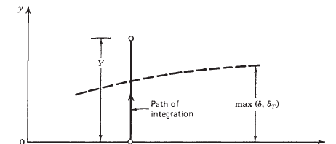

Pohlhausen’s The Integral Solution Method
Pohlhausen, 1921 developed a special method to solve these problems known as “The Integral Solution Method”
Pohlhausen simplified the boundary layer equations by eliminating y as a variable.
This is accomplished by integrating each equation term by term from y = 0 to y = Y, where Y > max(δ,δT) is situated in the free stream.

Slide 22
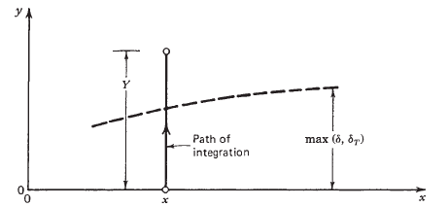
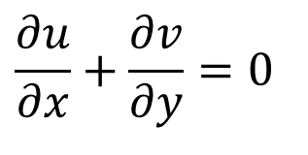

Pohlhausen Energy Equation for FP Thermal BL
Consider simplified energy equation of a Laminar FPBL:
$$\left\{u\frac{∂T}{∂x}+v\frac{∂T}{∂y}\right\}=α\left(\frac{∂^{2}T}{∂y^{2}}\right)$$
& Continuity equation:
$$\frac{∂u}{∂x}+\frac{∂v}{∂y}=0$$

Slide 23



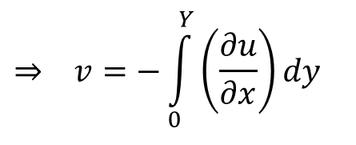
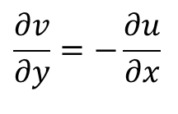
Pohlhausen Integral Approach to FP Thermal BL
Pohlhausen Integrated FPBL equations from y=0 to y=Y at all x.
$$\int_{0}^{Y}{\left\{u\frac{∂T}{∂x}+v\frac{∂T}{∂y}\right\}dy}=α\int_{0}^{Y}{\left(\frac{∂^{2}T}{∂y^{2}}\right)dy}$$
$$\int_{0}^{Y}{\left\{u\frac{∂T}{∂x}+v\frac{∂T}{∂y}\right\}dy}=α\left\{{\left.\frac{∂T}{∂y}\right|}_{Y}−{\left.\frac{∂T}{∂y}\right|}_{0}\right\}$$
$$\int_{0}^{Y}{\left\{u\frac{∂T}{∂x}+v\frac{∂T}{∂y}\right\}dy}=−α\left\{{\left.\frac{∂T}{∂y}\right|}_{0}\right\}$$
Using continuity equation :
$$\frac{∂v}{∂y}=−\frac{∂u}{∂x}$$
$$⇒ v=−\int_{0}^{Y}{\left(\frac{∂u}{∂x}\right)}dy$$

Slide 24
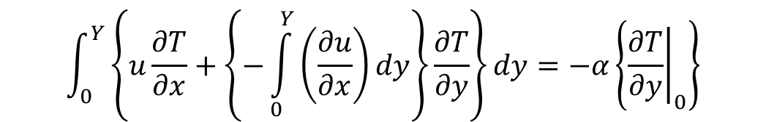
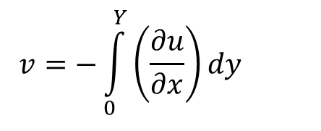
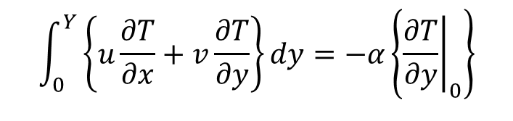
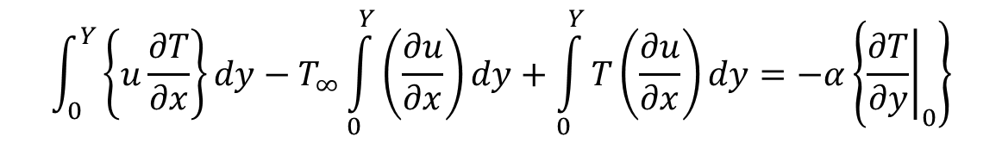
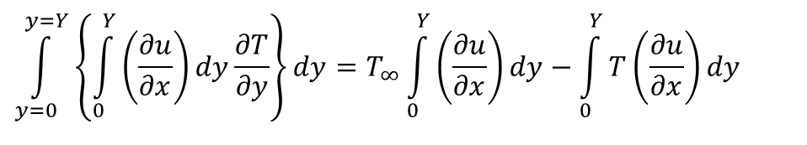
Pohlhausen Integral Approach to FPBL
$$\int_{0}^{Y}{\left\{u\frac{∂T}{∂x}+v\frac{∂T}{∂y}\right\}dy}=−α\left\{{\left.\frac{∂T}{∂y}\right|}_{0}\right\}$$
$$v=−\int_{0}^{Y}{\left(\frac{∂u}{∂x}\right)}dy$$
$$\int_{0}^{Y}{\left\{u\frac{∂T}{∂x}+\left\{−\int_{0}^{Y}{\left(\frac{∂u}{∂x}\right)}dy\right\}\frac{∂T}{∂y}\right\}dy}=−α\left\{{\left.\frac{∂T}{∂y}\right|}_{0}\right\}$$
The partial integration of the second term of the left side of above equation gives:
$$\int_{y=0}^{y=Y}{\left\{\int_{0}^{Y}{\left(\frac{∂u}{∂x}\right)}dy\frac{∂T}{∂y}\right\}dy}=T_{∞}\int_{0}^{Y}{\left(\frac{∂u}{∂x}\right)}dy−\int_{0}^{Y}{T\left(\frac{∂u}{∂x}\right)}dy$$
$$\int_{0}^{Y}{\left\{u\frac{∂T}{∂x}\right\}dy}−T_{∞}\int_{0}^{Y}{\left(\frac{∂u}{∂x}\right)}dy+\int_{0}^{Y}{T\left(\frac{∂u}{∂x}\right)}dy=−α\left\{{\left.\frac{∂T}{∂y}\right|}_{0}\right\}$$

Slide 25

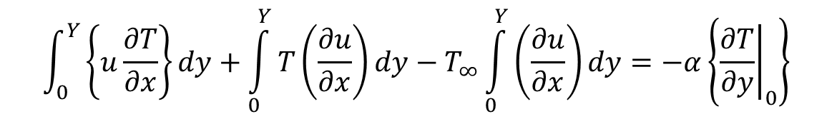


Pohlhausen Integral Approach to FPBL
$$\int_{0}^{Y}{\left\{u\frac{∂T}{∂x}\right\}dy}−T_{∞}\int_{0}^{Y}{\left(\frac{∂u}{∂x}\right)}dy+\int_{0}^{Y}{T\left(\frac{∂u}{∂x}\right)}dy=−α\left\{{\left.\frac{∂T}{∂y}\right|}_{0}\right\}$$
$$\int_{0}^{Y}{\left\{u\frac{∂T}{∂x}\right\}dy}+\int_{0}^{Y}{T\left(\frac{∂u}{∂x}\right)}dy−T_{∞}\int_{0}^{Y}{\left(\frac{∂u}{∂x}\right)}dy=−α\left\{{\left.\frac{∂T}{∂y}\right|}_{0}\right\}$$
$$\int_{0}^{Y}{\left\{\frac{∂\left(uT\right)}{∂x}\right\}dy}−\int_{0}^{Y}{\left\{\frac{∂\left(uT_{∞}\right)}{∂x}\right\}}dy=−α\left\{{\left.\frac{∂T}{∂y}\right|}_{0}\right\}$$
Using Leibnitz’s integral formula yields
$$\frac{d}{dx}\int_{0}^{Y}{u\left(T−T_{∞}\right)dy−}\frac{dT_{∞}}{dx}\int_{0}^{Y}{udy−}=−α\left\{{\left.\frac{∂T}{∂y}\right|}_{0}\right\}$$

Slide 26





Pohlhausen Integral Equations for FPBL
$$h\left(T_{s}−T_{∞}\right)=−k{\left.\frac{∂T}{∂y}\right|}_{y=0}$$
$$\frac{d}{dx}\int_{0}^{Y}{u\left(T_{∞}−T\right)dy}=α\left\{{\left.\frac{∂T}{∂y}\right|}_{0}\right\}$$
$$\frac{k}{ρc_{p}}\left\{{\left.\frac{∂T}{∂y}\right|}_{0}\right\}=\frac{d}{dx}\int_{0}^{Y}{u\left(T_{∞}−T\right)dy}$$
$$\frac{h\left(T_{s}−T_{∞}\right)}{ρc_{p}}=\frac{d}{dx}\int_{0}^{Y}{u\left(T_{∞}−T\right)dy}$$
Similarly, x-momentum equation can be integrated as:
$$\frac{τ_{wall}}{ρ}=\frac{d}{dx}\left\{\int_{0}^{h}{u\left(U−u\right)}dy\right\}$$

Slide 27





Total Momentum deficit across boundary layer
$$\frac{d}{dx}\left\{\int_{0}^{h}{u\left(U−u\right)}dy\right\}=\frac{τ_{wall}}{ρ}$$
$$F_{D}=\int_{0}^{L}{τ_{wall}dx}$$
$$F_{D}=ρ\int_{0}^{L}{\frac{dθ}{dx}dx}$$
$$\frac{dθ}{dx}=\frac{τ_{wall}}{ρ}$$
$$F_{D}=ρ\int_{θ at x=0}^{θ at x=L}{dθ}$$

Slide 28






The Displacement Thickness
Conservation of mass is applied to this Engineering CV @SSSF:
Assuming incompressible flow, this relation simplifies to
$$\iint_{CS}{ρ\vec{v}.d\vec{A}}=0$$
$$\int_{0}^{Y}{ρudy}−\int_{0}^{H}{ρUdy}=0$$
$$\int_{0}^{Y}{udy}−\int_{0}^{H}{Udy}=0$$
$$\int_{0}^{Y}{udy}=UH$$
$$\int_{0}^{Y}{\left(U−u\right)dy}=U\left(Y−H\right)$$

Slide 29


The Displacement Thickness
$$\int_{0}^{Y}{\left(U−u\right)dy}=Uδ^{∗}$$
$$δ^{∗}=\int_{0}^{Y}{\left(1−\frac{u}{U}\right)dy}$$
δ* is the engineering formal definition of the boundary-layer displacement Thickness and holds true for any incompressible flow.

Slide 30


Physical Interpretation of Momentum and displacement thicknesses
The ratio of displacement thickness to momentum thickness is called the shape factor, is often used in boundary-layer analyses:
$$\frac{δ^{∗}}{θ}>1$$

