Slide 1


MEL7405/MCL814: Convective Heat Transfer
https://web.iitd.ac.in/~pmvs/course_mel7405.php
P M V Subbarao
Professor
Mechanical Engineering Department
Happy New year 2026!!!
Based on a Historical Event with Epistemological Implications and Didactical Utilisations

Slide 2

A Superior Concept
This work is
“the mathematical principles of Natural philosophy”
Based on the phenomena of motions to investigate the forces of nature.
These forces to demonstrate the other phenomena.
when asked once about how this scientist gained his insight into the problems of nature, replied
“By constantly thinking unto them.”
In analogy with Euclid’s Geometric Progression (300 B.C.), Napier’s Logarithms (1614)
The Newton’s Law of Cooling (1701)

Slide 3
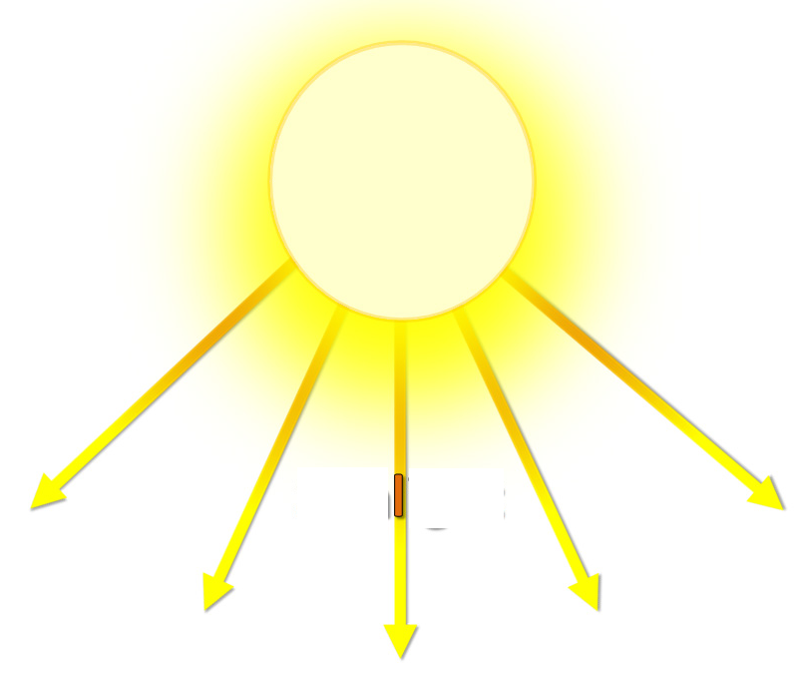
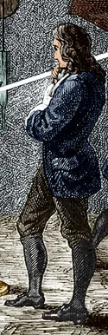

Another Newton’s Experience
Natural Philosophy!

Slide 4
A Natural Engineering for the Existence, Growth and Performance of Energetic Systems.
A True Design Reason behind Existence of Natural Systems…..
A Strong Design Modification for the Performance of Artificial Systems….

Slide 5
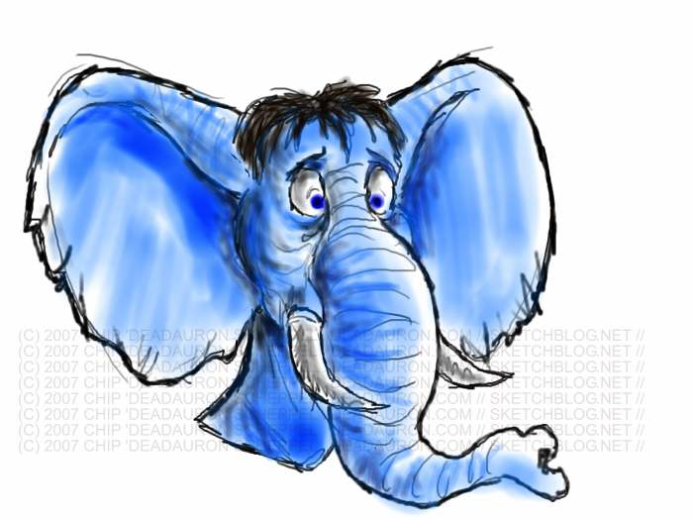
Why I Am Different ?
?

Slide 6
Reasons & Explanations
In mammals and birds, a highly active metabolism generates the required exothermic heat in their cells.
This heat is fed to the internal energy of the body, which results in the desired body temperature.
The body temperature is maintained at the desired value with a built-in thermo-regulatory mechanism.
This mechanism either releases the excess heat produced in the metabolism or triggers the body to generate higher metabolic rate at times, when the body temperature falls below the desired value.

Slide 7
System, Surrounding & Heat Interactions
Cold surroundings:
Warm blooded animals retain their heat by insulating their body against the environment by growing hair and feathers.
The hair traps a small layer of air around it as thermal insulation (air is a very poor heat conductor - k ~ 0.02 W/m.K).
This is one reason polar bears are furry.

Slide 8
System, Surrounding & Heat Interactions
Hot Surroundings:
On the other hand, warm blooded animals when faced with the need to release the excess metabolism generated heat energy, seek cool environment and divert their blood flow to the surface of their skin.
This ensures higher heat transfer rate to the cooler environment from their body and maintains the body temperature at a constant value.
When such a direct sensible cooling is not sufficient to remove the excess heat, an evaporative cooling mechanism aids in case of mammals with large quantities of reservoir fluids.
In other words, under such conditions, humans sweat.

Slide 9
Geometry of An Elephent ?!?!?!
Now to connect the geometry part that we discussed earlier.
Considering the points discussed so far, a bigger warm-blooded animal should in principle generate more metabolic heat energy simply because it has more volume hence more flesh and cells.
This metabolic heat release must be regulated if it is excess only through the heat transfer across the skin surface area.
Firstly, in such a situation, having a fur coat of a hair structure is the least desired thing and hence Elephants are mostly bald.
The hotter the climate in which they live, the balder they are.

Slide 10
Geometry of An Elephent ?!?!?!
Secondly, Elephants have large ears which are packed with capillary structure through which sizable quantity of blood flows.
Whenever there is excess heat that needs to be released, warm blood flows through these capillaries, while the elephant chooses a cold spot (like that of a shade) and uses the favorable thermal gradient to release the excess heat.
In other words, the ear flaps of the elephant serve as an enormous convection fin - a flapping one at that - to enhance heat transfer from the elephant body to the environment.

Slide 11
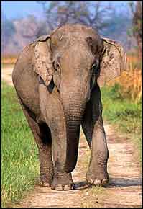
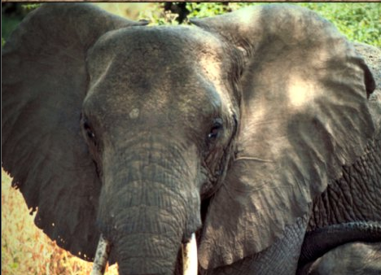
Geometrical Variations of Elephants
African Elephant
Indian Elephant

Slide 12
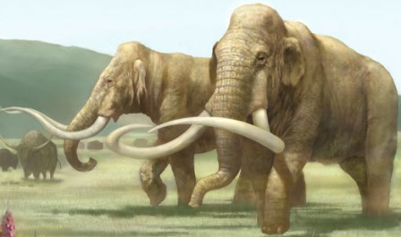
Mammoths, living in a cold tundra region, have fur coats and small hairy ears.

Slide 13
An Exotic & Artificial Device……
The basic invention is due to other sciences…
The final and reliable existence is governed by design for Heat Iteractions…

Slide 14

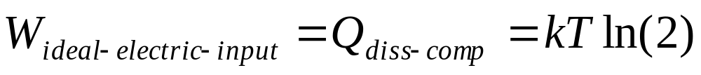
The Pentium 4 Processor
At a room temperature of 298K, W_{ideal-elec-input} = 0.018eV.
Best real‐world logic circuit designs can’t just magically cross this ~500× minimum power.

Slide 15
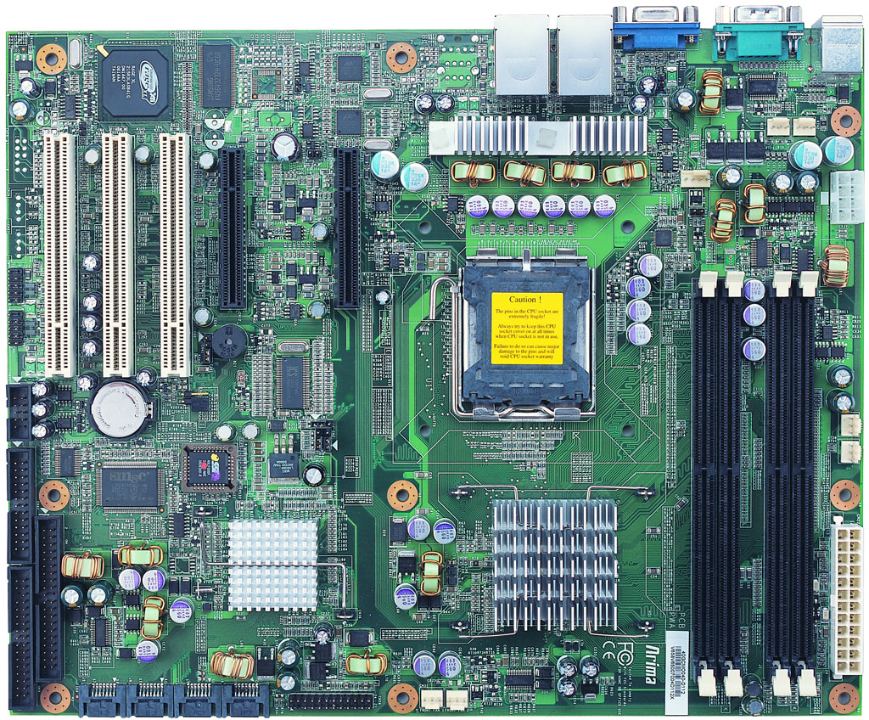
Basic Location on A Mother Board

Slide 16
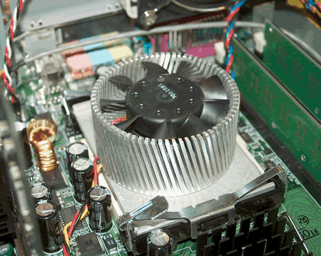
Reliable and Guaranteed Location in A Desktop

Slide 17
Fourier's Interpretation of Newton’s Experience
Natural Philosophy!

Slide 18
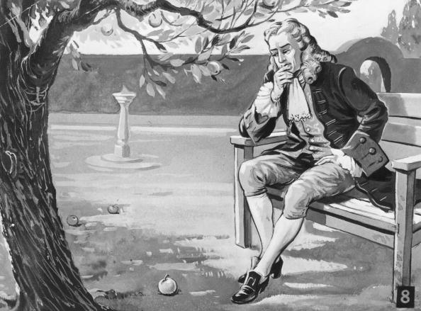
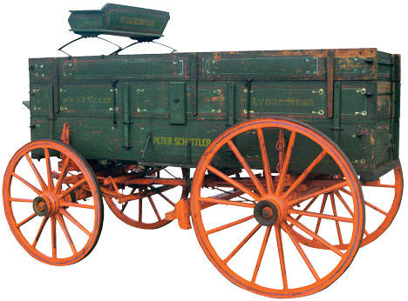
Newton: An Explorer of Force Creation???
Newton developed the theories of gravitation in 1666, when he was only 23 years old.
Some twenty years later, in 1686, he presented his three laws of motion in the
"Principia Mathematica Philosophiae Naturalis.“

Slide 19
Natural Philosophy by Newton
1660-70
Newtons Laws of Motion ~1686
Newtons Law of Viscosity ~ 1687
Newtons Law of Cooling ~ 1692-1693

Slide 20

Newton’s Work
In 1701, Newton published (in Latin and anonymously) in the Phil. Trans. of the Royal Society.
A short article, named as Scala graduum Caloris.
Established a relationship between the Degree of Heat and the time in cooling processes.
He did not write any formula but expressed verbally his cooling law:
the heat which hot iron, in a determinate time, communicates to cold bodies near it, that is,
the heat which the iron loses in a certain time is as the whole heat of the iron; and therefore (ideoque in Latin), if equal time of cooling be taken, the degrees of heat will be in geometrical proportion.

Slide 21
Newton’s Original Statement
the heat which hot iron, in a determinate time,
communicates to cold bodies near it,
that is,
the heat which the iron loses in a certain time is as the whole heat of the iron; and therefore (ideoque in Latin),
if equal time of cooling be taken, the degrees of heat will be in geometrical proportion.

Slide 22
Genesis of Newton’s Law of Cooling – Part 1
Isaac Newton published a paper, in Latin, on thermal science, Scala graduum Caloris, (Scale of the Degree of Heat), in the Philosophical Transactions (1701).
This paper presented a list of data measured by Newton believed to have been carried out in the 1690s.
Well before the Fahrenheit (1686-1736) and Celsius (1701-1744) temperature-calibration experiments.
Newton developed a test rig to obtain this data based on his observations on “cooling law of nature”.

Slide 23
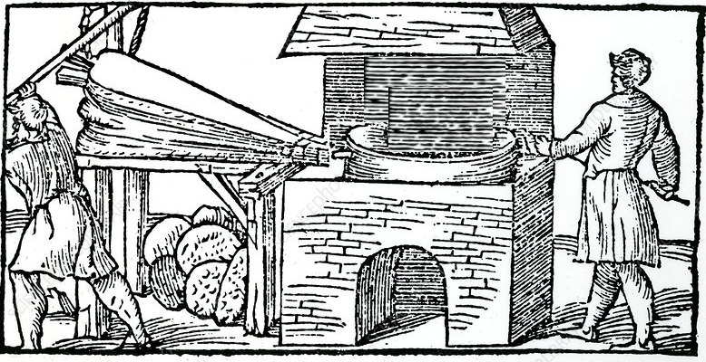
Newton’s Furnace & Law of Cooling
State 1

Slide 24
Newton’s Furnace & Law of Cooling
State 2

Slide 25
Genesis of Newton’s Law of Cooling – Part 1
Statement from his 1701 paper for clarity and convenience.
The three parts are presented as follows:
The First Statement:
For the heat, which the hot iron communicates in a given time, to cold bodies, which are near it, that is, the heat which the iron loses in a given time, is proportional to the whole heat of the iron.
And so, if the times of cooling are taken equal, the heats will be in a geometrical progression and consequently can easily be found with a table of logarithms.

Slide 26
Genesis of Newton’s Law of Cooling – Part 2
The Second Part :
Then by assuming that the excess of the heat of the iron and of the hardening bodies above the heat of the atmosphere, found by the thermometer, were in geometrical progression when the times were in arithmetical progression, all the heats were determined.

Slide 27
Genesis of Newton’s Law of Cooling – Part 3
The Third Part :
I placed the iron not in quiet air but in a uniformly blowing wind, so that the air warmed by the iron would continually be taken away by the wind, and cold air would come in its place with a uniform motion.
For thus equal parts of the air are warmed in equal times and carry away a heat proportional to the heat of the iron.
The heats so found had the same ratio to one another as those found by the thermometer and therefore, we have correctly assumed that the expansions of the oil were proportional to its heats.
The first part was later known as Newton’s law of cooling.

Slide 28
Westfall , Force in Newton’s Physics: 1971
“Almost without precedent, Newton created the scientific treatment of motion under conditions of resistance,
that is, of motion as it is found in the world. Recognizing the exponential nature of such motion,
he seized on a means of expressing it mathematically by means of the rectangular hyperbola.
With this device, he was able to derive the consequences for various assumed relations of velocity and resistance.”

