Slide 1

Technological Appreciation of 2020 SI Engines
P M V Subbarao
Professor
Mechanical Engineering Department
Head, CRDT
Analtomy of 2020 SI Artificial Horse….

Slide 2

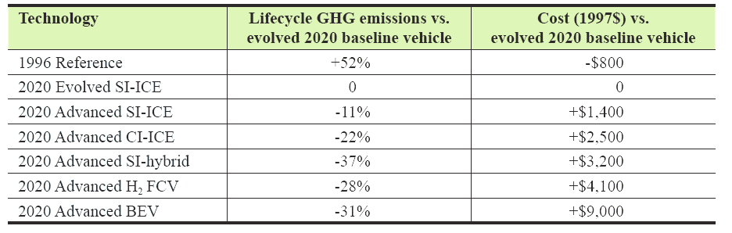
Prime Mover Options for Light Vehicles in 2020

Slide 3
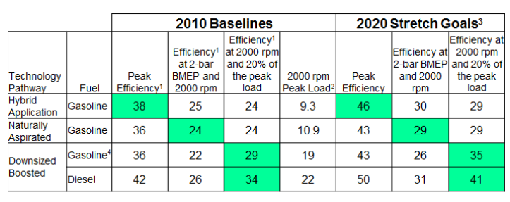

Fuel Economy Targets

Slide 4
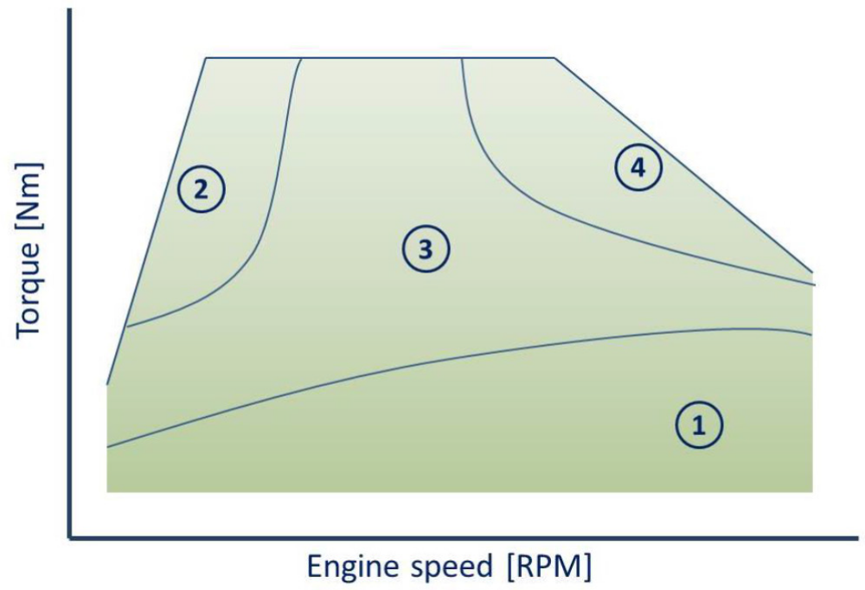
Strategic zones of improvements for SI Engine
Zone of High Torque @Low Speed
Zone of High Load
Zone of High Torque @Mid Speed
Zone of Partial Loads

Slide 5
Strategic zones of improvements for SI Engine
Low Thermal Efficiency
High thermal Stresses
Low Thermal Efficiency
Negative Work Cycle

Slide 6
Main Technological Issues to be Investigated
Combustion management and air charging systems.
The key elements for improving:
Loss due to Negative Work Cycle
Efficiency loss due to Reduced Compression Ratio
Efficiency loss due to Knocking Damage controls
Efficiency loss due to control of thermal stresses at high loads.
The major Study/discussion is twofold:
Technological assessment for SI ICEs available in 2020 & Future innovations.
Definition of a methodology to objectify the comparison between technological solutions for present and future.

Slide 7
Real Engine cycle Vs Air Standard Otto Cycle
Actual cycle departure from an Ideal cycle:
Irreversibility in various processes
Effect of finite duration of combustion
Leakages from the engine
Heat losses from cylinder
Finite time needed for blow-down
Effects due to real valve operation
3
Air-standard cycle
Actual cycle
p
2
4
1
V

Slide 8
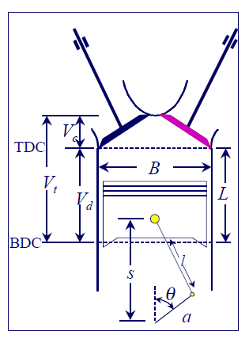
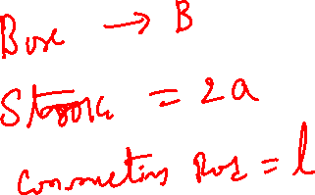
A Wonderful Kinematic Chain : Hardware available for An Artificial Horse

Slide 9
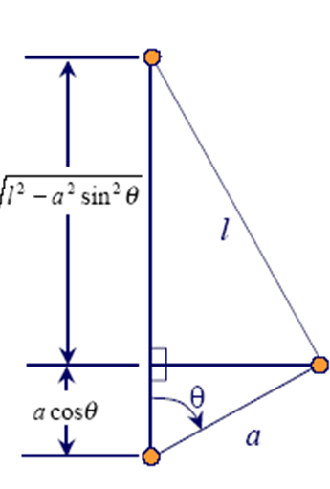
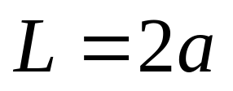
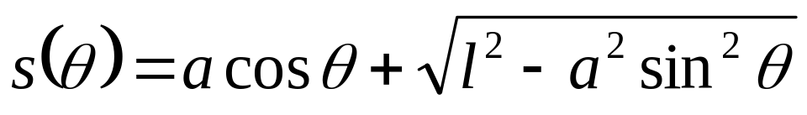
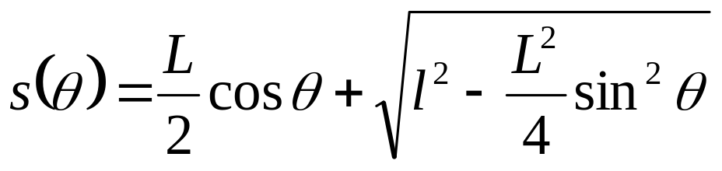
Effect of Stroke Length on Engine Kinematics
Instantaneous Piston Displacement:

Slide 10

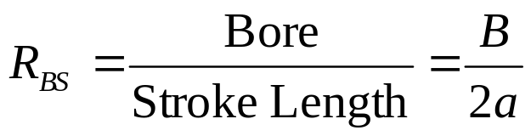
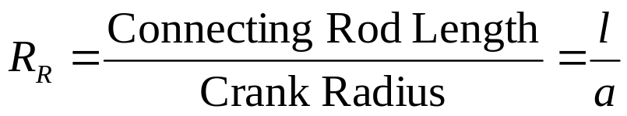
Engine Geometric Ratios
Engine Compression Ratio
Cylinder Bore-to-Stroke Ratio
Kinematic Rod Ratio

Slide 11
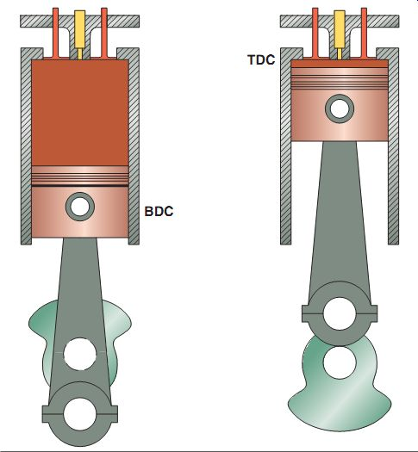

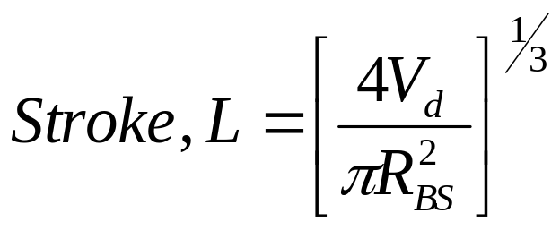
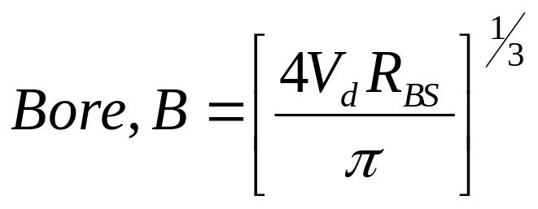
The Geometrical Characteristics of Engine Cylinder

Slide 12
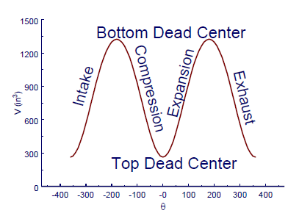
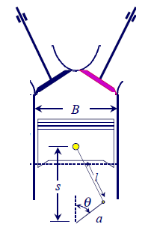



Instantaneous Engine Cylinder Volume

Slide 13
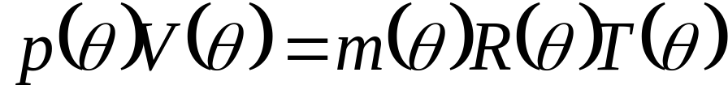
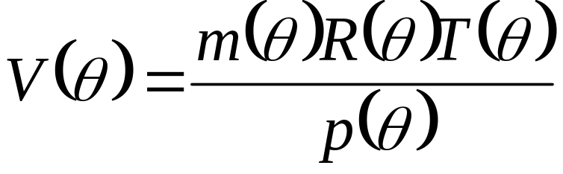
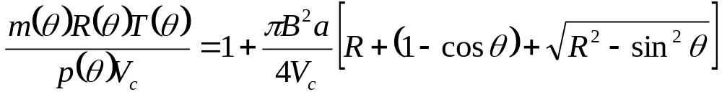
Ideal Gas as Working Fluid
(Blood of Artificial Animal)
How was the work developed by the engine related to the heat supplied (amount of coal burned)?

