Slide 1

Estimation of Forces Acting on of A Moving Vehicle
P M V Subbarao
Professor
Mechanical Engineering Department
Head, CRDT
Modelling of True Expectations from an Artificial Horse….

Slide 2

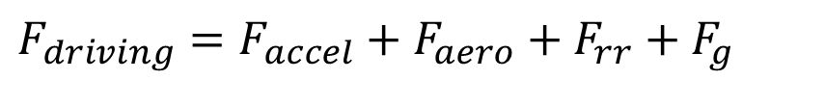
Resistance Forces on A Vehicle
The major components of the resisting forces to motion are comprised of :
Aerodynamic loads (F_{aero})
Rolling Resistance (F_{roll resist} )
Gradeability requirements (F_{grade})
Acceleration forces (F_{accel} = ma & Iα forces)
$$F_{driving}=F_{accel}+F_{aero}+F_{rr}+F_{g}$$

Slide 3
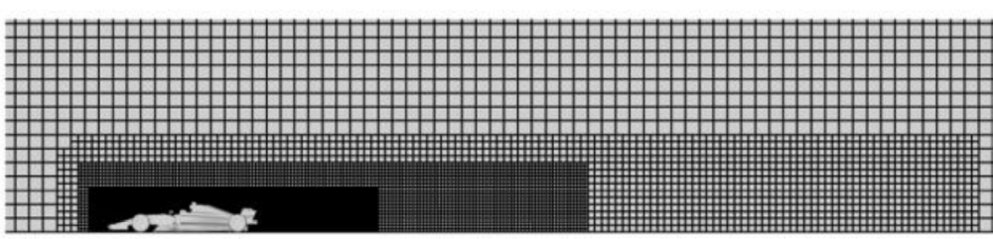
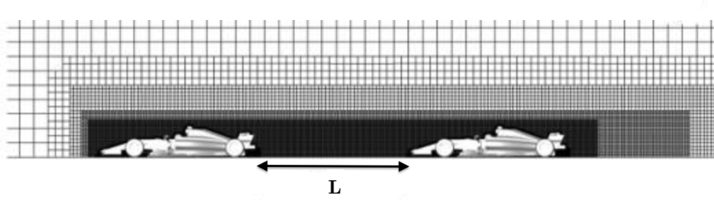

CFD Analysis : Freestream vs Wake

Slide 4
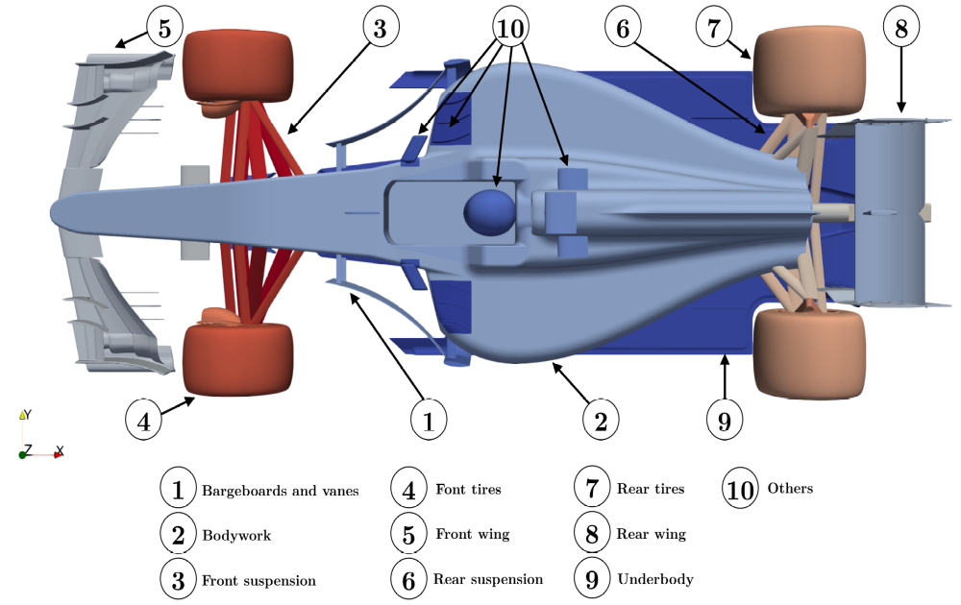
Major Car Elements Responsible for Downforce & Drag

Slide 5
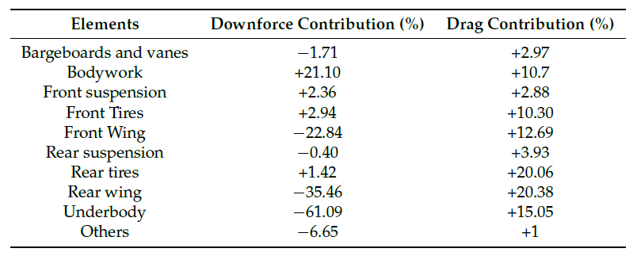
Distribution of Downforce & Drag

Slide 6
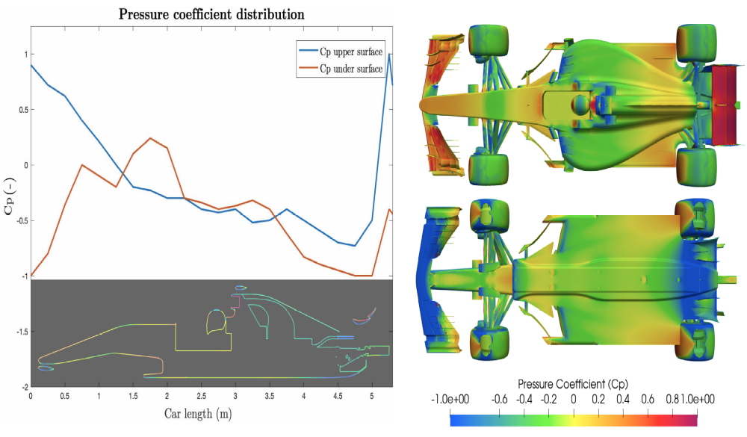
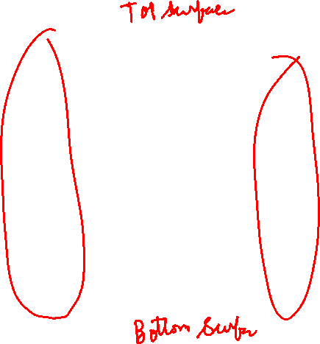
Surface Pressure Distribution.

Slide 7
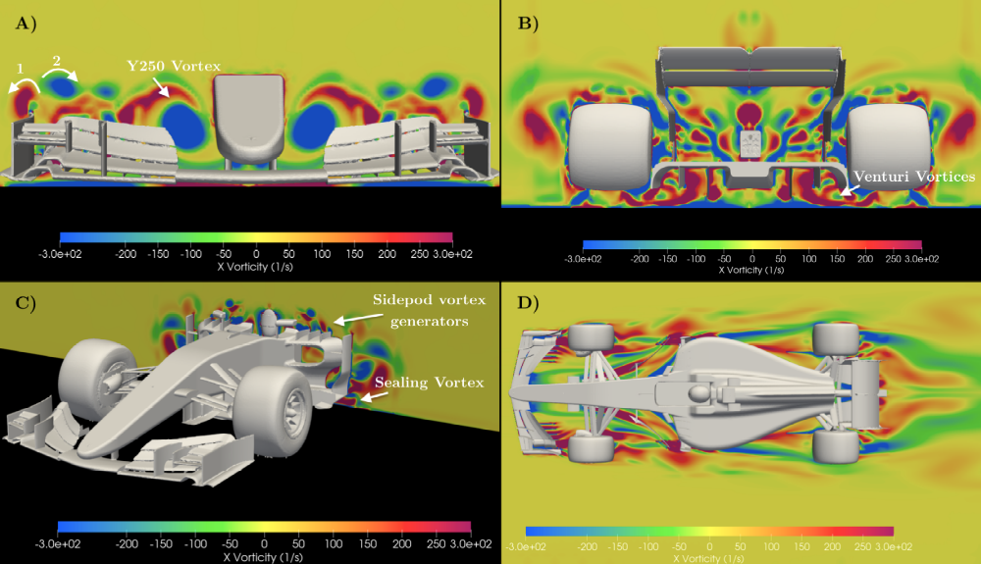
Vorticity Contours

Slide 8
Turbulent Wake and Drag

Slide 9
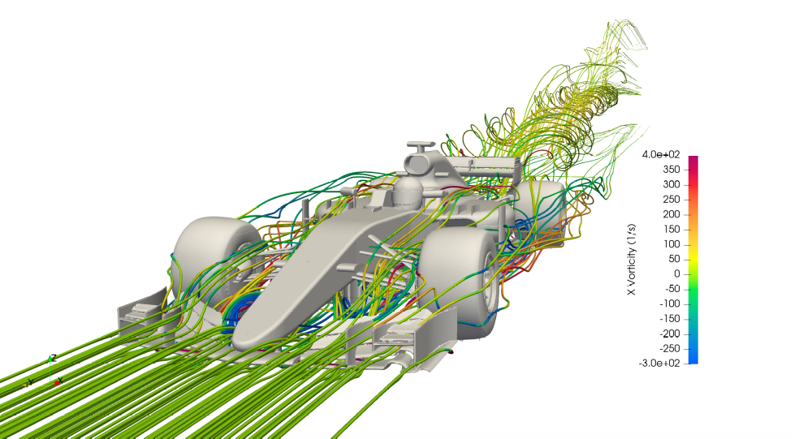
Distribution of Downforce & Drag
L
L_{s}
L

Slide 10
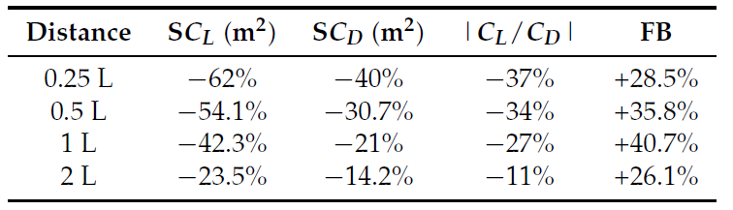
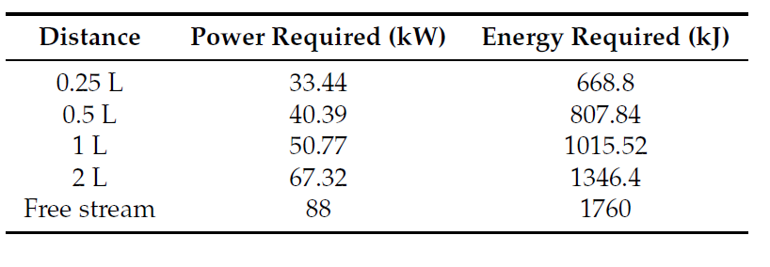
Car in Turbulent Wake

Slide 11
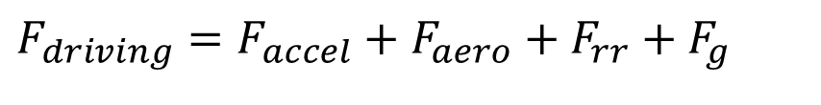
Resistance Forces on A Vehicle
The major components of the resisting forces to motion are comprised of :
Aerodynamic loads (F_{aero})
Rolling Resistance (F_{roll resist} )
Gradeability requirements (F_{grade})
Acceleration forces (F_{accel} = ma & Iα forces)
$$F_{driving}=F_{accel}+F_{aero}+F_{rr}+F_{g}$$

Slide 12
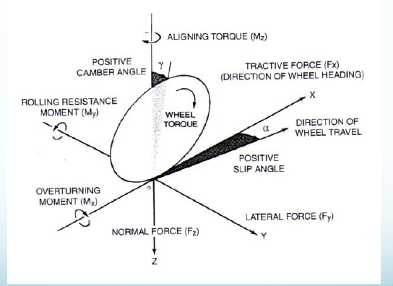
Force System on A Rolling Wheel

Slide 13
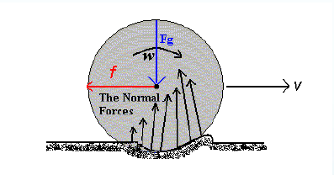
Road Conditions & Rolling Resistance

Slide 14
Rolling Resistance
Rolling Resistance mostly affected by:
1. Composition, type and tire condition consisting of inflation pressure, tire tread, the type of rubber
2. Composition and type of road consisting of macrotexture and microtexture
Macrotexture is related to the hysteresis component of tires. Hysteresis refers to the energy lost when tire deforms due to load and the energy lost is more than the energy recovered.
Microtexture is related to the microscale texture of the load that interacts with the tire.
3. Sliding speed in tire-road contact
4. Existence of external agents (rain, ice, snow etc.)

Slide 15
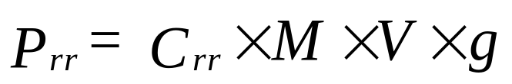


Model to Estimate Rolling Resistance
The magnitude of this force is Approximated as:
Rolling resistance of a vehicle is proportional to the component of weight normal to the surface of travel
$$F_{rr}∝Mg$$
$$F_{rr}=C_{rr}Mg$$
Power required to overcome rolling resistance:

Slide 16
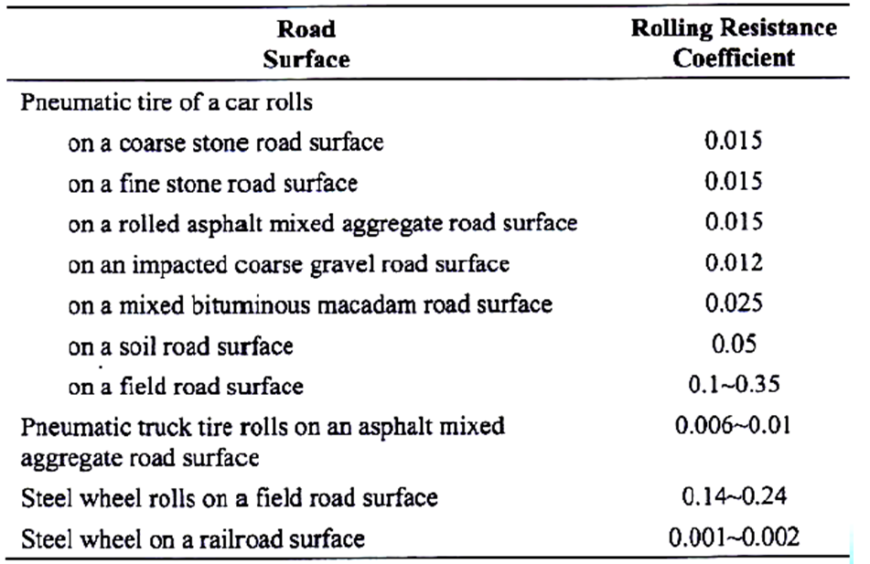
Effect of Road Condition on C_{rr}

Slide 17
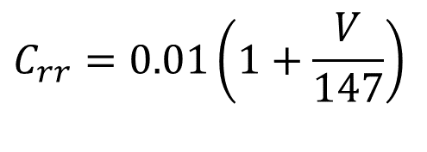
Typical Values of Coefficient of Rolling Resistance
Contact Type | C_{rr}
Steel wheel on rail | 0.0002...0.0010
Car tire on road | 0.010...0.035
Car tire energy safe | 0.006...0.009
Tube 22mm, 8 bar | 0.002
Race tyre 23 mm, 7 bar | 0.003
Touring 32 mm, 5 bar | 0.005
Tyre with leak protection 37 mm, 5 bar / 3 bar | 0.007 / 0.01
$$C_{rr}=0.01\left(1+\frac{V}{147}\right)$$

Slide 18
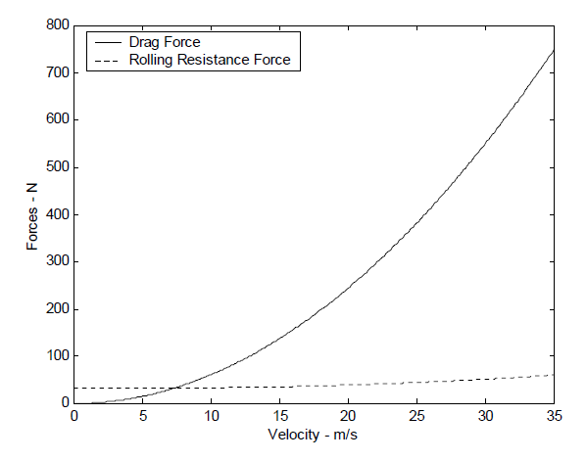
Rolling Resistance And Drag Forces Versus Velocity on A Good Road

Slide 19
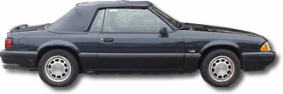
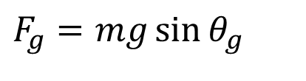
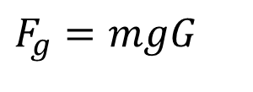
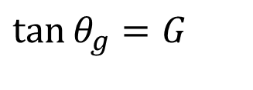
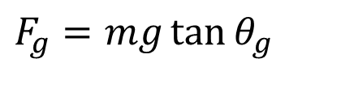

Grade Resistance
Composed of Gravitational force acting on the vehicle
_{θg}
$$F_{g}=mg\sin{θ_{g}}$$
For small angles,
_{Fg}
$$\sin{θ_{g}}≈\tan{θ_{g}}$$
$$F_{g}=mg\tan{θ_{g}}$$
_{θg}
_{mg}
$$F_{g}=mgG$$
$$\tan{θ_{g}}=G$$
The slope of the flyover ramp is considered as 1:20 gradient, with reference to a truck.
However, a slope of 1:10 would provide comfortable access for cars.

Slide 20
Steady Speed Resistance Curve
Resistance
Vehicle Speed

Slide 21
Inertial or Transient Forces
Transient forces are primarily comprised of acceleration related forces where a change in velocity is required.
These include:
The rotational inertia requirements (F_{Iα} ) and
the translational mass (F_{ma}).
If rotational mass is added to a translating vehicle, it adds not only rotational inertia but also translational inertia.

Slide 22
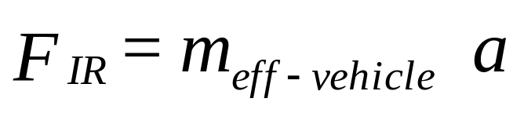
Overall Inertial Resistance of A vehicle
where:
F_{IR} = inertia resistance [N]
m_{eff-vehicle} = Vehicle mass + Equivalent mass of rotating parts [kg]
a = car acceleration [m/s²],
(from 0 to 100 km/h in: 6 s (4.63 m/s²), 18 s (1.543 m/s²))

Slide 23
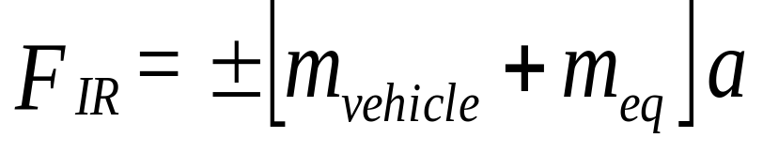
Effective Mass of A Vehicle
where: m_{vehicle} = Vehicle mass [kg]
m_{eq} = Equivalent mass of rotating parts [kg]
Generatl Rotating Parts:
Wheels & Axles
Propeller Shaft
Transmission gears
Engine Crankshaft and camshaft
Clutch
Flywheel

Slide 24
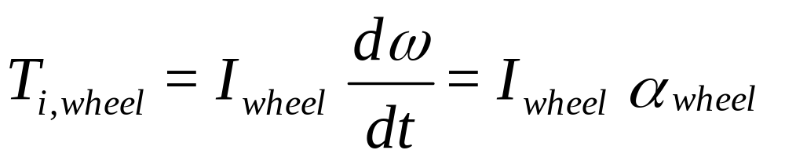
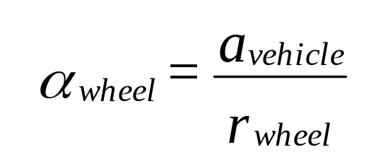
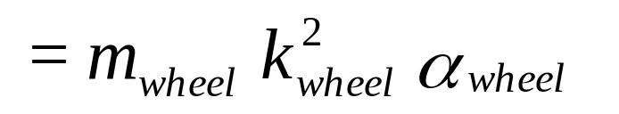
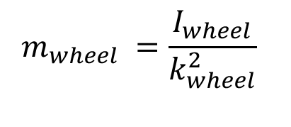
Equivalent Mass of A Wheel
Inertial torque due to a Wheel
= angular acceleration k = radius of gyration
$$m_{wheel} =\frac{I_{wheel}}{k_{wheel}^{2}}$$
Equivalent Mass of A Wheel
wheels and axles = 78% of total polar inertia
propeller shaft = 1.5%
Engine = 6% & Flywheel and clutch =14.5%

Slide 25
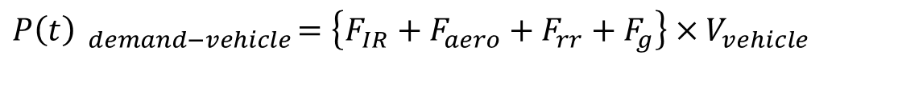
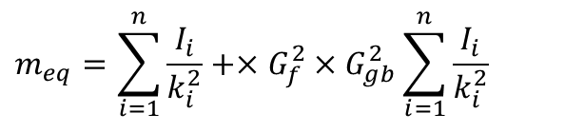
General Equation of Equivalent Mass of Rotating Parts
Therefore the equivalent mass of all rotational parts including losses is represented as:
$$m_{eq}=\sum_{i=1}^{n}{\frac{I_{i}}{k_{i}^{2}}}+×G_{f}^{2}×G_{gb}^{2}\sum_{i=1}^{n}{\frac{I_{i}}{k_{i}^{2}}}$$
$$P\left(t\right) _{demand−vehicle}=\left\{F_{IR}+F_{aero}+F_{rr}+F_{g}\right\}×V_{vehicle}$$

Slide 26
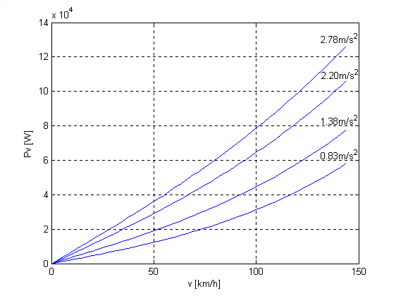
Effect of Velocity on Instantaneous Power Demand

Slide 27
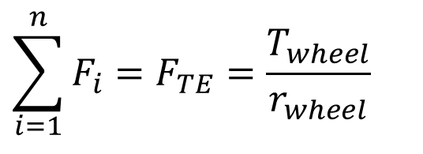
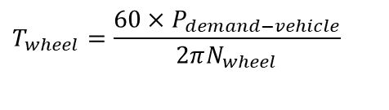

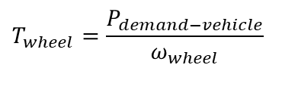
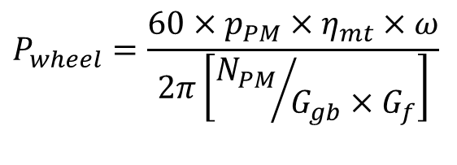
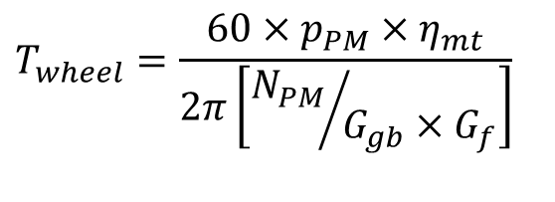
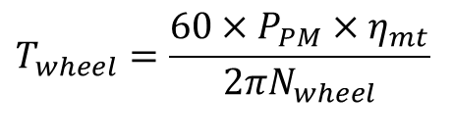
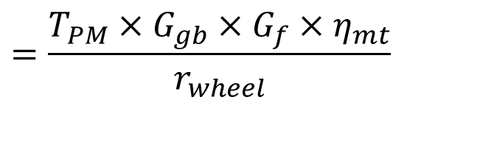
Required Torque & Power at Wheels
$$T_{wheel}=\frac{P_{demand−vehicle}}{ω_{wheel}}$$
$$T_{wheel}=\frac{60×P_{demand−vehicle}}{2πN_{wheel}}$$
$$T_{wheel}=\frac{60×P_{PM}×η_{mt}}{2πN_{wheel}}$$
$$T_{wheel}=\frac{60×p_{PM}×η_{mt}}{2π\left[{N_{PM}}/{G_{gb}×G_{f}}\right]}$$
$$P_{wheel}=\frac{60×p_{PM}×η_{mt}×ω}{2π\left[{N_{PM}}/{G_{gb}×G_{f}}\right]}$$
$$T_{wheel}=T_{PM}×G_{gb}×G_{f}×η_{mt}$$
Instantaneous Tractive Effort demanded by a vehicle :
$$\sum_{i=1}^{n}{F_{i}}=F_{TE}=\frac{T_{wheel}}{r_{wheel}}$$
$$=\frac{T_{PM}×G_{gb}×G_{f}×η_{mt}}{r_{wheel}}$$

Slide 28
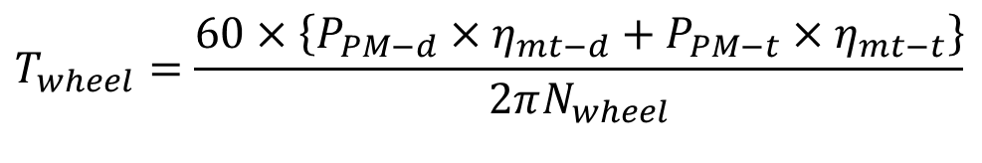
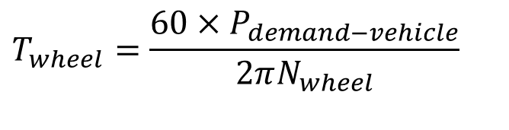
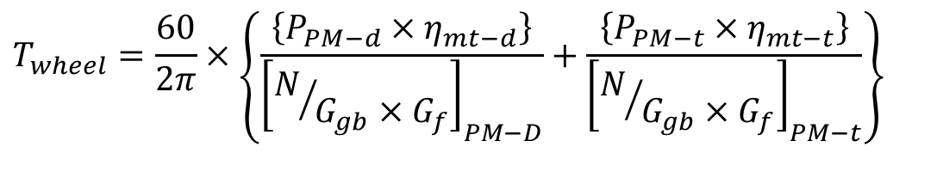
Required Torque & Power at Wheels For An Advanced Hybrid Vehicles
$$T_{wheel}=\frac{60×P_{demand−vehicle}}{2πN_{wheel}}$$
$$T_{wheel}=\frac{60×\left\{P_{PM−d}×η_{mt−d}+P_{PM−t}×η_{mt−t}\right\}}{2πN_{wheel}}$$
$$T_{wheel}=\frac{60}{2π}×\left\{\frac{\left\{P_{PM−d}×η_{mt−d}\right\}}{{\left[N/{G_{gb}×G_{f}}\right]}_{PM−D}}+\frac{\left\{P_{PM−t}×η_{mt−t}\right\}}{{\left[N/{G_{gb}×G_{f}}\right]}_{PM−t}}\right\}$$

Slide 29
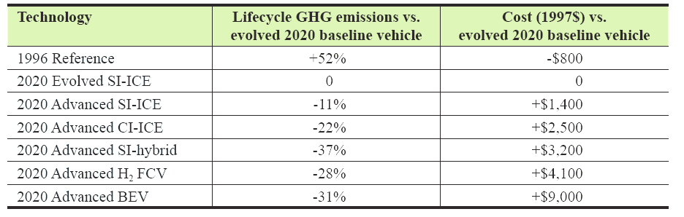
Prime Mover Options for Light Vehicles in 2020

