Slide 1

Estimation of Power & Torque Requirements of A Vehicle
P M V Subbarao
Professor
Mechanical Engineering Department
Head, CRDT
Modelling of True Expectations from an Artificial Horse….

Slide 2

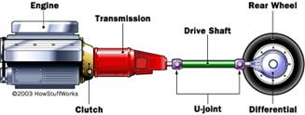
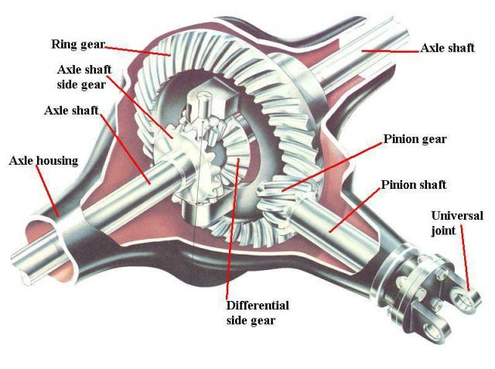

Vehicle Transmission System & Conventional Engine Speed

Slide 3
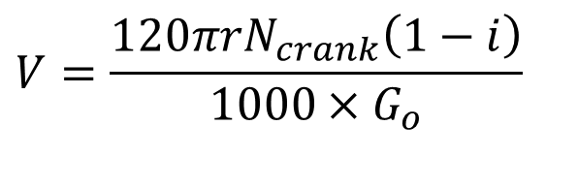
Vehicle Speed vs. Engine Speed
$$V=\frac{120πrN_{crank}\left(1−i\right)}{1000×G_{o}}$$
V | = | velocity , km/hr
r | = | wheel radius, m
N_{crank} | = | crankshaft rpm
i | = | driveline slippage
G_{O} | = | Overall gear reduction ratio

Slide 4
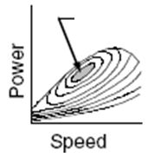
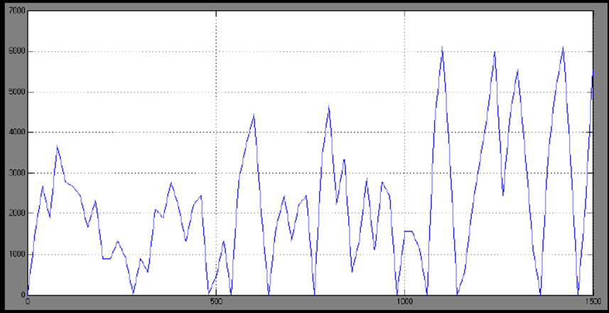


Conventional Engine RPM during Urban Driving Cycle
BOP

Slide 5
How to Design the Perfect Anatomy of An Artificial Horse?
First step: Forecast the vehicle requirements….

Slide 6

Types of Road Vehicles: Required Driving Force
Instantaneous Power Requirement of a selected vehicle is equal to the product of Resultant driving force and speed of a vehicle.

Slide 7
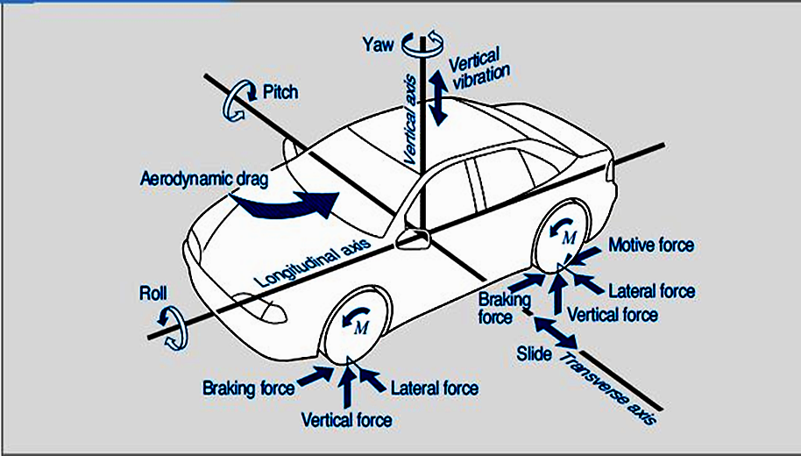
Distribution of Resistive Forces on A Vehicle

Slide 8
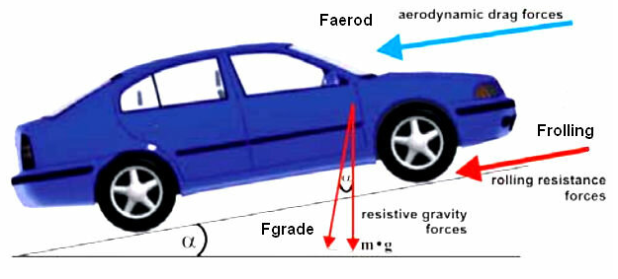
Forces To be Overcome by a Moving Automobile

Slide 9
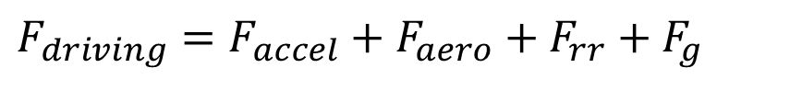
Resistance Forces on A Vehicle
The major components of the resisting forces to motion are comprised of :
Aerodynamic loads (F_{aero})
Rolling Resistance (F_{roll resist} )
Gradeability requirements (F_{grade})
Acceleration forces (F_{accel} = ma & Iα forces)
$$F_{driving}=F_{accel}+F_{aero}+F_{rr}+F_{g}$$

Slide 10
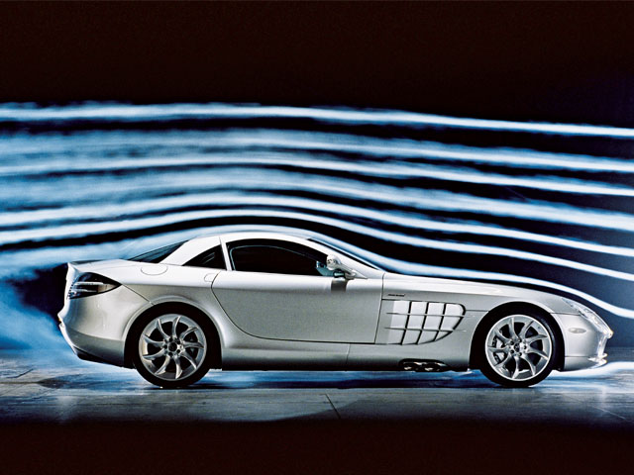
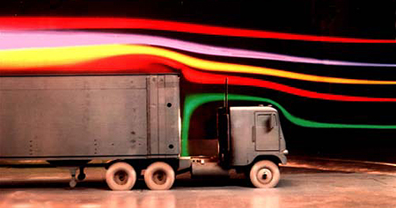
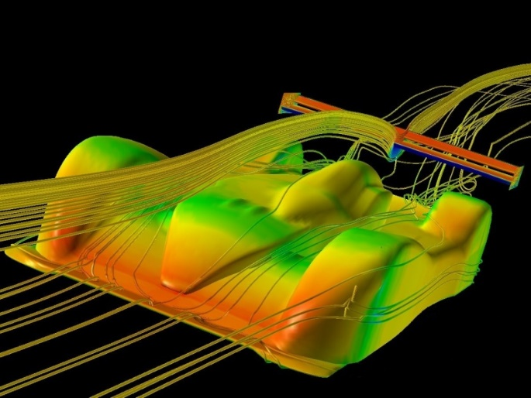
Aerodynamic Force : Flow Past A Bluff Body
Aerodynamic force is Composed of:
  Turbulent air flow around vehicle body (85%)
  Friction of air over vehicle body (12%)
  Vehicle component resistance, from radiators and air vents (3%)

Slide 11
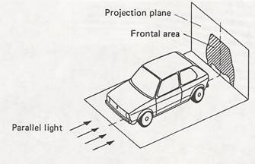
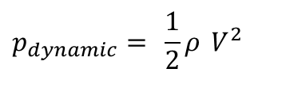
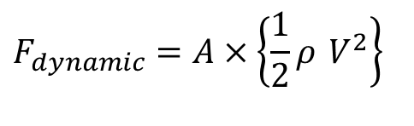
Modeling of Aerodynamic Resistance on A Vehicle
Light and Projection Analogy
$$p_{dynamic}= \frac{1}{2}ρ V^{2}$$
Define, Dynamic Pressure:
$$F_{dynamic}=A×\left\{\frac{1}{2}ρ V^{2}\right\}$$
Maximum Possible Resistance:

Slide 12
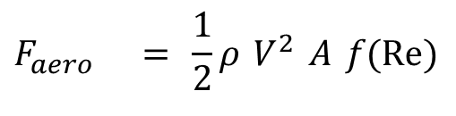

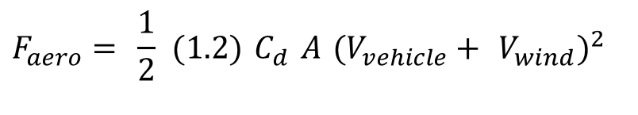

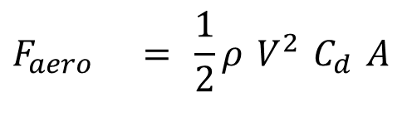
Modeling of Aerodynamic Resistance on A Vehicle
Actual resistance force is proportional to product of Maximum possible force and an aerodynamic variable:
Aerodynamic Drag Force:
$$F_{aero} = \frac{1}{2}ρ V^{2} A f(\operatorname{Re}{)}$$
$$F_{aero} = \frac{1}{2}ρ V^{2} C_{d} A$$
$$F_{aero}= \frac{1}{2} (1.2) C_{d} A (V_{vehicle}+ V_{wind})^{2}$$
Aero Power
$$P_{aero} = F_{aero}×V_{vehicle}$$

Slide 13
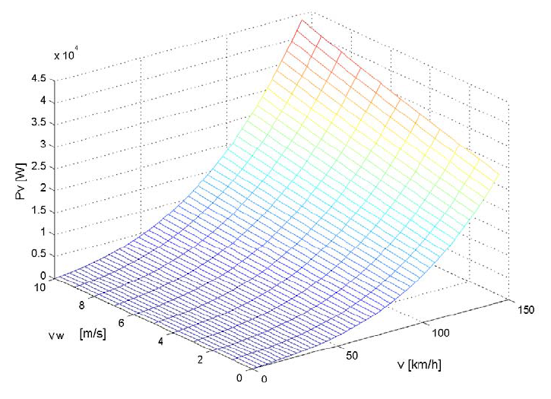
Aerodynamic Power Demanded by A Vehicle

Slide 14
Aerodynamic Drag Coefficient C_{d}
The typical modern cars achieves a drag coefficient of between 0.30 and 0.35.
Notably, certain cars can achieve figures of 0.25-0.30, although sometimes designers deliberately increase drag in order to reduce lift.
SUVs, with their flatter shapes, typically achieve a C_{d} of 0.35–0.45.

Slide 15


Aerodynamic Outer Shape to Accommodate three Cuboids

Slide 16
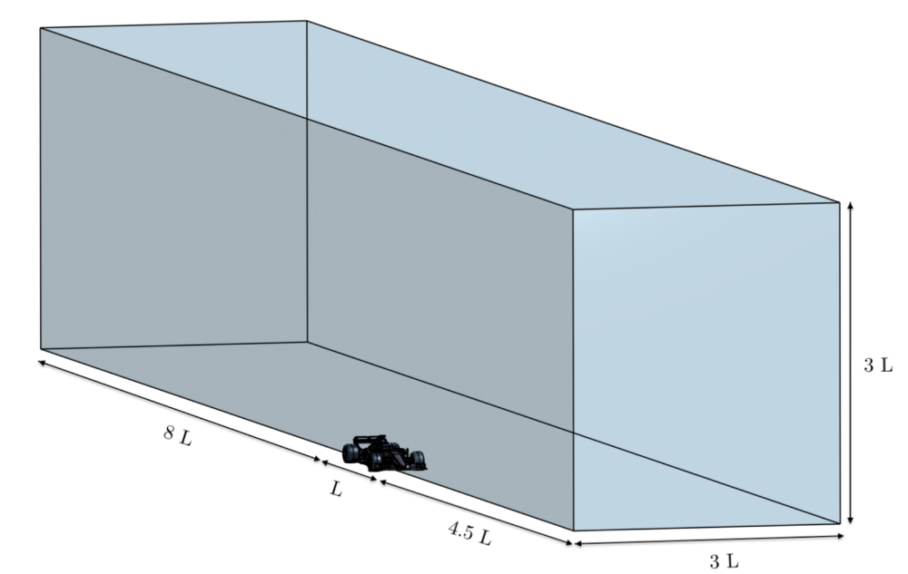
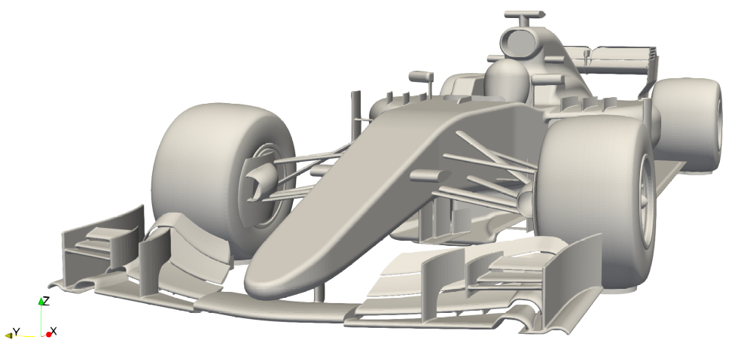
Aerodynamics of Formula 1 Car
Aerodynamic Study of the Wake Effects on a Formula 1 Car
Alex Guerrero and Robert Castilla *

Slide 17
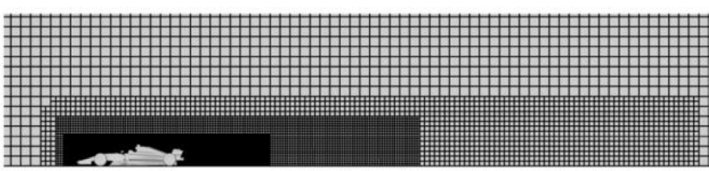
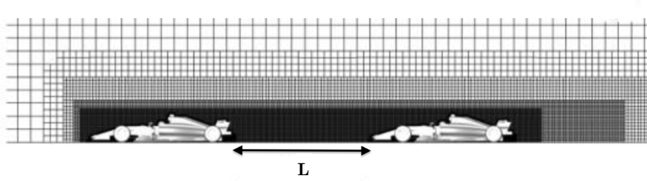
CFD Analysis : Freestream vs Wake

Slide 18
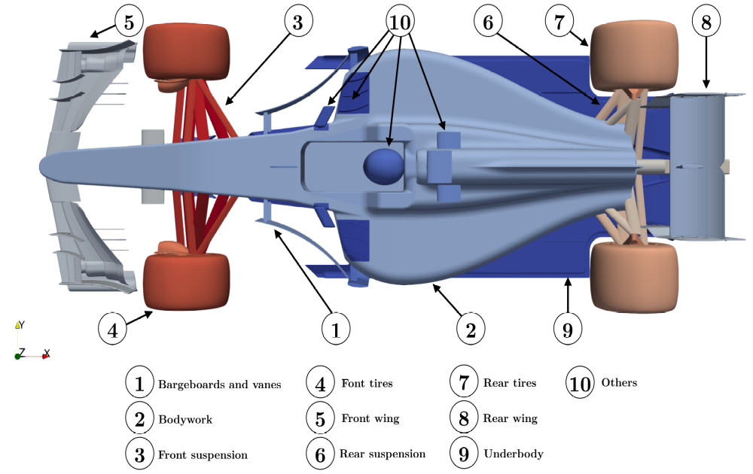
Major Car Elements Responsible for Downforce & Drag

Slide 19
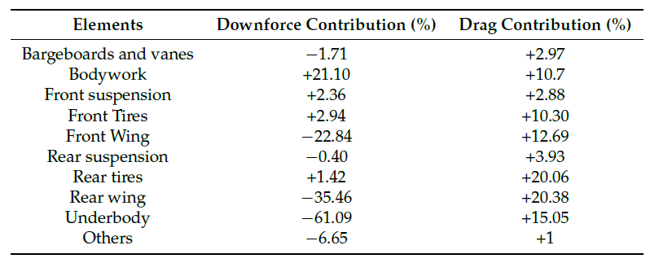
Distribution of Downforce & Drag
Aerodynamic Study of the Wake Effects on a Formula 1 Car
Alex Guerrero and Robert Castilla *

