Slide 1

The Green Hybrid Prime Movers
P M V Subbarao
Professor
Mechanical Engineering Department
An Attempt to Use A Pair of Most reversible and Zero Carbon Footprint Prime Movers.....

Slide 2

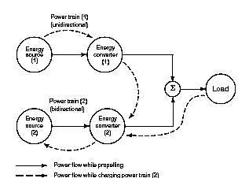
Future Conceptual Hybrid Scheme
High Energy density energy source
Digestive Prime Mover
Conventional: Fossil Fuels
Unconventional: Green Fuels
Conventional: CI & SI I C Engines
Unconventional: Fuel Cells
Conventional: Electric Battery
Unconventional: Hydraulic storage
Conventional: Electric MGs
Unconventional: Hydraulic MGs
Low Energy density energy source
Tractive Prime Mover

Slide 3
Reversible Process/Reactions are Green
An electro-chemical reactions is more reversible than combustion.
All fuel resources available for transportation must be converted into green fuel.
A green fuel participates in most reversible reaction/process in a specific hardware system.
Out of know fuels Hydrogen can perform most efficient reversible reaction to release calorific value directly as electric energy.
These systems are known as Fuel Cell.
A Fuel Cell carries out inverse process of an electrolyzer.

Slide 4
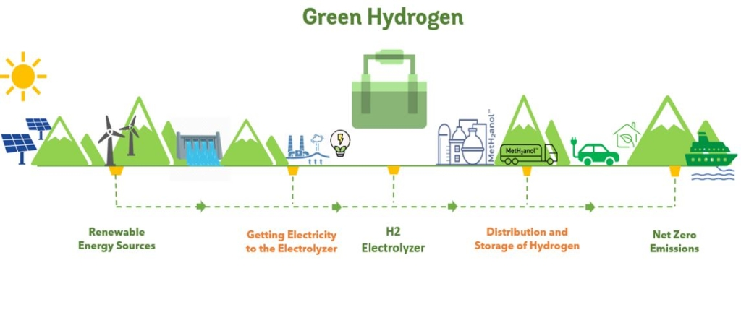
Green Hydrogen Production Systems

Slide 5
A Hydrogen Fuel Cell
A hydrogen fuel cell is the most reversible and popular device that has been used in fuel cell vehicles.
It consumes hydrogen and oxygen and only produces water vapor and heat as exhaust products.
Therefore, a hydrogen fuel cell vehicle produces zero tailpipe greenhouse gas (GHG) emission.
In general, hydrogen is produced using either steam methane reforming or electrolysis of water.
The adoption of FCEVs would significantly reduce a country’s dependence on foreign oil and Carbon release.

Slide 6
Hydrogen: The Primordial Bestower to The Ecosystem
On the ecosystem scale, hydrogen supports microbial communities in most terrestrial, aquatic, and host-associated ecosystems.
This is the primordial electron donor.
In all biological systems, hydrogen metabolism is the most superior energy generator.
Better understanding of hydrogen metabolism is the backbone of future renewable energy.
A ‘mole of electrons’ is 6.022 × 10²³ electrons.
The charge (F) is N · e, where e is 1.602 × 10⁻¹⁹ C.
F = N · e = 96485 C

Slide 7
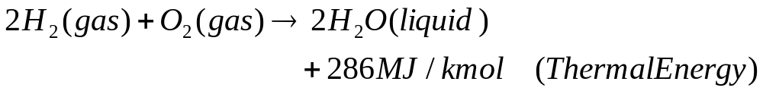
The Atomistic Hydrogen Metabolism
Most irreversible metabolism is combustion of hydrogen.
Hydrogen gas forms explosive mixtures with air in concentrations from 4–74%.
The explosive reactions may be triggered by spark, heat, or sunlight.
A controlled Combustion is used in Next generation Hydrogen DI-SI I.C. Engines.

Slide 8

The Holistic Art of Hydrogen Metabolism
Microorganisms conserve energy by metabolizing hydrogen.
Oxidation of this high-energy fuel yields electrons that can be used for respiration and carbon-fixation.
Electrochemical reaction of Hydrogen is the most reversible reaction.
Electrochemical reaction produces electricity
At cathode ½ O₂ + 2e- → O₂₋
At anode H₂ + O₂₋ → H₂O + 2e-
Overall reaction H₂+ ½ O₂ → H₂O
It is the change in this Gibbs free energy of formation,ΔG_{f}, that generates electrical energy.
A fuel cell only can convert this change in Gibbs free energy into electrical energy.

Slide 9
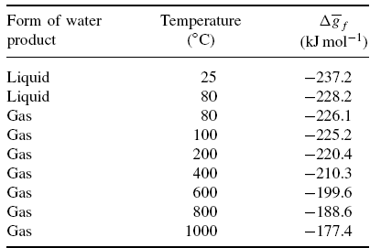
Change in Gibbs Free Energy
If the fuel cell is a ‘reversible’ device, then all this Gibbs free energy is converted into electrical energy.

Slide 10
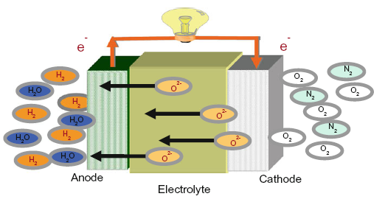

Electrical Energy Generated by An Ideal Fuel Cell
In the hydrogen fuel cell, two electrons pass round the external circuit for each molecule of hydrogen consumed.
Therefore, for one mole of hydrogen used, 2N electrons pass round the external circuit – where N is Avogadro’s number.
If −e is the charge on one electron, then the charge that flows is
If E is the voltage of the fuel cell, then the electrical work done moving this charge round the circuit is
Electrical work done = charge × voltage = -2F.V Joules.

Slide 11

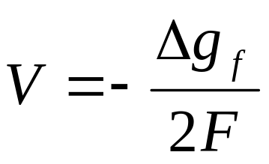
Ideal Cell Voltage
If the system is reversible (or has no losses), then this electrical work done will be equal to the Gibbs free energy released.
This fundamental equation gives the electromotive force (EMF) or reversible open circuit voltage of the hydrogen fuel cell.
In practice the voltage would be lower than this because of the voltage drops in the circuit elements.
Some of the irreversibilities apply a little even when no current is drawn, so even the OCV of a fuel cell will usually be lower.

Slide 12
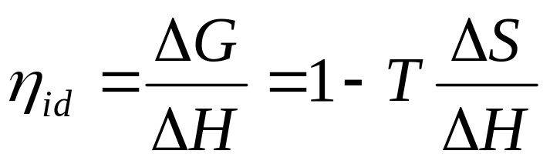
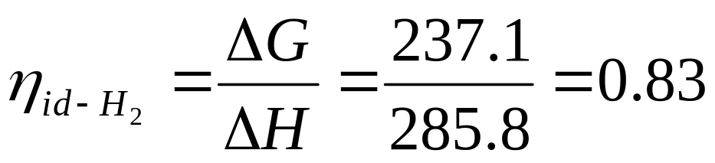
Ideal Fuel Cell Capacity
The “ideal” efficiency of a reversible galvanic cell is related to the enthalpy for the cell reaction by
η_{id} will be 100% if the electrochemical reaction involves no change in the number of gas moles, that is, when ΔS is zero.

Slide 13
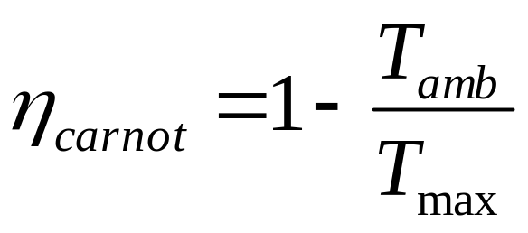
The Fundamental Law : Electrochemical Reaction
In a fuel system, generating chemical energy into electrical energy can be done by transforming hydrogen and oxygen into steam were restricted by efficiency limits of the Carnot thermal cycle.
(Larminie and Dicks 2000)

Slide 14
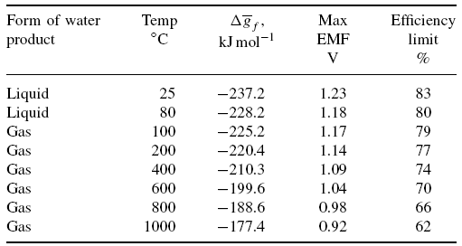
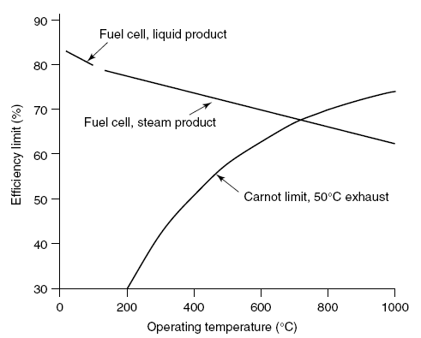
Second Law Analysis of Fuel Cell

Slide 15
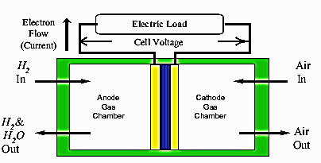
Flow Diagram for a Fuel Cell System

Slide 16
Fuel Cell Technologies
There are six major types of fuel cells depending on the type of their electrolyte.
Proton exchange membrane (PEM) or Polymer exchange membrane fuel cells (PEMFCs)
Alkaline fuel cells (AFCs)
Phosphoric acid fuel cells (PAFCs)
Molten carbonate fuel cells (MCFCs),
Solid oxide fuel cells (SOFCs)
Direct methanol fuel cells (DMFCs)

Slide 17

Classification based on electrolyte used
Max attained
production
e
V
H₂
AFC
60⁰C 100 kW
OH ⁻
O₂
H₂O
PEMFC
O₂
H₂
H ⁺
60⁰C 250 kW
H₂O
CH₃OH
O₂
DMFC
H ⁺
80⁰C 2 MW
CO₂
H₂O
PAFC
H ⁺
O₂
H₂
190⁰C 11 MW
H₂O
H₂
O₂
MCFC
CO₃ ²⁻
650⁰C 2 MW
H₂O
CO₂
H₂
SOFC
O ²⁻
1000⁰C 1 MW
H₂O
O₂
Fuel
Oxygen
Anode
Electrolyte
Cathode

Slide 18
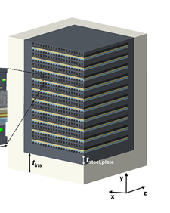
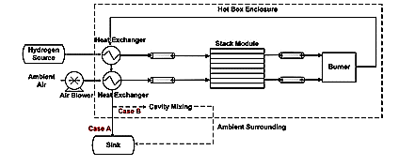
Fuel and Energy Flow Diagram of A Fuel Cell

Slide 19
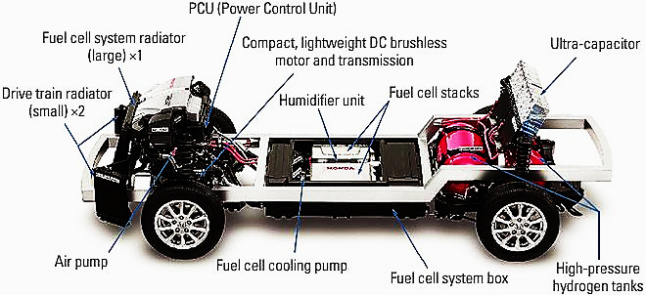
Fuel Cell Electric Prime Mover

Slide 20

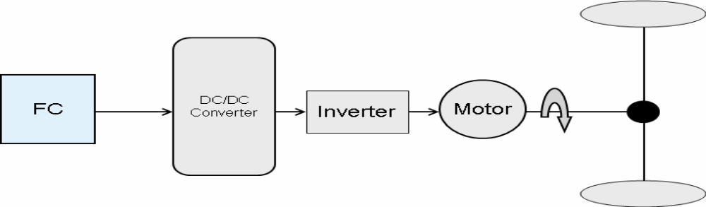
Fuel Cell Vehicles
Electric vehicles that use fuel cells in their power train are often called fuel cell vehicles.
If fuel cells are the only source of power in the vehicle then the configuration is a non-hybrid fuel cell vehicle.
This vehicle has a fuel cell to provide electric power, a DC/DC convertor to boost up the low output voltage of the fuel cell.
An inverter to feed the required waveforms to the electric motor.

Slide 21
Optimal Operation of Fuel Cell
Like other prime movers, fuel cells have an optimum operating point.
The Optimum point generates maximum efficient power and increases the fuel-economy.
The best design is the one that gives maximum power to the system while maintaining the optimal operating point of the fuel cell.

Slide 22
Load Vs Performance of A Fuel Cell
The instantaneous power demanded by a vehicle has a huge impact on operation of the fuel cells.
To meet the demand in non-hybrid fuel cell vehicles, the nominal power of the fuel cell is chosen at the maximum possible power of the vehicle.
Therefore, the real driving conditions may not let the the fuel cell to operate in optimal conditions,
Urban driving cycle leads to generation of lower loads on a huge fuel cell.

Slide 23
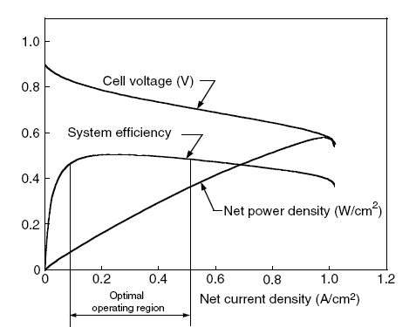
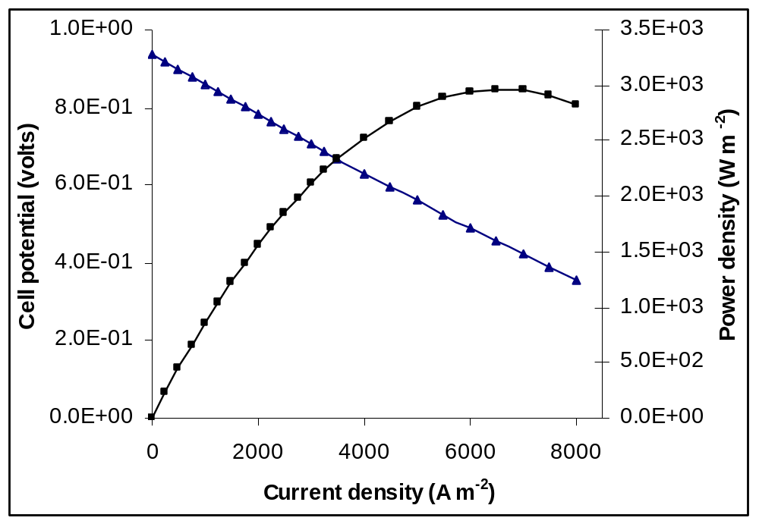
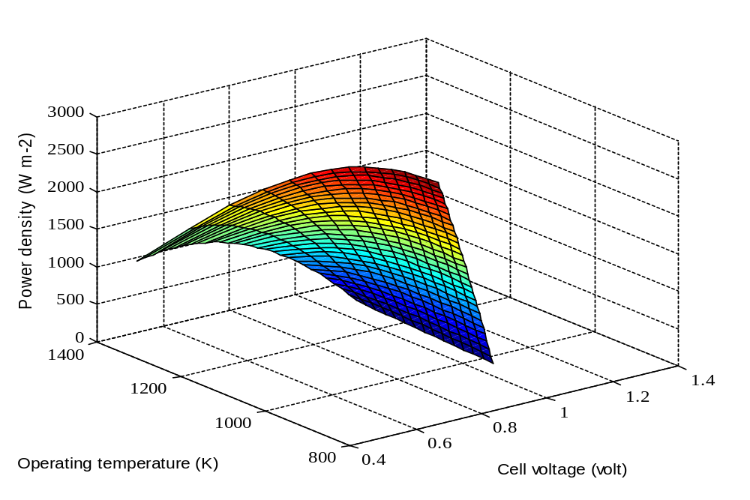
Performance characteristics of a single Fuel Cell

Slide 24
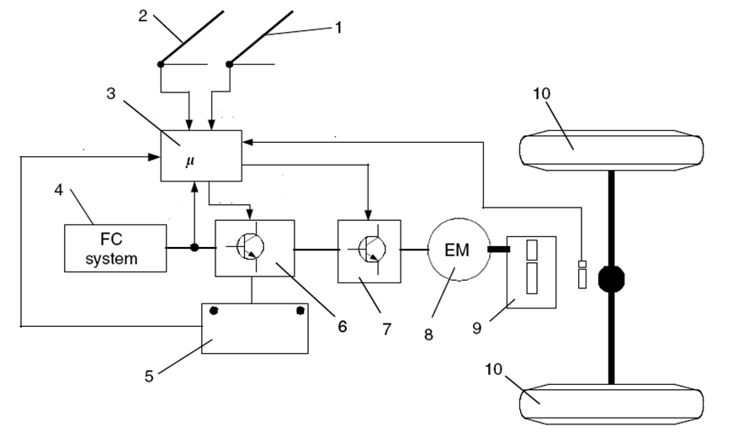
Hardware Configuration of a typical fuel cell Drive
brake pedal
accelerator pedal
vehicle controller
peaking
power sound
6: electronic interface;
7: motor controller;
8: traction motor;
9: transmission;
10: wheels.

Slide 25

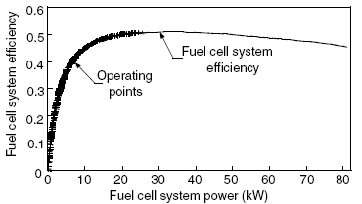
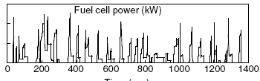
Performance of Fuel Cell-alone-powered Drive Train : City Driving
60
40
20

Slide 26
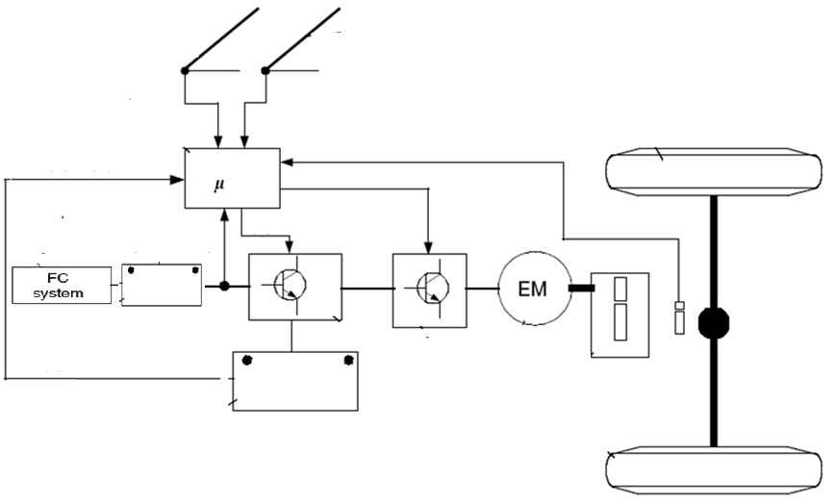
Configuration of a typical fuel cell Hybrid Drive
Battery
Regenerative Brake

Slide 27
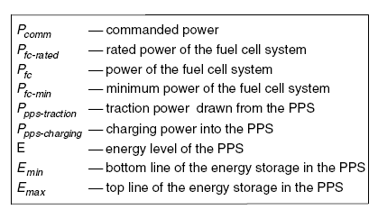
List of Control Parameters

Slide 28
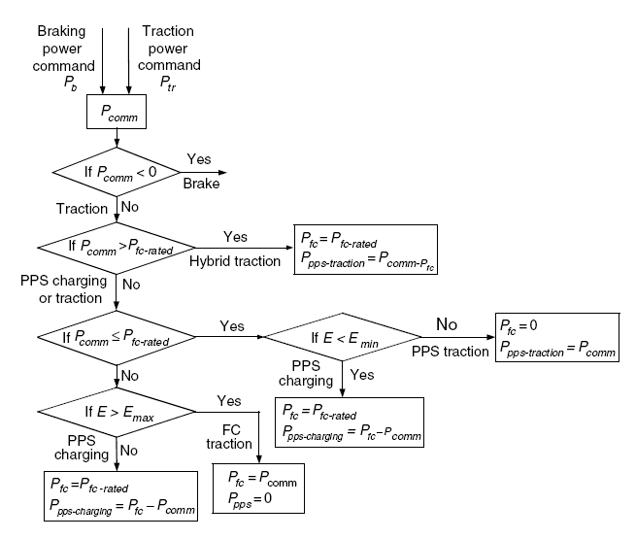
Flow chart of the control strategy

Slide 29


Performance of Fuel Cell-Hybrid-powered Drive Train : City Driving

Slide 30
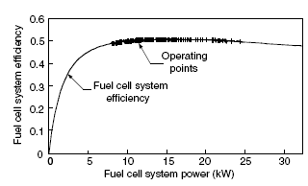
Optimal Operation of Fuel Cell

Slide 31
The main challenges in adopting Fuel Cell (FC) technologies

