Slide 1

Electric Prime Movers
P M V Subbarao
Professor
Mechanical Engineering Department
I I T Delhi
Non-Digestive Prime Movers….

Slide 2

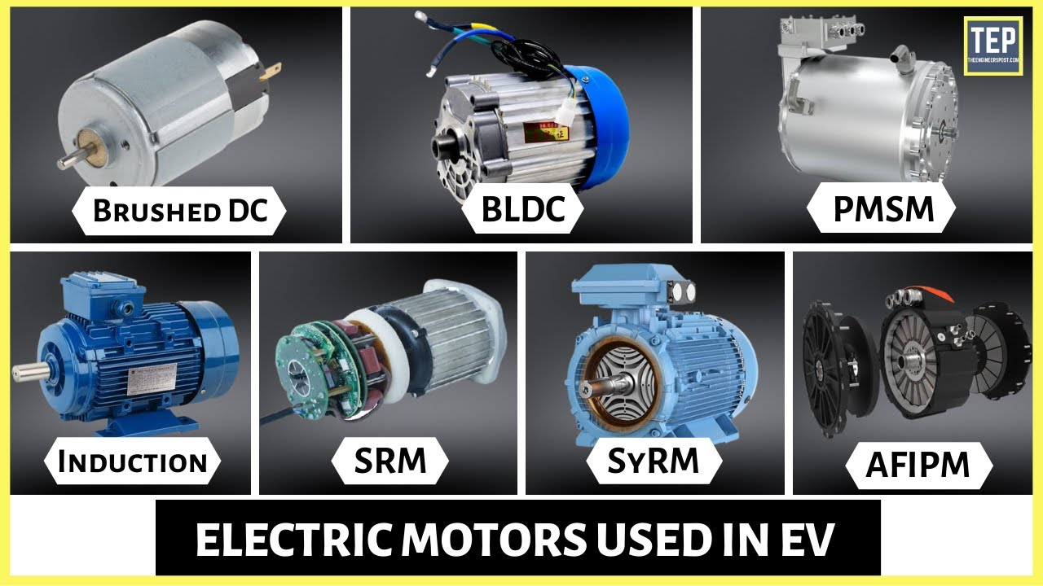
Various types of Electric Motors used in Electric Vehicles
DC Series Motor
Brushless DC Motor
Permanent Magnet Synchronous Motor (PMSM)
Three Phase AC Induction Motors
Switched Reluctance Motors (SRM)

Slide 3
Selection Criteria
Efficiency
Power density
Cost
Controllability
Reliability
Maturity of technology

Slide 4
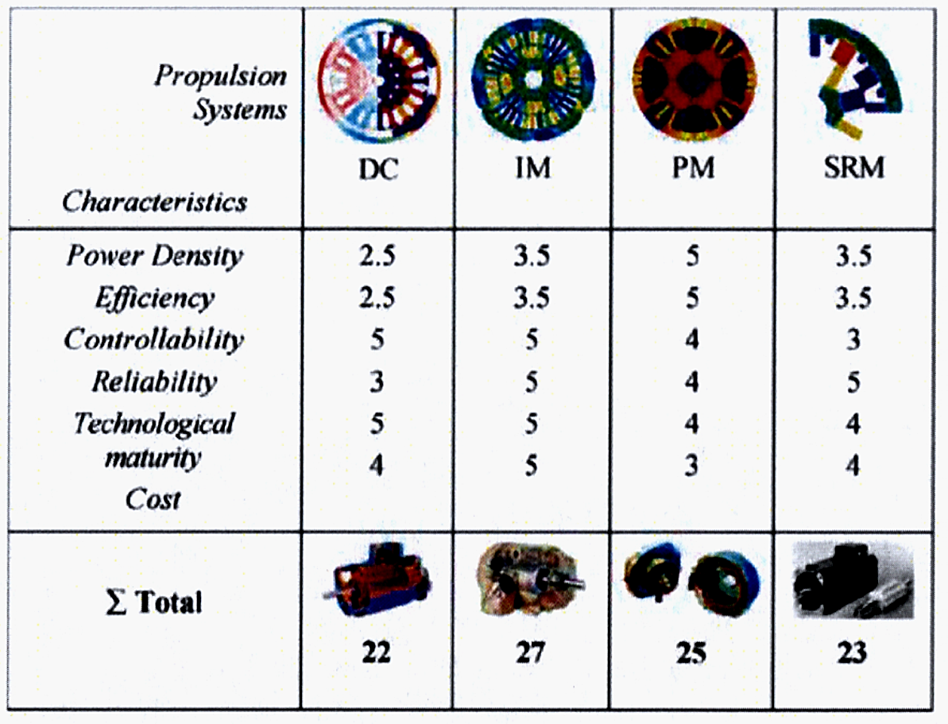
Figure of Merit Analysis

Slide 5
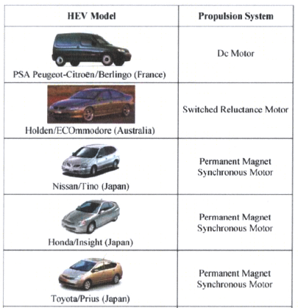
COMMON EVs AND THEIR PROPULSION SYSTEMS

Slide 6
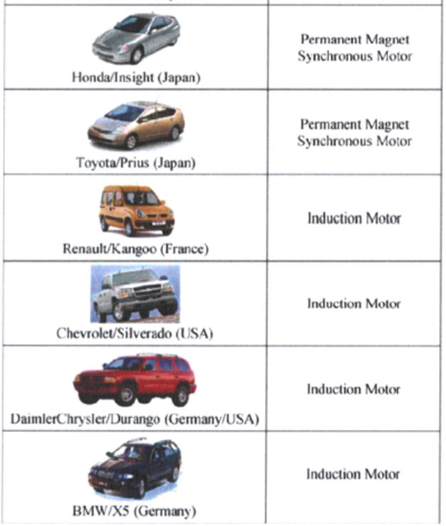
COMMON EVs AND THEIR PROPULSION SYSTEMS

Slide 7
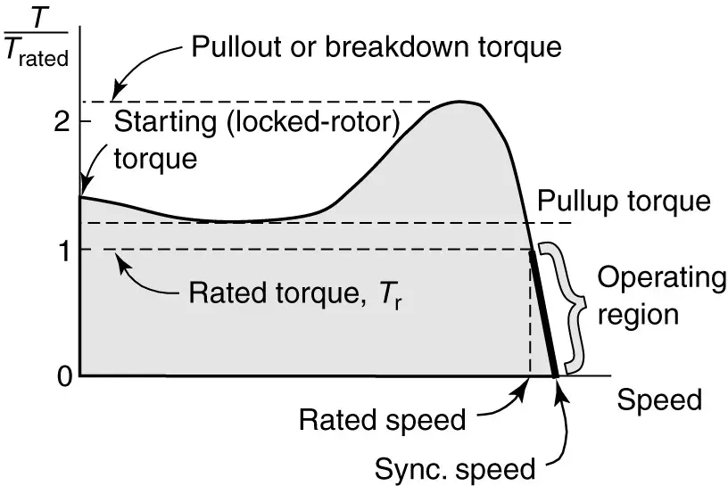
Torque Speed Characteristics of An Induction Motor w/o Electronics

Slide 8
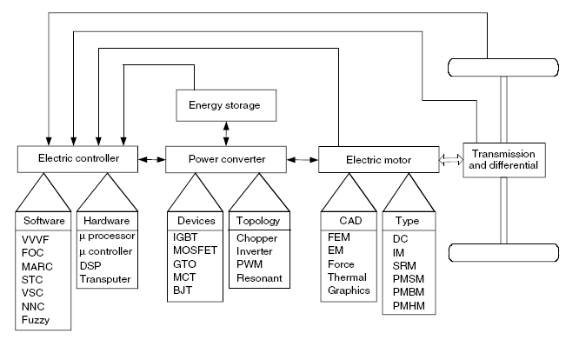
Functional Block Diagram of A Typical Electric Propulsion System

Slide 9
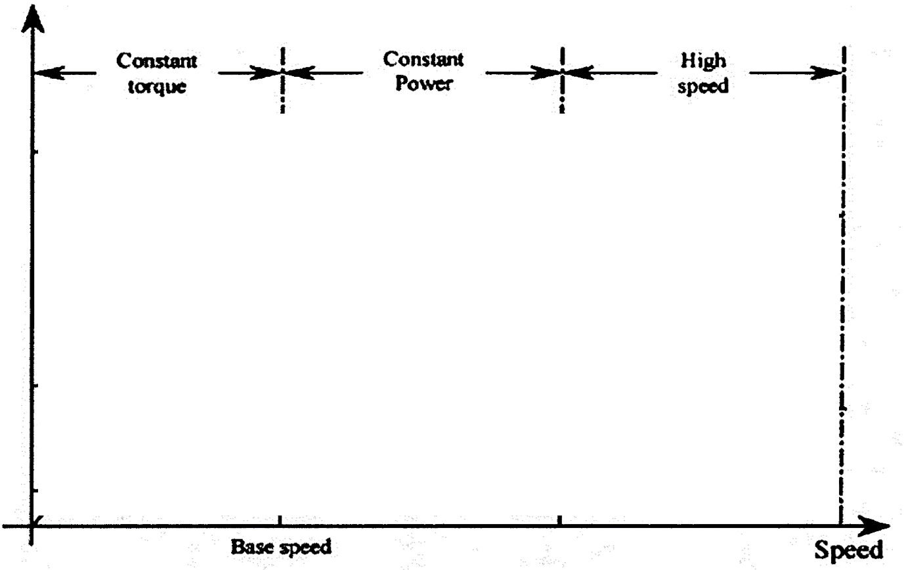
Variable Speed Operation of Motor + Electronics
Torque
Voltage/Power
Current

Slide 10
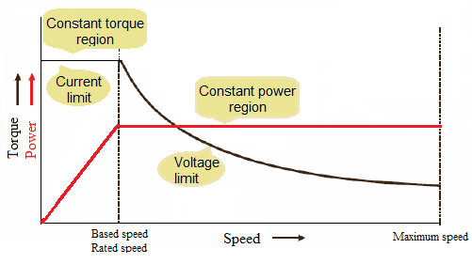
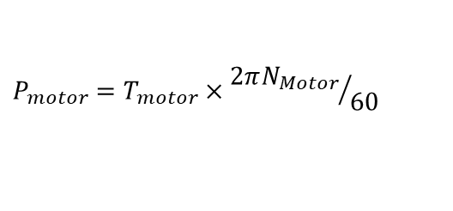
Characteristics of A Typical variable-speed electric motor
The range of the constant power operation depends primarily on the particular motor type and its control strategy.
$$P_{motor}=T_{motor}×{2πN_{Motor}}/{60}$$

Slide 11
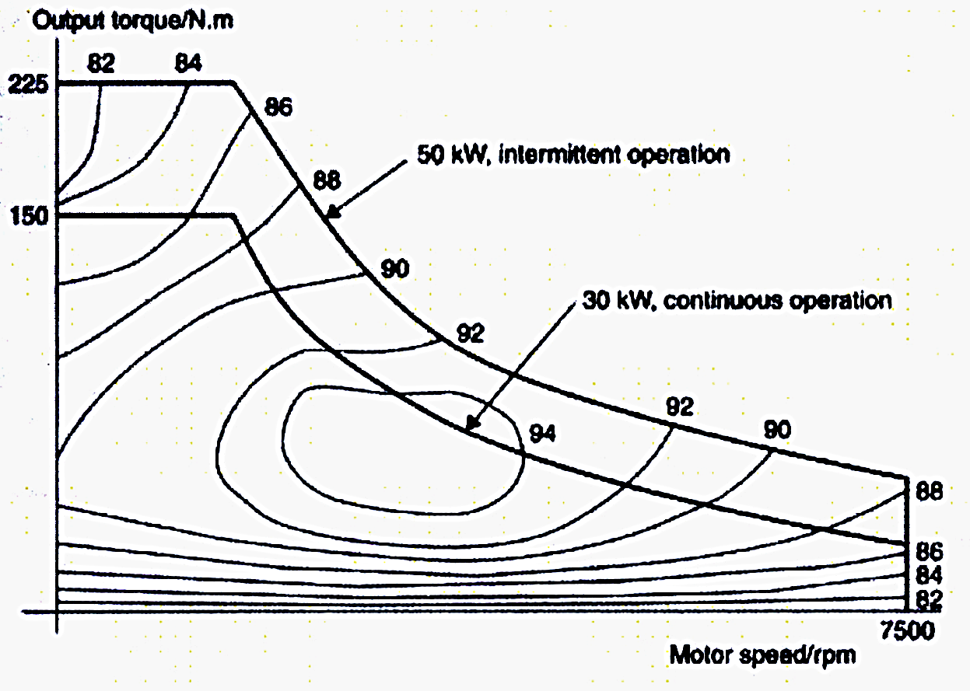
Nominal Characteristics of A Motor

Slide 12
Speed Ratio of Typical variable-speed electric motor
The maximum speed at which a motor generates a constant (maximum) torque is known as base speed.
The highest speed at which the motor generates constant maximum power is known as maximum speed.
This characteristic is usually represented by a speed ratio x, defined as the ratio of its maximum
speed to its base speed.

Slide 13
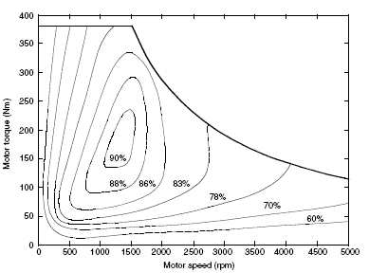



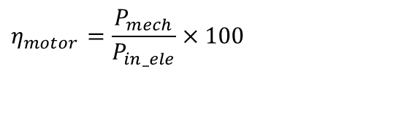

Performance of A Direct Powered Electric Vehicle
$$η_{motor}=\frac{P_{mech}}{P_{in_ele}}×100$$

Slide 14
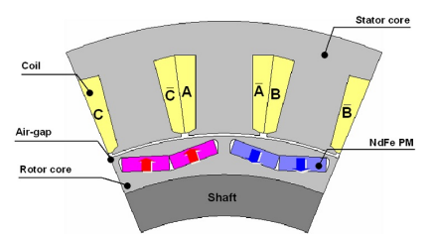
Metals Used in EV Motors

Slide 15
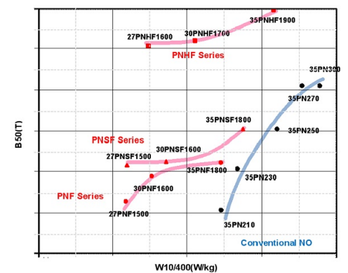
The products map of newly developed electrical steel for EVMs

Slide 16
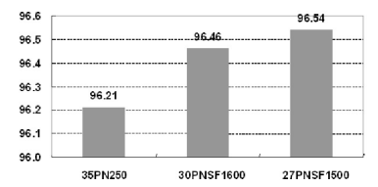
Impact of Steel Quality on Maximum EM Efficiency

Slide 17
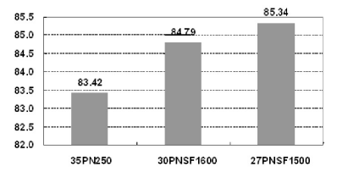
Impact of Steel Quality on EM Efficiency at High Speed

Slide 18
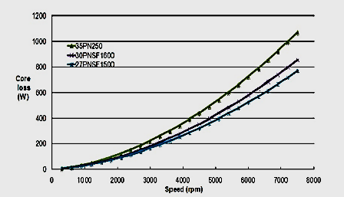
Impact of Steel Quality on Core Losses

Slide 19
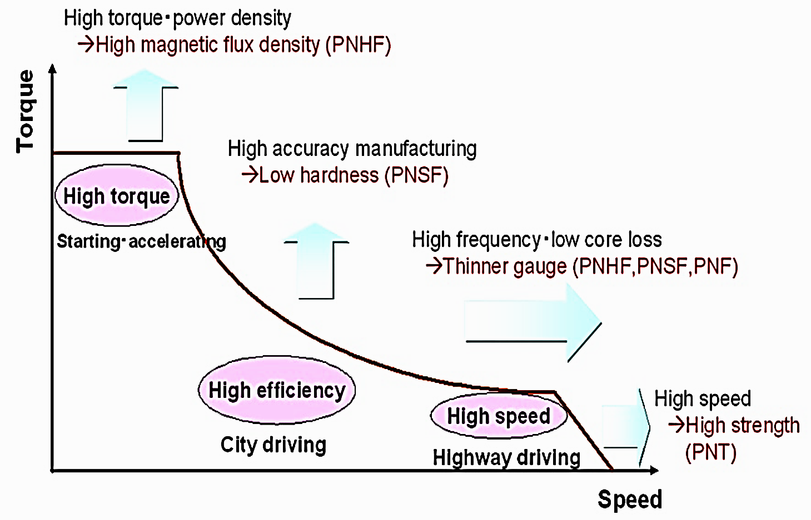
Performance, Utility & design of an Electric Motor

Slide 20
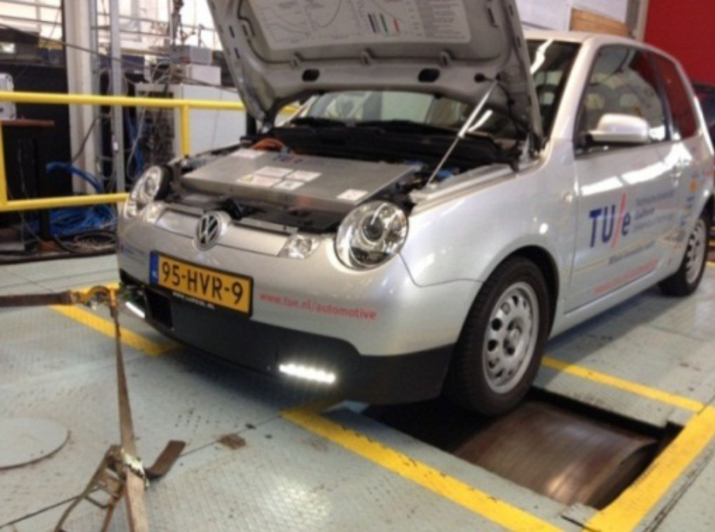
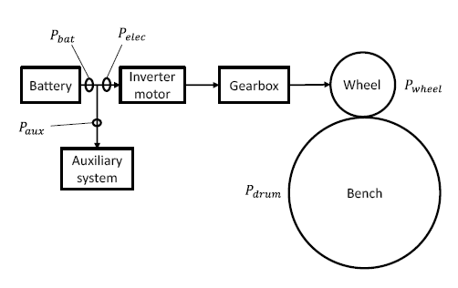
The Dynamometer Tests
Constant vehicle speed Test
Constant Power Test
Constant Torque Test

Slide 21
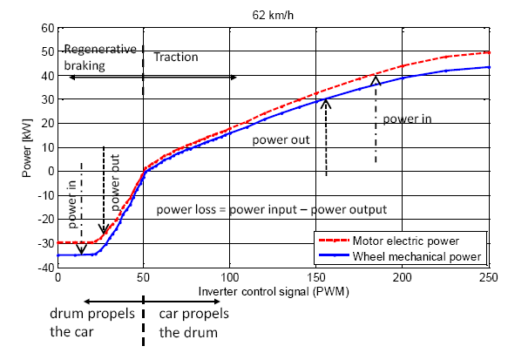
Motor Power Vs Wheel Power

Slide 22
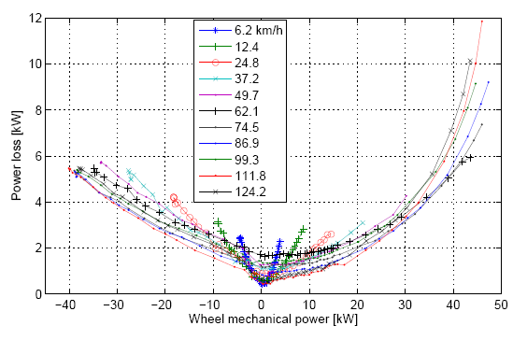
Motor Power Vs Power Train Losses

Slide 23
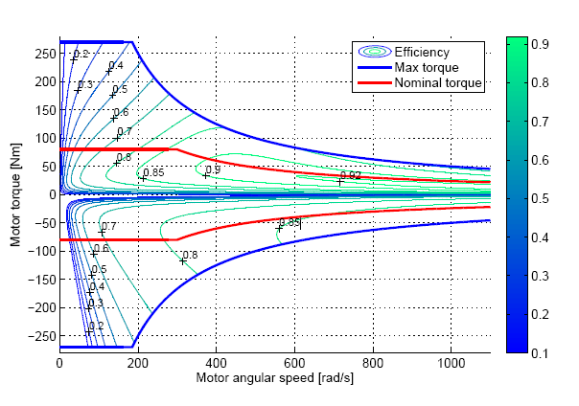
Energy Efficiency of Power Train

Slide 24
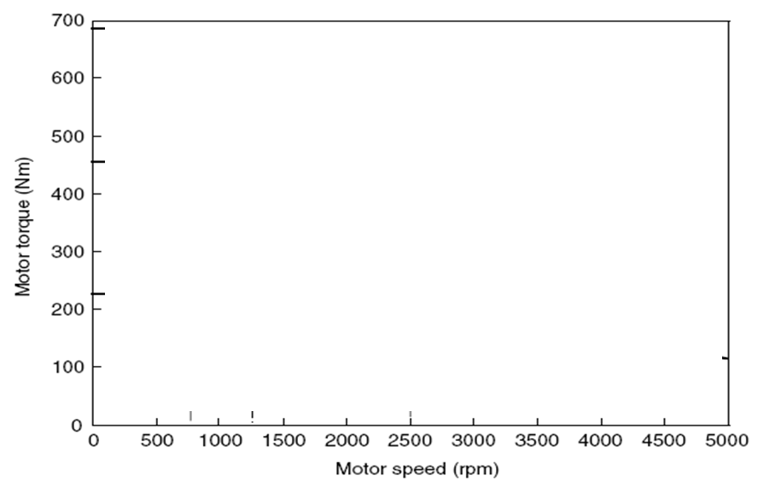
Speed ratio & Speed–torque profile of a 60 kW electric motor: No Gear
X=4
Resistance Torque due to aerodynamic Drag +RR

Slide 25
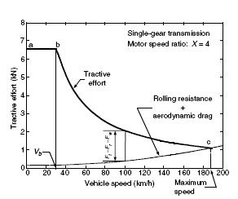
Tractive effort vs. vehicle speed with a traction motor of x =4
X=4

Slide 26
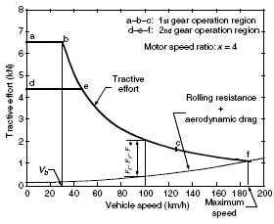
Tractive effort vs. vehicle speed with a traction motor of x =4

Slide 27
Mechanical Performance of EVs
In practice, automobile manufacturers and firms specializing in mechanical performance estimate the efficiency of electric vehicles by taking several factors into consideration.
The measurement process first requires testing the charging conditions and battery efficiency to find out how much energy is being injected.
The electric car, assessed on its average speed and energy recovery, is then driven in everyday situations and along typical routes, to calculate the number of kilometres travelled on a single charge.
The ratio between the two values obtained shows that the efficiency of an electric motor is three to four times higher than that of a gasoline or diesel combustion engine of equal power.

Slide 28
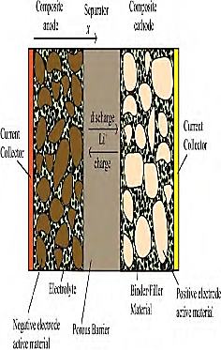
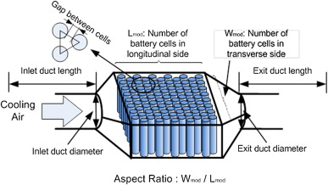
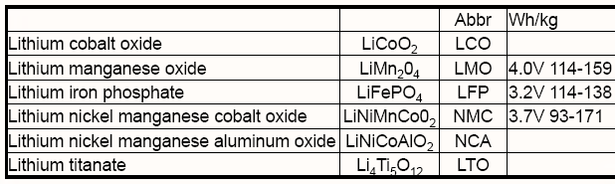
Structure of an EV Battery

Slide 29
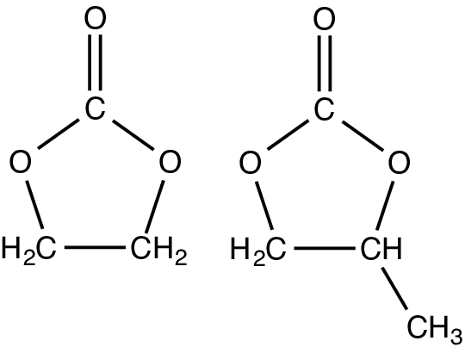
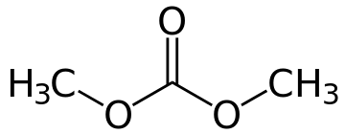
Electro-chemistry : 3.2 VDC
CHEMISTRY: (LITHIUM IRON PHOSPATE) LiFePO₄
_{2-Part Reaction:}
LiFePO₄ ←→ FePO₄ ← Electrolyte → Li + e- + C ←→ LiC₅
Cathode (+ electrode) Anode (- electrode)
Aluminum Current Collector Copper Current _{Collector}
→ _{Left to right is Charging.}
←_{Right to Left is Discharging.}
_{CELL VOLTAGE:}
Ethylene Carbonate (EC) /Dimethylcarbonate (DMC)

Slide 30
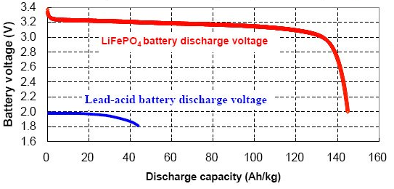
Capacity of A Battery
(LITHIUM IRON PHOSPATE)
_{Nominal Voltage:}
The average voltage is where the flat part of the curve intersects the green line. This is the “nominal cell voltage” @ 3.2 vpc.
The capacity per kilogram is nearly 3.5 times that of lead acid high rate batteries.
Difference in discharge
capacity/kg

Slide 31
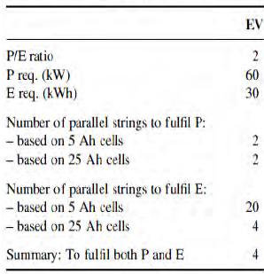
Details of A Typical EV Battery

Slide 32
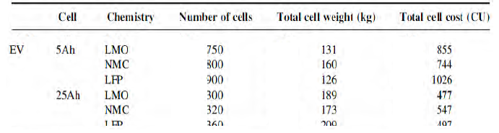
Details of A Typical EV Battery

Slide 33
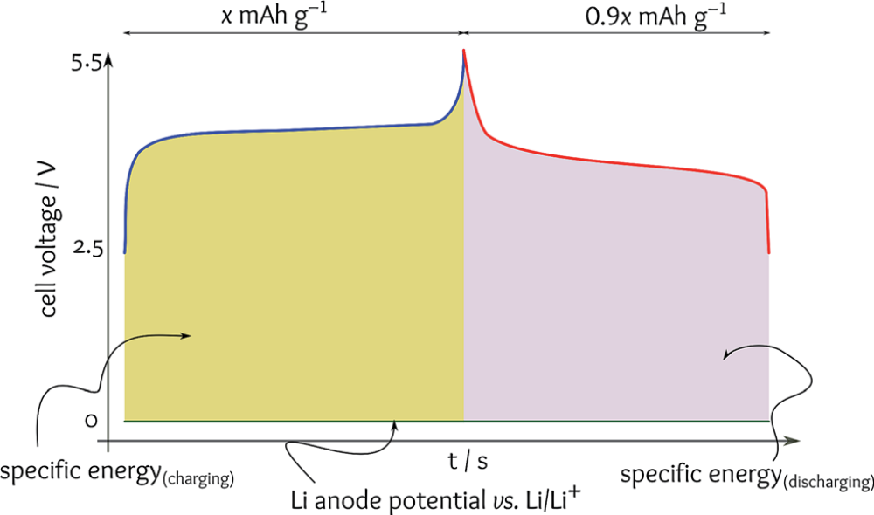
A typical model of the charge/discharge profile of a Li/LiCoO2 full cell.
Fluid,

Slide 34
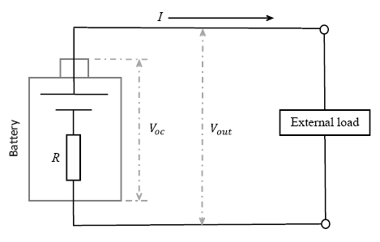
Battery model
The 85 kWh battery pack weighs 540 kg and contains 7,104 Lithium-ion battery cells in 16 modules wired in series.

Slide 35
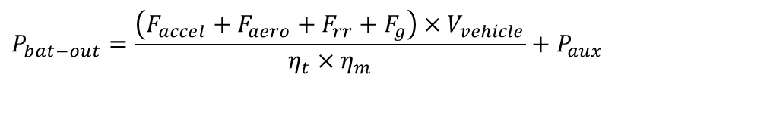
Energy Consumption
The energy consumption per unit distance in kWh/km is generally used to evaluate the vehicle energy consumption.
Energy consumption is an integration of the power output at the battery terminals.
For propelling, the battery power output is equal to resistance power and any power losses in the transmission and the motor drive, including power losses in electronics.
The power losses in transmission and motor drive are represented by their efficiencies η_{t} and η_{m} respectively.
Thus, the battery power output can be expressed as
$$P_{bat−out}=\frac{\left(F_{accel}+F_{aero}+F_{rr}+F_{g}\right)×V_{vehicle}}{η_{t}×η_{m}}+P_{aux}$$

Slide 36
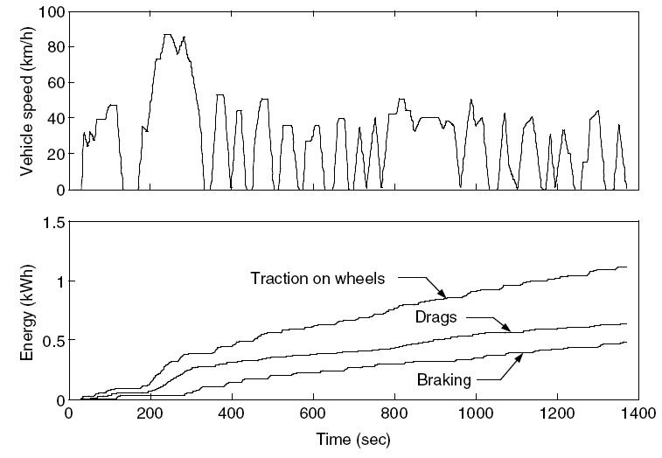
City Cycle : Total traction energy and energies consumed by drags and braking

Slide 37
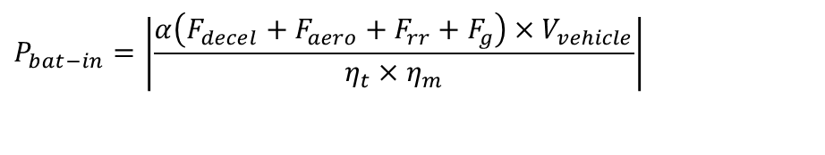
Regeneration
The major advantage of EV is the possibility of regeneration during breaking.
When regenerative braking is effective on an EV, a part of that braking energy is recovered by operating the motor drive as a generator and restoring it into the batteries.
The regenerative braking power at the battery terminals can also be expressed as
$$P_{bat−in}=\left|\frac{α\left(F_{decel}+F_{aero}+F_{rr}+F_{g}\right)×V_{vehicle}}{η_{t}×η_{m}}\right|$$
where road grade or deceleration (dV/dt) or both of them are negative.
α (0 < α <1) is the fraction of the total braking energy that can be applied by the electric generator, called the regenerative braking factor

Slide 38
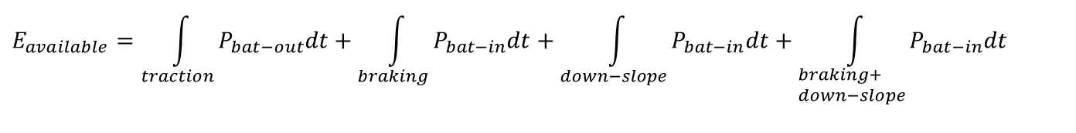
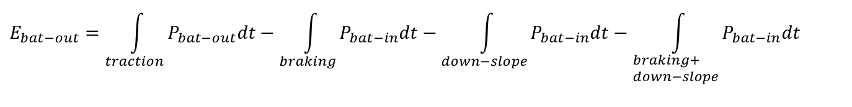
Net Energy Consumption
The regenerative braking factor α is a function of the applied braking strength and the design of the power train.
The net energy consumption from the batteries is
$$E_{bat−out}=\int_{traction}{P_{bat−out}dt}−\int_{braking}{P_{bat−in}dt}−\int_{down−slope}{P_{bat−in}dt}−\int_{\begin{aligned}&braking+ \\ &down−slope\end{aligned}}{P_{bat−in}dt}$$
$$E_{available}=\int_{traction}{P_{bat−out}dt}+\int_{braking}{P_{bat−in}dt}+\int_{down−slope}{P_{bat−in}dt}+\int_{\begin{aligned}&braking+ \\ &down−slope\end{aligned}}{P_{bat−in}dt}$$

Slide 39
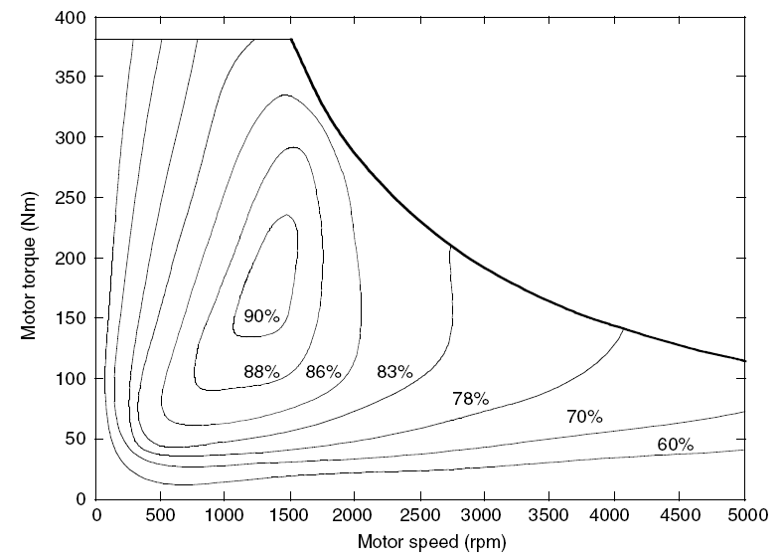
Travel Range
The travelling distance between two charges is called effective travel range.
This is determined by the total energy carried by the batteries, the resistance power, and the effectiveness of the regenerative braking (α).
The efficiency of a traction motor varies with its operating points on the speed–torque, where the most efficient operating area exists.
In power train design, most efficient area should overlap with or at least be as close as possible to the area of the greatest operation.

Slide 40
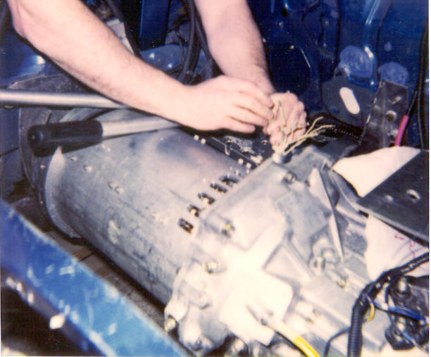
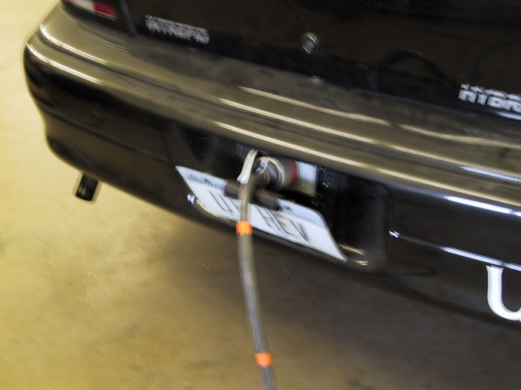
Energy and Power Needs
Rate is a problem.
Example: refill a gas tank with 15 gal in 5 min.
The energy rate is roughly that of 20 major campus buildings!
It is costly and problematic to fill batteries quickly.

Slide 41
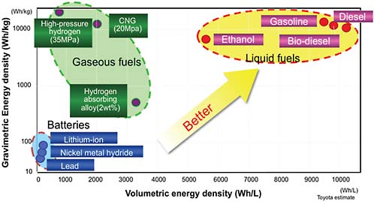
Compactness of An Energy Source

Slide 42
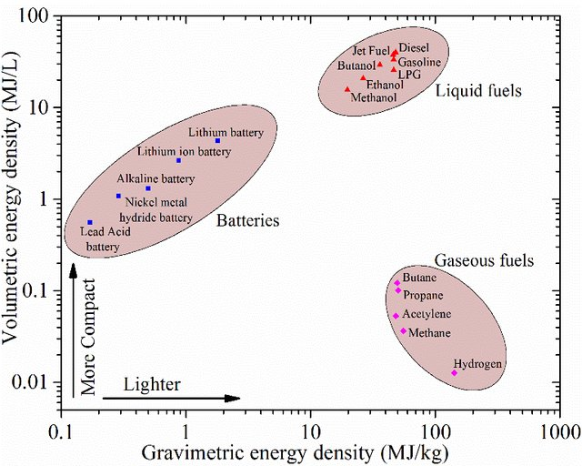
Compactness of An Energy Source: 2017

