Slide 1

21st Century Secular S.I. Engines
P M V Subbarao
Professor
Mechanical Engineering Department
I I T Delhi
Next Generation Eco-friendly SI-IC Engines…

Slide 2

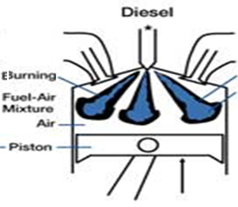
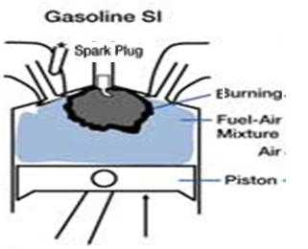
BEST Qualities of Two Religions in I.C. Engines
The Free Religious Engine
High power at full load
→ High CR, high ηvol.
High Fuel economy
→ Distinctly stratified charge,
Quality governing
Lower HC, PM & NO_{x}.

Slide 3
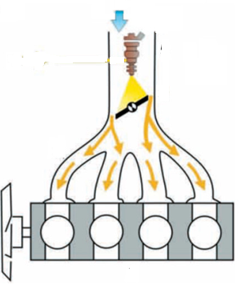
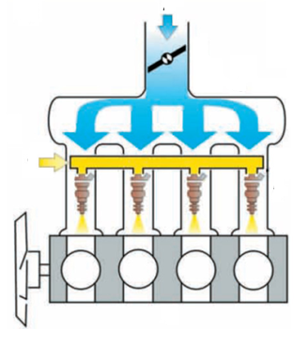
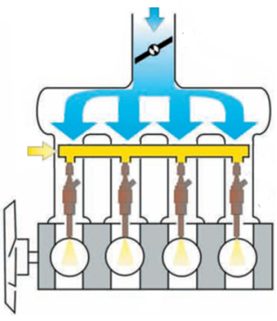
Evolution of Fuel Inductions Systems in SI Engines

Slide 4
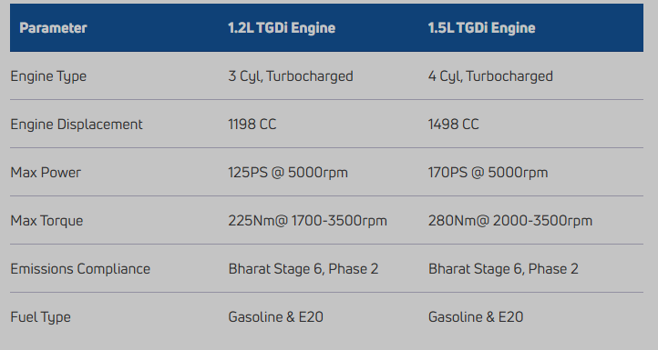
Automobiles with GDI I.C. Engine
2023 Hyundai Creta 1.5-litre turbo petrol engine: The new 1.5-litre turbo petrol unit or as Hyundai calls it, the G1.5 T-GDI engine. The turbo petrol unit’s total power out is 158bhp at 5,500rpm.
Tata Motors is bringing two new exciting Turbocharged Gasoline Direct Injection (TGDi) engines

Slide 5
Challenging Fluid Mechanics of Fuel Admission
GDI : 50 – 100 bar
Multi Poin Injection : ~ 5 bar
Driving Pressure
Single Point Injection 2 – 3 bar
Carburetor : 20 – 50 Pa
Technology of Fuel Admission

Slide 6
Fluid Mechanics of Fuel Admission
GDI : 20 – 50 μm
Multi Poin Injection : ~ 200μm
Droplet size
Single Point Injection 100 – 300μm
Carburetor : 1 ~ 3 mm
Technology of Fuel Admission

Slide 7
Performance of GDI-SI Engine
GDI engine
power
MPI engines
Carburetor
GDI engine
Fuel economy
Diesel engine
MPI engine
Carburetor
A/F ratio

Slide 8
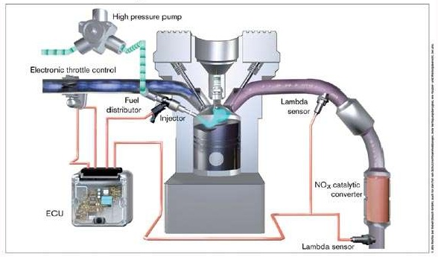
Structure of GDI Engine

Slide 9
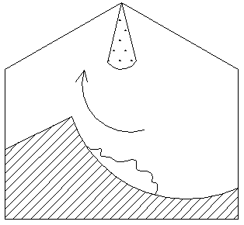
In-Cylinder Flow Geometry of A GDI Engine
Injection of gasoline directly inside the cylinder at high pressure.
Enhanced evaporation and mixing are facilitated through turbulent flow inside the cylinder.
Can generate homogeneous or stratified mixture.
Ultra lean mixtures can be used.
A Comprehensive use of Advanced Fluid Mechanics in the design and development of IC engines.

Slide 10
Objectives for the development of GDI engine
Very high fuel economy
Superior power output  than MPFI engine
Acceptable levels of (HC) emissions
It is basically a combination of two engine caring philosophies.

Slide 11
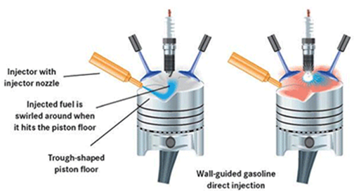
Critical Design Issues : GDI

Slide 12
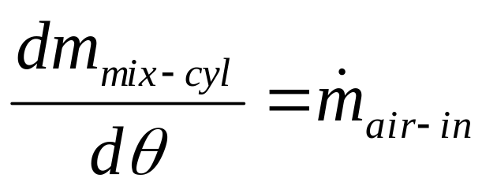
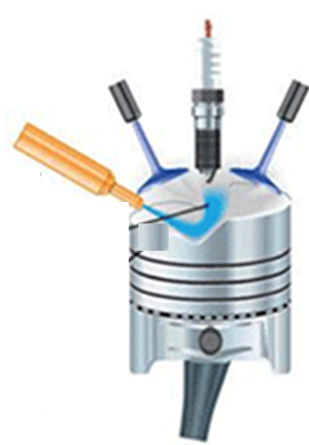
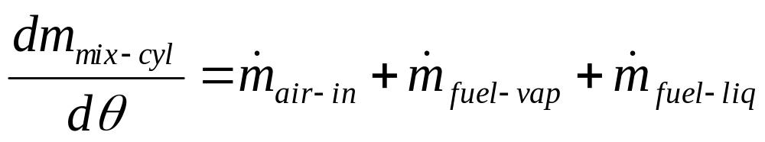
Air Flow Through Intake Valves : with Fuel Injection
GDI Engine:
MPFI Engine:

Slide 13
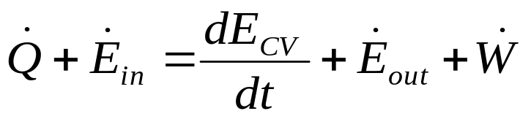
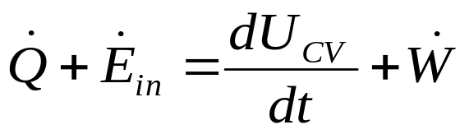
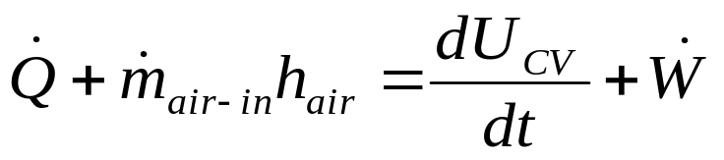
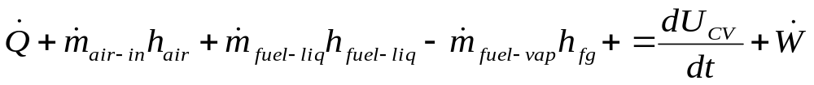
Variation of In-cylinder temperature during Intake
First law for USUF :
GDI Engine:
MPFI Engine:

Slide 14
Operating modes of the GDI engine
Superior output mode : SOM
Injection in late intake stroke
Wider spray with high penetration for charge homogenization
A/F – Stoichiometric
Homogeneous A-F Mixture
Complete Vaporization of Fuel
Ultra Lean combustion mode : ULCM
Very lean stratified mixture : A/F ~ 30
Injection during compression
Compact spray, deflected from the piston top to the spark plug
Distinct Stratification
At spark , ignitable mixture conditions
It is two engines in one place

Slide 15
Experimental Research @ IIT Delhi
A special purpose test rig was developed in IC engine laboratory of Mechanical Engineering Department, IIT Delhi, to investigate the characteristics of GDI engines.
A four stroke engine of Kawasaki Bajaj two wheeler is modified to work as GDI engine.
A mechanical driven petrol injector is placed in the cylinder head.
Pistons with various geometries of cavities (Cylindrical, Conical & Spherical) are tested using a compression ratio of 9.3 at various speeds.
Following preliminary results are obtained.

Slide 16
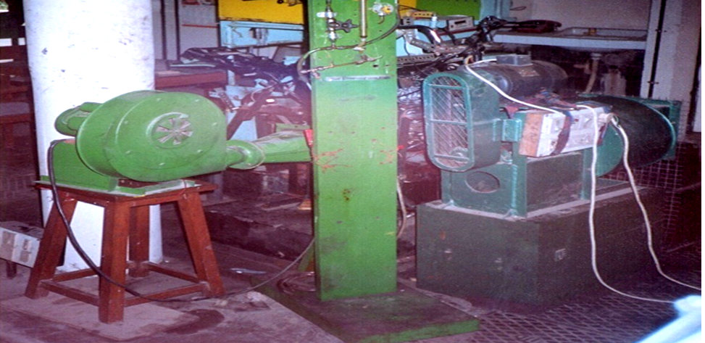
Kawasaki Bajaj two-wheeler Engine Test Rig

Slide 17
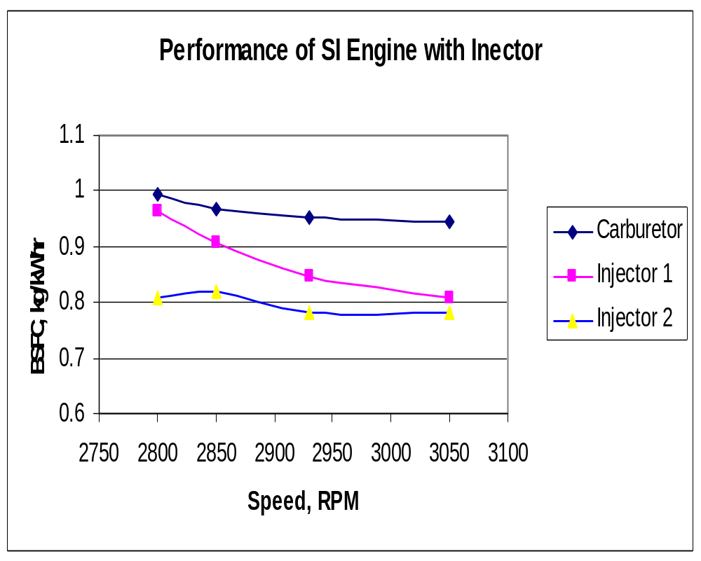

Slide 18
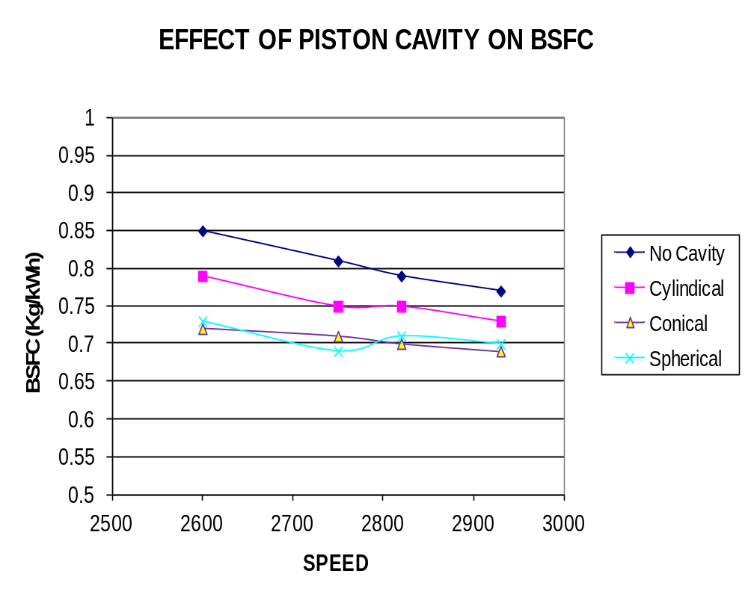

Slide 19
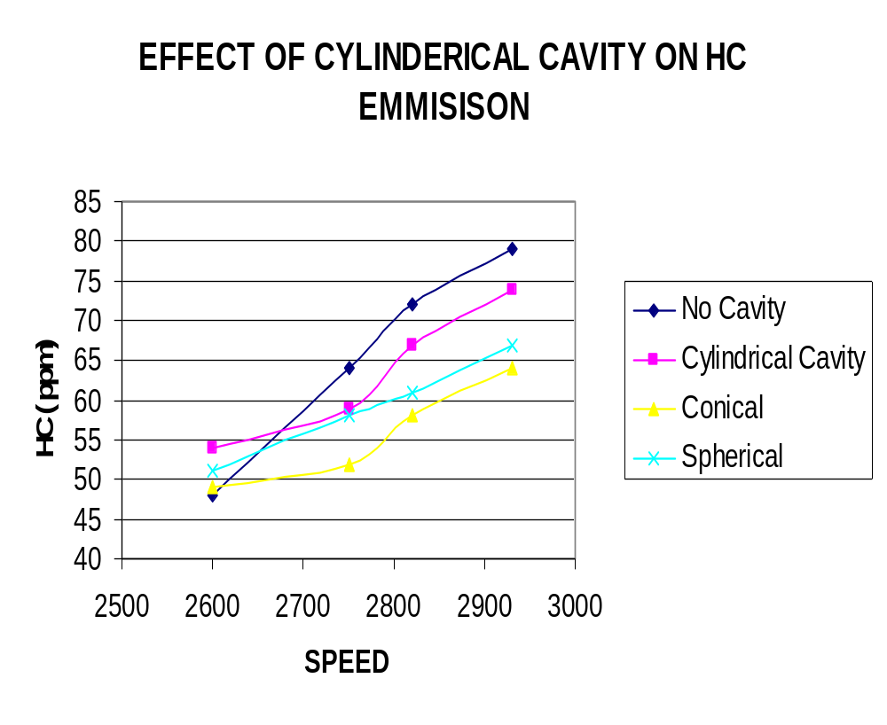

Slide 20
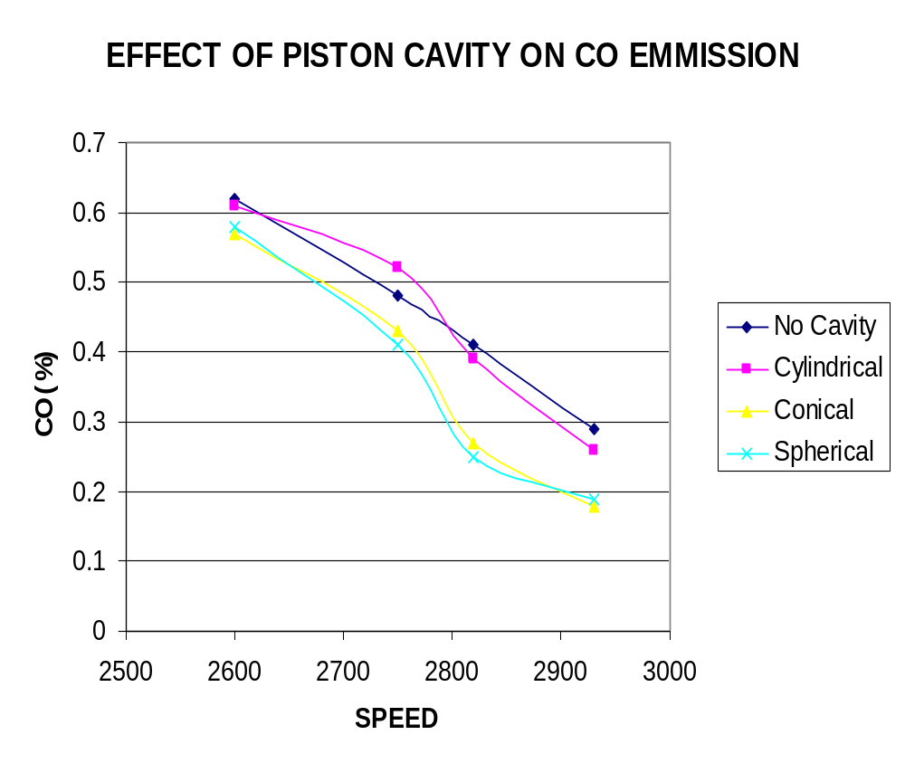

Slide 21
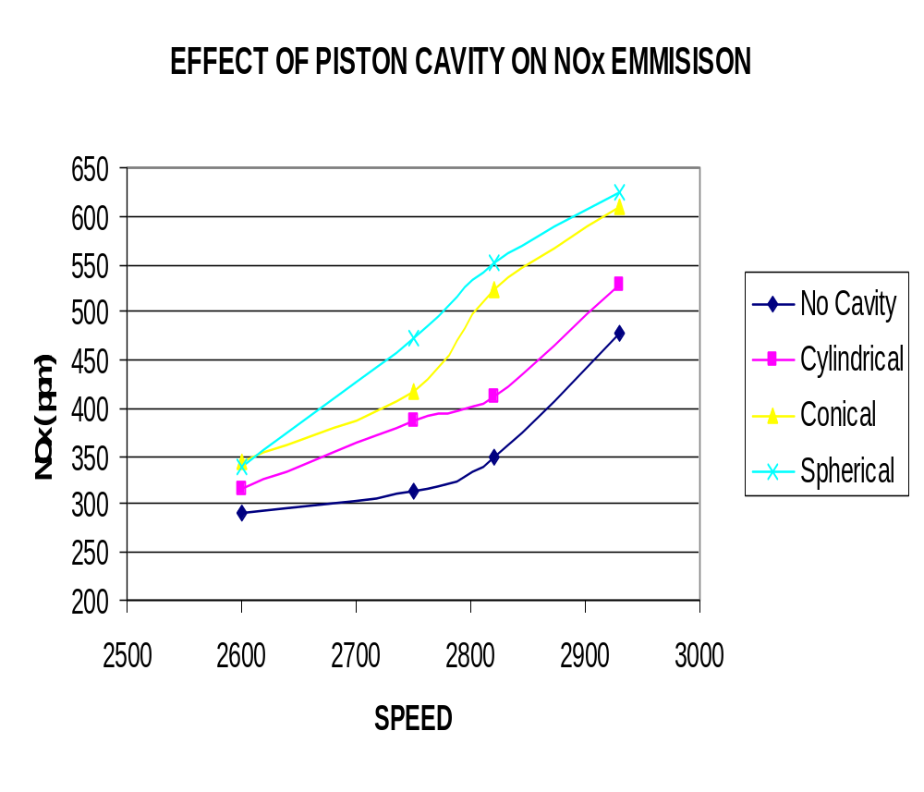

Slide 22
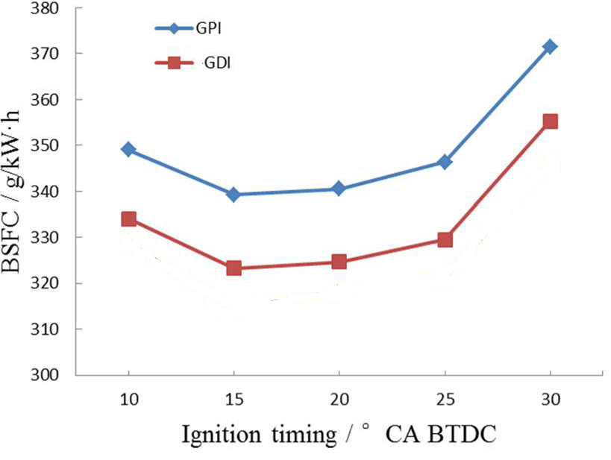
Fuel Economy in GDI

Slide 23
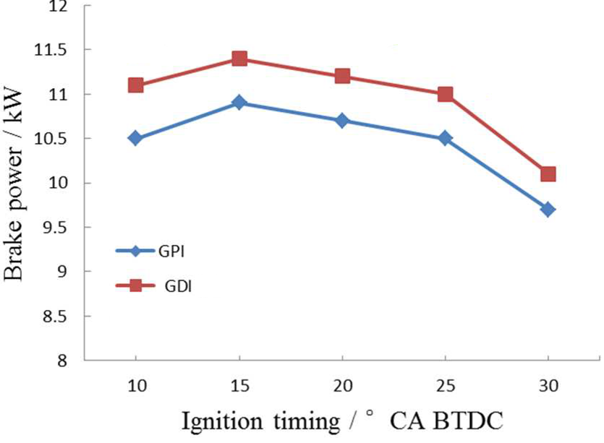
Compactness of GDI Engine

Slide 24
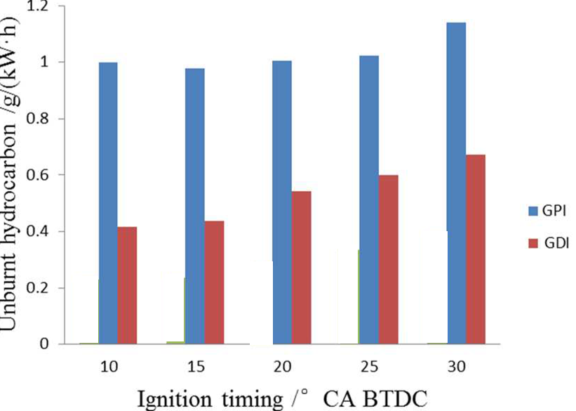
Lowered HC Emissions in GDI Engine

Slide 25
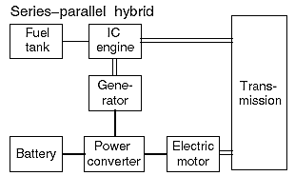
Advanced Architectures of Hybrid Electric Drive Trains
Constant Speed:
HCCI-DI Engines
GDI – SI Engines
RCCI-DI Engines
Regeneration

Slide 26
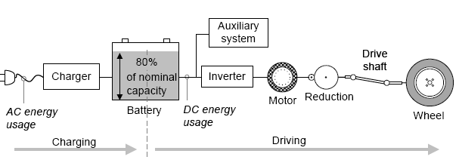
Energy Flow of A Battery Electric Vehicle

Slide 27
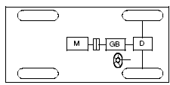
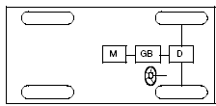

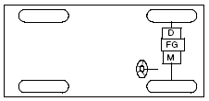
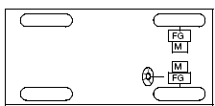
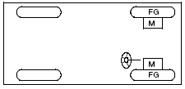
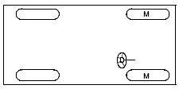
Present and Future configurations for an Electric Vehicle

Slide 28
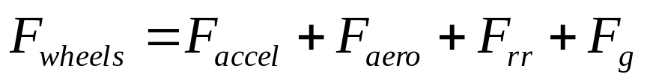

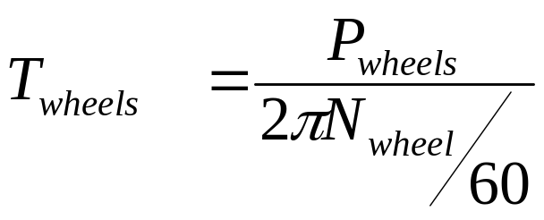
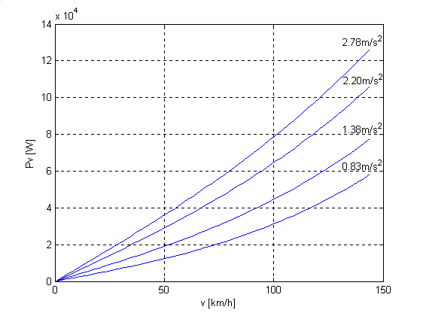

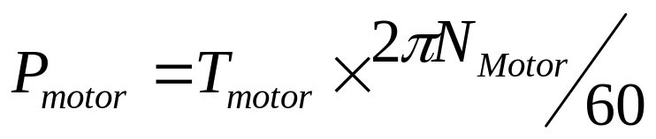
Resistance & Power Requirement at Wheels : City Driving

Slide 29
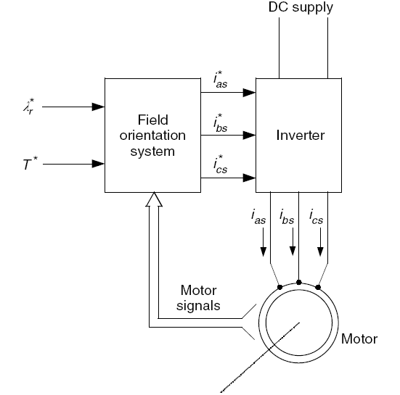
Motors in 2017 EVS
Tesla Models S & X : Three phase, four pole AC induction motor with copper rotor Drive inverter with variable frequency drive and regenerative braking system.

Slide 30
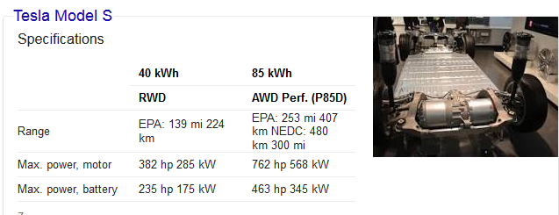
The Model X's all-wheel drive system uses two motors (one for the front and the other for the rear wheels).
The Tesla Model X 100D features an official EPA rated range of up to 295 mi, and a European NEDC testing cycle estimated range of 565 km.

Slide 31
Energy Flow of A Battery Electric Vehicle
https://www.ev-resource.com/bev-system-components.html

