Slide 1

Free Religion Compression Ignition Engines
P M V Subbarao
Professor
Mechanical Engineering Department
I I T Delhi
Eco-friendly Combustion in CI engines…..

Slide 2

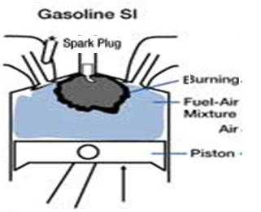
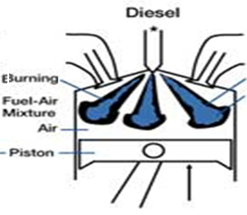
Religious I.C. Engines

Slide 3

CI Religion in I.C. Engines
Diesel Engines
→ High CR
→ No throttling , quality governed,
High fuel economy at part load
Best suited for low SIT fuels
Very good & faster reacting fuels
Low HC emissions
Low specific power
Heterogeneous combustion
High NOx and PM (Smoke)

Slide 4

SI Religion in I.C. Engines
MPFI Engines
High Specific Power
Homogeneous combustion
Very Low PM & low Nox
Best suited for High SIT Fuels
Very good for slow reacting fuels
High HC emissions
Poor performance at part load

Slide 5
BEST Qualities of Two Religions in I.C. Engines
The Free Religious Engine
High power at full load
→ High CR, high ηvol.
High Fuel economy
→ Distinctly stratified charge,
Quality governing
Lower HC, PM & NO_{x}.

Slide 6
BEST Qualities of Two Religions in I.C. Engines
Why SI Engine needs to be Homogeneous mixture only?
Why can not CI Engine use Homogeneous mixture?
Religious Philosophy:
SI Engine – Homogeneous Mixture – Light Fuels
CI Engine – Heterogeneous Mixture – Heavy Fuels

Slide 7
First Level of Free Religion CI Engine for Next Decade
HCCI-DI Engine.
Divide the fuel into Primary (main) and Pilot (Early) Fuel.
Pilot fuel is injected during late intake to early compression and responsible for homogenization.
Primary fuel is responsible for Compression Ignition and injected during later compression.
Split Ratio is the ratio of pilot fuel to total fuel.
Identify the conditions for avoidance of Self Ignition due to Pilot fuel Injection.
Develop a dual injection system.

Slide 8
Fuel Economy of Homogenization

Slide 9
Eco-friendly Behaviour of Homogenization
Smoke Opacity is the fraction (or %) of incident light which is adsorbed or scattered by the particulate matter in exhaust gas.

Slide 10
Effect of Degree of Homogenization : HC Emissions

Slide 11
Effect of Degree of Homogenization : CO Emissions

Slide 12
Effect of Exhaust Gas recirculation

Slide 13
Field Acceptability Testing of HCCI-DI Engine

Slide 14
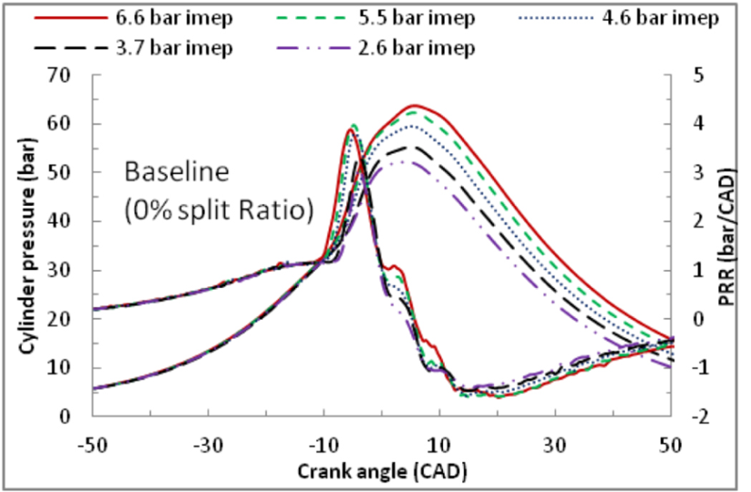
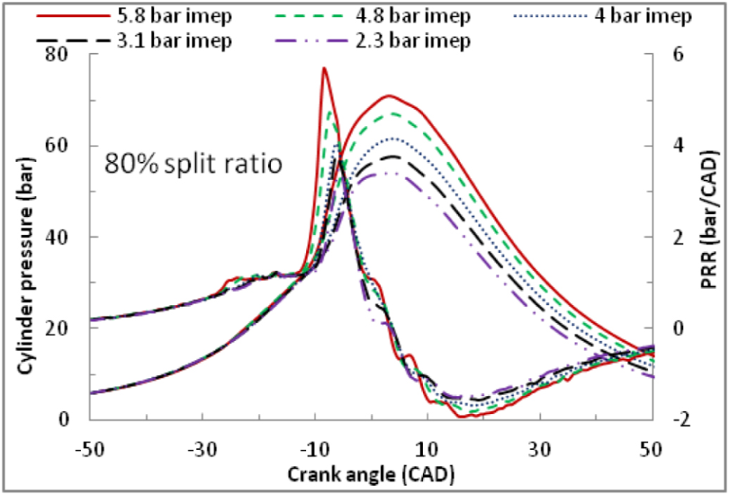
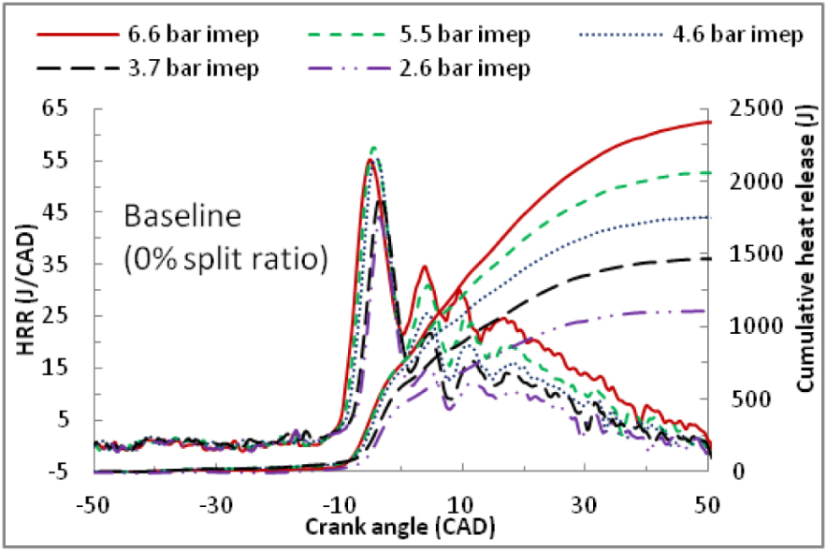
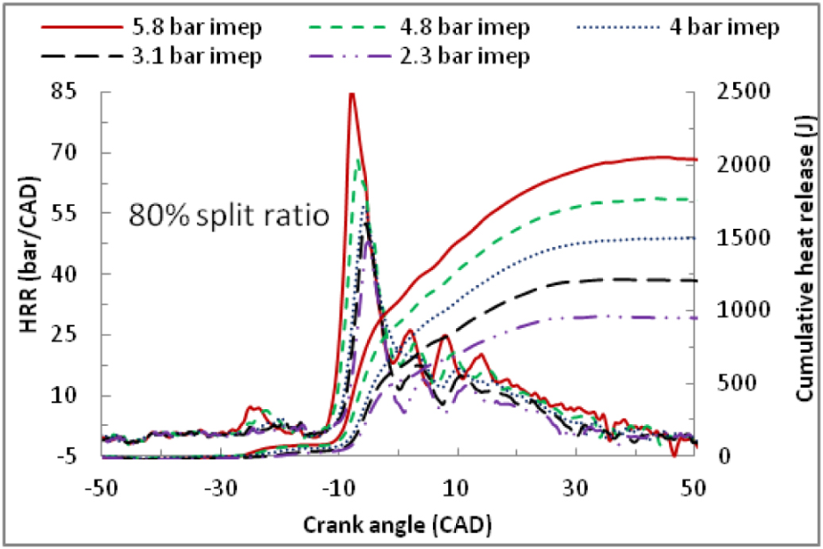
In-cylinder Processes in a Harsh HCCI-DI Engine

Slide 15
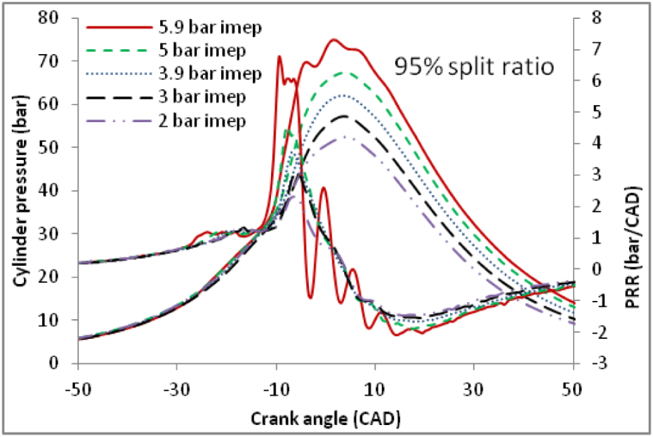
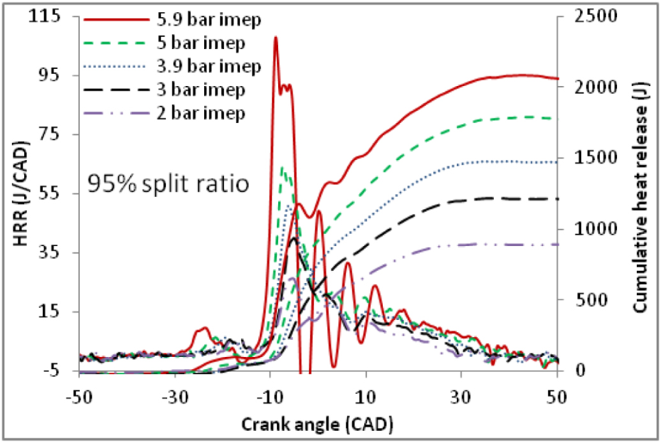
In-cylinder Processes in a Pure HCCI-DI Engine

Slide 16
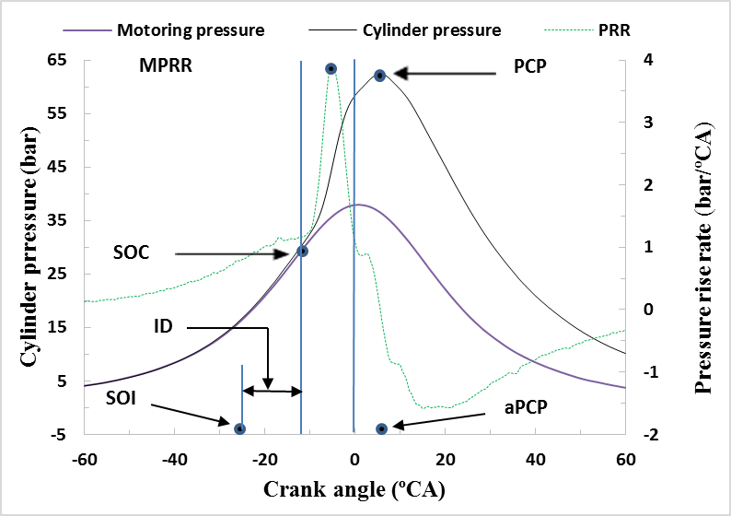
Special Parameters for Combustion Characterization
Identification of Different Combustion Parameters

Slide 17
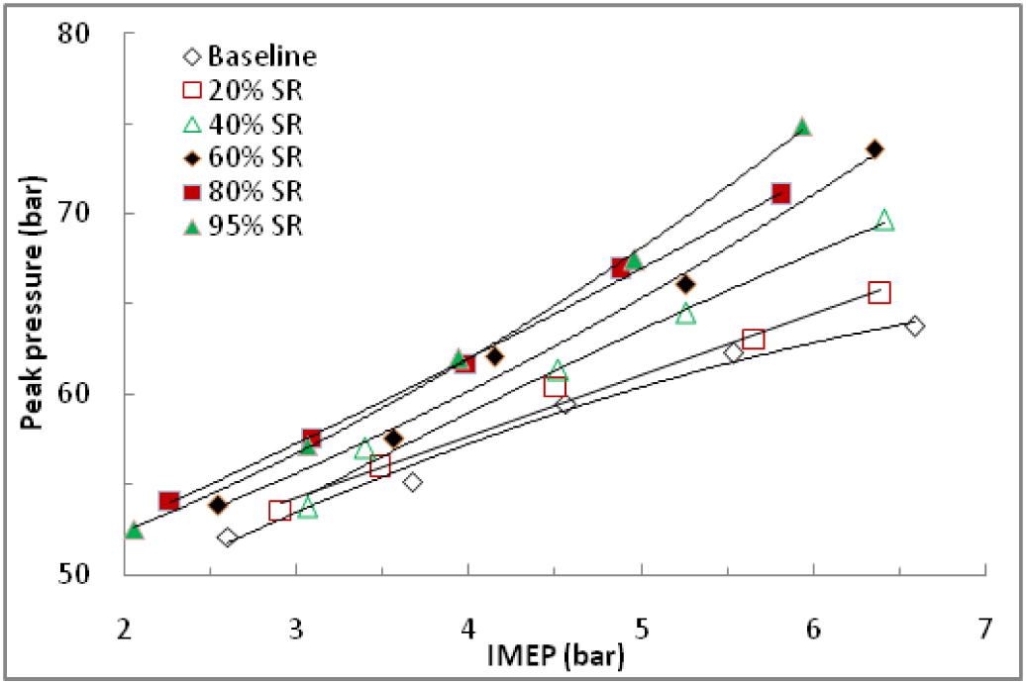
Evolution of CI Engine from Polite to Aggressive Attitude

Slide 18
Belligerent Nature of HCCI Engine

Slide 19
Evolution of Onset of Combustion

Slide 20
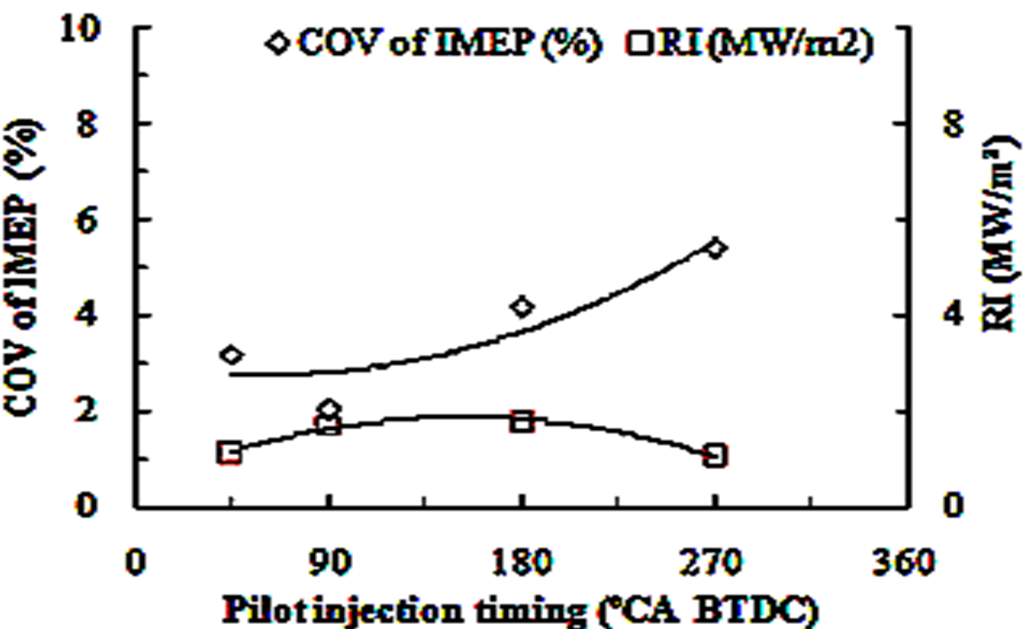
Selection of PIT : For Safe Combustion: 80% HCCI

Slide 21
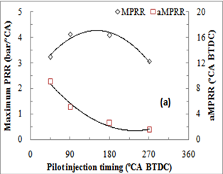
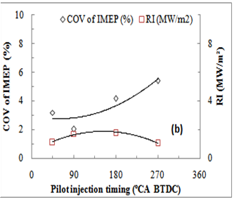
Selection of PIT : For Safe Combustion

Slide 22
Evolution of CI Engine from Polite to Aggressive Attitude in HCCI Mode
There is a need to control rate of combustion reaction in HCCI.

Slide 23
Secular Classification of Fuels
All available fuels are classified based on Reactivity, namely low reactivity fuels and High reactivity fuels.
Low Reactivity fuels: High Octane number or low cetane number.
LRF: Fossil fuels: CNG, Gasoline etc.
LRF Renewable fuels: Bio-gas, ethanol, methanol etc.
High Reactivity fuels: Low Octane number or High Cetane number.
HRF Fossil fuels: Diesel and other heavy fuel oils.
HRF Renewable fuels: Non edible vegetable oils, Bio-Diesel…

Slide 24
Definition of A Secular Engine
A method of creating a partially premix and partially stratified in-cylinder mixture with fuels of opposing cetane rating or reactivity, is basis for development of a secular engine.
Compression Ignition facilitates high compression ratio.
Therefore, a secular engine named as Reactivity Controlled Compression Ignition Engine (RCCI engine) is an ultimate option.
The auto-ignition is initiated by the high cetane rating fuel spray into the low cetane rating fuel-air mixture.
The resulting cetane rating gradient creates varying control (resistances) to onset of subsequent ignition and progress of combustion.

Slide 25

The Engine
Engine specifications
Bore × Stroke (mm) | 116×102
Connecting rod (mm) | 230
Displacement (cc) | 950
No. of valves | 2
Exhaust valve open | 35.5⁰ CA bBDC
Exhaust valve close | 4.5⁰ CA aTDC
Intake valve open | 4.5⁰ CA bTDC
Intake valve close | 35.5⁰ CA aBDC
Max. power (rated) | 10HP @ 1500 rpm
Max. power (de-rated) | 7 HP @ 1500 rpm
Compression ratio | 16 (rated 17.5)
Injection timing (⁰CA bTDC) | 20
Injection pressure (bar) | 200

Slide 26

Schematic layout of RCCI Engine Test Rig

Slide 27
Photographic view of the overall experimental set up

Slide 28

Close photographic view of the engine PFI, DI, head and sensor mounting spot

Slide 29
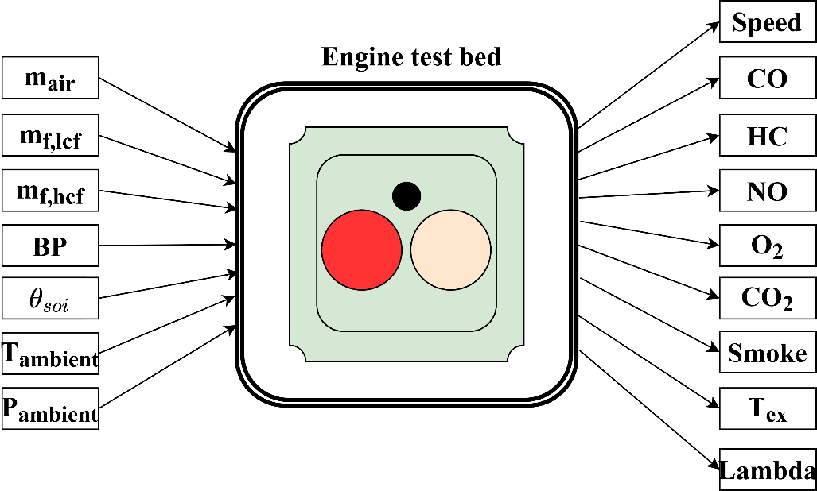
Engine Test Rig & List of Direct Measurements

Slide 30
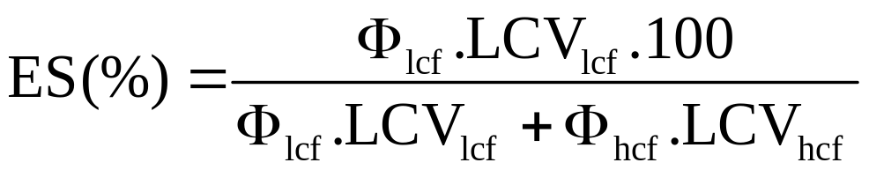
Estimated Input Parameters : Degree of Homogeneity
Energy Share (%)

Slide 31
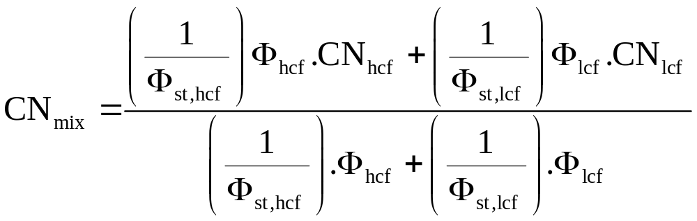


Estimated Input Parameters : Degree of Reactivity
Mixture Cetane Number
The mixture cetane rating (CNmix) is the effective in-cylinder cetane rating due to contributions from both low and high cetane rating fuels

Slide 32
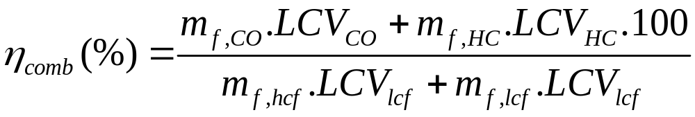
Estimated Performance Parameters : Combustion efficiency

Slide 33
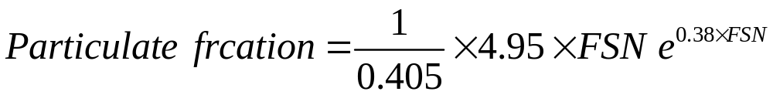
Estimated Performance Parameters : Emissions
Volumetric emissions were converted into g/kWh based on the flow rates and molecular weight considerations.
Conversion of smoke % to g/kWh involved a curve fitting by conversion of measured smoke % to the filter smoke number (FSN) by an empirical formula.
FSN then converted into particulate volume fraction.

Slide 34
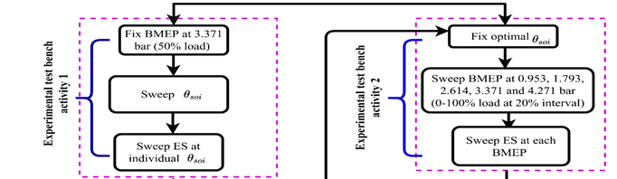
Selection of Optimal Operational Parameters

Slide 35
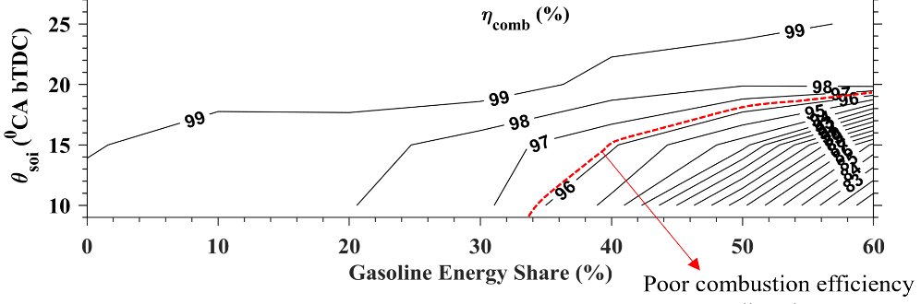
Optimal Selection of Main Fuel Injection Timing
Diesel-Gasoline RCCI

Slide 36
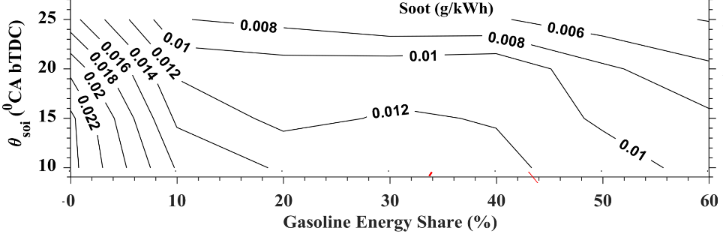
Control of Soot
Diesel-Gasoline RCCI

Slide 37
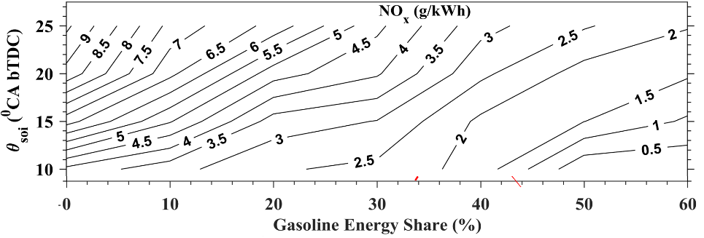
Control of NOx
Diesel-Gasoline RCCI

Slide 38
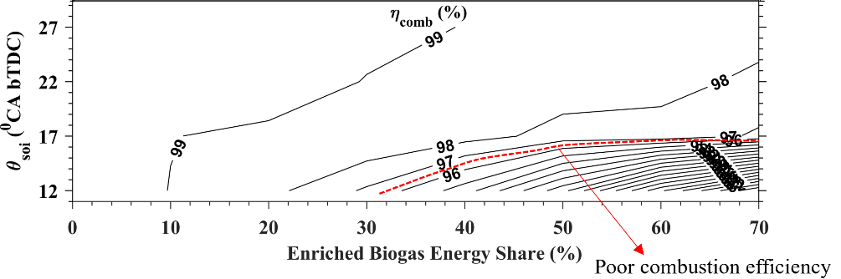
Optimal Selection of Main Fuel Injection Timing
Diesel-Enriched Biogas RCCI

Slide 39
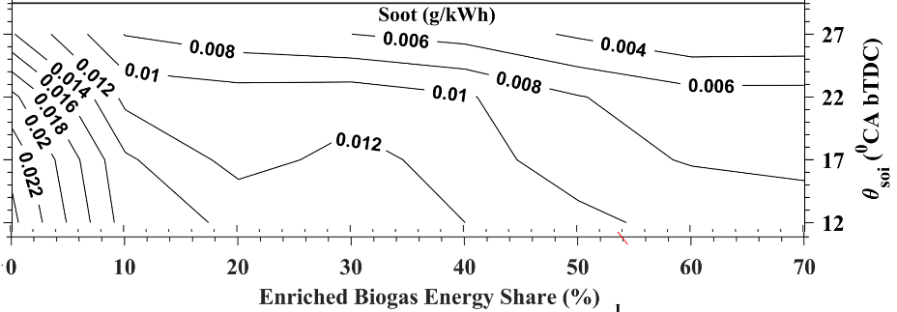
Control of Particulates
Diesel-Enriched Biogas RCCI

Slide 40
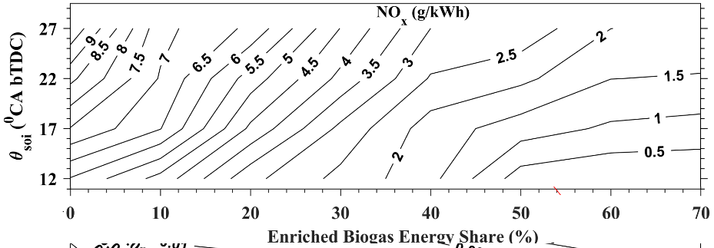
Control of NOx
Diesel-E-Biogas RCCI

Slide 41
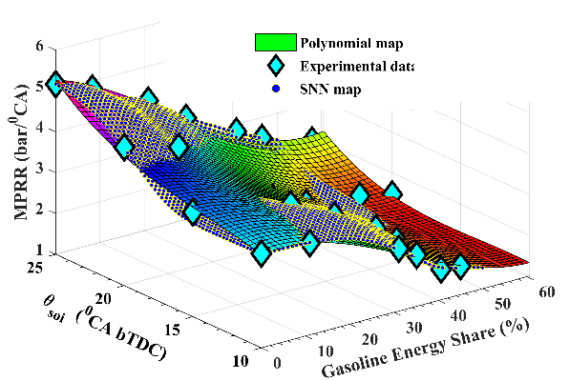
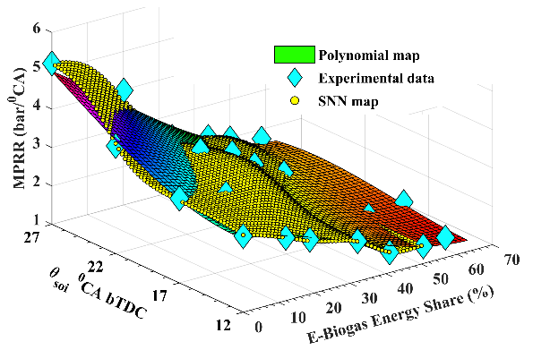
Polite Nature of RCCI Engine

