Slide 1

Green Methods for Eco-friendly Combustion in CI Engines
P M V Subbarao
Professor
Mechanical Engineering Department
Add Homogenization to Heterogeneous Combustion Process….

Slide 2

Need to Care the Heterogeneous Combustion in more detail
Ecology is sensitive to Diesel emissions.
Efficient utilization of energy resources
The conventional diffusion combustion can not meet upcoming stringent emission norms (Higher Smoke and NOx emissions )
Banning of Diesel engines across various Cities world wide regardless of their high efficiency and power out put (e.g. Delhi, Chandigarh)
Emerging topic worldwide to keep the High efficient diesel fuelled vehicles rolling on the roads.
Demands a thorough modification of Turbulent Non-premised Flames.

Slide 3
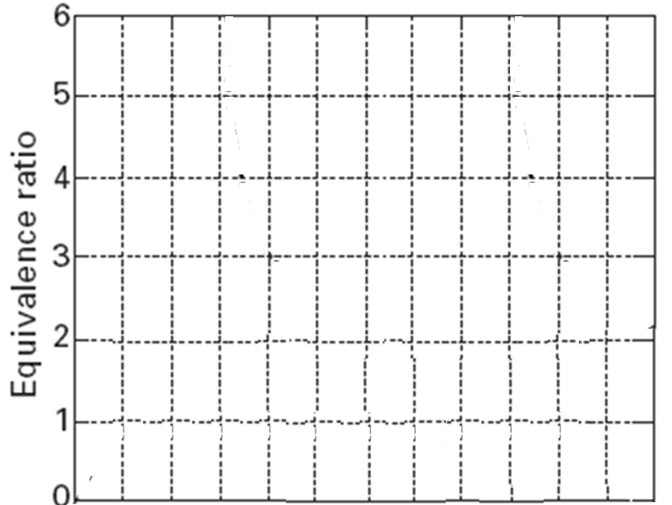
Temporal Evolution of Spatial Distribution of Equivalence Ratio in CI Engines
r_{cylinder}

Slide 4
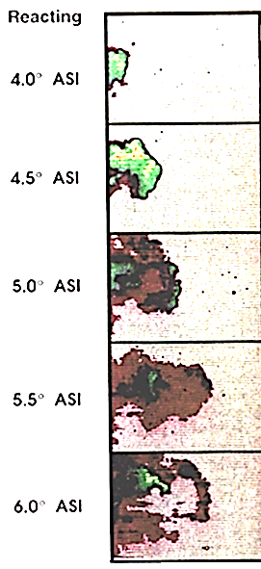
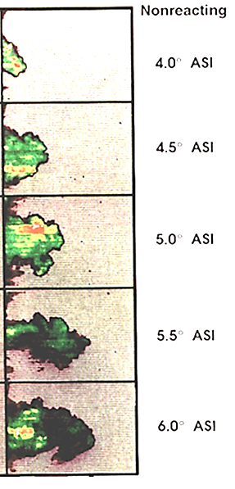

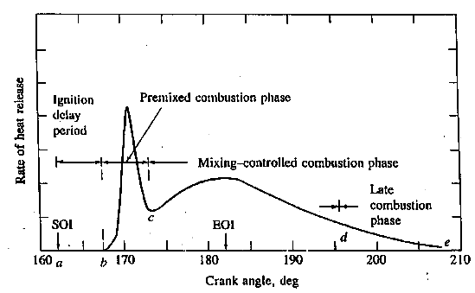
Rich Equivalence Ration & Onset of Premixed Ignition-Combustion
Fuel Equivalence Ratio

Slide 5
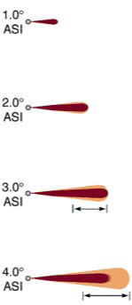



Auto Ignition & Premixed Burning
Fuel rich pre-premixed burning
– Release of energy and release of Chemiluminescence emissions.

Slide 6





Transition into Diffusion Burning

Slide 7

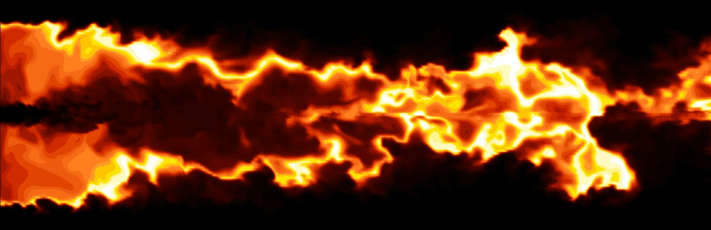
Diffusion Burning Flame
Oxidation of incomplete products of the rich premixed combustion.
Fuel vapor at the ‘jet’/ air interface
Local Extinction

Slide 8
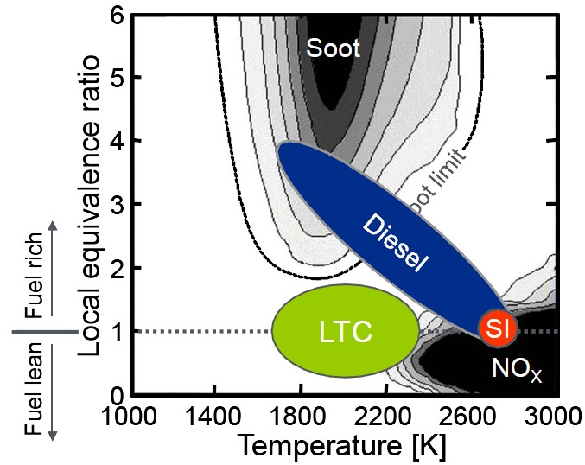

Diesel Engineer with Eco-inimical Combustion

Slide 9
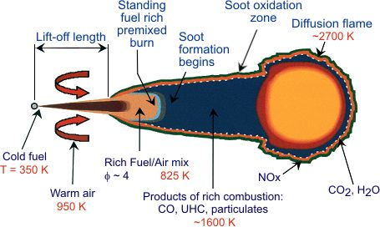
Diesel Engine Menace
Why Menace?
Stratified charge and unacceptable occurrence of φ-T combination in cylinder.
Stoichiometric zones: High AFT-NO_{x} in post flame.
Rich zone: High PAH- Soot.
Lean zone: Poor combustion- High CO and UBHC

Slide 10
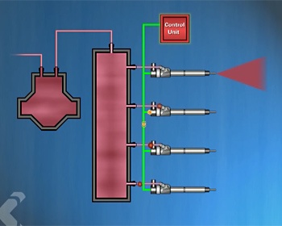
First Generation Common Rail Diesel Injection System
The Common Rail Diesel Injection System delivers a more controlled quantity of atomized fuel.
This leads to better fuel economy; a reduction in exhaust emissions; and a significant decrease in engine noise during operation.

Slide 11
History of CRDI
The common rail system prototype was developed in the 1960's by Robert Huber of Switzerland.
The technology was further developed by Dr.Marco Ganser at the swiss Federal Institute of Technology in Zurich.
The first successful usage in production vehicle began in Japan in the mid-1990's by Dr.Shohei Itoh & Masahina Miyaki of the Denso Corporation.

Slide 12
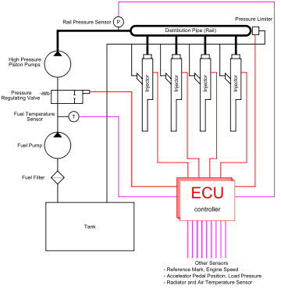
Present Generation (Electronically Controlled) CRDI

Slide 13
Common Rail Diesel injection system
In the Common Rail system, an accumulator, or rail, is used to maintain a common reservoir of fuel under a consistent controlled pressure that is isolated from the fuel injection locations.
A high-pressure pump increases the fuel pressure in the accumulator up to 1,600 bar .
The pressure is set by the engine control unit and is independent of the engine speed and quantity of fuel being injected into any of the cylinders.
The fuel is then transferred through rigid pipes to the fuel injectors, which inject the correct amount of fuel into the combustion chambers.

Slide 14
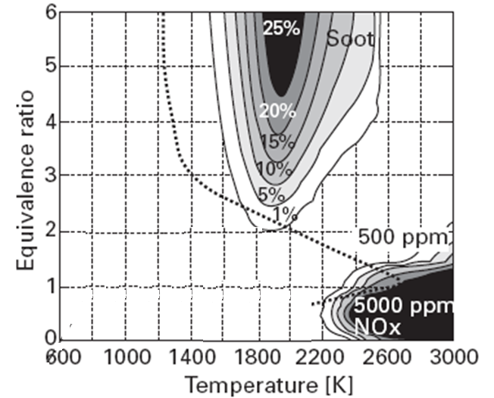
Eco-friendly Equivalence Ratio for CI Combustion
Low Pressure Injection
CRDI
Perfect CI Engine

Slide 15
Modern Injectors for CRDI
The injectors used in Common Rail systems are triggered externally by an Electronic Diesel Control, (EDC) unit.
EDC controls all the engine injection parameters including the pressure in the fuel rail and the timing and duration of injection.
Some common rail injectors are controlled by a magnetic solenoid on the injector.
In some injectors, hydraulic force from the pressure in the system is used to open and close the injector, but the available pressure is controlled by the solenoid triggered by the Electronic Diesel Control unit.

Slide 16
Next Generation Injectors for CRDI
Some new injectors use Piezo crystal wafers to actuate the injectors.
These crystals expand rapidly when connected to an electric field.
In a Piezo inline injector, the actuator is built into the injector body very close to the jet needle and uses no mechanical parts to switch injector needles.
The electronic diesel control unit precisely meters the amount of fuel injected, and improves atomization of the fuel by controlling the injector pulsations.
This results in quieter, more fuel-efficient engines; cleaner operation; and more power output.

Slide 17
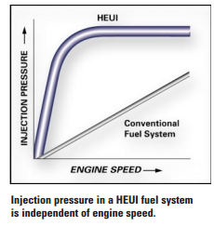
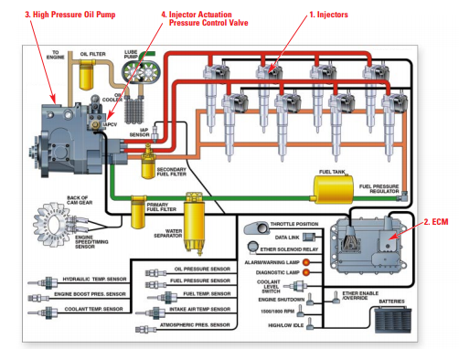
Next Generation Diesel Injection Systems
The HEUI (Hydraulically Actuated Electronically Controlled Unit Injector) technology

Slide 18
Eco-friendly Equivalence Ratio for CI Combustion

Slide 19
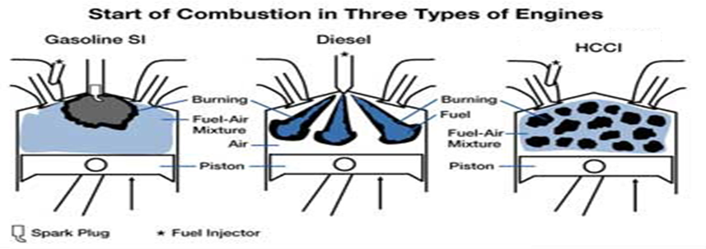
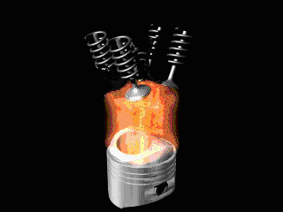
The Holistic Combustion Method
Fuel & Air Charge Undergoes Compression
Spontaneous Reaction Throughout Cylinder
Low Temperature and Fast Reaction Gives Low NOx

Slide 20
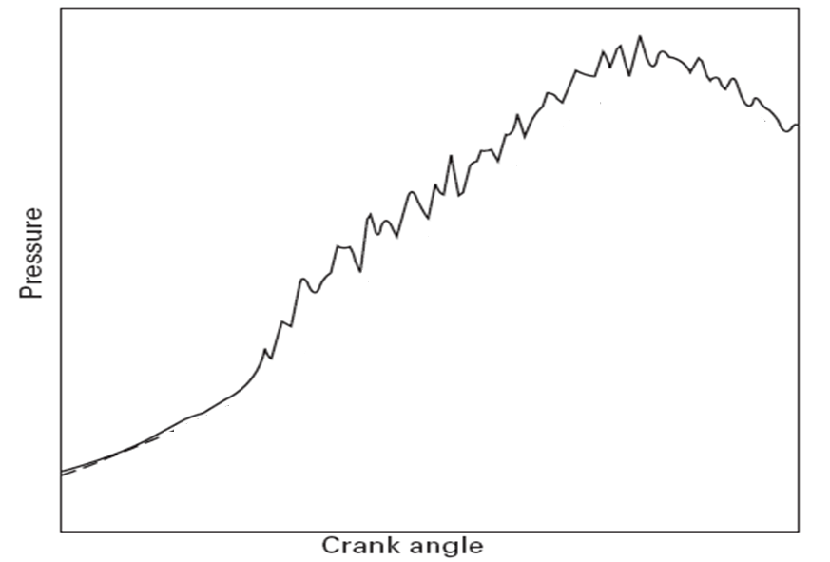

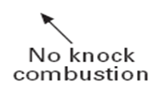

Mildly Knocking Eco-friendly Engine

Slide 21
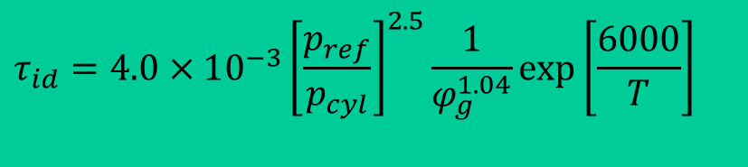
Homogeneous Charged Combustion
To achieve the kind of combustion depicted in previous discussion;
Three major aspects should be addressed:
1. How to create a homogeneous mixture in a CI engine?
2. How to achieve self ignition of this mixture?
3. How to control combustion so that engine is safe and performance is better?
$$τ_{id}=4.0×10^{−3}{\left[\frac{p_{ref}}{p_{cyl}}\right]}^{2.5}\frac{1}{φ_{g}^{1.04}}\exp\left[\frac{6000}{T}\right]$$

Slide 22
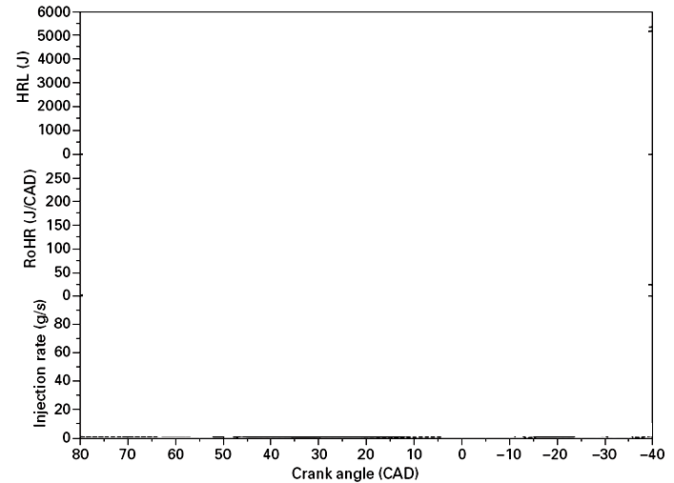
Effect of mixing time on Early (pilot) injection on combustion process

Slide 23
Advanced CI Engine for Next Decade
HCCI-DI Engine.
Divide the fuel into Primary (main) and Pilot (Early) Fuel.
Pilot fuel is responsible for homogenization.
Primary fuel is responsible for Compression Ignition.
Identify the conditions for avoidance of Self Ignition due to Pilot fuel Injection.
How to develop a dual injection system????

Slide 24
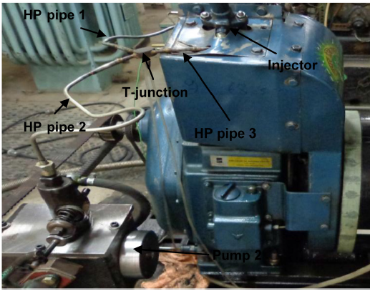
Developed HCCI-DI fuel injection system
External pump (Pilot)
2 pumps
Belt drive from extended
cam shaft
Fuel injector
HP pipe 1, 2 and 3
T-junction
Split ratio control lever
Inj. timing control cam
Developed System
Multi injection using single Injector without any geometry modification

Slide 25
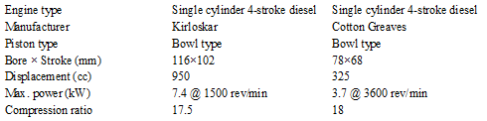
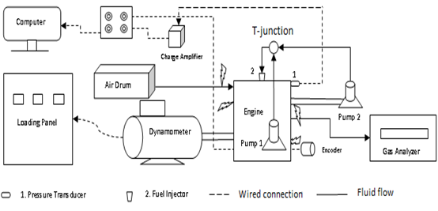
Schematic Diagram of HCCI-DI Engine test setup
Engine specifications

Slide 26
Dual Injection HCCI Engines

Slide 27
Temporal Evolution of Spatial Distribution of Equivalence Ratio during Pilot Injection
0.
0.
0.
0.
0.
0.
0.
r_{cylinder}

Slide 28
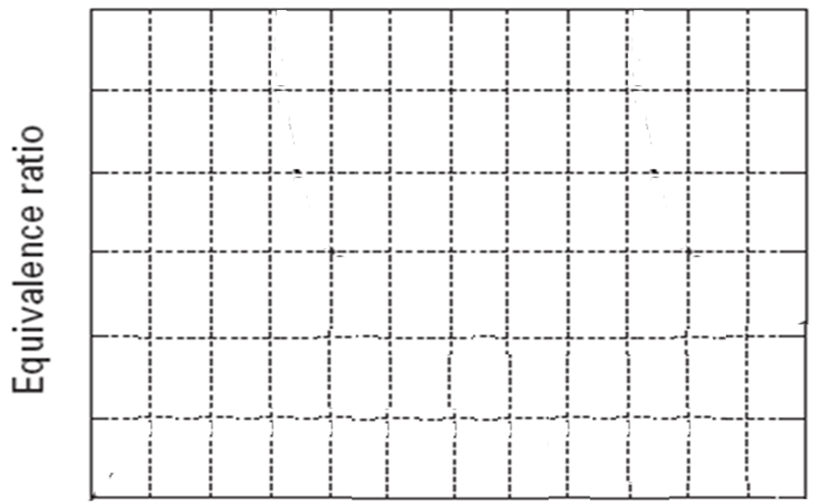
Temporal Evolution of Spatial Distribution of Equivalence Ratio during main injection
2.4
2.0
1.6
1.2
0.8
0.4
0.0
r_{cylinder}

Slide 29
Eco-friendly Equivalence Ratio for CI Combustion

Slide 30
Diagnostic Testing of HCCI-DI Engine

Slide 31
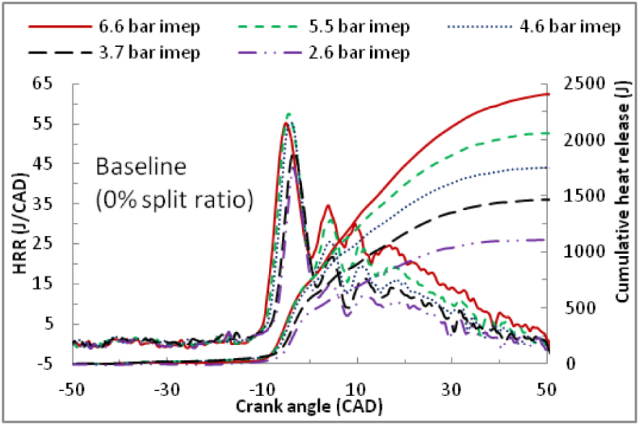
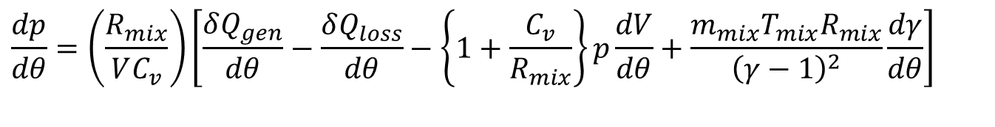
Rate of Combustion (Heat Release rate) in a Diesel Engine
$$\frac{dp}{dθ}=\left(\frac{R_{mix}}{VC_{v}}\right)\left[\frac{δQ_{gen}}{dθ}−\frac{δQ_{loss}}{dθ}−\left\{1+\frac{C_{v}}{R_{mix}}\right\}p\frac{dV}{dθ}+\frac{m_{mix}T_{mix}R_{mix}}{{\left(γ−1\right)}^{2}}\frac{dγ}{dθ}\right]$$

Slide 32
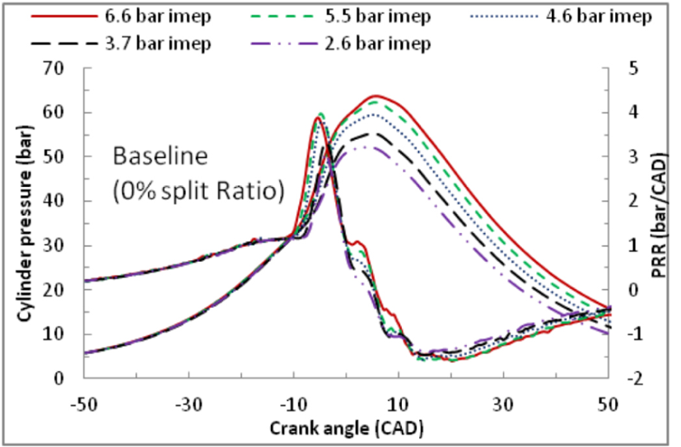
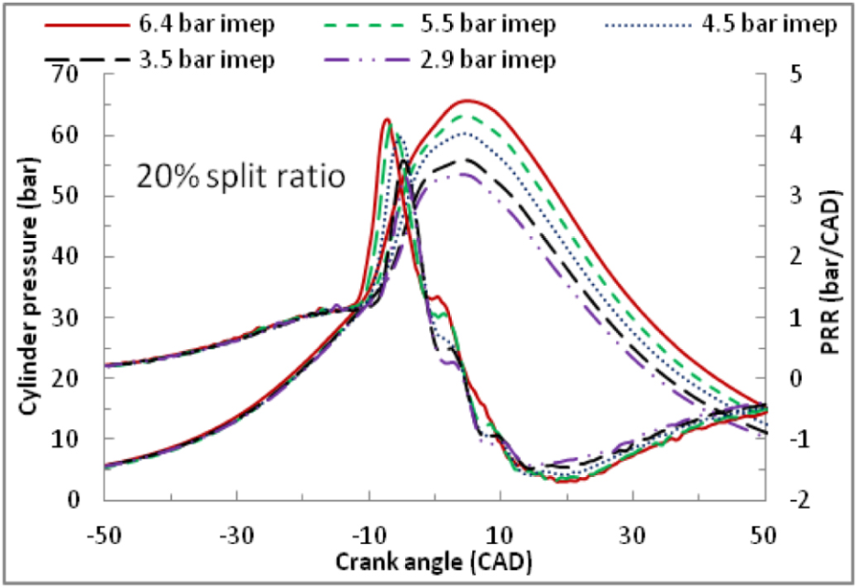
In-cylinder Processes in a Mild HCCI Engine

Slide 33
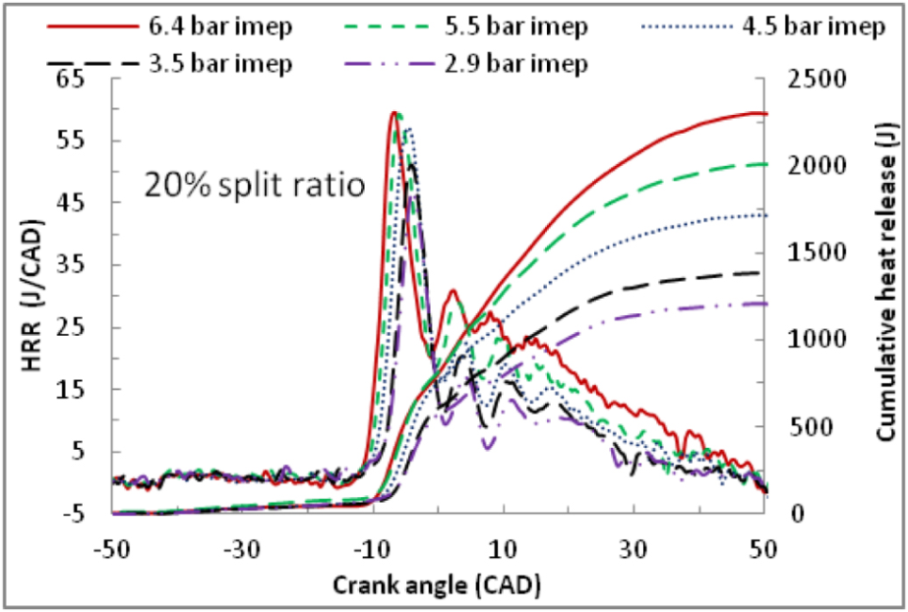
Pace of Combustion in a Mild HCCI-DI Engine

Slide 34
Diagnostic Testing of HCCI-DI Engine

Slide 35
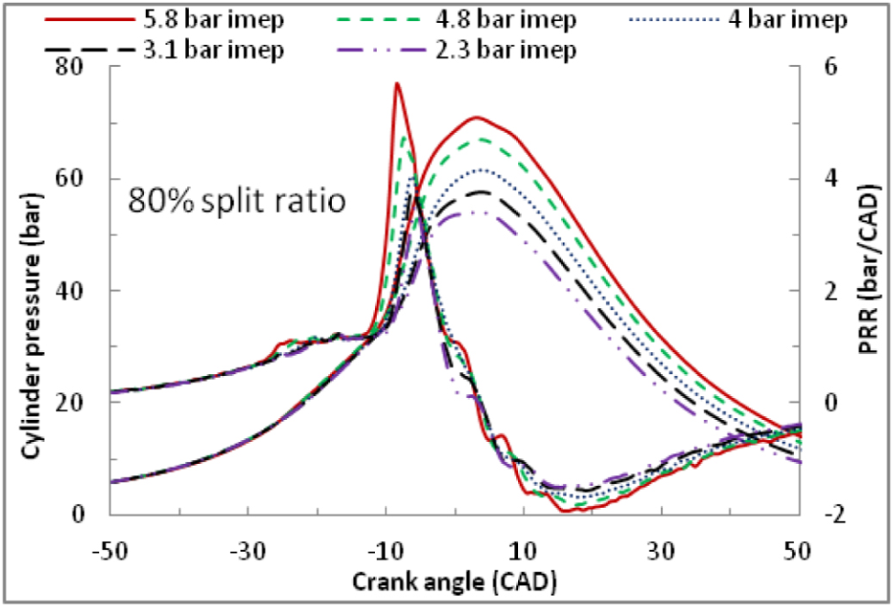
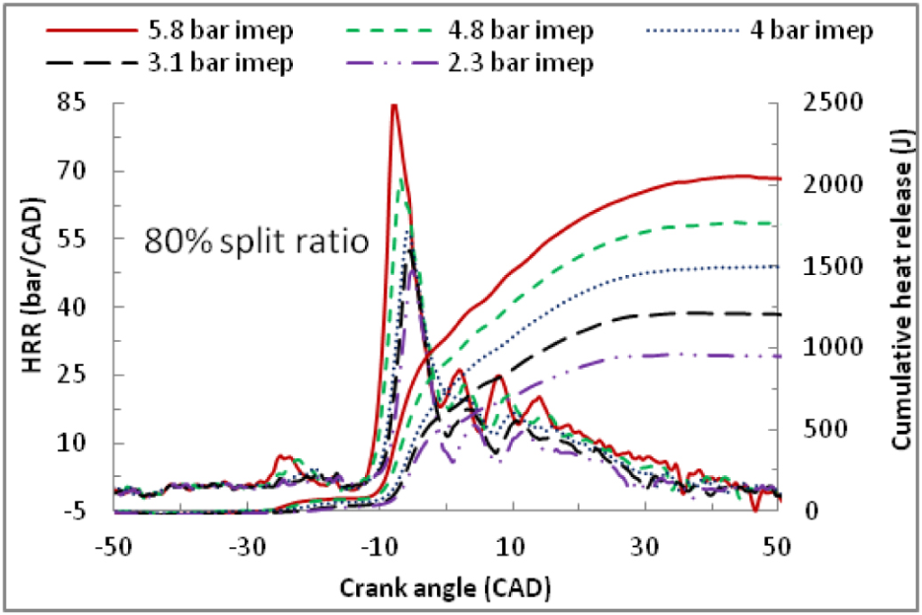
In-cylinder Processes in a Harsh HCCI-DI Engine

Slide 36
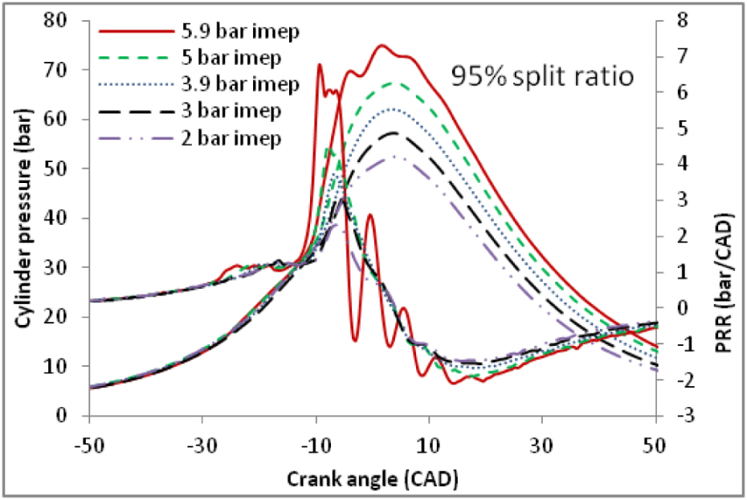
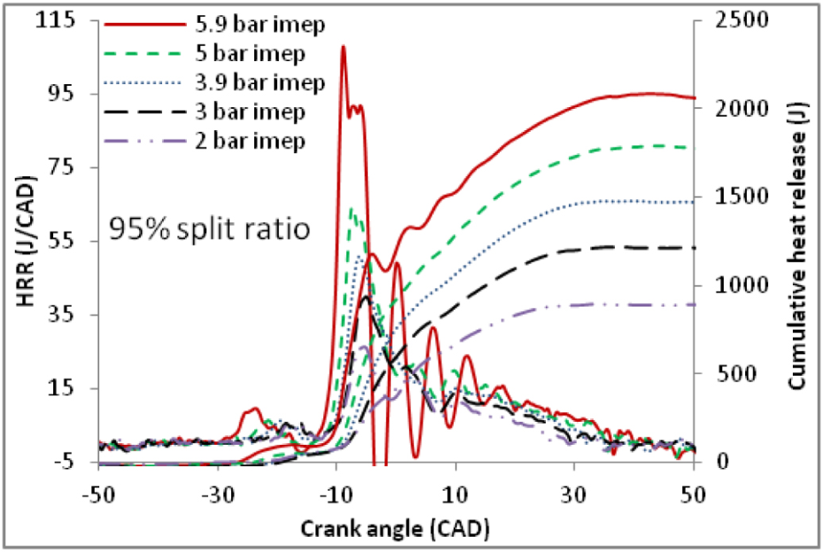
In-cylinder Processes in a Pure HCCI-DI Engine

Slide 37
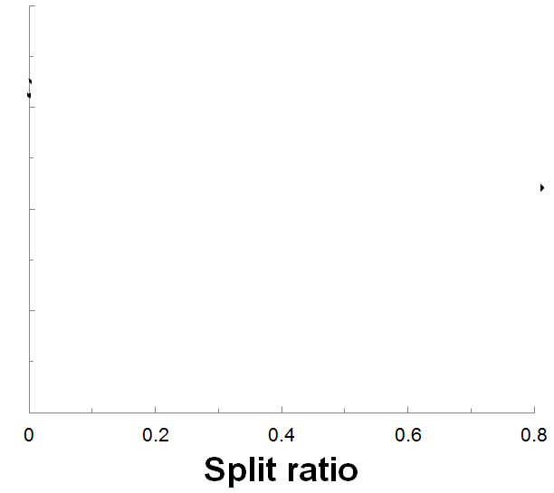
Effect of Split Ratio on Range of Equivalence Ratio in CI Engines
7.0
5.0
Rich Mixture Zone
φ
3.0
1.0
Lean Mixture Zone

Slide 38


Effect of Split Ratio on Range of Equivalence Ratio in CI Engines
7.0
$$τ_{id}=4.0×10^{−3}{\left[\frac{p_{ref}}{p_{cyl}}\right]}^{2.5}\frac{1}{φ_{g}^{1.04}}\exp\left[\frac{6000}{T}\right]$$
5.0
Rich Mixture Zone
φ
$$S_{flamelet−L,p}\left(p,T\right)=\left(S_{LO}+Kφ\right)×{\left(\frac{T}{298}\right)}^{\left[2.18−0.8\left(φ−1\right)\right]}×p^{\left[0.22\left(φ−1\right)−0.16\right]}$$
3.0
1.0
Lean Mixture Zone

Slide 39
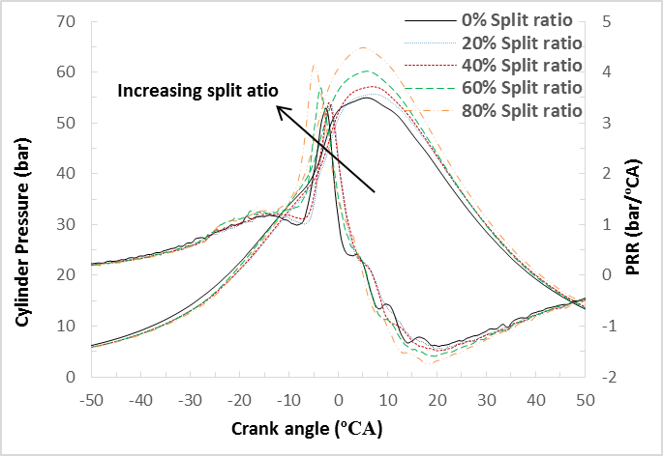
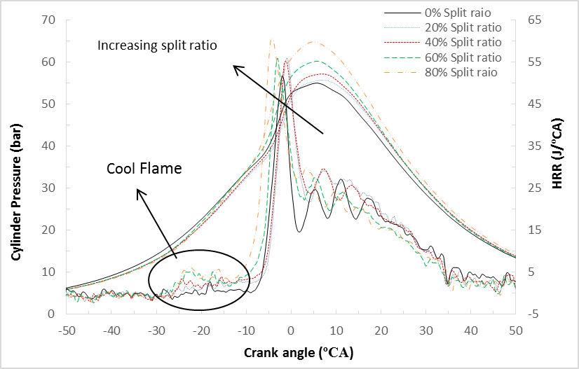
Effect of Split Ratio 80 % (Harsh) HCCI DI
Engine Cylinder Process

Slide 40
Fuel Economy of Homogenization

Slide 41
Eco-friendly Behaviour of Homogenization
Smoke Opacity is the fraction (or %) of incident light which is adsorbed or scattered by the particulate matter in exhaust gas.

Slide 42
Control of Particulates in 80 % (Harsh) HCCI DI
Engine - 1

Slide 43
Control of Particulates in 80 % (Harsh) HCCI DI
Engine - 2

Slide 44
Effect of Degree of Homogenization : Particulates

Slide 45
Effect of Degree of Homogenization : HC Emissions

Slide 46
Effect of Degree of Homogenization : CO Emissions

Slide 47
Effect of Degree of Homogenization : NOx Emissions

Slide 48
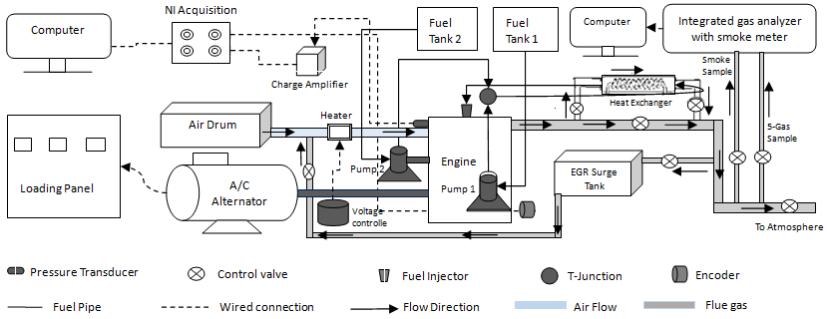
Schematic Diagram of HCCI-DI Engine test setup with EGR & Fuel Heating

Slide 49
Effect of Exhaust Gas recirculation

Slide 50
Role of Fuel Heating

Slide 51
High Speed Operation of HCCI-DI Engine

Slide 52
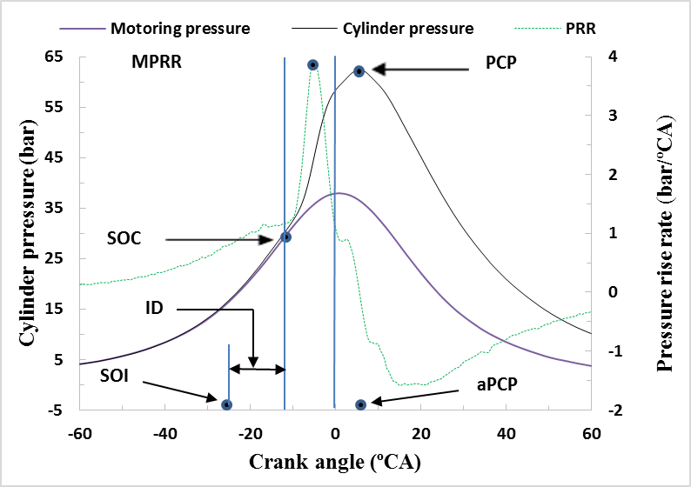
Special Parameters for Combustion Characterization
Identification of Different Combustion Parameters

