Slide 1

Fuel Injection Strategies for Eco-friendly Combustion in CI Engines
P M V Subbarao
Professor
Mechanical Engineering Department
Add Baby Care fir Teen Combustion Process in Heterogeneous Mixtures….

Slide 2


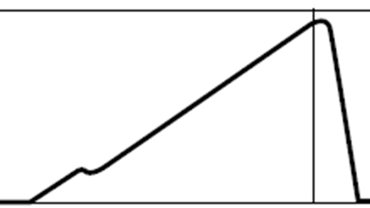

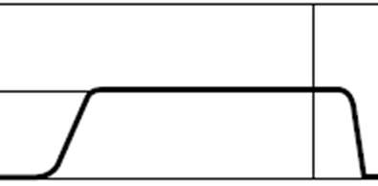
Fluid dynamics of High-Pressure Diesel Injection

Slide 3
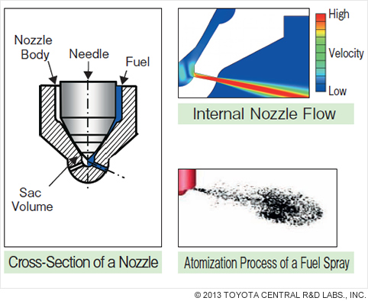
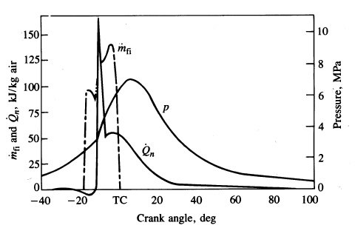
Feel the In-Cylinder Processes
Start of injection
Start of combustion
End of injection

Slide 4
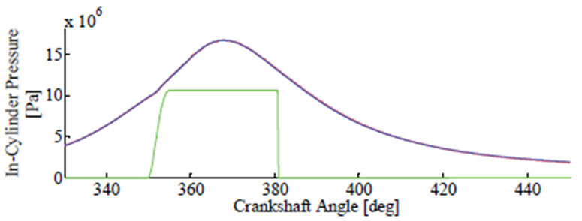
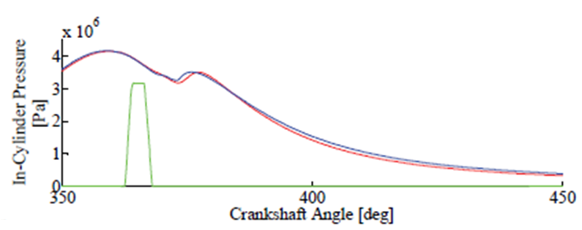
Cut-off Ratio & Nozzle Capacity

Slide 5
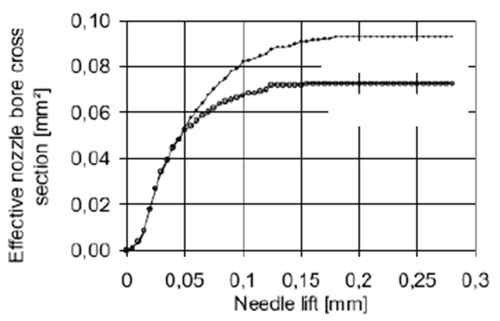


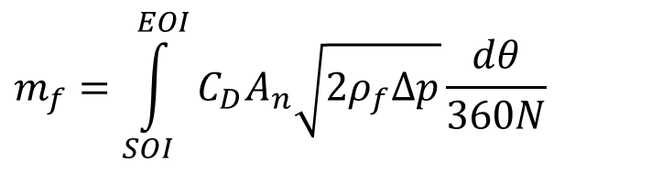
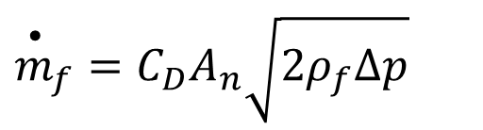
Sizing of Nozzle
$${\overset{•}{m}}_{f}=C_{D}A_{n}\sqrt{2ρ_{f}Δp}$$
Instantaneous Diesel Flow rate:
Mass of Diesel per cycle:
$${\overset{}{m}}_{f}=\int_{SOI}^{EOI}{C_{D}A_{n}\sqrt{2ρ_{f}Δp}\frac{dθ}{360N}}$$

Slide 6
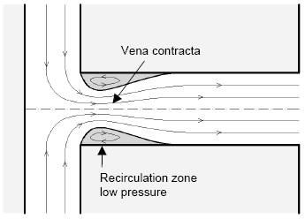
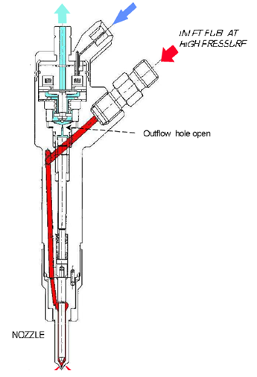
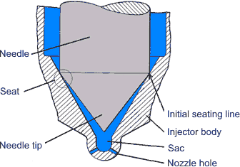
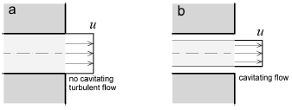
Fuel Exiting into High Pressure& Temperature Air Environment : An unexplored Fluid Mechanics

Slide 7
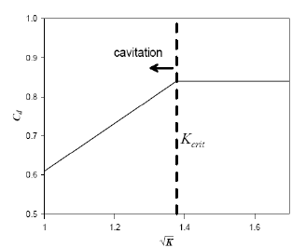
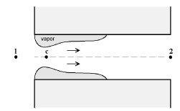
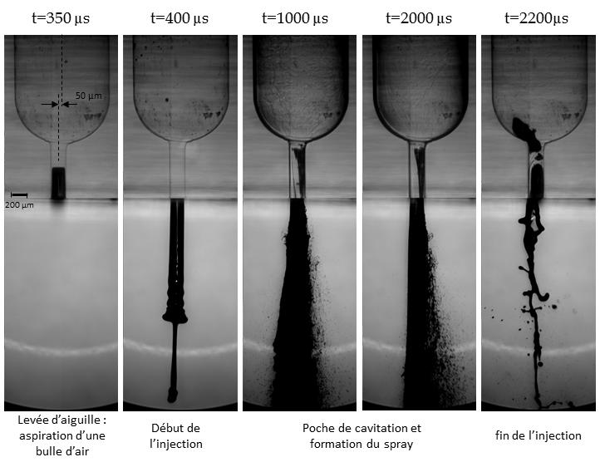
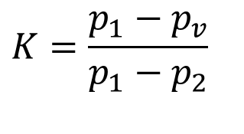
Boiling in Nozzle due Improper Fluid Mechanics????
Nurick’s Number, K
$$K=\frac{p_{1}−p_{v}}{p_{1}−p_{2}}$$
p_{v} is the vapor pressure of the fuel.

Slide 8
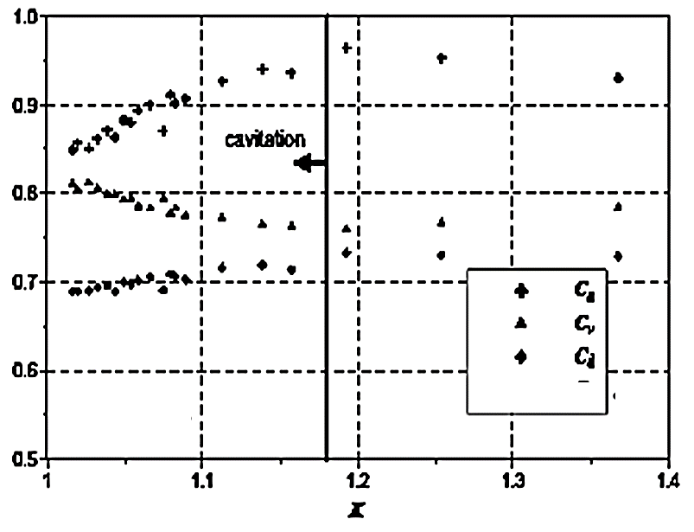
Optimal Design of Nozzle Hole

Slide 9
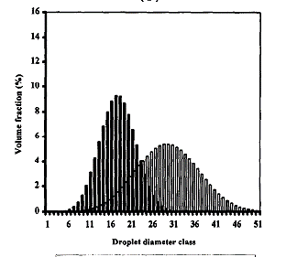

Effect of Nozzle Surface Finish : Distribution of Droplets

Slide 10




Strong Influence of In-Cylinder Conditions on SMD
where do is the discharge orifice diameter and
FN is the nozzle flow number defined by

Slide 11


Strong Influence of In-Cylinder Conditions on SMD
Where
is the liquid surface tension,
μ_{L} is the liquid viscosity,
ρ_{A} is the air density,
ρ _{L} is the liquid density,
Δp_{L}, is the injection pressure differential across the nozzle,
is the half spray angle and
t is the film thickness, given by

Slide 12
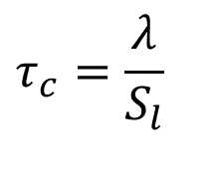
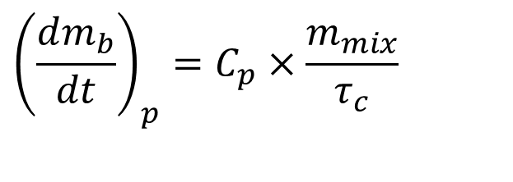
Premixed combustion
It is assumed that the rate of premixed combustion is proportional to the mass of the fuel-air mixture prepared during the ignition delay period and given as
$${\left(\frac{dm_{b}}{dt}\right)}_{p}=C_{p}×\frac{m_{mix}}{τ_{c}}$$
$$τ_{c}=\frac{λ}{S_{l}}$$
where λ is the Taylor microscale and S_{l} is the laminar flame speed.
m_{mix,j} is the mass of the fuel-air mixture in the given element.
C_{p} is an arbitrary tuning constant determined to (0.002 to 0.005) to match the test bed data.

Slide 13
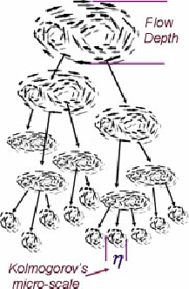
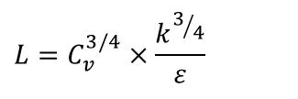
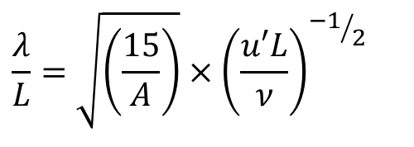
The Taylor microscale
The Taylor microscale is given as
$$\frac{λ}{L}=\sqrt{\left(\frac{15}{A}\right)}×{\left(\frac{u′L}{ν}\right)}^{{−1}/2}$$
where u' is the rms value of turbulent fluctuation velocity,
L is the integral length scale, and ν is the kinematic
viscosity.
The constant, A, is set to be close to unity.
The integral length scale is given as
$$L=C_{v}^{3/4}×\frac{k^{3/4}}{ε}$$
where the constant, C_{v}, is in the range of 0.06 – 0.12.

Slide 14
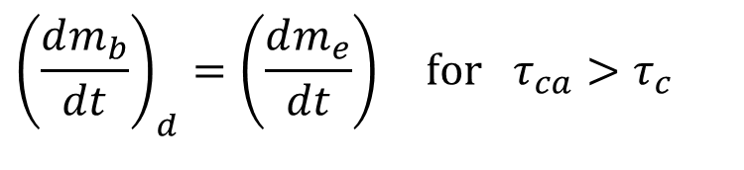
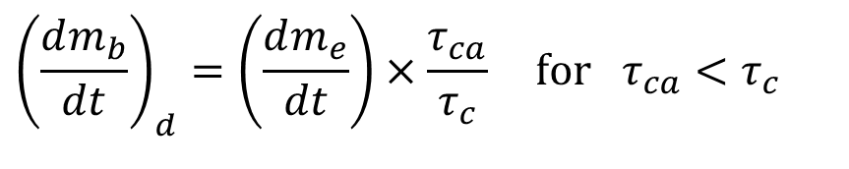
Diffusion combustion
Fuel-air mixing is the dominant mechanism to determine the rate of combustion during the diffusion combustion period.
The turbulent mixing time scale is introduced to represent the rate of fuel-air mixing as,
$${\left(\frac{dm_{b}}{dt}\right)}_{d}=\left(\frac{dm_{e}}{dt}\right)×\frac{τ_{ca}}{τ_{c}} \text{for} τ_{ca}<τ_{c}$$
$${\left(\frac{dm_{b}}{dt}\right)}_{d}=\left(\frac{dm_{e}}{dt}\right) \text{for} τ_{ca}>τ_{c}$$

Slide 15
where m_{b}; and m_{e} are the masses of burned fuel and entrained air in the element.
The time scales, τ_{c} and τ_{ca}, denote the mixing time and the time corresponding to one degree crank angle.
The arbitrary tuning constant, Ce, is chosen here to be 3.0 -- 5.0 X 10-5 to match the test bed data.

Slide 16
Types of CI Engine Injection Systems
Air assisted Fuel-Injection Systems.
Unit Injector System (UIS) – Single-Cylinder CI Engine.
Unit Pump System (UPS) – Multi-cylinder CI Engine.
Common Rail Injection System (CRS) – Multi-cylinder CI Engine.

Slide 17
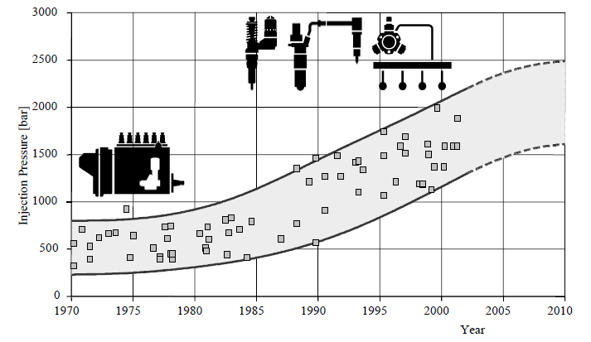
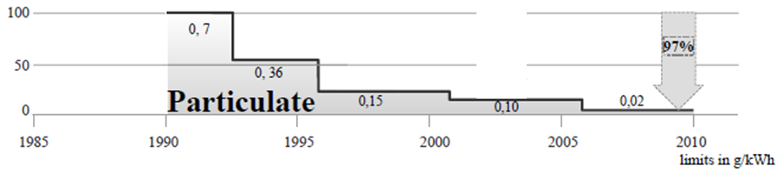
Development of Injection Pressure & Injection System in CI Engines

Slide 18
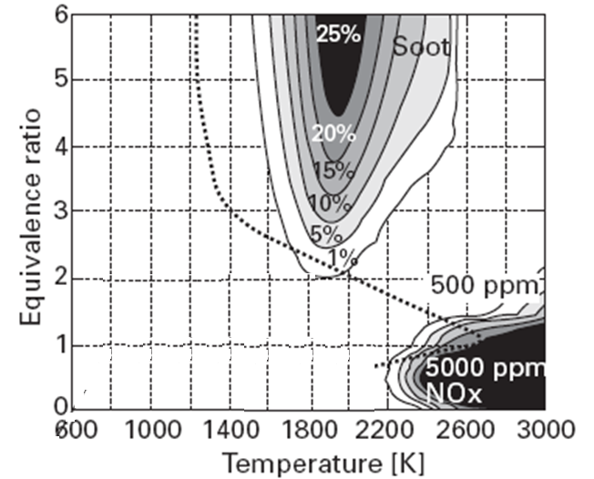
Actual Vs Eco-friendly Equivalence Ratio for CI Combustion

Slide 19
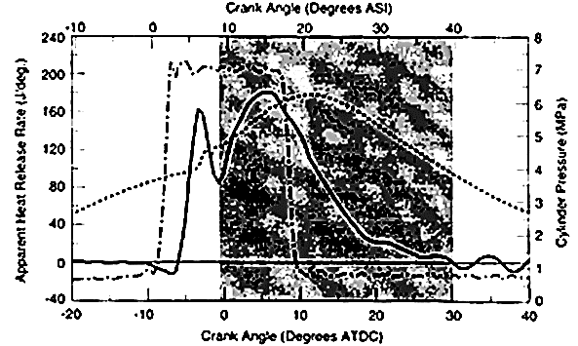
Incylinder Action & Reactions in CI-DI Engine

Slide 20
Diesel Engines : Market Penetration
Diesel driving fuel economy ~ 30% better than SI
5% from fuel energy/volume
15% from eliminating throttle loss
10% from thermodynamics
  2nd law losses (friction and heat transfer)
  Higher compression ratio
  Higher specific heat ratio
Dominant world wide heavy duty applications
Dominant military applications
Created “World Diesel Economy”

Slide 21
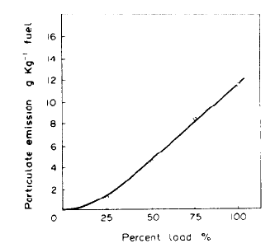
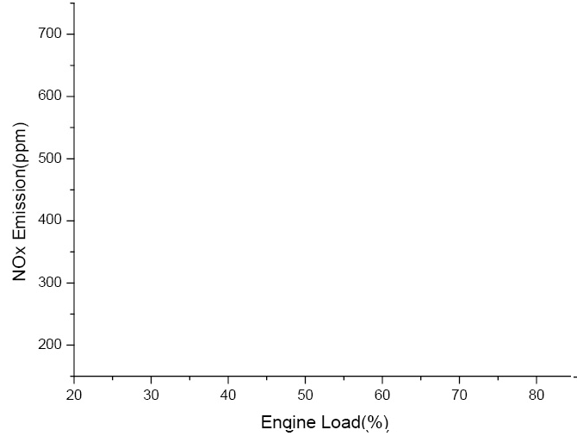
Dangerous Emissions in CI Engine

Slide 22
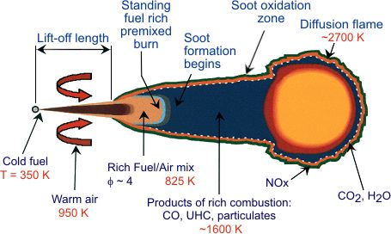
1980^{s} : Diesel Engine Menace
What Menace?
NOx
Respiratory problems.
Ground ozone and PM formation.
Acid rain.
Visibility and haze.
Nutrient pollution.
Soot
PM2.5 -- PM10 contributors.
Chronic respiratory issues.
Change in blood chemistry.
Increased coronary blockade.
Interferes with protein synthesis
Soot-NOx Nexus-”Diesel Dilemma” is the looming evil at the tail pipe of a dieselized global economy.

Slide 23
History of Indian Emission Standards
Standard | Reference | Date | Region
India 2000 | Euro 1 | 2000 | Nationwide
Bharat Stage II | Euro 2 | 2001 | NCR*, Mumbai, Kolkata, Chennai
 |  | 2003.04 | NCR*, 10 Cities†
 |  | 2005.04 | Nationwide
Bharat Stage III | Euro 3 | 2005.04 | NCR*, 10 Cities†
 |  | 2010.04 | Nationwide
Bharat Stage IV | Euro 4 | 2010.04 | NCR*, 10 Cities†
* National Capital Region (Delhi) † Mumbai, Kolkata, Chennai, Bengaluru, Hyderabad, Ahmedabad, Pune, Surat, Kanpur and Agra

Slide 24
Emission Standards for Diesel Heavy Duty Engines
Year | Reference | CO (g/kW-hr) | HC (g/kW-hr) | Nox (g/kW-hr) | PM (g/kW-hr)
1992 | - | 17.3-32.6 | 2.7-3.7 | - | -
1996 | - | 11.20 | 2.40 | 14.4 | -
2000 | Euro I | 4.5 | 1.1 | 8.0 | 0.36
2005† | Euro II | 4.0 | 1.1 | 7.0 | 0.15
2010† | Euro III | 2.1 | 0.66 | 5.0 | 0.10
2010‡ | Euro IV | 1.5 | 0.46 | 3.5 | 0.02
† earlier introduction in selected regions, Table 1 ‡ only in selected regions, Table 1

Slide 25
Need to Study Diffusion Combustion in more detail
Strict emission regulations
Efficient utilization of energy resources
The conventional diffusion combustion can not meet upcoming stringent emission norms (Higher Smoke and NOx emissions )
Banning of Diesel engines across various Cities world wide regardless of their high efficiency and power out put (e.g. Delhi, Chandigarh)
Emerging topic worldwide to keep the High efficient diesel fuelled vehicles rolling on the roads.
Demands thorough understanding of Turbulent Non-premised Flames.

