Slide 1

Advanced Studies on Combustion in CI Engines
P M V Subbarao
Professor
Mechanical Engineering Department
Combustion Process in Heterogeneous Mixtures….

Slide 2

Active Part of the Innovation : Air-standard Ideal Diesel Cycle
Q_{in}
Q_{out}
Air
BC
Compression
Process
Const pressure
heat addition
Process
Expansion
Process
Const volume
heat rejection
Process

Slide 3
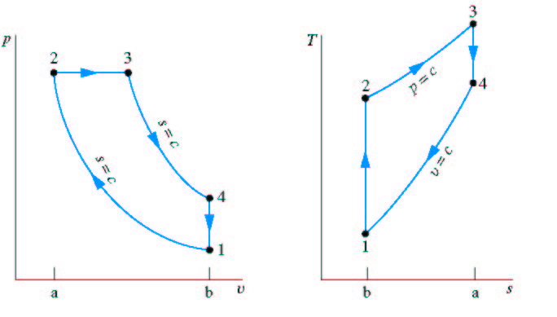
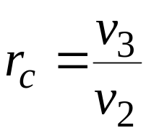

Air-Standard Diesel cycle
Process 1→ 2 Isentropic compression
Process 2 → 3 Constant pressure heat addition
Process 3 → 4 Isentropic expansion
Process 4 → 1 Constant volume heat rejection
Q_{in}
Cut-off ratio:
Q_{out}
v₂
TC
v₁
BC
TC
BC

Slide 4
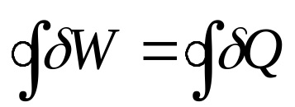
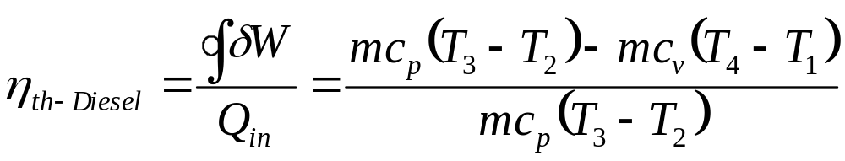
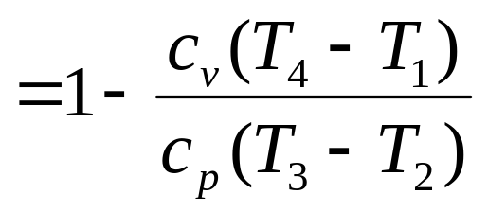
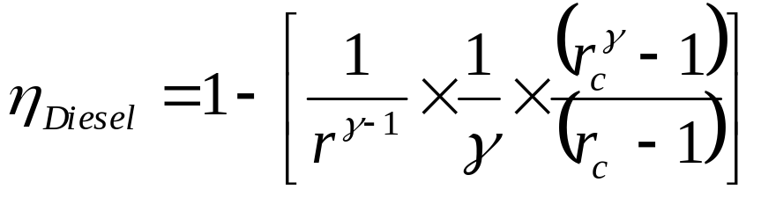
Analysis of Air Standard Diesel Cycle
Net cycle work:
Cycle thermal efficiency:

Slide 5
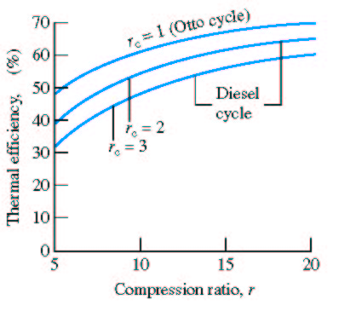
Thermal Efficiency
r_{c}=1
r_{c}=2
r_{c}=3
Typical CI Engines
15 < r < 20
When r_{c} (= v₃/v₂)→1 the Diesel cycle efficiency approaches the efficiency of the Otto cycle

Slide 6
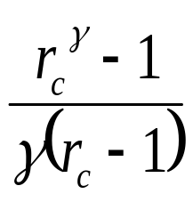
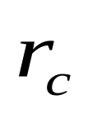
Structure of Efficient Diesel Cycle
Higher efficiency is obtained by adding less heat per cycle, Q_{in},
→ run engine at higher speed to get the same power.

Slide 7
Multi Cylinder diesel engines
1897 -- Diesel built the first diesel engine at the Augsburg Maschinenfabrik .
1898 -- Rudolph Diesel, filed a patent application
The single cylinder engine was used to power stationary machinery.
It weighed five tonnes and produced 20 hp at 172 rpm!
The engine operated at 26.2% efficiency, a very significant improvement on the 20% achieved by the best gasoline engines of the time.
1922 Benz introduces a 2-cylinder, 30 hp 800 rpm tractor engine.
1924 Benz introduces a 4-cylinder, 50 hp 1000 rpm truck engine.
1960- 1970 Peugeot introduces the 404 Diesel followed by the 504 Diesel and the 204 Diesel, the first diesel-powered compact car

Slide 8
Early CI Engine Cycle
Fuel injected
at TC
A
I
R
Air
Combustion
Products
Actual
Cycle
Intake
Stroke
Compression
Stroke
Power
Stroke
Exhaust
Stroke

Slide 9
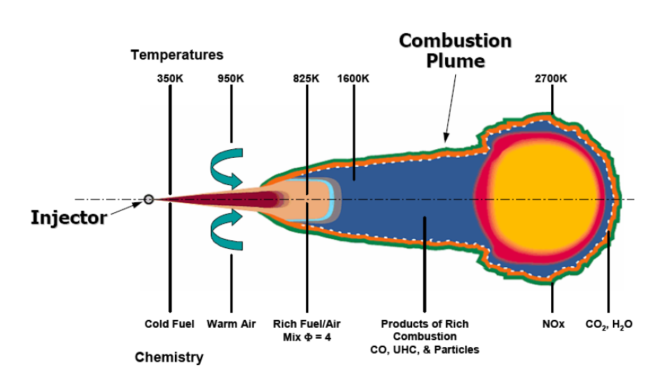
Schematic of a diesel spray & flame with temperatures and chemistry

Slide 10
Modern CI Engine Cycle
Fuel injected
at 35º bTC
A
I
R
Air
Combustion
Products
Actual
Cycle
Intake
Stroke
Compression
Stroke
Power
Stroke
Exhaust
Stroke

Slide 11
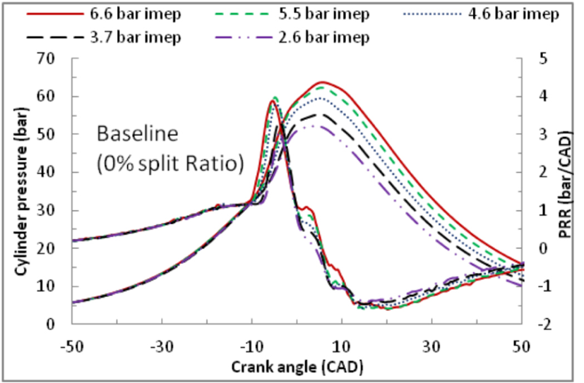
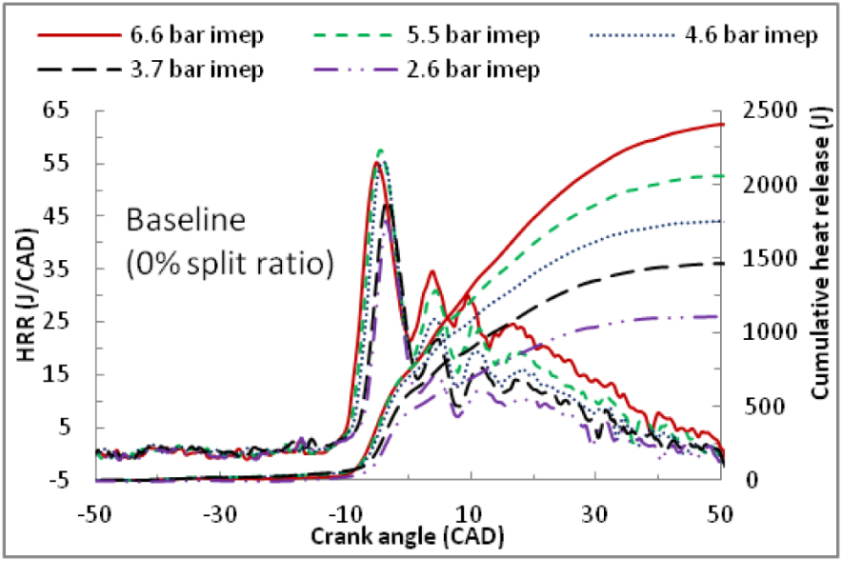
Rate of Combustion (Heat Release rate) in a Diesel Engine

Slide 12
Thermodynamic Dual Cycle
A
I
R
Q_{out}
Air
TC
BC
Intake
Stroke
Compression
Process
Sudden Combustion
Process
Slow Combustion
Process
Expansion
Process
Const volume
heat rejection
Process

Slide 13
Thermodynamic Dual Cycle
Q_{in}
Q_{in}
Q_{out}
Air
TC
BC
Compression
Process
Const volume
heat addition
Process
Const pressure
heat addition
Process
Expansion
Process
Const volume
heat rejection
Process

Slide 14
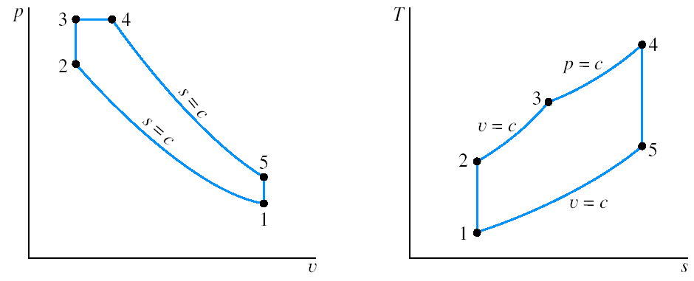
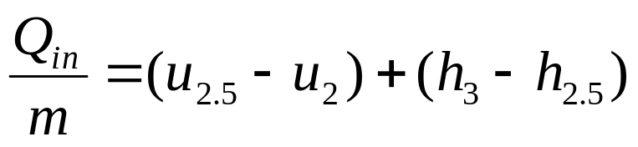
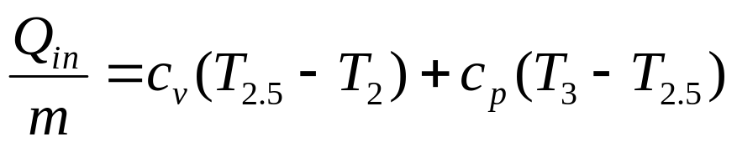
Dual Cycle
Process 1 → 2 Isentropic compression
Process 2 → 2.5 Constant volume heat addition
Process 2.5 → 3 Constant pressure heat addition
Process 3 → 4 Isentropic expansion
Process 4 → 1 Constant volume heat rejection
2.5
3
Q_{in}
3
2
Q_{in}
2.5
2
4
4
1
1
Q_{out}

Slide 15
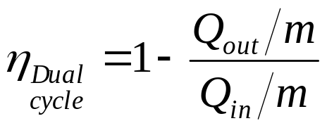
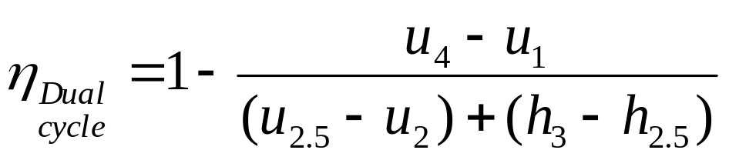
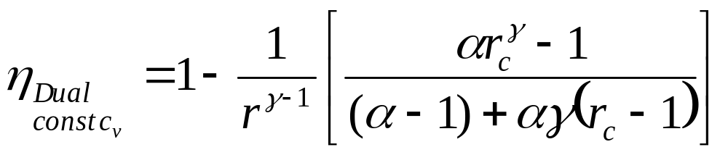
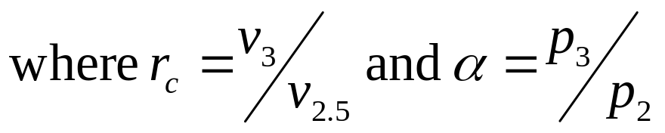
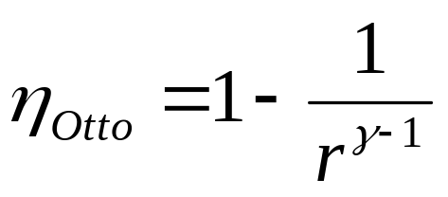
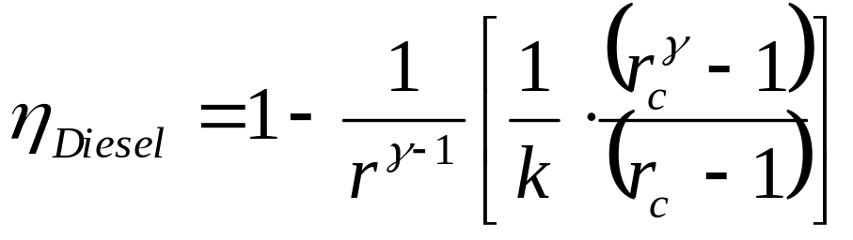
Thermal Efficiency
Note, the Otto cycle (r_{c}=1) and the Diesel cycle (α=1) are special cases:

Slide 16
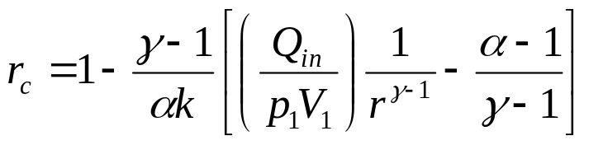
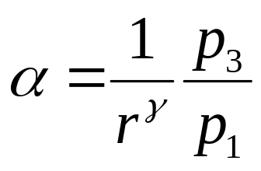
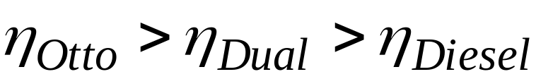

Generic Nature of The Dual Cycle
The use of the Dual cycle requires information about either:
the fractions of constant volume and constant pressure heat addition
(common assumption is to equally split the heat addition), or
maximum pressure p₃.
Transformation of r_{c} and α into more natural variables yields
For the same inlet conditions p₁, V₁ and the same compression ratio:
For the same inlet conditions p₁, v₁ and the same peak pressure p₃
(actual design limitation in engines):

Slide 17
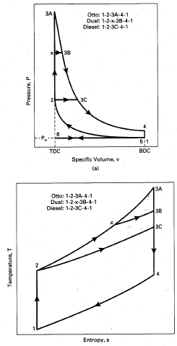
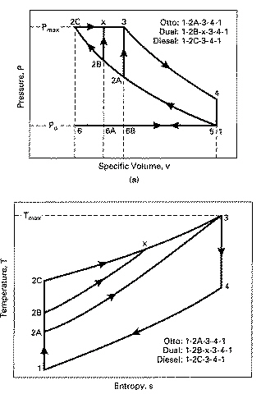
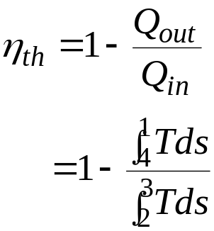
For the same compression ratio p₂/p₁:
For the same peak pressure p₃:
P_{max}
“x” →“2.5”
Pressure, P
Pressure, P
P_{o}
P_{o}
Specific Volume
Specific Volume
T_{max}
Otto
Dual
Diesel
Diesel
Temperature, T
Dual
Temperature, T
Otto
Entropy
Entropy

Slide 18
Type of Fuel Vs Combustion Strategy
Highly volatile with High self Ignition Temperature: Spark Ignition. Ignition after thorough mixing of air and fuel.
Less Volatile with low self Ignition Temperature: Compression Ignition , Almost simultaneous mixing & Ignition.

Slide 19
Nature of Diesel (CI) Combustion
Overall A/F Ratio: Full load ~19
This ratio is leaner than overall stoichiometric.
A/F ratio: idling ~ 80
Overall Lean but this is not premixed.
Overall air-fuel ratio is not important as CI engine-cylinder consists of a Heterogeneous mixture of
– liquid, vapor and air
– spatially non-uniform
Diffusion flame
– High temperature and pressure
– Mixing limited
Demands Highly Turbulent flow

Slide 20
Multi Physics in CI Engine Cylinder

Slide 21
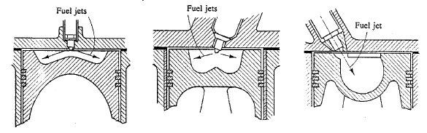
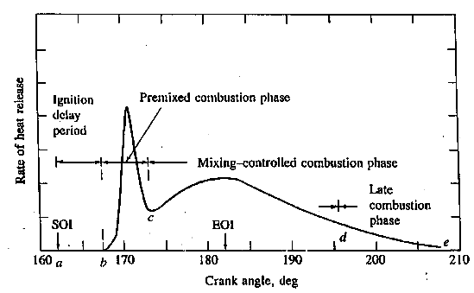
Enhanced Turbulence During Fuel Injection to Combustion

Slide 22
Rate of Combustion (Heat Release rate) in a Diesel Engine

Slide 23
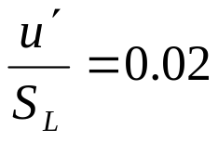
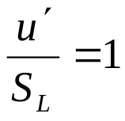
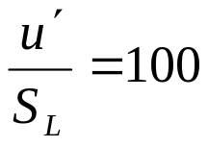
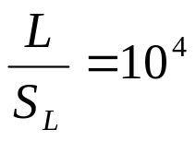

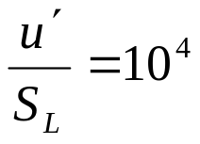
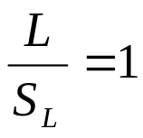
Regimes of Turbulent Flame
10⁸
Weak Turbulence
Reaction Sheets
Da
1
Flamelets in Eddies
Distributed Reactions
Cyclonic Turbulence
10⁻⁴
10⁸
Re_{T}

Slide 24
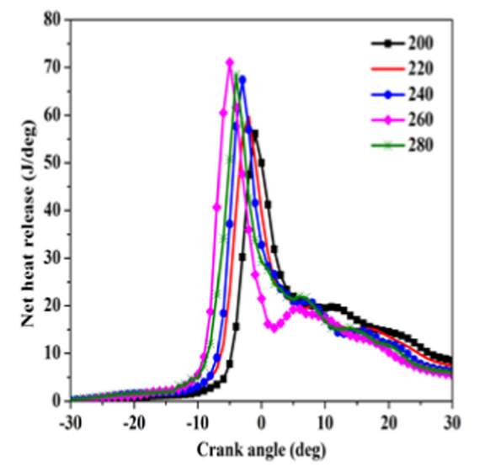
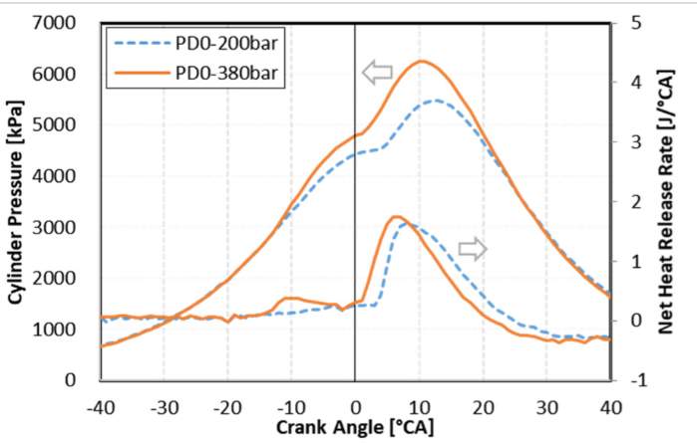
Effect of Diesel Injection Pressure on Degree of Pre-mixed Combustion

Slide 25
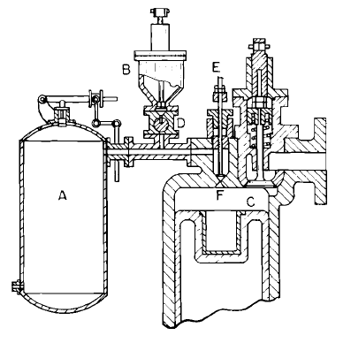
Coal dust injection system of Rudolph Diesel. AIR INJ ECTION
(After U.S. patent No. 54286 of 1895.)
Hopper
Injection valve
Rotary valve
Orifice
Compressed air tank
Combustion chamber
Diesel developed an engine that was more than seven times more efficient than the (100 years evolved steam engine).

