Slide 1
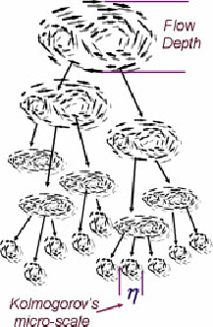

Performance of Turbulent Flames In SI Engines
P M V Subbarao
Professor
Mechanical Engineering Department
Role of Eddies in Faster and Clean Combustion in SI Engines….

Slide 2

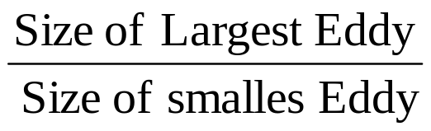
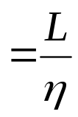
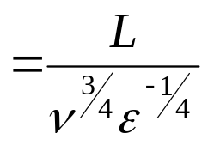
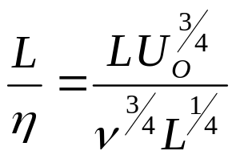
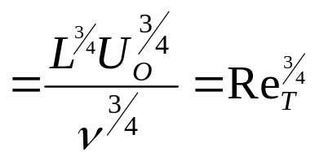
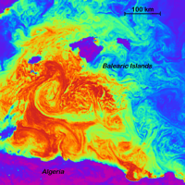
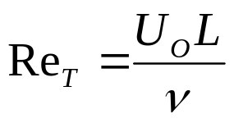
Span of Multi-scale Turbulent Flames
Multi-scale turbulent flames are essential for operation of high-speed engines.
The span of eddy scales:
Turbulent Reynolds Number:
Computational Methods will help in simulation of turbulent flames with various combinations of Da & Re_{T}

Slide 3
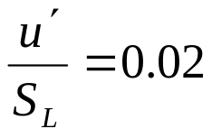
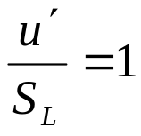
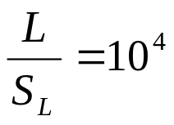

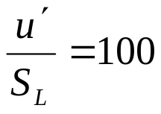
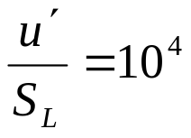
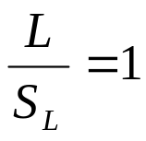
Regimes of Turbulent Flames
10⁸
Weak Turbulence
Reaction Sheets
Da
1
Flamelets in Eddies
Distributed Reactions
Cyclonic Turbulence
10⁻⁴
10⁸
Re_{T}

Slide 4
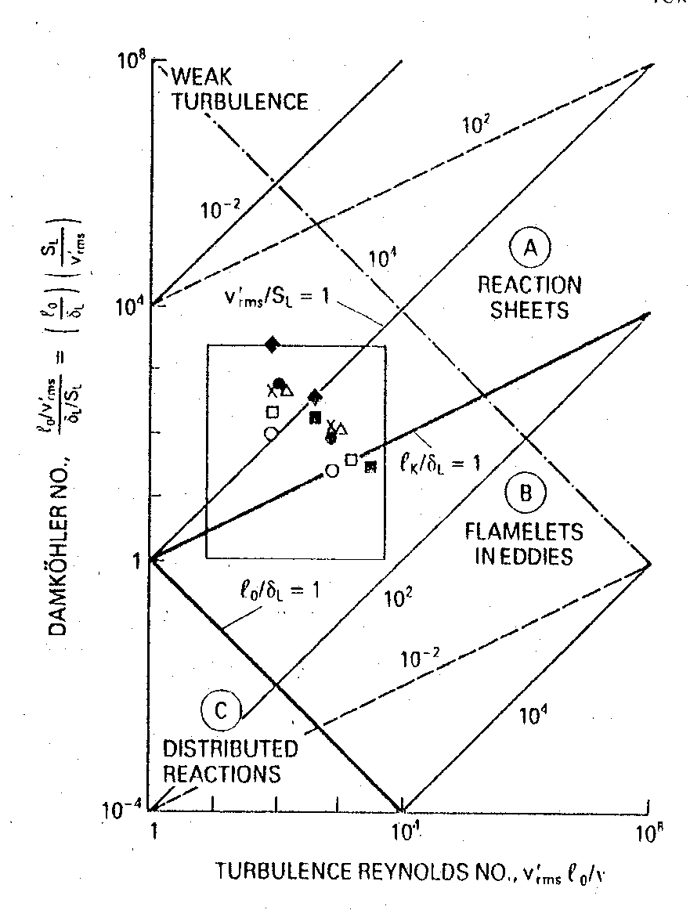
Regime of Fast SI Engine’s Turbulent Combustion

Slide 5
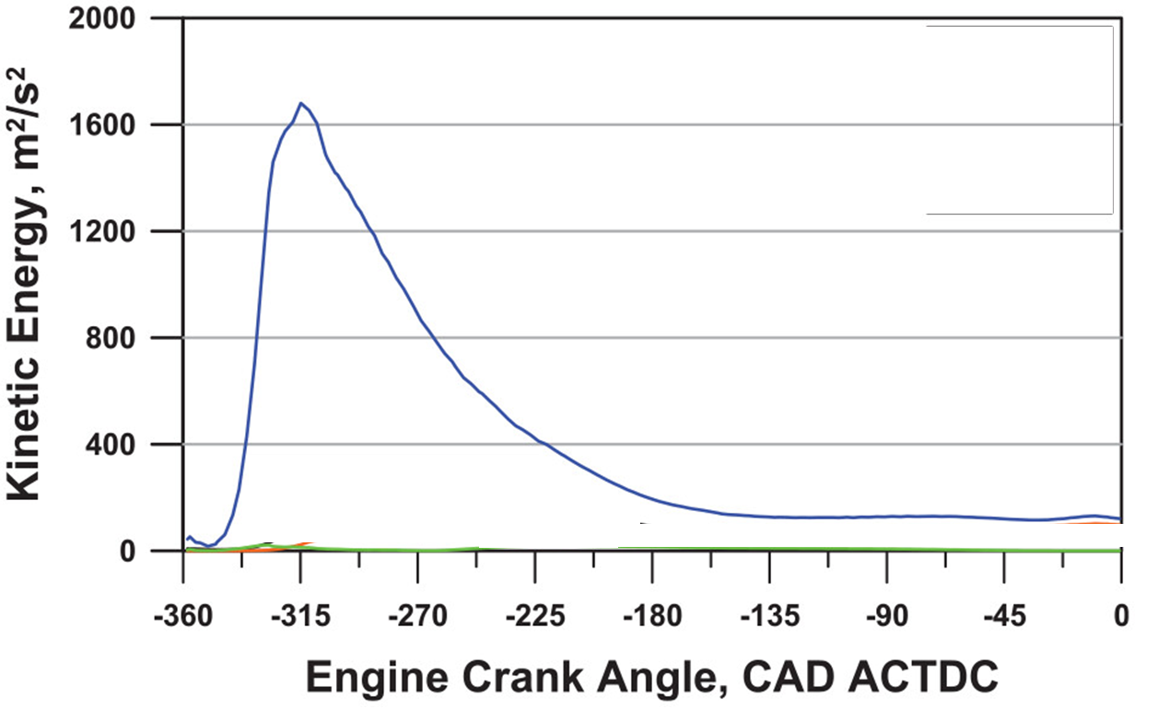
Energy of Large Eddies

Slide 6
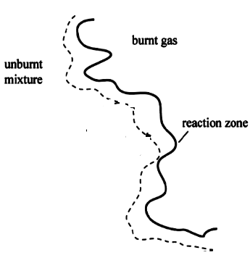
Mechanism of Turbulent Combustion in SI Engines
Values of Da and Re for a typical SI-engine lie predominantly in the reaction sheet flame region
The size of an energetic eddy must have a turnover time equal to the time needed to diffuse unbrunt mixture into and burnt mixture out of flame zone.
During its turnover time an eddy of size L will interact with the advancing flame front.
This will be able to transport preheated fluid from a region of thickness in front of the reaction zone over a distance corresponding to its own size.

Slide 7
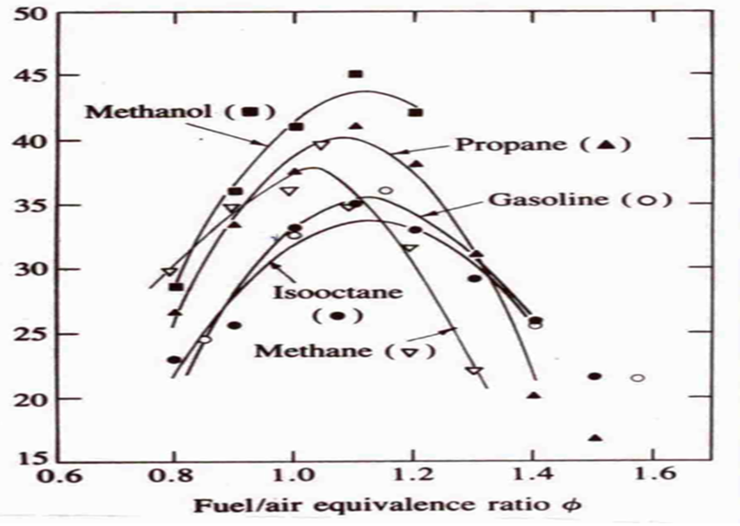
Effect of Equivalence Ratio on Laminar Burning Velocity
S_{flamelet,Lp,m/s}
Methane

Slide 8
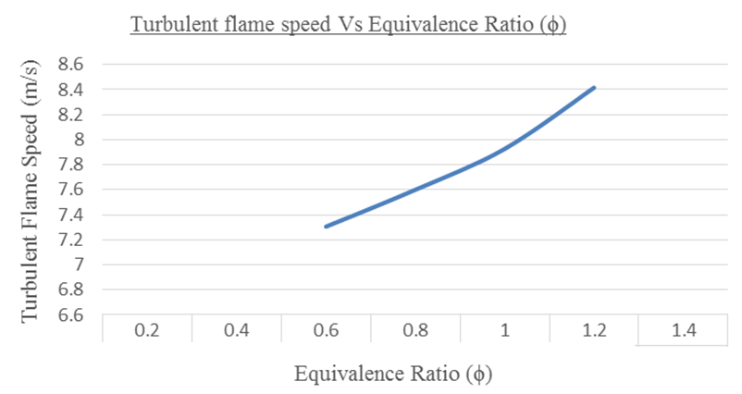
Methane

Slide 9
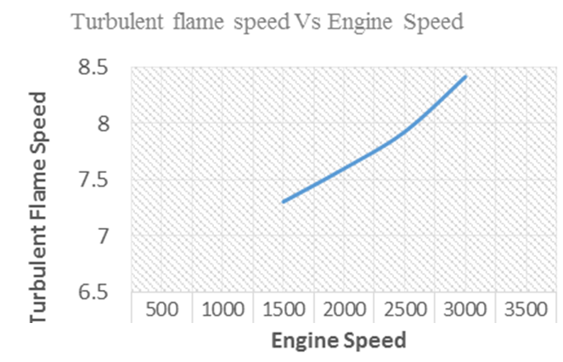
m/s

Slide 10
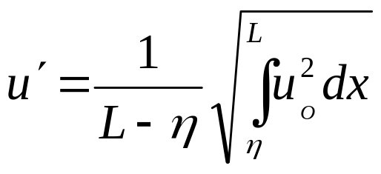
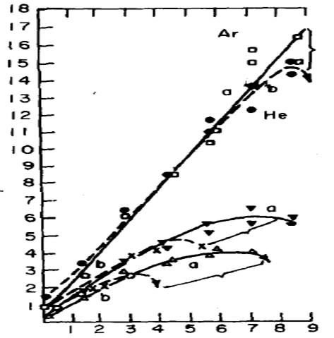

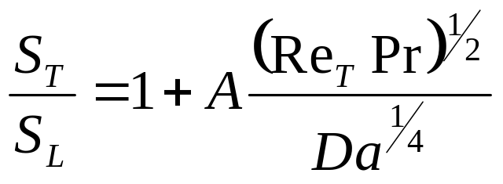



Model of the turbulent flame speed, S_{T}
Turbulence Intensity
S_{T}

Slide 11
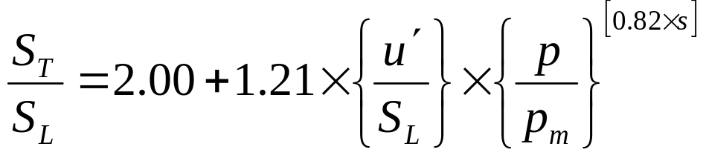
Engineering Correlations for Turbulent Burning Velocity
Groff and Matekunas obtained a relation that takes into account the effect of spark timing on the flame speed ratio.
They obtained the following relation for flame speed ratio
Where p is the pressure, kPa
p_{m} is the corresponding motoring pressure, kPa
s is the spark advance factor given by
s = 1.0 + 0.05θ ^{0.4}
where θ is the spark advance, crank angle degrees before top dead center.

Slide 12
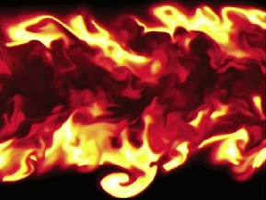
Regimes of Turbulent Flames
10⁸
Weak Turbulence
Reaction Sheets
Da
1
Flamelets in Eddies
Distributed Reactions
Cyclonic Turbulence
10⁻⁴
10⁸
Re_{T}

Slide 13
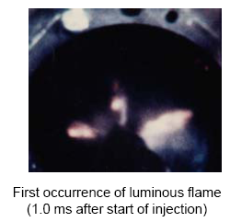
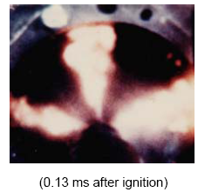
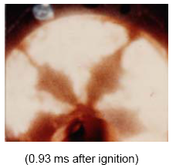
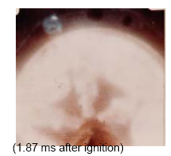
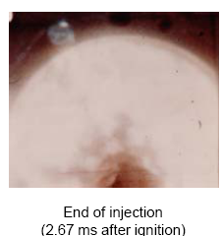
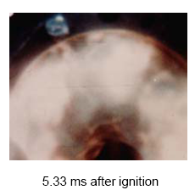
Images From CI Engine Combustion

Slide 14
Diesel’s Rational Engine
Theory and Construction of a Rational Heat-engine to Replace the Steam Engine and Combustion Engines Known Today.
This formed the basis for his work on and invention of, the diesel engine.
Eventually he obtained a patent for his design for a compression-ignition engine.
In his engine, fuel was injected at the end of compression and the fuel was ignited by the high temperature resulting from compression.

Slide 15
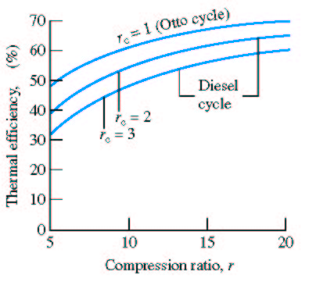
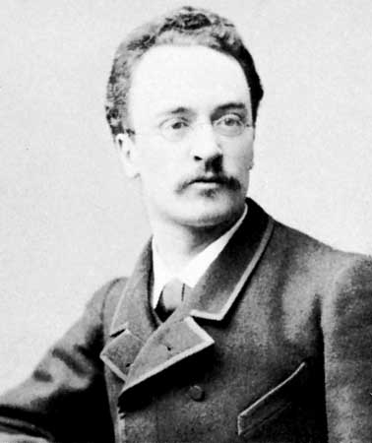
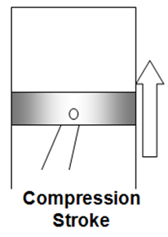
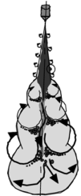
Diesel’s Direct Injection CI Engine
Typical CI engines
17 < r < 23
Typical SI engines
9 < r < 11
k = 1.4
Air & Residual gas mixture
Diesel engine operated at 26.2% efficiency, a very significant improvement on the 20% achieved by the best gasoline ( ~20 years ) engines of the time.

Slide 16
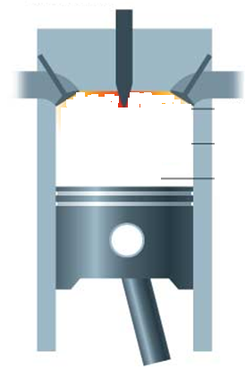
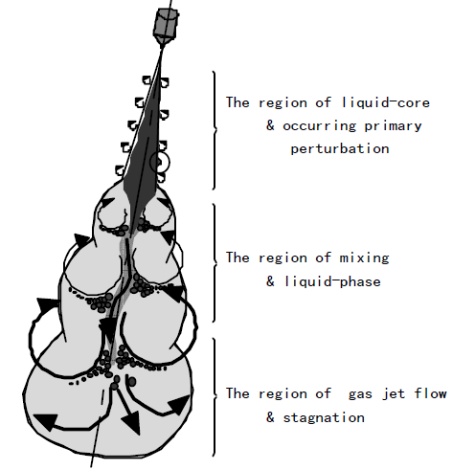
Schematic of Spray Dynamics in Diesel Engine
Every event will need some time!!!

Slide 17
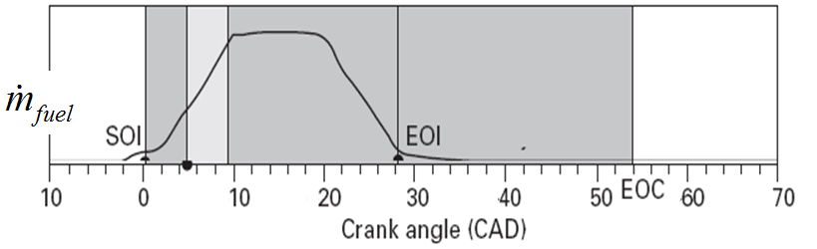
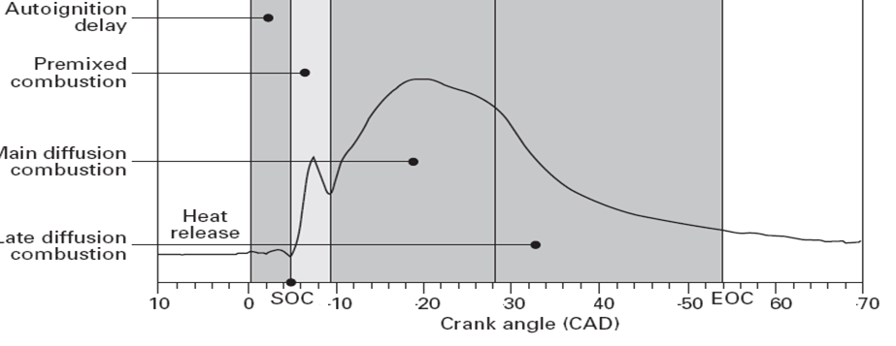
Chronological Order of Post Fuel Injection Events in CI Engine Cylinder
Spray development
Air entrainment and mixing
Droplet evaporation
Auto Ignition

Slide 18
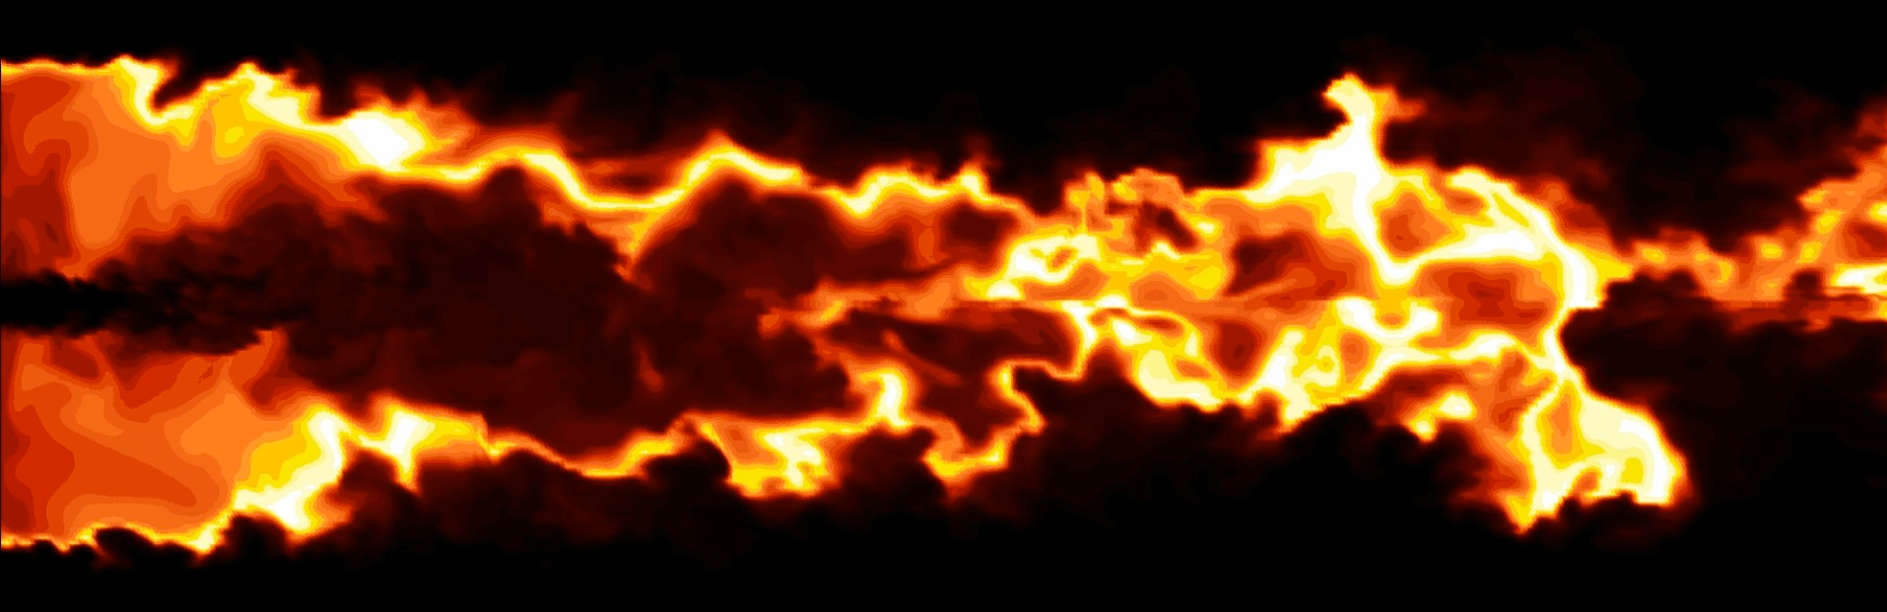
Ignition Delay
The sum of times required for sub processes preceding the self ignition of first packet of air-fuel mixture.
Larger the value of this delay, large will be the number of self igniting locales.
How to predict this delay?
Diesel was not aware of the symptoms to be sensed to Predict Auto Ignition of first packet of air-fuel mixture.

Slide 19
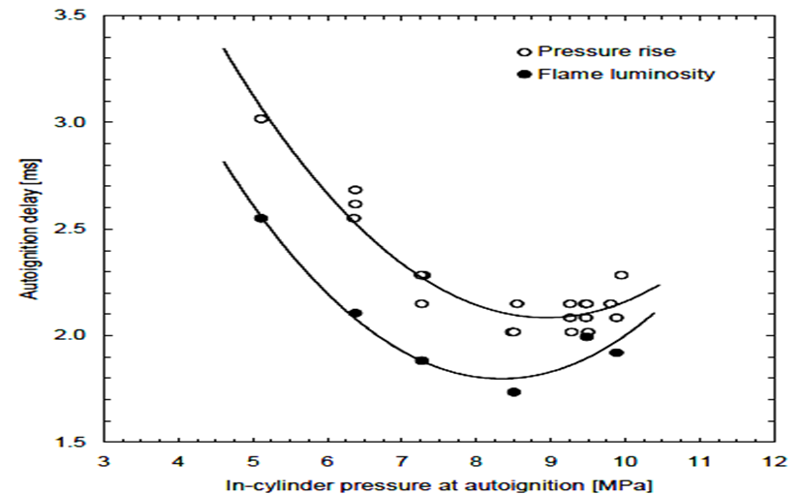
Engine Symptoms due to Self Ignition of first Packet of air-fuel Mixture

Slide 20
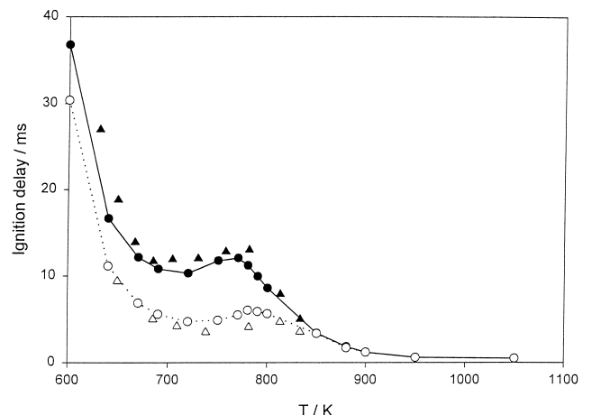
Effect of Gas Temperature on Ignition Delay

Slide 21
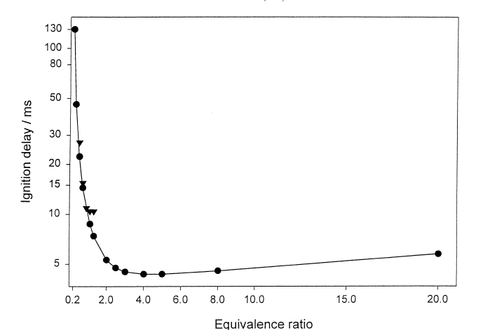
Effect of Equivalence Ratio on Ignition Delay

Slide 22
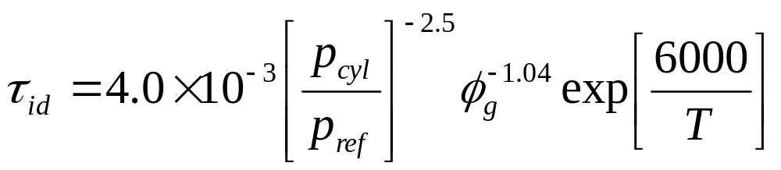
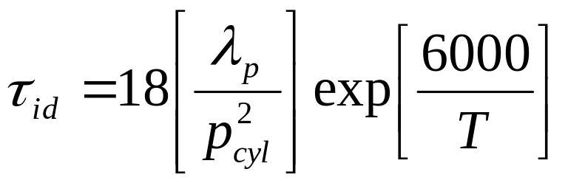
Mathematical Model to predict Ignition Delay
The most widely reported correlations related the ignition delay to the ambient gas condition.
An Arrhenius type equation for Ignition delay is:
λ_{p} :Premixed air fuel ratio.

Slide 23
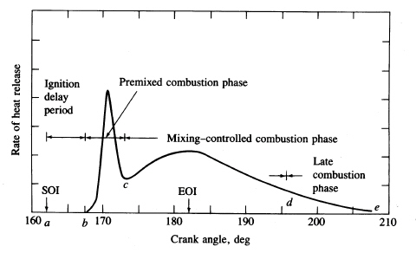
Temporal evolution of Combustion due to combined effort of Eddy Flame lets
End of
injecction
Start of
injection
-20
-10
TC
10
20
30

Slide 24
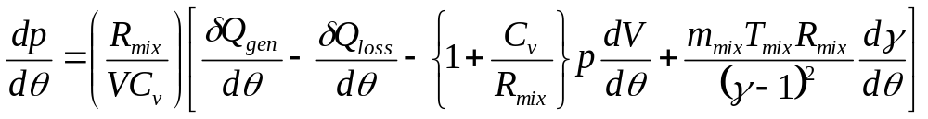
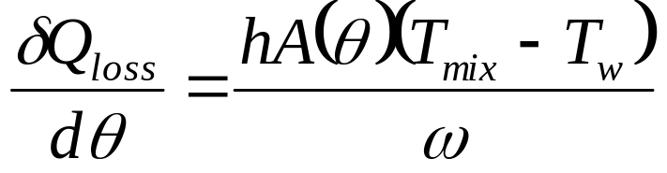
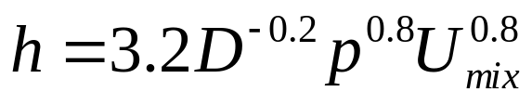
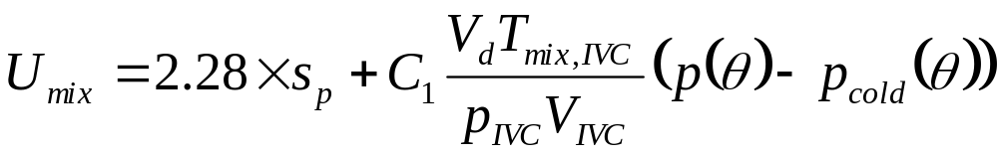
First Law Analysis of In-cylinder Process
In above Eq., the rate of the heat loss δQ_{loss}/dθ is expressed as:
The convective heat transfer coefficient is given by the Woschni model as
For combustion and expansion processes: C₁=0.00324.

Slide 25

In-cylinder Processes in a Diesel Engine

Slide 26

Rate of Combustion (Heat Release rate) in a Diesel Engine

Slide 27
Rate of Combustion (Heat Release rate) in a Diesel Engine

