Slide 1

Analysis of Turbulent Flames In SI Engines
P M V Subbarao
Professor
Mechanical Engineering Department
Essential Need for Highspeed Clean Engines ….

Slide 2

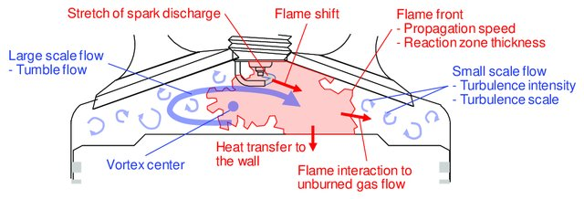
Means to Gain Comprehensive Understanding…
Cause of birth to Extinction of Turbulent Flame !!!!
Difficult to see in a working engine.
However, we can listen to the same!!!

Slide 3
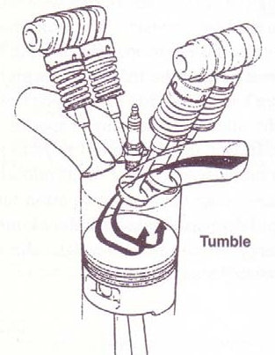
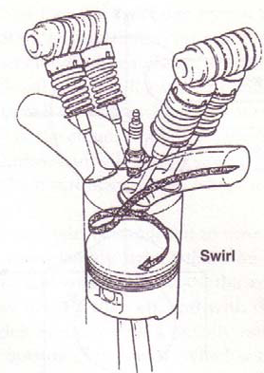
Engine Manifold Geometry to achieve high speed engines

Slide 4
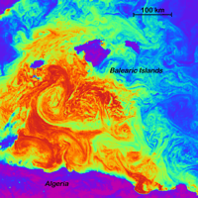
Turbulent Flames

Slide 5
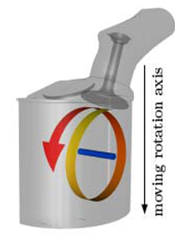
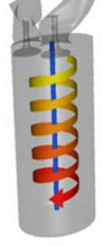
Phases of the turbulent Flow inside an Engine Cylinder
An vortical flow of air-fuel mixture into the cylinder through the intake valve or valves.
The flow in the cylinder can be divided into several distinct phases:
Decaying turbulent in-cylinder flow during (the later part of) the intake stroke.
Growing turbulent flow during the compression stroke.
Amplification of turbulence level due to combustion.
Flow with a strong attenuation of the turbulence during expansion stroke.

Slide 6
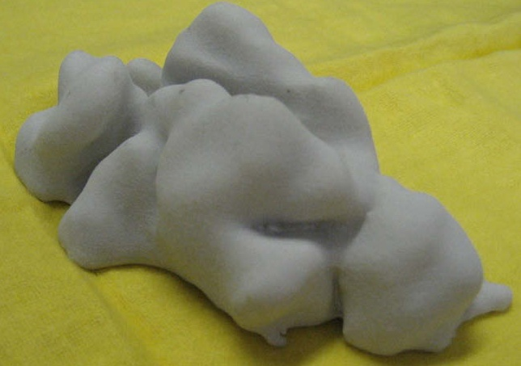
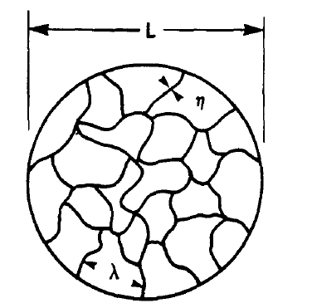
A Segment of Reconstructed Turbulent Flame in SI Engines

Slide 7
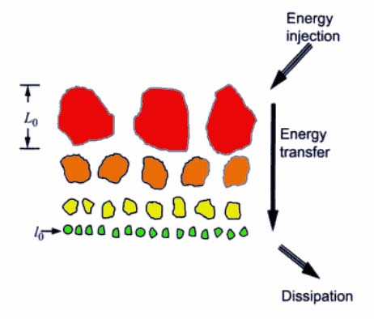
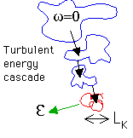
Large Scales: Parents Vortices

Slide 8
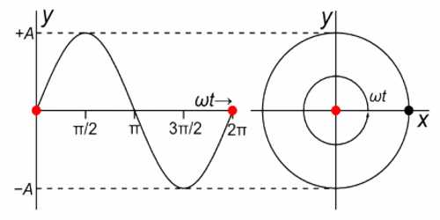
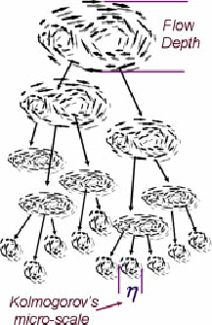
Energy Transactions among Eddies
The incoming vortical flow with large eddies pass energy sequentially and gradually to the smaller ones.
This process is known as the turbulent energy cascade.

Slide 9
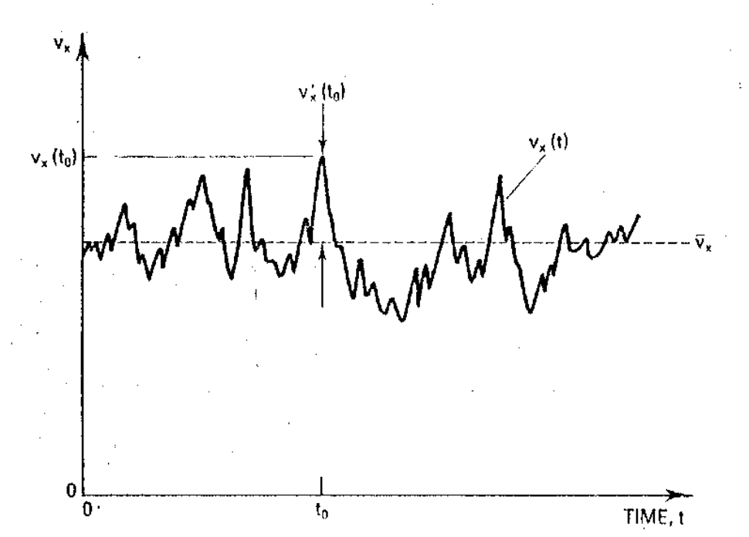
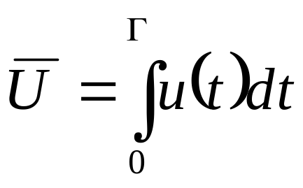
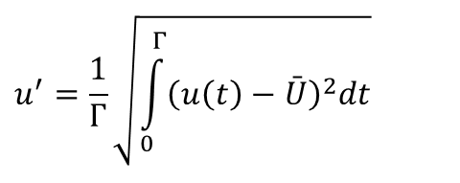
Characterization of Turbulence in Physical Space
Mean velocity component
Turbulence Level
$$u^{′}=\frac{1}{Γ}\sqrt{\int_{0}^{Γ}{{\left(u\left(t\right)−\bar{U}\right)}^{2}dt}}$$

Slide 10
Spectral Characterization of Turbulent Flow
Turbulent flows contain a wide range of eddies of different sizes (scales).
An eddy of a given size is the swirling of a fluid with a fixed size and kinetic energy.
A turbulent velocity field is due to eddies of many sizes,
  from eddies that are essentially large enough to fill the space available, in our case the engine cylinder,
  down to eddies often substantially below a millimeter in size.
The size of the largest eddy can be guessed by asking for the diameter of the largest sphere that will fit in the available space since turbulent eddies are approximately the same size in all directions.

Slide 11
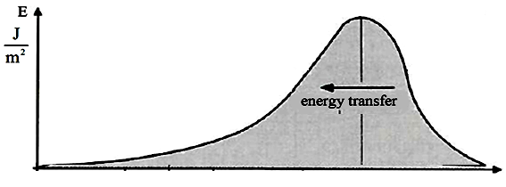




Energy Transactions Vs Size of Eddy
In Steady Turbulent Flows, the rate of energy transfer from one scale to the next must be the same for all scales.
The shortest scale dissipates this energy (d_{min}).
This rate of energy dissipation, per unit mass of fluid is denoted by ε.
d

Slide 12
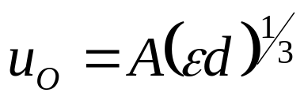
Kolmogrov’s Quantification of Eddy Energy
Kolmogorov, hypothesized that the characteristics of the turbulent eddies of size d depend solely on d itself and on the energy cascade rate ε.
This is to mean that the eddies know;
how big they are,
at which rate energy is supplied to them and
at which rate they must supply it to the next smaller eddies in the cascade.
Mathematically, u_{O} depends only on d and ε.
u_{O} = LT⁻¹, [d] = L and [ε] = L²T⁻³.
The only dimensionally acceptable possibility is:

Slide 13
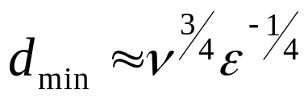
Size of the Smallest Eddy
The shortest eddy scale is set by viscosity, because the shorter the eddy scale, the stronger the velocity shear and the more important the effect of viscosity.
Consequently, the shortest eddy scale can be defined as the length scale at which viscosity becomes dominant.
Viscosity, denoted by ν, has for dimensions ν = L²T⁻¹.
It is reasonable to assume that d_{min} depends only on ε, the rate at which energy is supplied to that scale and on ν.
Then the only dimensionally acceptable relation is:
This is called the Kolmogorov scale η, is typically on the order of a few millimeters or shorter.

Slide 14
Influence of Kolmogorov Eddy Size on Wrinkling of Flame
When flame thickness is much smaller than smallest scale of turbulence, turbulent motion can only wrinkle (distort) the thin laminar flame zone.
This criterion is also referred to as Williams-Klimov criterion.
If all scales of turbulent motion are smaller than the reaction zone thickness, then transport within the zone is no longer governed by molecular processes only, but is controlled/influenced also by turbulence
This criterion is called Damköhler criterion.

Slide 15
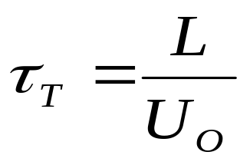
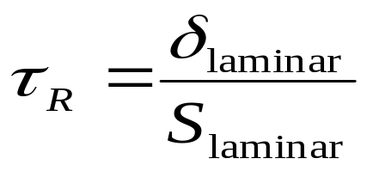
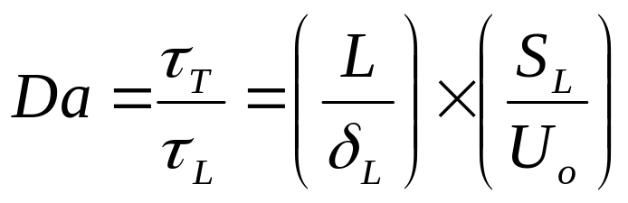
Clues to Develop a Healthy Turbulent Flow in An Engine Cylinder
Eddy turnover time:
Characteristic Chemical Reaction Time:
The ratio of the characteristic eddy time to the laminar burning
time is called the Damkohler Number Da.

Slide 16
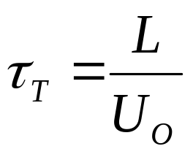
Clues to Develop a Healthy Turbulent Flow in An Engine Cylinder
Size of a Largest Eddy: L ≈ B
Orbital velocity of Parcels in this Eddy= U_{O}
Eddy turnover time:
Characteristic Chemical Reaction Time:
The ratio of the characteristic eddy time to the laminar burning
time is called the Damkohler Number Da.

Slide 17
Damköhler Number
When chemical reaction rates are fast in comparison to fluid mixing rates(turbulence),
Da >> 1 fast chemistry regime
Conversely when reactions are slow compared to mixing rates, Da << 1
For a fixed length scale ratio, Da falls as turbulence intensity goes up.

Slide 18
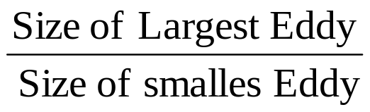
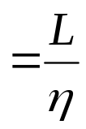
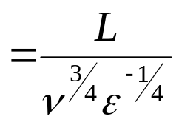
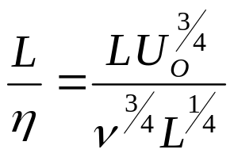
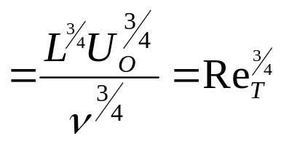
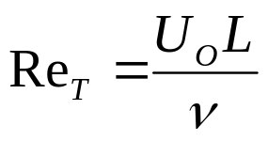
Span of Multi-scale Turbulent Flames
Multi-scale turbulent flames are essential for operation of high speed engines.
The span of eddy scales:
Turbulent Reynolds Number:
Computational Methods will help in simulation of turbulent flames with various combinations of Da & Re_{T}

Slide 19
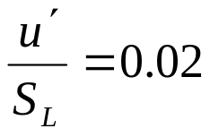
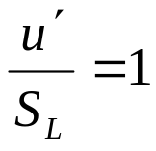
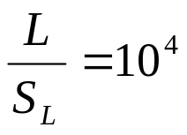

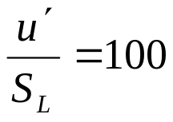
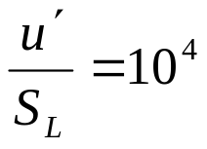
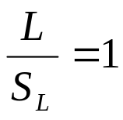
Regimes of Turbulent Flames
10⁸
Weak Turbulence
Reaction Sheets
Da
1
Flamelets in Eddies
Distributed Reactions
Cyclonic Turbulence
10⁻⁴
10⁸
Re_{T}

Slide 20
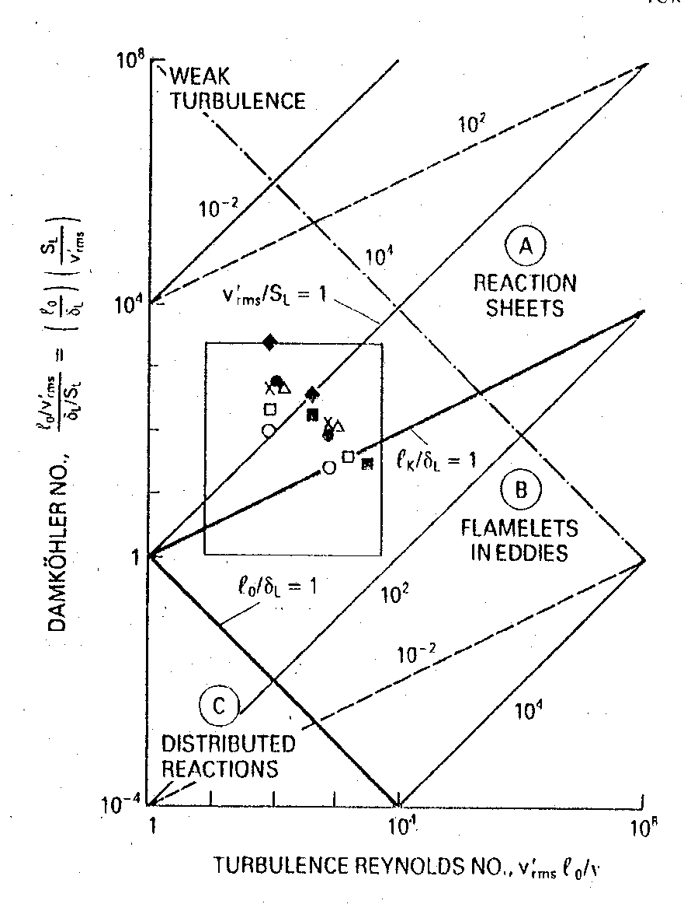
Regime of Fast SI Engine’s Turbulent Combustion

Slide 21
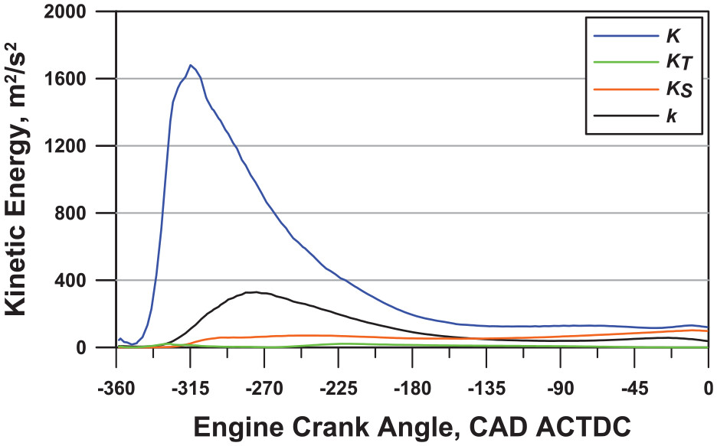
Energy of Large Eddies

Slide 22
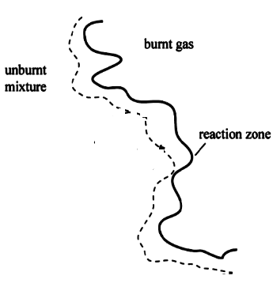
Mechanism of Turbulent Combustion in SI Engines
Values of Da and Re for a typical SI-engine lie predominantly in the reaction sheet flame region
The size of an energetic eddy must have a turnover time equal to the time needed to diffuse unbrunt mixture into and burnt mixture out of flame zone.
During its turnover time an eddy of size L will interact with the advancing flame front.
This will be able to transport preheated fluid from a region of thickness in front of the reaction zone over a distance corresponding to its own size.

