Slide 1

Fuel Spray and Wall Interactions in Ports of MPFI System
P M V Subbarao
Professor
Mechanical Engineering Department
Post Spray Process are more Crucial for Development of Green Vehicles…

Slide 2

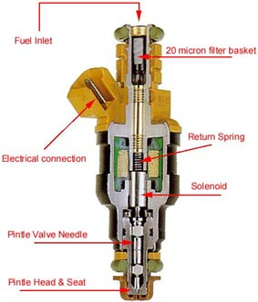
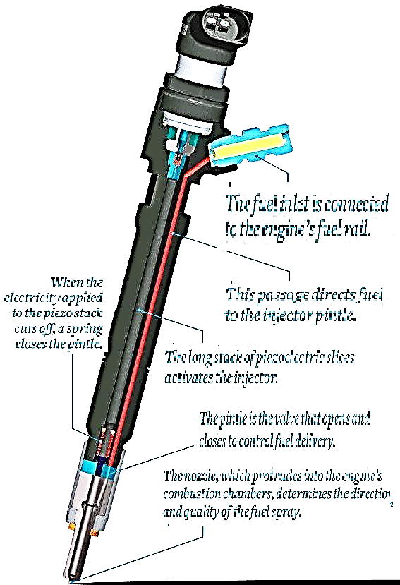
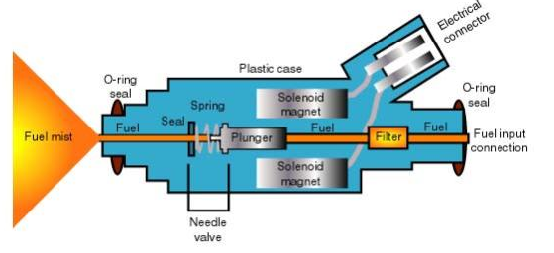
Anatomy of Modern Injectors to generate Pulsating Fuel Flow Jets
Solenoid Magnet

Slide 3
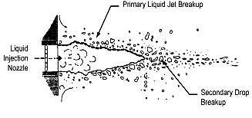
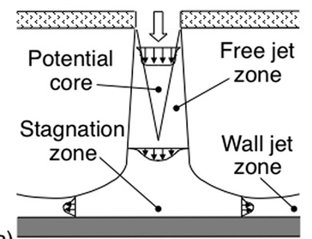
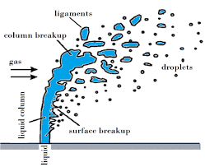
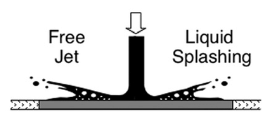
Types of Fuel Jet Breakup
What exactly going to Happen in MPFI System ???
Level 1: Jet Breakup in Quiescent Ambience
Level 3: Jet Breakup in a pipe flow
Level 2: Jet Breakup in an air flow
Level 4: Jet Breakup due to wall interactions

Slide 4
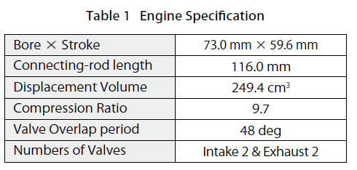
YAMAHA MOTOR TECHNICAL REVIEW
Shoichi Kato, Takanori Hayashida, Minoru Iida
A/F : 14.5, Coolant Temp. 80℃
MEP 380 kPa,

Slide 5
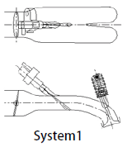
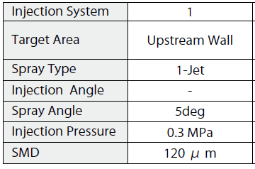
Proposal - 1

Slide 6
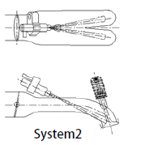
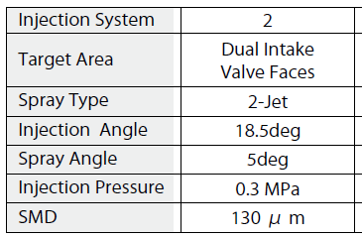
Proposal - 2

Slide 7
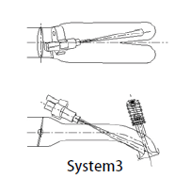
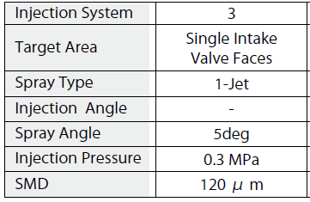
Proposal - 3

Slide 8
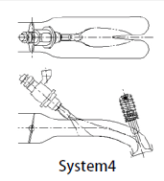
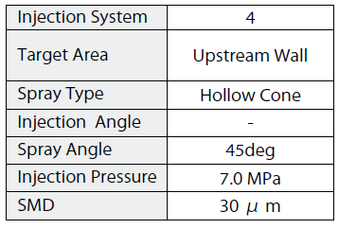
Proposal - 4

Slide 9
Geometrical Details of Proposals

Slide 10
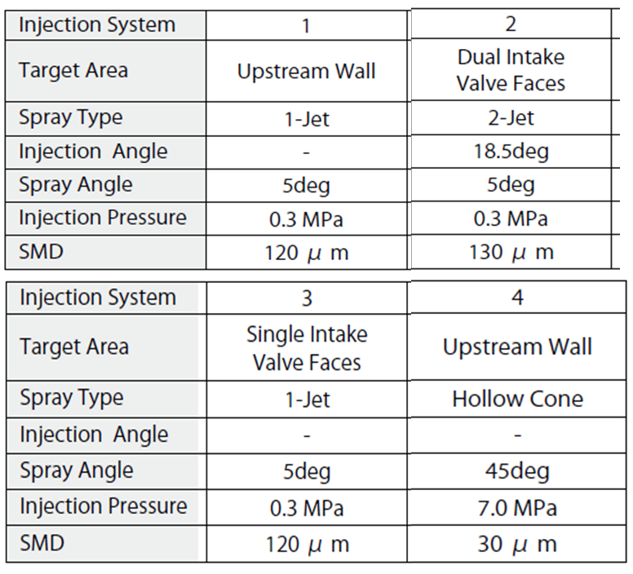
Technical Details of Proposals

Slide 11
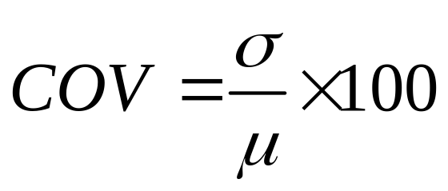
Method of Field Acceptability Testing
Select a range and resolution of Start of Injection.
This is measured as degrees before compression top dead center (BCTDC).
For each value of selected SIT, collect 600 samples of instantaneous p-θ diagrams.
Compute IMEP for each p-θ diagram.
For a given SIT, you have 600 random values of IMEP.
Calculate mean and SD for these IMEP values.
Define Coefficient of Variation (CoV) as:
Least value of CoV signifies most reliable operation and design.

Slide 12
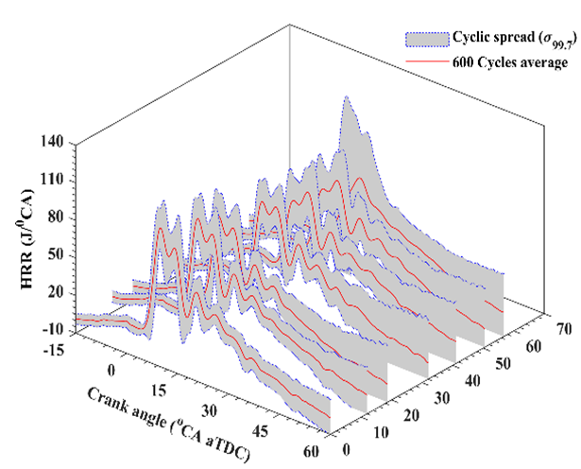
Field Acceptability Testing
Start of Injection

Slide 13
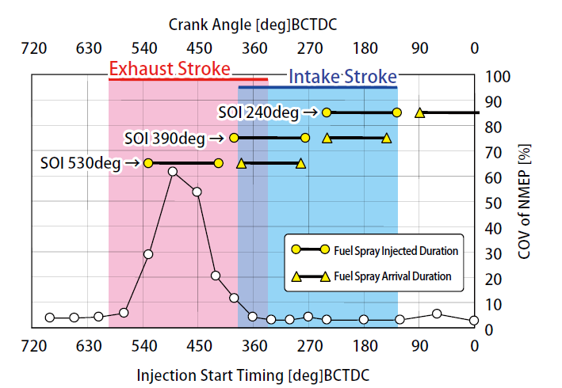
Selection of Injection Timing & Durations
All Systems

Slide 14
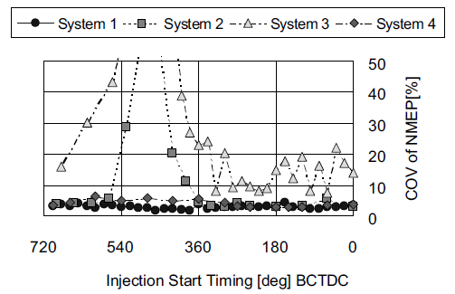
The System Reliability

Slide 15
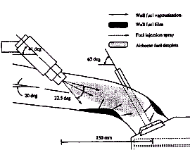
Air –Fuel Interactions in the Manifold
As the droplet group enters in the air stream, it decelerates or accelerates depending on local flow geometry.
At the same time, the vaporization of droplets is initiated.
As the droplets move to the end of the port, some of the unvaporized droplets are expected to impinge on the intake port wall bend to form droplet deposition films.
Because of the heat transfer from the wall and from the air stream, these liquid films also continuously generate fuel vapours.

Slide 16

Spray Wall Impingement & Formation of Films
The shape, size and location of impingement sites depend on;
Fuel spray cone angle.
Injection timing, back flow
Injection distance,
Impingement incidence angle.
For every impingement site, there exist;
the impingement probability and
the passing-by probability.
The impingement probability is proportional to spray covered wall area and the downstream flow cross-sectional area.

Slide 17
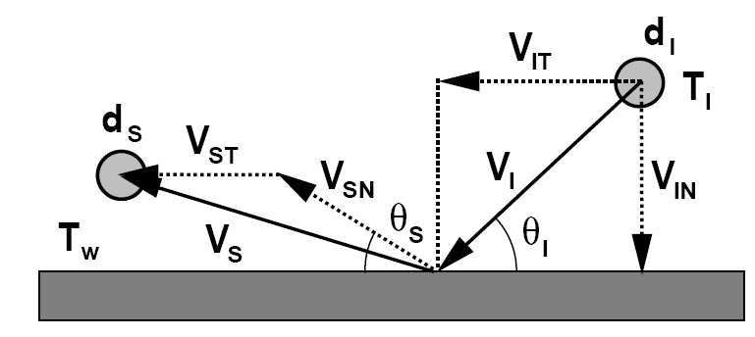
Maxwell’s Theory of Particle Surface Interactions
A particle impacting on a solid surface first undergoes an elastic deformation and rebound.

Slide 18
Kinematics of Liquid Droplet Impingement
It is very different from Maxwell’s theory.
A droplet impacting on a solid surface first undergoes deformation and spreads out at a certain velocity under the impingement-induced pressure gradients.
This spreading flow either remains stable or becomes unstable, leading to different impingement regimes:

Slide 19


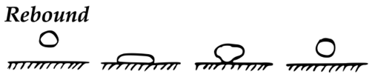
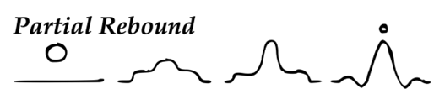

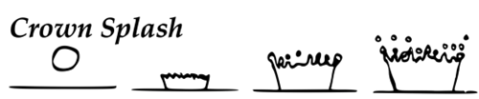
Drop impact mechanisms

Slide 20
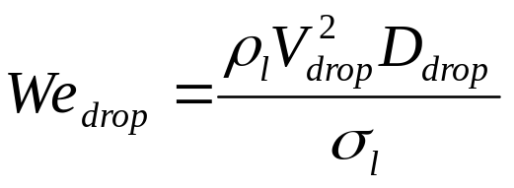
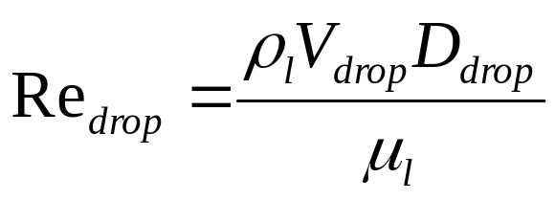
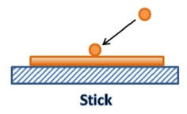
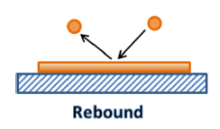
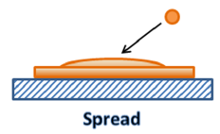
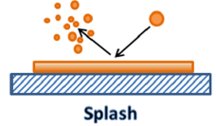
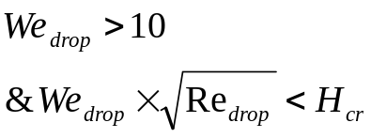



Physics of Liquid Droplet Impingement on A Wall
The wall impingement process is classified as four regimes:
The regime transition criteria are determined based on the Reynolds number and Weber number of the incident droplet and the surface condition:
splash is the most important and also the most complex.
Spread and Splash are commonly observed in SI engine ports.

Slide 21
Characterization of Liquid Droplet Impingement
Two basic issues arise in liquid droplet impingement processes.
Occurrence of type of Impacting regime.
Post-impingement characteristics, namely,
  the rebound velocity magnitude and its direction for the rebound regime,
  the fraction of the mass deposited on the wall and
  the size and velocity distributions of the secondary droplets for the splash/breakup regime.

Slide 22
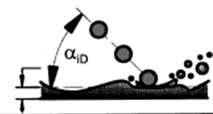
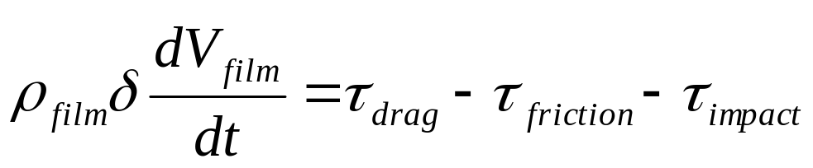

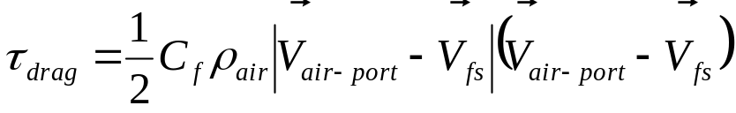
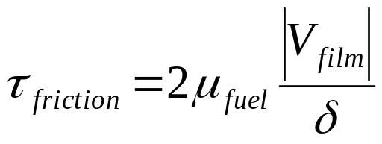
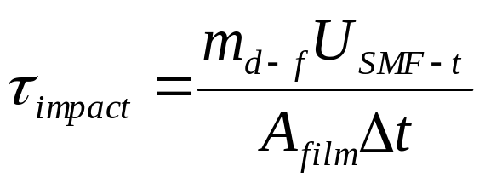
Spreading Dynamics of Films
There are two different forces exerted on a fuel wall film.
On the gas side, the gas flow tends to drive the film moving along the same direction.
On the wall side, the viscous friction tends to resist the film movement.
The force balance on the film gives the equation for the film motion:

Slide 23
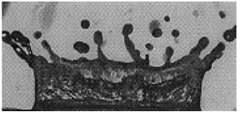
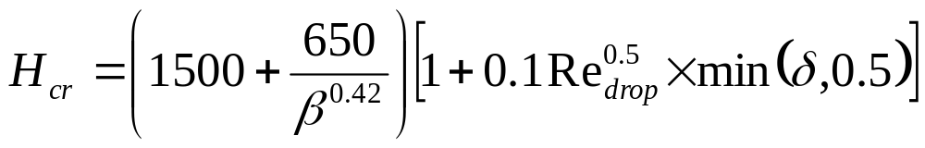
The Splash
Splash results in the rebounding of many smaller secondary droplets from the impinging location.
The size and velocities of the secondary droplets are statistically distributed.
β : non-dimensional surface roughness = (roughness height/incident droplet diameter),
δ : non-dimensional film thickness =(film thickness/incident droplet diameter)
The splash threshold film thickness H_{cr}

Slide 24
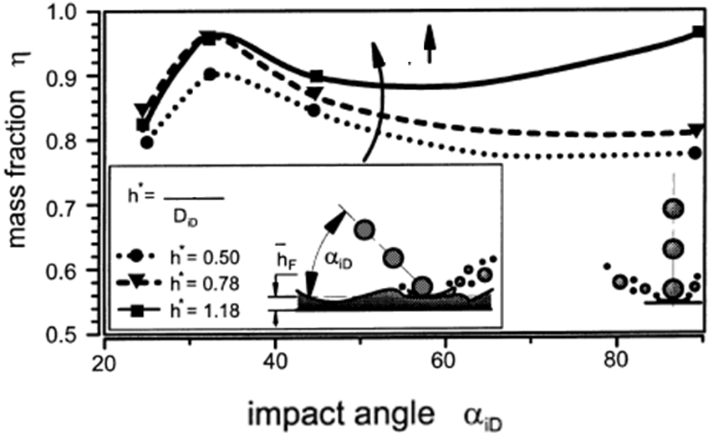

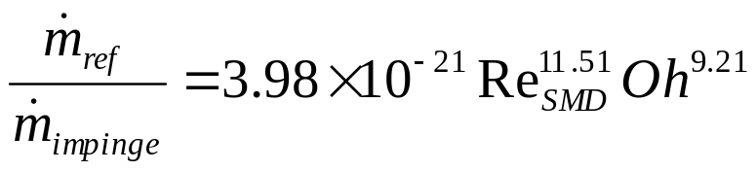
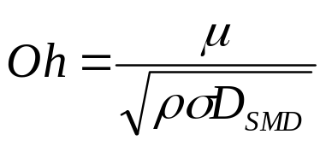
Deposited Film Mass Fraction
The ratio of the reflected to the impinging mass is
given by
Ohnesorge numbers

