Slide 1

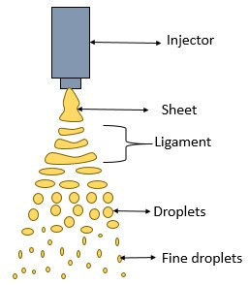
Stability Fluid Dynamics of Fuel Jets
P M V Subbarao
Professor
Mechanical Engineering Department
Engineering of Fuel Jet →Fuel Drops …...

Slide 2

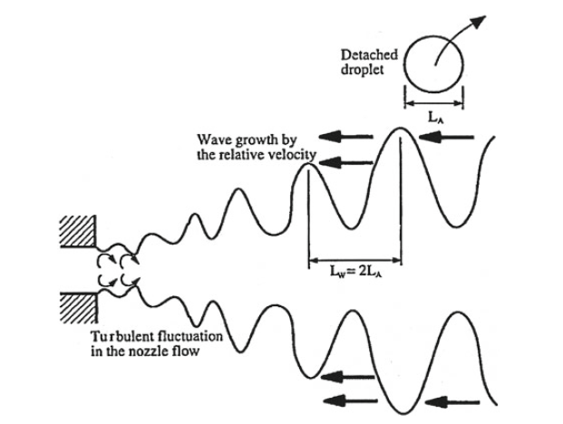


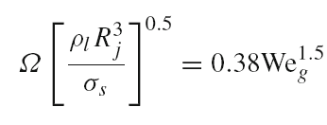
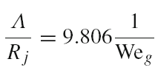
Kelvin-Helm Holtz Instability of Micro Fuel Jet
Two non-dimensional numbers, namely Reynolds number (Re) and Weber number (We) are identified for the fuel jet.
The growth rate (Ω ) and the corresponding wavelength Λ are estimated using these non-dimensional parameters.

Slide 3
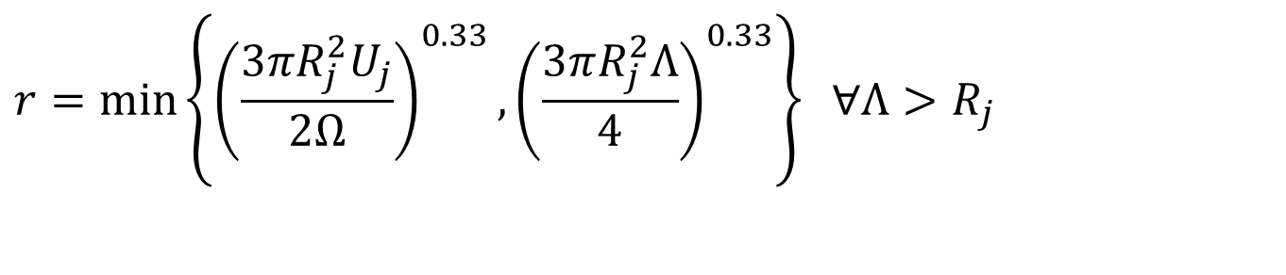
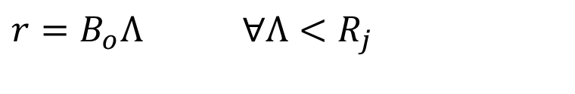
Postulations for Liquid breakup
New drops of radius, r, are formed from bulk liquid or blobs, with characteristic radius R_{j}.
$$r=B_{o}Λ ∀Λ<R_{j}$$
$$r=\min\left\{{\left(\frac{3πR_{j}^{2}U_{j}}{2Ω}\right)}^{0.33},{\left(\frac{3πR_{j}^{2}Λ}{4}\right)}^{0.33}\right\} ∀Λ>R_{j}$$

Slide 4
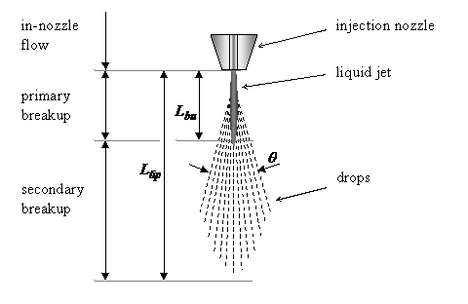
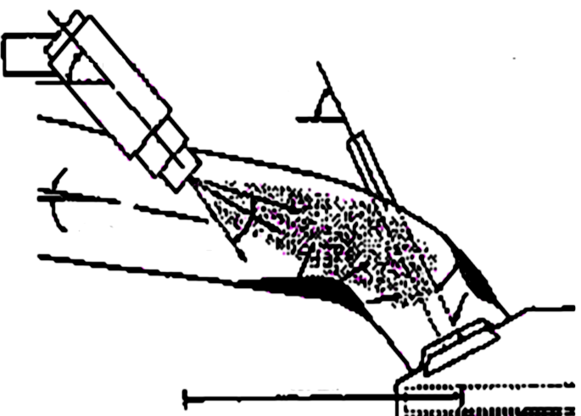
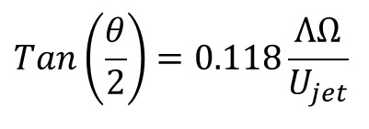
Geometrical Features of A Successful Fuel Spray
Orientation Angle of intake port
Orientation Angle of Valve
Spray Angle
The angle of spray that leads to formation of droplets described by the angle θ.
$$Tan\left(\frac{θ}{2}\right)=0.118\frac{ΛΩ}{U_{jet}}$$

Slide 5
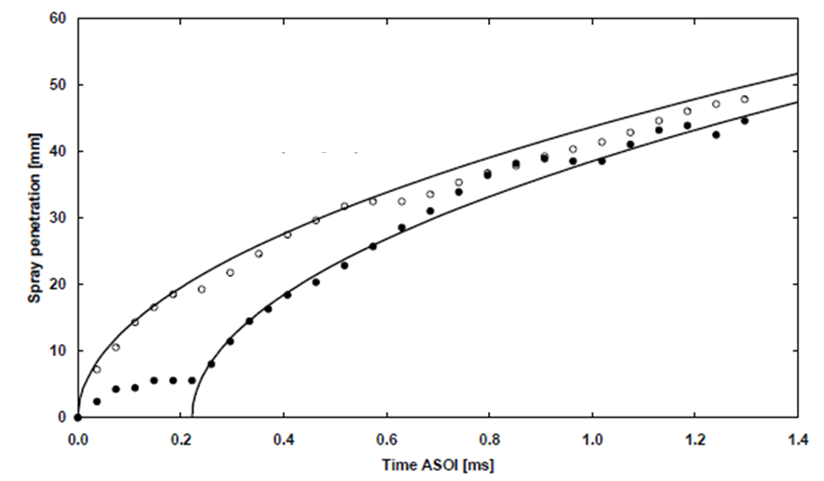
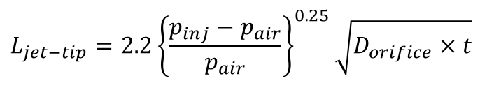
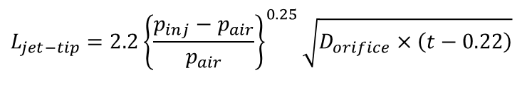
Penetration of Spray into Air Medium
$$L_{jet−tip}=2.2{\left\{\frac{p_{inj}−p_{air}}{p_{air}}\right\}}^{0.25}\sqrt{D_{orifice}×t}$$
$$L_{jet−tip}=2.2{\left\{\frac{p_{inj}−p_{air}}{p_{air}}\right\}}^{0.25}\sqrt{D_{orifice}×\left(t−0.22\right)}$$

Slide 6
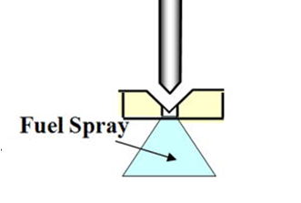
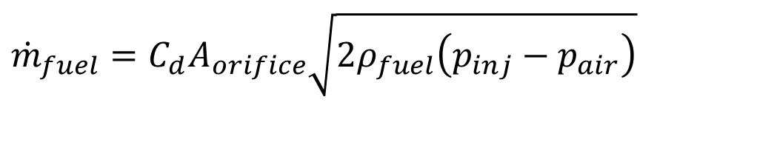
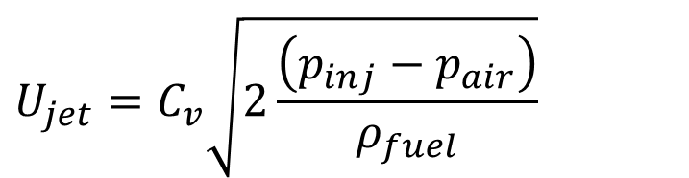
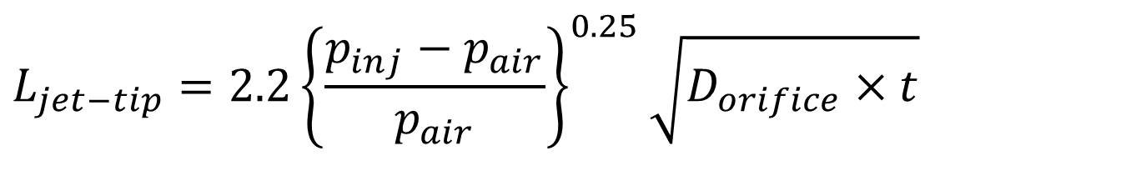
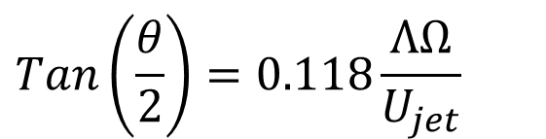

Basic Details of Spray for Port Injection
Spray/jet parameters:
$$Tan\left(\frac{θ}{2}\right)=0.118\frac{ΛΩ}{U_{jet}}$$
$$U_{jet}=C_{v}\sqrt{2\frac{\left(p_{inj}−p_{air}\right)}{ρ_{fuel}}}$$
$$L_{jet−tip}=2.2{\left\{\frac{p_{inj}−p_{air}}{p_{air}}\right\}}^{0.25}\sqrt{D_{orifice}×t}$$
$${\dot{m}}_{fuel}=C_{d}A_{orifice}\sqrt{2ρ_{fuel}\left(p_{inj}−p_{air}\right)}$$

Slide 7
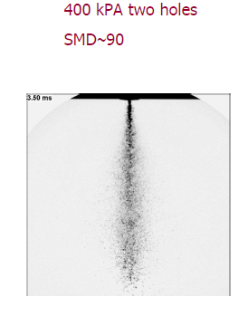
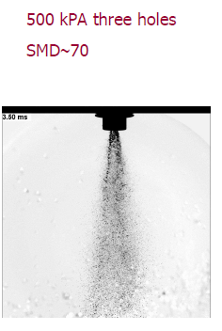
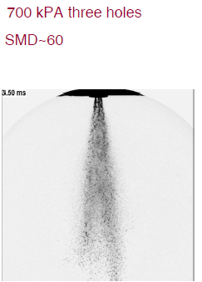
Structure of Gasoline Fuel Sprays in Ports
Average drop dia=90μm
Average drop dia=70μm
Average drop dia=50μm

Slide 8
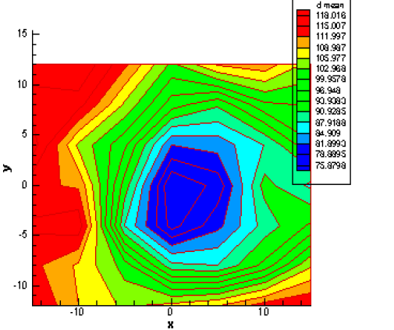
Mean diameter distribution of droplets in 100 mm downstream and 300 Kpa, 25º C

Slide 9
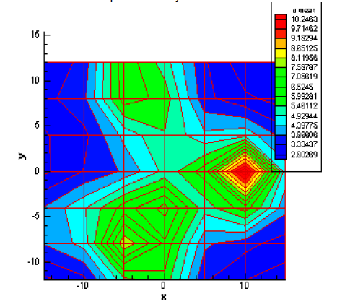
Distribution of droplets velocity (m/s) in 100 mm downstream and 300 Kpa, 25º C

Slide 10
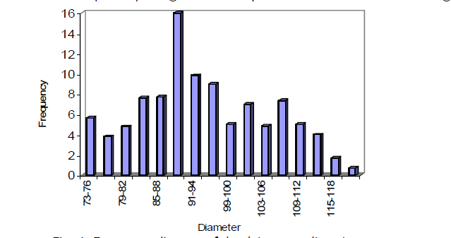

Frequency diagram for Size of droplets
D is the droplet diameter and
N is the normalized number
distribution.

Slide 11
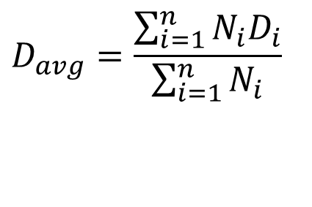
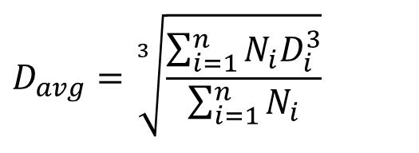
Selection of Statistical Method to Define Average Diameter of Droplet
Number distribution function:
For same total number of droplets:
$$D_{avg}=\frac{\sum_{i=1}^{n}{N_{i}D_{i}}}{\sum_{i=1}^{n}{N_{i}}}$$
$$D_{avg}=\sqrt[3]{\frac{\sum_{i=1}^{n}{N_{i}D_{i}^{3}}}{\sum_{i=1}^{n}{N_{i}}}}$$

Slide 12
The True Engineering Mean Diameter
This diameter is named after the German scientist who first employed it in 1920.
Dr Ing J. Sauter worked at the Laboratorium für Technische Physik of the Technische Hochschule, Müchen on aspects of internal combustion engines.
In particular, he studied atomization in carburettors and as part of his work devised a technique to determine the size of drops produced based on the absorption/scattering of light.
The true mean diameter must have the same ratio of volume to surface area as the entire ensemble.
This is known as the Sauter mean diameter or D_{32.}

Slide 13
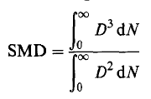
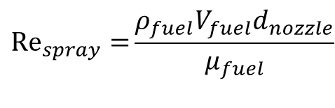
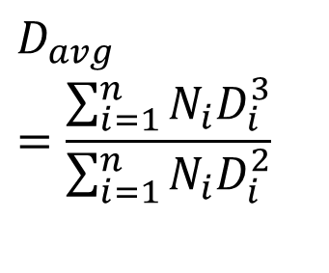
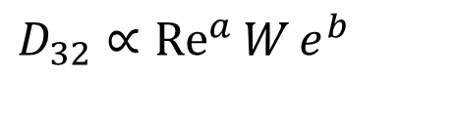
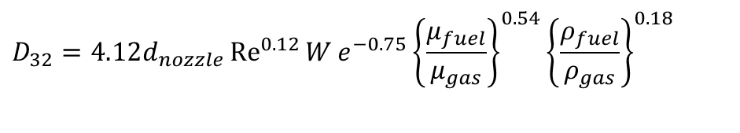
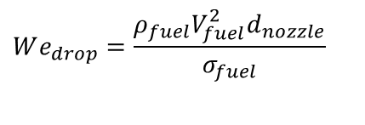
Sauter Mean Diameter
$$D_{avg}=\frac{\sum_{i=1}^{n}{N_{i}D_{i}^{3}}}{\sum_{i=1}^{n}{N_{i}D_{i}^{2}}}$$
Introducing the definition of SMD:
The value of SMD found to be a function of on Reynolds number and Weber number of the spray:
$$D_{32}∝{Re}^{a}{W}e^{b}$$
$${Re}_{spray}{=}\frac{ρ_{fuel}V_{fuel}d_{nozzle}}{μ_{fuel}}$$
$$We_{drop}=\frac{ρ_{fuel}V_{fuel}^{2}d_{nozzle}}{σ_{fuel}}$$
$$D_{32}=4.12d_{nozzle}{Re}^{0.12}{W}e^{−0.75}{\left\{\frac{μ_{fuel}}{μ_{gas}}\right\}}^{0.54}{\left\{\frac{ρ_{fuel}}{ρ_{gas}}\right\}}^{0.18}$$
where d_{nozz} is the nozzle diameter,
μ_{f} , μ_{g} are the fuel and gas dynamic viscosity, respectively,

Slide 14
Selection of Nozzle diameter & Flow Rate
d_{nozz}(mm) | L_{nozz}/d_{nozz} | SMD (micrometers)
0.1 | 36.1 | 0.12
0.2 | 18.05 | 1.75
0.3 | 12.0 | 8.45
0.4 | 9.0 | 25.8
0.5 | 7.22 | 61.3
0.6 | 6.02 | 124.3
0.7 | 5.16 | 226.2
Injection rate (kg/hr) | SMD(micrometers)
5 | 128.389
7 | 80.6993
9 | 57.0493
11 | 43.2497
13 | 34.345

Slide 15
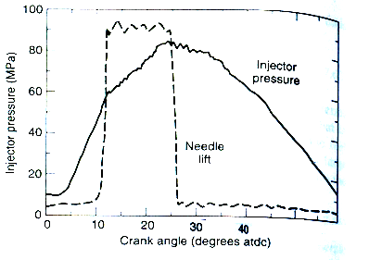
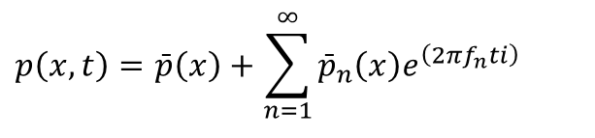
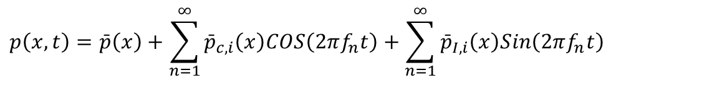
Need for Theory of Pulsating Fuel Flow
1.0
.
.
.
.
-450
-360
-270
-180
-90
-45
0
Crank angle in degrees
50
The pressure gradient across the injector openings can be defined as a trapezoidal pulse train.
This pulse train in real time is mapped as a Fourier series with non-dimensional time and frequency as governing parameters.
$$p\left(x,t\right)=\bar{p}\left(x\right)+\sum_{n=1}^{∞}{{\bar{p}}_{c,i}\left(x\right)COS\left(2πf_{n}t\right)}+\sum_{n=1}^{∞}{{\bar{p}}_{I,i}\left(x\right)Sin\left(2πf_{n}t\right)}$$
$$p\left(x,t\right)=\bar{p}\left(x\right)+\sum_{n=1}^{∞}{{\bar{p}}_{n}\left(x\right)e^{\left(2πf_{n}ti\right)}}$$

Slide 16
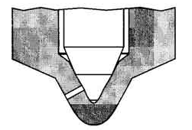
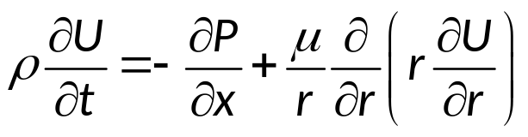
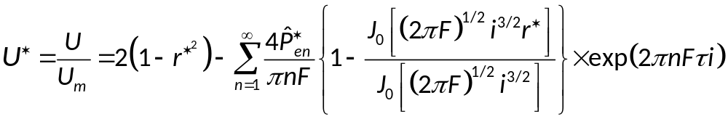
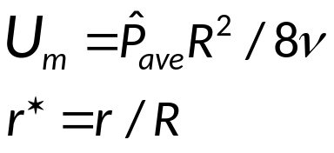
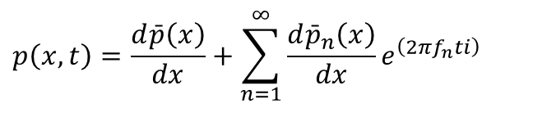
New Chapter in Fluid Mechanics
Fully developed axisymmetric pulsating laminar pipe flow.
The Navier-Stokes equation for an axisymmetric flow can be written as:
The pressure gradient in the above equation can be written in the form of a Fourier transform as discussed above.
$$p\left(x,t\right)=\frac{d\bar{p}\left(x\right)}{dx}+\sum_{n=1}^{∞}{\frac{d{\bar{p}}_{n}\left(x\right)}{dx}e^{\left(2πf_{n}ti\right)}}$$
The equation when solved gives absolute flow velocity and mass flow rate mapped against time in a complex space:

Slide 17
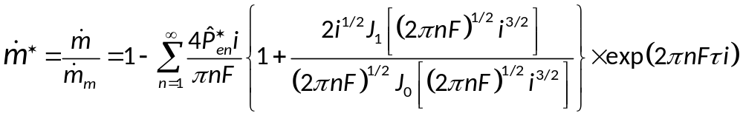
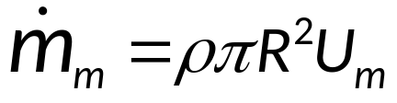
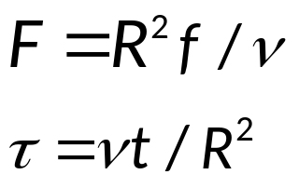
Instantaneous Mass Flow Rate
The mass flow rate can then be solved for:
The non-dimensional frequency and time are given as below
R is the radius of the nozzle tip.

Slide 18
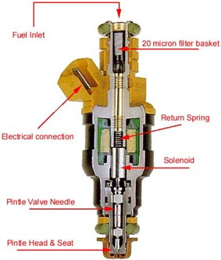
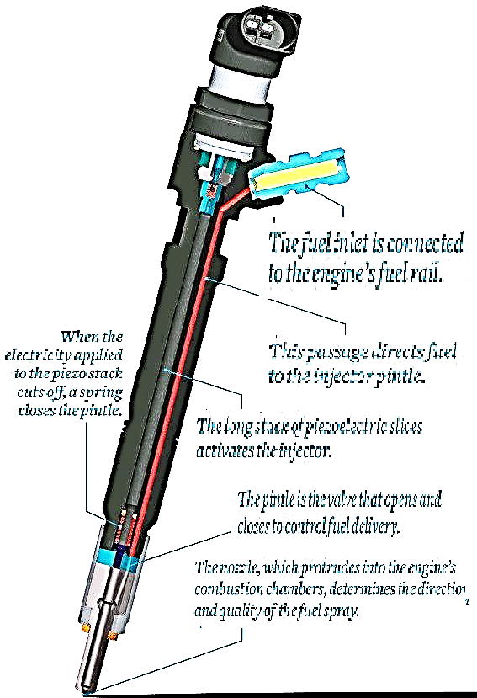
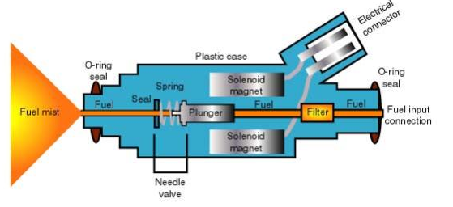
Anatomy of Modern Injectors to generate Pulsating Fuel Flow Jets
Solenoid Magnet

