Slide 1

Advanced MPFI Engines
P M V Subbarao
Professor
Mechanical Engineering Department
An Elaboration of Micro-Pulsating Fluid Mechanics …...

Slide 2

Why MPFI Systems ?
Efficiency and ecological performance have always been the top priorities for 21st century automobile manufacturers.
Significant advancements have been discovered and implemented to enhance fuel delivery systems.
One such breakthrough is the Multi-Point Fuel Injection System (MPFI) system.
This state-of-the-art technology has revolutionized the automotive industry with improved power and fuel economy and ultra low emissions.

Slide 3
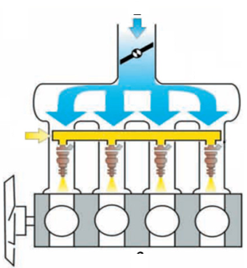
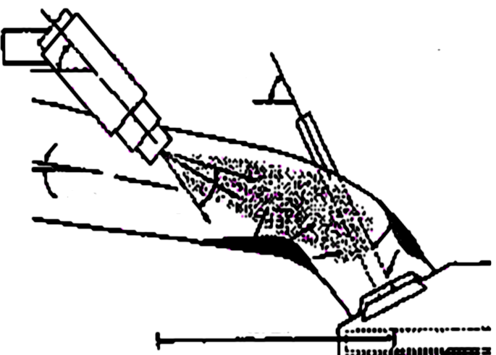
Multi-Point (Port) Fuel Injection System for SI Engine
Orientation Angle of intake port
Orientation Angle of Valve
Spray Angle
A MPFI is a system of injecting fuel into internal combustion engine through multi ports situated on intake valve of each cylinder.
It delivers an exact quantity of fuel in each cylinder at the right time.

Slide 4
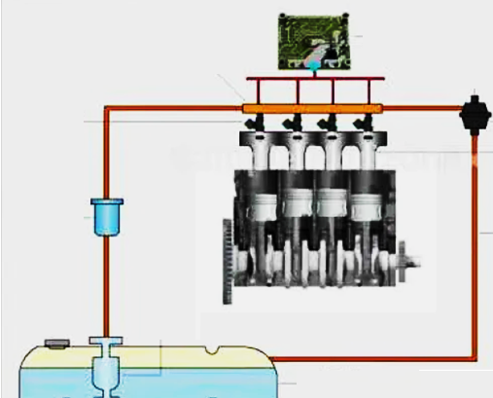
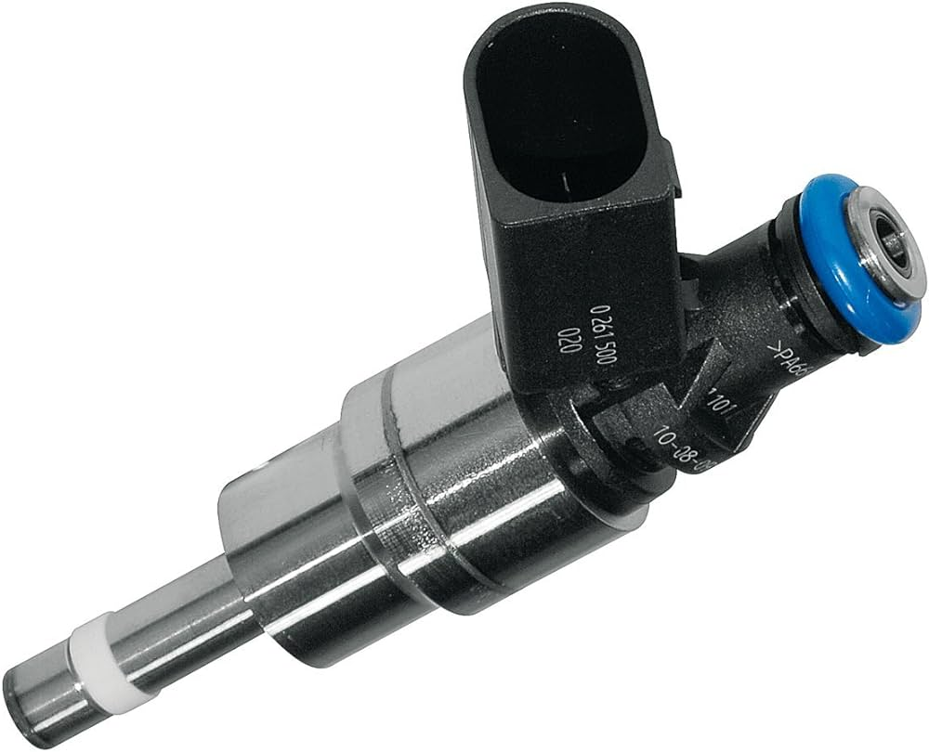
Major Components of MPFI Systems
Fuel Injectors: These electronically controlled valves deliver fuel directly into the intake valves with a precise spray pattern.

Slide 5
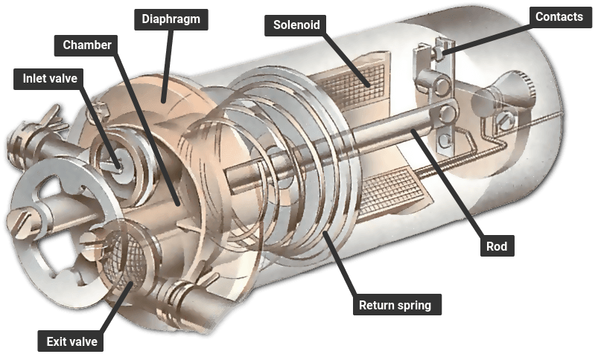
Major Components of MPFI Systems
Fuel Pump: It is the heart of the MPFI and pressurizes the fuel to ensure smooth delivery to the injectors.

Slide 6
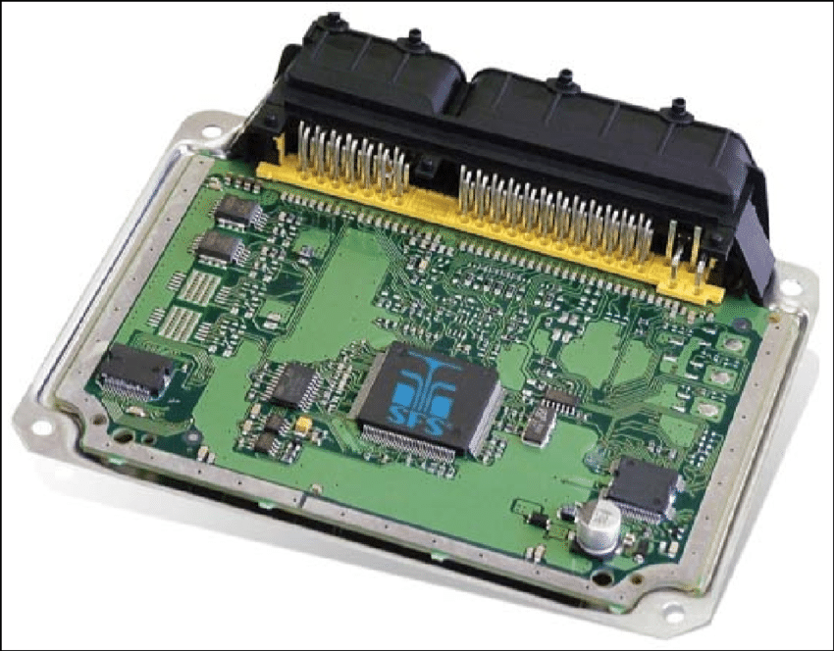
Major Components of MPFI Systems
Engine Control Unit: The ECU is the brain of the MPFI system.
ECU, like any brain, monitors various engine parameters thru sensors and optimally control the fuel injection process accordingly.

Slide 7
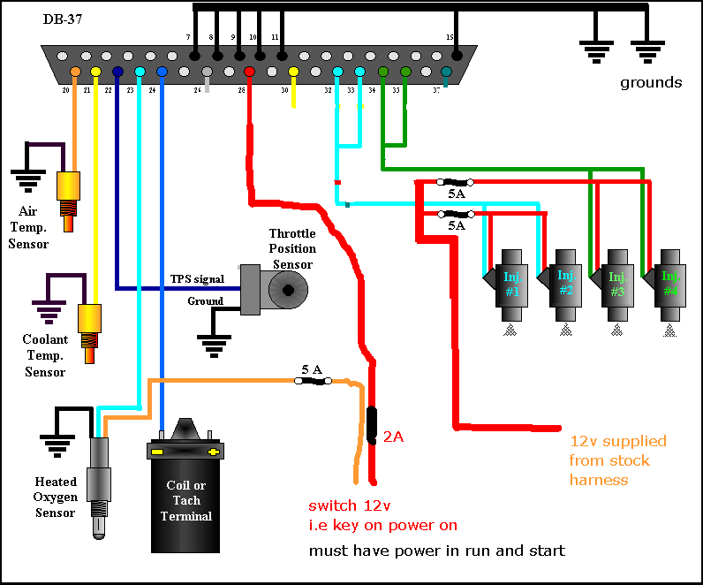
Major Components of MPFI Systems
Sensors: Various sensors, namely,
The throttle position sensor
The oxygen sensor
The Coolant temperature sensor,
These sensors provide vital information to the ECU, enabling it to optimize fuel delivery.

Slide 8
Working Strategy of MPFI
The MPFI system is a synchronized working network to ensure accurate fuel delivery.
Four major functions are given below:
Data Collection: The sensors collect data on engine parameters like throttle position, engine speed, and temperature.
Data Analysis: The ECU receives and processes the gathered data to determine the optimum air-fuel mixture for each cylinder.
Fuel Feed: Based on the calculations, the ECU triggers the fuel injectors to spray the precise amount of fuel into each cylinder's intake valve.
Combustion Control: The fuel is controlled to mix with the incoming air, made sure to creating a highly combustible mixture ignited by the spark plugs, and ensure to result in efficient combustion.

Slide 9
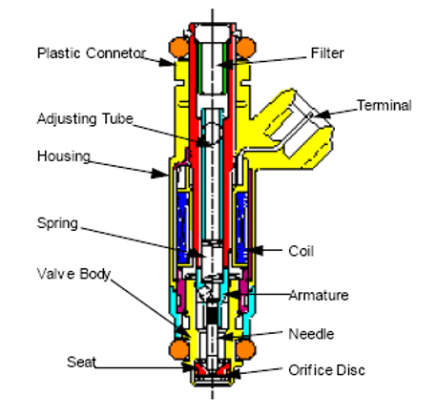
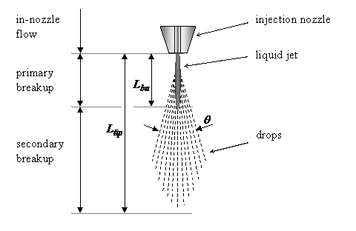
Duty & Anatomy of An Injector

Slide 10
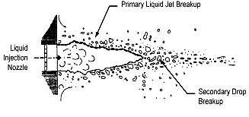
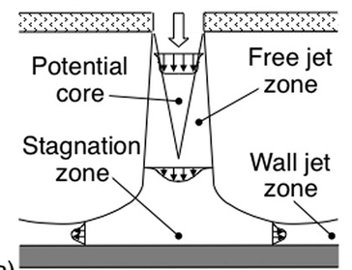
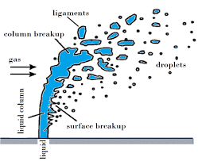
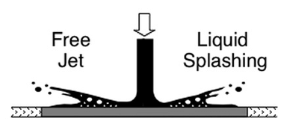
Types of Fuel Jet Breakup
What is best for MPFI System ???
Level 1: Jet Breakup in Quiescent Ambience
Level 3: Jet Breakup in a pipe flow
Level 2: Jet Breakup in an air flow
Level 4: Jet Breakup due to wall interactions

Slide 11

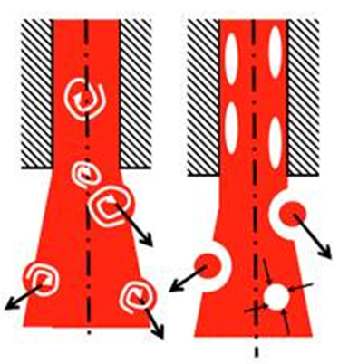
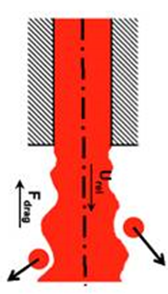
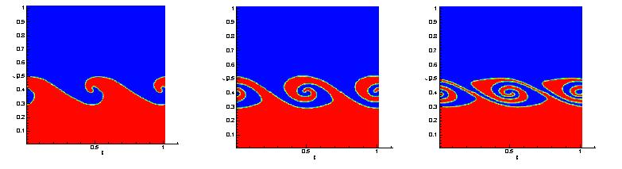
Instability of Fluid Ligament in Ambient Air

Slide 12
Wave Theory of Instability
WAVE theory is based on the temporal Kelvin-Helmholtz instability.
The model assumes a round liquid jet (density ρ_{l} ) with an inviscid outer gas phase.
The liquid velocity is assumed to be constant inside the jet and drops to zero at the interface between the liquid and gas phases.
The small disturbance introduced by manifold air flow in an axisymmetric fuel jet grows with time.

Slide 13
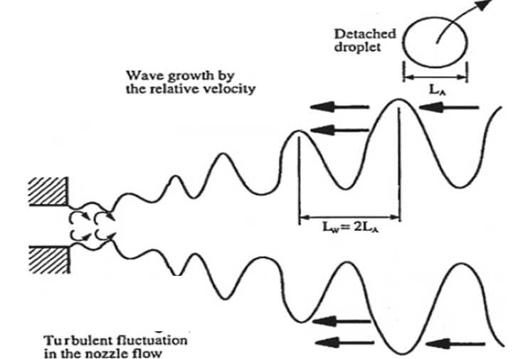
Kelvin-Helmholtz Instability

Slide 14
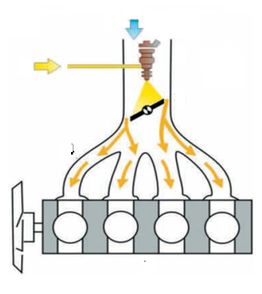

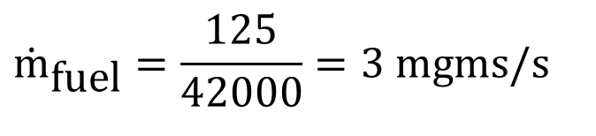

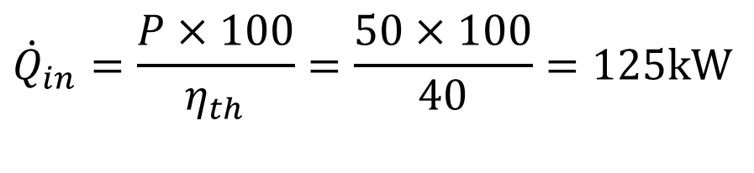
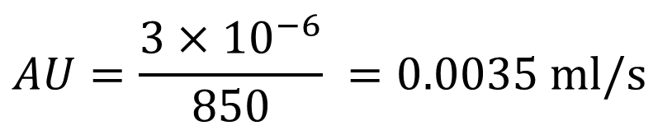
Micro-Fluid Mechanics of Fuel Injection Systems
Need for a microfluid Flow System
Consider an engine of P = 50kW
Assume thermal efficiency = 40%
∴Rate of heat input
$${\dot{Q}}_{in}=\frac{P×100}{η_{th}}=\frac{50×100}{40}=125\text{kW}$$
$${\dot{Q}}_{in}=125\text{kW}={\dot{m}}_{\text{fuel}}×HV$$
$${\dot{m}}_{\text{fuel}}=\frac{125}{42000}=3 \text{mgms}\text{/}\text{s}$$
$${\dot{m}}_{\text{fuel}}=ρAU=3 \text{mgms}\text{/}\text{s}$$
$$AU=\frac{3×10^{−6}}{850} =0.0035 \text{ml}\text{/}\text{s}$$

Slide 15
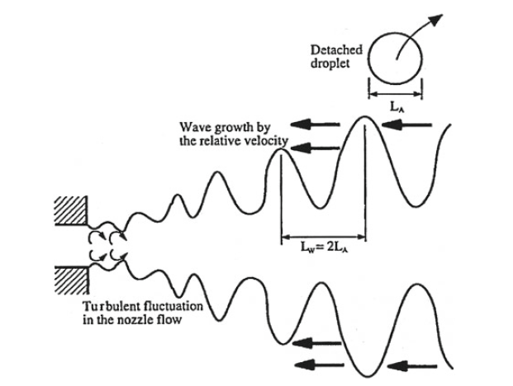


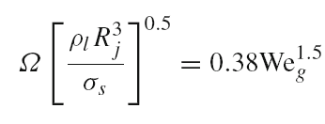
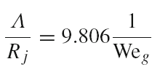
Kelvin-Helm Holtz Instability of Micro Fuel Jet
Two non-dimensional numbers, namely Reynolds number (Re) and Weber number (We) are identified for the fuel jet.
The growth rate (Ω ) and the corresponding wavelength Λ are estimated using these non-dimensional parameters.

Slide 16
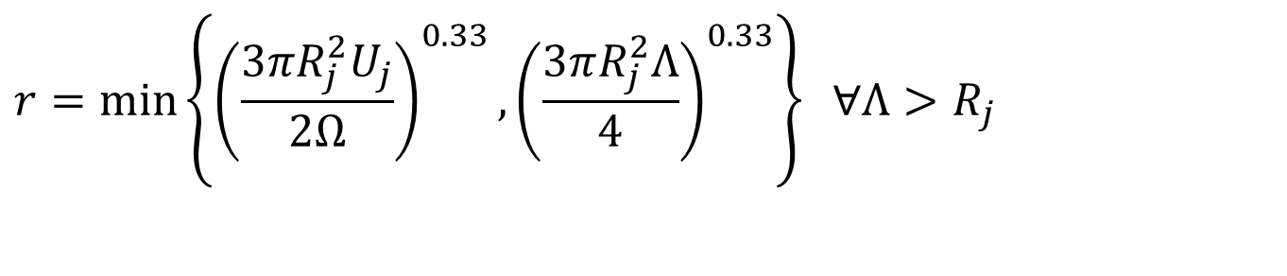
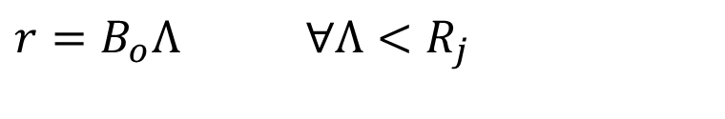
Postulations for Liquid breakup
New drops of radius, r, are formed from bulk liquid or blobs, with characteristic radius R_{j}.
$$r=B_{o}Λ ∀Λ<R_{j}$$
$$r=\min\left\{{\left(\frac{3πR_{j}^{2}U_{j}}{2Ω}\right)}^{0.33},{\left(\frac{3πR_{j}^{2}Λ}{4}\right)}^{0.33}\right\} ∀Λ>R_{j}$$

Slide 17
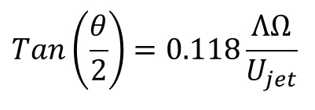
Geometrical Features of A Successful Fuel Spray
Orientation Angle of intake port
Orientation Angle of Valve
Spray Angle
The angle of spray that leads to formation of droplets described by the angle θ.
$$Tan\left(\frac{θ}{2}\right)=0.118\frac{ΛΩ}{U_{jet}}$$

Slide 18
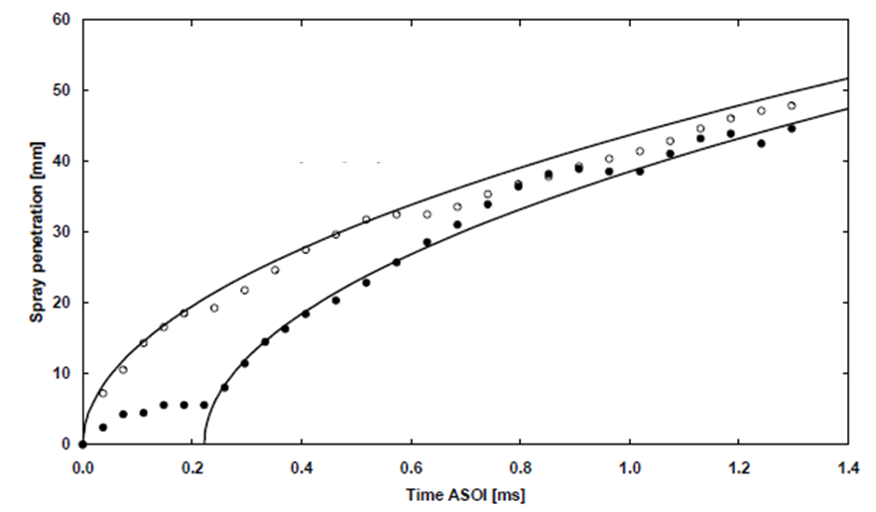
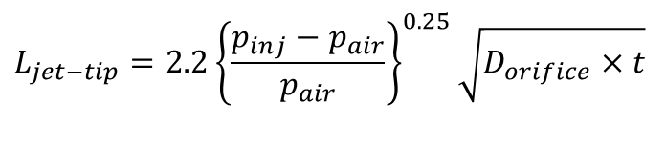
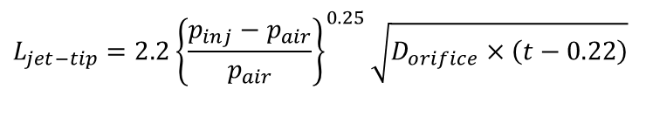
Penetration of Spray into Air Medium
$$L_{jet−tip}=2.2{\left\{\frac{p_{inj}−p_{air}}{p_{air}}\right\}}^{0.25}\sqrt{D_{orifice}×t}$$
$$L_{jet−tip}=2.2{\left\{\frac{p_{inj}−p_{air}}{p_{air}}\right\}}^{0.25}\sqrt{D_{orifice}×\left(t−0.22\right)}$$

