Slide 1

Evolution of Fuel Induction Systems
P M V Subbarao
Professor
Mechanical Engineering Department
A Novel Micro-Pulsating Flow Device…...

Slide 2

Thermochemistry of Fuel Ignition
Upper Flame Limit
Mists
Saturation line
Vapour Pressure in Air
Onset of
Piloted Ignition Region
Flammable Region
Inflammable Region
Lower Flame Limit
Mixture Temperature

Slide 3
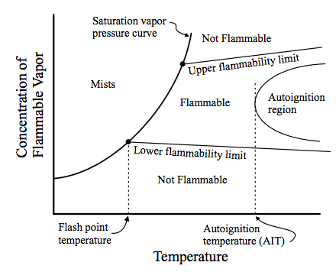
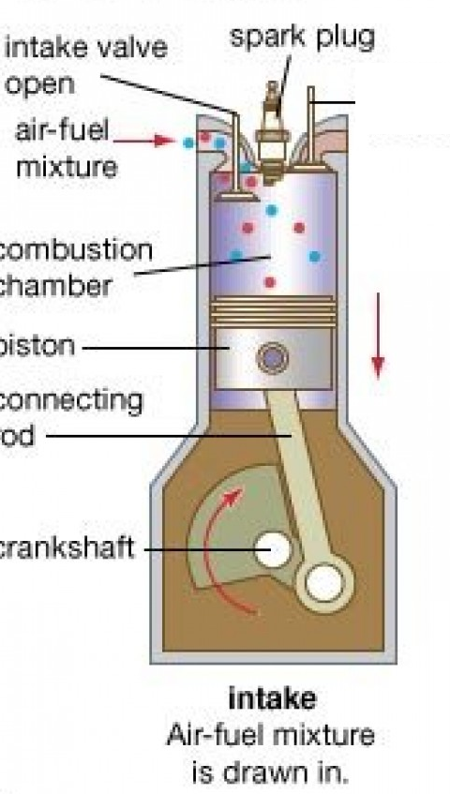

Flammability to Inflammability of Fuel-Air Mixture

Slide 4
The Role of Fuel Induction System
The tasks of the fuel induction systems are;
to introduce right amount of fuel @ specified schedule.
  This schedule must be in agreement with allowable Combustion Mechanism.
to prepare a mixture that satisfies the requirement of the Combustion Mechanism.
  This preparation is to be carried out over entire engine operating regime.
  In principle, the optimum air-fuel ratio for an engine is that which give the required power output with the lowest fuel consumption.
It should also ensure smooth and reliable operation.

Slide 5
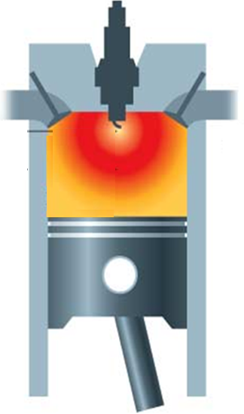
Fuel Admission Method for Otto’s Concept of Heat Addition
SI Engine
Occurrence of Heat Addition at constant volume created a SI Engine.
Faster rate of combustion initiated by an external spark/agent.
Demands well mixed fuel and air molecules chemically ready for ignition.
The required Fuel admission method is like a mother caring a Baby’s feed.

Slide 6
Evolution of Baby Fuel Feeding Systems
External mixture formation
Carburettors:
  Constant vacuum carburettor
  Multistage carburettor
  Multi-barrel carburettor
  Float-chamber-less membrane carburettor
Manifold injection
  Single-point injection
  Multi-point injection
    Continuous injection
    Intermittent injection

Slide 7
Types of Fuel Induction Systems : SI Engines
The fuel Induction systems used in SI engine are classified as:
  Carburetors – Popular till 1980s
  (https://www.newworldencyclopedia.org/entry/Carburetor)
  Throttle body Fuel Injection Systems 1980 to 1995
  Multi Point Fuel Injection Systems – 1995 onwards
  Direct Gasoline Injection System – 21st century option..

Slide 8
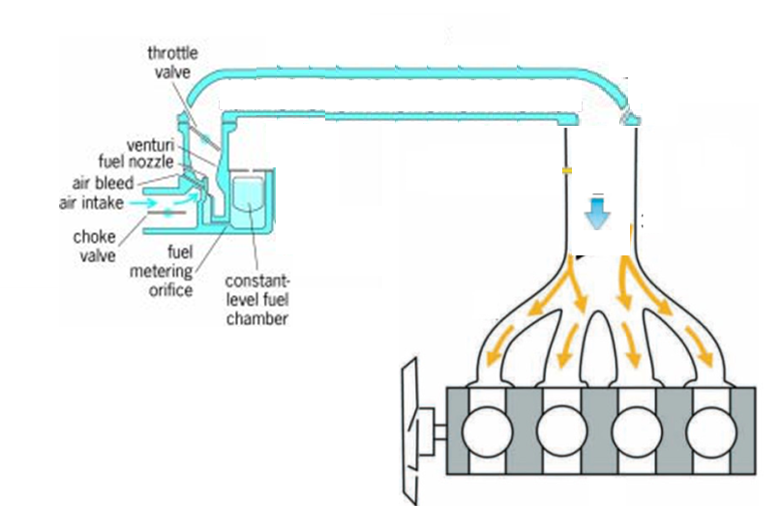

Evolution of Fuel Inductions Systems : SI Engines – First Generation

Slide 9
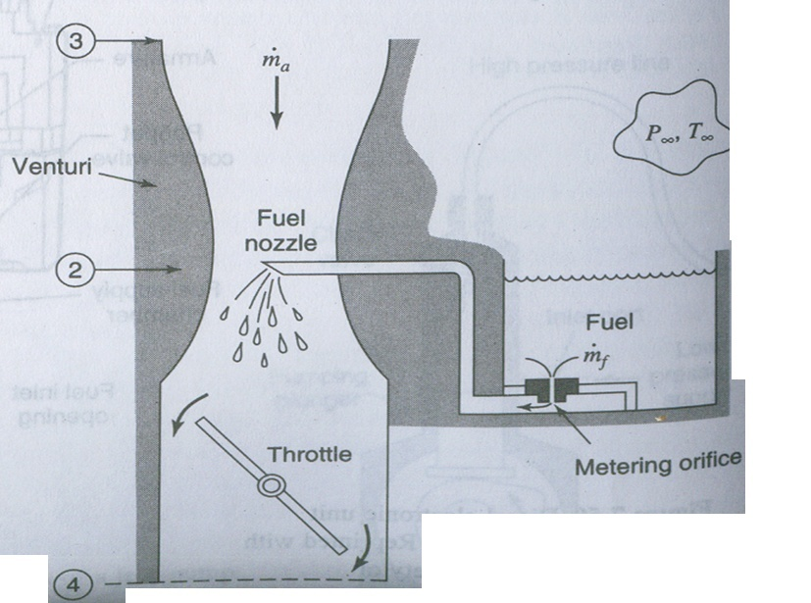
Fluid Mechanics Model for Carburetor
1
2
1
3

Slide 10
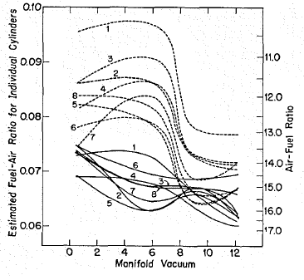
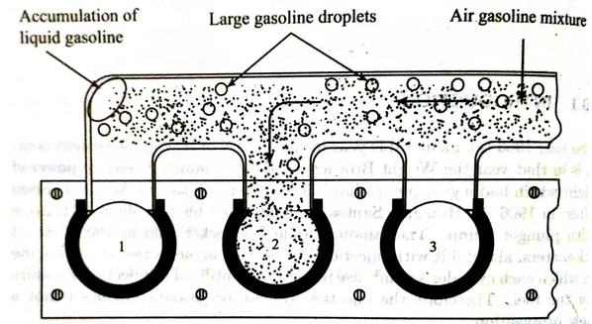
Performance of Bernoulli’s Effect
Cylinder 3
Cylinder 1
Cylinder 2
Cylinder 4

Slide 11
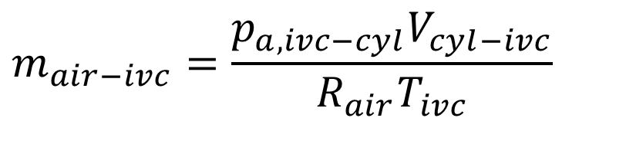
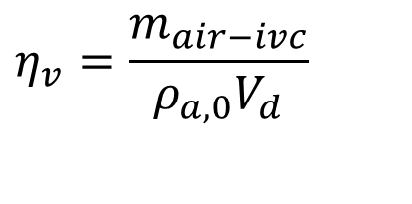
Impact of Uneven Distribution Fuel on Cylinder Volumetric Efficiency
For a mixture: the inlet manifold pressure is expressed as:
$$p_{ivc−cyl}=p_{air,ivc}+p_{fuel−vap,ivc}+p_{res−gas,ivc}$$
The mass of fresh air in the cylinder at the end of intake stroke.
$$m_{air−ivc}=\frac{p_{a,ivc−cyl}V_{cyl−ivc}}{R_{air}T_{ivc}}$$
$$η_{v}=\frac{m_{air−ivc}}{ρ_{a,0}V_{d}}$$

Slide 12
Ain Initiative in 1950 :
A Shift from Natural Induction to Artificial Induction Systems
Simple Fluid Mechanics to Advanced Fluid Mechanics…

Slide 13
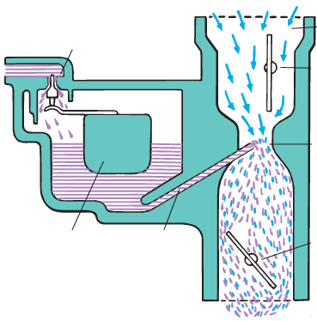
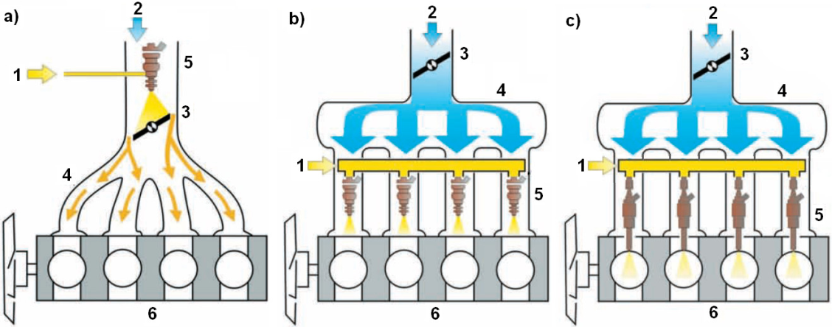
Evolution of Fuel Injection Systems for SI Engine
Triggered Numerous researches in optimizing the fuel injection system.
Recognition of the fuel behavior.
Analysis of the process of preparation of mixtures in the inlet port of fuel injection vehicles using MPFI system.

