Slide 1

Quasi-static Cycles for Automotive Prime Movers
P M V Subbarao
Professor
Mechanical Engineering Department
Allocation of More Time of Expansion Process ….

Slide 2

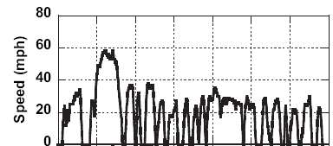
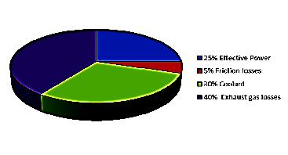
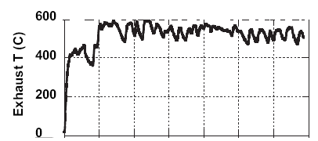

Urban Driving Cycle Vs Exhaust Temperature

Slide 3
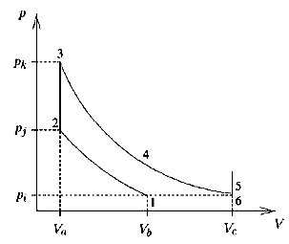
Ideal Fuel-air Model for Five Stroke Cycle : SI Engine
The five-stroke cycle consists in the following steps:
1-2 Isentropic Compression of air, fuel and residual gases.
2-3 Constant volume complete and adiabatic combustion.
3-4 Isentropic first Expansion of burned gases in HP cylinder.
4-5 Isentropic second expansion of the burned gases in HP+LP cylinders.
5-6 Constant volume Heat rejection.
6-1 Constant pressure exhaust by LP cylinder

Slide 4
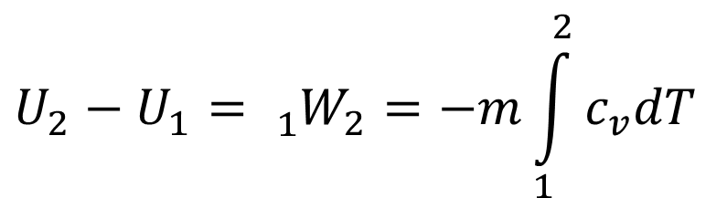
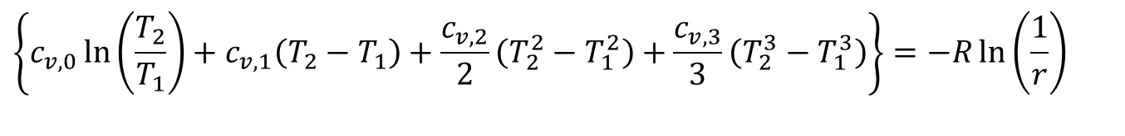
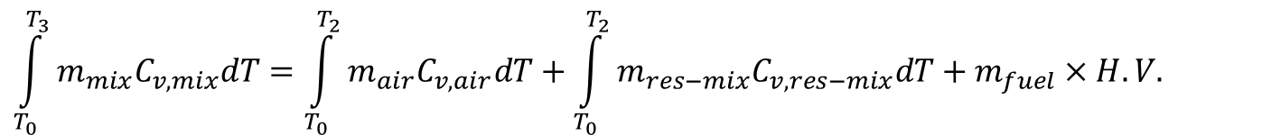

Fuel air Model of Individual Process of A five stroke SI Engine Cycle
1—2 Isentropic compression of a mixture of air, fuel and residual gas.
$$\left\{c_{v,0}\ln\left(\frac{T_{2}}{T_{1}}\right)+c_{v,1}\left(T_{2}−T_{1}\right)+\frac{c_{v,2}}{2}\left(T_{2}^{2}−T_{1}^{2}\right)+\frac{c_{v,3}}{3}\left(T_{2}^{3}−T_{1}^{3}\right)\right\}=−R\ln\left(\frac{1}{r}\right)$$
$$U_{2}−U_{1}={{}_{1}^{}W}_{2}=−m\int_{1}^{2}{c_{v}dT}$$
2—3 Complete combustion at constant volume, without heat loss, with burned gases in chemical equilibrium.
$$U_{3}=U_{2}$$
$$\int_{T_{0}}^{T_{3}}{m_{mix}C_{v,mix}dT}=\int_{T_{0}}^{T_{2}}{m_{air}C_{v,air}dT}+\int_{T_{0}}^{T_{2}}{m_{res−mix}C_{v,res−mix}dT}+m_{fuel}×H.V.$$

Slide 5
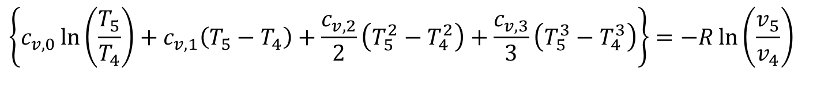
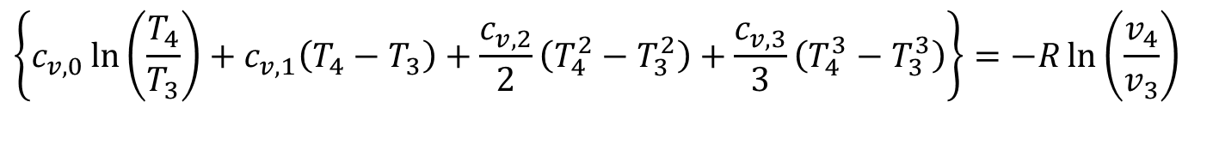
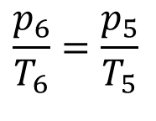
Fuel air Model of Individual Process of A five stroke SI Engine Cycle
3—4 Isentropic expansion of the burned gases in HP cylinder.
$$\left\{c_{v,0}\ln\left(\frac{T_{4}}{T_{3}}\right)+c_{v,1}\left(T_{4}−T_{3}\right)+\frac{c_{v,2}}{2}\left(T_{4}^{2}−T_{3}^{2}\right)+\frac{c_{v,3}}{3}\left(T_{4}^{3}−T_{3}^{3}\right)\right\}=−R\ln\left(\frac{v_{4}}{v_{3}}\right)$$
4-- 5 Further Isentropic expansion of the burned gases in HP+LP cylinder.
$$\left\{c_{v,0}\ln\left(\frac{T_{5}}{T_{4}}\right)+c_{v,1}\left(T_{5}−T_{4}\right)+\frac{c_{v,2}}{2}\left(T_{5}^{2}−T_{4}^{2}\right)+\frac{c_{v,3}}{3}\left(T_{5}^{3}−T_{4}^{3}\right)\right\}=−R\ln\left(\frac{v_{5}}{v_{4}}\right)$$
5 – 6 : Constant volume heat rejection: Zero work.
$$\frac{p_{6}}{T_{6}}=\frac{p_{5}}{T_{5}}$$
As p₅ → p_{atm} , will T₆ → T_{atm} ???

Slide 6
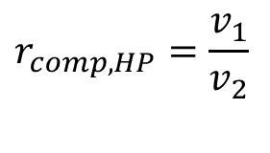
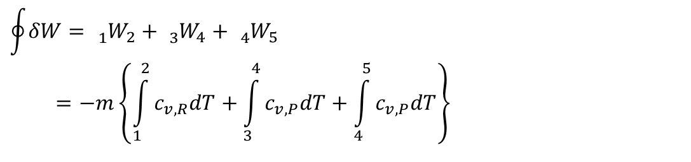
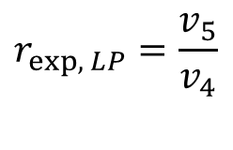
Estimation of Cyclic Work using Fuel air Model
The Cyclic Work
$$\oint{δW}={{}_{1}^{}W}_{2}+{{}_{3}^{}W}_{4}+{{}_{4}^{}W}_{5} \\ =−m\left\{\int_{1}^{2}{c_{v,R}dT}+\int_{3}^{4}{c_{v,P}dT}+\int_{4}^{5}{c_{v,P}dT}\right\}$$
Cycle Specifications:
$$r_{comp,HP}=\frac{v_{1}}{v_{2}}$$
HP Cylinder compression ratio:
$$r_{exp,{L}P}=\frac{v_{5}}{v_{4}}$$
LP Cylinder expansion ratio:

Slide 7
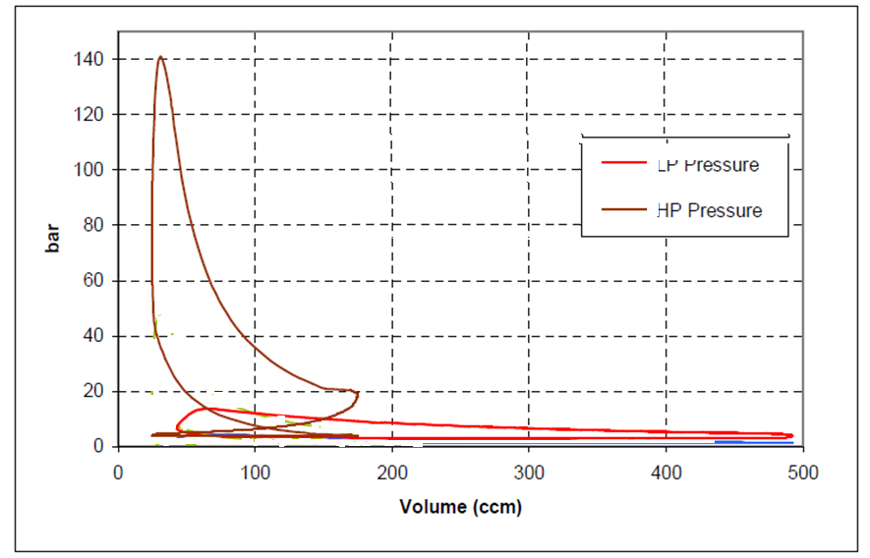

Real p-V diagram of HP Cylinder : 5-stroke SI cycle

Slide 8
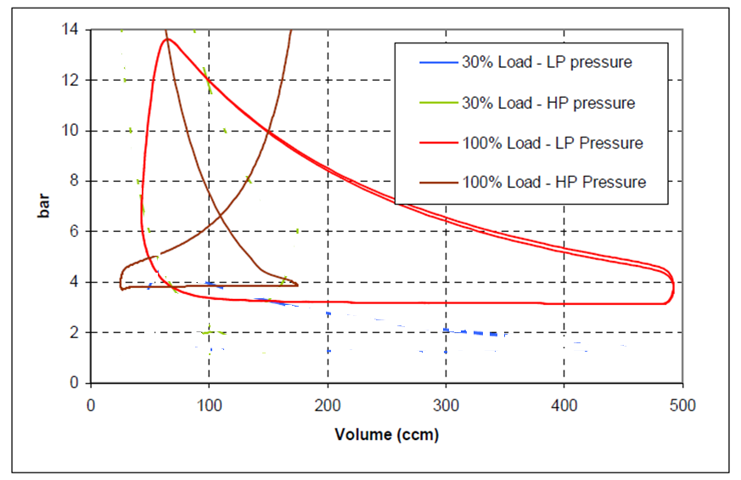

Pressure/Volume diagram of LP Cylinder : 5-stroke SI cycle

Slide 9
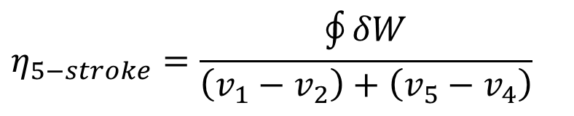
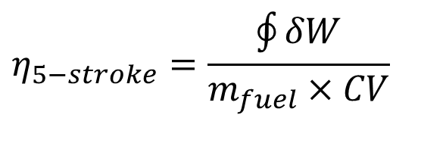
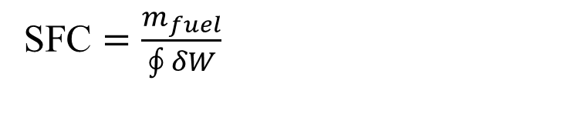
Estimation of Performance using Fuel air Model
$$η_{5−stroke}=\frac{\oint{δW}}{m_{fuel}×CV}$$
The Cyclic Efficiency:
$$η_{5−stroke}=\frac{\oint{δW}}{\left(v_{1}−v_{2}\right)+\left(v_{5}−v_{4}\right)}$$
Mean Effective Pressure:
Fuel Economy:
SFC $=\frac{m_{fuel}}{\oint{δW}}$

Slide 10
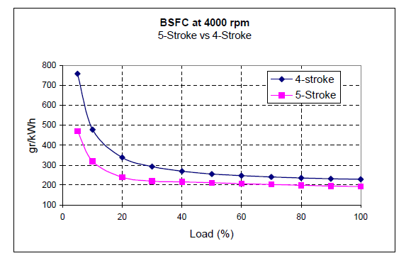
BSFC of the 4- and 5-stroke engines at 4000 rpm

Slide 11
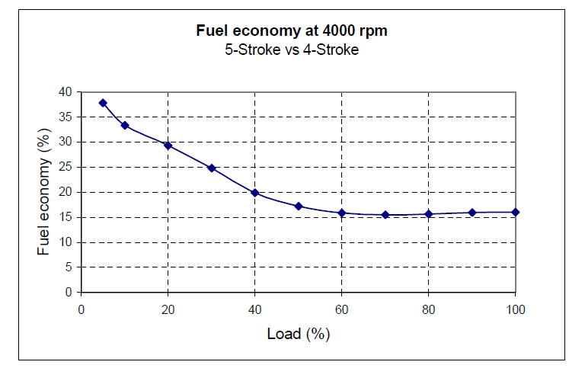
Fuel economy of the 5-stroke cycle vs. 4-stroke cycle
A 750 cc five-stroke engine is sufficient to produce equivalent torque/power, (46kW/110Nm at 4000 rpm), of 1200 cc four-stroke engine.

Slide 12
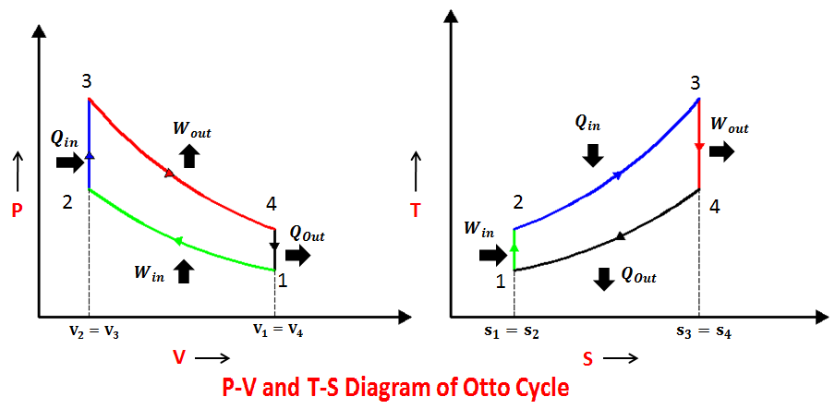
Quasi-static Cycles to Maximize Work output of An Engine

Slide 13
Classification of Six Stroke Engines
SIX STROKE ENGINE
Griffin six stroke engine
Bajulaz six stroke engine
Additional Cylinder
Beare head six stroke engine
Crower six stroke engine
Velozeta six stroke engine
Charge pump engine
Additional strokes

Slide 14
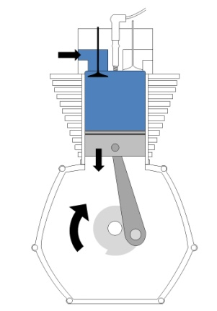
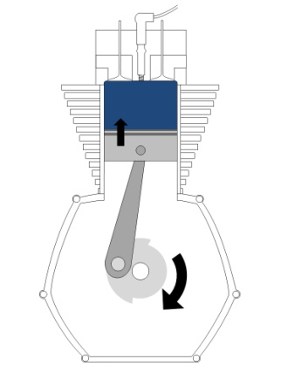
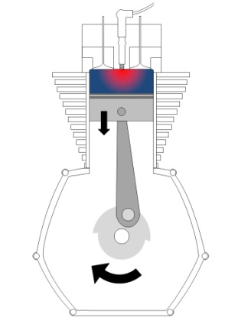
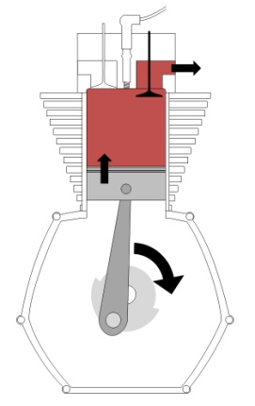
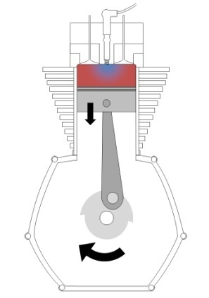
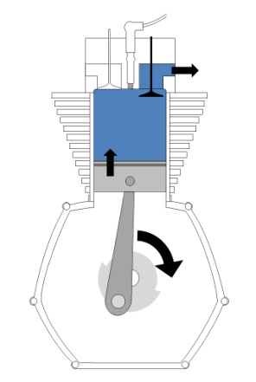
Crower six-stroke engine
1. Intake
2. Compression
3. Combustion &HP expansion
4. Partial Exhaust
5. Water Injection & Re-expansion
6. Re-exhaust

Slide 15
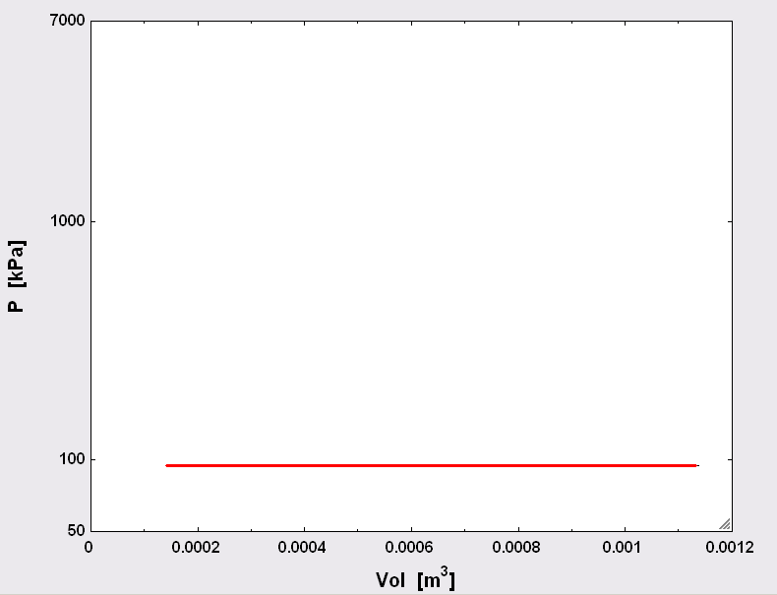

1. Intake
Ideal Crower six-stroke Cycle : Intake Process

Slide 16

2. Compression
Ideal Crower six-stroke Cycle : Compression

Slide 17

3. Combustion and Expansion
Ideal Crower six-stroke SI engine : Combustion and Expansion

Slide 18

4. Controlled Exhaust
Ideal Crower six-stroke engine ; Controlled Blow Down

Slide 19
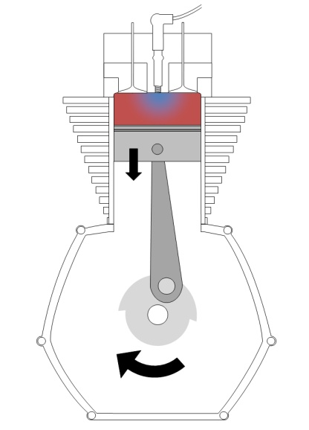
5. Water Injection & Re-Expansion
Ideal Crower six-stroke engine

Slide 20

6. Re-Exhaust
Ideal Crower six-stroke engine

Slide 21
Cyclic Analysis of Ideal Crower six-stroke engine
Q_{in,gasoline}
W_{stroke-3}
Q_{water-steam}
Q_{out,exhaust}
W_{stroke-5}

Slide 22
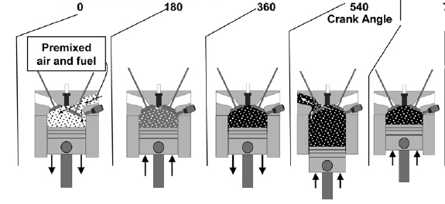
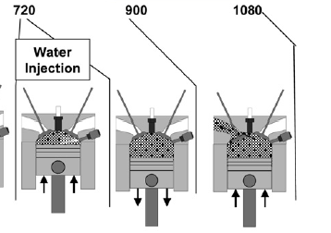
Implementation of Water Injection to get Six Stroke Cycle

Slide 23
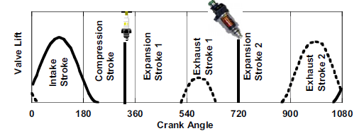
Schematic of typical intake & exhaust valve events for the six-stroke engine cycle.

Slide 24
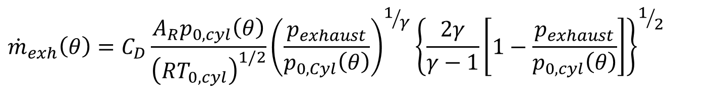
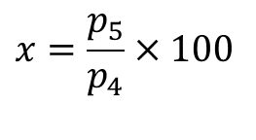
Controlled Blow Down : 4 -- 5
The blow down process is carried out at constant volume, using a dwell piston mechanism.
A selected percentage of blow down is allowed during dwell.
$$m_{gas−cyl}\left(θ+dθ\right)=m_{gas−cyl}\left(θ\right)−{\dot{m}}_{exh}\left(θ\right)$$
$${\dot{m}}_{exh}\left(θ\right)=C_{D}\frac{A_{R}p_{0,cyl}\left(θ\right)}{{\left(RT_{0,cyl}\right)}^{1/2}}{\left(\frac{p_{exhaust}}{p_{0,Cyl}\left(θ\right)}\right)}^{1/γ}{\left\{\frac{2γ}{γ−1}\left[1−\frac{p_{exhaust}}{p_{0,cyl}\left(θ\right)}\right]\right\}}^{1/2}$$
Percentage of Blow down, x
$$x=\frac{p_{5}}{p_{4}}×100$$

Slide 25
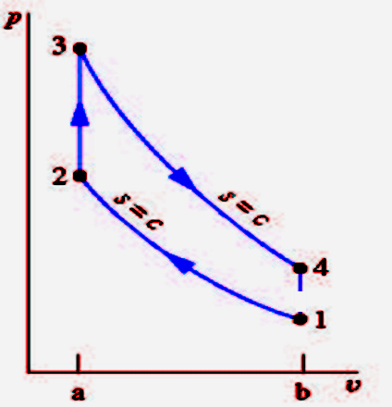
Intermediate Exhaust Process

Slide 26
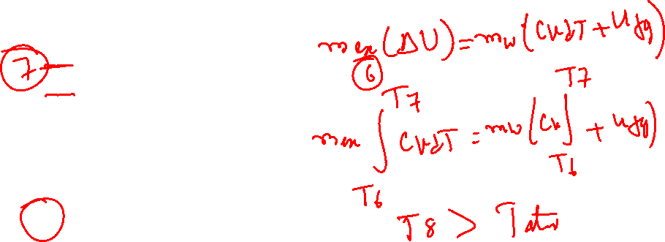
Instantaneous Water Injection & Evaporation : 6 -- 7
At the end of the intermediate exhaust stroke, water is injected which evaporates to steam.
This leads to rise in cylinder pressure.
Energy balances for 6 – 7:

Slide 27
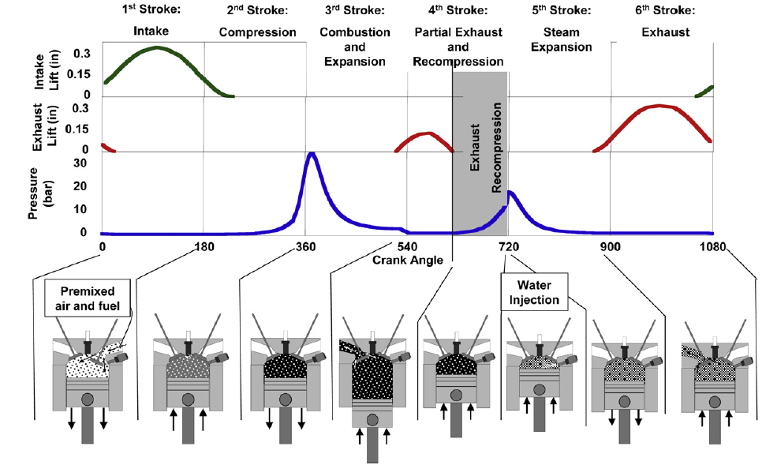
Details of exhaust valve events and cylinder pressure for the six-stroke cycle

Slide 28
Pressure vs Crank Angle

Slide 29
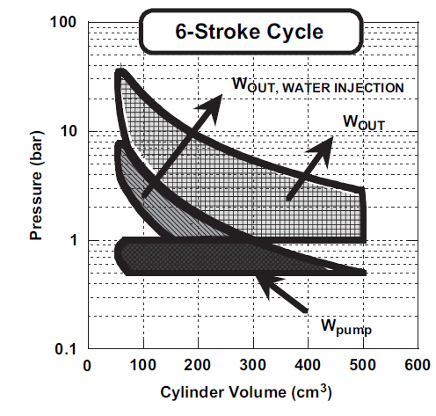
Improved Six Stroke Cycle with Double Exhaust and Expansion Strokes

Slide 30
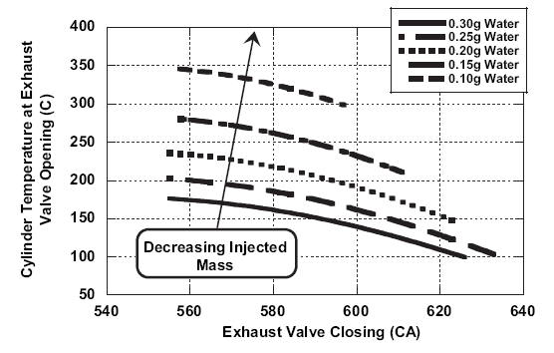
Mass of Water Vs Utilization of Exhaust Gas Energy

Slide 31
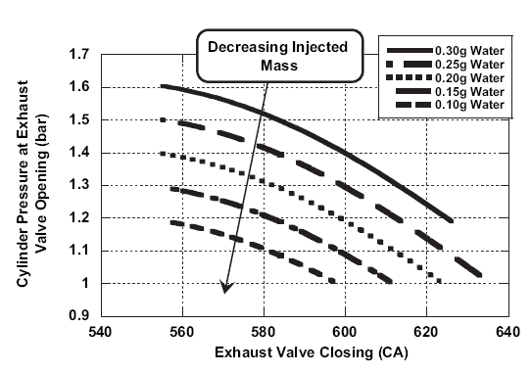
Exhaust gas cylinder pressure at second opening

Slide 32
Effect of compression ratio
Efficiency
Compression Ratio

