Slide 1

Eco-friendly Cycles for Automotive Prime Movers
P M V Subbarao
Professor
Mechanical Engineering Department
Broadening of Expansion Process ….

Slide 2

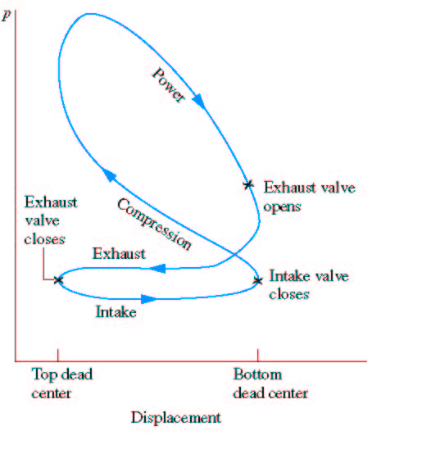
Actual Thermodynamic Cycle & Incomplete Execution of Expansion

Slide 3
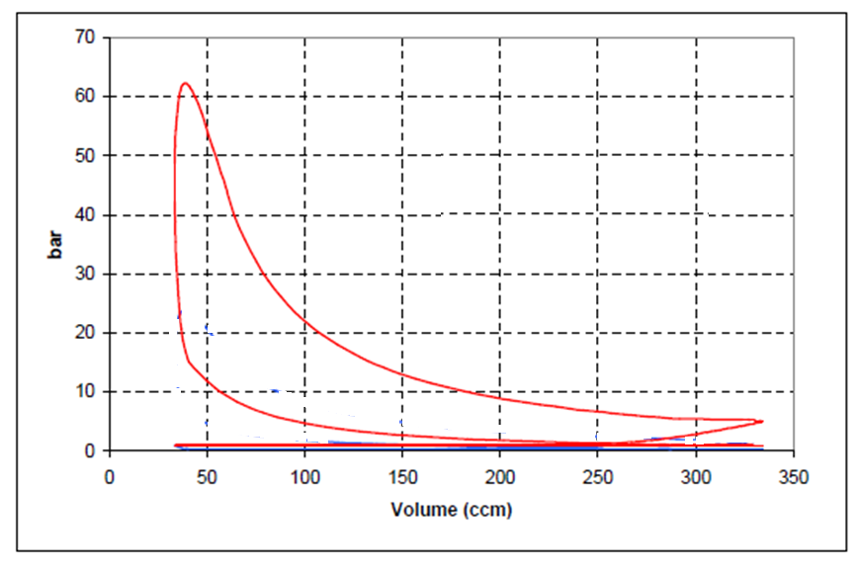

P-V diagram of 4-stroke cycle : SI Engine with Natural Aspiration : 4000rpm

Slide 4
The Crisis
The problem is due to the fact, that the single reciprocating device has a compression stroke which is equal to the expansion stroke.
On one hand, you need a high expansion stroke in order to convert the maximum of thermal energy into work.
On the other hand, you need a rather low compression stroke, in order to limit the thermal and mechanical stresses, as well as the uncontrolled ignition for gasoline cycles.

Slide 5
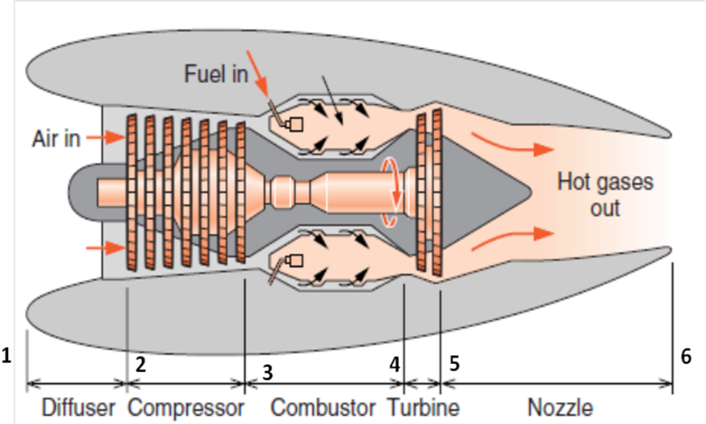
The Unreasonable Bias : CM vs CV
A
I
R
FUEL
Ignition
Fuel/Air
Mixture
Combustion
Products
Intake
Stroke
Compression
Stroke
Power
Stroke
Exhaust
Stroke

Slide 6
A Pair of Cylinders for Expansion
Fuel resources and Ecology are valuable.
Valuable resources must be used in a comprehensive/elaborative way.
The high-pressure cylinder: Main duty: Clean Combustion
The low-pressure cylinder: Main Duty: Complete Expansion

Slide 7
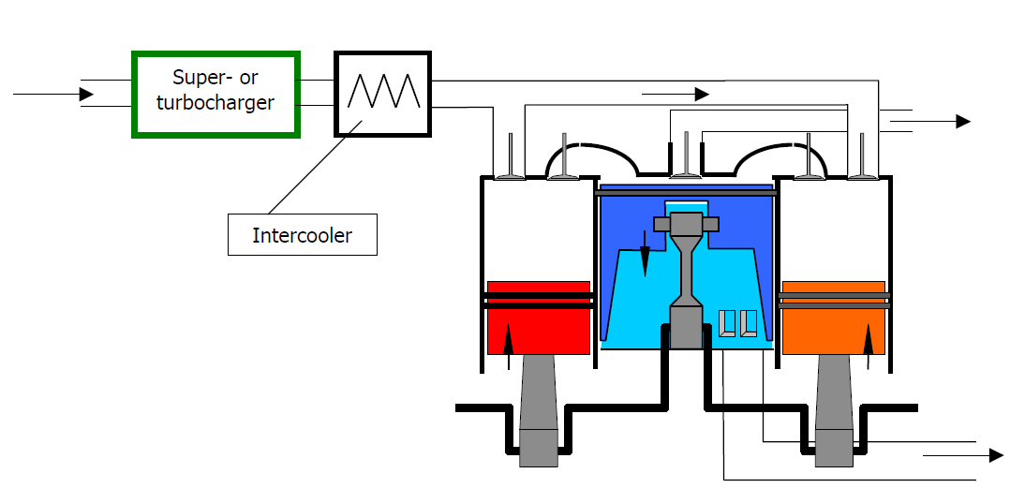

In 2000, a new engine is born ...
Three cylinder 5-Stroke engine
Five Stroke Internal Combustion Engine : A new concept for internal combustion engines, by Gerhard Schmitz, St.Vith 2011, Belgium

Slide 8
The Five Stroke Cycle
The five-stroke cycle consists in the following steps:
1. Intake process in the high pressure (HP) cylinder
2. Compression, followed by the ignition in HP cylinder
3. First expansion of the burned gases in HP Cylinder
4. Second expansion of the burned gases in HP+LP cylinders
5. Exhausting of the burned gases by LP Cylinder

Slide 9
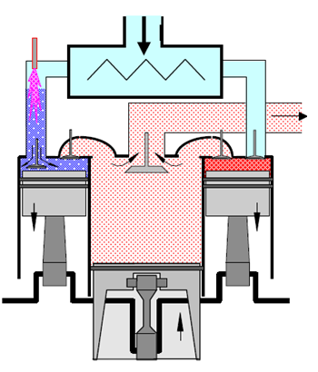
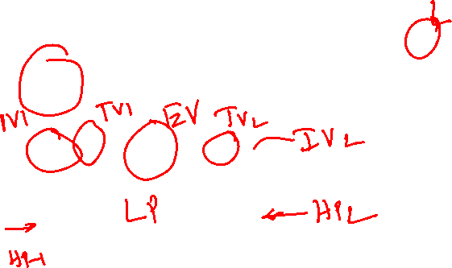
Basic Module of Modular Engine
Fresh air Intake
Two HP Cylinders.
One HP Cylinder
Three valves
Two five stroke Cycles in two crank revolutions.
Fuel injector
Expansion ratio > Compression ratio.

Slide 10
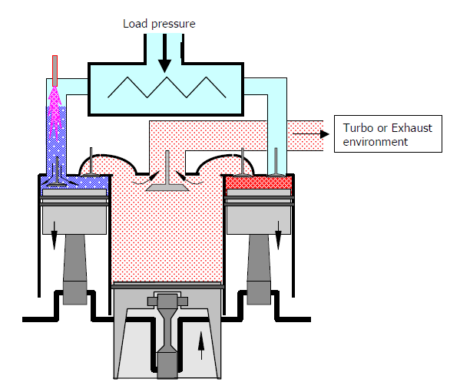
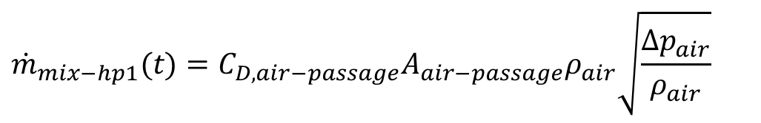
Onset of Intake Process in HP-1 Cylinder
Rate of air-fuel mixture into HP Cylinder 1,
$${\dot{m}}_{mix−hp1}(t)=C_{D,air−passage}A_{air−passage}ρ_{air}\sqrt{\frac{Δp_{air}}{ρ_{air}}}$$

Slide 11
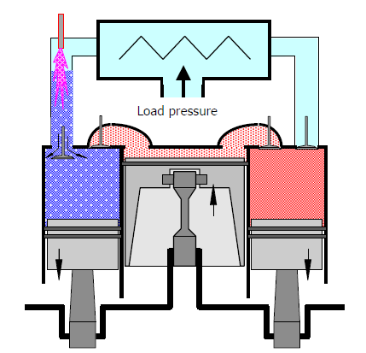
Intake Process in HP-1 Cylinder:
Start to End
End
Start

Slide 12
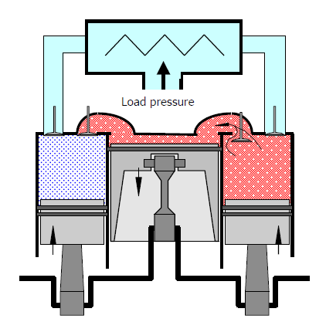

Onset of Compression in HP-1Cylinder
Compression in HP -1
$$δW(t)_{hp−1}={\left\{pdV\right\}}_{hp−1}$$

Slide 13
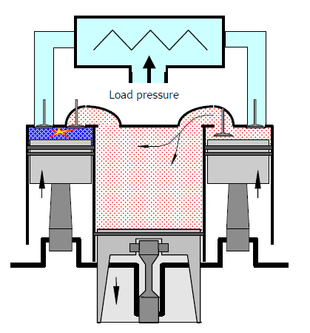
Compression Process in HP-1 Cylinder
Start
End
Ignition in HP 1

Slide 14
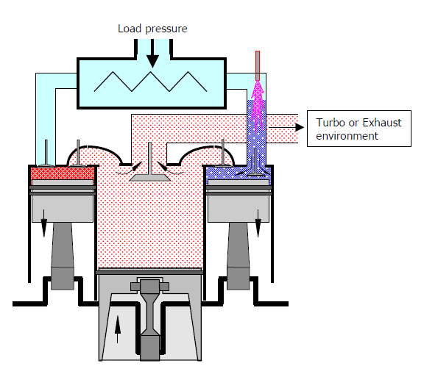

Onset of Combustion and Partial Expansion in HP-1 Cylinder
Combustion + Expansion in HP 1
$$δW(t)_{hp−1}={\left\{mpdv\right\}}_{hp−1}$$

Slide 15
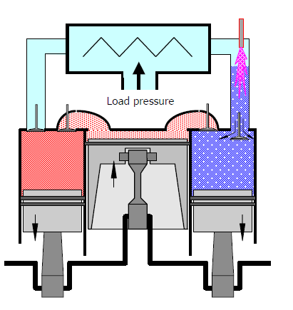
Combustion and Partial Expansion in HP-1 Cylinder
Start
End

Slide 16
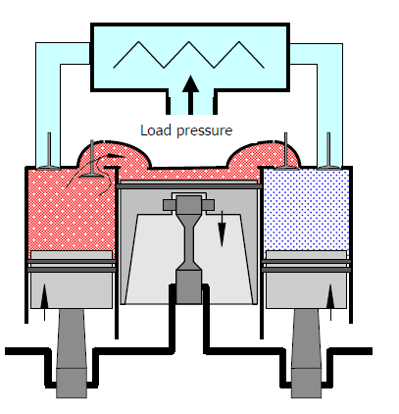

Onset of Second Part of Expansion in LP Cylinder
Gas Transfer from HP 1
Extended Expansion with LP Cylinder
$$δW(t)_{ext}={\left\{pdV\right\}}_{lp+hp−1}$$

Slide 17
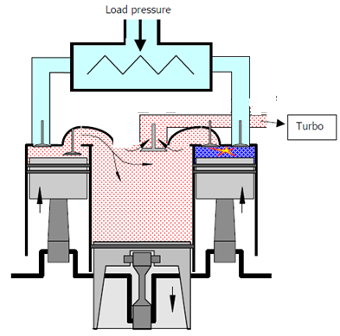
Second Part of Expansion in HP-1+LP
Start
End

Slide 18
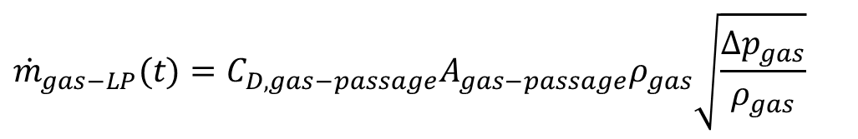
Exhaust Process in LP Cylinder
Simultaneous occurrence of Intake Process in HP-1
Opening of Exhaust valve & onset of
Exhaust process in LP Cylinder
Exhaust Process in LP Cylinder,
$${\dot{m}}_{gas−LP}(t)=C_{D,gas−passage}A_{gas−passage}ρ_{gas}\sqrt{\frac{Δp_{gas}}{ρ_{gas}}}$$

Slide 19
Exhaust Process in L P Cylinder
End
Start

Slide 20
Onset of Second Cycle in HP-2
Combustion + Expansion in HP 1
Intake in HP2
$$δW(t)_{hp−1}={\left\{mpdv\right\}}_{hp−1}$$
Exhaust from LP

Slide 21
Intake process in HP-2
Exhaust Process by LP and First Expansion in HP-1
Start
End

Slide 22
Onset of Compression in HP-2
Gas Transfer from HP 1
Compression in HP 2
Onset of Extended Expansion in LP

Slide 23
Compression & Igntion Process in HP-2
Start
End

Slide 24
Combustion and Expansion in Process in H P-2 Cylinder
End
Start

Slide 25

Transfer from HP-2 to LP & Extended Expansion
Transfer Hp Cylinder 2
Compression in HP -1
$$δW(t)_{hp−1}={\left\{pdV\right\}}_{hp−1}$$
Extended Expansion in LP Cylinder
$$δW(t)_{ext}={\left\{pdV\right\}}_{lp+hp−2}$$

Slide 26
Combined Expansion in HP-2 & LP Cylinders
Start
End

Slide 27
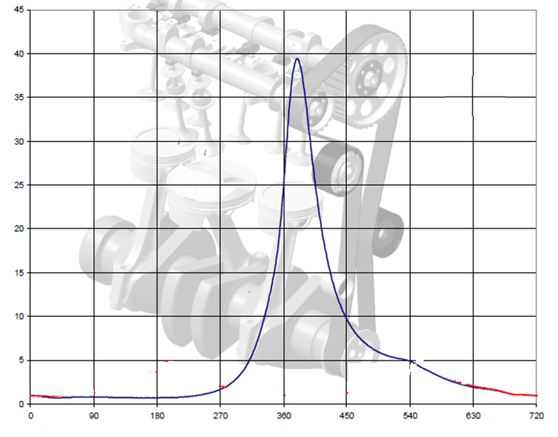
Extended Pressure vs Crank Angle Diagram

Slide 28
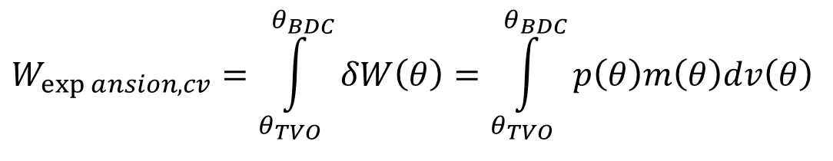

Work Delivered during Expansion in LP Cylinder : Twice in a Cycle
$$δW\left(θ\right)=p\left(θ\right)dV\left(θ\right)$$
$$W_{\exp{a}nsion,cv}=\int_{θ_{TVO}}^{θ_{BDC}}{δW\left(θ\right)}=\int_{θ_{TVO}}^{θ_{BDC}}{p\left(θ\right)m\left(θ\right)dv\left(θ\right)}$$

Slide 29
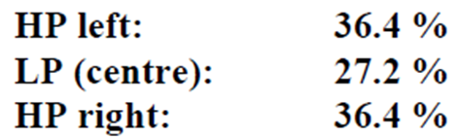
The Five Stroke Cycle
The five-stroke cycle consists in the following steps:
1. Admission in the high pressure (HP) cylinder
2. Compression, followed by the ignition
3. First expansion of the burned gases
4. Second expansion of the burned gases
5. Exhausting of the burned gases.

