Slide 1

Advanced Turbocharging Systems for Next generation
P M V Subbarao
Professor
Mechanical Engineering Department
Turbocharging for Sustainable Development…

Slide 2

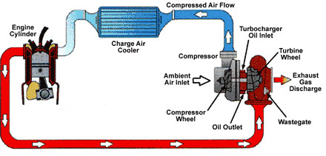
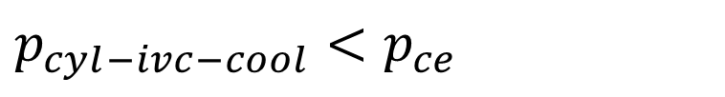
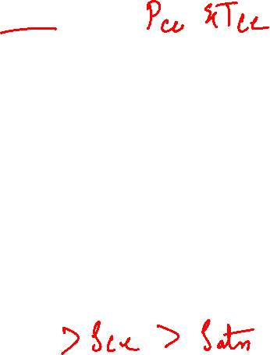
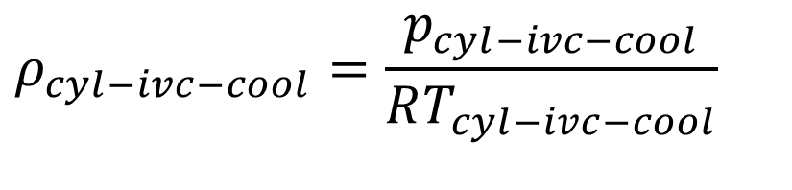
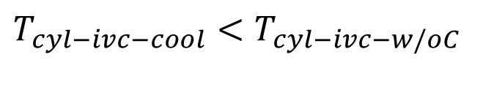

Turbocharger with Intercooler
An interesting Information Obtained thru Simulations…
For any engine $P_{GT−max}>P_{comp−Opt}$
$$p_{cyl−ivc−cool}<p_{ce}$$
$$ρ_{cyl−ivc−cool}=\frac{p_{cyl−ivc−cool}}{RT_{cyl−ivc−cool}}$$
$$T_{cyl−ivc−cool}<T_{cyl−ivc−w/oC}$$

Slide 3
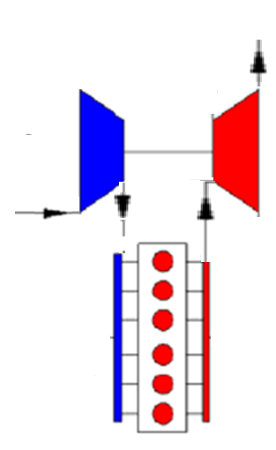
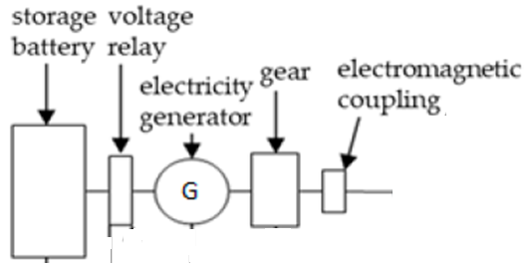

Clues for Development of further Compact & Sustainable Engines

Slide 4




Clues for Development of further Compact Engines

Slide 5
Classification of Next generation Systems
Series Turbo-cool System : Double compression system.
Parallel Turbo-cool System: Single compression system

Slide 6
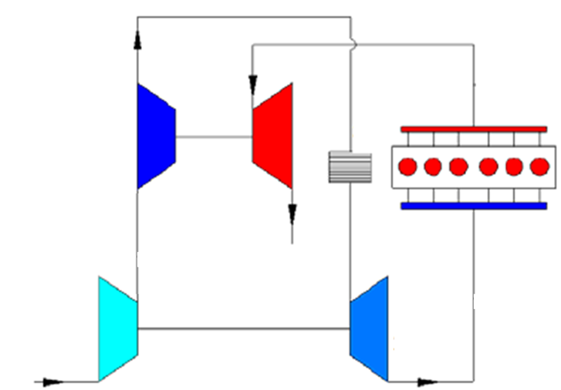
Scheme of the Series turbo-cooling system
HP-compressor
Gas Turbine
Air Turbine
LP-compressor

Slide 7
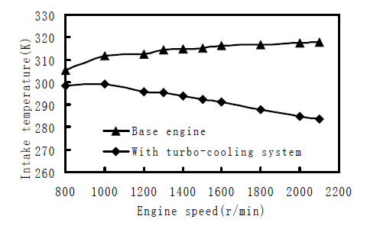
Effect of Series Turbo-cooling

Slide 8
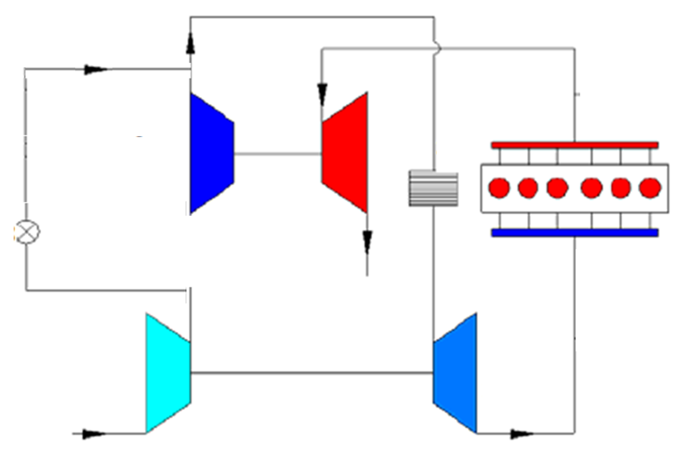

Scheme of the Parallel turbo-cooling system
HF-compressor
Engine
Gas Turbine
LF-compressor
Air Turbine

Slide 9
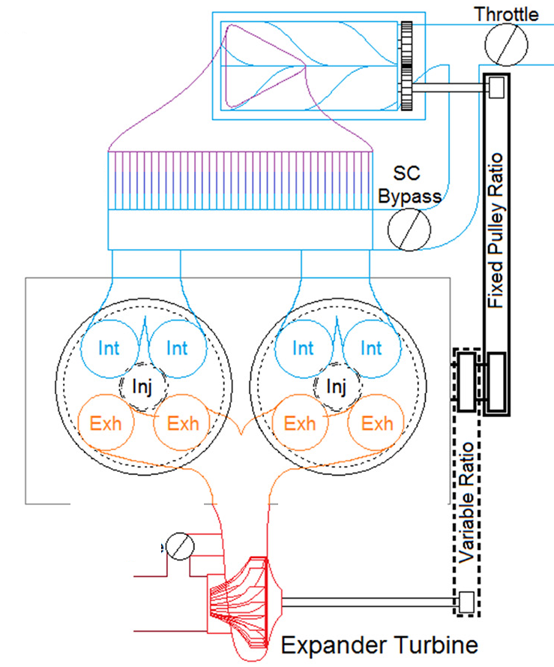
Turbine Compounded Engine
Screw Compressor
Air Cooler
Engine
Gas Turbine

Slide 10
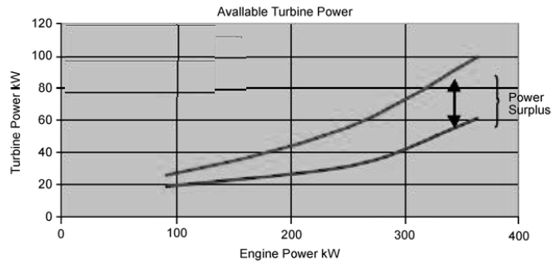
Surplus Power Chart : turbo-compound installation
Turbine power output
Compressor power Input

Slide 11
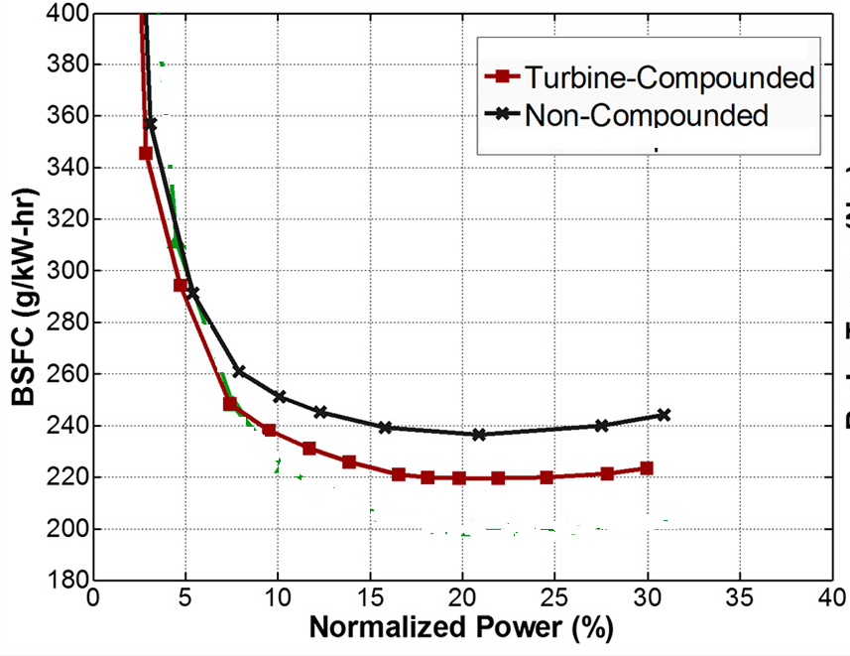
Turbine Compounded Engine : Fuel Economy @ 2000rpm

Slide 12
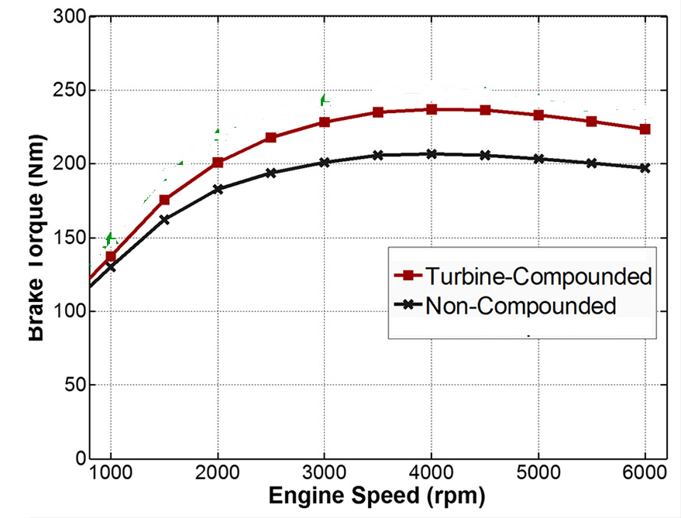
Turbine Compounded Engine : Enhanced Power: Constant Fuel Economy

Slide 13
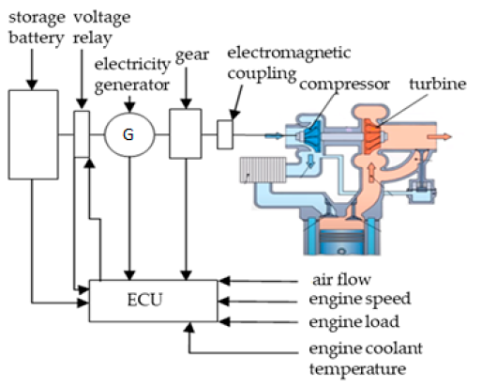
Engines with Hybrid Turbocharger

Slide 14
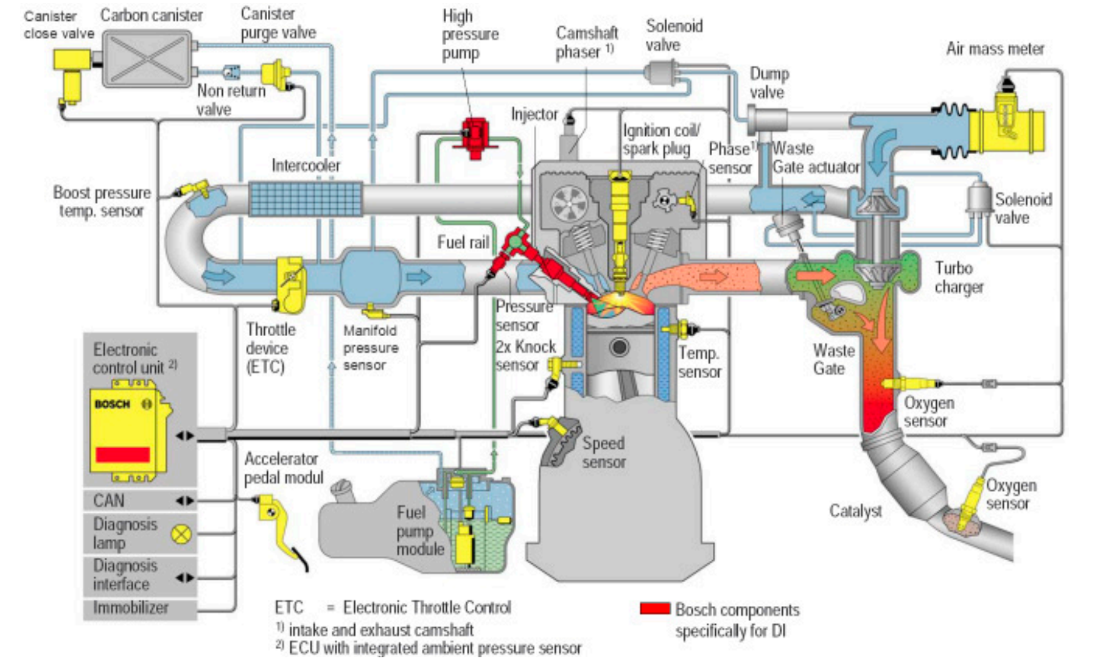
Advanced Turbocharged Engine

Slide 15
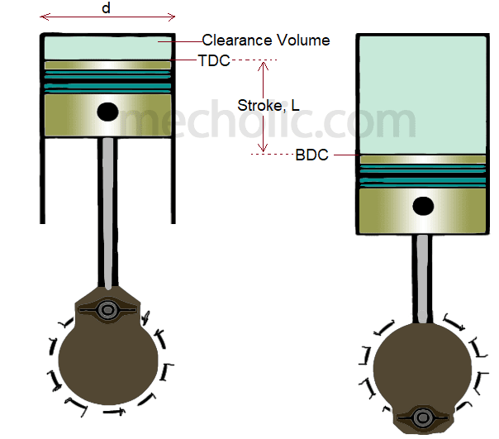
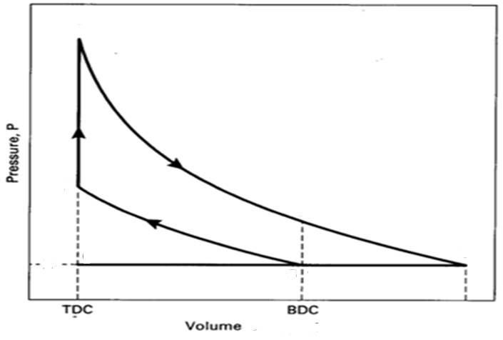
Open to Better Innovation
3
Audi A3 35 TDI Premium Plus
2
4
0
5
1
Notes:
Total volumes are mass multiplied by specific volume (or mass divided by density). In an open process with exhaust blow-down gases, occupy more volume than just the cylinder volume, after filling the exhaust pipe (expanding with mass conservation.)
Way to determine this volume change is to find specific volume (or density) at point 4 (before blowdown) and point 6 (end of exhaust stroke) = V₄ – V₆

Slide 16
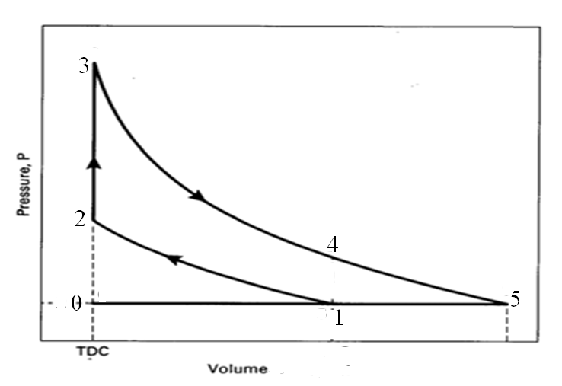
Modelling of Ideal High Expansion Ratio Cycle
Select the value of compression ratio based on current practice, (r_{comp})
Select required value of V₁
Notes:
Total volumes are mass multiplied by specific volume (or mass divided by density). In an open process with exhaust blow-down gases, occupy more volume than just the cylinder volume, after filling the exhaust pipe (expanding with mass conservation.)
Way to determine this volume change is to find specific volume (or density) at point 4 (before blowdown) and point 6 (end of exhaust stroke) = V₄ – V₆

Slide 17
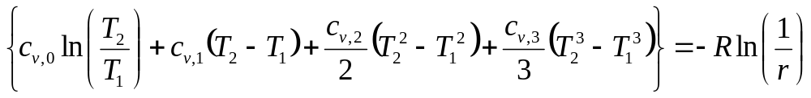
True Phenomenological Model for Isentropic Compression
The root of above equation gives value of T_{2.}

Slide 18
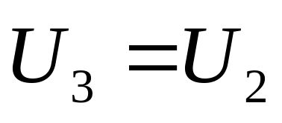
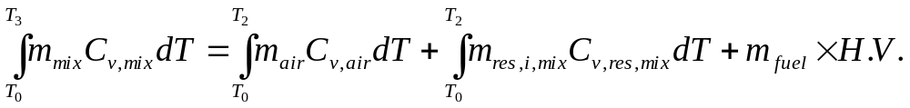
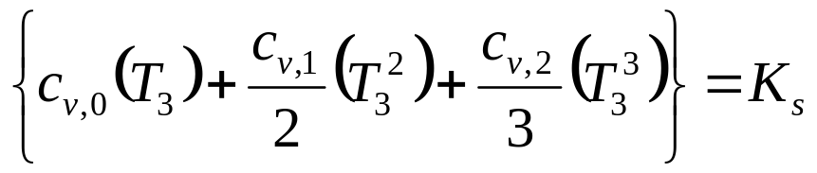
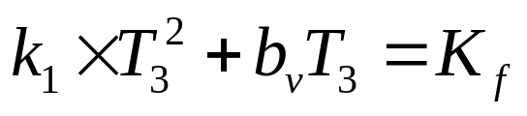
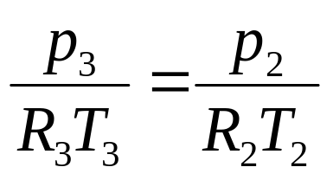
Engineering Model for Prediction of Highest Temperature
Second order Property Model:
First order Property Model:

Slide 19
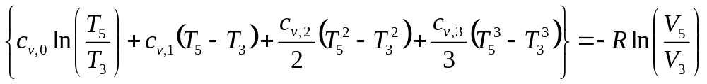
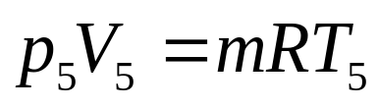
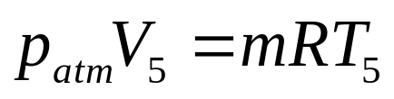
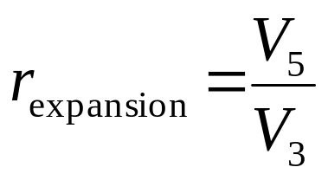
Modelling of Ideal High Expansion Ratio Cycle
Estimate maximum possible value of expansion ratio:
∴ V₅ is the maximum volume of cylinder:
Notes:
Total volumes are mass multiplied by specific volume (or mass divided by density). In an open process with exhaust blow-down gases, occupy more volume than just the cylinder volume, after filling the exhaust pipe (expanding with mass conservation.)
Way to determine this volume change is to find specific volume (or density) at point 4 (before blowdown) and point 6 (end of exhaust stroke) = V₄ – V₆

Slide 20
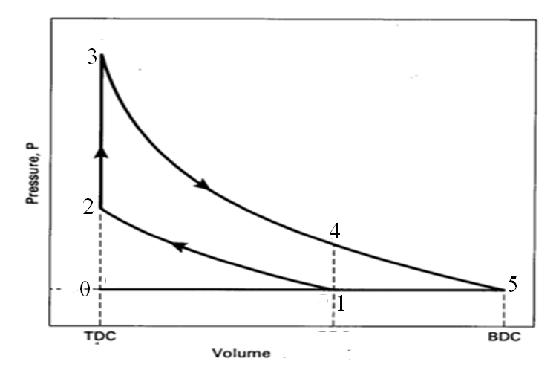
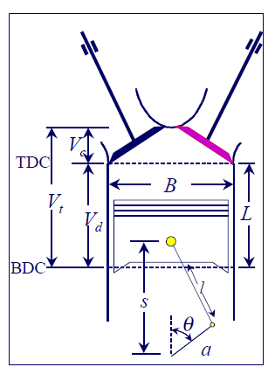
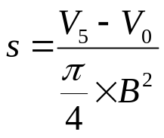
Constant Pressure Process: 5 –1
Keep the inlet valve open during 5 to 1.
Design four bar mechanism with a stroke length of, s
Notes:
Total volumes are mass multiplied by specific volume (or mass divided by density). In an open process with exhaust blow-down gases, occupy more volume than just the cylinder volume, after filling the exhaust pipe (expanding with mass conservation.)
Way to determine this volume change is to find specific volume (or density) at point 4 (before blowdown) and point 6 (end of exhaust stroke) = V₄ – V₆

Slide 21
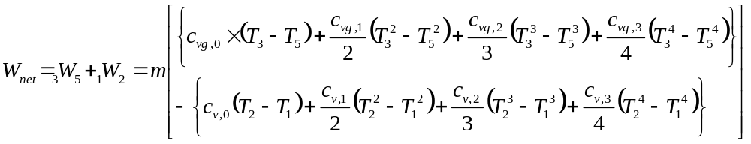
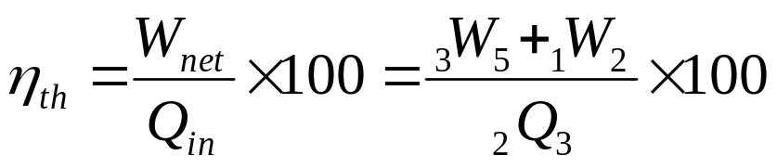
Net Characteristics of High expansion ratio Otto’s Model: Realistic Analysis

Slide 22
Air Standard High Expansion Ratio Otto Cycle
0 – 5 Constant pressure intake process (Open system)
5 – 1 Constant pressure air exhaust process (Open system)
1 – 2 Isentropic compression process (closed system)
2 – 3 Constant volume Heat Addition (closed system)
3 – 4 – 5 Isentropic expansion (closed system)
5 – 0: Constant pressure exhaust process (Open system)
Notes:
Total volumes are mass multiplied by specific volume (or mass divided by density). In an open process with exhaust blow-down gases, occupy more volume than just the cylinder volume, after filling the exhaust pipe (expanding with mass conservation.)
Way to determine this volume change is to find specific volume (or density) at point 4 (before blowdown) and point 6 (end of exhaust stroke) = V₄ – V₆

