Slide 1

Analysis of Turbocharging
P M V Subbarao
Professor
Mechanical Engineering Department
Optimal Use of Power Generated due to Extended Expansion Process …

Slide 2

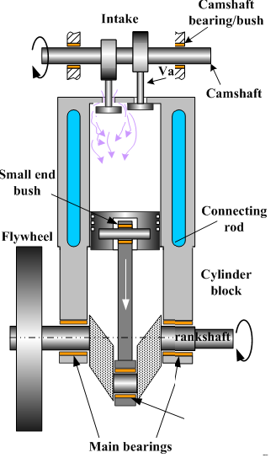

Thermodynamic Layout of A Turbocharged I.C. Engine
ce
ti
Engine
p_{ce}, T_{ce}
p_{ti}, T_{ti}
ci
C
Т
te
p_{ci}, T_{ci}
p_{te}, T_{te}

Slide 3

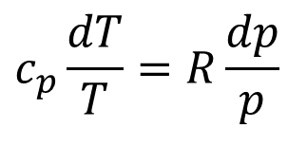
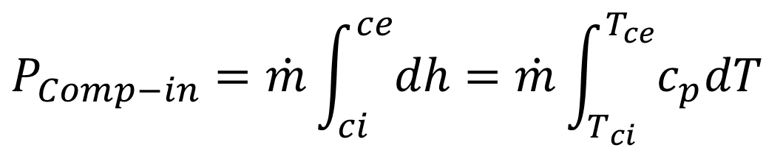
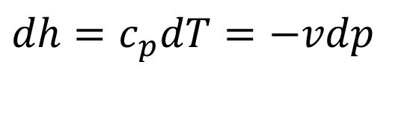
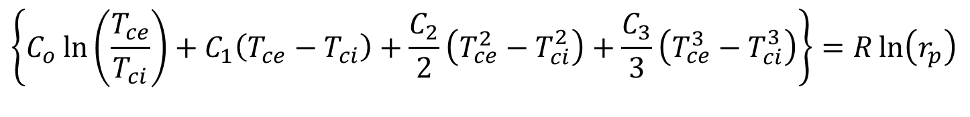
Phenomenological Model for Isentropic Compressor
$$c_{p}\frac{dT}{T}=R\frac{dp}{p}$$
$$\left\{C_{o}\ln\left(\frac{T_{ce}}{T_{ci}}\right)+C_{1}\left(T_{ce}−T_{ci}\right)+\frac{C_{2}}{2}\left(T_{ce}^{2}−T_{ci}^{2}\right)+\frac{C_{3}}{3}\left(T_{ce}^{3}−T_{ci}^{3}\right)\right\}=R\ln\left(r_{p}\right)$$
$$dh=c_{p}dT=−vdp$$
$$P_{Comp−in}=\dot{m}\int_{ci}^{ce}{dh}=\dot{m}\int_{T_{ci}}^{T_{ce}}{c_{p}dT}$$

Slide 4


Irreversible Compressor
p_{ce}
h_{cea}
Penalty due to Irreversibility
_{h,ces}
h
$$P_{act}$$
p_{ci}
h_{ci}
s

Slide 5
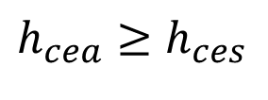

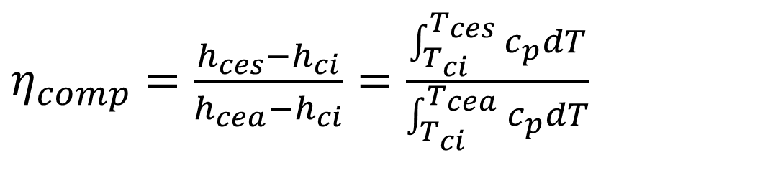
Thermodynamics of Irreversible Compressor
Work consumed by A compressor = mass flow rate × Increase in Enthalpy of gas
$$P_{act}=\dot{m}\left(h_{cea}−h_{ci}\right)$$
For an irreversible compressor of given pressure ratio, the actual temperature rise is more than isentropic temperature rise.
$$h_{cea}≥h_{ces}$$
Define, isentropic Efficiency of A Compressor:
$η_{comp}=\frac{h_{ces}−h_{ci}}{h_{cea}−h_{ci}}=\frac{\int_{T_{ci}}^{T_{ces}}{c_{p}dT}}{\int_{T_{ci}}^{T_{cea}}{c_{p}dT}}$

Slide 6
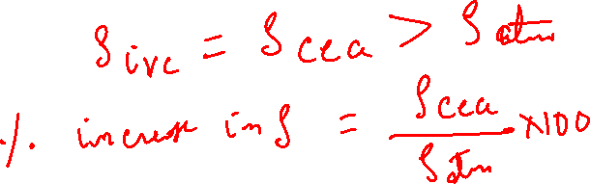
The Problem of Thermodynamic Tuning
ce
ti
Engine
p_{ce}, T_{cea}
p_{ti}, T_{ti}
ci
C
Т
te
p_{ci}, T_{ci}
p_{te}, T_{te}

Slide 7
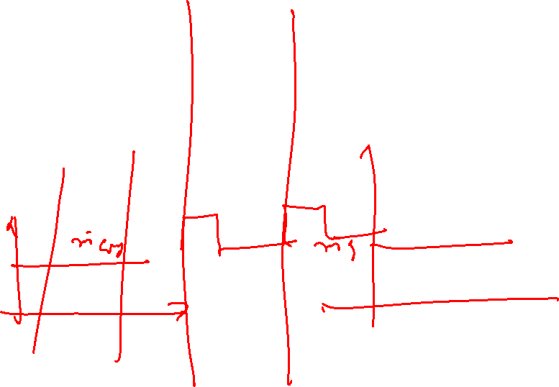
The Problem of Fluid dynamic Tuning
ce
ti
Engine
p_{ce}, T_{ce}
p_{ti}, T_{ti}
ci
C
Т
te
p_{ci}, T_{ci}
p_{te}, T_{te}

Slide 8
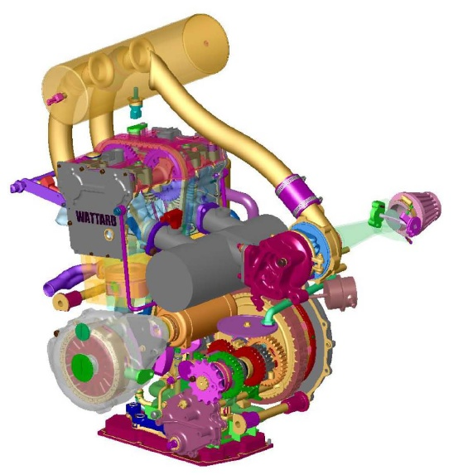
Turbocharged engine with Reservoirs

Slide 9
Three constraints on Compressor Sizing
Generation of required Boost Pressure (ratio).
Isentropic efficiency must be better than 60%.
Mass flow rate must be higher than average engine mass flow rate at Full load.
Flexible parameters:
Compressor geometry : radial to Mixed
Compressor Speed : low to high.

Slide 10
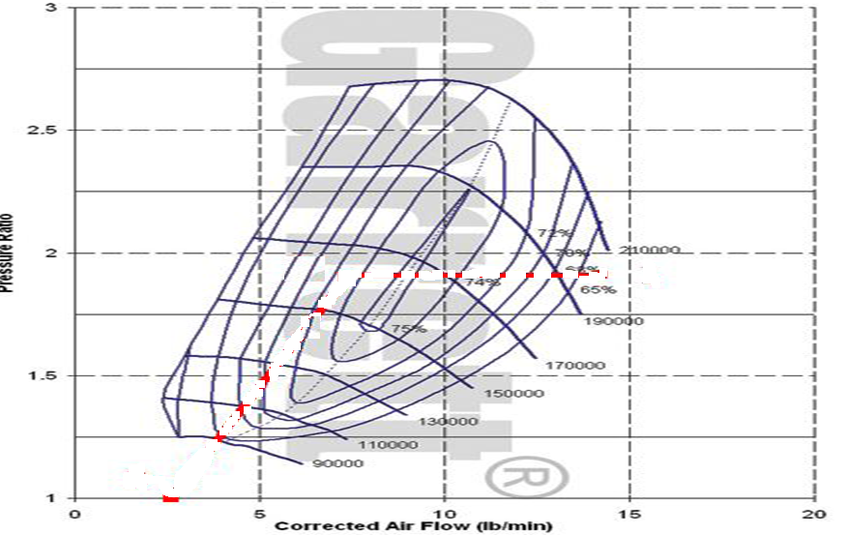
Engine in the House of Compressor
Average engine mass flow rate at Full load

Slide 11
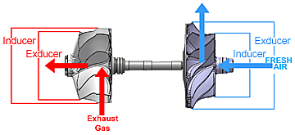
The Power needs of Compressor

Slide 12
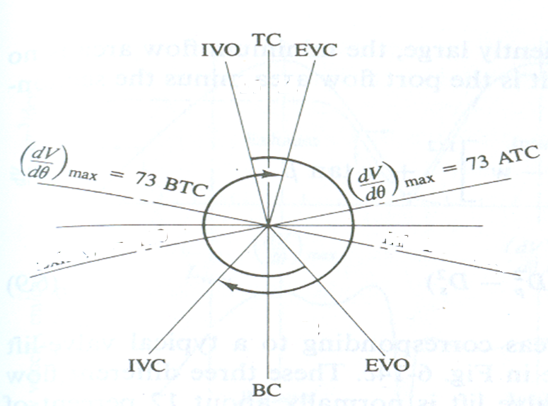

The Turbine to Drive the Compressor
ce
ti
Engine
p_{ce}, T_{ce}
p_{ti}, T_{ti}
ci
C
Т
te
p_{ci}, T_{ci}
p_{te}, T_{te}

Slide 13

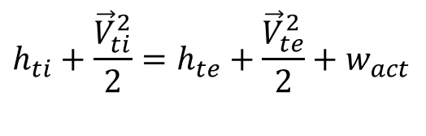
Irreversible Adiabatic Flow Through Turbine : SSSF
$$h_{ti}+\frac{{\vec{V}}_{ti}^{2}}{2}=h_{te}+\frac{{\vec{V}}_{te}^{2}}{2}+w_{act}$$
$$h_{te}=h_{ti}−w_{act}$$
ti
h
h_{te-actual}
H_{ti-iso}
s

Slide 14
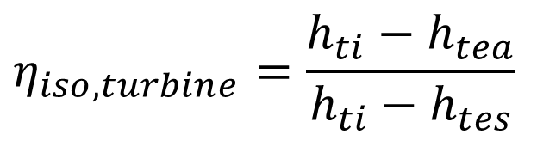
Irreversible Adiabatic Flow Through Turbine : SSSF
Actual Power generated available per unit mass flow rate:
w_{act} = h_{ti} – h_{tea}
Isentropic Power available for unit mass flow rate
w_{iso} = h_{ti} –h_{tes}
Isentropic Efficiency of a turbine
$$η_{iso,turbine}=\frac{h_{ti}−h_{tea}}{h_{ti}−h_{tes}}$$

Slide 15
Performance Studies on Turbocharged Engine

Slide 16
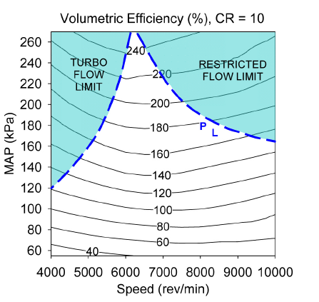
The Turbo Effectiveness
% increase in density at IVC, CR = 10

Slide 17
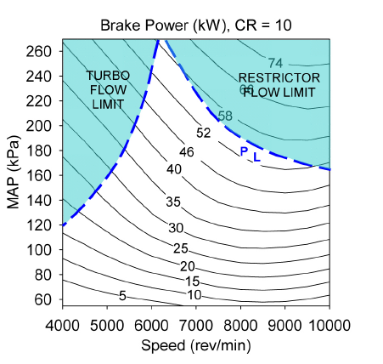
Engine Power Rating

Slide 18
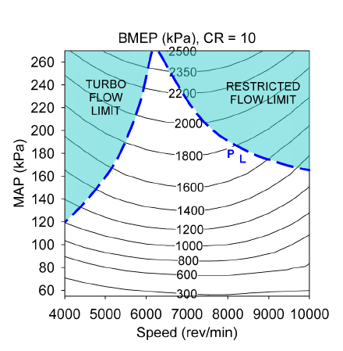
Engine Compactness

Slide 19
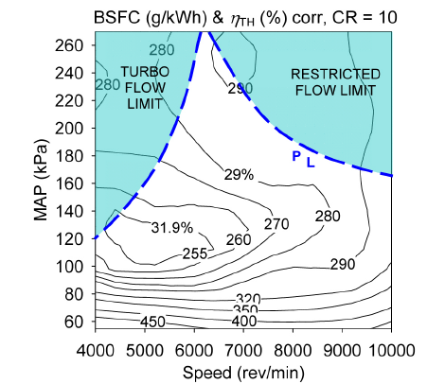
Engine Fuel Economy

Slide 20
Sustainable Thinking/Understanding for Future
Turbocharged modes were found to match or exceed the capabilities of typical larger bore normally aspirated engines found in passenger vehicles.
Case studies showed that A normally aspirated engine could be readily matched with the smaller turbocharged unit, with a 66% reduction in engine capacity.
Is it possible to achieve a reduction in fuel consumption and CO₂ emissions?
How to reduce fuel consumption at idle conditions?

Slide 21
Advanced Turbo-charging Systems
Higher density is achieved through increased pressure @ IVC.
Compression ratio has a great impact on fuel consumption of an engine.
Generally, with a higher the compression ratio, alower the fuel consumption can be reached.
However, Knock limit constrains the compression ratio increase of SI engines.
It is known to all that any effort that leads decrease in intake air temperature at IVC will allow higher values of CR without knock!
Attainment of higher density at IVC with lower T_{ivc} is the theme of advanced turbo-charging methods.

