Slide 1

Turbocharging of I.C. Engines
P M V Subbarao
Professor
Mechanical Engineering Department
Ideas to Extend Expansion Process & Develop Compact Engines …

Slide 2

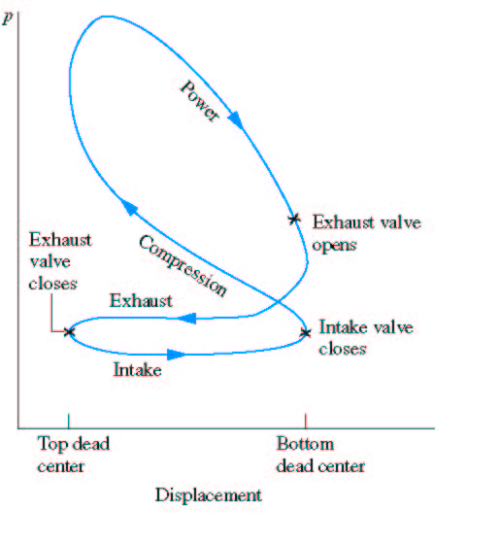
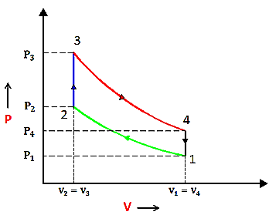
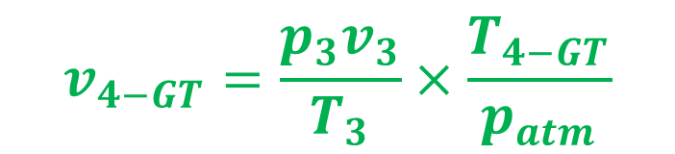
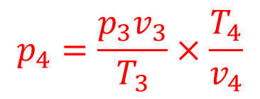
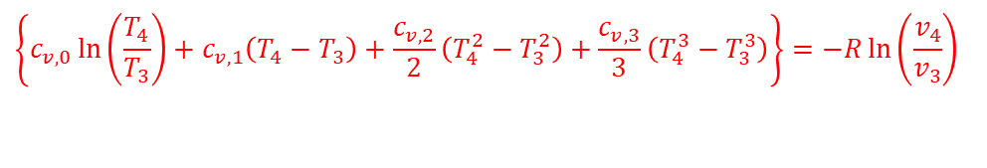

3—4 Isentropic (Incomplete) expansion of the burned gases
$$\left\{c_{v,0}\ln\left(\frac{T_{4}}{T_{3}}\right)+c_{v,1}\left(T_{4}−T_{3}\right)+\frac{c_{v,2}}{2}\left(T_{4}^{2}−T_{3}^{2}\right)+\frac{c_{v,3}}{3}\left(T_{4}^{3}−T_{3}^{3}\right)\right\}=−R\ln\left(\frac{v_{4}}{v_{3}}\right)$$
$$p_{4}=\frac{p_{3}v_{3}}{T_{3}}×\frac{T_{4}}{v_{4}}$$
A Gas Turbine can do this easily!
p_{atm}
$$v_{4−GT}=\frac{p_{3}v_{3}}{T_{3}}×\frac{T_{4−GT}}{p_{atm}}$$

Slide 3
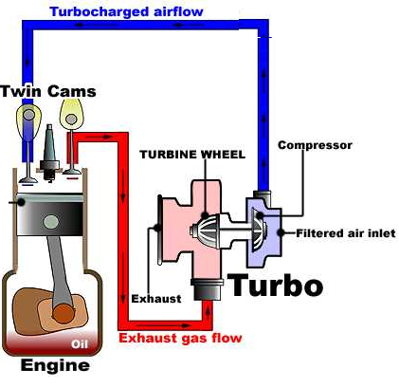
A Turbocharged Engine
The Primary Objective:
Conversion of unutilized exhaust gas microscopic kinetic energy into shaft work.
Invention of better ways to utilize the additional Mechanical Power.
The Best Feasible Option
Direct driving of an air compressor using additional shaft power delivered by Gas Turbine

Slide 4
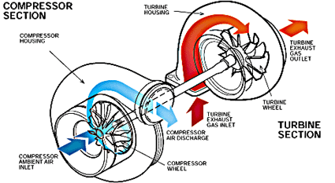
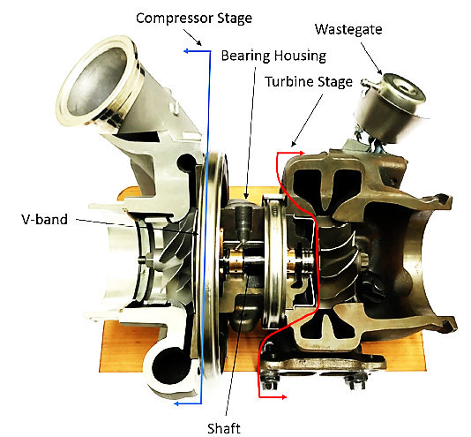
Turbocharger
Turbine :A device to utilize waste microscopic kinetic energy of Engine exhaust gas.
Compressor :A device to increase microscopic kinetic energy of intake air.

Slide 5
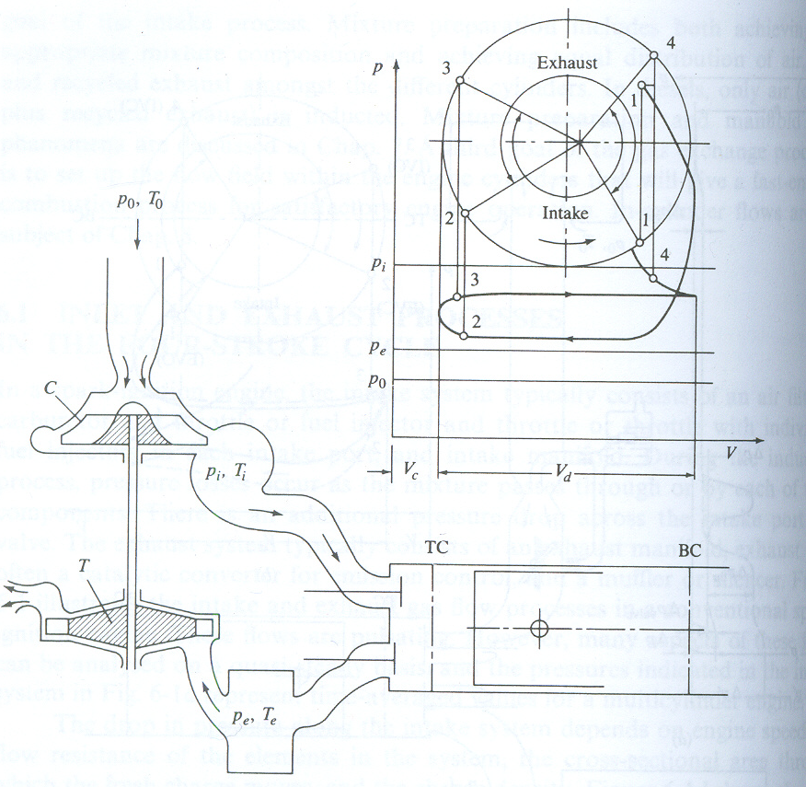
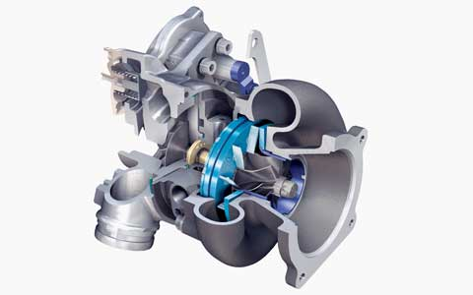
Engine Artificial Respiratory System: An Inclusion of CV
Turbo-Charged Engine

Slide 6
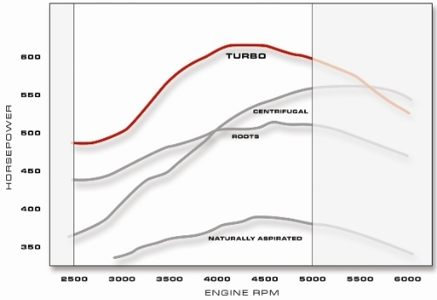
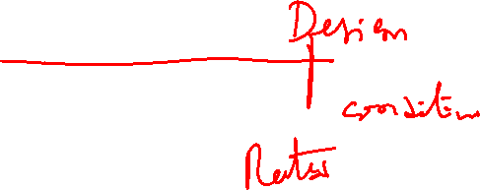
Characteristics of Turbo-Charged Engines

Slide 7
Matching of Turbocharger with Engine
I.C. Engines are intermittent control volumes.
Can accept or deliver flow across the boundary intermittently.
Turbine and compressor are continuous control volumes.
They need to continuously accept and deliver flow across boundary.
Demands a special engineering art called as tuning.
An art of tuning CVs with semi-CM.
  Fluid Dynamic Turning.
  Thermodynamic Tuning.

Slide 8
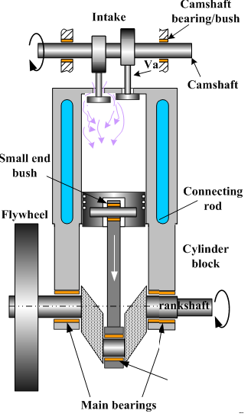
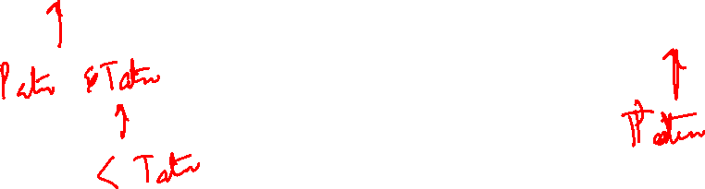
Thermodynamic Layout of A Turbocharged I.C. Engine
ce
ti
Engine
p_{ce}, T_{ce}
p_{ti}, T_{ti}
ci
C
Т
te
p_{ci}, T_{ci}
p_{te}, T_{te}

Slide 9
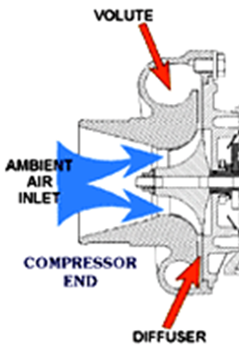
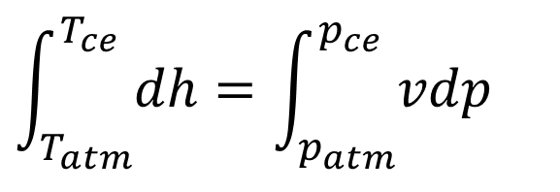
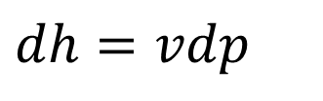
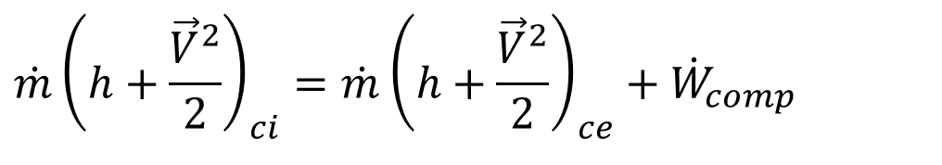
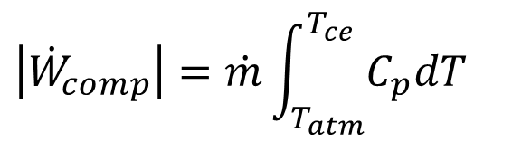

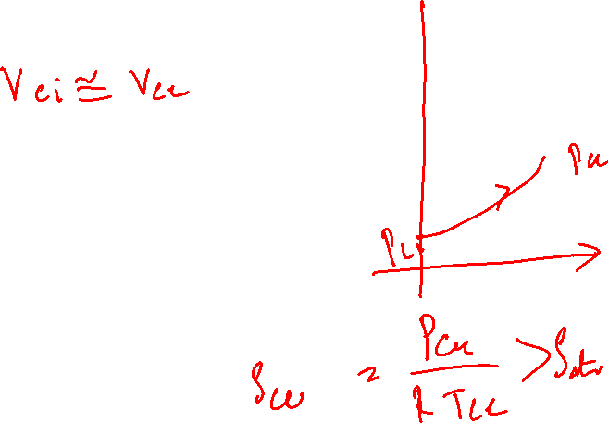
Steady State Steady Flow Model of An Isentropic Compressor
$$\dot{m}{\left(h+\frac{{\vec{V}}^{2}}{2}\right)}_{ci}=\dot{m}{\left(h+\frac{{\vec{V}}^{2}}{2}\right)}_{ce}+{\dot{W}}_{comp}$$
$$\dot{m}h_{ci}=\dot{m}h_{ce}+{\dot{W}}_{comp}$$
Infinitesimal Isentropic compression of intake air:
$$dh=vdp$$
$$\int_{T_{atm}}^{T_{ce}}{dh}=\int_{p_{atm}}^{p_{ce}}{vdp}$$
$$\left|{\dot{W}}_{comp}\right|=\dot{m}\int_{T_{atm}}^{T_{ce}}{C_{p}dT}$$

Slide 10

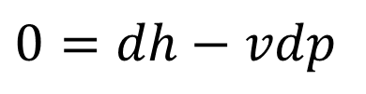
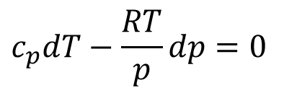
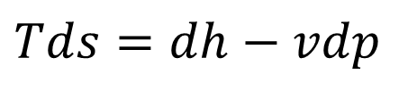
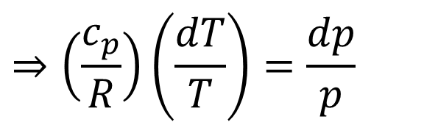
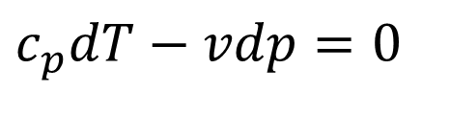
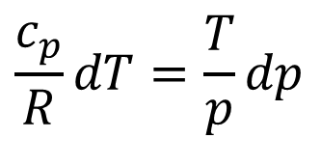
True Modelling of Isentropic Compression Process: ci - ce
For an infinitesimal compression process in a CV:
$$Tds=dh−vdp$$
For a infinitesimal reversible adiabatic compression process in a CV:
$$0=dh−vdp$$
$$c_{p}dT−vdp=0$$
$$c_{p}dT−\frac{RT}{p}dp=0$$
Working fluid possess ideal gas nature:
$$\frac{c_{p}}{R}dT=\frac{T}{p}dp$$
$$⇒\left(\frac{c_{p}}{R}\right)\left(\frac{dT}{T}\right)=\frac{dp}{p}$$

Slide 11
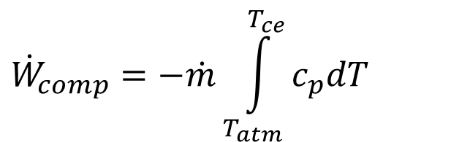
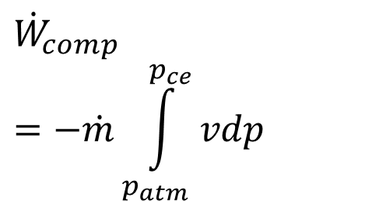
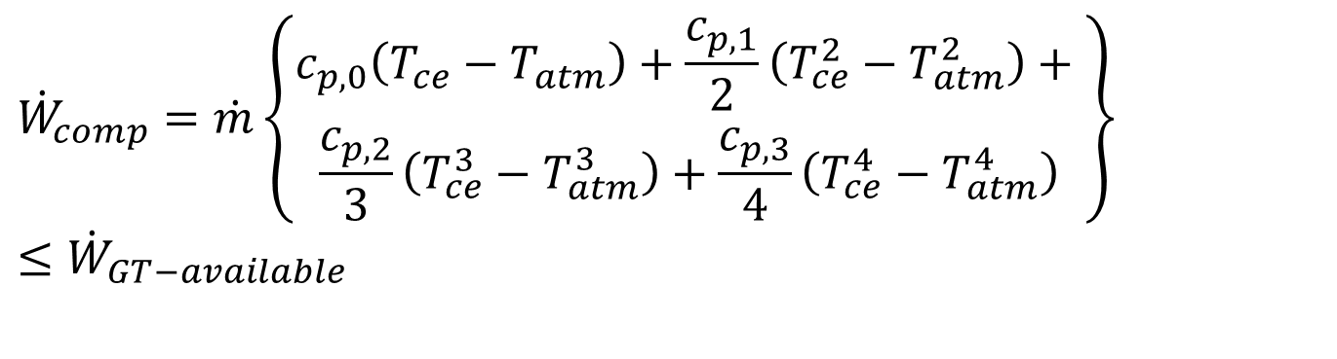
Extra Pumping Power Demand
The expenditure due to compression:
$${\dot{W}}_{comp}=−\dot{m}\int_{p_{atm}}^{p_{ce}}{vdp}$$
$${\dot{W}}_{comp}=−\dot{m}\int_{T_{atm}}^{T_{ce}}{c_{p}dT}$$
$${\dot{W}}_{comp}=\dot{m}\left\{\begin{aligned}c_{p,0}\left(T_{ce}−T_{atm}\right)+\frac{c_{p,1}}{2}\left(T_{ce}^{2}−T_{atm}^{2}\right)+ \\ \frac{c_{p,2}}{3}\left(T_{ce}^{3}−T_{atm}^{3}\right)+\frac{c_{p,3}}{4}\left(T_{ce}^{4}−T_{atm}^{4}\right)\end{aligned}\right\}$$
$$≤{\dot{W}}_{GT−available}$$

Slide 12
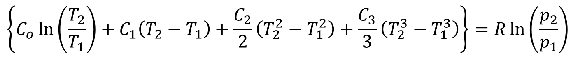
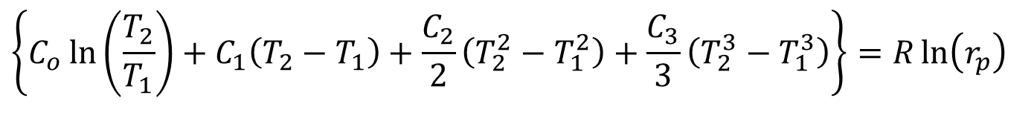
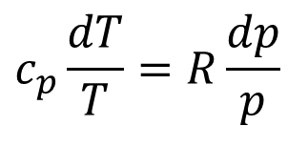
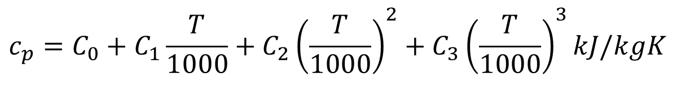
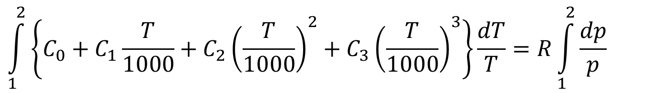
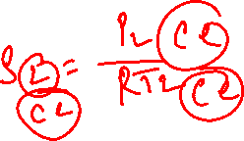
Phenomenological Model for Isentropic Compressor
$$c_{p}\frac{dT}{T}=R\frac{dp}{p}$$
Let the air is modeled as:
$$c_{p}=C_{0}+C_{1}\frac{T}{1000}+C_{2}{\left(\frac{T}{1000}\right)}^{2}+C_{3}{\left(\frac{T}{1000}\right)}^{3}kJ/kgK$$
$$\int_{1}^{2}{\left\{C_{0}+C_{1}\frac{T}{1000}+C_{2}{\left(\frac{T}{1000}\right)}^{2}+C_{3}{\left(\frac{T}{1000}\right)}^{3}\right\}\frac{dT}{T}}=R\int_{1}^{2}{\frac{dp}{p}}$$
$$\left\{C_{o}\ln\left(\frac{T_{2}}{T_{1}}\right)+C_{1}\left(T_{2}−T_{1}\right)+\frac{C_{2}}{2}\left(T_{2}^{2}−T_{1}^{2}\right)+\frac{C_{3}}{3}\left(T_{2}^{3}−T_{1}^{3}\right)\right\}=R\ln\left(\frac{p_{2}}{p_{1}}\right)$$
$$\left\{C_{o}\ln\left(\frac{T_{2}}{T_{1}}\right)+C_{1}\left(T_{2}−T_{1}\right)+\frac{C_{2}}{2}\left(T_{2}^{2}−T_{1}^{2}\right)+\frac{C_{3}}{3}\left(T_{2}^{3}−T_{1}^{3}\right)\right\}=R\ln\left(r_{p}\right)$$

