Slide 1

Modeling of SI Engine Expansion Capability
P M V Subbarao
Professor
Mechanical Engineering Department
Head, CRDT
Estimate and Enhance Expansion Ratio….

Slide 2

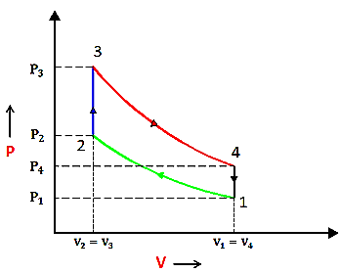
The Quick Closure Model : Constant Volume Process Heat Rejection: 4 – 1

Slide 3
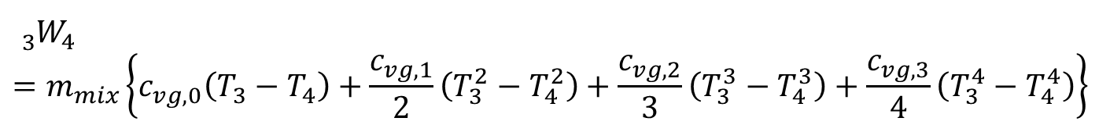
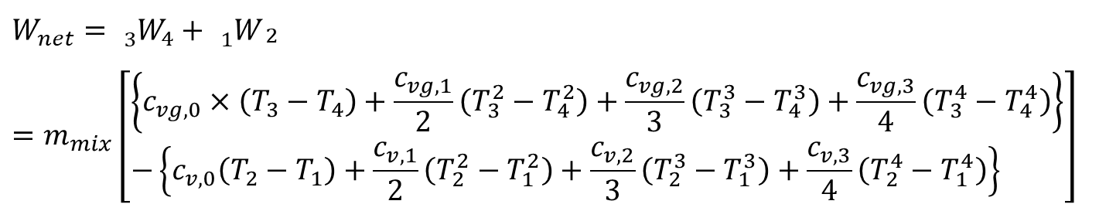
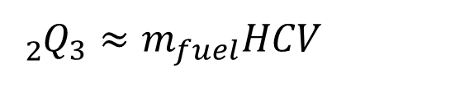
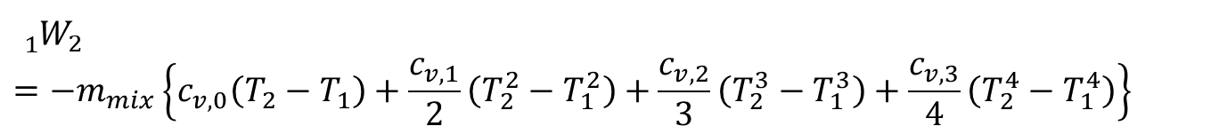
Evaluation of Process Effects: Realistic Model
$${{}_{1}^{}W}_{2}=−m_{mix}\left\{c_{v,0}\left(T_{2}−T_{1}\right)+\frac{c_{v,1}}{2}\left(T_{2}^{2}−T_{1}^{2}\right)+\frac{c_{v,2}}{3}\left(T_{2}^{3}−T_{1}^{3}\right)+\frac{c_{v,3}}{4}\left(T_{2}^{4}−T_{1}^{4}\right)\right\}$$
$${{}_{2}^{}Q}_{3}≈m_{fuel}HCV$$
$${{}_{3}^{}W}_{4}=m_{mix}\left\{c_{vg,0}\left(T_{3}−T_{4}\right)+\frac{c_{vg,1}}{2}\left(T_{3}^{2}−T_{4}^{2}\right)+\frac{c_{vg,2}}{3}\left(T_{3}^{3}−T_{4}^{3}\right)+\frac{c_{vg,3}}{4}\left(T_{3}^{4}−T_{4}^{4}\right)\right\}$$
$$W_{net}={{}_{3}^{}W}_{4}+{{}_{1}^{}W}_{\begin{aligned}2 \\ \end{aligned}}=m_{mix}\left[\begin{aligned}&\left\{c_{vg,0}×\left(T_{3}−T_{4}\right)+\frac{c_{vg,1}}{2}\left(T_{3}^{2}−T_{4}^{2}\right)+\frac{c_{vg,2}}{3}\left(T_{3}^{3}−T_{4}^{3}\right)+\frac{c_{vg,3}}{4}\left(T_{3}^{4}−T_{4}^{4}\right)\right\} \\ &−\left\{c_{v,0}\left(T_{2}−T_{1}\right)+\frac{c_{v,1}}{2}\left(T_{2}^{2}−T_{1}^{2}\right)+\frac{c_{v,2}}{3}\left(T_{2}^{3}−T_{1}^{3}\right)+\frac{c_{v,3}}{4}\left(T_{2}^{4}−T_{1}^{4}\right)\right\}\end{aligned}\right]$$

Slide 4
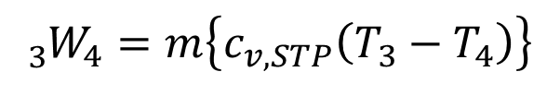
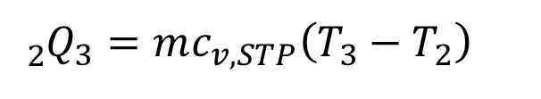

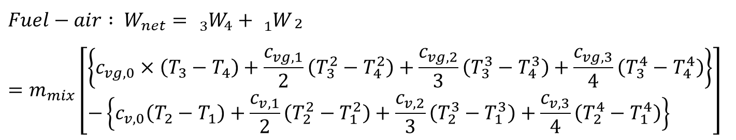
Evaluation Process Effects: Air Standard Model
$${{}_{1}^{}W}_{2}=−m\left\{c_{v,STP}\left(T_{2}−T_{1}\right)\right\}$$
$${{}_{2}^{}Q}_{3}=mc_{v,STP}\left(T_{3}−T_{2}\right)$$
$${{}_{3}^{}W}_{4}=m\left\{c_{v,STP}\left(T_{3}−T_{4}\right)\right\}$$
$$W_{net}={{}_{3}^{}W}_{4}+{{}_{1}^{}W}_{2}=mc_{v,STP}\left\{\left(T_{3}−T_{4}\right)−\left(T_{2}−T_{1}\right)\right\}$$
$$Fuel−air : W_{net}={{}_{3}^{}W}_{4}+{{}_{1}^{}W}_{\begin{aligned}2 \\ \end{aligned}}=m_{mix}\left[\begin{aligned}&\left\{c_{vg,0}×\left(T_{3}−T_{4}\right)+\frac{c_{vg,1}}{2}\left(T_{3}^{2}−T_{4}^{2}\right)+\frac{c_{vg,2}}{3}\left(T_{3}^{3}−T_{4}^{3}\right)+\frac{c_{vg,3}}{4}\left(T_{3}^{4}−T_{4}^{4}\right)\right\} \\ &−\left\{c_{v,0}\left(T_{2}−T_{1}\right)+\frac{c_{v,1}}{2}\left(T_{2}^{2}−T_{1}^{2}\right)+\frac{c_{v,2}}{3}\left(T_{2}^{3}−T_{1}^{3}\right)+\frac{c_{v,3}}{4}\left(T_{2}^{4}−T_{1}^{4}\right)\right\}\end{aligned}\right]$$

Slide 5
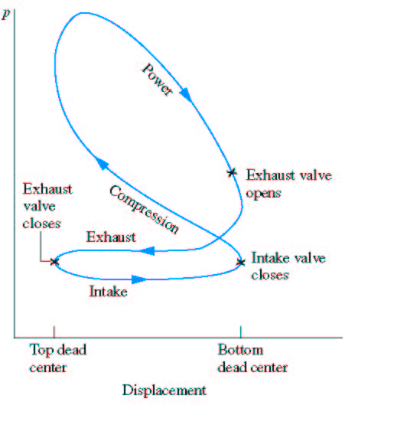
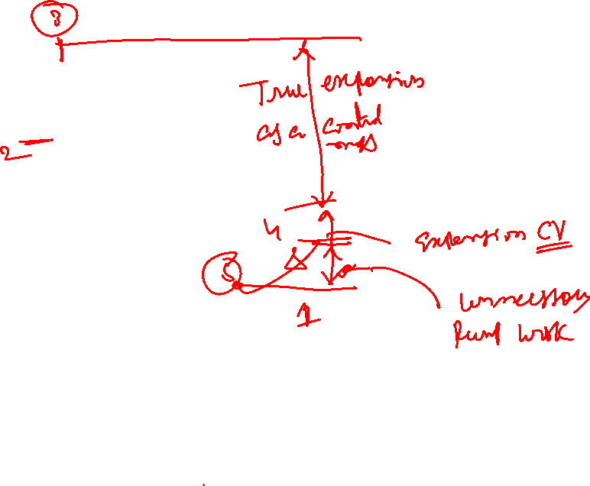
The Pseudo Cooling Process

Slide 6
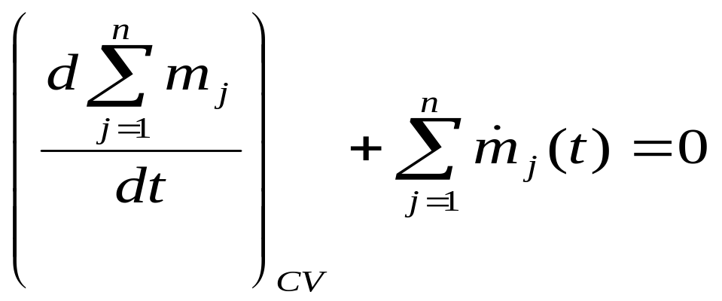
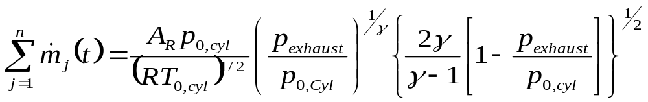
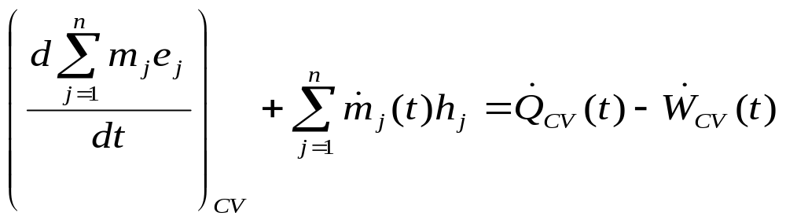
4—5 Ideal adiabatic blow down
Sudden Exhaust :

Slide 7
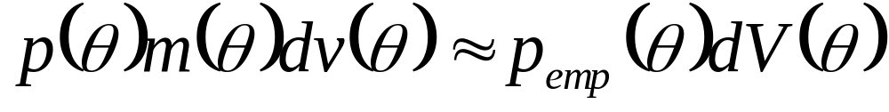
More Realistic Exhaust blow down
Late in power cycle exhaust valve is opened
Pressure differential pushes hot exhaust gas out of cylinder and through exhaust system.
The mass blow down process, which occurs between EVO and BDC (180 CA), is to be thermodynamically designed to enhance the predictive capability of the cyclic integral.
An empirical correlation for the blow down pressure is obtained as in the following form:

Slide 8
Nature of Blowdown
After EVO, the mass in cylinder decreases sharply as gas blowdown occurs due to the significant pressure difference across the exhaust valve.
In most of the cases, 20% -- 50% of the exhaust gas exits the exhaust valve during the blowdown process.
During the exhaust stroke, the piston moves towards TDC, which further pushes the mass of gases in cylinder to leave the engine.
At 720º CA, the mass of gases residing in the clearance volume, which is termed as the residual gas, will be mixed with the fresh intake charge in the subsequent cycle

Slide 9
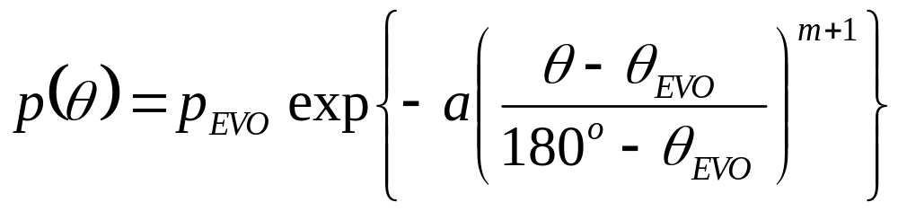
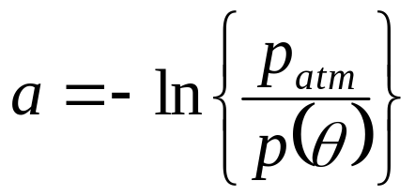
Empirical Relations for Pressure during blowdown
where
and m =0.45 is the shape factor determined by experimental correlation.

Slide 10
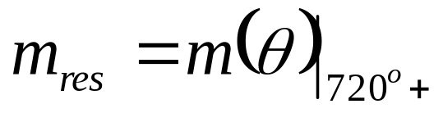
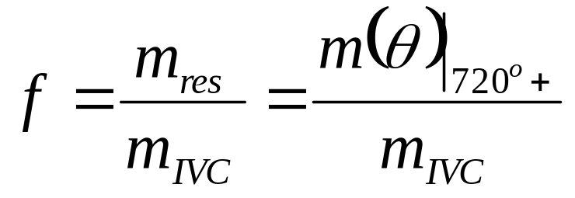

Intake Conditions
The residual mass fraction (f ), a parameter which is crucial in the determination of the charge air/gas temperature at IVC (Ti).
This is estimated from the previous cycle.
Hence, the residual mass fraction can be estimated by

Slide 11
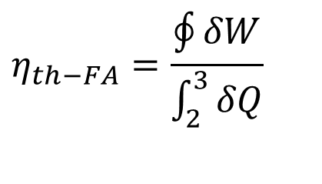
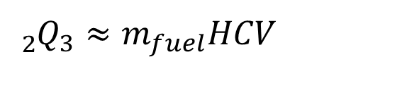
Cyclic Integral of Ideal Fuel-Air Cycle
$$η_{th−FA}=\frac{\oint{δW}}{\int_{2}^{3}{δQ}}$$
$${{}_{2}^{}Q}_{3}≈m_{fuel}HCV$$
$$W_{net}={{}_{3}^{}W}_{4}+{{}_{1}^{}W}_{\begin{aligned}2 \\ \end{aligned}}=m_{mix}\left[\begin{aligned}&\left\{c_{vg,0}×\left(T_{3}−T_{4}\right)+\frac{c_{vg,1}}{2}\left(T_{3}^{2}−T_{4}^{2}\right)+\frac{c_{vg,2}}{3}\left(T_{3}^{3}−T_{4}^{3}\right)+\frac{c_{vg,3}}{4}\left(T_{3}^{4}−T_{4}^{4}\right)\right\} \\ &−\left\{c_{v,0}\left(T_{2}−T_{1}\right)+\frac{c_{v,1}}{2}\left(T_{2}^{2}−T_{1}^{2}\right)+\frac{c_{v,2}}{3}\left(T_{2}^{3}−T_{1}^{3}\right)+\frac{c_{v,3}}{4}\left(T_{2}^{4}−T_{1}^{4}\right)\right\}\end{aligned}\right]$$

Slide 12
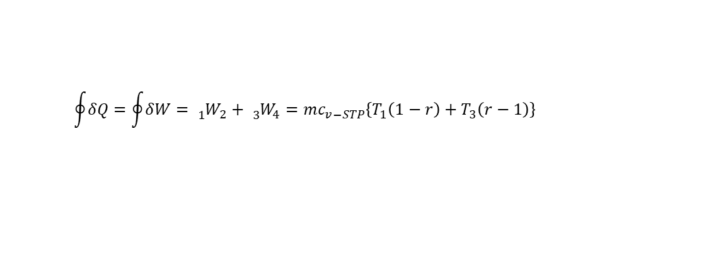
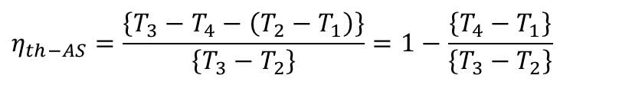
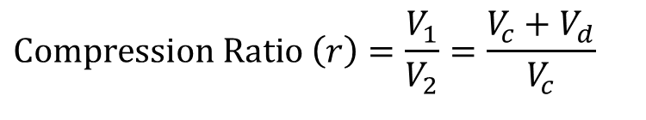
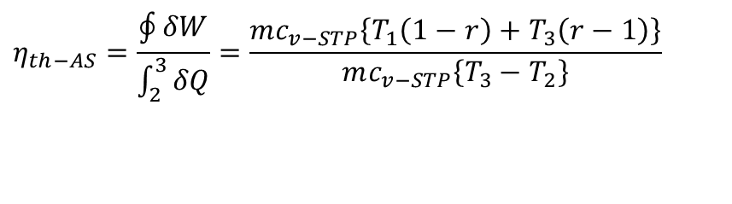
Cyclic Integral of Standard Air Cycle
$$\text{Compression} \text{Ratio} \left(r\right)=\frac{V_{1}}{V_{2}}=\frac{V_{c}+V_{d}}{V_{c}}$$
$$\oint{δQ}=\oint{δW}={{}_{1}^{}W}_{2}+{{}_{3}^{}W}_{4}=mc_{v−STP}\left\{T_{1}\left(1−r\right)+T_{3}\left(r−1\right)\right\}$$
$$η_{th−AS}=\frac{\oint{δW}}{\int_{2}^{3}{δQ}}=\frac{mc_{v−STP}\left\{T_{1}\left(1−r\right)+T_{3}\left(r−1\right)\right\}}{mc_{v−STP}\left\{T_{3}−T_{2}\right\}}$$
$$η_{th−AS}=\frac{\left\{T_{3}−T_{4}−\left(T_{2}−T_{1}\right)\right\}}{\left\{T_{3}−T_{2}\right\}}=1−\frac{\left\{T_{4}−T_{1}\right\}}{\left\{T_{3}−T_{2}\right\}}$$

Slide 13
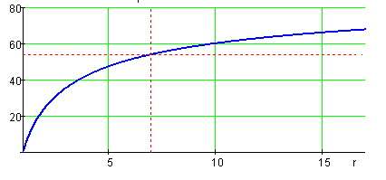
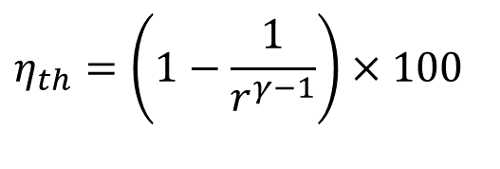
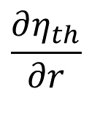
Air-standard Otto Cycle & Clue to Achieve Higher Efficiency
$$η_{th}=\left(1−\frac{1}{r^{γ−1}}\right)×100$$
$$\frac{∂η_{th}}{∂r}$$

Slide 14
Limitation of Four Bar Mechanism & Scavenging
Expansion Ratio = Compression Ratio.
In a Real engines of 19th & 20th Century:
Expansion Ratio < Compression Ratio?
21st Century Engines:
Expansion Ratio > Compression Ratio.

Slide 15
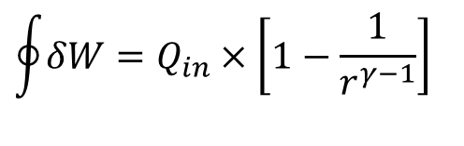
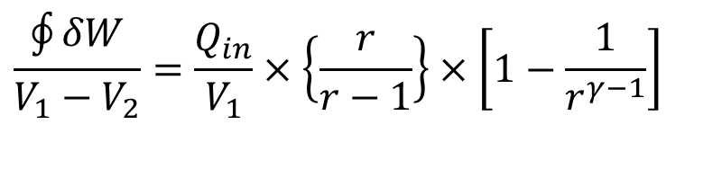
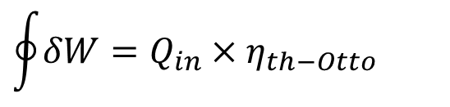
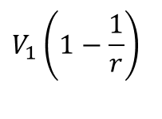
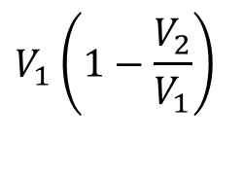
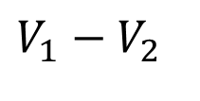
Hardware Superiority of Otto Cycle
$$\oint{δW}=Q_{in}×η_{th−Otto}$$
Net cycle work:
$$\oint{δW}=Q_{in}×\left[1−\frac{1}{r^{γ−1}}\right]$$
Piston Displacement volume
$$V_{1}−V_{2}$$
$$V_{1}\left(1−\frac{V_{2}}{V_{1}}\right)$$
$$V_{1}\left(1−\frac{1}{r}\right)$$
Work done per unit piston displacement volume:
$$\frac{\oint{δW}}{V_{1}−V_{2}}=\frac{Q_{in}}{V_{1}}×\left\{\frac{r}{r−1}\right\}×\left[1−\frac{1}{r^{γ−1}}\right]$$

Slide 16
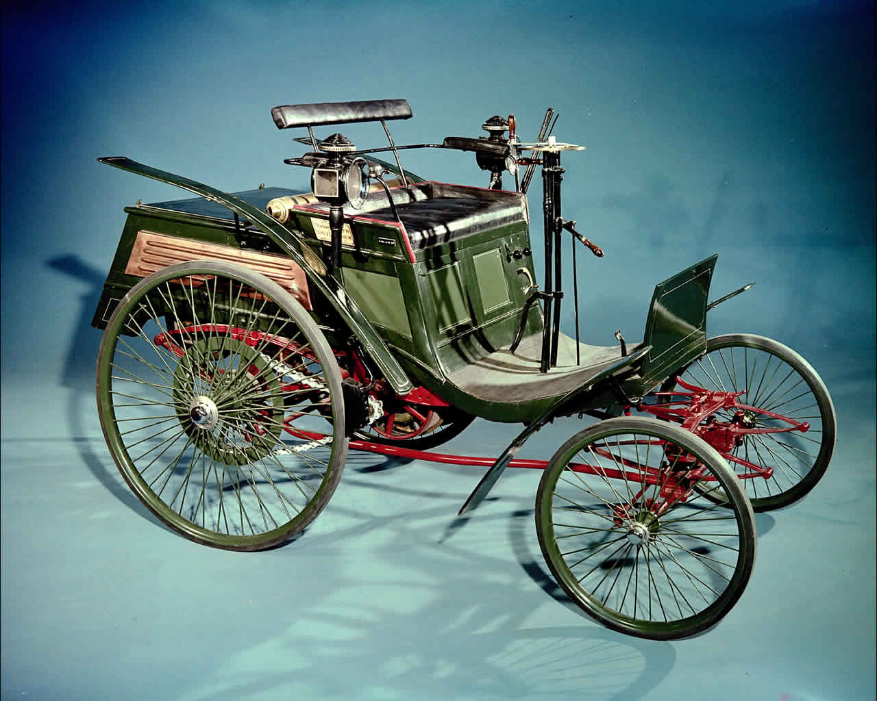
The Historical Event in Automobiles
In 1893, the Benz Velo became the world's first inexpensive, mass-produced car.
12000 unites were produced.
0.7 hp and 958cc!!!
The Mercedes 35 HP (German: Mercedes 35 PS) was a radical early car model designed in 1901.
Engine volume: 5,918CC.
The racecar was of a disappointing performance by multiple technical complications and enduring just for few laps.

Slide 17
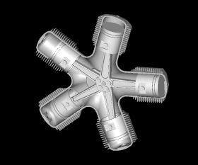
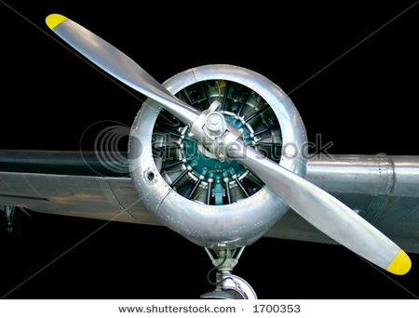
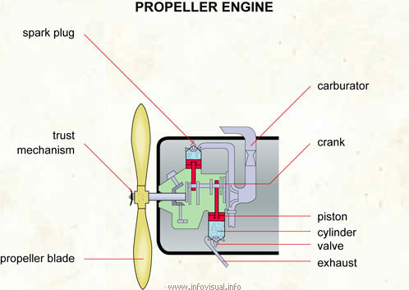
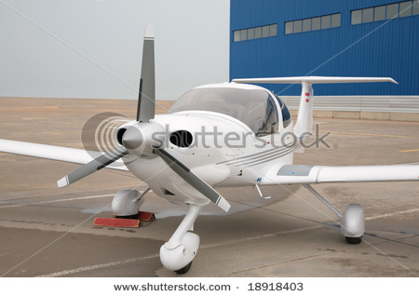
SI Engine for Propulsion

Slide 18
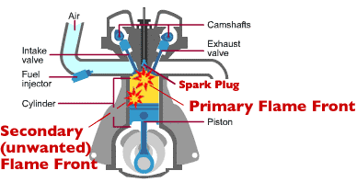
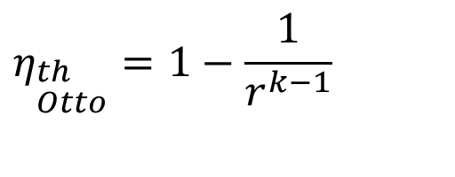
Thermo-chemical Feasibility of Otto’s Model
$$η_{\begin{aligned}&th \\ &Otto\end{aligned}}=1−\frac{1}{r^{k−1}}$$

Slide 19
Thermo-chemical Feasibility of Ignition
Upper Flame Limit
Saturation line
Vapour Pressure in Air
Onset of
Piloted Ignition Region
Lower Flame Limit
Mixture Temperature

Slide 20

Design Constraints: Flammability Characteristics
Rich Mixture
Stoichiometric Line
Flammable mist
Flammable Vapour
$$\frac{{\overset{•}{m}}_{f}}{{\overset{•}{m}}_{a}}$$
Lean Mixture Line
Burning Impossible
Flash Point
Mixture Temperature

Slide 21
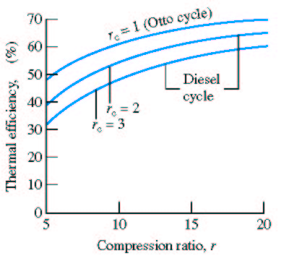
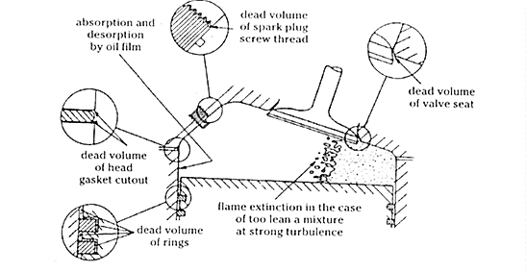

Irrationality of Otto’s Model
$$η_{\begin{aligned}&th \\ &Otto\end{aligned}}=1−\frac{1}{r^{k−1}}$$
Fuel/Air
Mixture
Typical SI engines
9 < r < 11
k = 1.4
Compression
Stroke

Slide 22
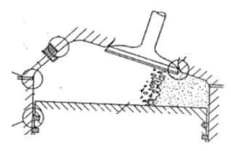
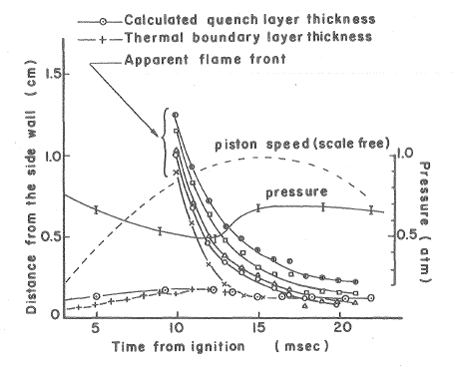
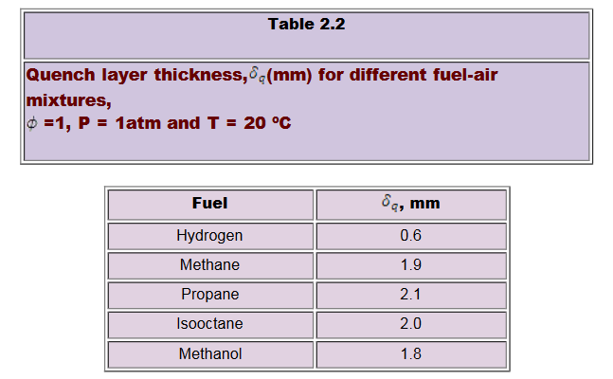
Flame Quenching at Wall

Slide 23
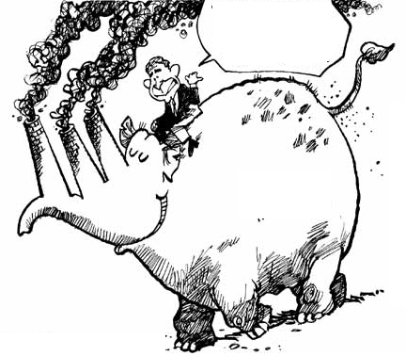
Live with A Promising Irrational Engine Model????
Advanced Cities
Generation of
photochemical smog
Artificial Horses
eye and respiratory irritation in humans
epinasty, chlorosis, curling, leaf abscission and growth retardation in plans

