Slide 1

Models for Estimation of Gas Temperature in SI Engines
P M V Subbarao
Professor
Mechanical Engineering Department
Head, CRDT
An Essential Requirement to Construct A Sustainable SI Engines…..

Slide 2

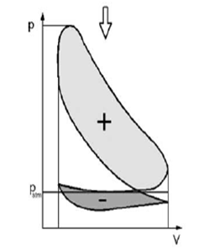

Indicative Gas Cycle of a Four Stroke SI Engine

Slide 3
Methodology to Development of Artificial Horse
Fuel (Resource)
Automotive Prime Mover
--Cycle
-- Basic Hardware
-- Auxiliaries & Controls
The Great Need :
Mechanical Power
Land, Water & Air (Sinks)

Slide 4
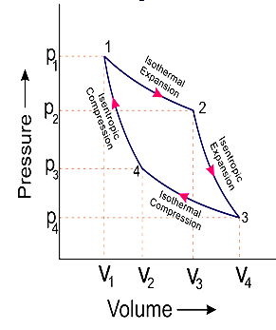
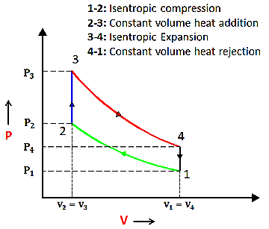
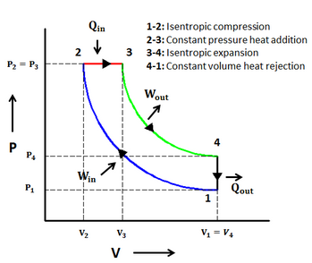
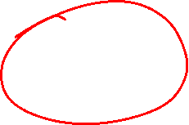
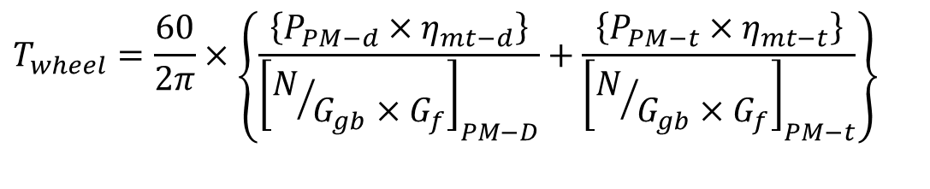
Cyclic Work To be Delivered by An Artificial Horse
Ideal cycle work to be provided by A Powering Engine:
$$T_{wheel}=\frac{60}{2π}×\left\{\frac{\left\{P_{PM−d}×η_{mt−d}\right\}}{{\left[N/{G_{gb}×G_{f}}\right]}_{PM−D}}+\frac{\left\{P_{PM−t}×η_{mt−t}\right\}}{{\left[N/{G_{gb}×G_{f}}\right]}_{PM−t}}\right\}$$
Air-standard Modelling is the final outcome of 19th century !!!

Slide 5
Important Feature of Model Vs SI Engine
Predictions by Air-standard Cycle
Stoichiometric Mixture
η_{th}, %
Actual Prime Mover
Lean
Rich
Fuel/air Ratio

Slide 6

Otto’s Hardware Model for Artificial Horse
Actual
Engine Cycle
A
I
R
FUEL
Ignition
Fuel/Air
Mixture
Combustion
Products
Intake
Stroke
Compression
Stroke
Power
Stroke
Exhaust
Stroke

Slide 7

Otto’s Hardware Model for Artificial Horse
A
I
R
FUEL
Ignition
Fuel/Air
Mixture
Combustion
Products
Actual
Engine Cycle
Intake
Stroke
Compression
Stroke
Power
Stroke
Exhaust
Stroke
Q_{in}
Q_{out}
Thermodynamic Model
Cycle
Air
TC
BC
Compression
Process
Const volume
heat addition
Process
Expansion
Process
Const volume
heat rejection
Process

Slide 8
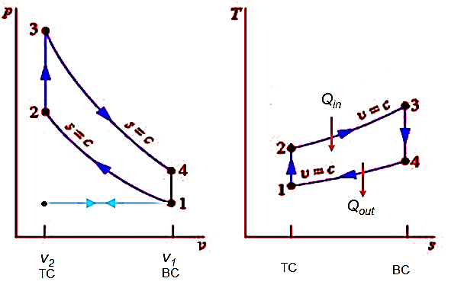
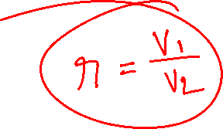
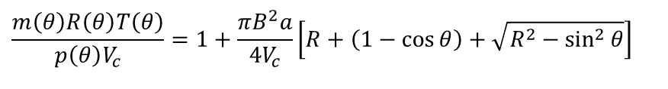
Otto’s Model Cycle for his Artificial Horse
$$\frac{m\left(θ\right)R\left(θ\right)T\left(θ\right)}{p\left(θ\right)V_{c}}=1+\frac{πB^{2}a}{4V_{c}}\left[R+\left(1−\cos{θ}\right)+\sqrt{R^{2}−\sin^{2}{θ}}\right]$$
Process 1→ 2 Isentropic compression
Process 2 → 3 Constant volume heat addition
Process 3 → 4 Isentropic expansion
Process 4 → 1 Constant volume heat rejection

Slide 9
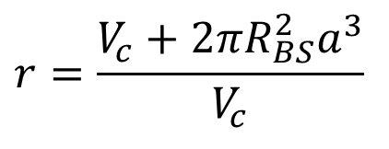
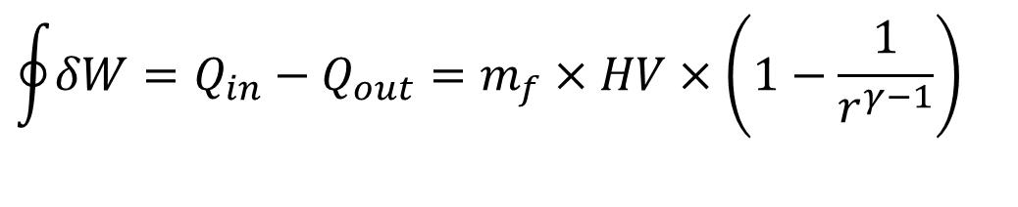
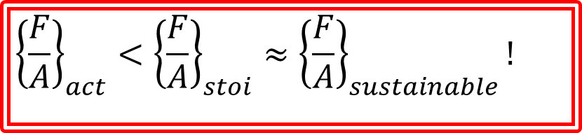
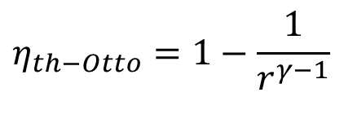
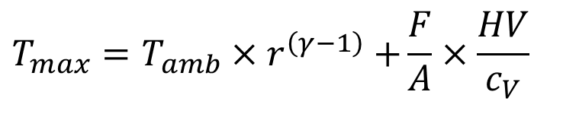


Engine Geometry Vs Air standard Otto Cycle
$$η_{th−Otto}=1−\frac{1}{r^{γ−1}}$$
$$r=\frac{V_{c}+2π{R_{BS}^{2}a}^{3}}{V_{c}}$$
$$\oint{δW}=Q_{in}−Q_{out}=m_{f}×HV×\left(1−\frac{1}{r^{γ−1}}\right)$$
$$T_{min}≈T_{amb}$$
$$T_{max}=T_{amb}{×r}^{\left(γ−1\right)}+\frac{F}{A}×\frac{HV}{c_{V}}$$
$${\left\{\frac{F}{A}\right\}}_{act}<{\left\{\frac{F}{A}\right\}}_{stoi}≈{\left\{\frac{F}{A}\right\}}_{sustainable}!$$
The term stoichiometry was first used by Jeremias Benjamin Richter in 1792 : the Art of Measuring the Chemical Elements.
The term is derived from the Ancient Greek words στοιχεῖον stoicheion "element" and μέτρον metron "measure".

Slide 10
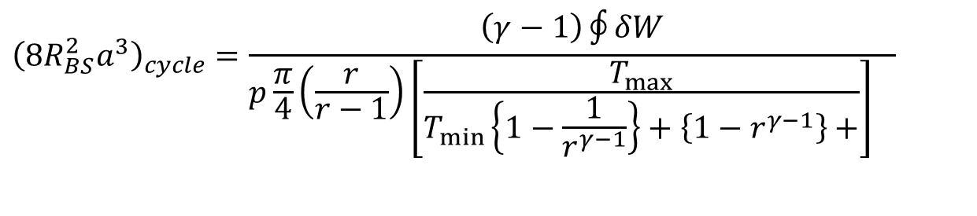
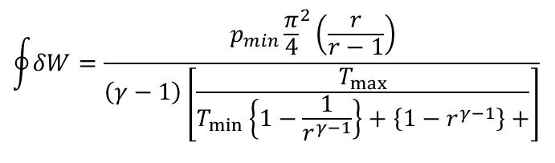
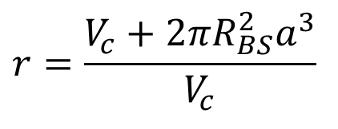
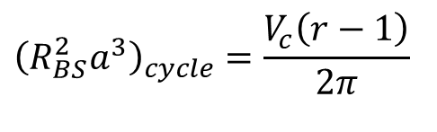
Advanced Analysis Missed in 20th Century :
AS Otto Cycle Volume to meet the Demand
$$r=\frac{V_{c}+2π{R_{BS}^{2}a}^{3}}{V_{c}}$$
$$\oint{δW}=\frac{{p_{min}{\frac{π}{4}}^{2}\left(\frac{r}{r−1}\right)}_{}}{\left(γ−1\right)\left[\frac{T_{max}}{T_{min}\left\{1−\frac{1}{r^{γ−1}}\right\}+\left\{1−r^{γ−1}\right\}+}\right]}$$
$${\left(8{R_{BS}^{2}a}^{3}\right)}_{cycle}=\frac{\left(γ−1\right)\oint{δW}}{{p\frac{π}{4}\left(\frac{r}{r−1}\right)\left[\frac{T_{max}}{T_{min}\left\{1−\frac{1}{r^{γ−1}}\right\}+\left\{1−r^{γ−1}\right\}+}\right]}_{}}$$
$${\left(R_{BS}^{2}a^{3}\right)}_{cycle}=\frac{V_{c}\left(r−1\right)}{2π}$$

Slide 11
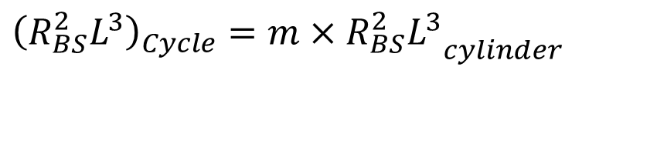
Cycle Volume Vs Cylinder Volume
A given cycle can be met using m number of similar cylinders if required.
$${\left(R_{BS}^{2}L^{3}\right)}_{Cycle}=m×{R_{BS}^{2}L^{3}}_{cylinder}$$
Any restriction on stroke length can be satisfied by using multi-cylinder engine.
Why was Geometric-Chemical analysis ignored in 20th Century and before?

Slide 12
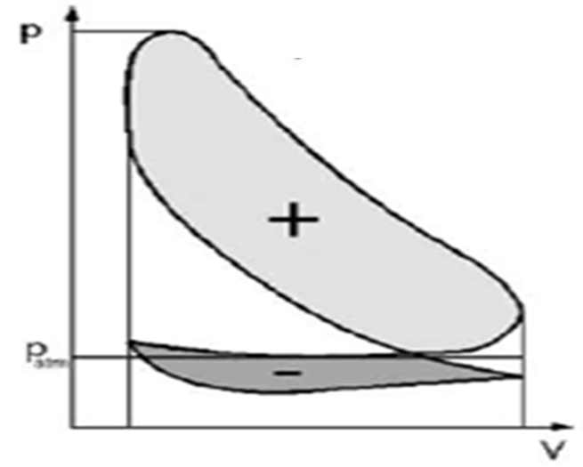
Indicative Gas Cycle of a Four Stroke SI Engine
Ignition
Fuel/Air
Mixture
Compression
Stroke
Power
Stroke
A
I
R
FUEL
Combustion
Products
Exhaust
Stroke
Intake
Stroke

Slide 13
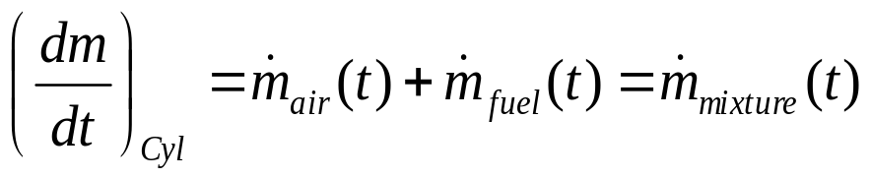
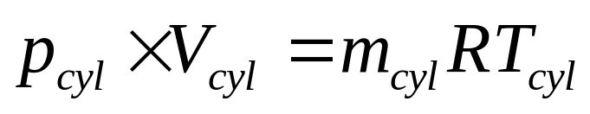
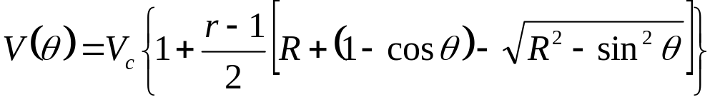
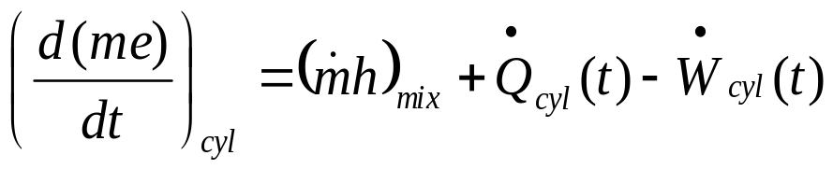
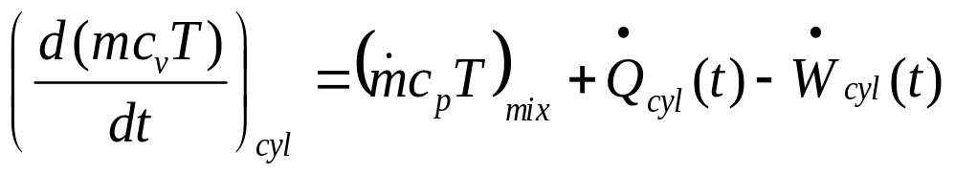
Modelling of Intake Process : SI Engine
FUEL
A
I
R
SI Engine

Slide 14
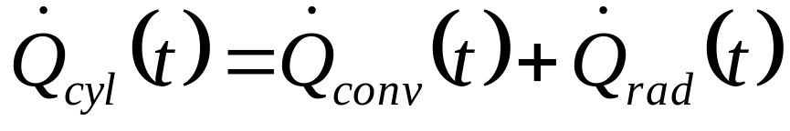
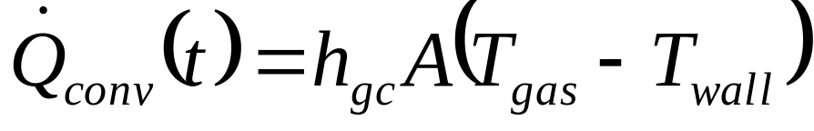
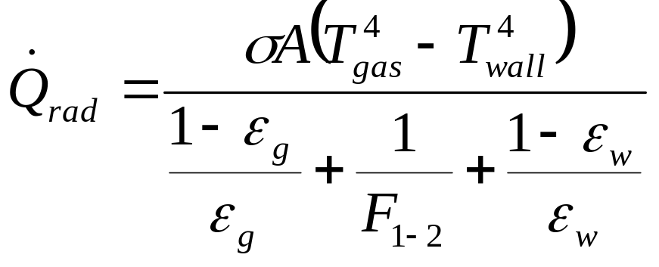
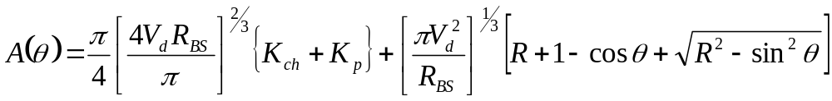
Instantaneous Heat Transfer During Intake Process

Slide 15
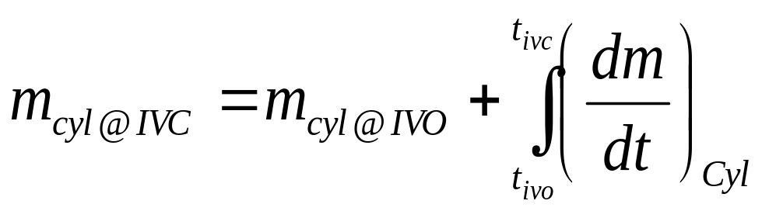
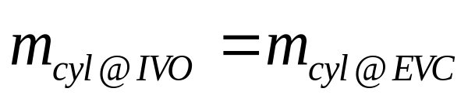
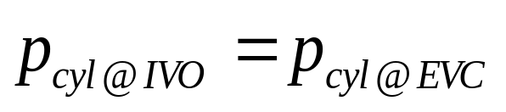
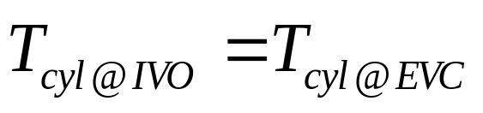
Total Mass of mixture inhaled during Intake Process
FUEL
A
I
R

Slide 16
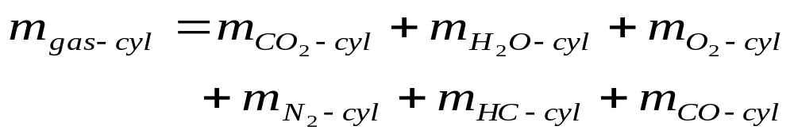
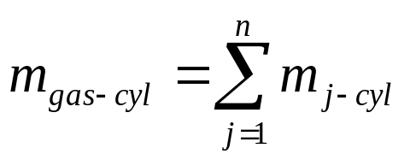
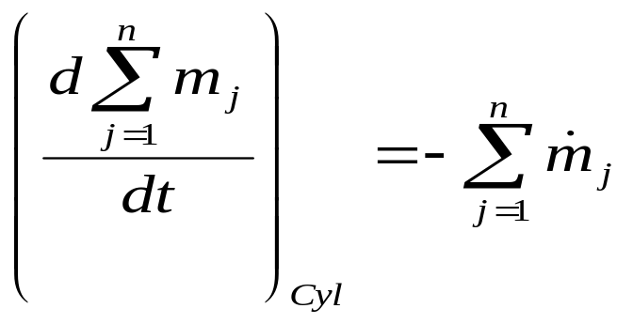
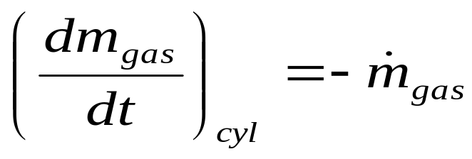
Modeling of Exhaust Process : SI Engine
Combustion
Products
Exhaust
Stroke

Slide 17
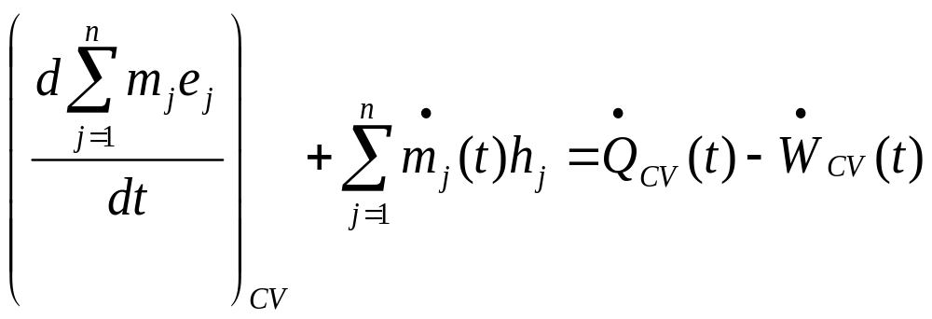
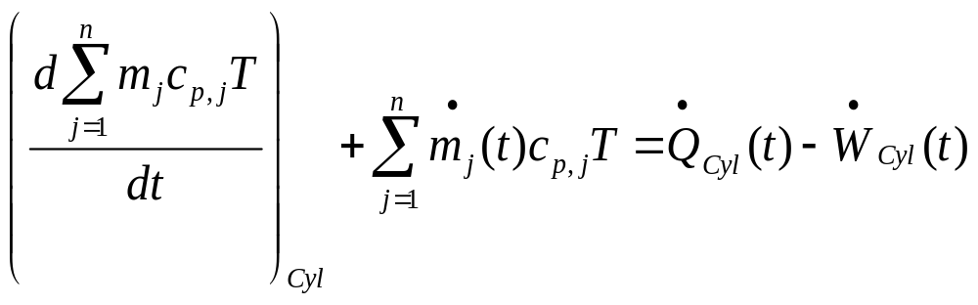
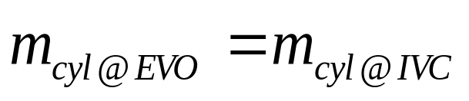
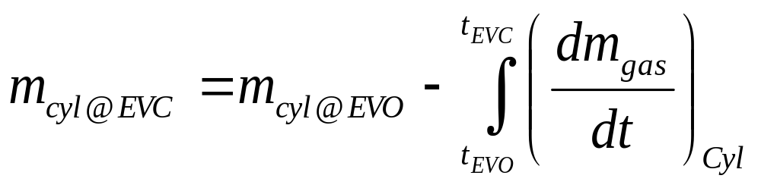
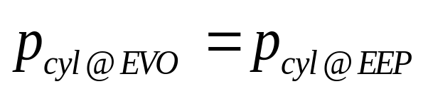
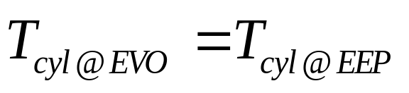

Slide 18
21st Century Phenomenological Models for Engine Cycles
Fuel-air analysis is more accurate analysis when compared to Air-standard cycle analysis.
An accurate representation of constituents of working fluid is considered.
More accurate models are used for properties of each constituents.
Process | Otto’s Engine | Diesel’sEngine
Intake | Air + Fuel +Residual gas | Air + Residual gas
Compression | Air+Fuel vapour +Residual gas | Air + Residual gas
Expansion | Combustion products | Combustion Products
Exhaust | Combustion products | Combustion Products

Slide 19
Fuel-Air Model for Otto Cycle
Air+Fuel vapour +Residual gas
Products of Combustin
TC
Products of Combustin
BC
Compression
Process
Const volume
combustion
Process
Expansion
Process
Const volume
Blow down
Process
Otto
Cycle

Slide 20
21st Century Analysis of Ideal Otto Cycle
This is known as Fuel-air Cycle.
1—2 Isentropic compression of a mixture of air, fuel vapour and residual gas without change in chemical composition.
2—3 Complete combustion at constant volume, without heat loss, with burned gases in chemical equilibrium.
3—4 Isentropic expansion of the burned gases which remain in chemical equilibrium.
4—5 Ideal adiabatic blow down.

Slide 21
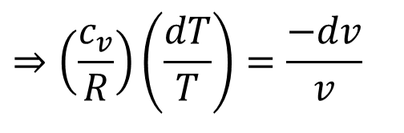
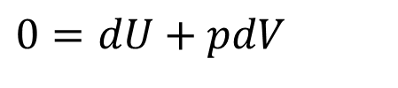
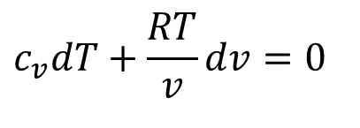

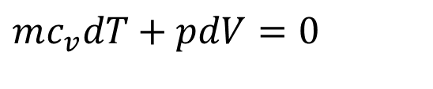
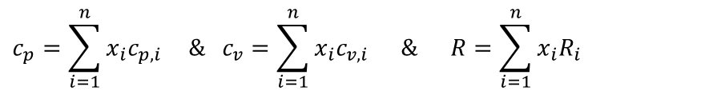
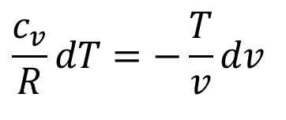
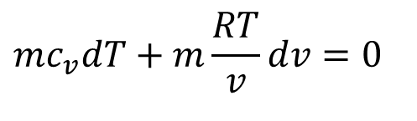
Isentropic Compression Process: 1 - 2
For a infinitesimal compression process:
$$TdS=dU+pdV$$
$$0=dU+pdV$$
$$mc_{v}dT+pdV=0$$
Assume ideal gas nature with variable properties:
$$mc_{v}dT+m\frac{RT}{v}dv=0$$
$$c_{v}dT+\frac{RT}{v}dv=0$$
$$\frac{c_{v}}{R}dT=−\frac{T}{v}dv$$
$$⇒\left(\frac{c_{v}}{R}\right)\left(\frac{dT}{T}\right)=\frac{−dv}{v}$$
Mass averaged properties for an ideal gas mixture:
$$c_{p}=\sum_{i=1}^{n}{x_{i}c_{p,i}}\text{ \& }c_{v}=\sum_{i=1}^{n}{x_{i}c_{v,i}}\text{ \& }R=\sum_{i=1}^{n}{x_{i}R_{i}}$$

Slide 22

Variation of Specific Heat of Ideal Gases
$$c_{p}=C_{0}+C_{1}\frac{T}{1000}+C_{2}{\left(\frac{T}{1000}\right)}^{2}+C_{3}{\left(\frac{T}{1000}\right)}^{3}kJ/kgK$$
Gas | C₀ | C₁ | C₂ | C₃
Air | 1.05 | -0.365 | 0.85 | -0.39
Methane | 1.2 | 3.25 | 0.75 | -0.71
CO₂ | 0.45 | 1.67 | -1.27 | 0.39
Steam | 1.79 | 0.107 | 0.586 | -0.20
O₂ | 0.88 | -0.0001 | 0.54 | -0.33
N₂ | 1.11 | -0.48 | 0.96 | -0.42

Slide 23

γ
c_{p}
c_{v}

Slide 24

Properties of Fuels
$$C_{p,f}=C_{0}+C_{1}\frac{T}{1000}+C_{2}{\left(\frac{T}{1000}\right)}^{2}+C_{3}{\left(\frac{T}{1000}\right)}^{3}+\left(\frac{C_{4}}{T^{2}}\right) kJ/kgK$$
Fuel | C₀ | C₁ | C₂ | C₃ | C₄
Methane | -0.29149 | 26.327 | -10.610 | 1.5656 | 0.16573
Propane | -1.4867 | 74.339 | -39.065 | 8.0543 | 0.01219
Isooctane | -0.55313 | 181.62 | -97.787 | 20.402 | -0.03095
Gasoline | -24.078 | 256.63 | -201.68 | 64.750 | 0.5808
Diesel | -9.1063 | 246.97 | -143.74 | 32.329 | 0.0518

Slide 25




Isentropic Compression model with variable properties : 1 - 2
$$\frac{V\left(θ\right)}{V_{c}}=1+\frac{r−1}{2}\left[R+\left(1−\cos{θ}\right)−\sqrt{R^{2}−\sin^{2}{θ}}\right]$$
$$v\left(θ\right)=\frac{V_{c}}{m}\left\{1+\frac{r−1}{2}\left[R+\left(1−\cos{θ}\right)−\sqrt{R^{2}−\sin^{2}{θ}}\right]\right\}$$
$$\left(\frac{c_{v}}{R}\right)\left(\frac{dT}{T}\right)=\frac{−dv}{v}$$
$$p\left(θ\right)=R\frac{T\left(θ\right)}{v\left(θ\right)}$$

Slide 26





True Phenomenological Model for Isentropic Compression
$$c_{v}\frac{dT}{T}=−R\frac{dv}{v}$$
Let the mixture is modeled as:
$$c_{v}=c_{v,0}+c_{v,1}T+c_{v,2}T^{2}+c_{v,3}T^{3}kJ/kgK$$
$$\int_{1}^{2}{\left\{c_{v,0}+c_{v,1}T+c_{v,2}T^{2}+c_{v,3}T^{3}\right\}\frac{dT}{T}}=−R\int_{1}^{2}{\frac{dv}{v}}$$
$$\left\{c_{v,0}\ln\left(\frac{T_{2}}{T_{1}}\right)+c_{v,1}\left(T_{2}−T_{1}\right)+\frac{c_{v,2}}{2}\left(T_{2}^{2}−T_{1}^{2}\right)+\frac{c_{v,3}}{3}\left(T_{2}^{3}−T_{1}^{3}\right)\right\}=−R\ln\left(\frac{v_{2}}{v_{1}}\right)$$
$$\left\{c_{v,0}\ln\left(\frac{T_{2}}{T_{1}}\right)+c_{v,1}\left(T_{2}−T_{1}\right)+\frac{c_{v,2}}{2}\left(T_{2}^{2}−T_{1}^{2}\right)+\frac{c_{v,3}}{3}\left(T_{2}^{3}−T_{1}^{3}\right)\right\}=−R\ln\left(\frac{1}{r}\right)$$

Slide 27







Carnot’s Concept of Air-Standard Model
Let the mixture is modeled as air with constant properties measured at STP:
$$c_{v}=c_{v,0}+c_{v,1}T+c_{v,2}T^{2}+c_{v,3}T^{3}kJ/kgK$$
$$c_{v,STP}\int_{1}^{2}{\frac{dT}{T}}=−R\int_{1}^{2}{\frac{dv}{v}}$$
$$c_{v,STP}\ln\left(\frac{T_{2}}{T_{1}}\right)=−R\ln\left(\frac{v_{2}}{v_{1}}\right)$$
$$c_{v,STP}\ln\left(\frac{T_{2}}{T_{1}}\right)=−R\ln\left(\frac{1}{r}\right)$$
$$c_{v,STP}\ln\left(\frac{T_{2}}{T_{1}}\right)=R\ln\left(r\right)$$
$$\frac{T_{2}}{T_{1}}={\left(\frac{V_{1}}{V_{2}}\right)}^{\left\{γ−1\right\}}$$
$$c_{v−STP}\int_{1}^{2}{dT}=−\int{pdv}={{}_{1}^{}W}_{2}=−c_{v−STP}\left(T_{2}−T_{1}\right)=−T_{1}c_{v−STP}\left(r^{γ−1}−1\right)$$

Slide 28




Realistic Estimate of Work for Isentropic Compression
$$mc_{v}dT=−pdV$$
Let the mixture is modeled as:
$$c_{v}=c_{v,0}+c_{v,1}T+c_{v,2}T^{2}+c_{v,3}T^{3}kJ/kgK$$
$${{}_{1}^{}W}_{2}=−\int_{1}^{2}{\left\{c_{v,0}+c_{v,1}T+c_{v,2}T^{2}+c_{v,3}T^{3}\right\}dT}$$
$${{}_{1}^{}W}_{2}=−m\left\{c_{v,0}\left(T_{2}−T_{1}\right)+\frac{c_{v,1}}{2}\left(T_{2}^{2}−T_{1}^{2}\right)+\frac{c_{v,2}}{3}\left(T_{2}^{3}−T_{1}^{3}\right)+\frac{c_{v,3}}{4}\left(T_{2}^{4}−T_{1}^{4}\right)\right\}$$

Slide 29


Generalized First Order Models for Variable Specific Heats
$$c_{p}=a_{p}+k_{1}×T$$
$$c_{v}=b_{v}+k_{1}×T$$
For design analysis of Engine Models:
a_{p} = 28.182 – 32.182 kJ/kmol.K
b_{v} = 19.868 – 23.868 kJ/kmol.K
k₁ = 0.003844–0.009844 kJ/kmol.K²

Slide 30


The Role of Isentropic Compression
Second order Property Model:
$$\left\{c_{v,0}\ln\left(\frac{T_{2}}{T_{1}}\right)+c_{v,1}\left(T_{2}−T_{1}\right)+\frac{c_{v,2}}{2}\left(T_{2}^{2}−T_{1}^{2}\right)+\frac{c_{v,3}}{3}\left(T_{2}^{3}−T_{1}^{3}\right)\right\}=R\ln\left(r\right)$$
$$k_{1}×\left(T_{2}−T_{1}\right)+b_{v}\ln\left\{\frac{T_{2}}{T_{1}}\right\}=R\ln\left[r\right]$$
First order Property Model:
Ready for combustion:
In a combustion reaction, bonds are being broken and formed between different atoms in molecules.
The parts of the molecules that undergo bond breakage and formation need to line up with each other.
There needs to be the appropriate overlap in the orbitals that are "donating" and "accepting" electrons.
The probability of occurrence of appropriate overlap is proportional to temperature of reacting molecules.

Slide 31
Collision Theory
Collision theory says that ”in order for a chemical reaction to happen, three separate things need to happen” :
1. The molecules have to hit each other
2. The molecules have to hit each other in the right way (both have to be facing the right way)
3. The molecules have to hit each other with enough speed (energy of motion, or "kinetic energy") to activate the reaction.
Number of successful collisions ∝ Frequency of collisions × Time available for collision.

Slide 32
Phenomenological Modeling of Combustion
Engineering Objective of Combustion:
To Create Maximum Possible Temperature through conversion of free energy into microscopic kinetic energy.
Thermodynamic Strategy for conversion:
Constant temperature combustion
Constant volume combustion
Constant pressure combustion

Slide 33
Engineering Strategy to Utilize A Resource
Engineering constraint: Both combustion and expansion have to be finished in a single stroke.
Rapid combustion : Constant Volume combustion
  Less time to combustion process.
  More time to adiabatic expansion
Slow combustion : Constant pressure combustion
  More time to combustion process.
  Less time to adiabatic expansion

Slide 34

2—3 Complete combustion at constant volume, without heat loss.
Otto’s Strategy : Premixed, Homogeneous Combustion
2—3 : Loss of Purity of Substance
$$R_{2}≠R_{3}$$

Slide 35
Second law limit on possible extent of reaction
Reactants Products
At any time a reactor contains a combination of reactants and products.
A reaction is said to be complete when the entropy of an adiabatic reactor reaches its maximum value.
The value of maximum entropy will vary with the pressure and temperature of the reaction.
A reaction system and parameters of reaction should be designed such that the maximum entropy is obtained when the reaction is almost complete (>98%).

Slide 36

Mathematical Model for Culmination of Reaction
$$\sum_{i}{X_{i}R_{i}⇔\sum_{j}{Y_{j}P_{j}}} \\ Maximize:\sum_{i}{S_{Ri}+\sum_{j}{S_{Pj}}}$$
For every fuel, a designer should know all possible reactants !!!
Some products will influence the efficiency of reaction.
Few other may not influence the efficiency of reaction but severely affect the environment.
The optimal parameters for efficient reaction may not be optimal for safe reaction !!
There may be a need to use secondary reactor with catalysts.
Catalytic Converter

Slide 37
Stoichiometry of Actual Combustion
C_{X}H_{Y}S_{Z}O_{K} +ε 4.76 (X+Y/4+Z-K/2) AIR → P CO₂ +Q H₂O +R SO₂ + T N₂ + U O₂ + V CO+WCH₄
Conservation species:
Conservation of Carbon: X = P+V+W
Conservation of Hydrogen: Y = 2 Q4W
Conservation of Oxygen : K + 2 ε (X+Y/4+Z-K/2) = 2P +Q +2R +2U+V
Conservation of Nitrogen: 2 ε 3.76 (X+Y/4+Z-K/2) = T
Conservation of Sulfur: Z = R

Slide 38
Modeling of Combustion
C_{X}H_{Y}S_{Z} +ε 4.76 (X+Y/4+Z) AIR + Moisture in Air + Moisture in fuel → P CO₂ +Q H₂O +R SO₂ + T N₂ + U O₂ + V CO+WCH₄
Exhaust gases: P CO₂ +QH₂O+R SO₂ + T N₂ + U O₂ + V CO+WCH₄ kmols.
Excess air coefficient : ε.
Volume fraction = mole fraction.
Volume fraction of CO₂ : x₁ = P * 100 /(P+Q+R + T + U + V+W)
Volume fraction of CO : x₂= VCO * 100 /(P +Q+R + T + U + V+W)
Volume fraction of O₂ : x₄= U * 100 /(P +Q+R + T + U + V+W)
Volume fraction of N₂ : x₅= T * 100 /(P +Q+R + T + U + V+W)

Slide 39


2—3 Complete & Adiabatic combustion at constant volume
First law for a Closed system under going process 2 - 3
0
0
$$(U_{3}−U_{2})={{}_{2}^{}Q}_{3}−{{}_{2}^{}W}_{3}$$
$$U_{3}=U_{2}$$

Slide 40






Engineering Model for Prediction of Highest Temperature
$$U_{3}=U_{2}$$
$$\int_{T_{0}}^{T_{3}}{m_{mix}C_{v,mix}dT}=\int_{T_{0}}^{T_{2}}{m_{air}C_{v,air}dT}+\sum_{j=1}^{m}{\int_{T_{0}}^{T_{2}}{m_{fuel,j}C_{v,fuel,j}dT}}+\int_{T_{0}}^{T_{2}}{m_{res,mix}C_{v,res,mix}dT}$$
$$\int_{T_{0}}^{T_{3}}{m_{mix}C_{v,mix}dT}=\int_{T_{0}}^{T_{2}}{m_{air}C_{v,air}dT}+\int_{T_{0}}^{T_{2}}{m_{res,i,mix}C_{v,res,mix}dT}+m_{fuel}×H.V.$$
$$\left\{c_{v,0}\left(T_{3}\right)+\frac{c_{v,1}}{2}\left(T_{3}^{2}\right)+\frac{c_{v,2}}{3}\left(T_{3}^{3}\right)\right\}=K_{s}$$
Second order Property Model:
First order Property Model:
$$k_{1}×T_{3}^{2}+b_{v}T_{3}=K_{f}$$
$$\frac{p_{3}}{R_{3}T_{3}}=\frac{p_{2}}{R_{2}T_{2}}$$

Slide 41



2—3 constant volume Heat addition to air with constant properties
First law for a Closed system under going process 2 - 3
0
$$(U_{3}−U_{2})={{}_{2}^{}Q}_{3}−{{}_{2}^{}W}_{3}$$
$${{}_{2}^{}Q}_{3}=U_{3}−U_{2}=mc_{v,STP}\left(T_{3}−T_{2}\right)$$
$${{}_{2}^{}Q}_{3}=mc_{v,STP}\left(T_{3}−T_{2}\right)≈m_{fuel}HCV$$

Slide 42




3—4 Isentropic expansion of the burned gases
For a infinitesimal expansion process:
$$Tds=du+pdv$$
$$c_{v}\frac{dT}{T}=−R\frac{dv}{v}$$
Using second order models for properties:
$$\left\{c_{v,0}\ln\left(\frac{T_{4}}{T_{3}}\right)+c_{v,1}\left(T_{4}−T_{3}\right)+\frac{c_{v,2}}{2}\left(T_{4}^{2}−T_{3}^{2}\right)+\frac{c_{v,3}}{3}\left(T_{4}^{3}−T_{3}^{3}\right)\right\}=−R\ln\left(\frac{v_{4}}{v_{3}}\right)$$
Mass averaged properties:
$$c_{p}=\sum_{i=1}^{n}{x_{i}c_{p,i}}\text{ \& }c_{v}=\sum_{i=1}^{n}{x_{i}c_{v,i}}\text{ \& }R=\sum_{i=1}^{n}{x_{i}R_{i}}$$

Slide 43




3—4 Isentropic expansion of Standard Air
For a infinitesimal expansion process:
$$Tds=du+pdv$$
$$c_{v}\frac{dT}{T}=−R\frac{dv}{v}$$
$$c_{v,STP}\ln\left(\frac{T_{4}}{T_{3}}\right)=−R\ln\left(\frac{v_{4}}{v_{3}}\right)$$
$$\frac{T_{4}}{T_{3}}={\left(\frac{V_{4}}{V_{3}}\right)}^{\left\{1−γ\right\}}$$
$$p_{4}=\frac{mRT_{4}}{V_{4}}$$
$$c_{v−STP}\int_{3}^{4}{dT}=−\int_{3}^{4}{pdv}={{}_{3}^{}W}_{4}=−c_{v−STP}\left(T_{4}−T_{3}\right)=T_{3}c_{v−STP}\left(r^{γ−1}−1\right)$$

Slide 44


Limitation of Four Bar Mechanism & Scavenging
Expansion Ratio = Compression Ratio.
In a Real engines of 19th & 20th Century:
Expansion Ratio < Compression Ratio?
21st Century Engines:
Expansion Ratio > Compression Ratio.

Slide 45


The Quick Closure Model
$$\oint{δQ}=\oint{δW}={{}_{1}^{}W}_{2}+{{}_{3}^{}W}_{4}=mc_{v−STP}\left\{T_{1}\left(1−r\right)+T_{3}\left(r−1\right)\right\}$$
$$η_{th−AS}=\frac{\oint{δW}}{\int_{2}^{2}{δQ}}=\frac{mc_{v−STP}\left\{T_{1}\left(1−r\right)+T_{3}\left(r−1\right)\right\}}{mc_{v−STP}\left\{T_{3}−T_{2}\right\}}$$

Slide 46


Air-standard Otto Cycle & Clue to Achieve Higher Efficiency
$$η_{th}=1−\frac{1}{r^{γ−1}}$$

Slide 47






Hardware Feasibility of Otto Cycle
$$\oint{δW}=Q_{in}×η_{th−Otto}$$
Net cycle work:
$$\oint{δW}=Q_{in}×\left[1−\frac{1}{r^{γ−1}}\right]$$
Piston Displacement volume
$$V_{1}−V_{2}$$
$$V_{1}\left(1−\frac{V_{2}}{V_{1}}\right)$$
$$V_{1}\left(1−\frac{1}{r}\right)$$
Work done per unit piston displacement volume:
$$\frac{\oint{δW}}{V_{1}−V_{2}}=\frac{Q_{in}}{V_{1}}×\left\{\frac{r}{r−1}\right\}×\left[1−\frac{1}{r^{γ−1}}\right]$$

Slide 48


Thermo-chemical Feasibility of Otto’s Model
$$η_{\begin{aligned}&th \\ &Otto\end{aligned}}=1−\frac{1}{r^{k−1}}$$

Slide 49
Thermo-chemical Feasibility of Ignition
Upper Flame Limit
Saturation line
Vapour Pressure in Air
Onset of
Piloted Ignition Region
Lower Flame Limit
Mixture Temperature

Slide 50

Design Constraints: Flammability Characteristics
Rich Mixture
Stoichiometric Line
Flammable mist
Flammable Vapour
$$\frac{{\overset{•}{m}}_{f}}{{\overset{•}{m}}_{a}}$$
Lean Mixture Line
Burning Impossible
Flash Point
Mixture Temperature

Slide 51



Irrationality of Otto’s Model
$$η_{\begin{aligned}&th \\ &Otto\end{aligned}}=1−\frac{1}{r^{k−1}}$$
Fuel/Air
Mixture
Typical SI engines
9 < r < 11
k = 1.4
Compression
Stroke

Slide 52



Flame Quenching at Wall

Slide 53

Live with A Promising Irrational Engine Model????
Advanced Cities
Generation of
photochemical smog
Artificial Horses
eye and respiratory irritation in humans
epinasty, chlorosis, curling, leaf abscission and growth retardation in plans

Slide 54

Engine Damage From Severe Knock
Damage to the engine is caused by a combination of high temperature and high pressure.
Piston
Piston crown
Cylinder head gasket
Aluminum cylinder head

Slide 55


Critical Compression Ratio
Formula Name Critical r
CH₄ Methane 12.6
C₃H₈ Propane 12.2

