Slide 1

Influence of Cylinder Geometry on Gas to Wall Heat Transfer
P M V Subbarao
Professor
Mechanical Engineering Department
Head, CRDT
Geometry Supports Modest Speed Engines…..

Slide 2

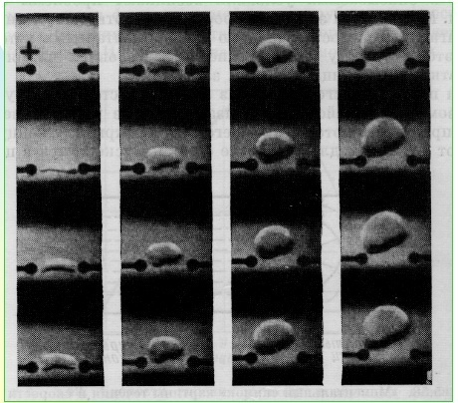
Evolution of Baby Spark into Baby Flame

Slide 3


Shape of baby Flame

Slide 4
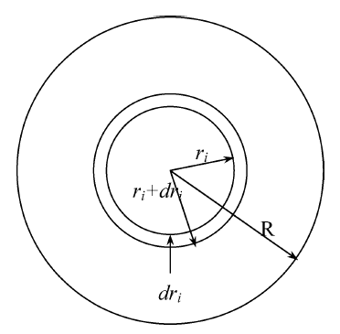
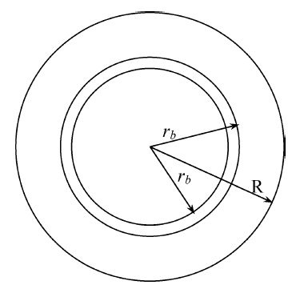
Cross-Section of View of Laminar Flame
r_{i} : Initial radius of flame or radius of flame.
r_{b} : instantaneous radius of growing flame.

Slide 5
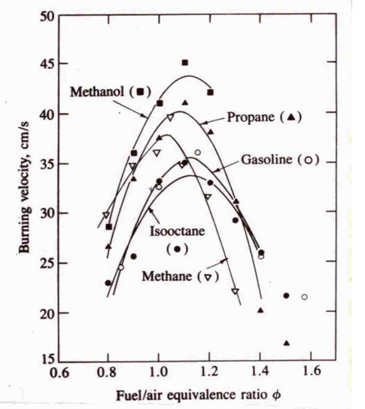
Laminar Burning Velocity

Slide 6
Mixture Burn Time
B
If we take a typical value of 50º crank angle for the overall burn
N (rpm) t_{90%}(ms) S_{comb,req} (m/s)
Standard car at idle 500 16.7 3.0
Standard car at max power 4,000 2.1 23.8
Formula car at max power 19,000 0.4 125
How is Otto’s Engine Ran at higher Speed????

Slide 7
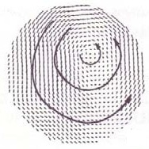
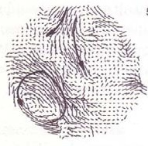
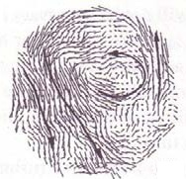
Evidence of Organized Structure in an Engine 1200 rpm motored engine
90 Cycle Mean Velocity Distribution
In Mid- Plane
Instantaneous Velocity Distribution
In Mid Plane During Cycle 1
Instantaneous Velocity Distribution
In Mid Plane During Cycle 20

Slide 8
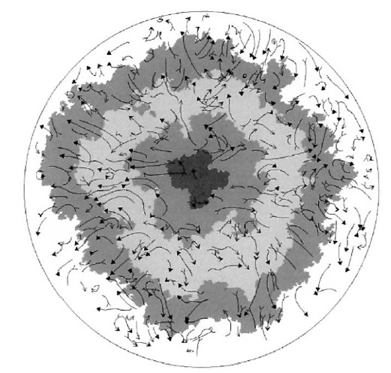
The Real Growth Kernel to Flame

Slide 9
Major Steps
Recognition of Turbulence
Design of cylinder for Creation of Turbulence
Characterization of Generated turbulence

Slide 10
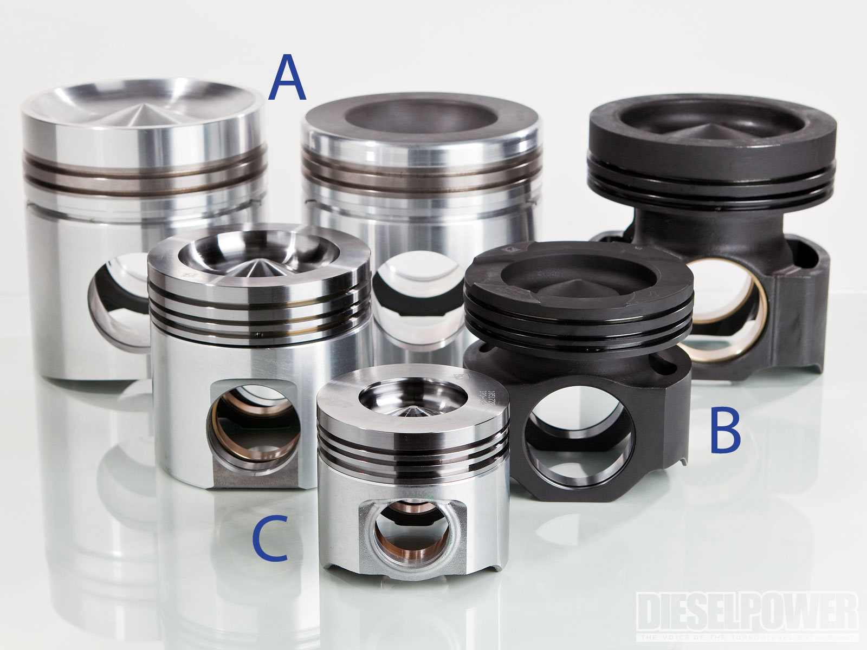
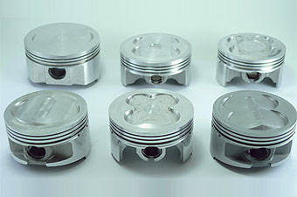
Shapes of Piston Heads

Slide 11
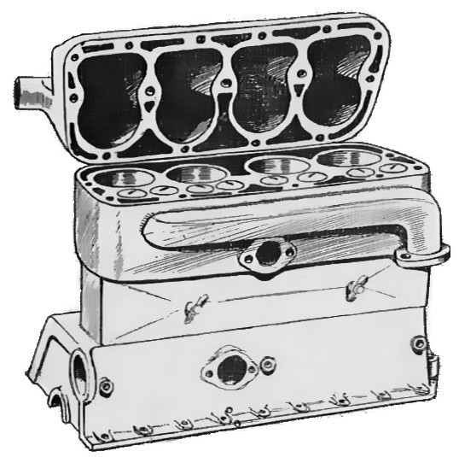
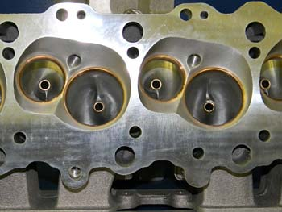
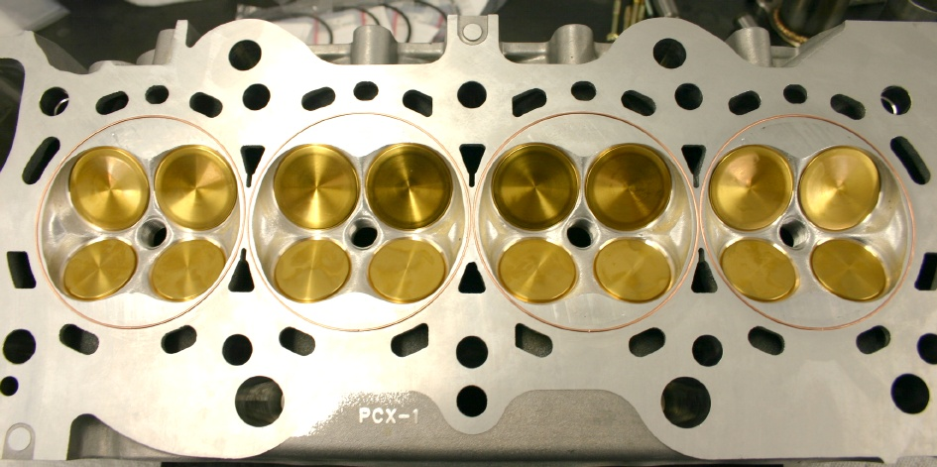
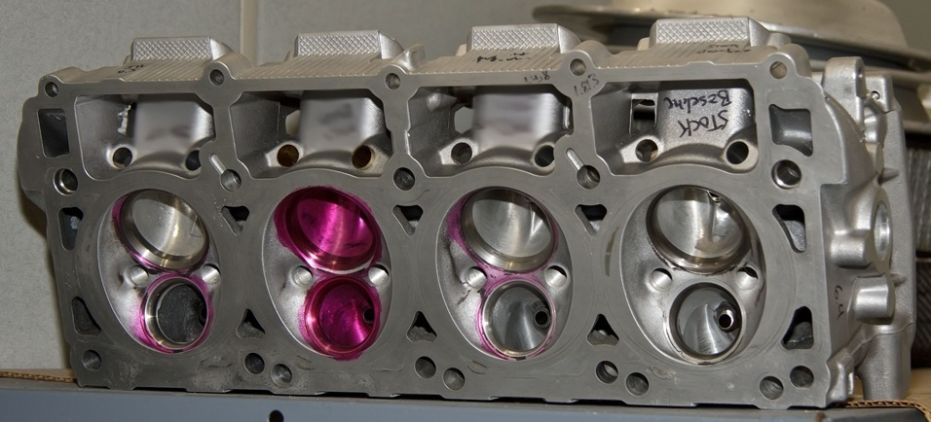
Shapes of Cylinder Heads

Slide 12
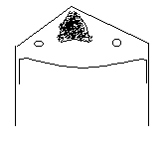
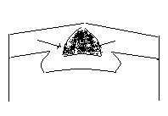
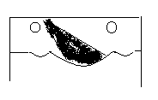
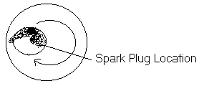
Creative Ideas to Generate Turbulent Flow : Swirl based systems

Slide 13
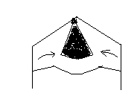
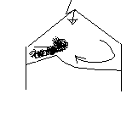
Creative Ideas to Generate Turbulent Flow : Squish based GDI concepts

Slide 14
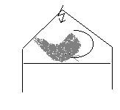
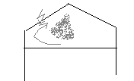
Creative Ideas to Generate Turbulent Flow : : Tumble based GDI systems

Slide 15
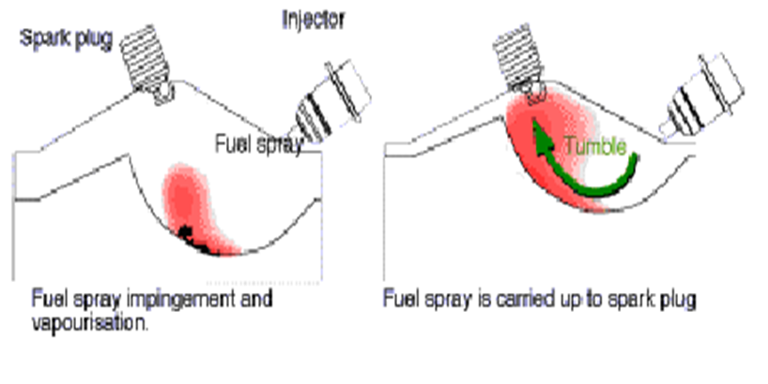
Creative Ideas to Generate Turbulent Flow

Slide 16
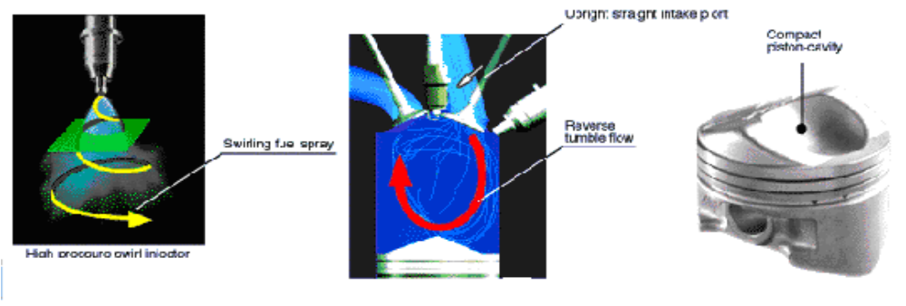
Peripheral Technologies
Electronically controlled spray type injector - Hollow cone spray
Tumbling Port
Combustion Chamber Geometry
Hollow Cone Spray
Tumbling Flow
Piston Cavity

Slide 18
Geometrical Characterization of Turbulent Structure
The velocity field in a cylinder contains vortices of sizes (eddies)
  Eddies that are essentially large enough to fill the space available, in our case the engine cylinder,
  Eddies often substantially below a millimeter in size.
The size of the largest eddy can be guessed by asking for the diameter of the largest sphere that will fit in the available space
Hence, at TC the largest eddy will be roughly the clearance height, while at BC it will be roughly the cylinder bore.

Slide 19
Energetic Characterization of Turbulent Structure
The kinetic energy of these eddies varies:
The largest eddies are relatively weak; as the size drops, the energy rises rapidly to a peak, and then falls continually down to the smallest eddies.
The most energetic eddy, at the peak, which is responsible for most of the transport, is about 1/6 the size of the largest eddy ‐ thus,
1/6 of the bore, or
1/6 of the clearance height

Slide 20
Engine Geometry Vs Flame Area Maps
The instantaneous area of the spherical flame front the moving across the chamber is one of the main parameter, which is influenced by R_{BS}.
Simulation of flame shape and the interaction between the flame front and the combustion chamber walls demand an advanced geometrical processing algorithms.
In investigations of this type, it is customary to plot maps of normalized flame area (A_{fl}/B²) the normalized flame front radius (R_{fl}/B).
Influence of RBS on normalized flame area and normalized flame front found to be very significant.

Slide 21
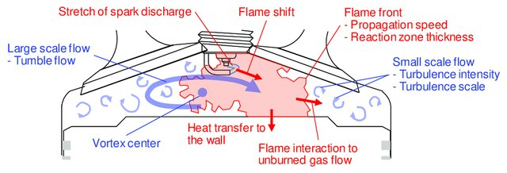
Flame Shape and Volume in SI Engine

Slide 22
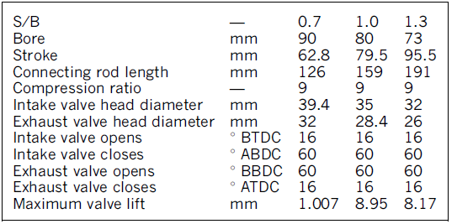
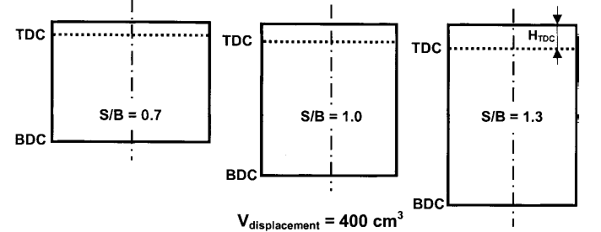
Classes of Cylinder Geometries
R_{BS}=1.43
R_{BS}=1.0
R_{BS}=0.77

Slide 23
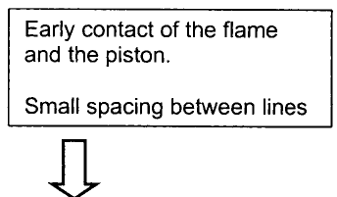
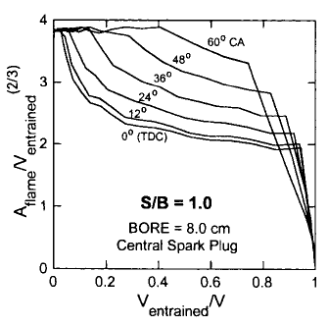
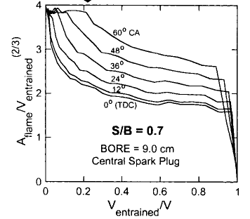
Flame Area Maps vs R_{BS}
Square Cylinder
R_{BS}=1.43
R_{BS}=1.0

Slide 24
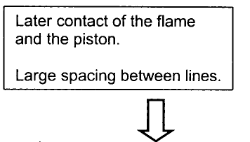
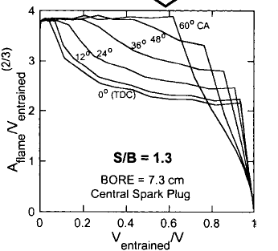
Flame Area Maps vs R_{BS}
Square Cylinder
R_{BS}=1.0
R_{BS}=0.77

Slide 25
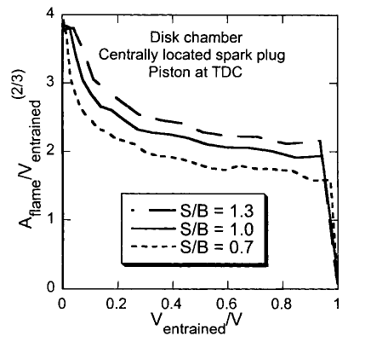
Comparison of normalized flame areas
R_{BS}0.77
R_{BS} 1.00
R_{BS}01.43

Slide 26
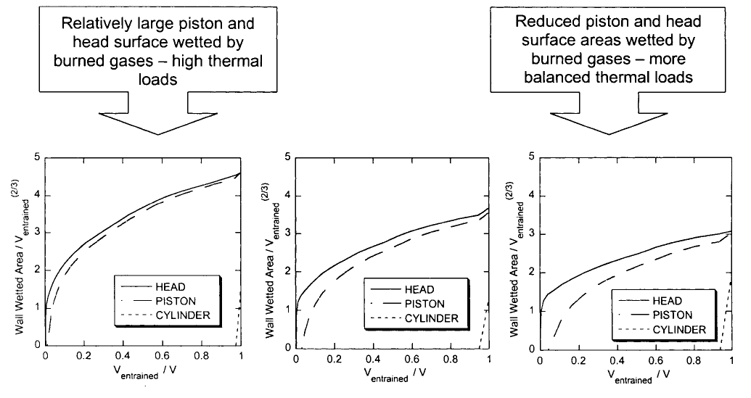
Wall Wetted Areas
The effect of the stroke-to-bore ratio on combustion, heat transfer and efficiency of a homogeneous charge spark ignition engine of given displacement
Z S Filipi andDNAssanis
W.E. Lay Automotive Laboratory, The University
of Michigan, Ann Arbor, Michigan, USA

Slide 27
Ability to Transfer Heat : A Signature of Survival
Due to the increased piston- and head surface area, the heat loss increases as the bore/stroke-ratio is increased excessively.
These characteristics favor higher engine speeds, over-square engines are often tuned to develop peak torque at a relatively high speed.
Due to the decreased piston- and head surface area, the heat loss decreases as the bore/stroke-ratio is decreased.
These characteristics favor lower engine speeds and use of poor quality fuels with low running cost.

