Slide 1

Influence of Cylinder Geometry on Thermo-fluid Behaviour of SI Engine
P M V Subbarao
Professor
Mechanical Engineering Department
Head, CRDT
Geometry is A Reason Behind Everything that Survives for Longtime…..

Slide 2

Geometry Vs Engine Heat Transfer
Essential for Sustainability

Slide 3
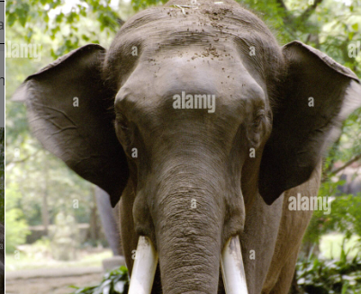
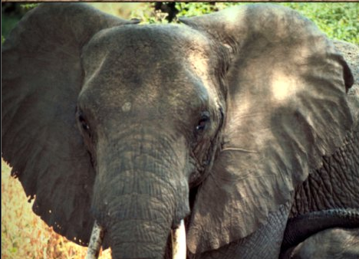
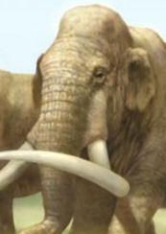
Shape in Nature
Indian Elephant
African Elephant
Mammoths

Slide 4
Energy Audit of Conventional S.I. Engine Indicative Cycle at Design Conditions
Case Study:
Net Indicative work per cycle : 373.2 J
Fuel Energy Input (J): 943.0 J
Total cooling loss -187.3 J
Heat transfer density (W/cm²) at...
...cylinder head: -45.168
... piston upper face: -42.378
...cylinder wall: -14.228
Effective torque (Nm): 110.0

Slide 5
Effect on Heat Transfer
Simple geometric relationships show that an engine cylinder with low bore -to- stroke ratio will have a smaller surface area exposed to the combustion chamber gasses compared to a cylinder with longer bore-to- stroke ratio.
The smaller area leads directly to reduced in-cylinder heat transfer, increased energy transfer to the crankshaft and, therefore, higher efficiency.

Slide 6
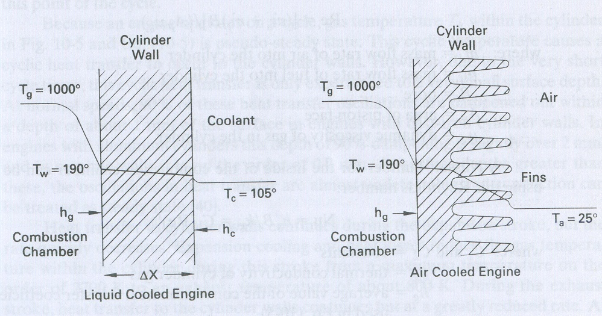
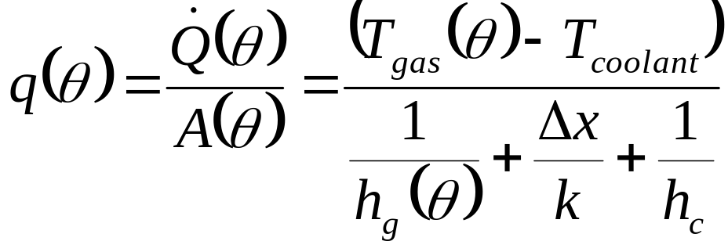
Instantaneous Heat Transfer (loss) form Cylinder

Slide 7
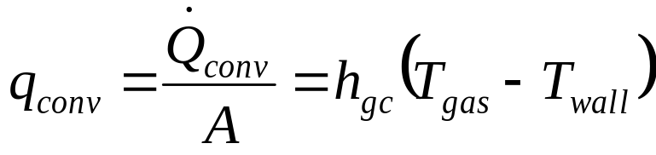
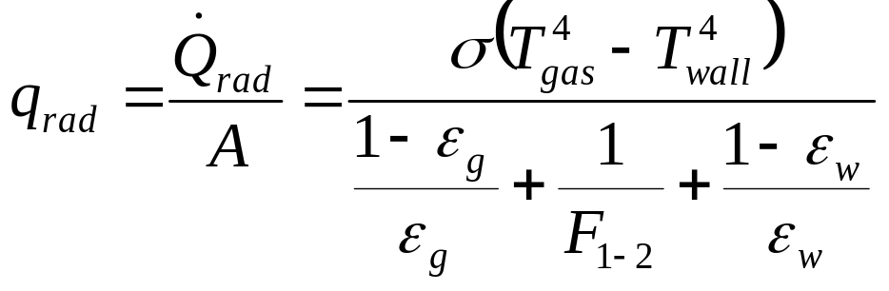
Gas to Surface Heat Transfer
Heat transfer to walls is cyclic.
Gas temperature T_{g} in the combustion chamber varies greatly over and engine cycle.
Coolant temperature is fairly constant.
Heat transfer from gas to walls occurs due to convection & radiation.
Convection Heat transfer:
Radiation heat transfer between cylinder gas and combustion chamber walls is

Slide 8
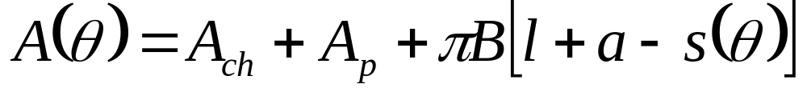
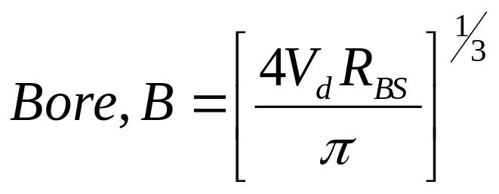
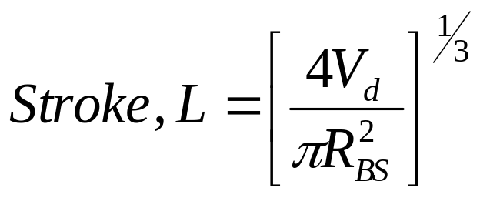
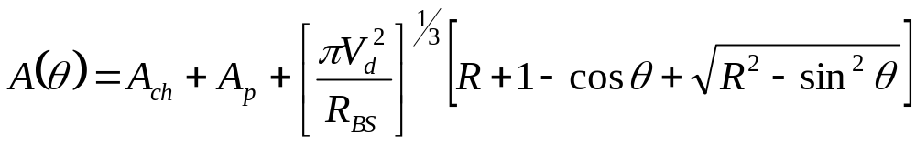
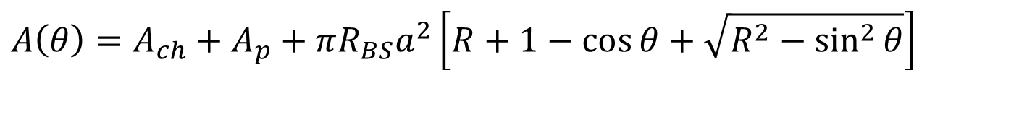
Instantaneous Cylinder Surface Area
$$A\left(θ\right)=A_{ch}+A_{p}+πR_{BS}a^{2}\left[R+1−\cos{θ}+\sqrt{R^{2}−\sin^{2}{θ}}\right]$$

Slide 9
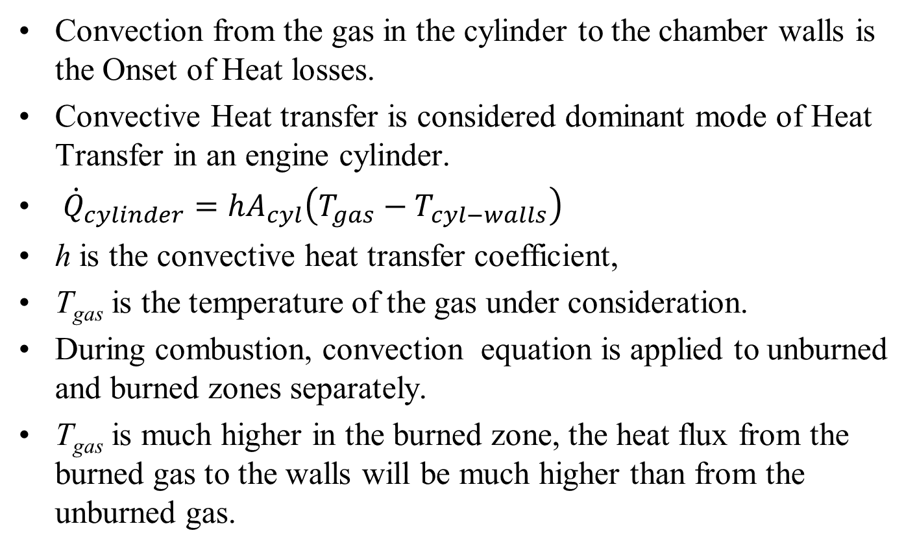
Domination of Convection in Engine Heat Transfer : 21st Century Analysis
Convection from the gas in the cylinder to the chamber walls is the Onset of Heat losses.
Convective Heat transfer is considered dominant mode of Heat Transfer in an engine cylinder.
${\dot{Q}}_{cylinder}=hA_{cyl}\left(T_{gas}−T_{cyl−walls}\right)$
h is the convective heat transfer coefficient,
T_{gas} is the temperature of the gas under consideration.
During combustion, convection equation is applied to unburned and burned zones separately.
T_{gas} is much higher in the burned zone, the heat flux from the burned gas to the walls will be much higher than from the unburned gas.

Slide 10
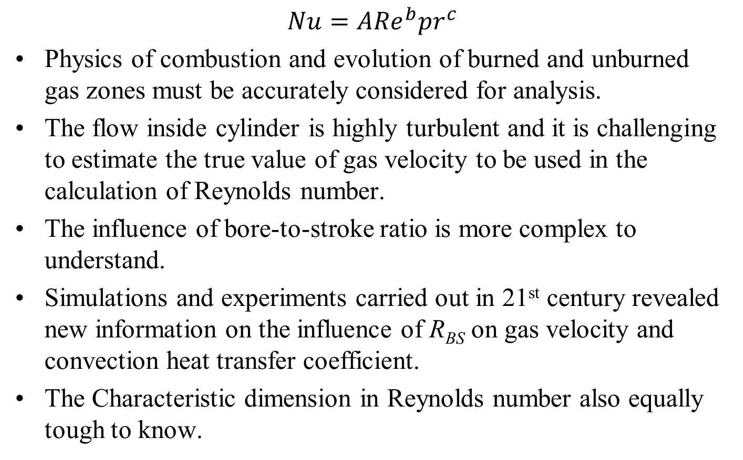
Convective Heat Transfer Coefficient of Gas
$$Nu=A{Re}^{b}{pr}^{c}$$
Physics of combustion and evolution of burned and unburned gas zones must be accurately considered for analysis.
The flow inside cylinder is highly turbulent and it is challenging to estimate the true value of gas velocity to be used in the calculation of Reynolds number.
The influence of bore-to-stroke ratio is more complex to understand.
Simulations and experiments carried out in 21st century revealed new information on the influence of R_{BS} on gas velocity and convection heat transfer coefficient.
The Characteristic dimension in Reynolds number also equally tough to know.

Slide 11
Kinematics and Shape of Flame and Burned Gas Volumes in SI Engine Cylinder

Slide 12
Onset of A Successful Combustion in SI Engine
A successful spark creates a shock wave in the air-fuel mixture.
This shock wave expands against air fuel mixture.
A photographic study of the phenomena controlling the initial behaviour of spark-ignited flames confirmed that combustion starts as self-ignition.
This self ignition occurs in the volume of very hot gases (kernel) behind the shock wave.
Spark-ignited flames pass through a non-steady propagation period before reaching a steady speed.
This transient period is relatively important, compared to the total time available for combustion, in an engine cycle.

Slide 13
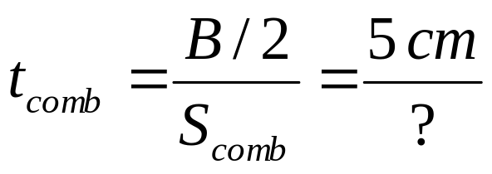
Mixture Burn Time
B
S_{comb} : Flame velocity
If we wish 90% of fuel to burn during of 50º crank angle.
N (rpm) t_{90%}(ms) S_{comb,req} (m/s)
Standard car at idle 500 16.7 3.0
Standard car at max power 4,000 2.1 23.8
Formula car at max power 19,000 0.4 125

Slide 14
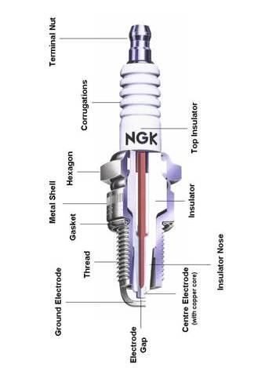
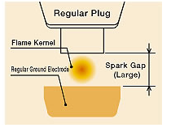
Initiation of Combustion in SI engine: Spark Ignition

Slide 15
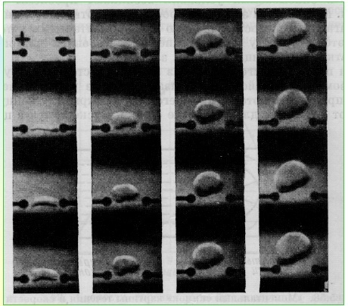
Evolution of Baby Spark into Baby Flame

