Slide 1

First Order Semi-Exact Nonlinear ODEs
P M V Subbarao
Professor
Mechanical Engineering Department
I I T Delhi
Clues to Tune Thermofluid Models….

Slide 2

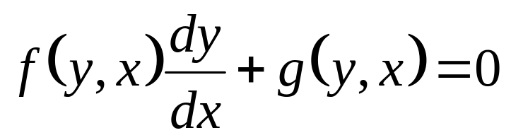
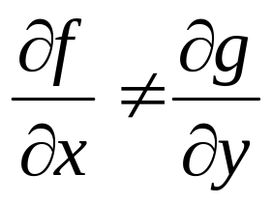
Non-Exact Equations
A general FO ODE of the form
is called as a non-exact ODE, when
A general linear equation is not always exact.
But we somehow still managed to solve it.
By multiplying both sides by the “integrating factor”.
Sometimes a non-exact differential equation can be rewritten as an exact equation.
One way this could happen is multiplying the differential equation by an appropriate function.

Slide 3
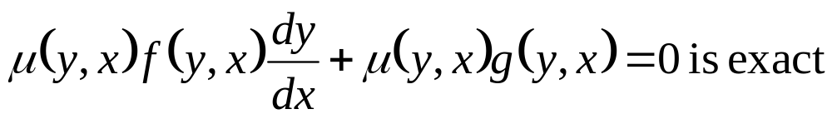
Semi-Exact Differential Equations
A semi-exact differential equation is a non-exact equation that can be transformed into an exact equation after a multiplication by an integrating factor.
Consider a non-exact equation:
It is sometimes possible multiply it by another function of x and/or y to obtain an equivalent equation which is exact.
That is, one can sometimes find a function μ(y,x) such that
Such a function μ(y, x) is called an integrating factor.

Slide 4
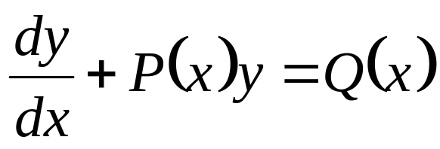
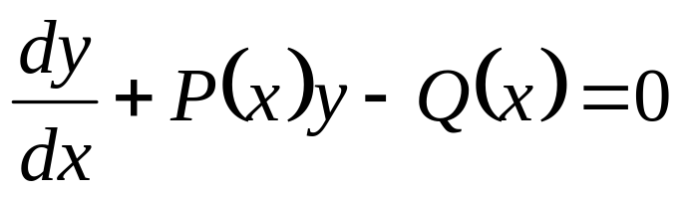
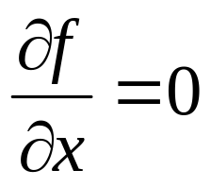
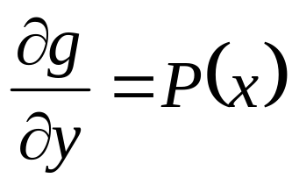
Example: Non-Exact L FO ODE
As
, a general linear equation is not exact.

Slide 5
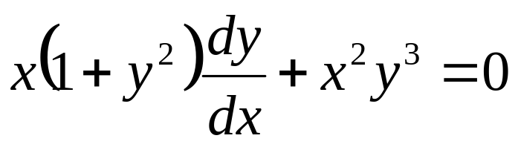
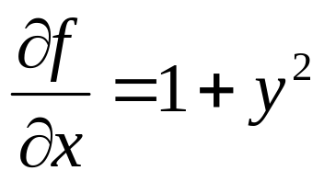
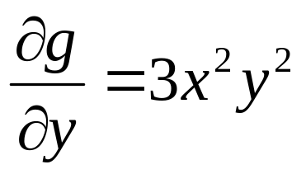
Example: Non-Exact NL FO ODE
As
, this equation is not exact

Slide 6
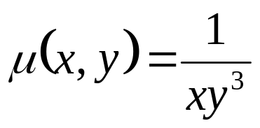
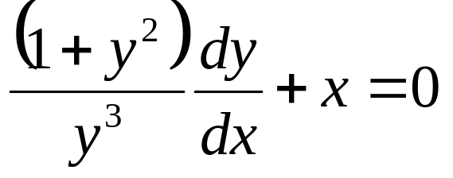
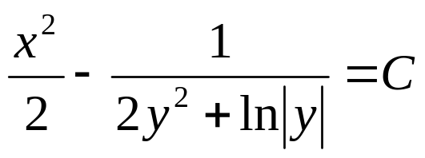
Test for Semi-Exact NL FO ODE
Let us multiply both sides of the differential equation by
This is not only exact, but is also separable.
The general solution is
In certain cases, it is easy to find an integrating factor.
In general, the problem of finding an integrating factor μ(x, y) for a given differential equation is very difficult.

Slide 7
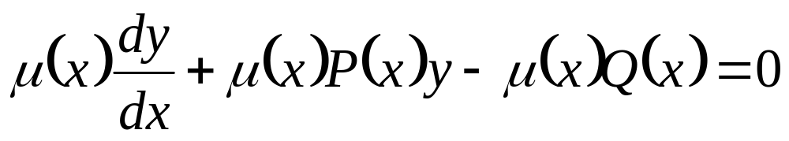
General L ODEs are Semi-Exact FO ODE
Let us multiply the linear equation by μ, a function , which depends only on x.
Note that that , P, Q and μ dependent only on x.

Slide 8
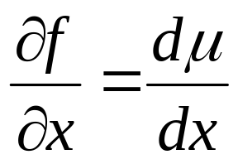
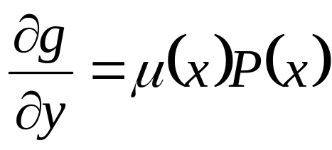
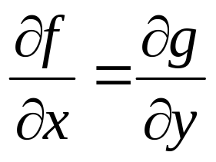
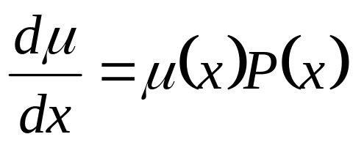
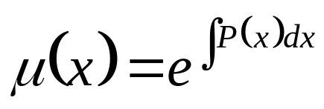
General L ODEs are Semi-Exact L FO ODE
Let us look for a particular function, μ, that makes the previous equation exact.
Develop a condition for exactness as
μ is an integrating factor:
Therefore, the FO LODE is semi-exact, and the function that transforms it into an exact equation is

Slide 9
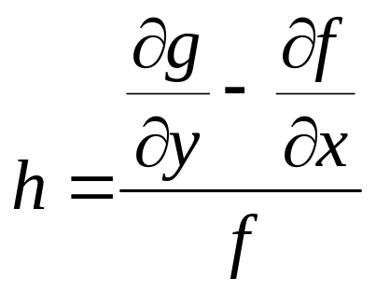
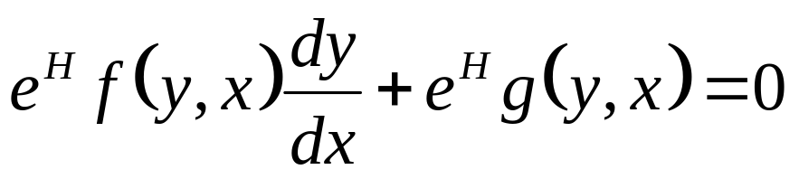
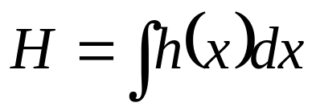
Theorem A: FO non-exact NL ODE
If the equation
is not exact, with
, the function g(y, x) ≠ 0,
and where the function h defined as
depends only on x, not on y, then the equation below is exact.
where H is an antiderivative of h,

Slide 10
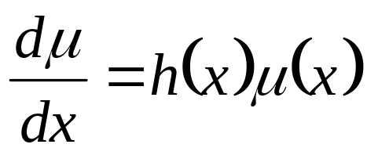
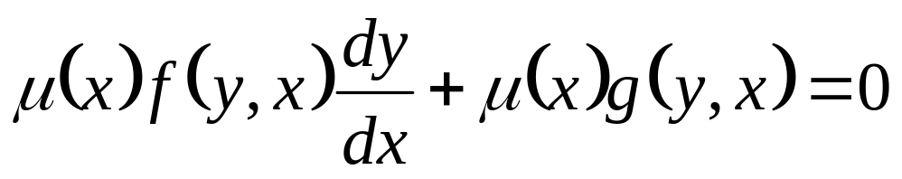
Remarks
The function μ(x) = e^{H(x)} is called an integrating factor.
Any integrating factor is solution of the differential equation
Multiplication by an integrating factor transforms a non-exact equation
into an exact equation
This is exactly what happened with linear equations.

Slide 11
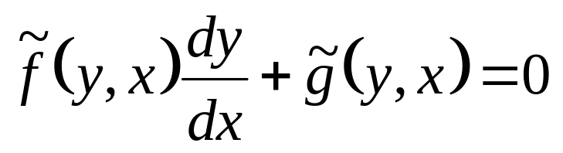
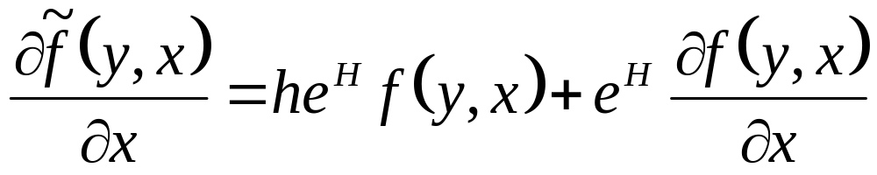
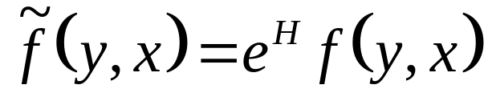
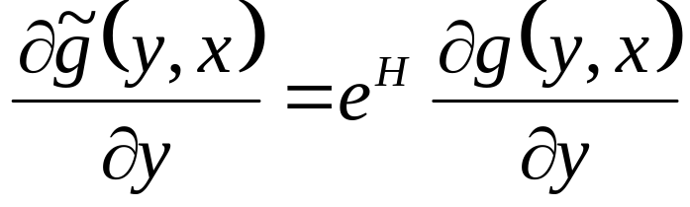
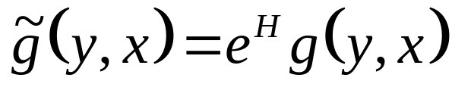
Verification Proof of Theorem
There is a need to verify that modified equation
, is exact.

Slide 12
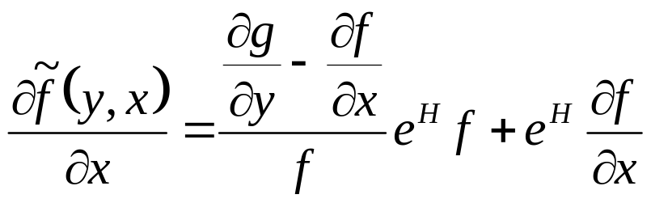
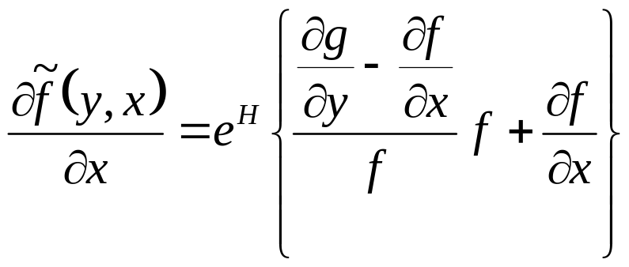
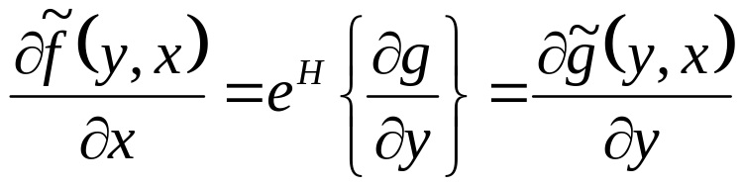
Verification Proof of Theorem
Use definition of h from theorem,
and substitute in above equation
This establishes the Theorem.

Slide 13
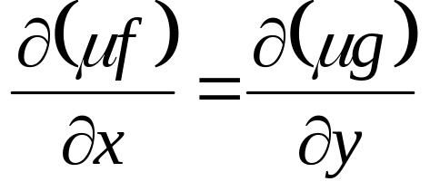
Proof of theorem Semi-Exact NL FO ODEs – type A
Equations with Integrating Factors that depend only on x.
Consider a general first order ODE
Let us suppose that there exists an integrating factor for this equation that depends only on x.
If μ(x) is to really be an integrating factor, then
must be exact; i.e.,

Slide 14
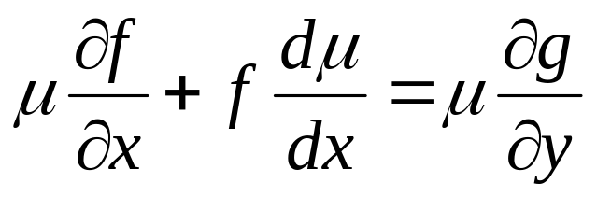
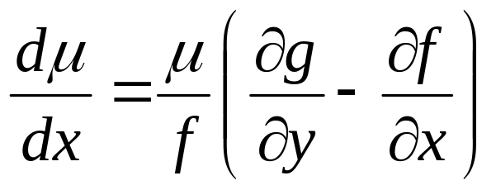
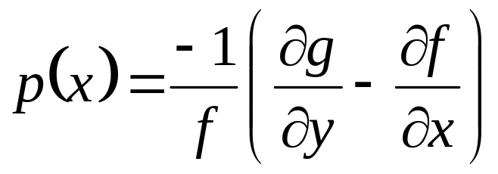
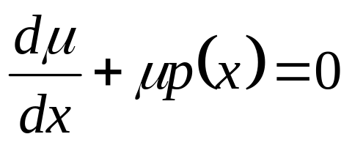
Semi-Exact NL FO ODEs – type A
Carrying out the differentiations (using the product rule, and the fact that (x) depends only on x), we get
Now if μ is dependent only on x (and not on y), then necessarily dμ/dx depends only on x.
Thus, the self consistency requires the right hand side of above equation to be a function of x alone.
Let us presume this to be the case and set

Slide 15
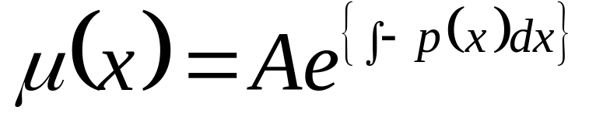
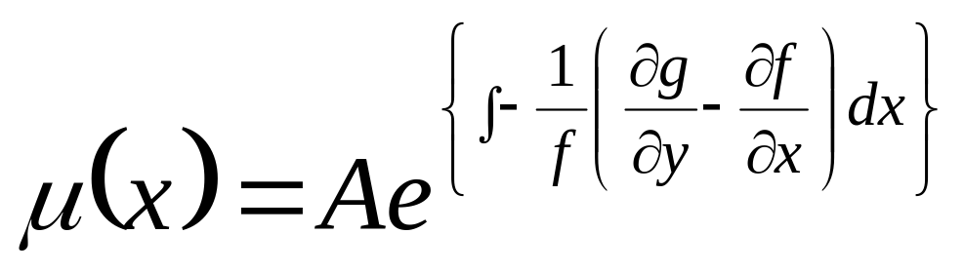
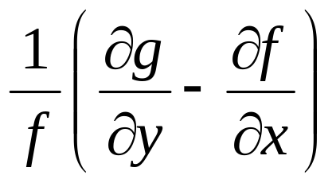
This is a first order linear differential equation!
The general solution of above equation is
This formula gives us an integrating factor and valid only
depends only on x.

Slide 16
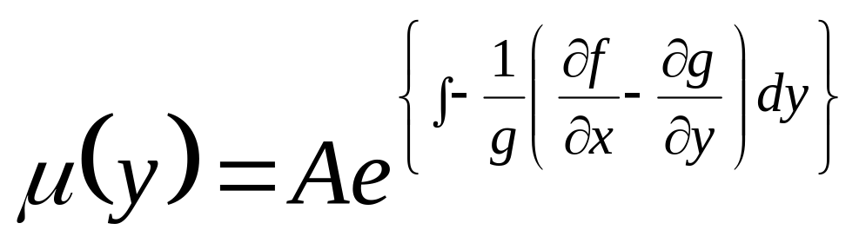
Semi-Exact NL FO ODEs – type B
Equations with Integrating Factors that depend only on y.
Consider again general first order ODE
Let us suppose that there exists an integrating factor for this equation that depends only on y.

Slide 17
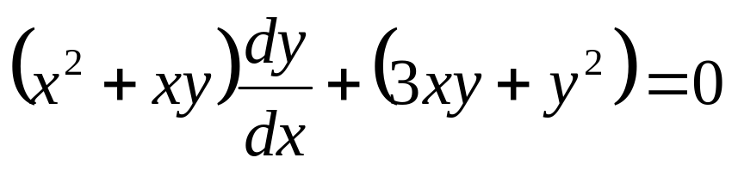
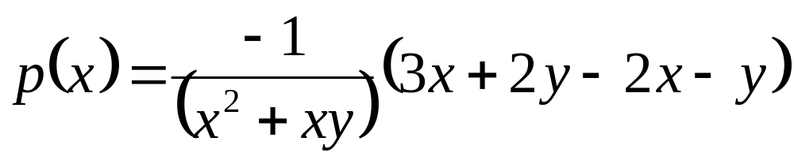
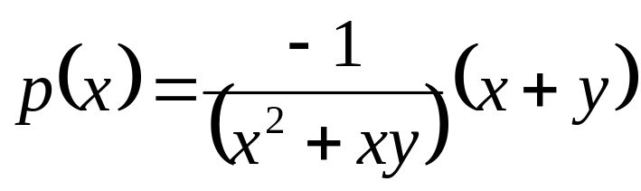
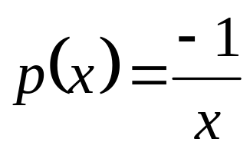
Example : NL Semi-exact FO ODE
Find all solutions y to the differential equation

Slide 18
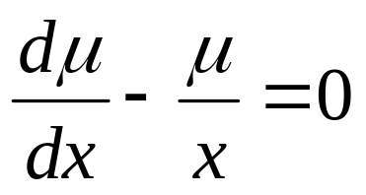

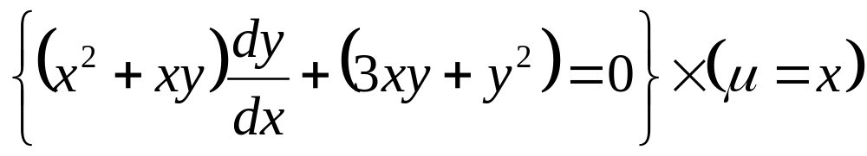
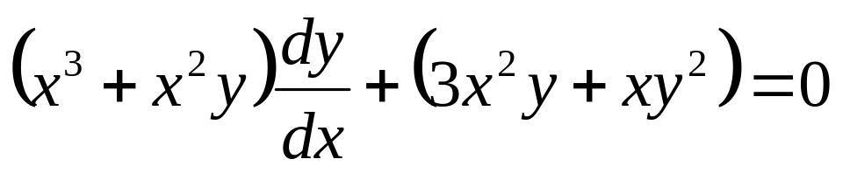
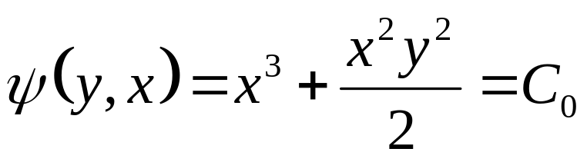
Example : NL Semi-exact FO ODE
Then, multiplying the original differential equation in by the integrating factor μ=x, to obtain

