Slide 1

First Order Exact Nonlinear ODEs
P M V Subbarao
Professor
Mechanical Engineering Department
I I T Delhi
Backbone of Thermofluid Research….

Slide 2

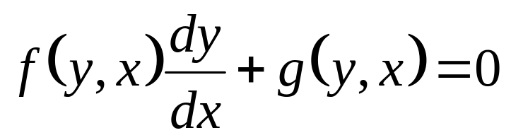
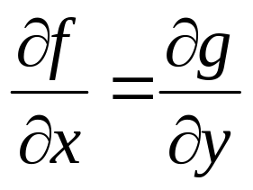
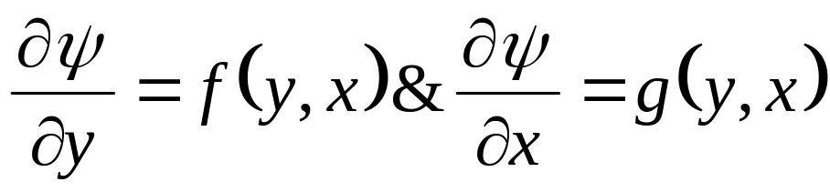
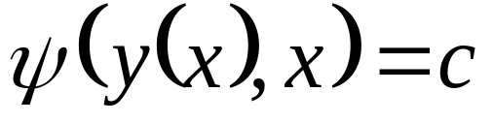
Theorem of Exact Equation : NL-NS-FO-ODE
For a Nonlinear ordinary, first order differential equation
then there exists a function ψ(y(x), x) such that
if
The general solution is given implicitly by

Slide 3
Practical Problems to Solve Exact Nonlinear FO-ODE
The theory is nice and tidy.
However, there are two practical problems.
First, the solution is only given implicitly by ψ.
Second, a method is to be formulated to determine ψ.
The first problem is inherent in the method and is unavoidable.

Slide 4
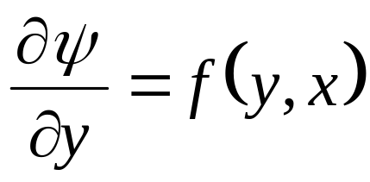
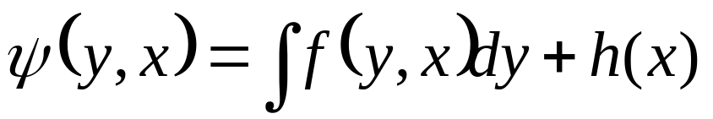
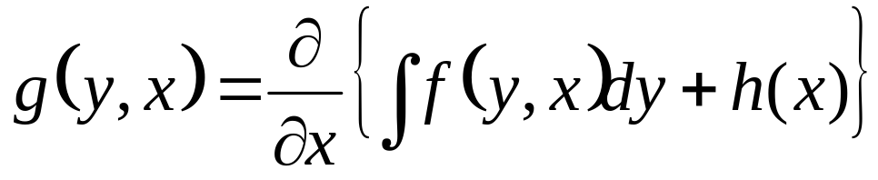
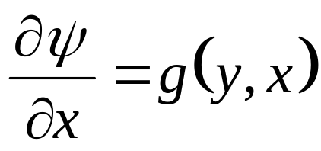
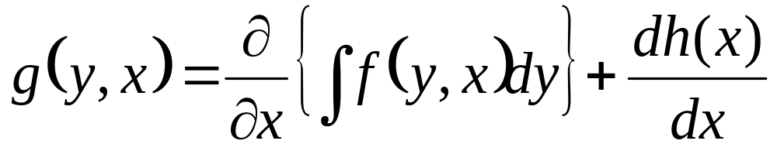
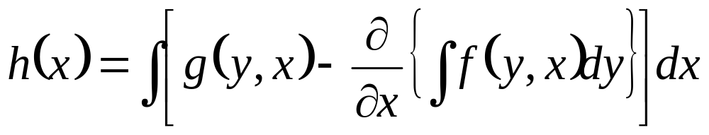
Method to Determine ψ(y, x)
We know that ∃ a ψ ⊥
Determining ψ(y, x) is actually rather straight-forward.

Slide 5
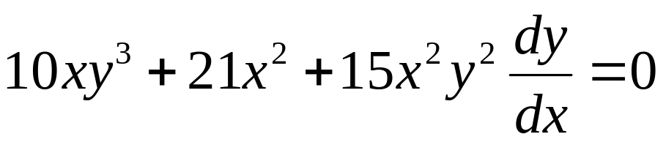
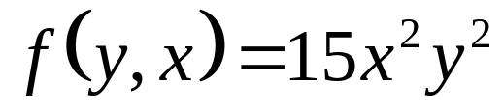
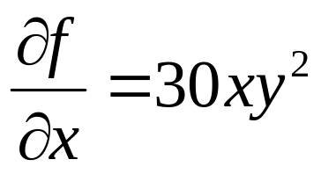
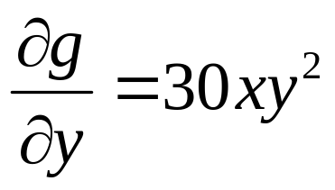
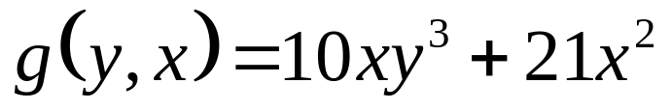
Example: Solution of Exact FO-NL-ODE
Test for exactness of the ODE.

Slide 6
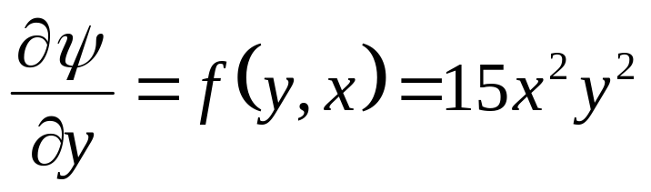
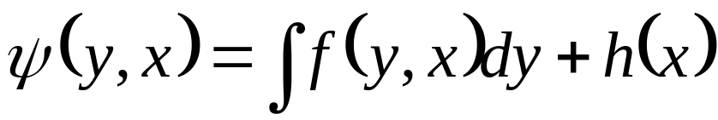
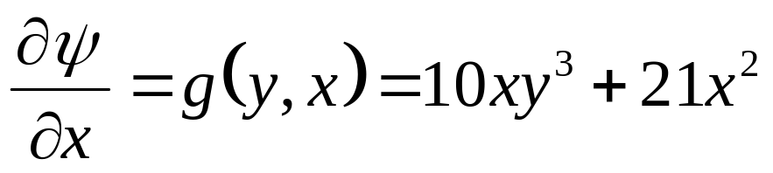
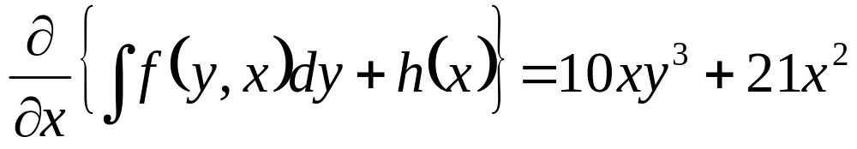
Example: Solution of Exact FO-NL-ODE

Slide 7
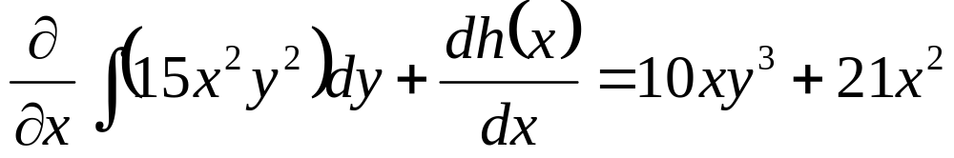
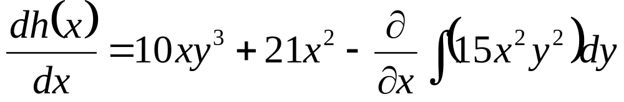
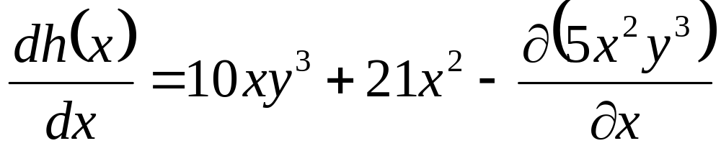
Example: Solution of Exact FO-NL-ODE

Slide 8
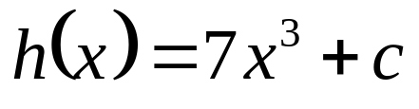
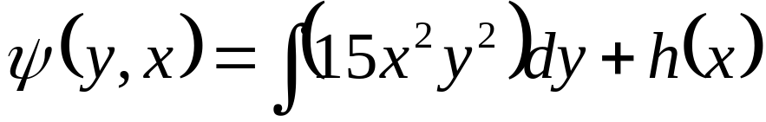
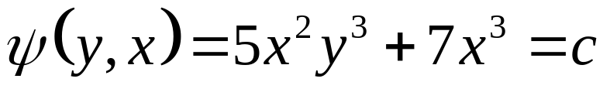
Example: Solution of Exact FO-NL-ODE

Slide 9
Exact FO-NL-ODEs for Research in Thermofluids

Slide 10
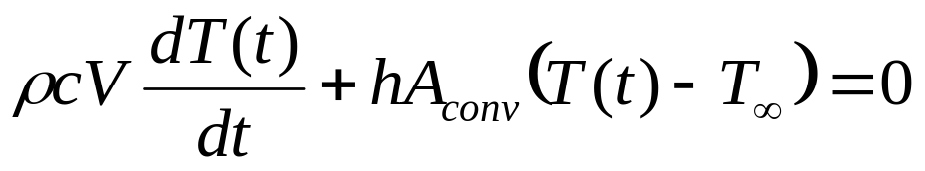
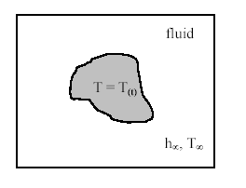
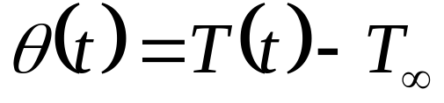
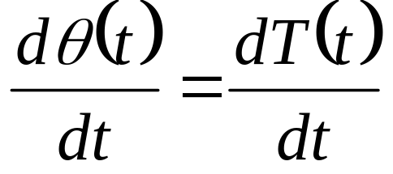
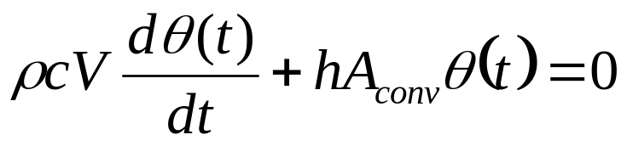
Heat Treatment of Metallic Nano Particles
For these cases Bi ≤ 1.0.and the temperature profile within the body is quite uniform.
The ODE for Instantaneous temperature of metallic solid is:
Define

Slide 11
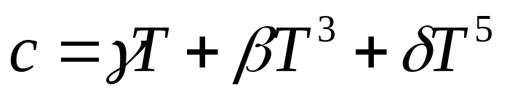
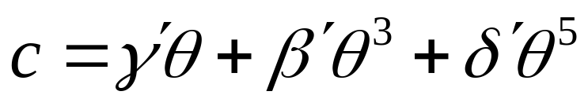
Cooling of Metallic Particles at Very High Temperatures
Experimental investigations on the specific heats of metals may be divided into three sub-regions.
The liquid helium region is roughly between 0.1° and 4° K;
The intermediate temperature range is 4° to 300° K; and
The high temperature range is 298.15° K and above, which is of our interest.
The most widely used equation for specific heat is the cube law with higher order lattice terms.

Slide 12
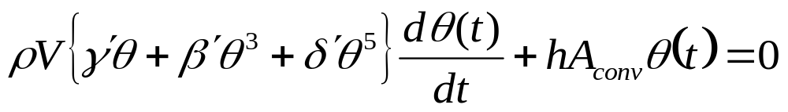
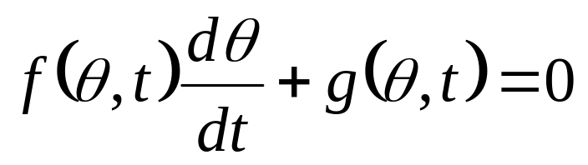
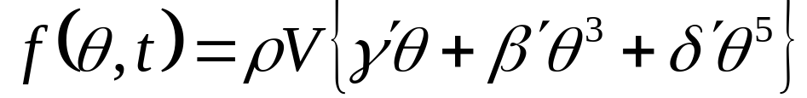
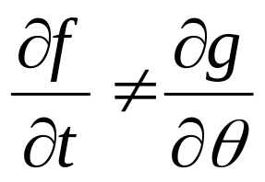
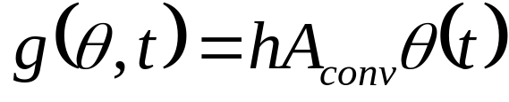
Non Linear FO-ODE for Cooling of Nano Metallic Particles
Compare with standard form of NL-FO-ODE
Above equation is not an Exact NL-FO-ODE.

Slide 13
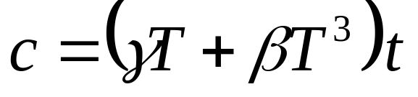
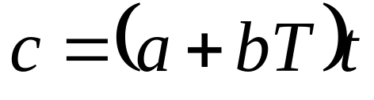
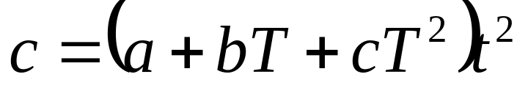
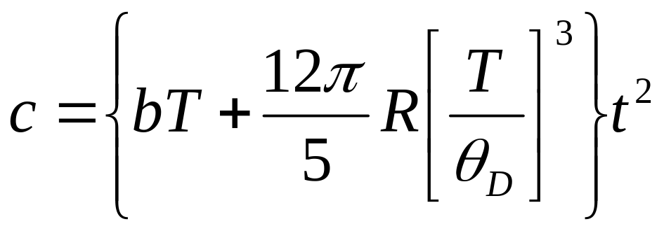
Models for Specific Heat to Obtain Exact ODE

Slide 14
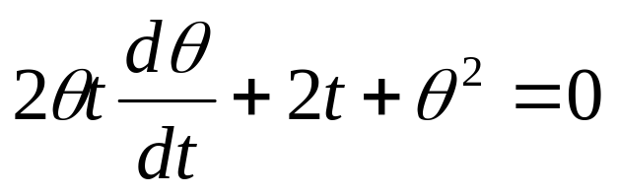
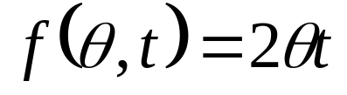
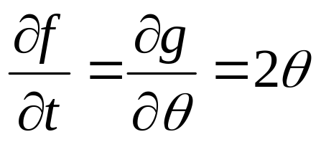
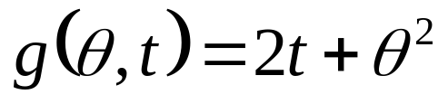
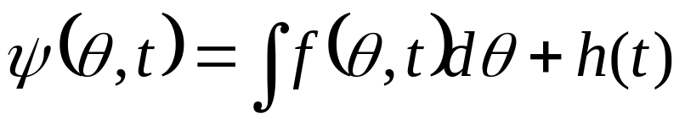
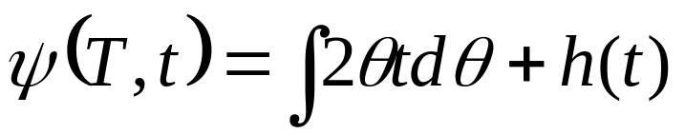
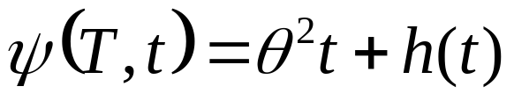
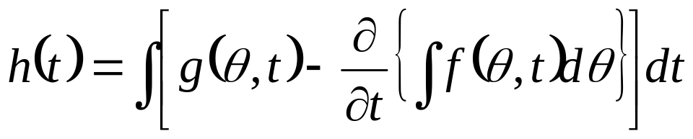
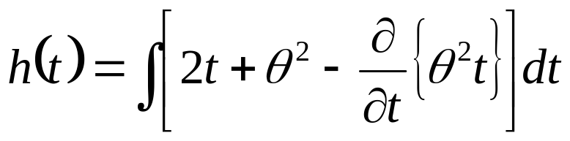
A modified Model to Obtain Exact ODE
The general solution is given by

Slide 15


The general Solution of an Exact NL FO-ODE

Slide 16



James Watt’s Engine : Most Important Innovation for Conservation
James Watt radically improved Newcomen's engine (1769) by condensing the steam outside the cylinder .

Slide 17

James Watt Engine
Watt's Double-Acting Engine, 1784.
The Watt Hammer, 1784.
Trevithick's Locomotive, 1804
The " Atlantlc," 1832.

Slide 18
Infusion of Analytical Ideas into Power Plant Development
Sir James Watt is an ingenious engineering scientist, who carried out most useful hardware research and development.
He was not aware of many of the thermodynamic quantities.
Later engineers used Charles and Boyle laws in sizing of cylinder.
Prof. James Black carriedout research to determine specific heats of steam and water.
There was a gradual infusion of analytical and theoretical research into basic hardware development.
Analytical methods helped in removal of uncertainty in engine operation.
Many theoreticians got motivated to work on theory of James Watt Engine.

Slide 19
A MANUAL of the STEAM ENGINE and other PRIME MOVERS 1859 Rankine
The conventional name “work of the thermodynamics ” by Rankine.
Harmony meaning of this work becomes " the manual of the steam engine and the other motive for action machines.’’
Rankine is the largest meritorious person who in addition raises the technology of the steam engine to science, the word, "energy " is something due to him.
This was related to the policy of researching the steam engine theoretically, brought the progress of the steam engine.

Slide 20
Outlines of the Science of Energetics (1855) by William John Macquorn Rankine
Proceedings of the Royal Philosophical Society of Glasgow, Volume 3, by Royal Philosophical Society of Glasgow, 1855. pp.121-141.
The object of the present paper is, to present the principles, forming part of a science whose subjects are, material bodies and physical phenomena in a more systematic form.
It is proposed to call the Science Of Energetics.
Definition of new terms: Substance, Property, Mass, Accident, Effort, or Active Accident, Passive Accident, Radical Accident, Effort as a Measure of Mass, Work. Energy, Actual and Potential.
Carnot theory is a special case of “Science of Energetics”

Slide 21


Mathematical Thermodynamics & Equation of State for A vapour
Greatest need for EoS of saturated and superheated steam.
The specific volume of A vapour: v = f (p,T)
R and a are constants.
The is called as Rankine’s Equation of state, 1849.
The EoS must be valid for all process and hence it must be an exact function.

Slide 22



Research on EoS for Vapours
Callender’s Characteristic Equation for saturated and superheated vapours.
R and b are constants.
c is a function of temperature and it is called as co-aggregation volume.

Slide 23
JO H A N N E S D . V A N D E R W A A L S
The equation of state for gases and liquids
Nobel Lecture, December 12, 1910
I intend to discuss in sequence:
(1) the broad outlines of my equation of state and how I arrived at it;
(2) what my attitude was and still is to that equation;
(3) how in the last four years I have sought to account for the discrepancies which remained between the experimental results and this equation;
(4) how I have also sought to explain the behaviour of binary and ternary mixtures by means of the equation of state.

Slide 24



Van der Waals EOS
One of the oldest but most extensively used of the EOS of non ideal gases
Any EOS model must reproduce graphs such as that of the previous
a, b are the Van der Waals constants for the particular gas;
for water: a = 0.5658 J-m³/mole²; b = 3.049x10⁻⁵ m³/mole,

Slide 25

Improved Cubic Equations of State

Slide 26

The constants a, b, c, Ao, Bo varies with substance

Slide 27



Slide 28



Exact NL FO ODE for EoS
Let the temperature T of a substance depend on variables p, v and R.
  T = F(p,v,R)= Constant.
This is written as F(.) and is called as Point (pfaffian) Function.
The rate of change of F with respect to p (holding v & R constants) is called the partial derivative of F with respect to x and is denoted by .
Similarly, the rate of change of f with respect to v is called the partial derivative of f with respect to v and is denoted by .

Slide 29


The Total Change in A Property of Substance
A total change in Temperature is expressed as:
Define functions M,N & P such that:
This is called as pfaffian differential equation.
As F(p,v,R) is a point function, differentiation is independent of order.

Slide 30
Invention of an Abstract Mathematical Concept
This is a necessary and sufficient condition for F(.) to be a
Point function or state function.
The exact function.
Thermodynamic properties are so related that F(.) is constant.
Every substance is represented as F(.) in Mathematical
(Caratheodory) Thermodynamics.
This is shows a surface connectivity of Property of a substance.

Slide 31


Slide 32

p-v-T Diagram of H₂O

Slide 33

Inaccessibility of Thermodynamic State
From an point on any (property) surface (of a substance) only on the same surface are accessible along that solution surface.
Any given substance, starting from an initial state on its property relation surface it can access only those states which lie on this surface.
This total differential may not satisfy

Slide 34


The Exact FO-NL-ODEs for Thermodynamics
Consider an analytic function G(x,y,z) such that
Then G(x,y,z) is not a property function (surface) of any substance…
However, if another analytic function H (x,y) is such that:
Then
Is an ordinary differential equation with
F(x,y) = constant

Slide 35

Ideal Gas Model : A Simplest Exact NL-ODE

Slide 36

Integration of Exact Differential
we move in the X -Y plane from an initial point (x_{i},y_{i}), to a final point (x_{f},y_{f}).
The corresponding change in is given by
Δf = f_{f}-f_{i} = ∫ df = ∫ P(x,y)dx + Q(x,y)dy
The difference (Δf) on the left-hand side depends only on the initial and final points, the integral on the right-hand side can only depend on these points as well.
The value of the integral is independent of the path taken in going from the initial to the final point.
The integral of an exact differential over a closed circuit is always zero

Slide 37
Conclusions
A thermodynamic system should be described using an Exact function.
The change in this function can be calculated without doing any action.
Instruments can be easily developed to measure these functions.
Function tables can be prepared and marketed.
Any industrial process can use these tables.
Primary functions are in general directly measured.
Derived functions are calculated using the measured primary functions.
Special instruments can be developed to measure derived properties !
This function is called as PROPERTY in Thermodynamics.

Slide 38
Exact NL FO ODEs
All pfaffian differential equations in two variables are Point functions.
Theorem of Caratheodory:
If, in the neighborhood of an arbitrary point in the domain of the variables of a Pfaffian Differential Equation, there are points which are inaccessible to it along the solution surface of the equation, then this equation has an integrating denominator.
It is possible to multiply any differential equation by a function of independent variables and create a pfaffian differential equation.
This function is called integrating denominator.

