Slide 1

First Order Nonlinear & Non-autonomous ODEs
P M V Subbarao
Professor
Mechanical Engineering Department
I I T Delhi
Models for Simple Non-linear Processes in Thermofluids ….

Slide 2

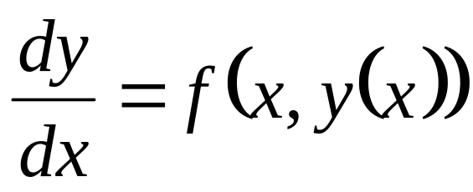
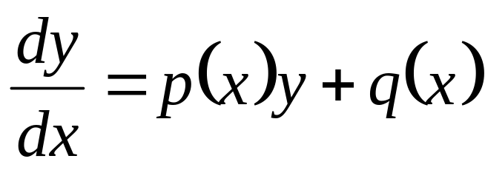
General First Order ODEs : Definition
The first-order differential equation (on the unknown y is
where f(x,y(x)) is given or known and this called as source function.
First order linear ODE:
These are always separable…..

Slide 3
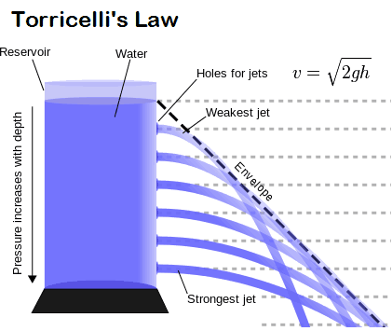
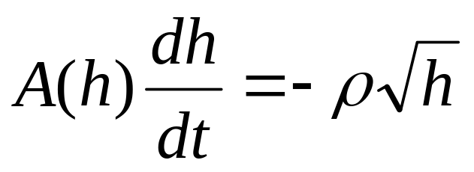
Torricelli’s theorem : The First Separable ODE
The theorem was discovered by and named after the Italian scientist Evangelista Torricelli, in 1643.
This is a separable, nonlinear differential equation for the depth y

Slide 4
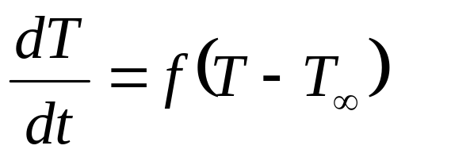
Newton’s Study on Nonlinear Thermofluid Systems
In 1701, Newton published (in Latin and anonymously) in the Phil. Trans. of the Royal Society a short article (Scala graduum Caloris).

Slide 5
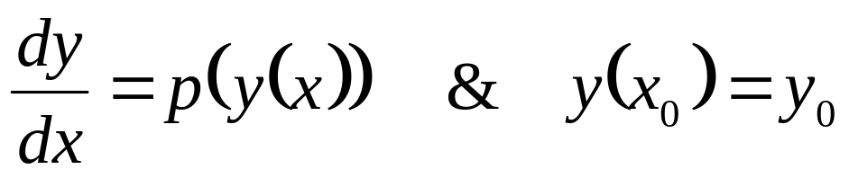
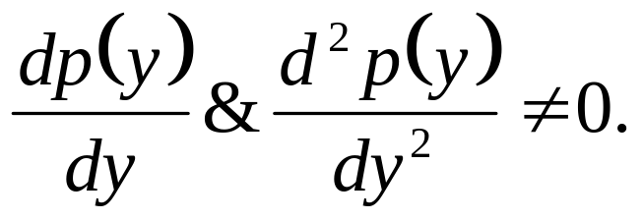
Autonomous Differential Equation
An autonomous differential equation is an ordinary differential equations which does not explicitly depend on the independent variable.
An autonomous, nonlinear, first-order differential equation has the following form:
where

Slide 6
The Guess and Check method
Guess and check is a method, in which any function that satisfies the autonomous equation is found.
It doesn't matter what method is used to find the function.
The task is to prove that it is a solution.
The way to guess is to use your knowledge and intuition to find a function whose derivative behaves in the required way.

Slide 7
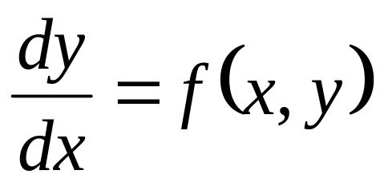
Non-autonomous and Nonlinear Equations
The general form of the non-autonomous, first-order differential equation is
The equation can be a nonlinear function of both y and x.
There is No general method of solution for 1st-order NL-ODEs.
However, a variety of techniques are invented for special class of NL-NA-ODE.

Slide 8
Central Idea for Innovation of Solutions to NL-NA-ODE
The sole idea lies in separability of an ODE.
All separable NL-ODEs are easily solved.
Innovation of solution to few non-separable NL ODEs deals with transformation of NL-NS-ODE into NL-S-ODE.
Let us discuss few such methods available in literature.

Slide 9
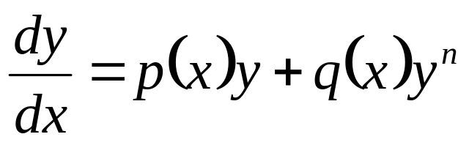
The Bernoulli Equation
In 1696 Jacob Bernoulli solved what is now known as the Bernoulli differential equation.
This is a first order nonlinear differential equation.
The following year Leibniz solved this equation by transforming it into a linear equation.
Let us learn Leibniz's idea in more detail.
The Bernoulli equation is
where p, q are given functions and n ∈ ℜ.
Remarks:
(a) For n ≠ 0,1 the equation is nonlinear.
(b) If n = 2, it is called as logistic equation
(c) This is not the Bernoulli equation from fluid dynamics.

Slide 10
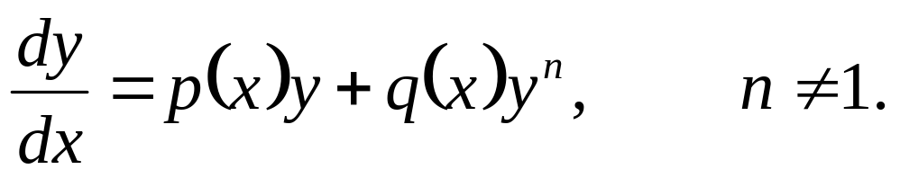
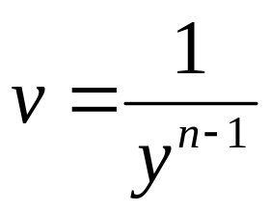
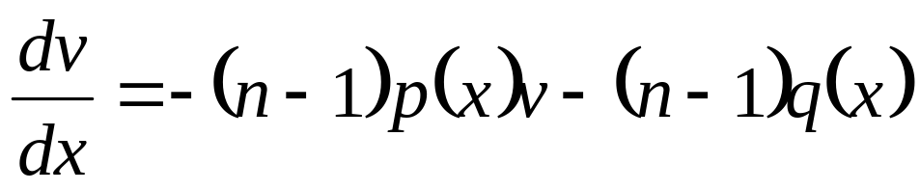
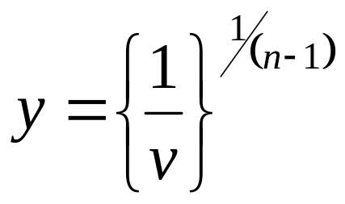
Bernoulli Theorem
The function y is a solution of the Bernoulli equation
is solution of the linear differential equation.
iff the function
The Bernoulli equation for y, which is nonlinear, is transformed into a linear equation for v = 1/y^{(n-1)}.
The linear equation for v cane be solved using the integrating factor method.
The last step is to transform back to

Slide 11
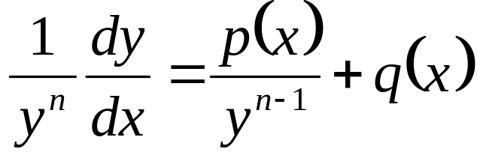
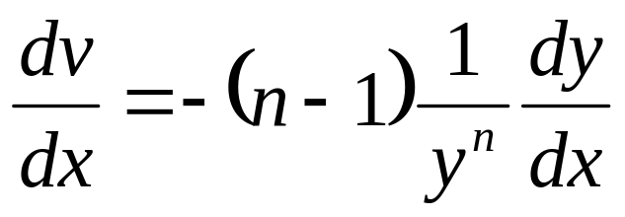
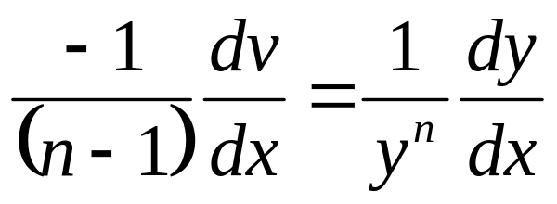
Proof of Bernoulli’s Theorem
Divide the Bernoulli equation by y^{n}
Introduce the new unknown
and compute its derivative,
Substitute v and this last equation into the Bernoulli equation to get linear first order inhomogeneous ODE.

Slide 12
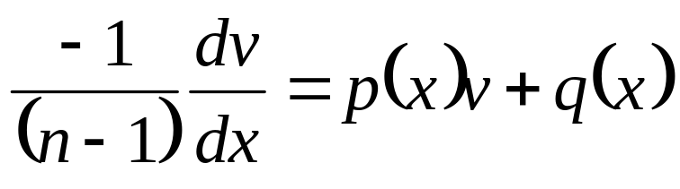
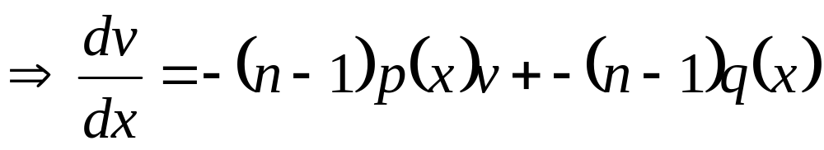
The Transformed ODE
This establishes the Theorem.

Slide 13
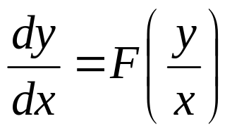
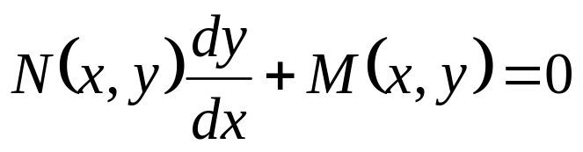
Euler Homogeneous Equations
This is another special nonlinear differential equation and it is not separable, but it can be transformed into a separable equation changing the unknown function.
This is the case for differential equations known as Euler homogenous equations.
An Euler homogeneous differential equation has the form
Another form of Euler homogeneous equations is
Where the functions N, M, of x; y, are homogeneous of the same degree.

Slide 14
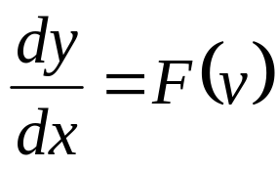
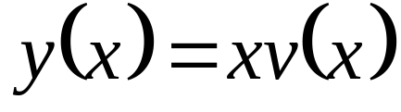
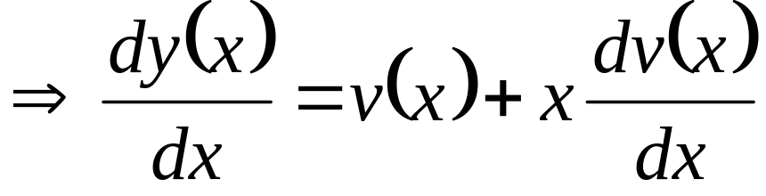
Solving Euler Homogeneous Equations
The original homogeneous equation for the function y is transformed into a separable equation for the unknown function v = y/x.
First the Euler equations is solved for v, in implicit or explicit form, and then transforms back to y = x v.
Next step is to replace dy/dx in terms of v.
This is done as follows
These expressions are introduced into the differential equation for y.

Slide 15
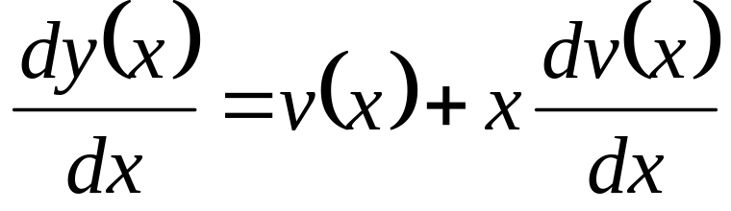
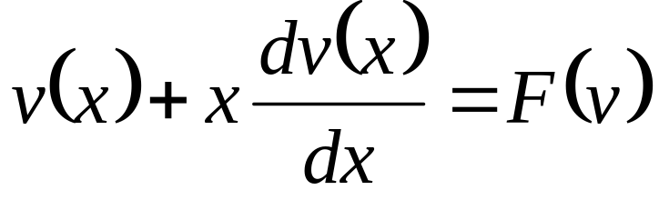
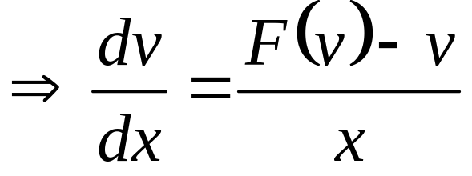
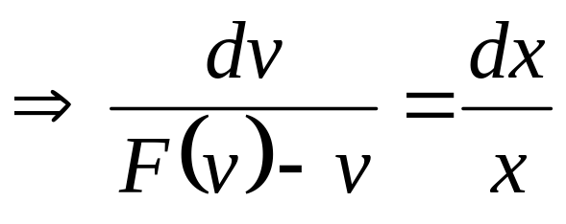
Separable ODE

Slide 16
Exact Differential Equations
A differential equation is exact when a total derivative of a function, called potential function is zero.
Exact equations are simple to integrate.
Any potential function must be equal to a constant is an implicit solution of an Exact ODE.
This solution define level surfaces of a potential function.
An integrating factor converts few non-exact equations into an exact equation.
These are called as semi-exact differential equations

Slide 17
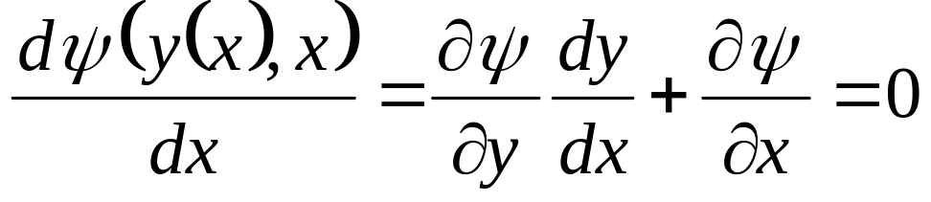
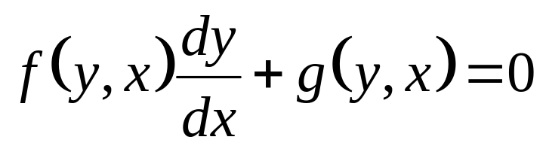
Origin of Exact Equation
The idea behind exact equations is actually quite simple.
Consider a function, ψ(y(x), x).
As usual, x is the independent variable and y is the dependent variable.
A set of functions, ψ; namely, ψ(y(x), x) = c exist in thermofluids.
Differentiating ψ with respect to x gives
Note that this is of the form
where f and g are functions of both the independent variable, x, and the dependent variable y.

Slide 18
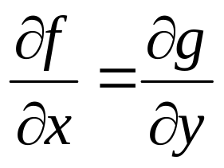
Properties of Exact Equation
A differential equation is exact if certain parts of the differential equation have matching partial derivative.
An exact differential equation for y is
where the functions f and g satisfy
The general solution is simply a matter of determining ψ and setting ψ(y, x) = c.
The correct value of c will be determined from the initial condition in the case of the initial value problem.

Slide 19
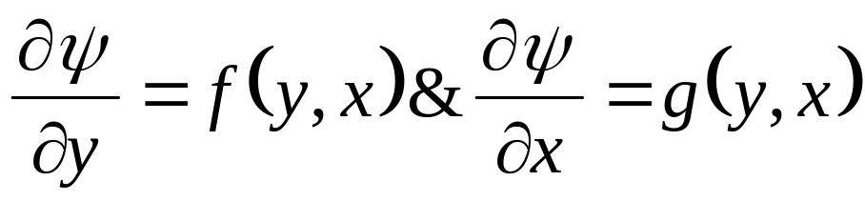
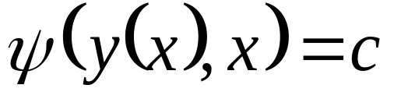
Theorem of Exact Equation : NL-NS-FO-ODE
For a Nonlinear ordinary, first order differential equation
then there exists a function ψ(y(x), x) such that
if
The general solution is given implicitly by

Slide 20
Practical Problems to Solve Exact Nonlinear FO-ODE
The theory is nice and tidy.
However, there are two practical problems.
First, the solution is only given implicitly by ψ.
Second, a method is to be formulated to determine ψ.
The first problem is inherent in the method and is unavoidable.

